Slide 1
Seismic Radar
Sherif M. Hanafy

Slide 2
Outline
Motivation
Method
Field Example
Conclusions

Slide 3
Outline
Motivation
Method
Field Example
Conclusions

Slide 4
Motivation
Surface Example
Subsurface Example

Slide 5
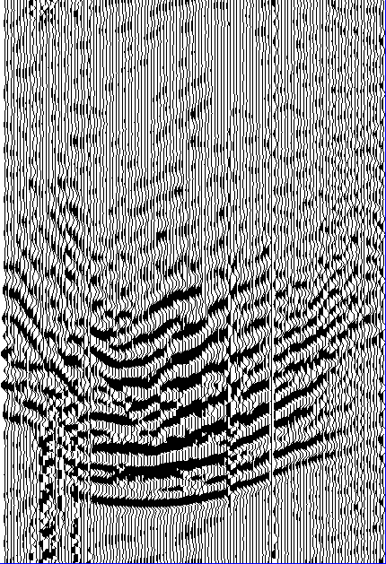
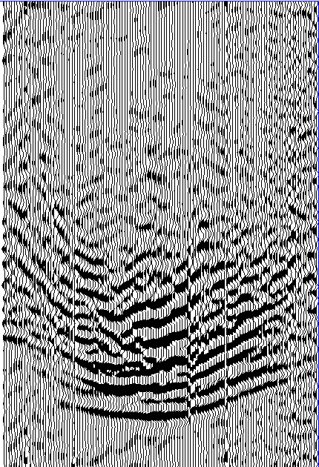
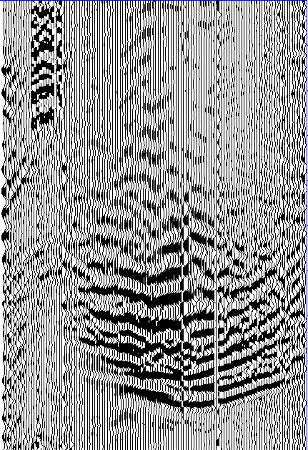
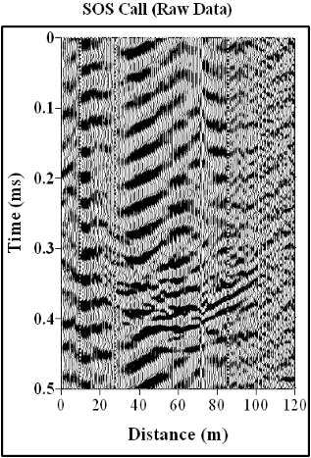
Motivation
Step 1
Collect reference Green’s functions while drilling
Step 2
Listen for any passive seismic signals due to hydro-fracture activity

Slide 6
Outline
Motivation
Method
Field Example
Conclusions

Slide 7
Method
We use a gather-to-gather cross-correlation
Cross-correlation results
Signal from unknown source
Band-limited reference Green’s function

Slide 8
Method
Gather-to-gather no-shift cross-correlation
Correlation Value
G₁
G₂
G₃
……….
G_{n}
Passive data
x
The location of the seismic source is the location of the biggest correlation value

Slide 9
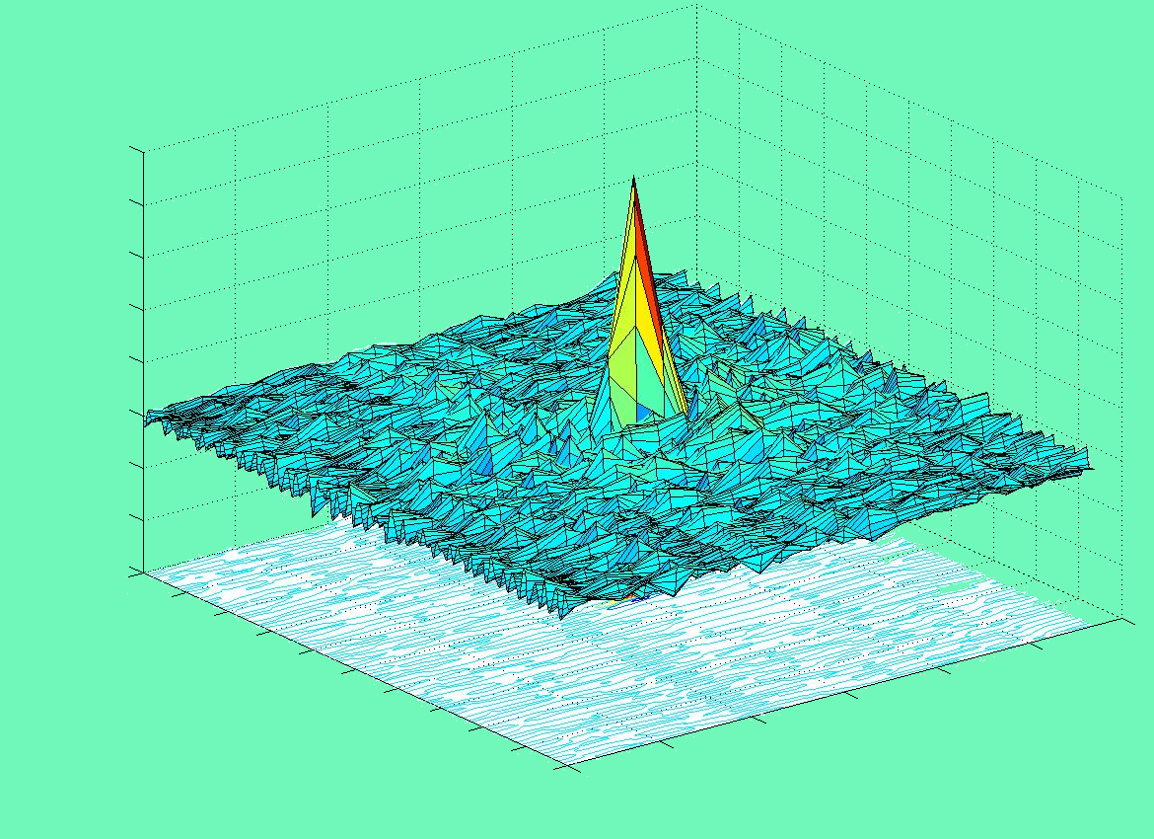
Method
What about excitation time?
1
Excitation Time
Location of Source
Normalized Amplitude
-1
-0.25
45
Time Shift (ms)
X (m)
0.25
0

Slide 10
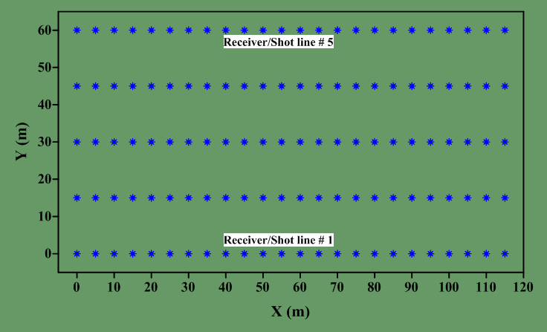
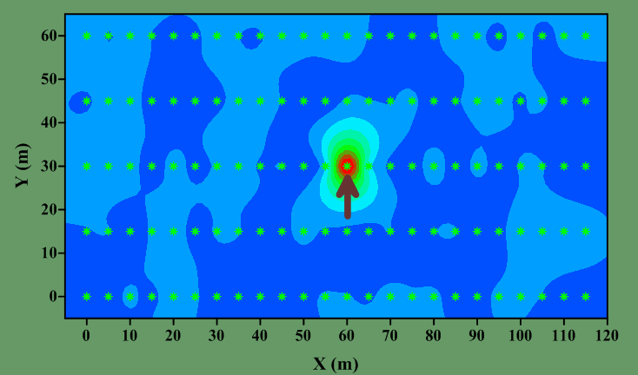
Sources/Receivers Layout

Slide 11
Outline
Motivation
Method
Field Example
Conclusions

Slide 12
Field Example
Data are collected at Tucson, AZ., USA.
120 Green’s functions are recorded
5 parallel lines with inline offset = 5 m and crossline offset = 15 m.
Each line contains 24 station.

Slide 13
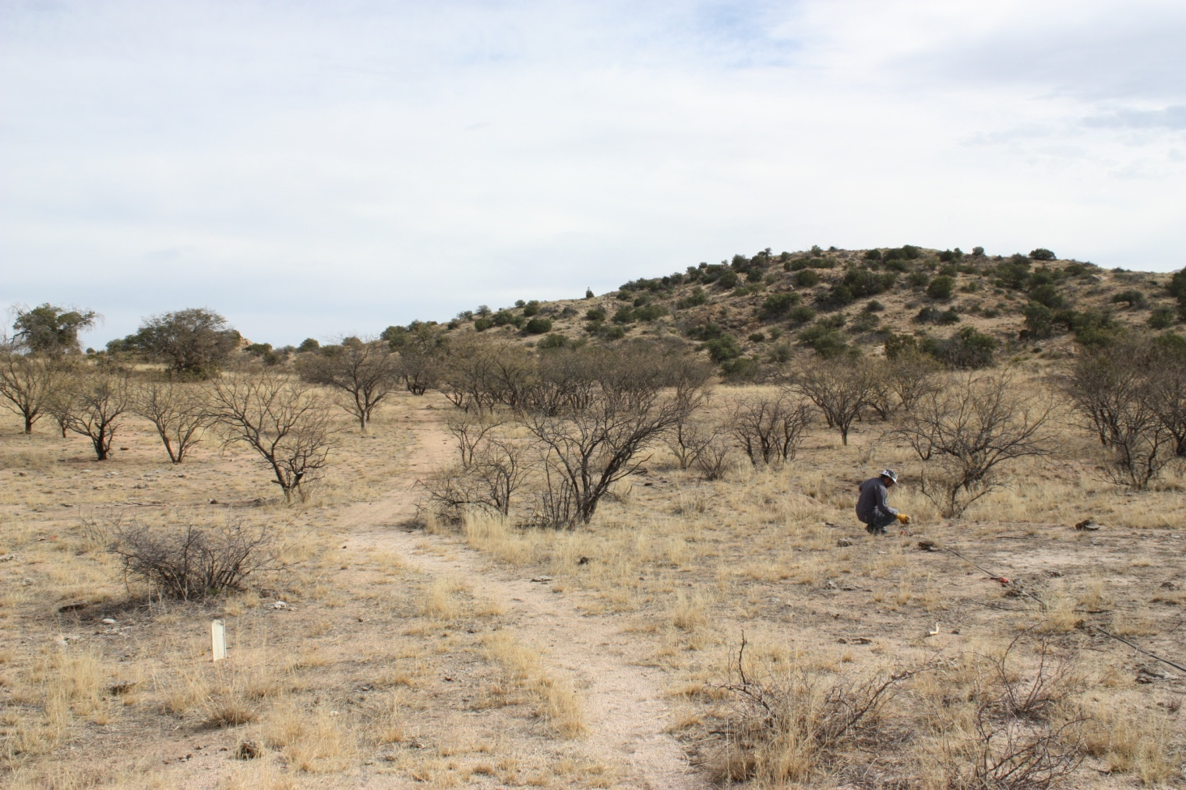
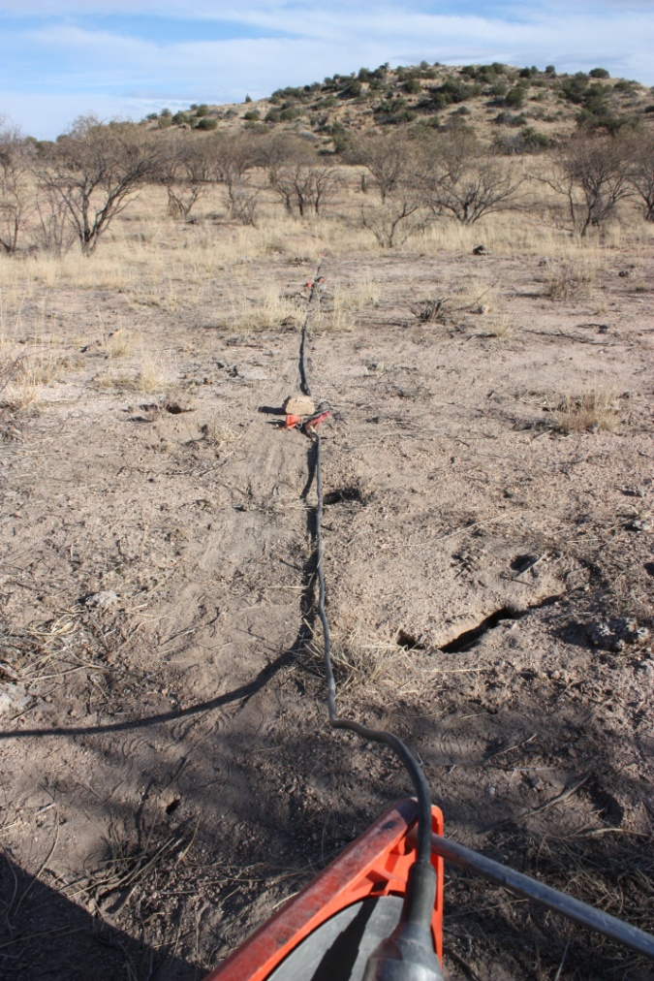
Field Example

Slide 14
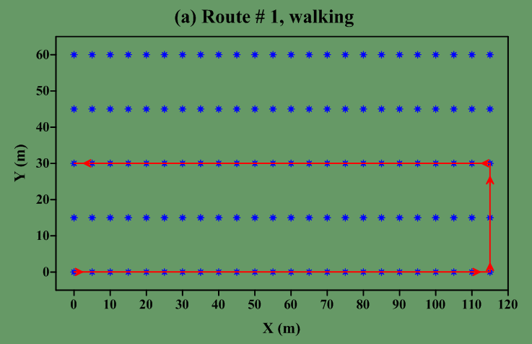
Four Different Routes

Slide 15
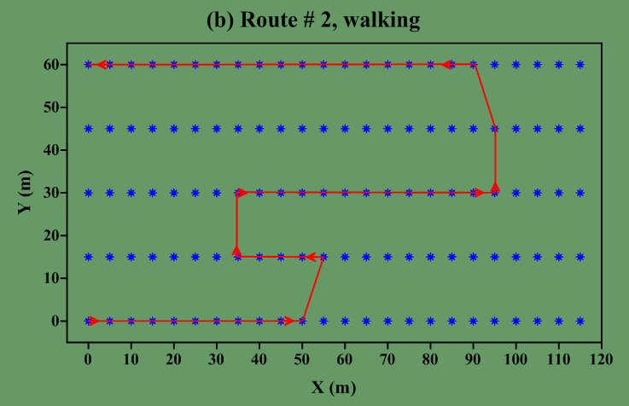
Four Different Routes

Slide 16
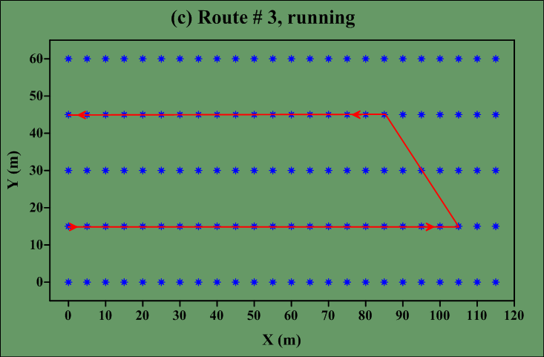
Four Different Routes

Slide 17
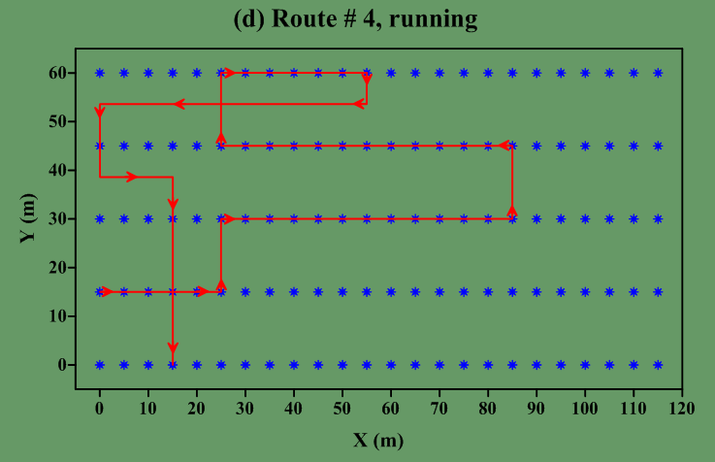
Four Different Routes

Slide 18
Results of Route 2

Slide 19
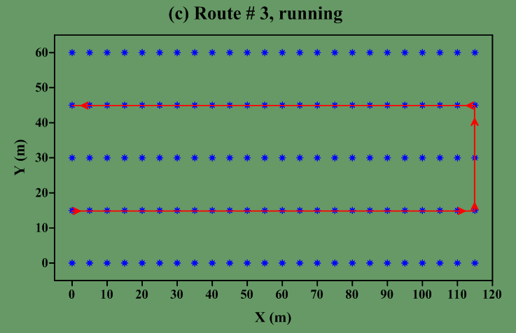
Results of Route 3

Slide 20
Velocity Calculation
Route # 2 (Walking)
Stations 2 to 11 is 45 m
Time is 17.7 s
Velocity = 45/17.7 = 2.5 m/s.
Route # 3 (Running)
Stations 87 to 74 is 65 m
Time is 11.9 s
Velocity = 65/11.9 = 5.5 m/s.

Slide 21
Outline
Motivation
Method
Field Example
Conclusions

Slide 22
Conclusions
Seismic data can be used to track moving objects in almost real time.
Location and velocity of the moving object can be found.
One field experiment is made to test the accuracy of the proposed method.

Slide 23
Application
Secure important areas and buildings.
Detect hydro-fracture and trace movement of injected fluids in the subsurface.

Slide 24
When it does not work?
If the area of interest has many activities, such as in cities, near road; simply where many moving objects are expected.

Slide 25
Thank You

