Slide 1
Seismic Scanning Tunneling Macroscope
Gerard T. Schuster, Sherif M. Hanafy,
and Yunsong Huang

Slide 2
Outline
Introduction
Motivation. Get super resolution by TRM
Method. Time Reversal Mirrors (TRM)
Field Test. Qademah Site
Conclusions

Slide 3
Outline
Introduction
Motivation. Get super resolution by TRM
Method. Time Reversal Mirrors (TRM)
Field Test. Qademah Site
Conclusions

Slide 4
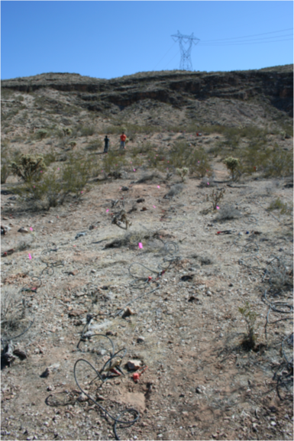
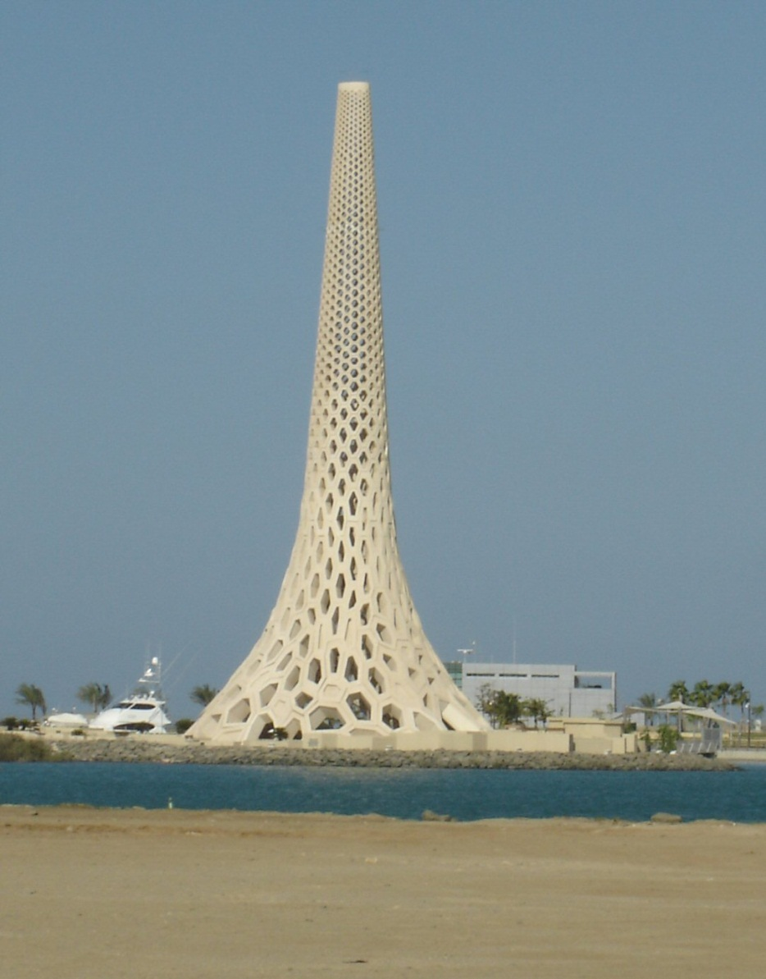
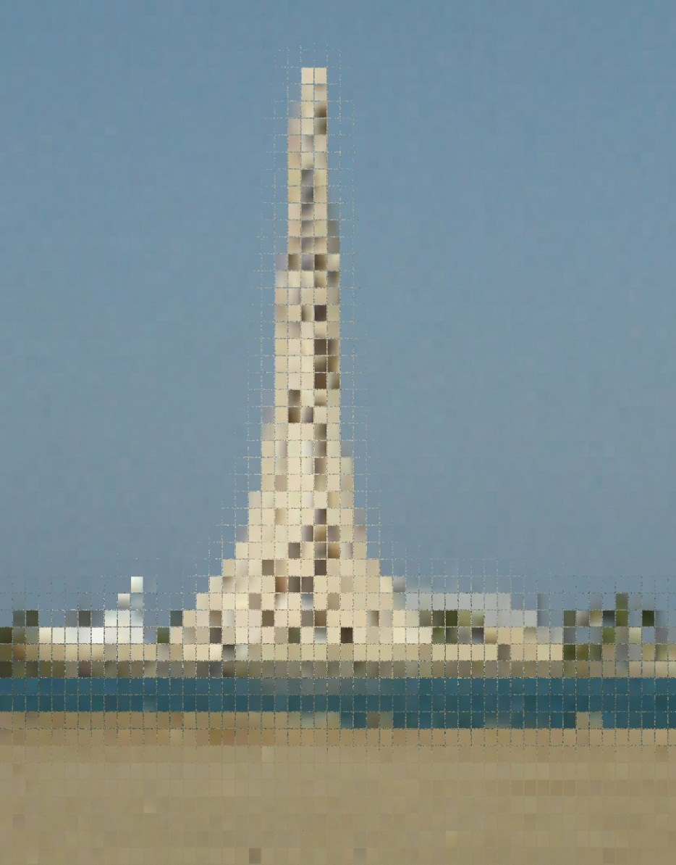
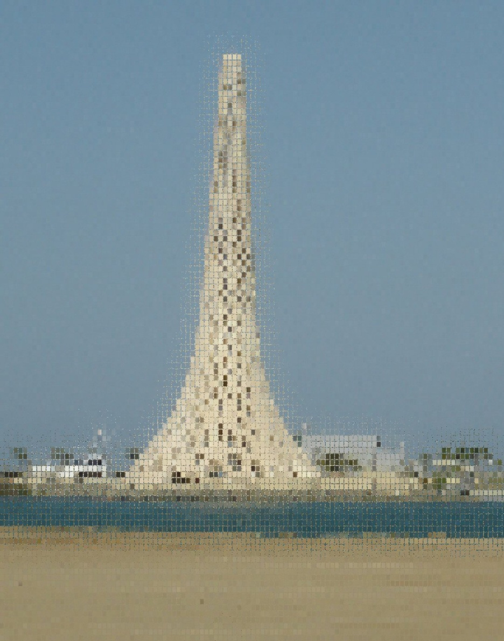
Resolution
L
Depth
Z
Δx
Δx
$$∆x=\frac{λz}{2L}$$
Rayleigh Resolution:
$$∆x=\frac{λ}{2}$$
Abbe Resolution:
$$∆x<\frac{λ}{2}$$
Super Resolution ?

Slide 5
Outline
Introduction
Motivation. Get super resolution by TRM
Method. Time Reversal Mirrors (TRM)
Field Test. Qademah Site
Conclusions

Slide 6
Motivation
Motivation: Achieve super resolution
IBM, 1986, Scanning Tunneling Microscope
Problem: Source and receiver need to be in the near-field
Solution: Use scatterer points
IBM
Scanning paths
IBM
Sample
Key Idea: slight changes in sample topography lead to enormous changes in Amps, as long
as stylus is within λ/2 of surface

Slide 7
Outline
Introduction
Motivation. Get super resolution by TRM
Method. Time Reversal Mirrors (TRM)
Field Test. Qademah Site
Conclusions

Slide 8
Time Reversal Mirrors (TRM)
$$s_{o}$$
Image
Plane
$$s^{′}$$

Slide 9
Time Reversal Mirrors (TRM)
TRM Profile
Image
Plane
$$s^{′}$$
$$s′$$
$$s_{o}$$
Migration Formula
$$m\left(s^{′}\right)=\sum_{g}{G^{∗}(g|s^{′})G(g|s_{o}) }$$
Measured
Data
Measured
Data
Calculated
Data
$$G(g|s_{o})$$

Slide 10
Point Scatterer
$$s$$
Image
Plane
$$s^{′}$$
$$G(s_{o}|s)$$
$$s_{o}$$
$$m\left(s^{′}\right)=\int_{−ω}^{ω}{\int_{−L}^{L}{G\left(s_{o} | s\right)G\left(g | s_{o}\right)}}G^{∗}\left(s_{o} | s^{′}\right)G^{∗}\left(g | s_{o}\right)dgdω$$
Target Location
Trial Location
$$G(g|s_{o})$$
$$G(s_{o}|s)G(g|s_{o})$$

Slide 11
Point Scatterer
$$m\left(s^{′}\right)=\int_{−ω}^{ω}{\int_{−L}^{L}{G\left(s_{o} | s\right)G\left(g | s_{o}\right)}}G^{∗}\left(s_{o} | s^{′}\right)G^{∗}\left(g | s_{o}\right)dgdω$$
$$G\left(x | x^{′}\right)=\frac{e^{iω\left|x−x^{′}\right|/c}}{|x−x^{′}|}$$
$$m\left(s^{′}\right)=\int_{−ω}^{ω}{\frac{e^{iω(\left|s−s_{o}^{}\right|−\left|s^{′}−s_{o}^{}\right|)/c}}{(\left|s−s_{o}^{}\right|\left|{s^{′}−s}_{o}^{}\right|)}}dω\int_{−L}^{L}{\frac{1}{|g−s_{o}|^{2}}dg}$$
$$m\left(s^{′}\right)=\frac{sin[ω(\left|s−s_{o}^{}\right|−\left|s^{′}−s_{o}^{}\right|)/c}{\left|s−s_{o}^{}\right|−\left|s^{′}−s_{o}^{}\right|}.\frac{1}{(\left|s−s_{o}^{}\right|\left|{s^{′}−s}_{o}^{}\right|)}\int_{−L}^{L}{\frac{1}{|g−s_{o}|^{2}}dg}$$
|s-s0| ~ λ/40
|s-s0| ~ λ
$$m\left(s^{′}\right)=A.B$$
0.2 0.7
0.2 0.7
S’
S’
Near-field: super-resolution
Far-field: Rayleigh resolution

Slide 12
TRM Profile
1. Near Field Case, |s-s0| << λ
$$Only B$$
$$Only A$$
$$m\left(s^{′}\right)=A.B$$
2. Far Field Case, |s-s0| = λ
$$Only B$$
$$Only A$$
$$m\left(s^{′}\right)=A.B$$

Slide 13
Outline
Introduction
Motivation. Get super resolution by TRM
Method. Time Reversal Mirrors (TRM)
Field Test. Qademah Site
Conclusions

Slide 14
Field Test
SET 1: Raw Data
X
t
SET 2: Raw Data + Scat.
X
t
SET 3: Scattered Data
X
t

Slide 15
Experimental Setup
Rec. Line 5
24 geophones / line
0.5 m
10 m
Rec. Line 4
0.5 m
0.2 m
5 m
Rec. Line 3
1 m
Rec. Line 2
1 m
Rec. Line 1
1 m
scatterer
Rec. Line
0.2 m
24 sources

Slide 16
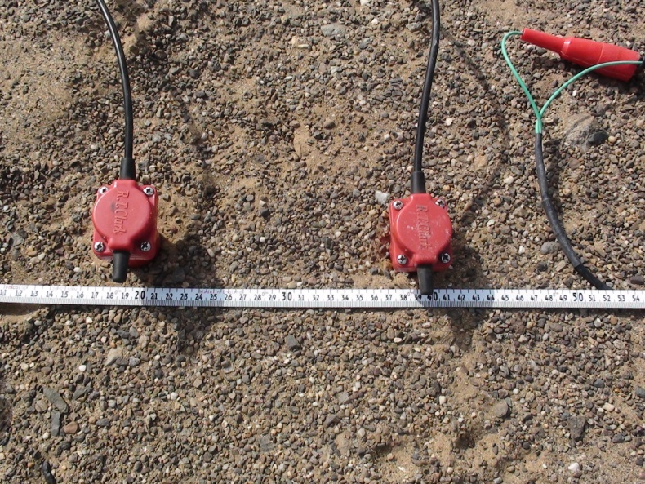
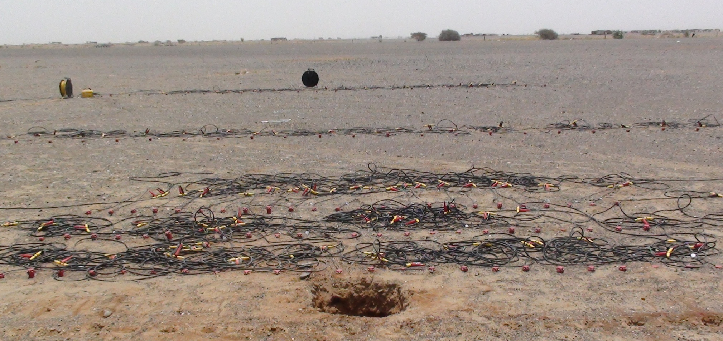
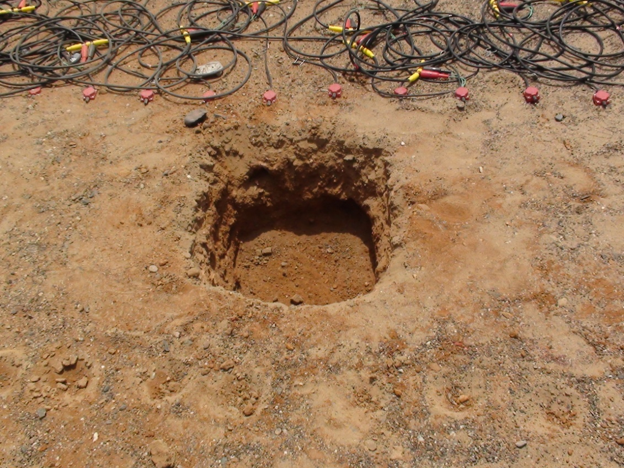
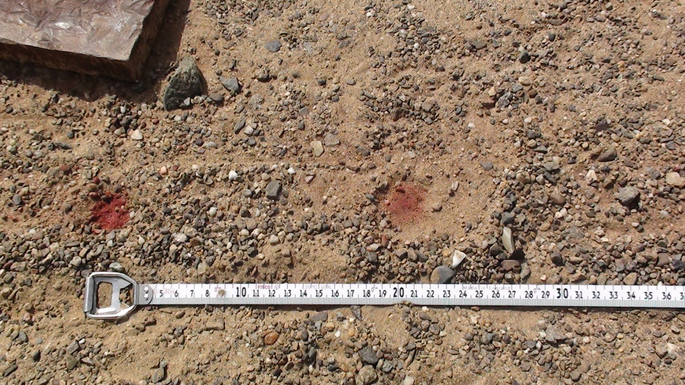
Site Photos

Slide 17
TRM Profiles
Using SET 3 CSGs

Slide 18
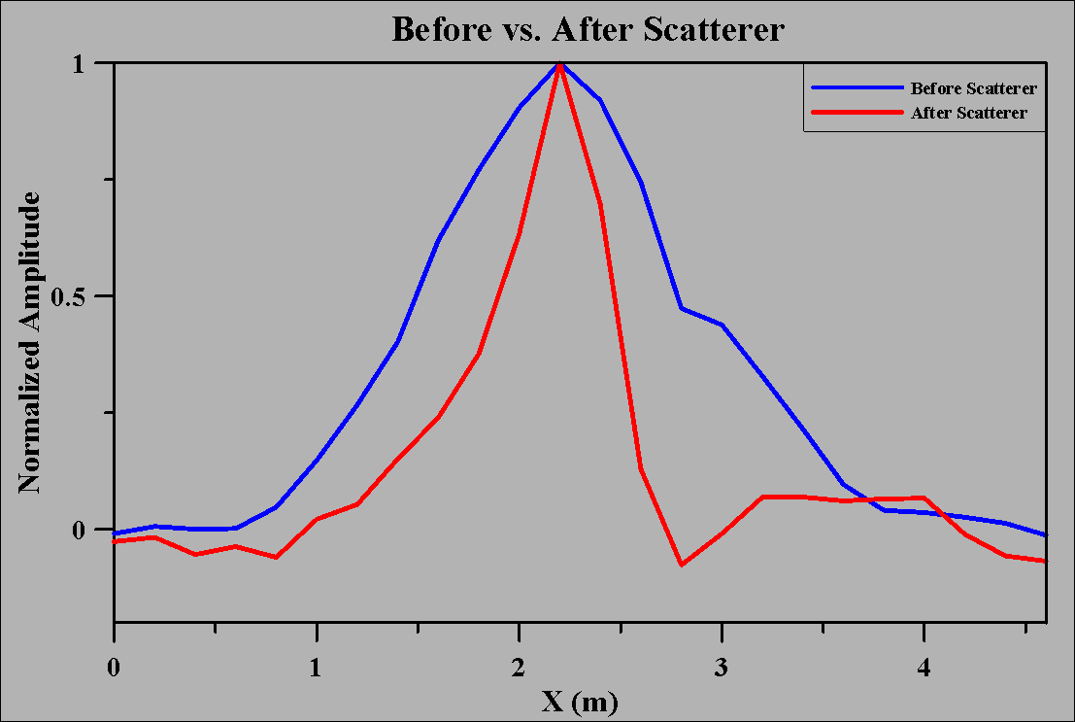
TRM Profiles
Before vs. After Scatterer
SET 1
SET 3

Slide 19
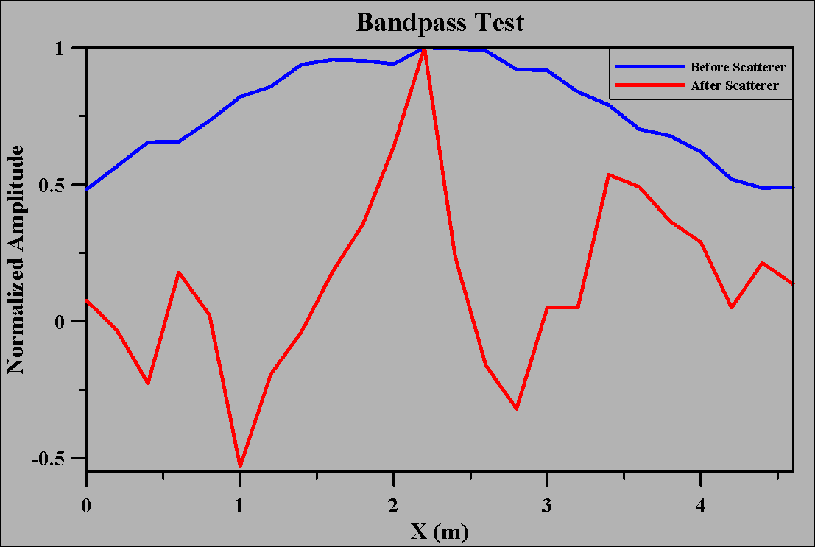
TRM Profiles
Bandpass test
SET 1
SET 3

Slide 20
2nd Field Experiment

Slide 21
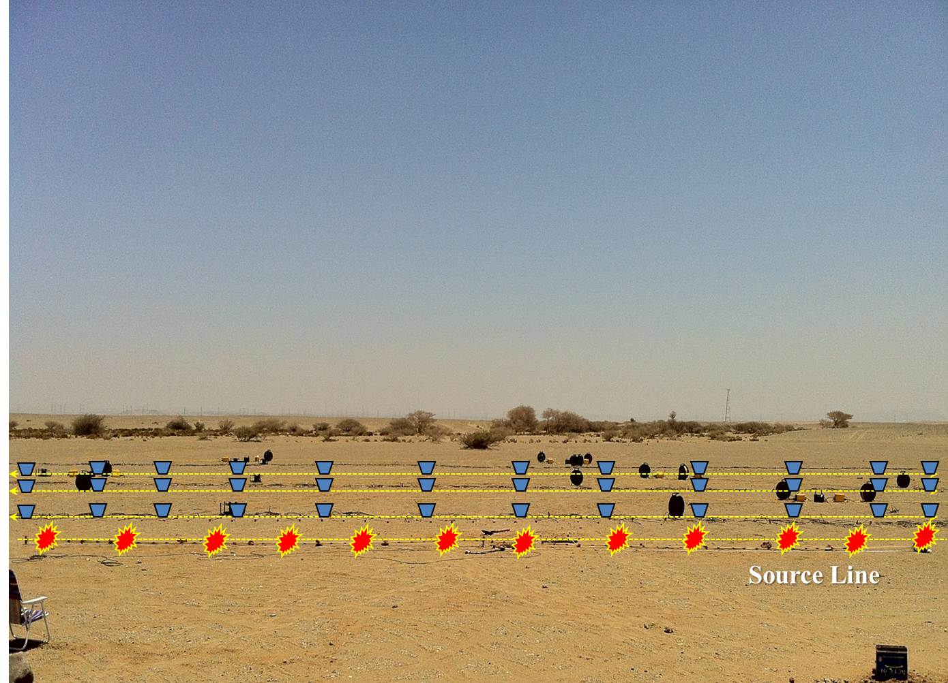
Data Set # 1

Slide 22
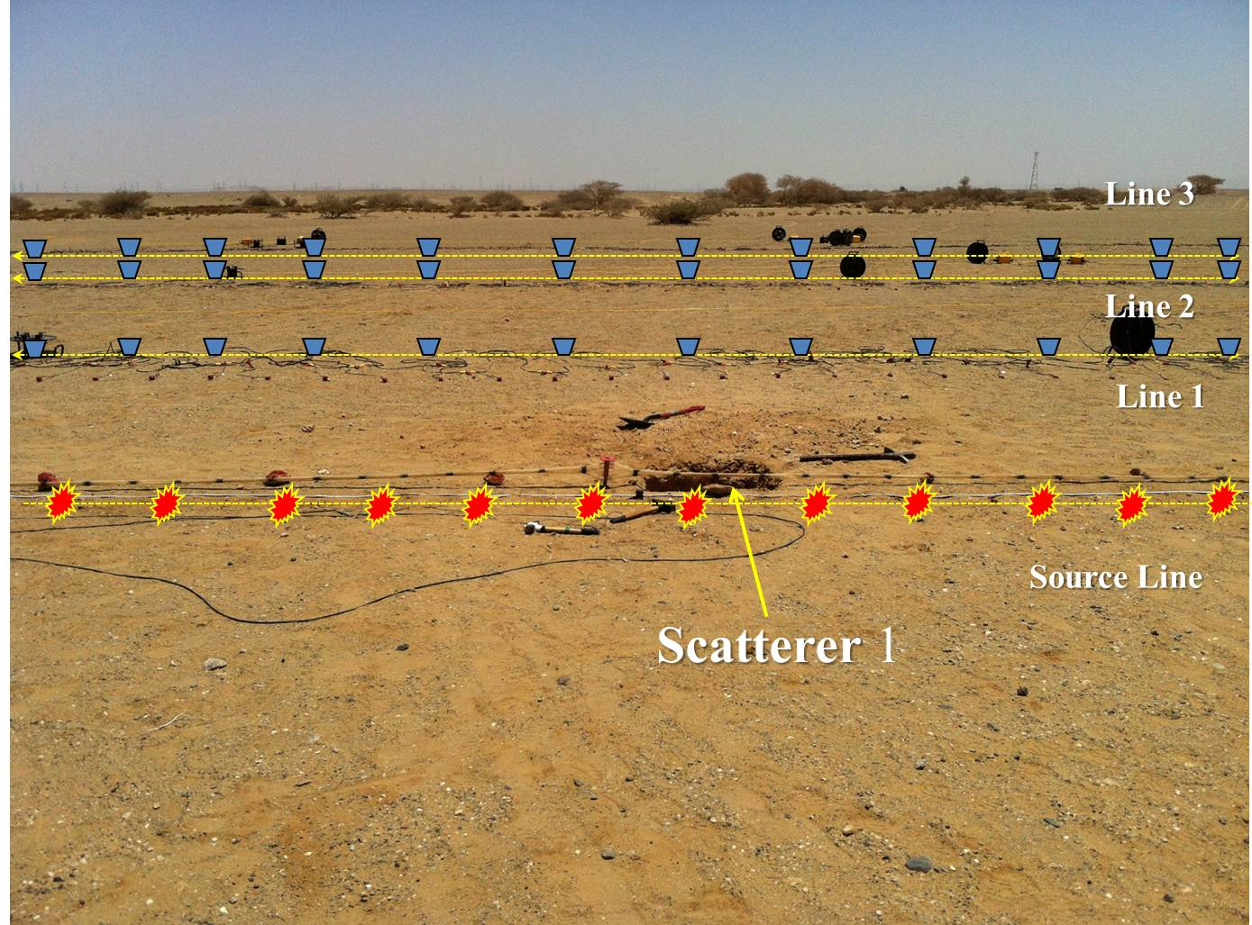
Data Set # 2

Slide 23
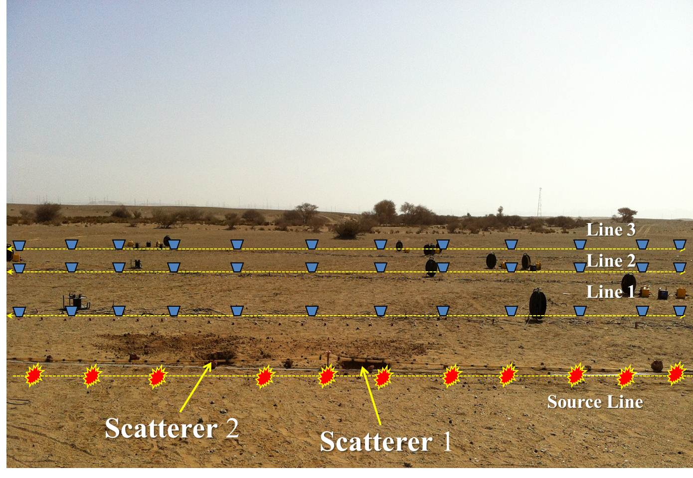
Data Set # 3

Slide 24
TRM Profiles
$$λ/2$$
$$λ/8$$
$$λ/2$$
$$λ/{10}$$

Slide 25
Outline
Introduction
Motivation. Get super resolution by TRM
Method. Time Reversal Mirrors (TRM)
Field Test. Qademah Site
Conclusions

Slide 26
Conclusions
TRM profiles have the shape of a sink curve if no scatterer in the near-field of the shot point
TRM profiles have the shape of a spike if scatterer exists in the near-field of the shot point
Field data shows that super resolution can be achieved if scatter points exists in the source near field
|s-s0| ~ λ/40
|s-s0| ~ λ
0.2 0.7
0.2 0.7
S’
S’

Slide 27
Points for future research
What if scatter points are at the far field of both sources and receivers?
Can we increase the resolution of migration images?
Can we use SSP data?

Slide 28
Thank You Questions?

