Slide 1
GROUNDWATER AQUIFER CHARACTERIZATION USING GEOPHYSICAL METHODS
Abstract ID: 143
KAUST
Sherif M. Hanafy
SAGEEP 2013, Tus. 19 March 2013

Slide 2
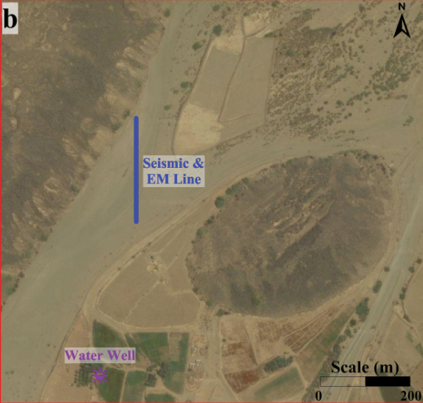
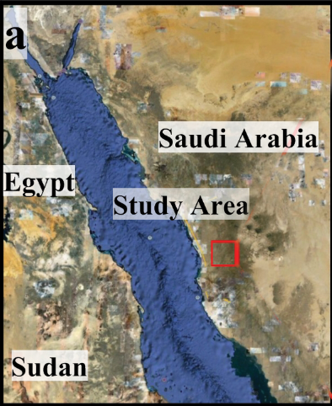
Motivation
To characterize the shallow subsurface at Wadi Qudaid for its water storage and reuse potential.
Seismic Method
Traveltime tomography
Early arrival waveform inversion (EWI)
EM
Electric

Slide 3
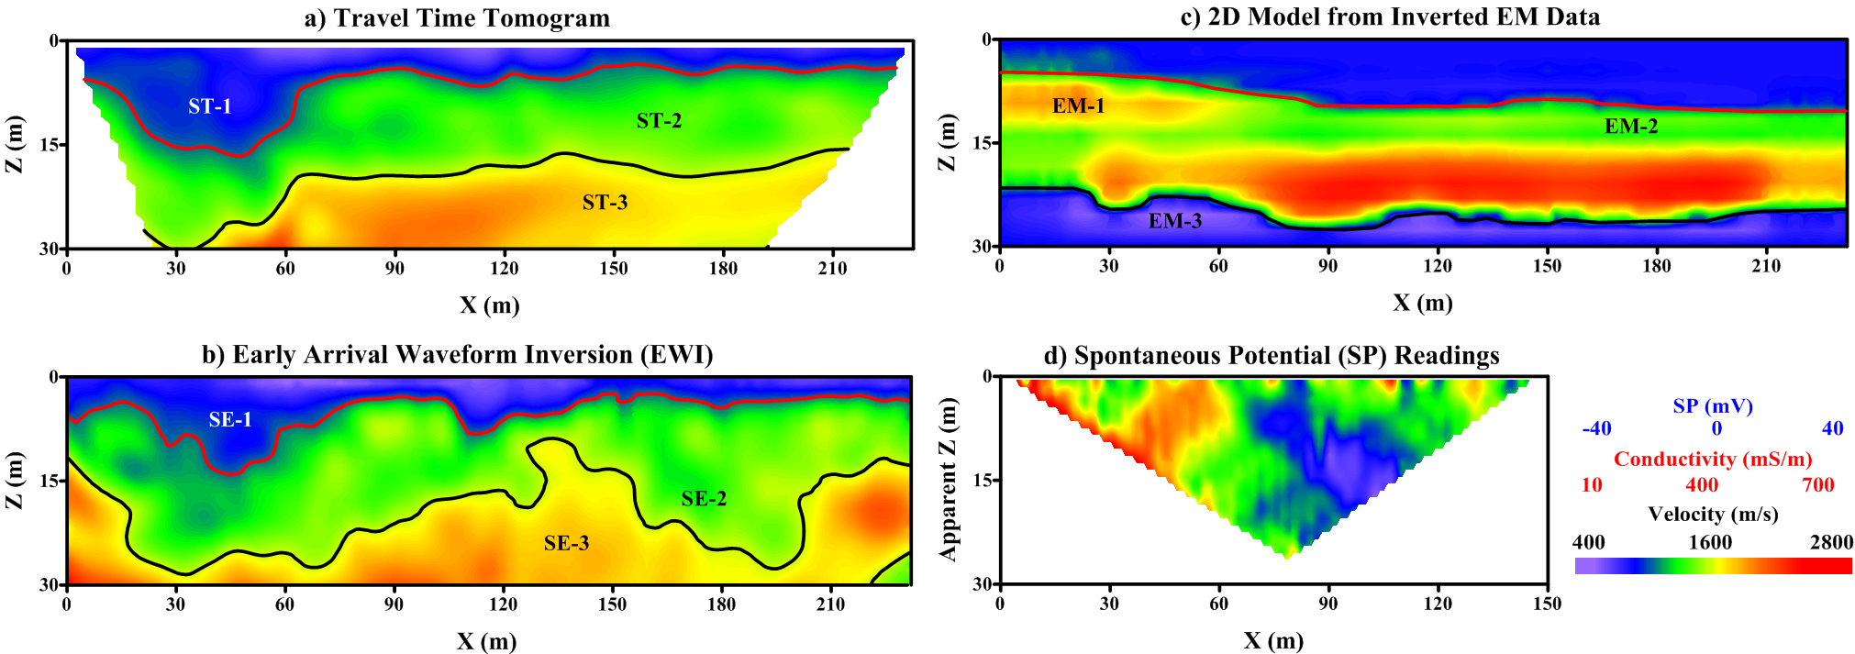
Summery of Results

