Slide 1



Fault Detection by Surface Scanning Tunneling Macroscope: Field Test
Sherif M. Hanafy
27 October 2014

Slide 2
Outline
Problem
Theory: Introduction to SSTM
Numerical Tests
  Elastic synthetic examples
  Field example
Conclusions
Future Work

Slide 3
Outline
Problem
Theory: Introduction to SSTM
Numerical Tests
  Elastic synthetic examples
  Field example
Conclusions
Future Work

Slide 4
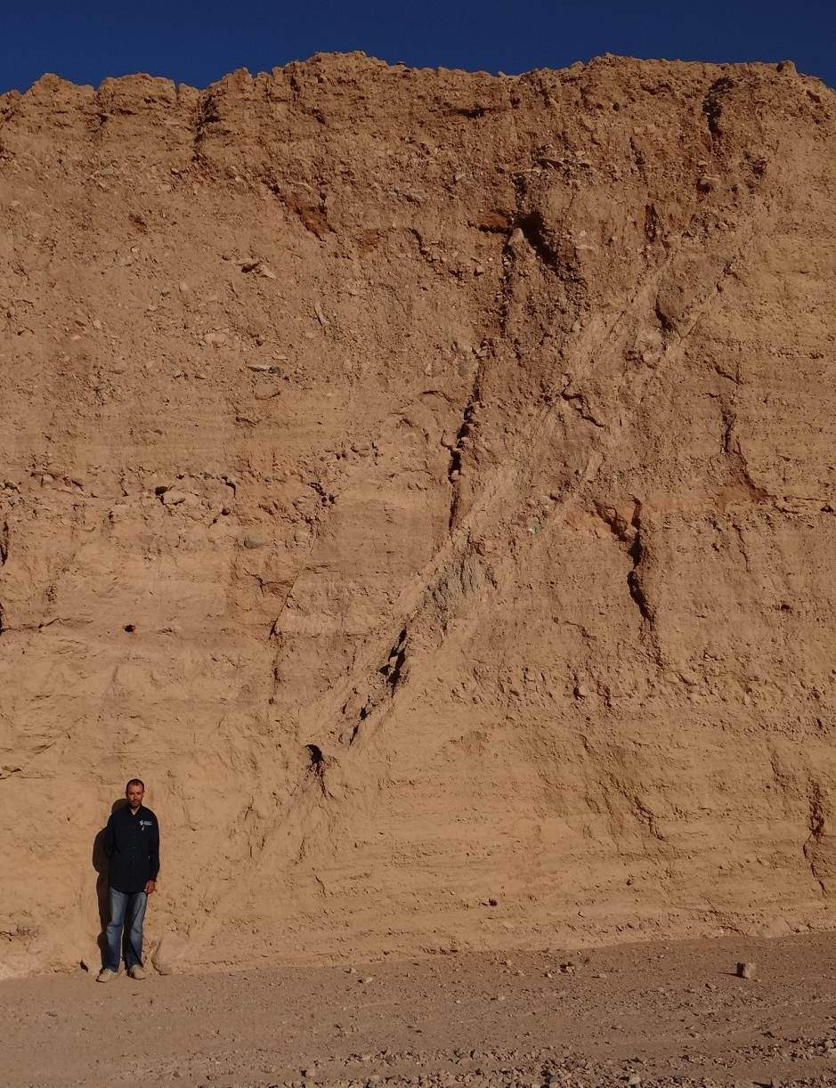
Problem
Problem:
Detection of the presence of near-surface impedance anomalies and faults
Solution:
Seismic scanning tunneling macroscope (SSTM) method

Slide 5
Outline
Problem
Theory: Introduction to SSTM
Numerical Tests
  Elastic synthetic examples
  Field example
Conclusions
Future Work

Slide 6

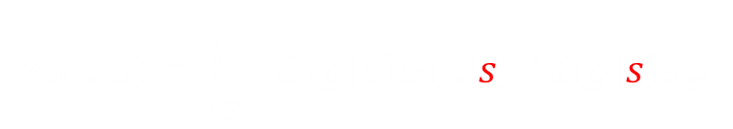
Prestack Migration x ε V
$$m(x,s)=\int_{B}{{\left[G\left(g | x\right)G\left(x | s\right)\right]}^{∗}d\left(g | s\right)dg}$$
Prestack Migration:
Mig. Kernel
Data
scattered
direct
s
s
B
Migration image m(x,s)
Migration profiles

Slide 7
Prestack Migration x ε V
$$m(x,s)=\int_{B}{{\left[G\left(g | x\right)G\left(x | s\right)\right]}^{∗}d\left(g | s\right)dg}$$
Prestack Migration:
scattered
direct
s
B
1. Eliminate green image
and keep profiles

Slide 8
Prestack Migration x ε V
$$m(x,s)=\int_{B}{{\left[G\left(g | x\right)G\left(x | s\right)\right]}^{∗}d\left(g | s\right)dg}$$
Prestack Migration:
scattered
direct
s
B
1. Eliminate green image
and keep profiles
2. Lower recording plane
to just above scatterer
3. Only keep profile on recording plane sεB

Slide 9
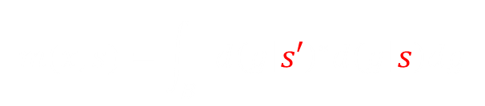
Prestack Migration x ε V
$$m(x,s)=\int_{B}{{\left[G\left(g | x\right)G\left(x | s\right)\right]}^{∗}d\left(g | s\right)dg}$$
Prestack Migration:
Mig. Kernel
Data
Data
$$m(x,s)=\int_{B}{{d\left(g | s′\right)}^{∗}d\left(g | s\right)dg}$$
scattered
direct
s
1. Eliminate green image
and keep profiles
B
2. Lower recording plane
to just above scatterer
3. Only keep profile on recording plane sεB
x ε B so G(g|x)G(x|s) = recorded data and no migration
velocity needed
4. Eliminate data. Migration
profile → SSTM m(x,s)
m(x,s)

Slide 10
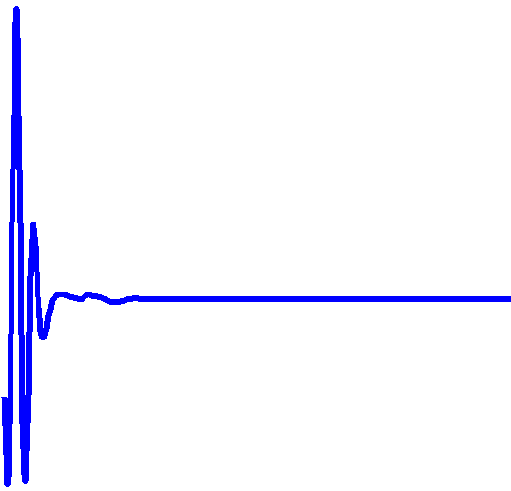

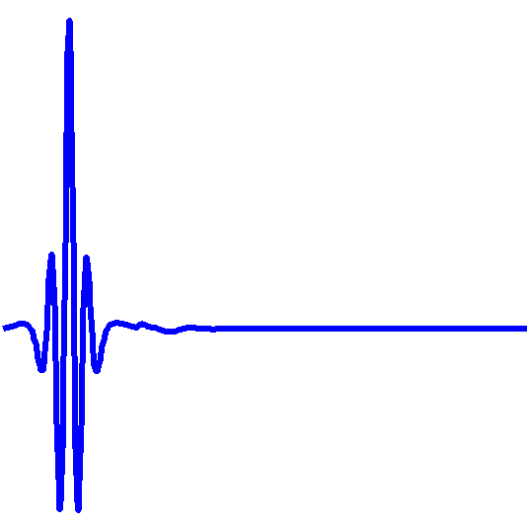
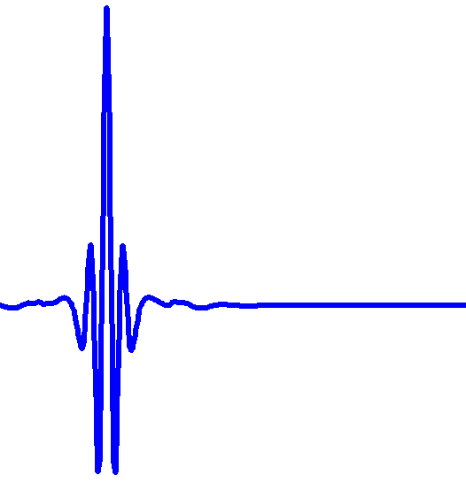
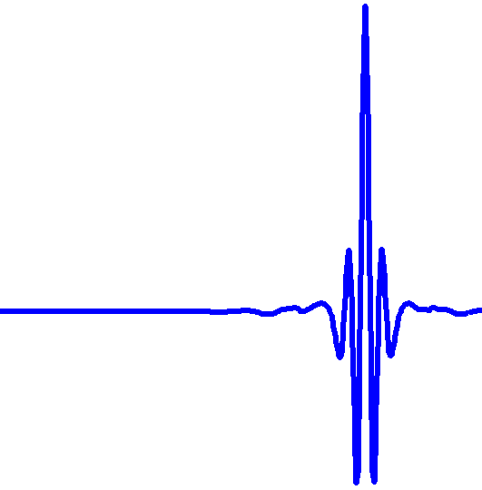





Theory
$$m(x,s)=\int_{B}{{d\left(g | s′\right)}^{∗}d\left(g | s\right)dg}$$
Pre-stack SSTM profiles
B
0
400 m
SSTM Profile
Pre-stack SSTM Profiles
$$m(x,s=10)$$
Source Location (s)
$$m(x,s=50)$$
$$m(x,s=100)$$
$$m(x,s=300)$$
Trial Location

Slide 11
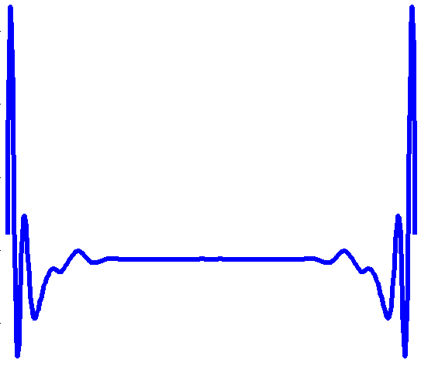
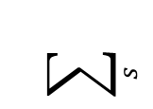
Theory
Pre-stack SSTM Profiles
Source Location (s)
$$\sum_{s}{}$$
Stacked SSTM Profile
Trial Location
Trial Location

Slide 12
Outline
Problem
Theory: Introduction to SSTM
Numerical Tests
  Elastic synthetic examples
  Field example
Conclusions
Future Work

Slide 13
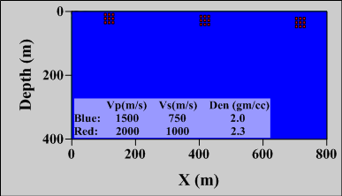
Numerical Tests
3-Scatterers Velocity Model
Depth to scatterer clusters
Cluster # 1: 0.1 λ
Cluster # 2: 0.3 λ
Cluster # 3: 0.4 λ

Slide 14
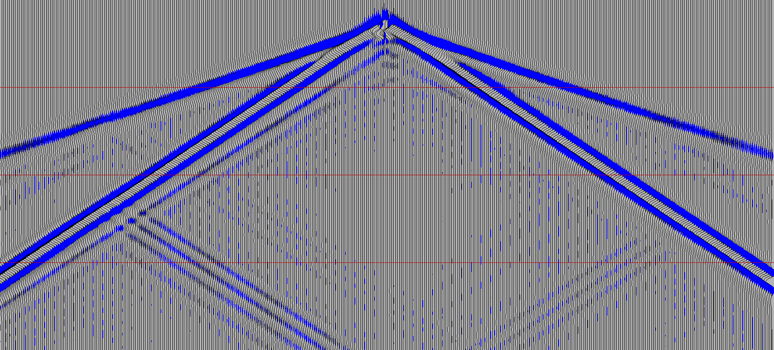
Shot Gather Example
Halo and Mute Early-arrivals
Common Shot Gather # 200
Time (s)
0.0
Mute early-arrivals
P
Halo
Practical problems
Zero and near offset traces
Early arrivals
S
0.7
0.0
400
X (m)

Slide 15
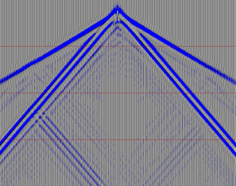
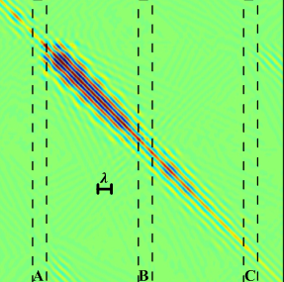
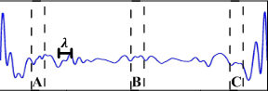
Halo Test
Source Location (s)
Pre-stack SSTM
Scatterers are not clearly shown on the SSTM profiles
Trial Location
Stacked SSTM

Slide 16
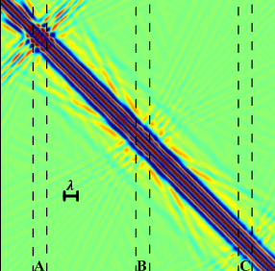
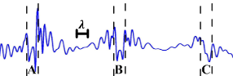
Mute Early-arrivals Test
Source Location (s)
Pre-stack SSTM
Scatterers are shown on both the pre-stacked and the stacked SSTM profiles
Trial Location
Stacked SSTM

Slide 17
Outline
Problem
Theory: Introduction to SSTM
Numerical Tests
  Elastic synthetic examples
  Field example
Conclusions
Future Work

Slide 18
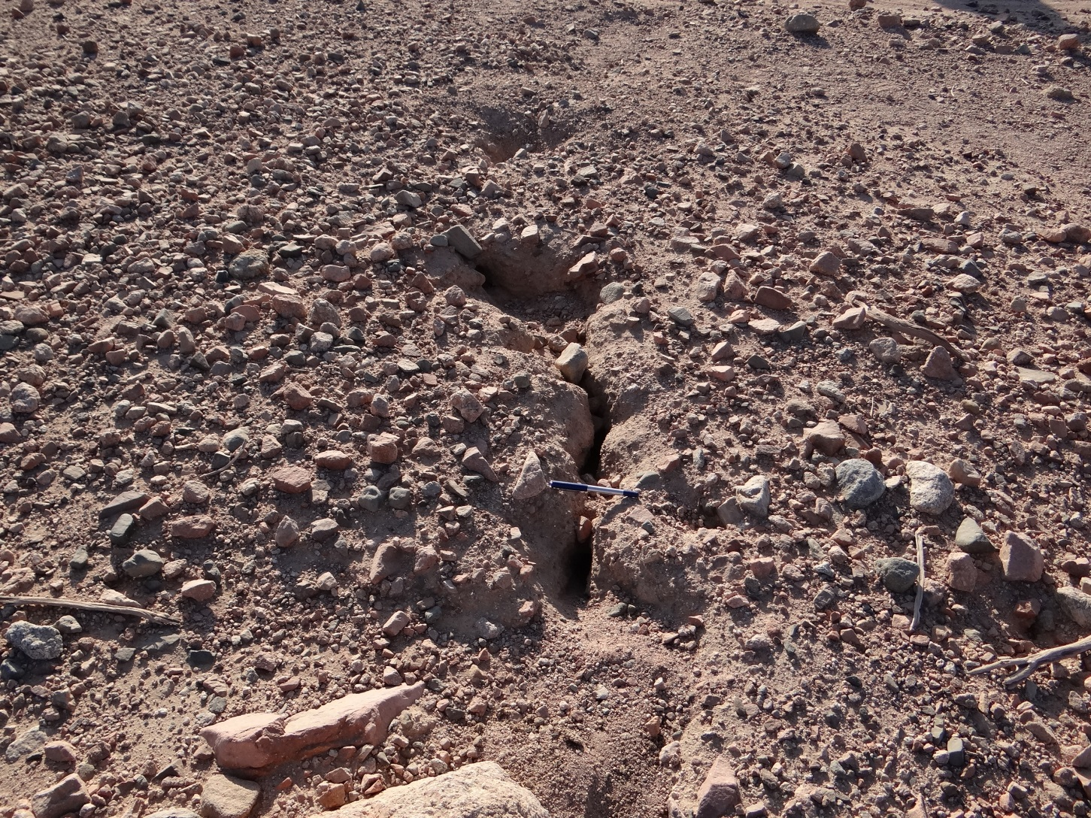
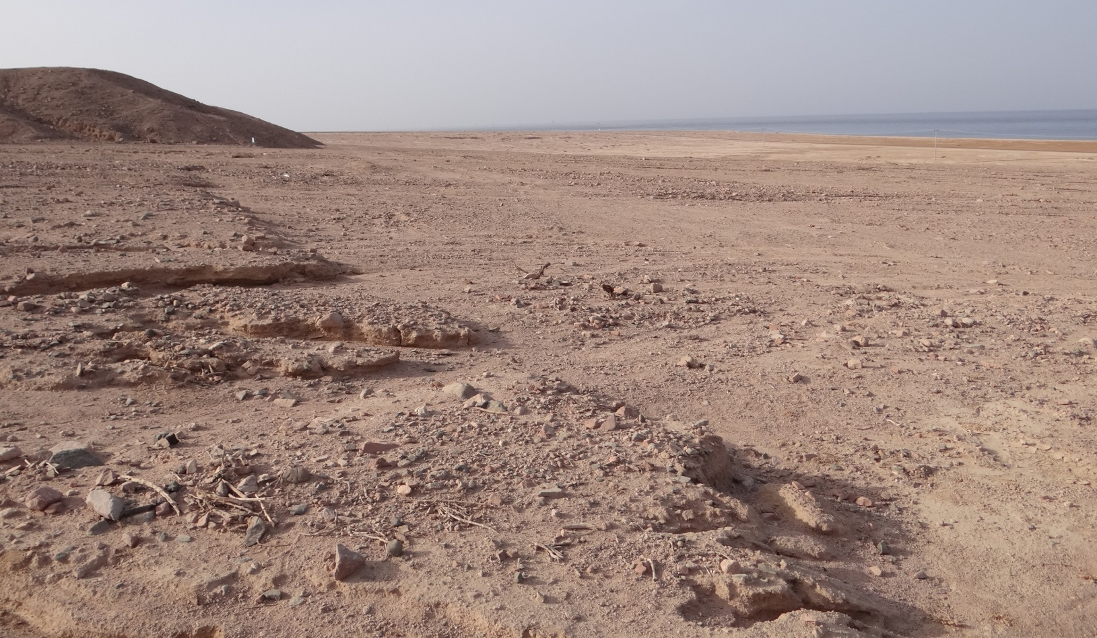
Field Test

Slide 19
Data Collection

Slide 20
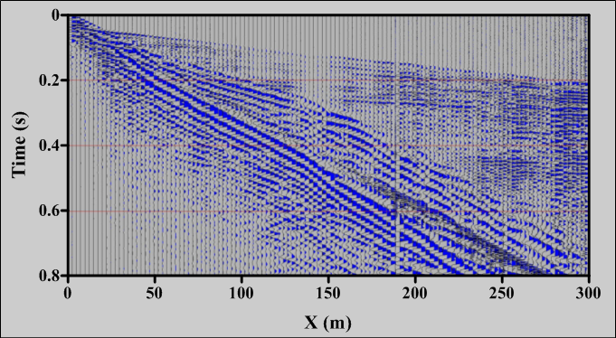
Shot Gather Sample
Shot Gather # 1
No. of sor. = no. of rec. = 120
Sor. int. = rec. int. = 2.5 m
Source is a 200 lb weight drop

Slide 21
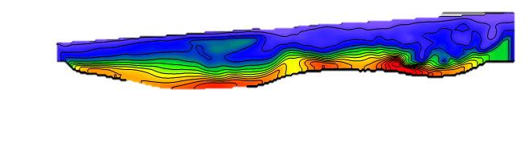
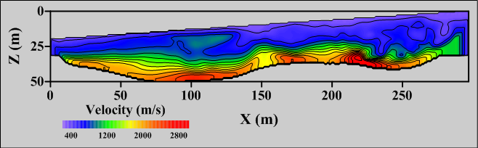
Traveltime Tomogram
Ground truth:
The 1995 fault rupture
0
Z (m)
c
d
a
F
b
50
0
Offset (m)
400
Velocity (m/s)
400
2800

Slide 22
Shot Gather Sample
Shot Gather # 1

Slide 23
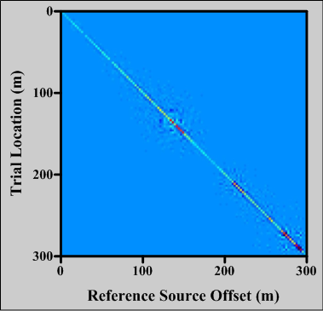
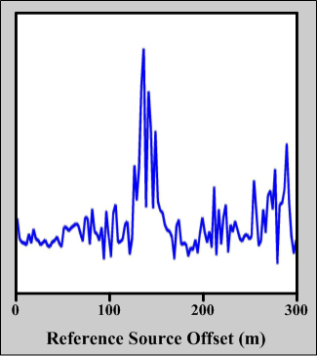
SSTM Profiles
Pre-stacked SSTM
Stacked SSTM
F
a
b
c
d
X
X
a
c
d
a
c
d
F
b
F
b

Slide 24
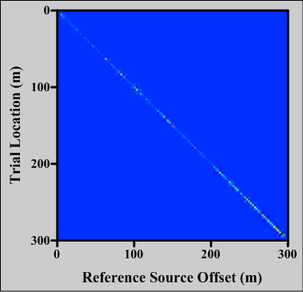
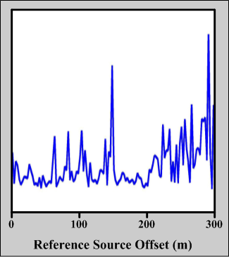
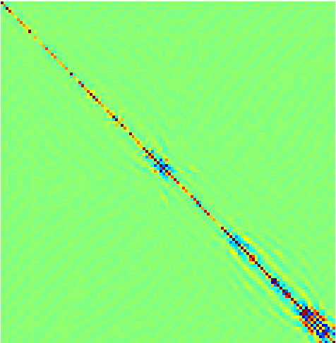
SSTM Profiles
Band pass test, 5 – 15 Hz pass, peak freq. = 35 Hz.
Pre-stacked SSTM
Stacked SSTM
F
a
b
c
d
F
X
X
c
b
d
a
c
d
a
c
d
F
b
F
b

Slide 25
Outline
Problem
Theory: Introduction to SSTM
Numerical Tests
  Elastic synthetic examples
  Field example
Conclusions
Future Work

Slide 26
Conclusions
SSTM can be used to locate near-surface impedance anomalies and faults.
Elastic Synthetic examples show that scatterers need to be very close to source line.
SSTM tested on a field data, where fault and colluvial wedges can be located with SSTM method

Slide 27
Possible Applications
Near-surface fault detection
Near-surface local anomaly detection
QC for velocity tomograms
Locate near-surface bodies such as pipes, archeology, etc.

Slide 28
Outline
Problem
Theory: Introduction to SSTM
Numerical Tests
  Elastic synthetic examples
  Field example
Conclusions
Future Work

Slide 29
Future Work
Synthetic tests using more complex velocity model
Apply f-k filter to isolate scatterer effect on the shot gathers

Slide 30
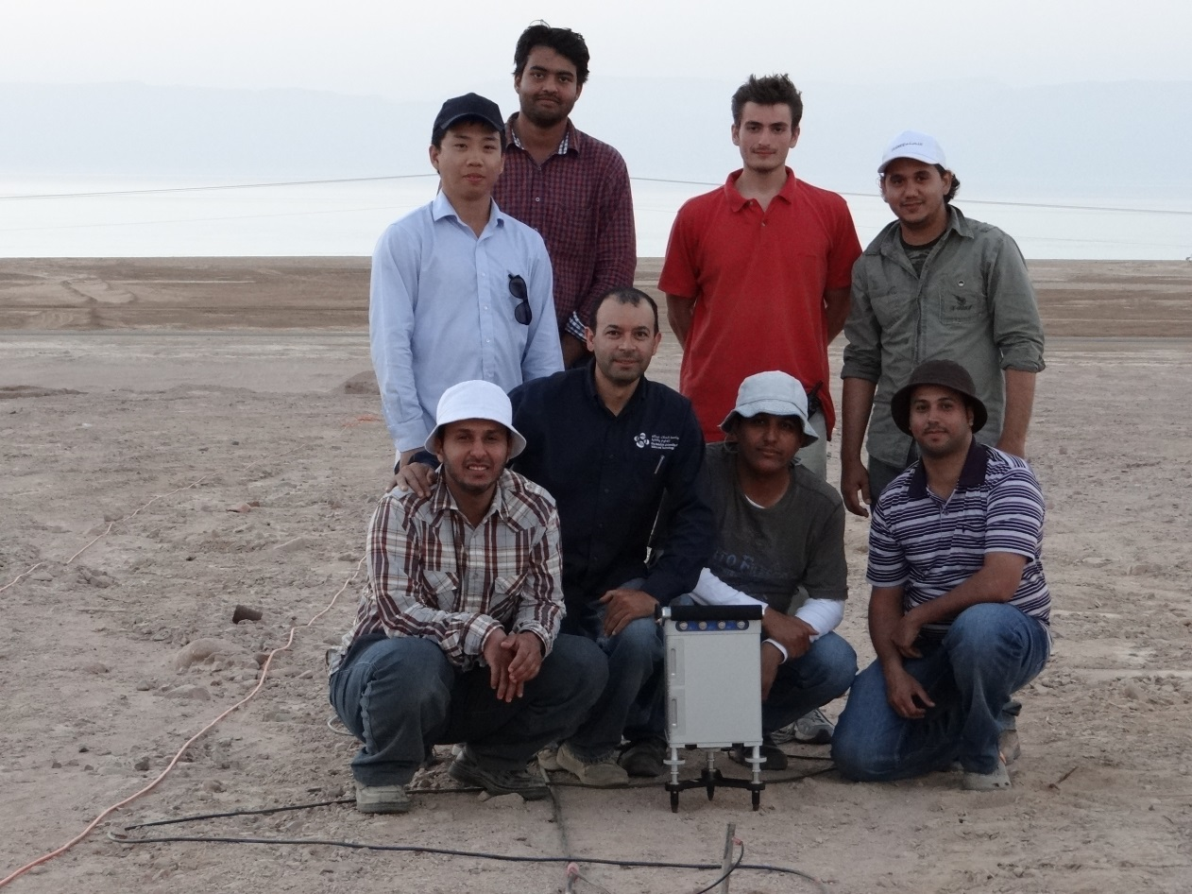
Acknowledgements
I would like to thank
The CSIM sponsors for their support
The students of the ‘Geophysical Field Methods’ class for their help in data collection
Thank You

