Slide 1
Elastic Stress Tensor and 1st-order Wave Equation
σ
..
ij
=
ρ
u
+ F
i
i
x
j

Slide 2
Outline
Traction Paradox
Stress Tensor
Elastic Wave Equation
What Does T n mean?
Summary
Appendix
.

Slide 3
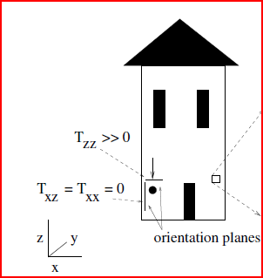
Traction Paradox
Material body can be acted upon by external forces, which are of two kind: surface forces
and body forces. Surface forces or contact forces act on the bounding surface as a result of mechanical
contact between bodies, and their intensity is proportional to the area of contact.
Contact Forces
Body Forces: Fields act away from source: gravity,
electric, thermal, etc
Many
force vectors
Many body
force vectors
Shrink to
infinitesmal cube
Shrink to
infinitesmal cube
Many
force vectors
One body force vector

Slide 4
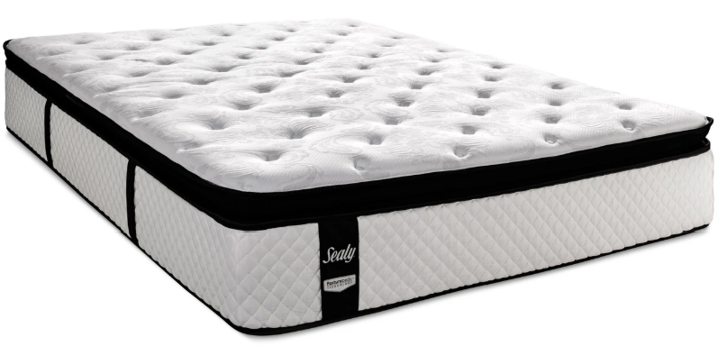
Traction Paradox
Material body can be acted upon by external forces, which are of two kind: surface forces
and body forces. Surface forces or contact forces act on the bounding surface as a result of mechanical
contact between bodies, and their intensity is proportional to the area of contact.
Traction vector T(n) is force/area vector
that external medium exerts on face with normal n.
^
^
^
^
n
T(n)
^
n
Note: Two vectors are needed
to describe traction, n and T. Hence,
6 components are needed, three for
orientation of T and three for orientation n
for face of cube. These six components
Of information are described by
stress tensor s
^
^
^
T(n)
n
^
^
ij
T(n)
Tractions change with different orientations of face! Weird!
Example: Face mask in water has same pressure on it regardless of orientation,
but the normal vector changes with orientation..so does traction vector.
ij

Slide 5
Traction Paradox
Material body can be acted upon by external forces, which are of two kind: surface forces
and body forces. Surface forces or contact forces act on the bounding surface as a result of mechanical
contact between bodies, and their intensity is proportional to the area of contact.
Traction vector T(n) is force/area vector
that external medium exerts on face with normal n.
^
^
^
^
n
T(n)
^
n
Note: Two vectors are needed
to describe traction, n and T. Hence,
6 components are needed, three for
orientation of T and three for orientation n
for face of cube. These six components
are described by stress tensor s
^
^
^
T(n)
n
ij
^
^
ij
T(n)
^
-n
^
^
^
Tractions are equal and opposite across face T(n) =-T(-n)
n
Newton’s 3rd law: For every action, there is an equal and opposite reaction.
The statement means that in every interaction, there is a pair of forces acting on the two interacting objects.
The size of the forces on the first object equals the size of the force on the second object.

Slide 6
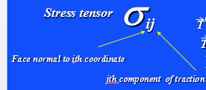
Traction Vector (Force/area)
(Force/area external medium exerts on face of cube)
n
x
^
3
3
σ
σ
13
n
x
n
^
^
σ
23
1
σ
σ
2
1
11
21
σ
12
22
x
2
T
(x )
Traction vector
1
T
(x )
^
^
^
1
= σ i + σ j + σ k
11
12
13
Materialbody can be acted upon by external forces, which are of two kind: surface forces
and body forces. Surface forces or contact forces act on the bounding surface as a result of mechanical
contact between bodies, and their intensity is proportional to the area of contact.
σ
Stress tensor
ij
(x)
T
T
(y)
Face normal to ith coordinate
T
(z)
jth component of traction

Slide 7
Outline
Traction Paradox
Stress Tensor
Elastic Wave Equation
What Does T n mean?
Summary
Appendix
.

Slide 8
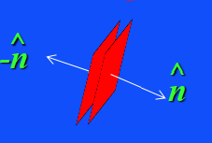
Stress Tensor
I can see why normal streses are
equal and opposite for equilibrium, otherwise forces on
cube would be unbalanced and accelerate.
But why are shear stresses equal and opposite?
x
σ
3
33
σ
σ
32
σ
31
σ
x
13
11
1
σ
σ
11
σ
13
12
σ
x
31
2
σ
σ
Stress tensor symmetric, otherwise equilibrium cube would rotate:
=
ij
ji
σ
Stress tensor
ij

Slide 9
Net Forces on Cube
x
dx
3
σ
σ
(x)
(x+dx)
σ
x
σ
13
12
(x+dx)
(x)
11
1
11
σ
σ
(x+dx)
(x)
13
12
x
2
σ
jth component force on ith face at x:
(x)
ij
σ
jth component force on ith face at x+dx:
(x+dx)
ij
i
σ
Σ
[σ
σ
Σ
Sum over
face indices i
(x+dx )-
(x)] =
dx
ij
i
ij
i
ij
i
i
Total difference of
jth component force/area on cube
x
i
σ
σ
Actually, we need to multiply
by area dA to get net force!
Add up jth comp contributions from all faces:
dx
dx
σ
jth component net force/area on cube:
ij
i
ji
i
dx
Σ
=
Σ
=
ij,i
i
Repeated indicies = summation (Einstein notation)
i
x
i
x
i
i
Index after comma=differentiation

Slide 10
Outline
Traction Paradox
Stress Tensor
Elastic Wave Equation
What Does T n mean?
Summary
Appendix
.

Slide 11
Elastic Wave Equation (F=ma)
x
3
x
1
x
2
Total mass in cube
Note: Net force on face, not stress, causes acceleration
Note: Net force gradient, not stress, causes acceleration
..
σ
σ
σ
(
)
=
ρ
u
dxdydz
+
+
dxdydz
xx,x
yx,y
zx,z
Actually, we need to multiply
by area dA to get net force!
Sum of xth component net forces on cube = inertial forces

Slide 12
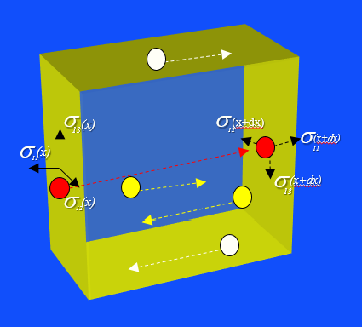
Elastic Wave Equation (F=ma)
..
σ
σ
σ
=
ρ
u
+
+
xx,x
yx,y
zx,z
..
σ
σ
σ
=
ρ
v
+
+
xy,x
yy,y
zy,z
σ
σ
σ
..
=
ρ
w
+
+
xz,x
yz,y
zz,z
Elastic
σ
..
ji
=
ρ
u
+ F
i
i
x
3 eqns, 9 unknowns
Acoustic
j
P
..
=
ρ
u
+ F
-
x
i
i
3 eqns, 4 unknowns
i

Slide 13
Acoustic vs Elastic Stress
Hydrostatic Case
-P
0
0
No shear strength
=
0
-P
0
0
0
-P
T(n)
n
x
n
y
n
n
z

Slide 14
Outline
Traction Paradox
Stress Tensor
Elastic Wave Equation
What Does T n mean?
Summary
Appendix
.

Slide 15
What does σ n mean?
T(n)
n
x
n =
n
y
n
z
Note, if n=(1,0,0) then σ n = (σ_{xx} ,σ_{xy} ,σ_{xz} )
→ traction components along plane n=(1,0,0)

Slide 16
Recall
x3
^
T(n)
B
^
^
What is projection (ABC/ABO) of ABC on ABO?
T(-x2)
n
O
Answer: (n1,n2,n3) = (OBC,OAB,OAC)/ABC
A
C
x1
^
x2
n=(cos ,sin ) = (AC/BC, AB/BC)
T(-x3)
C
^
α
α
α
α
Ratio of line lengths
gives components of
normal unit vector
α
90-
α
A
B
Projection of BC onto AB
AB=BCcos(90-α)=BCsin(α)
AC=ABcos(α)
total forces= T_{BC} BC+ T_{AB} BCsin(α)+T_{AC} BCcos(α)= T_{BC} + T_{AB} sin(α)+T_{AC} cos(α)
BC

Slide 17
Stress Matrix n = T(n)
[ ]
^
^
Sum of forces on all 4 faces
Shrink Volume to zero
0
ABC area
^
^
^
^
Shrink Volume to zero
T(n)ABC + T(-x1)OBC + T(-x2)OAB + T(-x3)OAC 0
ABC
T(n) = [T(-x1)OBC + T(-x2)OAB + T(-x3)OAC ]/ABC 0
x3
^
T(n)
This means that, given the stress matrix, we can find the
traction on any oriented plane with normal vector n by
Dot product unit vector n by stress matrix.
B
^
^
T(-x2)
n
Noting (n1,n2,n3) = (OBC,OAB,OAC)/ABC
And setting to zero and rearranging gives
O
^
^
^
A
C
T(n1)
T(n2)
T(n3)
x1
^
x2
n
^
T(-x3)
x
T(n)x
n
=
^
y
T(n)y
^
n
T(n) = T(xj)nj
^
or
z
^
T(n)z
Einstein notation (i.e., summation)

Slide 18
Stress Matrix n = T(n)
..
If body is oscillating then we have to add in dxdydz ρ u, but it shrinks to zero
much faster than traction forces so it can be considered neglible compared to
tractions for small enuf dxdydz
[ ]
^
^
Sum of forces on all 4 faces
Shrink Volume to zero
0
ABC area
^
^
^
^
Shrink Volume to zero
T(n)ABC + T(-x1)OBC + T(-x2)OAB + T(-x3)OAC 0
ABC
x3
^
This means that, given the stress matrix, we can find the
traction on any oriented plane with normal vector n by
simply multiplying unit vector n by stress matrix.
T(n)
B
^
^
Noting (n1,n2,n3) = (OBC,OAB,OAC)/ABC
And setting to zero and rearranging gives
T(-x2)
n
O
A
C
x1
^
x2
n
^
T(-x3)
x
T(n1)
X
Y
z
n
=
^
y
T(n2)
^
n
T(n) = T(xj)nj
^
or
z
^
T(n3)
Einstein notation (i.e., summation)

Slide 19
What does σ n mean?
This means that, given the stress matrix, we can find the
traction on any oriented plane with normal vector n by
Multiplying unit vector n by stress matrix.
T(n)
n
x
n
y
n
n
z

Slide 20
2nd Rank Stress Tensor (No change in vector length under coordinate transformation)
If N orthogonal transformation matrix (i.e., N’N=I) then
(y,y)=(Nx,Nx)=x’N’Nx=x’x
n
n
y
n
z
Ax=z → AN’Nx=N’Nz
Multiply both sides by N
NAN’x’= z’
This is how 2nd rank tensor transforms under
a coordinate transformation

Slide 21
Principal Stress Directions
^
^
n
T(n)
^
n
^
^
T(n)
n
Similarity Transform: Rotation matrix so that stress matrix is diagonalized
^
T(n)
No shear stresses in this coordinate system!
τ
0
0
N
T
11
N
=
0
τ
0
22
0
0
τ
33
Geometric Interpretation
ax₁ + bx₂ + cx₁ x₂ = cnst describes an ellipse
2
2
2
ex₁ + fx₂ = cnst describes an ellipse with no crossterms
x2
2
x2
x1
x2
x1
rotation
x1
x1
x2
)
x1
(
x3
x1
x1
T
T
[N ][N]
[ ]
[N ][N]
x1
x2
)
τ
x2
(
x3
x1
x2
)
0
0
x2
= cnst
= cnst
(
x3
11
0
τ
0
x2
x3
22
x3
0
0
τ
x3
33

Slide 22
Principal Stress Directions
^
^
n
T(n)
^
n
^
^
T(n)
n
Rotation matrix so that stress matrix is diagonalized
^
T(n)
No shear stresses in this coordinate system!
τ
0
0
N
T
11
N
=
0
τ
0
22
0
0
τ
33
x2
x2
x1
x1
Zero shear stresses for above coord. system
Shear stresses for above coord. system

Slide 23
Outline
Traction Paradox
Stress Tensor
Elastic Wave Equation
What Does T n mean?
Summary
Appendix
.

Slide 24
Summary
^
^
n
T(n)
^
n
^
^
T(n)
n
^
^
n
T(n)
^
^
T(n)
n
^
^
^
T(n)
n
^
^
ij
1. Traction: T(n) = Force/area ext. media exerts along a face with normal n
T(n)
^
Surface forces or contact forces act on the bounding surface as a result of mechanical
contact between bodies, and their intensity is proportional to the area of contact.
Tractions change with different orientations of face! Weird!
ij
2.
Traction vector
T
^
^
^
^
(x )
= σ n + σ n + σ n
1
11
1
21
2
31
3
σ
T
T
T
(x)
(y)
(z)
3.
Stress tensor
ij
Face normal to ith coordinate axis
jth component of traction
σ
..
ij
=
ρ
u
+ F
4. Elastic wave eqn.
3 eqns, 9 unknowns
i
i
x
j

Slide 25
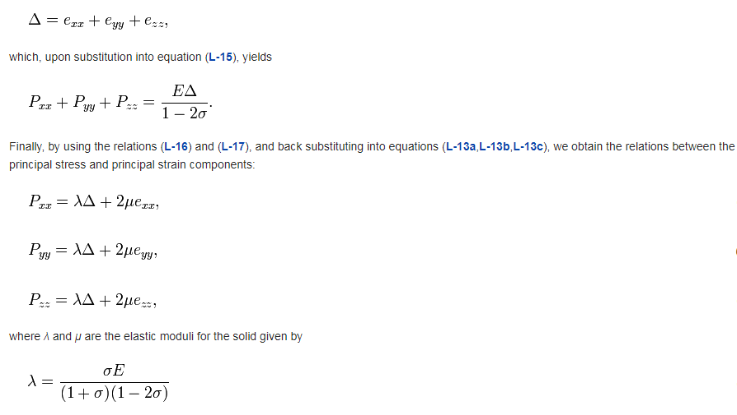
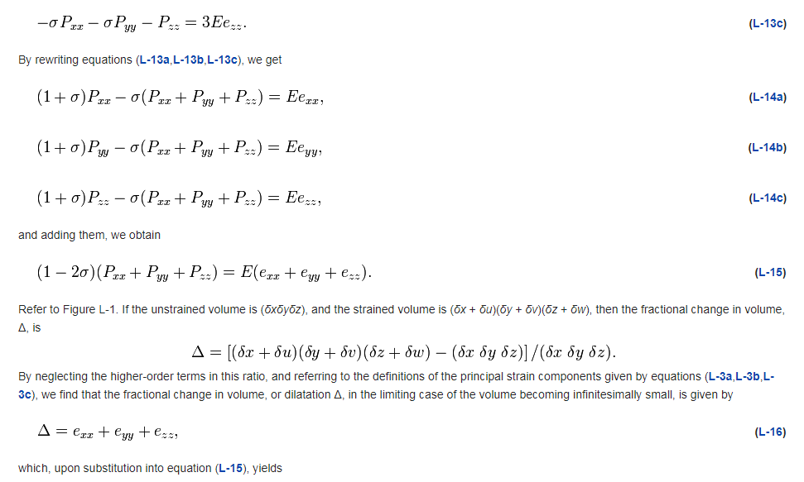
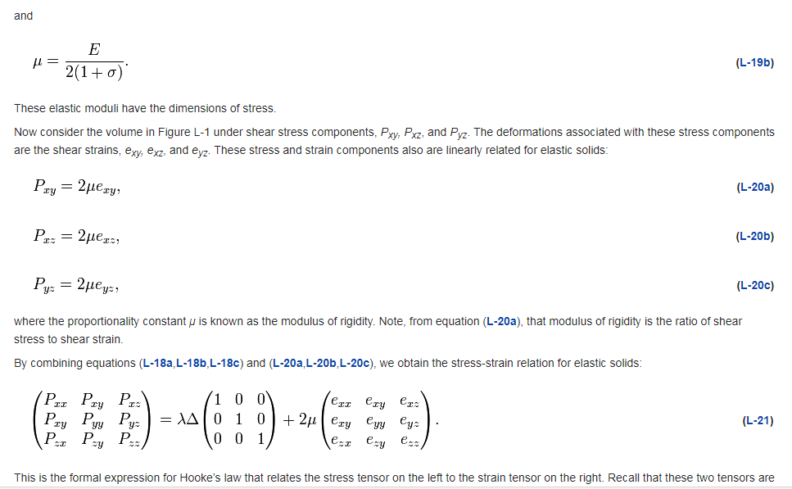
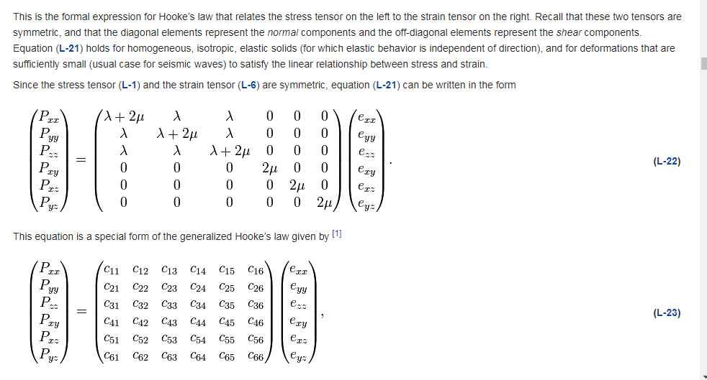
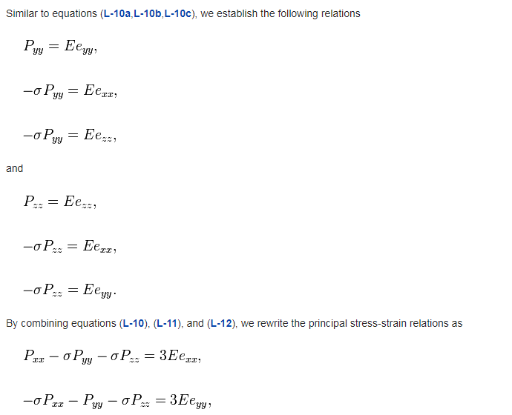
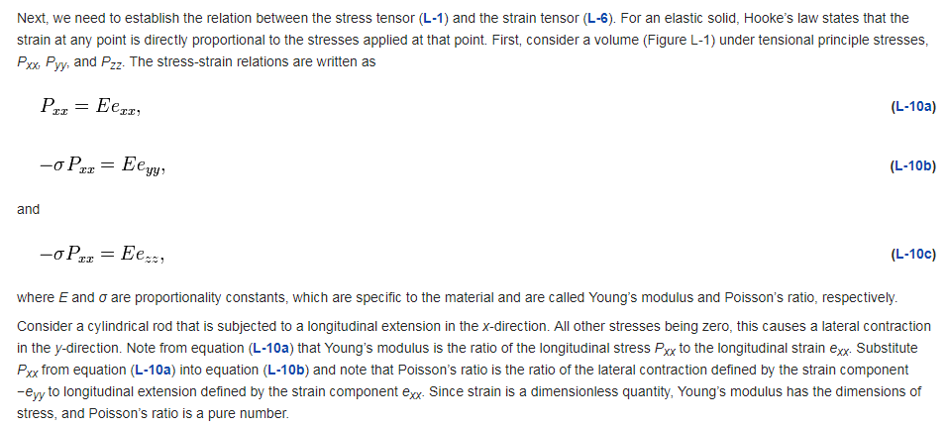
Summary
^
^
n
T(n)
^
n
^
^
T(n)
n
^
^
n
T(n)
^
^
T(n)
n
^
^
^
T(n)
n
^
^
ij
1. Traction: T(n) = Force/area ext. media exerts along a face with normal n
T(n)
^
ij
Isotropic
Hooke’s Law
μ, λ
Anisotropic
Hooke’s Law
21 parameters c_{ij}

