Slide 1
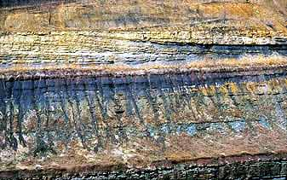
Zero-Offset Data
(aka poststack data)
d = L o
=
∫
g
d
=
g
dr
d
(
(
r
r
)
)
(
(
r
r
r
r
)
)
o
o
(
(
r
r
)
)
r
o
o
o
o
o
o
V/2
Depth
Time

Slide 2
Born Forward Modeling
~
ω
τ
i
e
xx’
d = ∑ L m
d(x) =
∑
g(x|x’)
m(x’)
x’
A(x,x’)
reflectivity
i
j
ij
j

Slide 3
Seismic Inverse Problem
Given: d = Lm
Find: m(x,y,z)
2
Soln: min || Lm-d ||
Waveform inversion
(non-linear)
Least squares migration
(linear)
T
-1
T
m = [L L] L d
Migration
T
L d

Slide 4
Migration
Intuitive: Modeling
Poststack Mig
Prestack
Least Squares
Migration
Green’s Theorem

Slide 5
ZO Migration
Smear Reflections along Fat Circles
τ
Exploding Reflector assumption:
Let c = v/2, or ½ actual velocity so
Exploding reflector time=2-way time
+ T
xx
o
2-way time
τ
2
2
=
(x-x ) + y
xx
x
c
Where did reflections
come from?
Thickness = c*T /2
o
x
τ
d(x , )
xx

Slide 6
ZO Migration
Smear Reflections along Fat Circles
& Sum
2-way time
Hey, that’s our
ZO migration formula
τ
∑
d(x , )
xx
x

Slide 7
ZO Migration
Smear Reflections along Circles
& Sum
2-way time
Out-of--Phase
τ
d(x , )
m(x)=
∑
In-Phase
xx
x

Slide 8
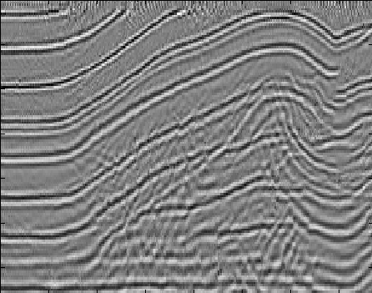
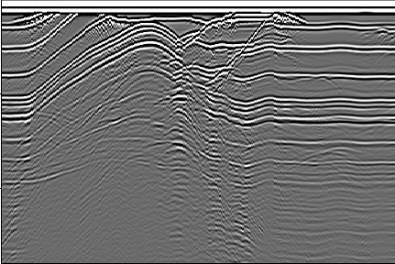
Migration
ZO Data
ZO Data
0 km
3 km
0 km 7 km

Slide 9
ZO Migration: Smear Trace Sample over Circle
m(x) =
∑
d (g, )
τ
g
xg
Loop over data
for ixtrace=1:ntrace;
for ixs=istart:iend;
for izs=1:nz;
r = sqrt((ixtrace*dx-ixs*dx)^2+(izs*dx)^2);
time = 1 + round( r/c/dt );
mig(ixs,izs) = mig(ixs,izs)/r + data(ixtrace,time);
end;
end;
end;
Loop over x in model
Loop over z in model
Smear over
circle
Traveltime

Slide 10
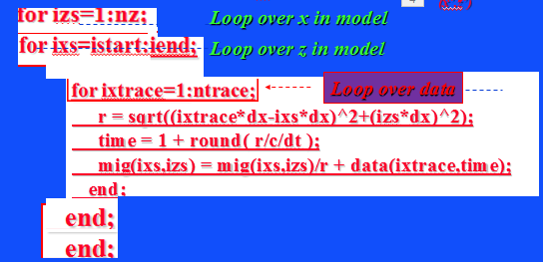
ZO Migration: Smear Trace Sample over Circle
m(x) =
∑
d (g, )
τ
g
xg
Loop over data
for ixtrace=1:ntrace;
for ixs=istart:iend;
for izs=1:nz;
r = sqrt((ixtrace*dx-ixs*dx)^2+(izs*dx)^2);
time = 1 + round( r/c/dt );
mig(ixs,izs) = mig(ixs,izs)/r + data(ixtrace,time);
end;
end;
end;
Loop over x in model
Loop over z in model
Traveltime

Slide 11


ZO Migration: Sum Trace Samples along
migration hyperbola into m(x)
(x,z)
(x’,z’)
Loop over x in model
for ixtrace=1:ntrace;
for ixs=istart:iend;
for izs=1:nz;
r = sqrt((ixtrace*dx-ixs*dx)^2+(izs*dx)^2);
time = 1 + round( r/c/dt );
mig(ixs,izs) = mig(ixs,izs)/r + data(ixtrace,time);
end;
end;
end;
Loop over z in model
Loop over data
Sum samples along hyperbola

Slide 12
ZO Diffraction Stack Migration
m(x) =
∑
d (g, )
τ
Trial image pt x
xg
g
traces
g
x
Notes:
It is often thought that RTM does not enjoy filtering tricks of KM such as U+D separation, obliquity factor, angle gather separation, anti-aliasing filter, etc. This is not true as shown above. The RTM formula is shown above in traditional form: apply adjoint Green’s function to data and backpropagate data, then zero-lag correlation with source field. Rearranging brackets gives different interpretation: RTM is just like KM in the sense that you apply a dot product of the hyperbolas to the data to get migration image. In this case the hyperbolas conatin all the scattering events and the Green’s functions are computed by FD solves rather than ray tracing.

Slide 13
ZO Diffraction Stack Migration
m(x) =
∑
d (g, )
τ
Trial image pt x
xg
g
traces
2D dot product of migration
Operator and d(g,t)
g
x
Migration Image
Notes:
It is often thought that RTM does not enjoy filtering tricks of KM such as U+D separation, obliquity factor, angle gather separation, anti-aliasing filter, etc. This is not true as shown above. The RTM formula is shown above in traditional form: apply adjoint Green’s function to data and backpropagate data, then zero-lag correlation with source field. Rearranging brackets gives different interpretation: RTM is just like KM in the sense that you apply a dot product of the hyperbolas to the data to get migration image. In this case the hyperbolas conatin all the scattering events and the Green’s functions are computed by FD solves rather than ray tracing.

Slide 14
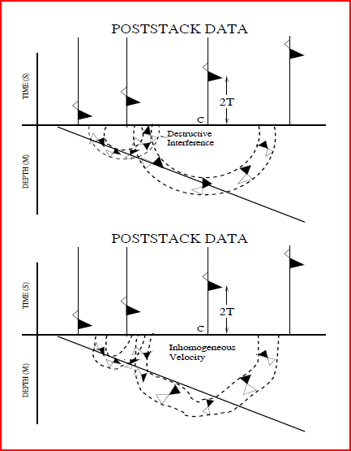
ZO Diffraction Stack Migration: C(x,z)
m(x) =
∑
d (g, )
τ
Trial image pt x
xg
g
Ray tracing
Notes:
It is often thought that RTM does not enjoy filtering tricks of KM such as U+D separation, obliquity factor, angle gather separation, anti-aliasing filter, etc. This is not true as shown above. The RTM formula is shown above in traditional form: apply adjoint Green’s function to data and backpropagate data, then zero-lag correlation with source field. Rearranging brackets gives different interpretation: RTM is just like KM in the sense that you apply a dot product of the hyperbolas to the data to get migration image. In this case the hyperbolas conatin all the scattering events and the Green’s functions are computed by FD solves rather than ray tracing.

Slide 15
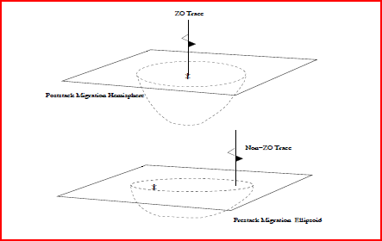
3D ZO Diffraction Stack Migration
m(x) =
∑
d (g, )
τ
Trial image pt x
xg
g
Impulse Response of Mig. Op.
Notes:
It is often thought that RTM does not enjoy filtering tricks of KM such as U+D separation, obliquity factor, angle gather separation, anti-aliasing filter, etc. This is not true as shown above. The RTM formula is shown above in traditional form: apply adjoint Green’s function to data and backpropagate data, then zero-lag correlation with source field. Rearranging brackets gives different interpretation: RTM is just like KM in the sense that you apply a dot product of the hyperbolas to the data to get migration image. In this case the hyperbolas conatin all the scattering events and the Green’s functions are computed by FD solves rather than ray tracing.

Slide 16
Migration
Intuitive: Modeling
Poststack
Prestack
Least Squares
Migration
Green’s Theorem

Slide 17
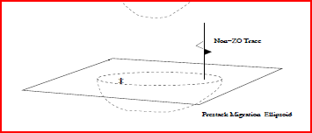
3D Prestack Diffraction Stack Migration
Motivation: ZO only good if no lateral vel change
s
g
x
Notes:
It is often thought that RTM does not enjoy filtering tricks of KM such as U+D separation, obliquity factor, angle gather separation, anti-aliasing filter, etc. This is not true as shown above. The RTM formula is shown above in traditional form: apply adjoint Green’s function to data and backpropagate data, then zero-lag correlation with source field. Rearranging brackets gives different interpretation: RTM is just like KM in the sense that you apply a dot product of the hyperbolas to the data to get migration image. In this case the hyperbolas conatin all the scattering events and the Green’s functions are computed by FD solves rather than ray tracing.

Slide 18
3D Prestack Diffraction Stack Migration
∑
m(x) =
=
d(x’, τ + τ )
Trial image pt x
sx
xg
s,g
s
g
x
Notes:
It is often thought that RTM does not enjoy filtering tricks of KM such as U+D separation, obliquity factor, angle gather separation, anti-aliasing filter, etc. This is not true as shown above. The RTM formula is shown above in traditional form: apply adjoint Green’s function to data and backpropagate data, then zero-lag correlation with source field. Rearranging brackets gives different interpretation: RTM is just like KM in the sense that you apply a dot product of the hyperbolas to the data to get migration image. In this case the hyperbolas conatin all the scattering events and the Green’s functions are computed by FD solves rather than ray tracing.

Slide 19
Prestack Migration
Question: Why Prestack when poststack
migration seems good enough?
Answer: Stacking to get stacked section assumes
layered medium assumption.
Solution: Migrate shot gathers so no layer
assumption needed. This is prestack
migration.

Slide 20
Diffraction Stack Migration: Prestack
Down time
Up time
τ
τ
T(s,g) =
+
sx
xg
Where is scatterer?
s
g
τ
τ
sx
xg
∑
τ
τ
+
d(s,g, )
sx
xg
x
s,g
Narrow band case: direct wave correlated with data

Slide 21
115.
Diffraction Stack Modeling: Prestack
m = L d
d = L m
T
ω
τ
ω
τ
~
i
i
sx
~
e
~
xg
d(s,g) =
2
∑
e
ω
W(ω )
m(x)
x
A(s,x)
A(g,x)

Slide 22
115.
Diffraction Stack Migration: Prestack
m = L d
T
-
τ
-
ω
ω
τ
i
i
∫
~
∫
~
*
e
sx
xg
∑
e
dω
dω
ω
2
~
m(x) =
W(ω )
d(s,g)
s,g
A(s,x)
A(g,x)
..
Broadband case
~
∑
W(ω )=1
m(x)
=
d(s,g, τ + τ )
s,g
sx
xg
A(s,x)
A(x,g)
Narrow band case: direct wave correlated with data

Slide 23
MATLAB Inefficient Prestack Migration
Data Loops
Model Loops
for isx=1:nx % Loop over shot
for igx=1:nx % Loop over receivers
for ix=1:nx % Loop over model x
for iz=1:nx % Loop over model z
t=timer(ix,iz,isx)+timer(ix,iz,igx)
sample=gather(isx,igx,t) % Shot gather has 2 time derivatives
mig(ix,iz)=mig(ix,iz)+sample
end
end
end
end

Slide 24
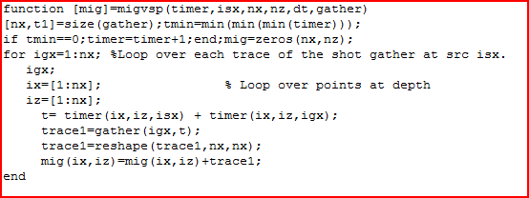
MATLAB Prestack Migration

Slide 25
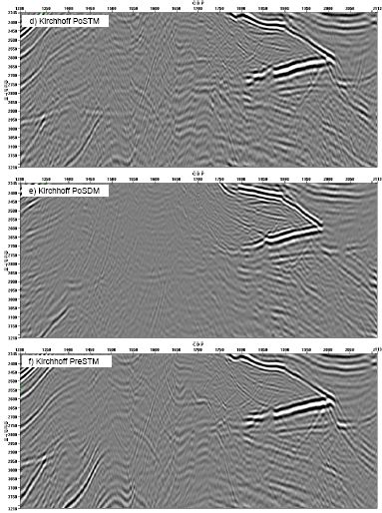
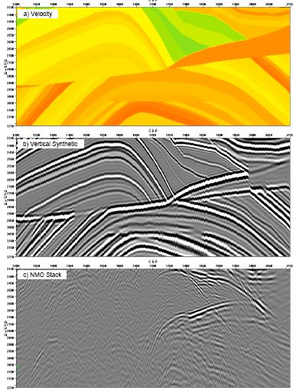
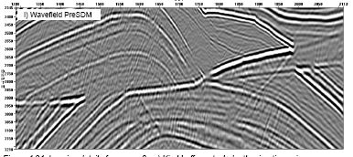
Poststack vs Prestack Migration

Slide 26
Poststack vs Prestack Migration

Slide 27
Prestack Migration
1. No 1D assumption about velocity model
2. More sensitive to velocity model errors
compared to poststack migration
3. More than 100 times slower than poststack
migration
4. More sensitive to velocity model than time
migration

Slide 28
Summary
Migration Motivation: diffractions, dipping layers,
conflicting dips, out-of-plane reflections
3D ZO Diffraction Stack Migration
m(x) =
∑
d (g, )
τ
Trial image pt x
xg
g
3D Prestack Diffraction Stack Migration
∑
m(x) =
=
d(x’, τ + τ )
Trial image pt x
sx
xg
s,g

Slide 29
Migration
Intuitive: Modeling
Poststack
Prestack
Least Squares
Migration
Green’s Theorem

Slide 30
Zero-Offset Data
(aka poststack data)
d = L o
=
∫
g
d
=
g
dr
d
(
(
r
r
)
)
(
(
r
r
r
r
)
)
o
o
(
(
r
r
)
)
r
o
o
o
o
o
o
V/2
Depth
Time

Slide 31

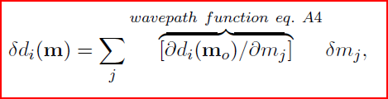



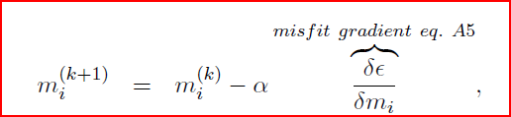
Iterative Least Squares Migration
Step 1:
Step 2:
Step 3:
Step 4:

Slide 32
MATLAB SD Least Squares Migration
p=p0 % Data without direct wave
m=adjoint(p,c) % Initial reflectivity model
c % Velocity model
for i=1:niter
p=forward(m,c) % predicted data
alpha=step(p,p0,c,m) % step length
dP=p-p0 % data residual
dm =adjoint(dP,c) % migrate residual
m = m –alpha*dm % Update model
end

Slide 33
Dot Products and Adjoint Operators
∑
Recall: (u,u) = u* u
i
i
i
∑
∑
Recall: (v,Lu) = v* ( L u )
i
ij
j
i
j
∑
∑
=
[ L v* ]u
ij
i
j
j
i
=
∑
∑
[ L* v ]* u
j
i
ij
i
j
So adjoint of L is L ⬄
∑
L*
i
ij

Slide 34
Dot Product Test with CG code
Actual
model
Predicted
model
Actual
data
Predicted
data
T
T
T
d Lm =(d,Lm) = (Lm,d) = m L d
d=forward(m,c)
m=adjoint(d,c)
d d =
T
m
T
m
All migration codes should pass the dot product test

Slide 35
Migration
Least Squares:
Examples
Intuitive: Modeling
Poststack
Prestack
Footprint
Migration
0
T
T
0
.
L
L
.
r = L L
.
1
.
.
.
0
Green’s Theorem
Migration butterfly

Slide 36
Migration = Blurred r
T
m = L d
d = L r
but
Migrated Section
Data
Modeling

Slide 37
Migration = Blurred r
T
m = L
d = L r
L r
but
Migrated Section
Migration Image m =
True Reflectivity Model r

Slide 38
Migration Deconvolution
Reflectivity
Migration image
L
T
L
r
=
m
=
Migration Green’s function

Slide 39
Migration Deconvolution
Migration Deconvolution
-1
-1
[
L
T
L
]
L
T
L
r
=
[
L
T
L
]
m
1
=
1

Slide 40
Migration Deconvolution
-1
r
=
[
L
T
L
]
m
=
1

Slide 41
Migration Deconvolution
-1
r
=
[
L
T
L
]
m
=
1
Assume Local v(z) Approximation

Slide 42
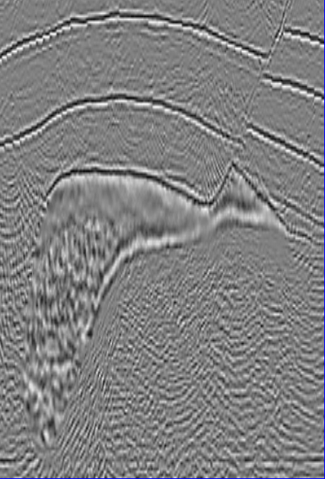
Migration Noise Problems
Note: Artifacts stronger near surface. Why?
0
Footprint
Depth (km)
Weak illumination
Migration noise and artifacts
3.5
Notes:
Irregular acquisition geometry
Limited recording aperture
Footprint and aliasing
Some footprint caused by
Irregular acquisition geometry
Limited recording aperture
aliasing and illumination loss in migration imaging

Slide 43
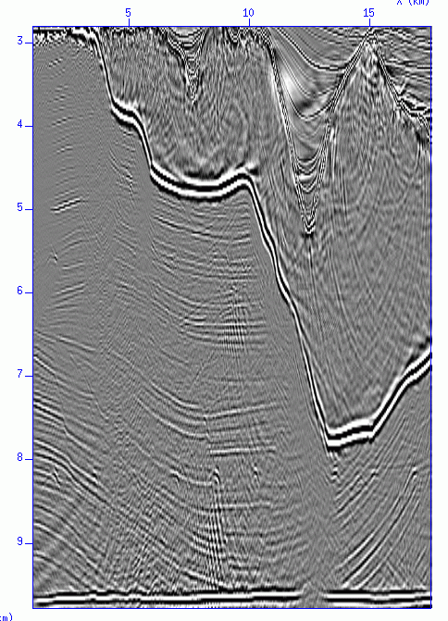
Wave Equation Migration Before LSM
0
Depth (km)
10
0
X (km)
20

Slide 44
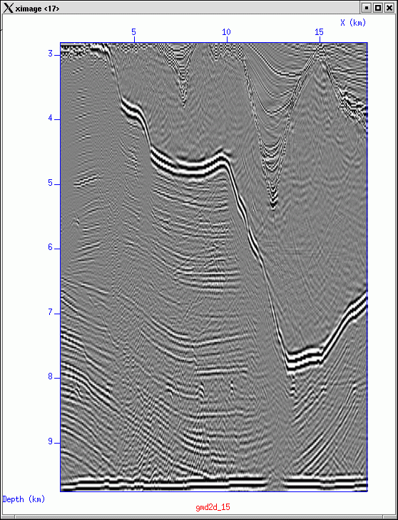
Wave Equation Migration after MD
0
X (km)
0
Depth (km)
10
0
X (km)
20

Slide 45
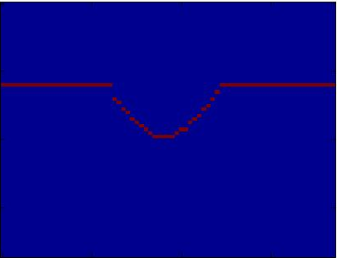
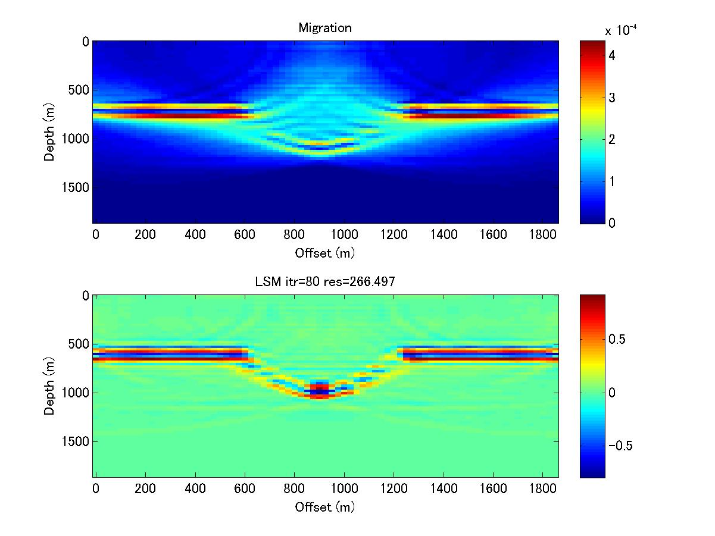
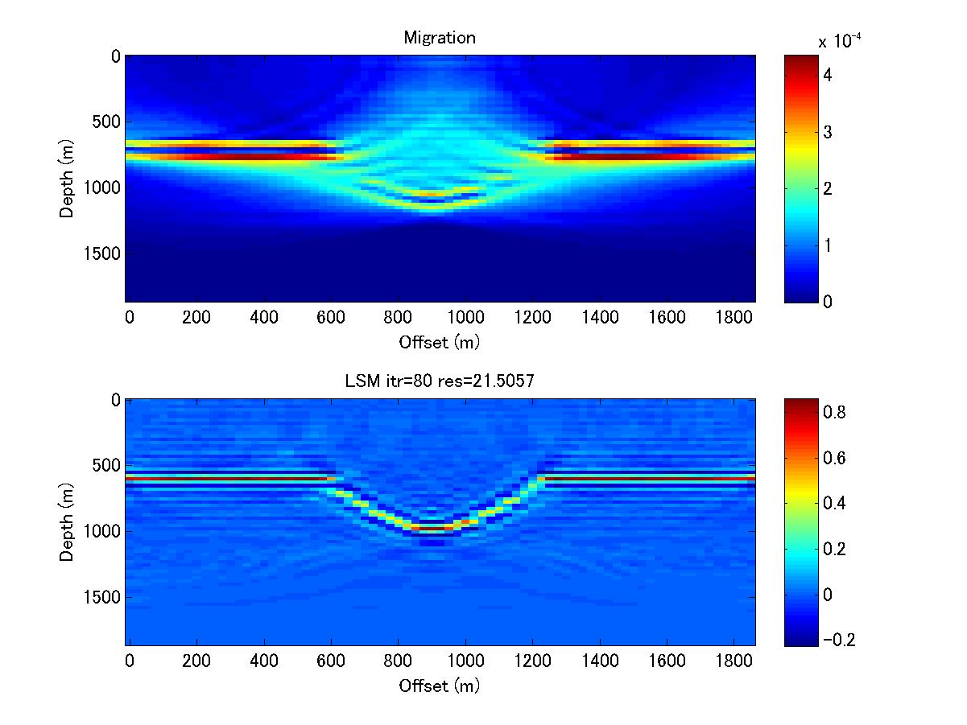
Acquisition Footprint (Geophone Aliasing)
Coarse Kirchhoff Migration Image (15 Hz)
Actual Model
LSM Image (15 Hz)
0
0
Depth (km)
Depth (km)
2
2
0
2
0
2
X (km)
X (km)
Note: Artifacts stronger near surface. Why?

Slide 46
Standard Kirchhoff Image vs LSM Image
Kirchhoff Migration Image (15 Hz)
Actual Model
LSM Image (15 Hz)
0
0
Depth (km)
Depth (km)
2
2
0
2
0
2
X (km)
X (km)

Slide 47
Migration
Least Squares:
Examples
Intuitive: Modeling
Poststack
Prestack
Footprint
Migration
Green’s Theorem

Slide 48
2D Poststack Data from Japan Sea
JAPEX 2D SSP marine data description:
Acquired in 1974,
Dominant frequency of 15 Hz.
0
TWT (s)
5
0
20
X (km)
Notes:
48

Slide 49
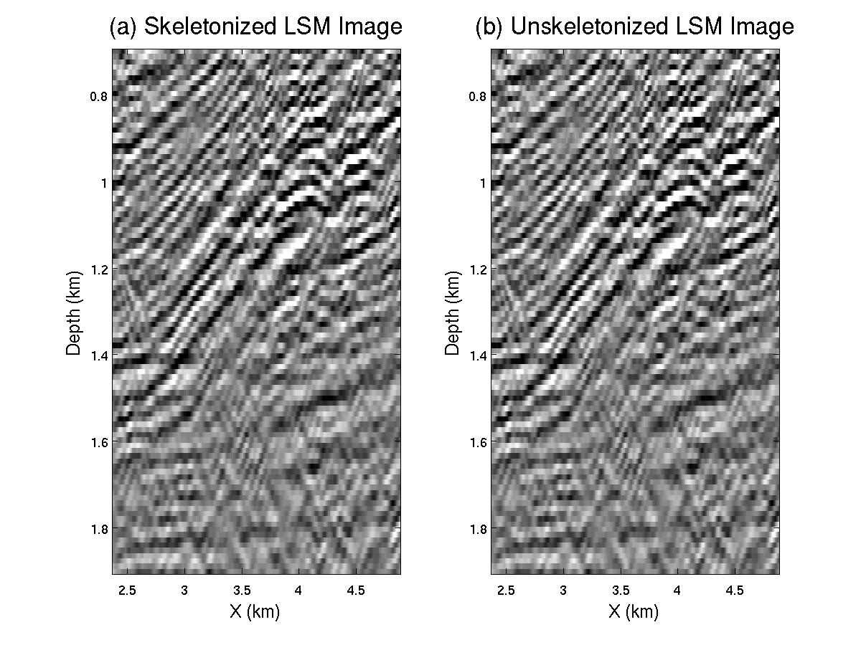
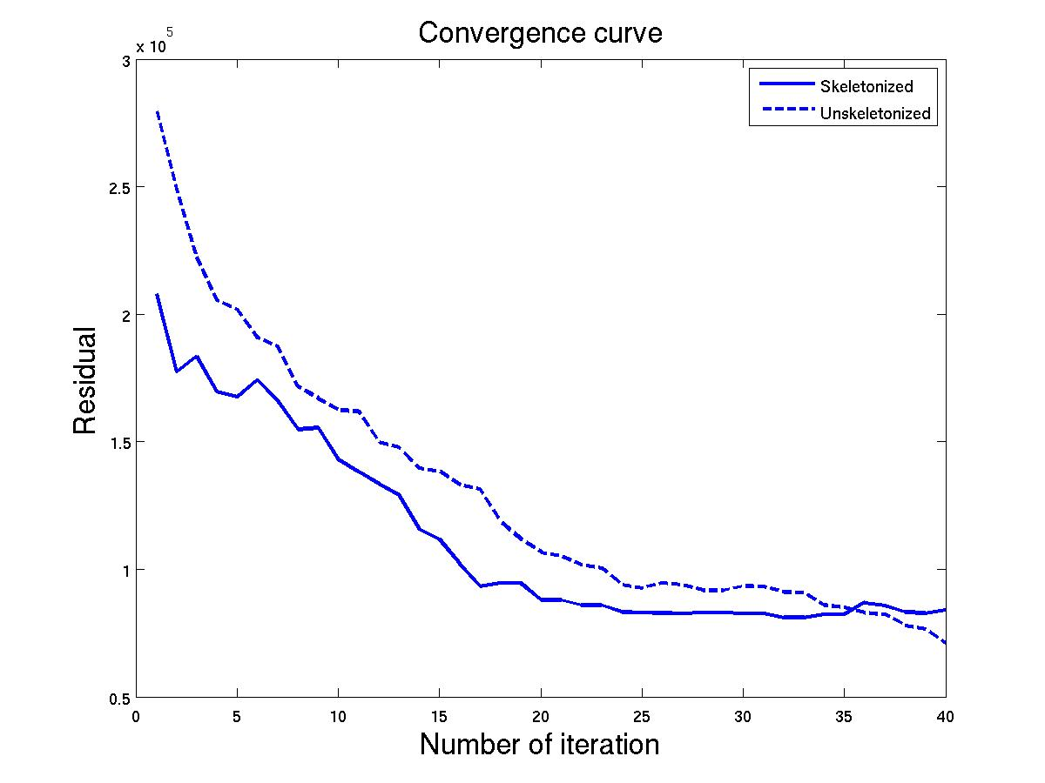
Multi-scale LSM Applied to JAPEX Data
Multi-scale (MS) LSM vs. Standard LSM
Convergence Curves
MS LSM Image
Standard LSM Image
X10 ⁵
0.7
0.7
3.0
Multi-scale LSM
Standard LSM
20 Hz
Depth (km)
Residual
25
30
32
34
36
38
1.9
1.9
40
0.5
2.4
4.9
2.4
4.9
0
X (km)
X (km)
Iteration
40
Notes:
I apply band-pass filter to data.
The frequency band increase with iteration
49

Slide 50
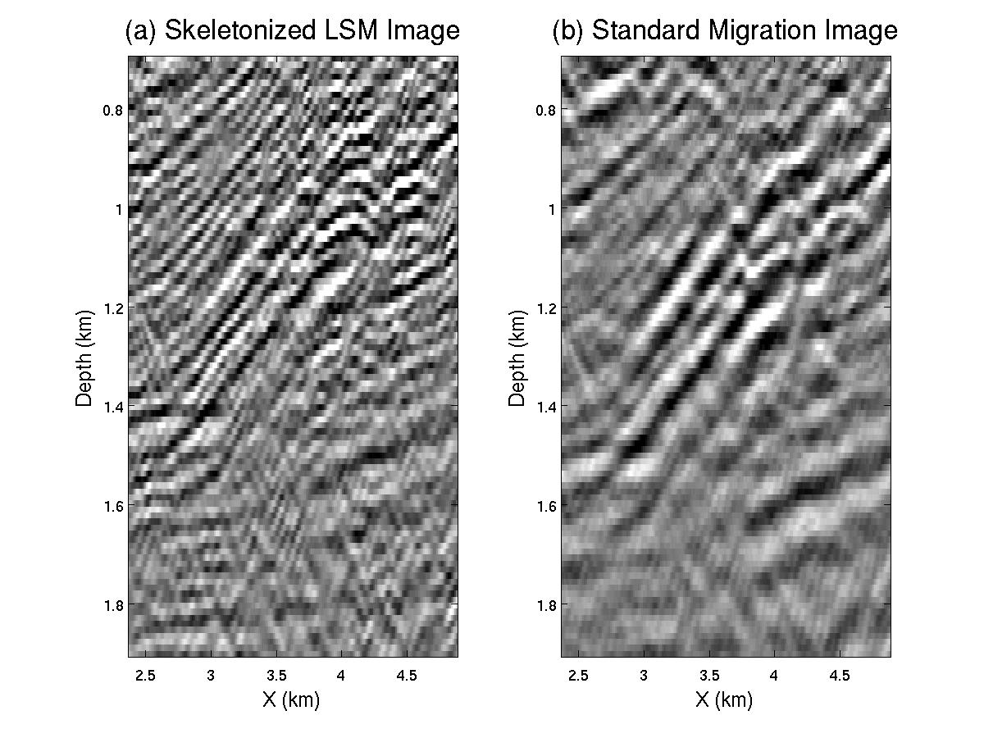
LSM vs. Kirchhoff Migration
LSM Image
Kirchhoff Migration Image
0.7
0.7
Depth (km)
Depth (km)
1.9
1.9
2.4
4.9
2.4
4.9
X (km)
X (km)

Slide 51
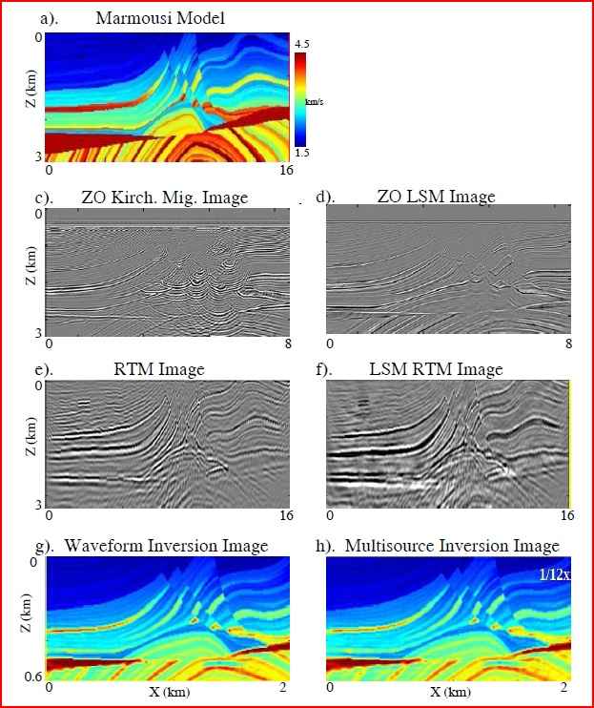
Kirchhoff MD

Slide 52
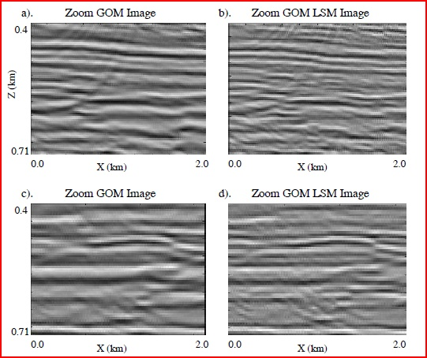
Kirchhoff LSM

Slide 53
Migration Summary
Migration Motivation: diffractions, dipping layers,
conflicting dips, out-of-plane reflections
Full Waveform Inversion
m = m - αL δm
(k+1)
(k)
T
(k)
(k)
Least Squares Migration
m = m - αL δm
(k+1)
(k)
T
(k)
3D ZO Diffraction Stack Migration
m(x) =
∑
d (g, )
τ
Trial image pt x
xg
g
3D Prestack Diffraction Stack Migration
∑
m(x) =
=
d(x’, τ + τ )
Trial image pt x
sx
xg
s,g

Slide 54
ZO Summary
x
obliquity
..
θ
x’
m(x’)
∑
τ
=
d(x, )
1. ZO migration:
cos
xx’
θ
x
A(x,x’)
Approx. reflectivity
2. ZO migration assumptions: Single scattering data
~
3. ZO migration matrix-vec: m=L d
T
Compensates for
Illumination footprint and poor
illumination
T
-1
T
4. LSM ZO migration matrix-vec: m=[L L] L d
5. ZO migration smears an event along appropriate
doughnut

Slide 55
Summary
x
obliquity
..
θ
x’
m(x’)
∑
τ
=
d(x, )
1. ZO migration:
cos
xx’
θ
x
A(x,x’)
Approx. reflectivity
2. ZO migration assumptions: Single scattering data
~
3. ZO migration matrix-vec: m=L d
T
Compensates for
Illumination footprint and poor
illumination
T
-1
T
4. LSM ZO migration matrix-vec: m=[L L] L d
5. ZO migration smears an event along appropriate
doughnut

Slide 56
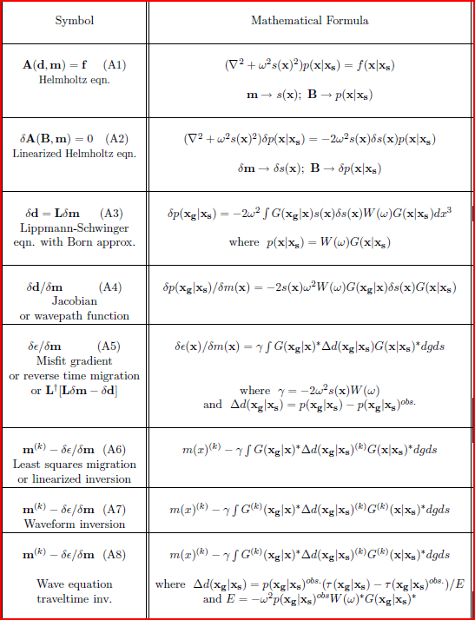
Kirchhoff MD

Slide 57
Kirchhoff MD

Slide 58
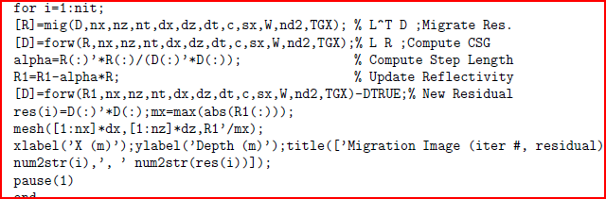
Kirchhoff MD

Slide 59
Least Squares
Recall: Lm=d
Find: m that minimizes sum of squared
residuals r = L m - d
∑
i
j
ij
j
i
(r ,r) = ([Lm-d],[Lm-d])
= m L Lm -2m Ld-d d
d
(r ,r)
d
= 2 m L Lm -2 m Ld
d
= 0
For all i
dm
dm
dm
i
i
i
L Lm = Ld
Normal equations

Slide 60
Review
Inverse Acoustic Problem
r
Given:
d(r )
Find:
m( r ) (c - c )/(c + c )
1
2
1
2
r
r
T
r
r
*
L d
Soln:
m
(
r
)
∫
g
dr
Soln:
m
(
r
)
(
r
r
)
d
(
r
)
o
m(x’)
∑
τ
Smear
=
d(x, )
xx’
x
& Sum
reflectivity
A(x,x’)
Data

Slide 61
Prestack Migration

Slide 62
115.
Diffraction Stack Migration: Prestack
-
τ
-
ω
ω
τ
i
i
∫
~
∫
~
*
e
xx’
x’x’’
∑
e
dω
dω
m(x) =
W(ω )
d(x’)
x’
A(x,x’)
A(x’’,x’)
..
Broadband case
~
∑
W(ω )=1
=
d(x’, τ + τ )
x’
xx’
x’x’’
A(x,x’)
A(x’’,x’)
Narrow band case: direct wave correlated with data

Slide 63
Exploding Reflector
½ Velocity
r
r
d = L o
r
r
r
r
d
(
r
)
=
∫
g
(
r
r
)
o
(
r
)
d
(
r
)
=
g
(
r
r
)
o
(
r
)
dr
o
o
r
o
o
o
o
V/2
Depth
Time

Slide 64
Forward Acoustic Problem
2
2
Given:
d + k d = 0
r
Find:
d(r)
r
r
r
∫
inc
Soln:
d
(
r
)
=
g
(
r
r
)
m
(
r
)
d(r )dr
r
r
r
r
r
r
d = L m
Exploding
Reflector
d
(
r
)
=
∫
g
(
r
r
)
o
(
r
)
dr
d
(
r
)
=
g
(
r
r
)
m
(
r
)
r
Reflectivity

Slide 65
Acoustic ZO Migration
r
Given:
d(r )=Lm
Find:
m( r ) (c - c )/(c + c )
1
2
1
2
r
r
T
r
r
*
L d
Soln:
o
(
r
)
∫
g
dr
Soln:
m
(
r
)
(
r
r
)
d
(
r
)
o
c
1
Depth
c
2

Slide 66
Migration
ZO Data
ZO Data
0 km
3 km
0 km 7 km

