Slide 1
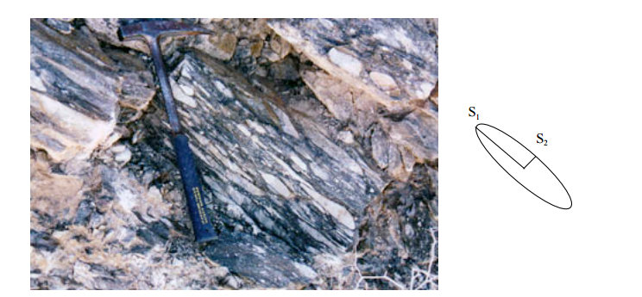
Let σ be the 3x3 stress matrix and let n be a 3x1 unit vector. What is the physical meaning of σ n for n=(0,1,0)?
What is the physical meaning of n^{T}σ n? What is the physical meaning of n^{T}σ^{T}σ n?
What is the physical meaning of ε n, where ε is the 3x3 strain matrix?
4. What is the physical meaning of n^{T}ε n? What is the meaning of n^{T}ε n=constant, when the angle of n varies from
0-360⁰?
5. Provide an example of a deformed cube that suggests that there is always a rotation angle where the shear
components of stress are zero.
6. A geologist examines the stress tensor in his coordinate system and says that there is shear strain in the rock
associated with the deformed rock. However, the geophysicist whose coordinate system is rotated such that his strain
matrix is diagonalized so that the shear strain components are zero. When the geologist talks to the geophysicist,
he says that the rock has been sheared while geophysicist says that it only has normal strain, no shear strain.
Who is right? In fact, the geophysicist says that the principle extension is along S₁ below and principle shortening is
along S₂ , and so the tectonic stress field at the time of deformation was extensional stress along NW.
7. What is pure shear? Simple shear? Draw a pictorial representation of the stress orientations that produce each of
these types of strain.
8. How does pure shear deform a circle? A line in some orientation? Demonstrate this by drawing a circle,
including some diameters and deforming it.

Slide 2
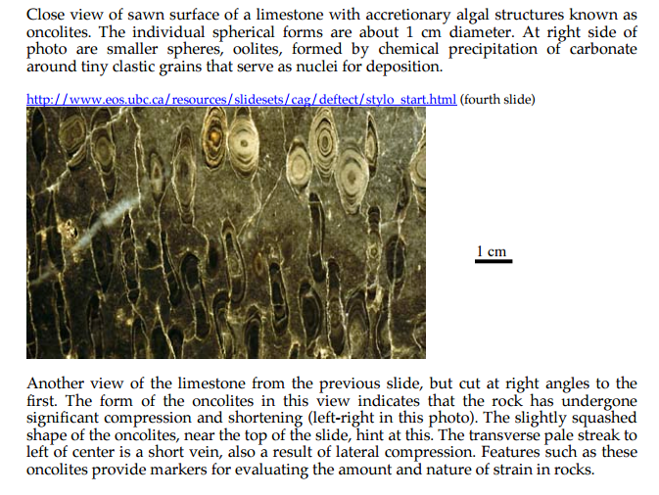
http://seismo.berkeley.edu/~burgmann/EPS116/labs/lab8_strain/lab8_2011. Also http://www.files.ethz.ch/structuralgeology/jpb/files/english/12finitestrain.pdf

Slide 3
Recall: Equation in x,y for an ellipse oblique to the x,y axes
C₁ x² + C₂ xy + C₃ y² + C₄ x + C₅ y + C₆ = 0 (C₁ C₃ > 0)
A unit circle that is homogeneously deformed transforms to an ellipse. This ellipse is called the strain ellipse.
Strains may be inhomogeneous over a large region but approximately homogeneous locally
In a general sense, the strain ellipse characterizes 2-D strain at a position in space and a point in time; it can vary with x,y,x,t.
Characterization of the strain ellipse
a An ellipse has a major semi-axis (a) and a minor semi-axis (b). An ellipse can be characterized by the (relative) length and
orientation of these axes
b Ellipses with perpendicular axes of equal length (i.e., circles) deform homogeneously to become ellipses with perpendicular axes of
unequal length
c The set of axes of a circle that have the same orientation before and after the deformation are known as the principal axes for strain.
They allow the strain to be described in the most simple form. These are the axes of the strain ellipse.

Slide 4
