Slide 1
Isotropic tensor
By Zoncai Feng
Nov.23.2014

Slide 2
Isotropic tensor
Definition:
A tensor is said to be isotropic if its components with respect to some coordinate system do not vary if either the coordinate system or the medium is rotated. (By rotation we mean either a pure rotation where the determinant of the rotation matrix is 1 or reflection where the determinant of the rotation matrix is –1)
Else the tensor is said to be anisotropic.

Slide 3
Before going to the 4-order tensor ……
(We haven’t prove is 4-order tensor…… )
1. All scalars are isotropic zero-order tensor(a quantity that has only magnitude such as temperature, entropy, or mass )
2. The isotropic first-order tensor(vectors) is the zero-vector.

Slide 4
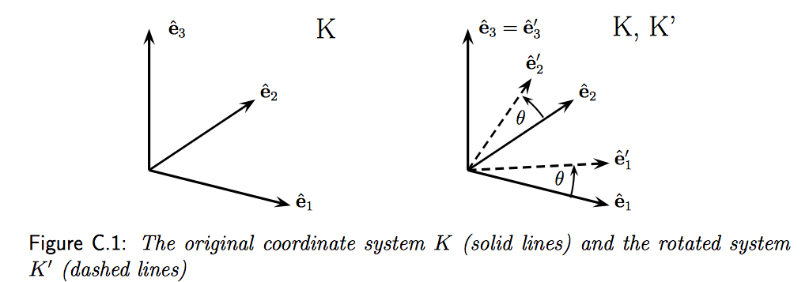
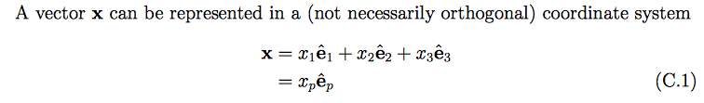
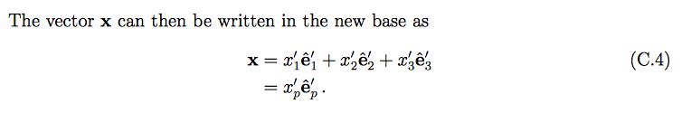

Slide 5


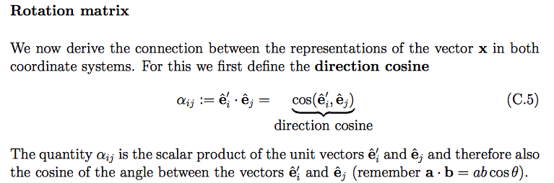
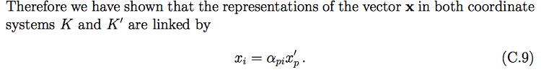

Slide 6
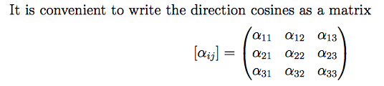


Slide 7
Before going to the 4-order tensor ……
1. All scalars are isotropic zero-order tensor(a quantity that has only magnitude such as temperature, entropy, or mass )
2. The isotropic first-order tensor(vectors) is the zero-vector.

Slide 8
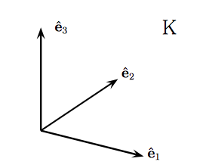

(By rotation we mean either a pure rotation where the determinant of the rotation matrix is 1 or reflection where the determinant of the rotation matrix is –1)

Slide 9
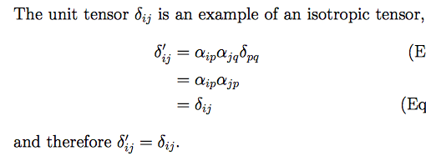
3. The isotropic second-order tensor is the ?
Therefore the isotropic tensor of order two is the identity tensor I with components δij

Slide 10
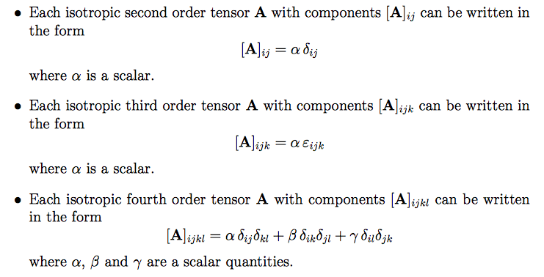
Conclusion
1. All scalars are isotropic zero-order tensor(a quantity that has only magnitude such as temperature, entropy, or mass )
2. The isotropic first-order tensor(vectors) is the zero-vector.

Slide 11
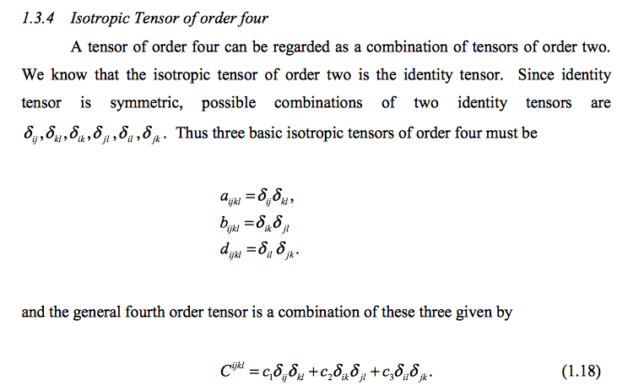

Slide 12
