Slide 1
Super-virtual Interferometric Diffractions as Guide Stars
Wei Dai¹, Tong Fei², Yi Luo² and Gerard T. Schuster¹
¹ KAUST ² Saudi Aramco
Feb 9, 2012

Slide 2
Outline
Introduction
Super-virtual stacking theory
Synthetic data examples
Field data examples
Summary

Slide 3
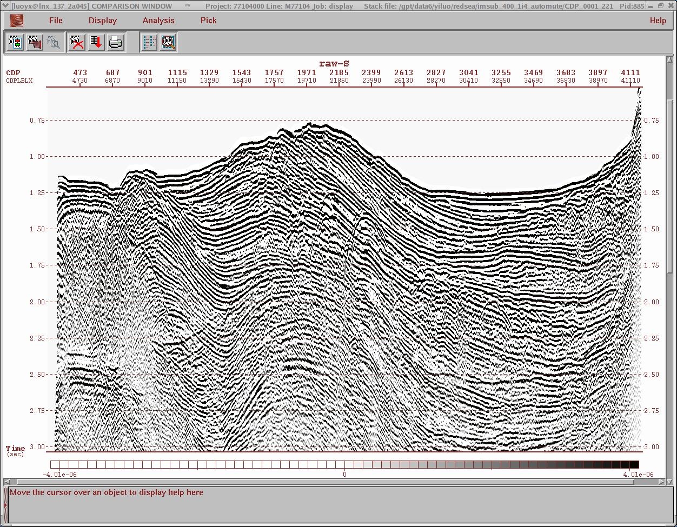
Introduction
Diffracted energy contains valuable information about the subsurface structure.
Goal: extract diffractions from seismic data and enhance its SNR.

Slide 4
Previous Work
Reciprocity equation of correlation and convolution types (Wapenaar et al., 2004).
Diffracted waves detection (Landa et al., 1987)
Diffraction imaging (Khaidukov et al., 2004;Vermeulen et al., 2006; Taner et al., 2006; etc)

Slide 5

Guide Stars
Flip

Slide 6
Outline
Introduction
Super-virtual stacking theory
Synthetic data examples
Field data examples
Summary

Slide 7
Step 1: Virtual Diffraction Moveout + Stacking
dt
dt
=
dt
dt
w3
w2
w1
y z
y z
y z
y’
y’
Benefit: SNR = N

Slide 8
Step 2: Dedatum virtual diffraction to known surface position
Convolution to restore diffractions
x
y z
y z
x
y z
*
=
y’
x
y z
y z
x
y z
*
=
y’
Notes:
The solution is the convolve the redatumed shot record with a real trace recorded at y from a new source position. The unknown time advance is cancelled out and result of the convolution is a virtual trace located at z.

Slide 9
Stacking Over Geophone Location
Benefit: SNR = N
Desired shot/
receiver combination
x
z
Common raypaths
Notes:
If there are a number of shot/receiver positions located between x and z, a number of combinations of shot and redatumed records can be convolved to generate the same raypath, and these results stacked to increase the SNR and attenuate artefacts from non-refractione vents which will again exhibit non-stationary behaviour. We term this stacking result a ‘super-virtual’ trace.

Slide 10
Super-virtual Diffraction Algorithm
1. Crosscorrelate and stack to generate virtual diffractions
w z
w z
w z
=
Virtual src
excited at -tzz’
z’
2. Convolve and stack to generate super-virtual diffractions
w z
w z
*
=
z
Benefit: SNR = N
Notes:
10
In summary these are the three steps to generate a super virtual trace.

Slide 11
Workflow
Raw data
Select a master trace
dt
dt
Cross-correlate to generate virtual diffractions
Repeat for all the shots and stack the result to give virtual diffractions
=
dt
Convolve the virtual diffractions with the master trace
*
=
Stack to generate Super-virtual Diffractions

Slide 12
Outline
Introduction
Super-virtual stacking theory
Synthetic data examples
Field data examples
Summary

Slide 13
Synthetic Results: Fault Model
km/s
0
3.4
Z (km)
3
1.8
0
X (km)
6
Notes:
13

Slide 14
Synthetic Shot Gather: Fault Model
Shot at Offset 0.2 km
0
Diffraction
Time (s)
3
0
Offset (km)
2
Notes:
14

Slide 15
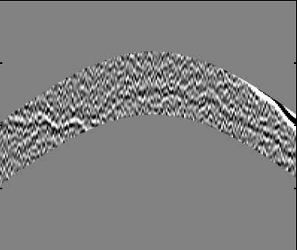


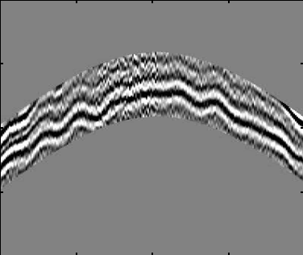
Synthetic Shot Gather: Fault Model
Windowed Data
0
0.5
Z (km)
Time (s)
3
0
X (km)
6
1.5
Median Filter
Our Method
0.5
0.5
Time (s)
Time (s)
1.5
1.5
0
Offset (km)
2
0
Offset (km)
2
Notes:
15

Slide 16
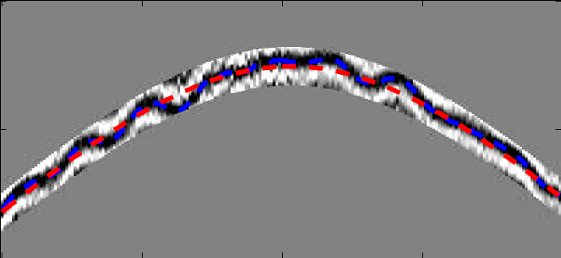
Estimation of Statics
0.5
Picked Traveltimes
Predicted Traveltimes
Time (s)
Estimate statics
1.0
0
Offset (km)
2
Notes:
16

Slide 17
Outline
Introduction
Super-virtual stacking theory
Synthetic data examples
Field data examples
Summary

Slide 18
Experimental Cross-well Data
0.3
0.6
Time (s)
0.9
180
Depth (m)
280
Time (s)
Picked Moveout
0.6
Time (s)
1.0
0.9
0
Depth (m)
300
180
Depth (m)
280
Notes:
18

Slide 19
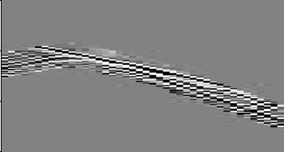
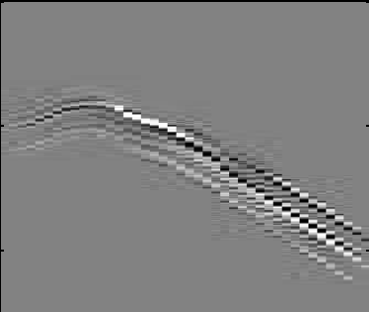
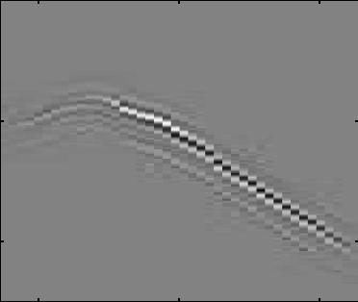
Experimental Cross-well Data
Time Windowed
0.6
Time (s)
0.9
180
Depth (m)
280
Median Filter
Super-virtual Diffractions
0.6
0.6
Time (s)
Time (s)
0.9
0.9
180
Depth (m)
280
180
Depth (m)
280
Notes:
19

Slide 20
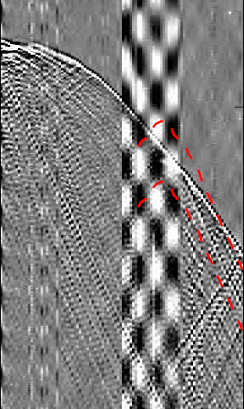
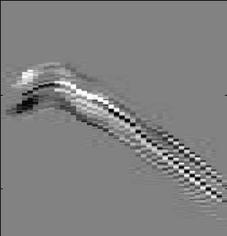
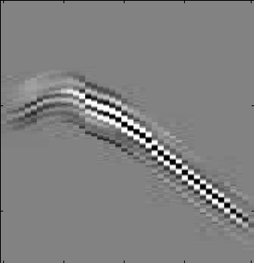
Experimental Cross-well Data
Median Filtered
0.3
0.6
Time (s)
0.9
180
Depth (m)
280
Time (s)
Super-virtual Diffraction
0.6
Time (s)
1.0
0.9
0
Depth (m)
300
180
Depth (m)
280
Notes:
20

Slide 21
Diffraction Waveform Modeling
Velocity
0
0
Depth (km)
1.2
Time (s)
Born
Reflectivity
Modeling
0
Depth (km)
4.0
1.2
0
Distance (km)
3.8
0
Distance (km)
3.8

Slide 22
Diffraction Waveform Inversion
Initial Velocity
Inverted Velocity
0
0
Depth (km)
Depth (km)
1.2
1.2
Estimated Reflectivity
True Velocity
0
0
Depth (km)
Depth (km)
1.2
1.2
0
Distance (km)
3.8
0
Distance (km)
3.8

Slide 23
Outline
Introduction
Super-virtual stacking theory
Synthetic data examples
Field data examples
Summary

Slide 24
Summary
Super-virtual diffraction algorithm can greatly improve the SNR of diffracted waves..
Limitation
Dependence on median filtering when there are other coherent events.
Wavelet is distorted (solution: deconvolution or match filter).

Slide 25
Acknowledgments
We thank the sponsors of CSIM consortium for their financial support.

