Slide 1
LSRTM with Factorization-free Priorconditioning
Gaurav Dutta¹, Matteo Giboli², Paul Williamson², Gerard T. Schuster¹
¹ King Abdullah University of Science and Technology,
² TOTAL E&P, CSTJF, Pau.
October 20, 2015

Slide 2
Outline
Motivation
Theory of Priorconditioning
Numerical Examples
LSRTM using very sparse shots
Denoising multisource LSRTM
Conclusions

Slide 3
Outline
Motivation
Theory of Priorconditioning
Numerical Examples
LSRTM using very sparse shots
Denoising multisource LSRTM
Conclusions

Slide 4
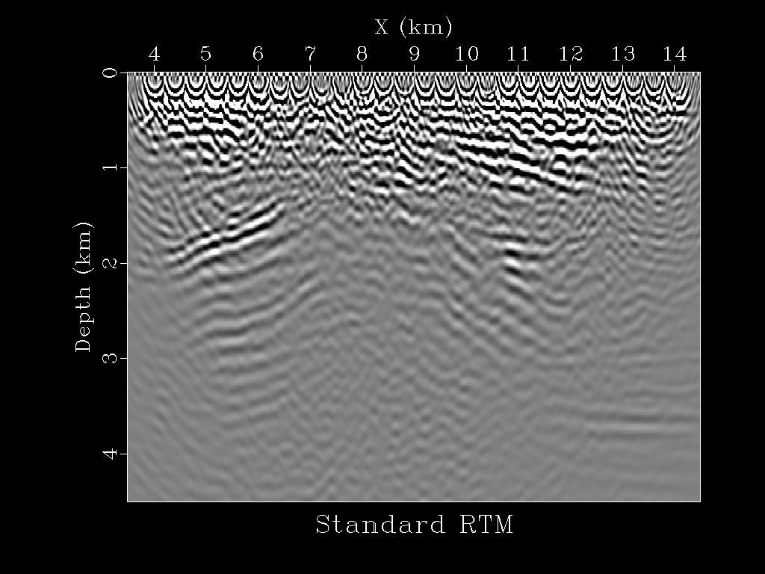
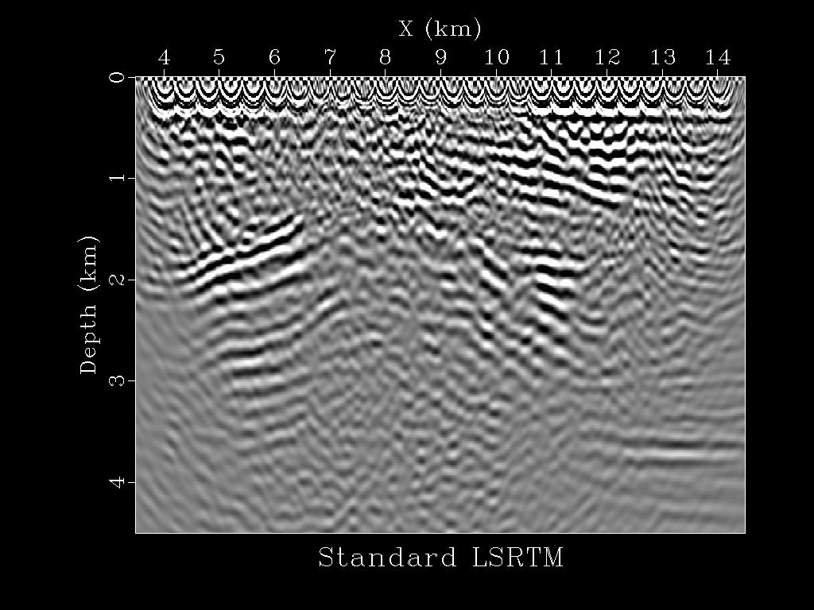
Motivation
$$φ(m)=\frac{1}{2}{\left\|Lm−d\right\|}^{2}$$
LSRTM:
Problems: 1) Sparsely sampled data $→$low SNR.
2) Crosstalk with blended sources.
RTM
LSRTM
1
Z (km)
4
4
X (km)
15
4
X (km)
15

Slide 5
Motivation
$$φ(m)=\frac{1}{2}{\left\|Lm−d\right\|}^{2}$$
LSRTM:
Problems: 1) Sparsely sampled data $→$low SNR.
2) Crosstalk with blended sources.
Solution:
$${}_{m }^{min}{{\left\|Rm\right\|}_{1}} s.t. {\left\|d−Lm\right\|}_{2}< ∅$$
RTM
LSRTM
1
Z (km)
4
4
X (km)
15
4
X (km)
15

Slide 6
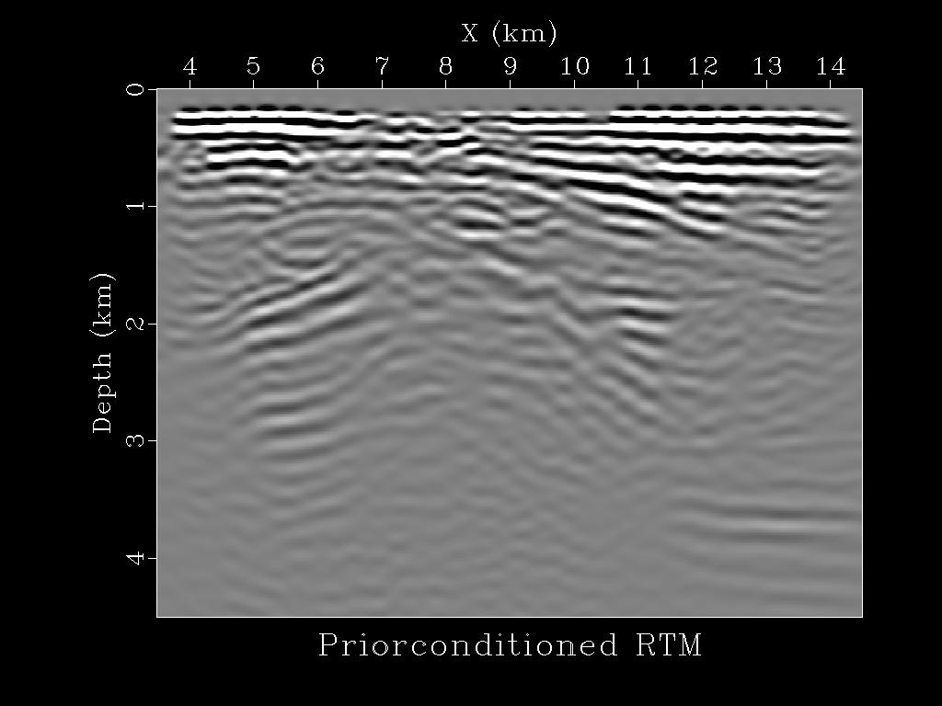
Motivation
$$φ(m)=\frac{1}{2}{\left\|Lm−d\right\|}^{2}$$
LSRTM:
Problems: 1) Sparsely sampled data $→$low SNR.
2) Crosstalk with blended sources.
Solution:
$${}_{m }^{min}{{\left\|Rm\right\|}_{1}} s.t. {\left\|d−Lm\right\|}_{2}< ∅$$
Priorconditioned RTM
LSRTM
1
Z (km)
4
4
X (km)
15
4
X (km)
15

Slide 7
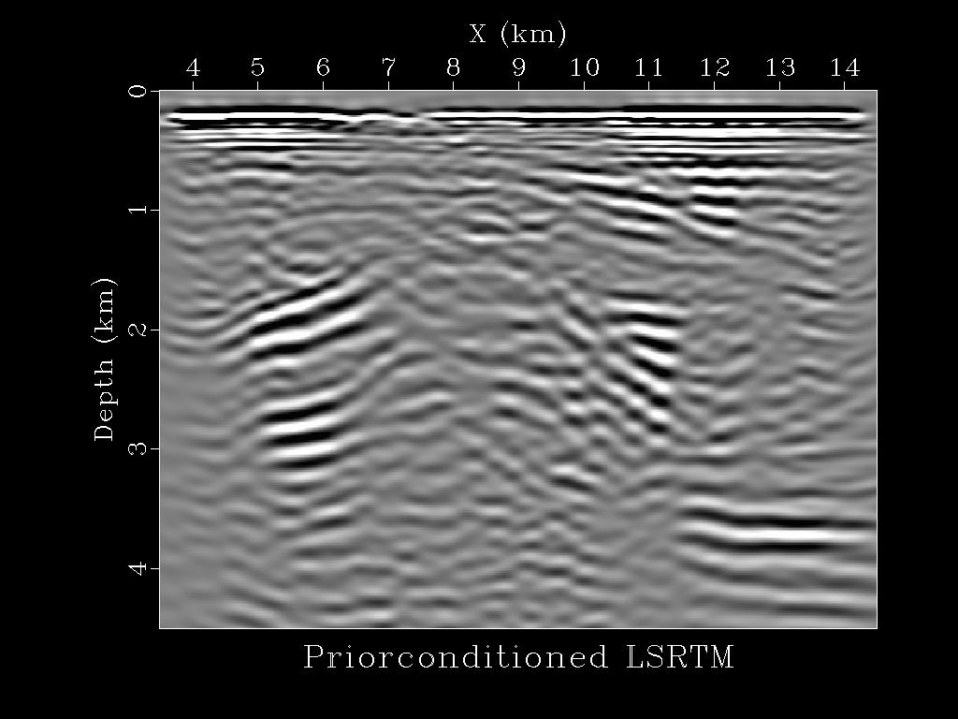
Motivation
$$φ(m)=\frac{1}{2}{\left\|Lm−d\right\|}^{2}$$
LSRTM:
Problems: 1) Sparsely sampled data $→$low SNR.
2) Crosstalk with blended sources.
Solution:
$${}_{m }^{min}{{\left\|Rm\right\|}_{1}} s.t. {\left\|d−Lm\right\|}_{2}< ∅$$
Priorconditioned RTM
Priorconditioned LSRTM
1
Z (km)
4
4
X (km)
15
4
X (km)
15

Slide 8
Outline
Motivation
Theory of Priorconditioning
Numerical Examples
LSRTM using very sparse shots
Denoising multisource LSRTM
Conclusions

Slide 9
Background
LSM produces images with
1) balanced amplitudes,
2) better resolution, and
3) fewer artifacts than standard migration (Lailly, 1984; Nemeth et al., 1999; Duquet et al., 2000; Plessix and Mulder, 2004; Dai and Schuster 2009; Tang, 2009; Wong et al., 2011).
Computational cost for 3D is still an issue.
Two possible solutions:
1) phase-encoded migration (Romero et al., 2000; Dai et al., 2010).
2) sparsity promoting imaging (Douma and de Hoop, 2006; Herrmann et al., 2007, 2009; Wang and Sacchi, 2007; Herrmann and Li, 2012).

Slide 10
Background
If sparse shots are used, regularization is required.
Model reparameterization approaches (Claerbout 1992; Harlan, 1995; Fomel and Guitton, 2006) are efficient for solving regularized inverse problems.
Choice of a suitable basis for reflectivity:
1) perfect reconstruction,
2) can be used with conjugate gradient,
3) efficient computation and minimal redundancy.

Slide 11
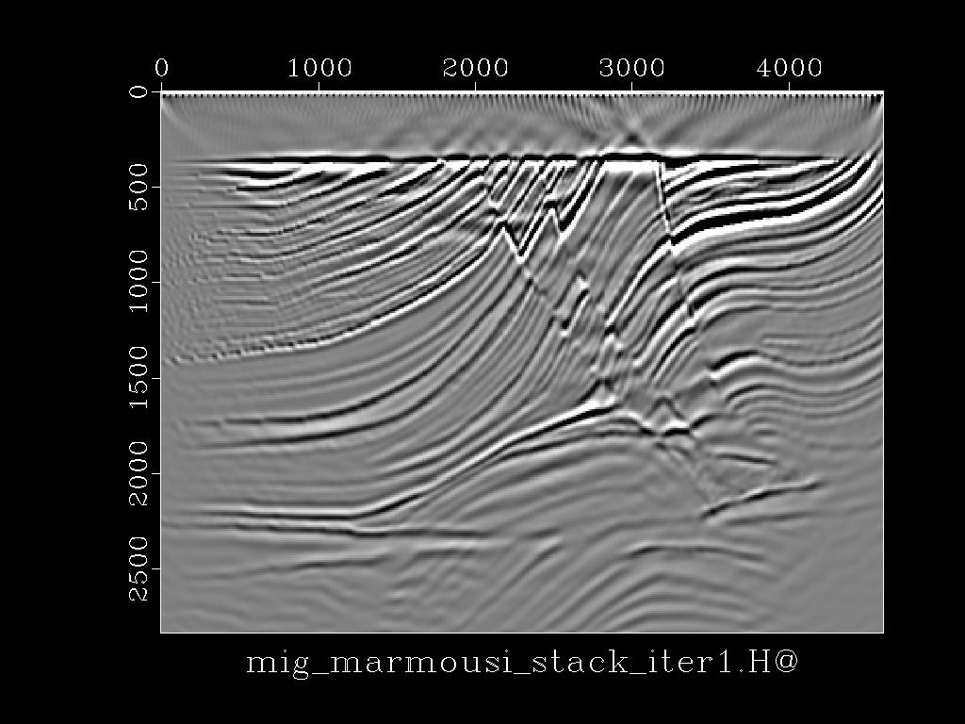
Theory
Aim: Given observed data, $d$, we seek to find a reflectivity model, $m$.
Objective function:
$$φ\left(m\right)=\frac{1}{2}{\left\|Lm−d\right\|}^{2}+λR(m)$$
$λ$ is very large:
$$φ\left(m\right)≈λR(m)$$
The prior information is the solution
$λ$ is very small:
$$φ\left(m\right)≈\frac{1}{2}{\left\|Lm−d\right\|}^{2}$$
Unconstrained problem
Works well in a lot of cases.

Slide 12
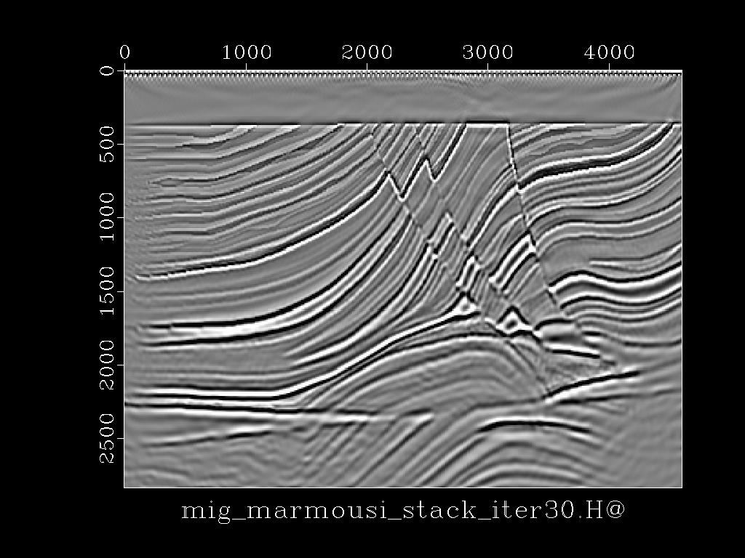
Theory
Aim: Given observed data, $d$, we seek to find a reflectivity model, $m$.
Objective function:
$$φ\left(m\right)=\frac{1}{2}{\left\|Lm−d\right\|}^{2}+λR(m)$$
$λ$ is very large:
$$φ\left(m\right)≈λR(m)$$
The prior information is the solution
$λ$ is very small:
$$φ\left(m\right)≈\frac{1}{2}{\left\|Lm−d\right\|}^{2}$$
Unconstrained problem
Works well in a lot of cases.

Slide 13
Theory
Aim: Given observed data, $d$, we seek to find a reflectivity model, $m$.
Objective function:
$$φ\left(m\right)=\frac{1}{2}{\left\|Lm−d\right\|}^{2}+λR(m)$$
$λ$ is very large:
$$φ\left(m\right)≈λR(m)$$
The prior information is the solution
$λ$ is very small:
$$φ\left(m\right)≈\frac{1}{2}{\left\|Lm−d\right\|}^{2}$$
Unconstrained problem
Works well in a lot of cases.
Not sufficient when the data are very sparse, have noise.
Does not lead to geologically meaningful solutions.

Slide 14
Theory
Aim: Given observed data, $d$, we seek to find a reflectivity model, $m$.
Objective function:
$$φ\left(m\right)=\frac{1}{2}{\left\|Lm−d\right\|}^{2}+λR(m)$$
$λ$ is very large:
$$φ\left(m\right)≈λR(m)$$
The prior information is the solution
$λ$ is very small:
$$φ\left(m\right)≈\frac{1}{2}{\left\|Lm−d\right\|}^{2}$$
Unconstrained problem
Works well in a lot of cases.
Not sufficient when the data are very sparse, have noise.
Does not lead to geologically meaningful solutions.

Slide 15
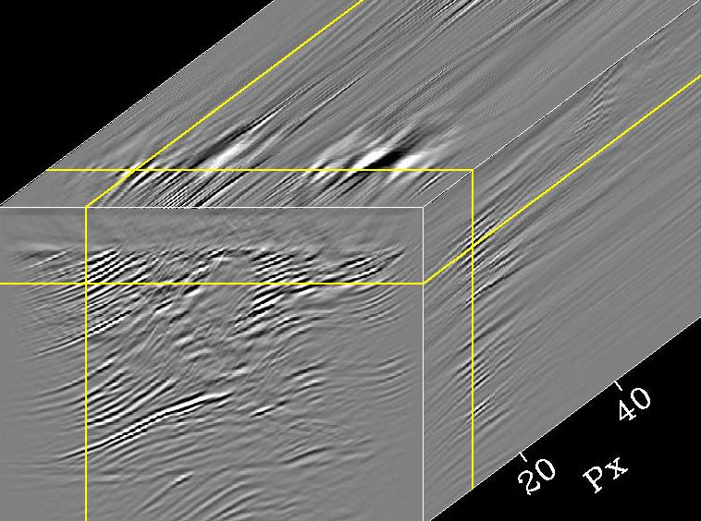
Theory
$$φ\left(m\right)=\frac{1}{2}{\left\|Lm−d\right\|}^{2}+λ R(m)$$
Reformulate the problem:
$${}_{m }^{min}{{\left\|Rm\right\|}_{1}} s.t. {\left\|d−Lm\right\|}_{2}< ∅$$
$R$ = Local radon transform
$φ$ = Tolerance
1
$${}_{m }^{min}{{\left\|WRm\right\|}_{2}} s.t. {\left\|d−Lm\right\|}_{2}< ∅$$
Z (km)
20
$$P_{x}$$
$WR$ = Weighted Local radon transform
-20
3
4
8
X (km)

Slide 16
Theory
$${}_{m }^{min}{{\left\|WRm\right\|}_{2}} s.t. {\left\|d−Lm\right\|}_{2}< ∅$$
Normal equations:
$$\left(λR^{T}W^{T }WR+L^{T}L\right)m=L^{T}d$$
Change of basis:
$$WRm=p⇒ m=R^{−1}W^{−1}p$$
New problem:
$${}_{m }^{min}{{\left\|p\right\|}_{2}} s.t. {\left\|d−LR^{−1}W^{−1}p\right\|}_{2}< ∅$$

Slide 17
Theory
New problem:
$${}_{p }^{min}{{\left\|p\right\|}_{2}} s.t. {\left\|d−LR^{−1}W^{−1}p\right\|}_{2}< ∅$$
$$WRm=p⇒ m=R^{−1}W^{−1}p$$
New normal equations:
$$\left(λI+W^{−T}R^{−T}L^{T}LR^{−1}W^{−1}\right)p=W^{−T}R^{−T}L^{T}d$$
Assuming $λ=0$:
$$\left(W^{−T}R^{−T}L^{T}LR^{−1}W^{−1}\right)p=W^{−T}R^{−T}L^{T}d$$
$${\hat{L}}^{T}$$
$$\hat{L}$$
$${\hat{L}}^{T}$$
$$φ\left(p\right)=\frac{1}{2}{\left\|\hat{L}p−d\right\|}^{2}$$

Slide 18
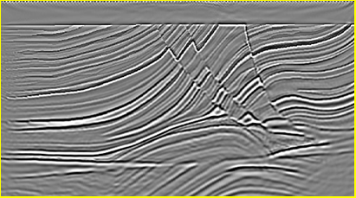
Theory
$$φ\left(m\right)=\frac{1}{2}{\left\|Lm−d\right\|}^{2}+λR(m)$$
$$φ\left(p\right)=\frac{1}{2}{\left\|\hat{L}p−d\right\|}^{2}$$
1
Z (km)
1
3
Z (km)
20
$$P_{x}$$
3
-20
4
X (km)
8
4
X (km)
8

Slide 19
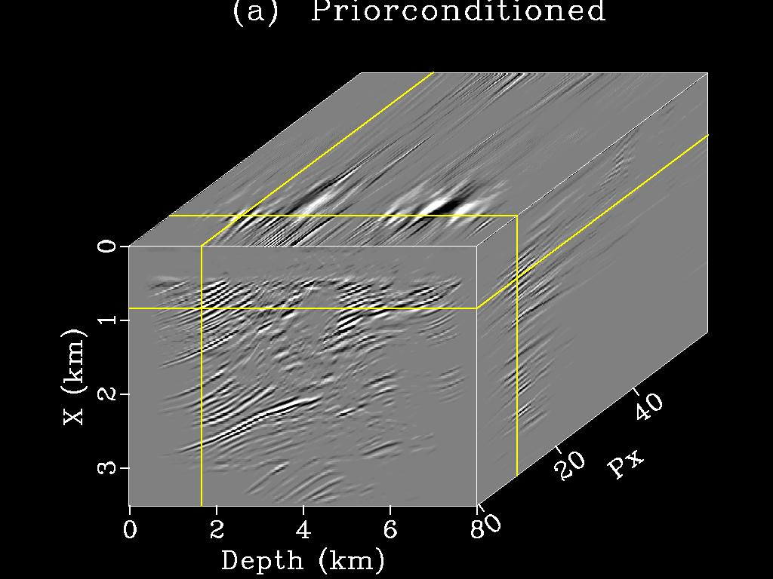
Theory
$$φ\left(m\right)=\frac{1}{2}{\left\|Lm−d\right\|}^{2}+λR(m)$$
$$φ\left(p\right)=\frac{1}{2}{\left\|\hat{L}p−d\right\|}^{2}$$
1
Z (km)
1
Z (km)
20
3
20
$$P_{x}$$
-20
$$P_{x}$$
3
-20
4
X (km)
8
Benefits:
4
X (km)
8
This approach is factorization-free or matrix-free.
$R$and $R^{−1}$ should be available.
The prior information is imposed into the solution through the operators$R$and $R^{−1}$.

Slide 20
Theory
Differences between standard preconditioning and implicit preconditioning:
Standard preconditioning improves the condition number of the system $L^{T}Lm=L^{T}d$.
The condition number of ${\hat{L}}^{T}\hat{L}p={\hat{L}}^{T}d$may be larger.
The priorconditioner is selected based on the regularization term.
$$φ\left(m\right)=\frac{1}{2}{\left\|Lm−d\right\|}^{2}+λR(m)$$
$$φ\left(p\right)=\frac{1}{2}{\left\|\hat{L}p−d\right\|}^{2}$$
4) Faster convergence than using an explicit regularization term.

Slide 21
Workflow
$$φ\left(p\right)=\frac{1}{2}{\left\|\hat{L}p−d\right\|}^{2}$$
Conjugate-Guided-Gradient Method with model weight guide (Ji, 2006)
$$r⇐\hat{L}p−d$$
$r=$ Residual
while condition do
$$diag\left(W_{p}\right)⇐f(p)$$
$f\left(p\right)=$ Function of model p
$$Δp⇐W_{p}^{T} {\hat{L}}^{T}(\hat{L}p−d)$$
$$Δr⇐\hat{L} Δp$$
$$\left(p,r\right)⇐cgstep(p,r,Δp,Δr)$$
end while
$$m⇐p$$

Slide 22
Outline
Motivation
Theory of Priorconditioning
Numerical Examples
LSRTM using very sparse shots
Denoising multisource LSRTM
Conclusions

Slide 23
2D Example
True Velocity
Migration Velocity
km/s
1
4
Z (km)
3
3
2
4
X (km)
8
4
X (km)
8

Slide 24
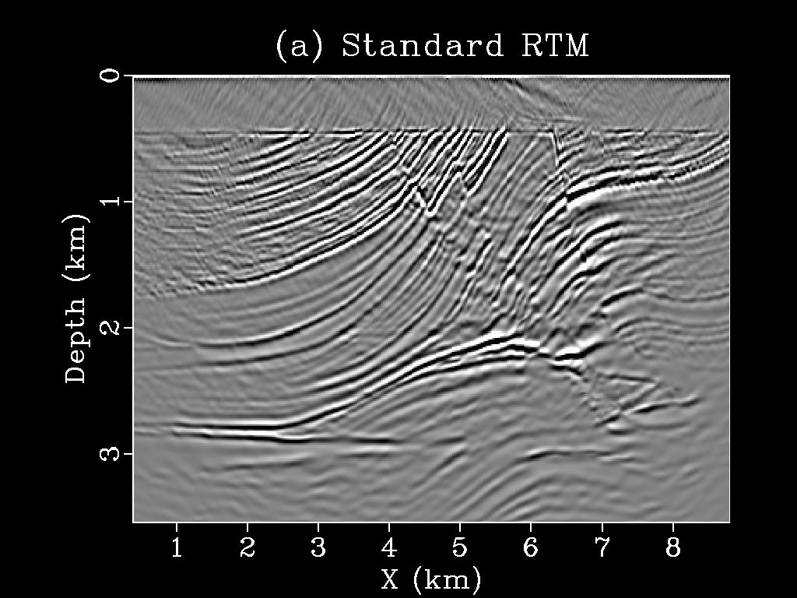
2D Example
12 shots
RTM
Migration Velocity
km/s
4
1
Z (km)
3
3
2
4
X (km)
8
4
X (km)
8

Slide 25
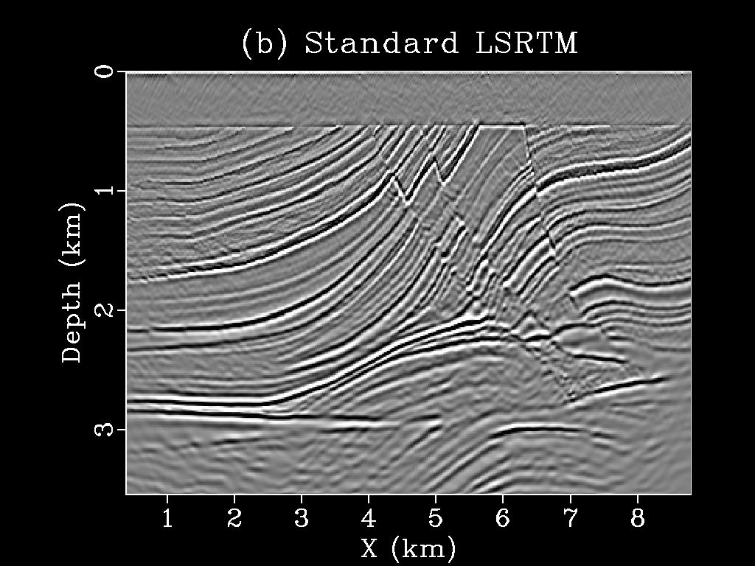
2D Example
12 shots
RTM
LSRTM
1
Z (km)
3
4
X (km)
8
4
X (km)
8
10 iterations

Slide 26
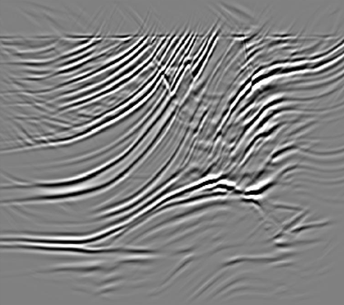
2D Example
12 shots
Priorconditioned RTM
LSRTM
1
Z (km)
3
4
X (km)
8
4
X (km)
8
10 iterations

Slide 27
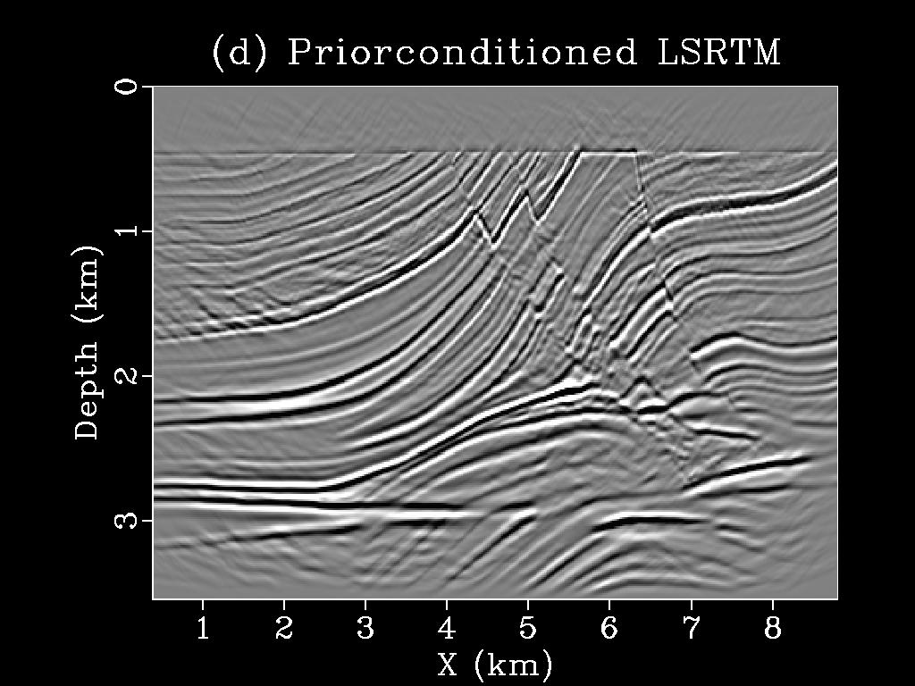
2D Example
12 shots
Priorconditioned RTM
Priorconditioned LSRTM
1
Z (km)
3
4
X (km)
8
4
X (km)
8
10 iterations

Slide 28
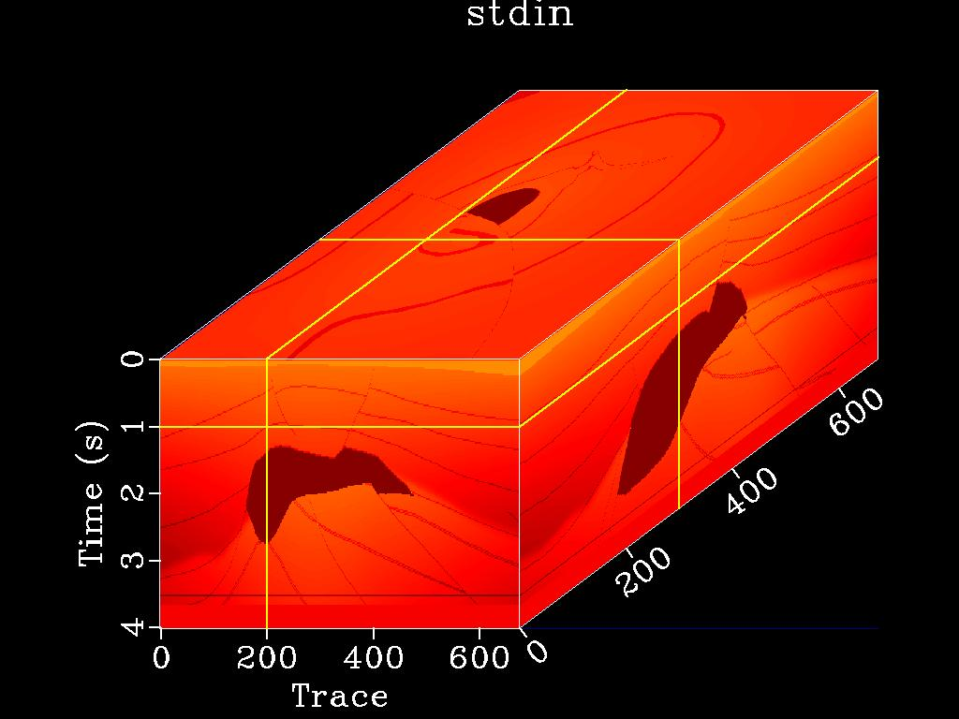
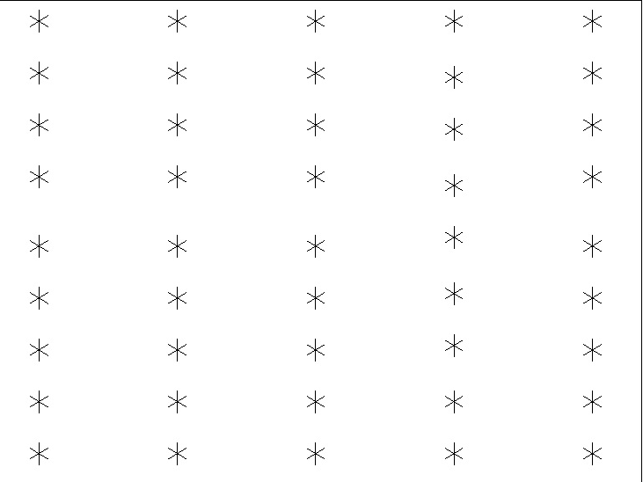
3D Example
SEG/EAGE Salt model
Sandia/SEG C3 45 shot subset
10
Crossline Y(km)
1
10
Z (km)
Y (km)
5
2
3
10
5
Inline X(km)
9
5
X (km)
45 shots, 625 samples per trace, 8ms sampling rate, 201X201 receiver grid, 5X9 source grid, 960 m shot and shot-line separation

Slide 29
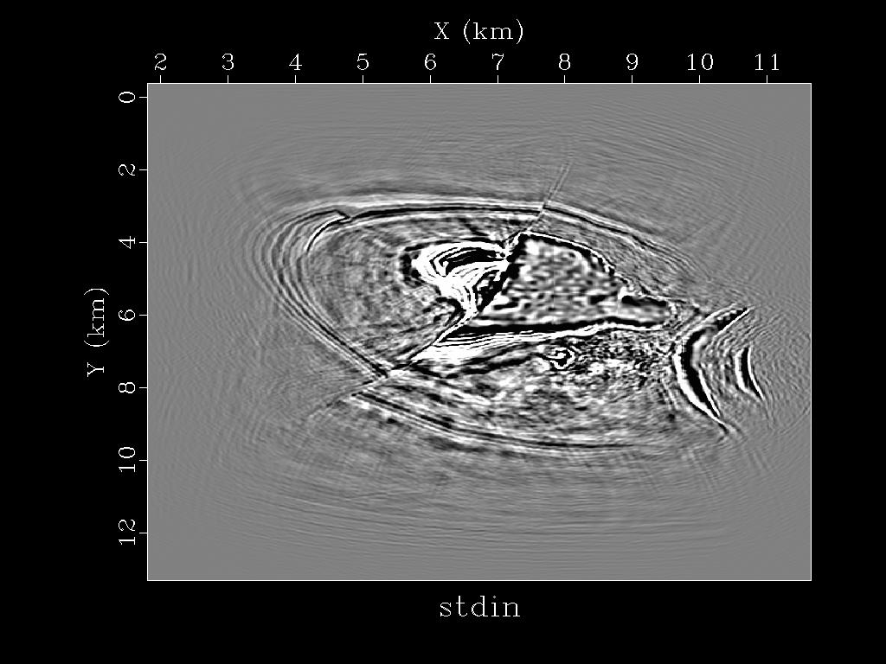
RTM
10
Y (km)
5
1
Z (km)
3
5
X (km)
10
5
Y (km)
10

Slide 30
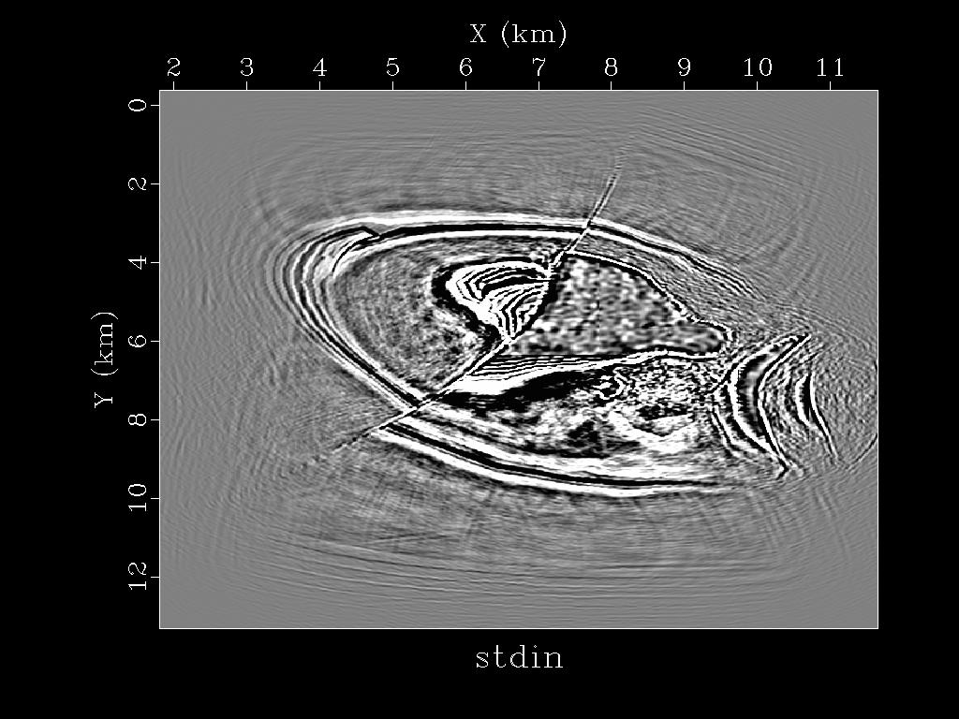
LSRTM
10
Y (km)
5
1
Z (km)
3
5
X (km)
10
5
Y (km)
10

Slide 31
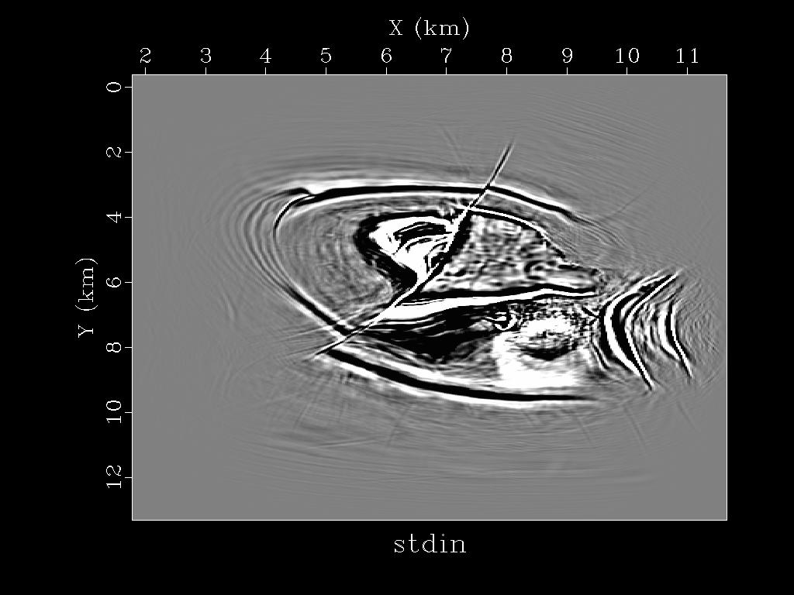
Priorconditioned LSRTM
10
Y (km)
5
1
Z (km)
3
5
X (km)
10
5
Y (km)
10

Slide 32
2
Y (km)
14
OBS Survey Parameters
-2
Survey Geometry Map
3D OBS data parameters:
234 OBS stations
400m OBS spacing
129 source-lines
40-50m water depth
Receiver stations
X (km)
Source boat sail lines
18

Slide 33
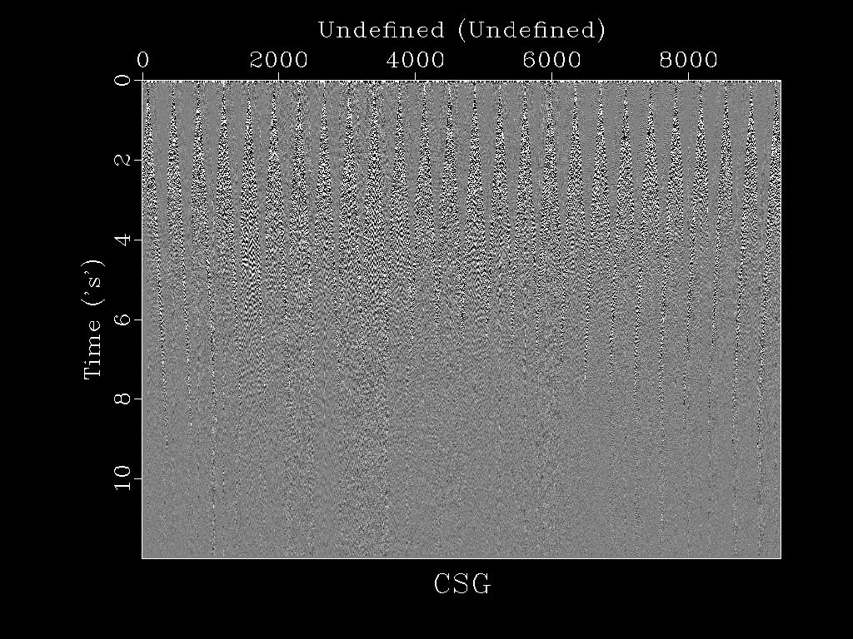
OBS Data
1
Shot No.
26
Acquisition
0
26 OBS nodes – 402.5 m spacing.
360 shots – 50 m spacing.
Time (s)
For migration
26 shots – 402.5 m spacing.
360 receivers – 50 m spacing.
Velocity model by GN FWI (Altheyab, 2015).
10

Slide 34
OBS Tomogram
Velocity Model (AlTheyab, 2015)
km/s
1
3
Z (km)
2.5
4
2
4
X (km)
15

Slide 35
OBS Data
10 iterations
RTM
LSRTM
1
Z (km)
4
4
X (km)
15
4
X (km)
15

Slide 36
OBS Data
10 iterations
Priorconditioned RTM
LSRTM
1
Z (km)
4
4
X (km)
15
4
X (km)
15

Slide 37
OBS Data
10 iterations
Priorconditioned RTM
Priorconditioned LSRTM
1
Z (km)
4
4
X (km)
15
4
X (km)
15

Slide 38
Outline
Motivation
Theory of Priorconditioning
Numerical Examples
LSRTM using very sparse shots
Denoising multisource LSRTM
Conclusions

Slide 39
Denoising Multisource LSM
True Velocity
Migration Velocity
km/s
1
4
Z (km)
3
5
2
5
X (km)
15
5
X (km)
15

Slide 40
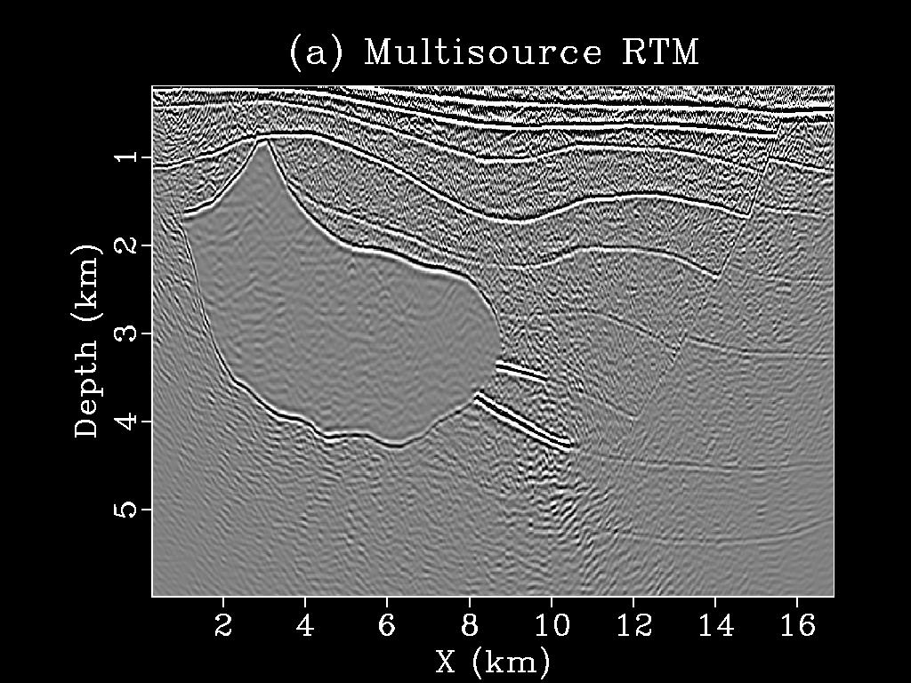
Denoising Multisource LSM
Multisource RTM
Migration Velocity
km/s
1
4
Z (km)
3
5
2
5
X (km)
15
5
X (km)
15
100 shots 1 supergather

Slide 41
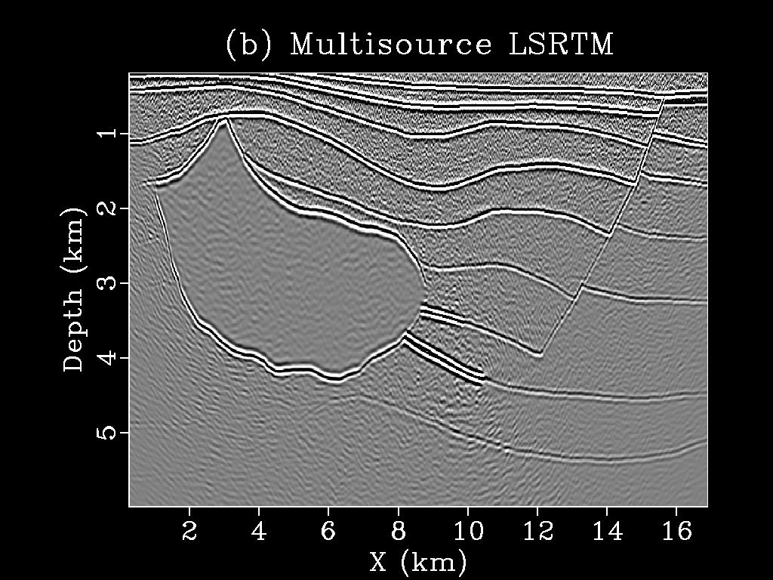
Denoising Multisource LSM
10 iterations !!!
Multisource RTM
Multisource LSRTM
km/s
1
4
Z (km)
3
5
2
5
X (km)
15
5
X (km)
15
100 shots 1 supergather

Slide 42
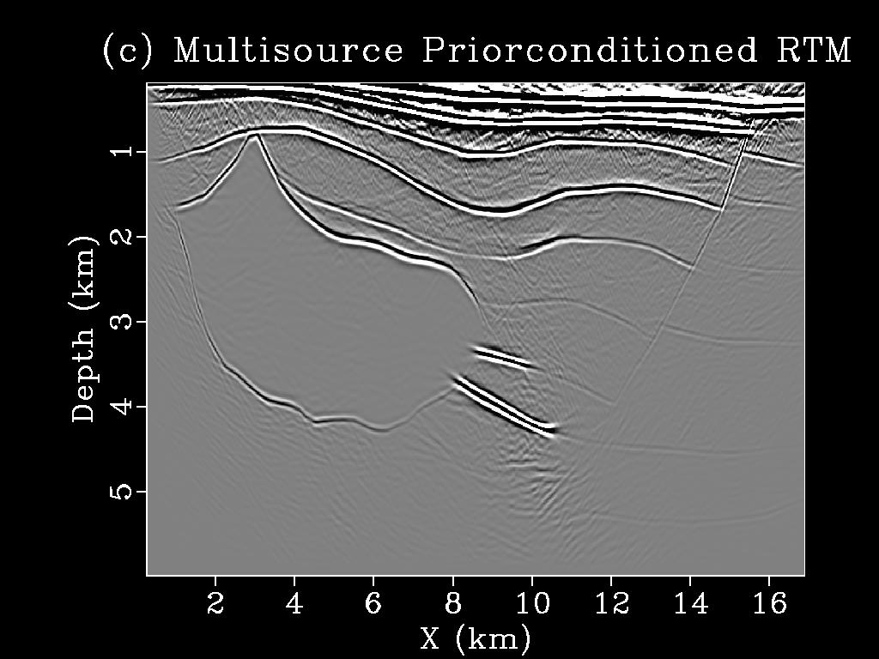
Denoising Multisource LSM
10 iterations !!!
Priorconditioned Multisource RTM
Multisource LSRTM
km/s
1
4
Z (km)
3
5
2
5
X (km)
15
5
X (km)
15
100 shots 1 supergather

Slide 43
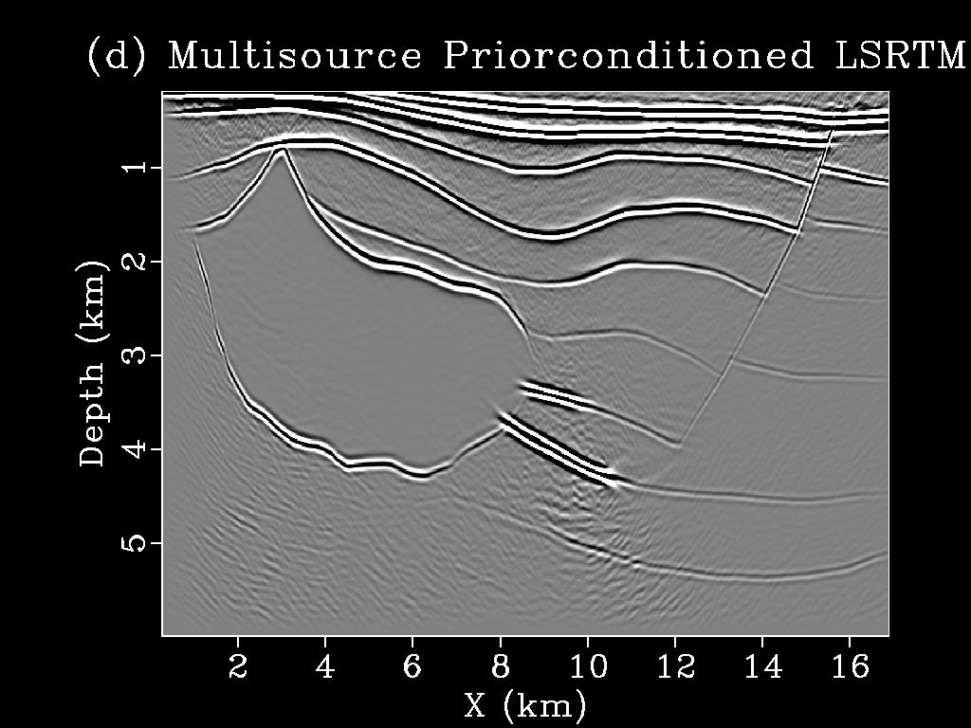
Denoising Multisource LSM
10 iterations !!!
Priorconditioned Multisource RTM
Priorconditioned Multisource LSRTM
km/s
1
4
Z (km)
3
5
2
5
X (km)
15
5
X (km)
15
100 shots 1 supergather

Slide 44
Outline
Motivation
Theory of Priorconditioning
Numerical Examples
LSRTM using very sparse shots
Denoising multisource LSRTM
Conclusions

Slide 45
Conclusions
LSM needs regularization to produce meaningful images for sparse shots/ noisy data.
RTM
LSRTM
1
Z (km)
4
4
X (km)
15
4
X (km)
15

Slide 46
Conclusions
A regularization based implicit preconditioning approach is presented for LSM.
RTM
LSRTM
1
Z (km)
4
4
X (km)
15
4
X (km)
15

Slide 47
Conclusions
A regularization based implicit preconditioning approach is presented for LSM.
Priorconditioned RTM
Priorconditioned LSRTM
1
Z (km)
4
4
X (km)
15
4
X (km)
15
Not suitable for well-sampled data.
The method is sensitive to presence of internal multiples/free-surface multiples in the data.

Slide 48
Acknowledgements
My co-authors, Matteo Giboli, Paul Williamson and Gerard T. Schuster.
TOTAL E&P France for permission to present this work.
Sponsors of the CSIM consortium.
KAUST Supercomputing Laboratory (KSL) and IT research computing group.

Slide 49
Thank You !!!

