Slide 1
Skeletonized Wave-Equation Surface Wave Dispersion (WD) Inversion
Jing Li*, Gerard Schuster, Zongcai Feng
and Sherif Hanafy
King Abdullah University of Science and Technology (KAUST)

Slide 2
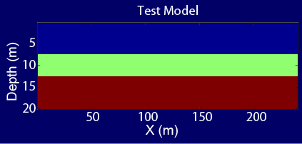
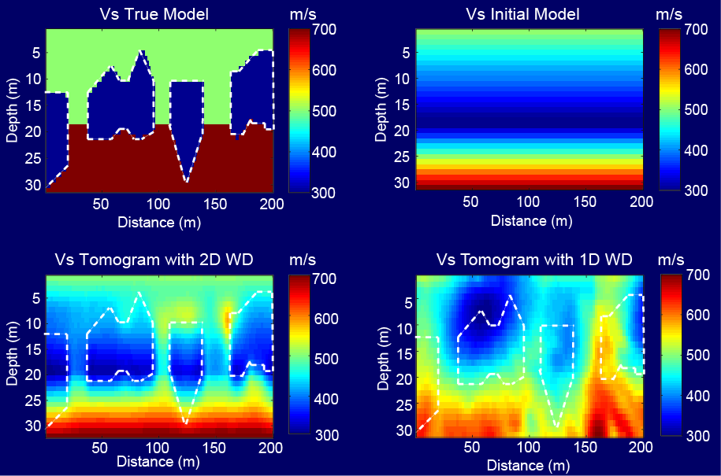
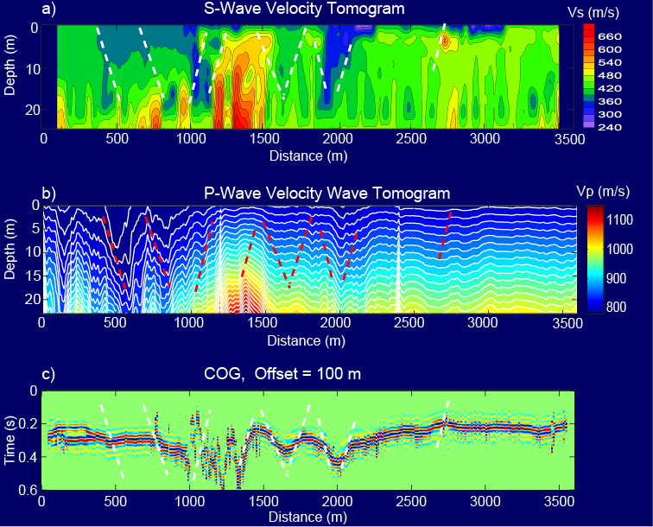
Outline
Motivation
Theory
  Radon Transform
  Skeletonized WD Inversion
  Checkerboard Test
Results (Synthetic and Field Data)
Conclusions and Future Work
z (m)
z (m)
x (m)
x (m)
Phase velocity (m/s)
Predicted
Observed
Frequency (Hz)
z (m)
x (m)
z (m)
x (m)
Notes:
My talk is organized in the following way:
1. The first part is motivation. I will talk about a least squares migration (LSM ) advantages and challenges.
2. The second part is theory for a deblurring filter, which is an alternative method to LSM.
3. In the third part, I will show a numerical result of a deblurring filter.
4. The fourth is the main part of my talk.
Deblurred LSM (DLSM) is a fast LSM with a deblurring filter.
I will explain how to use the filter in LSM algorithm.
5. Then I will show numerical results of the DLSM.
6. Then I will conclude my presentation.
Each figure has a slide number is shown at the footer.
2

Slide 3
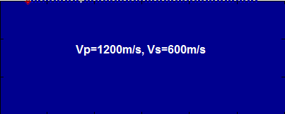
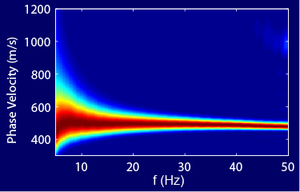
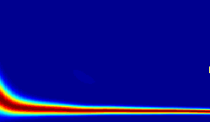
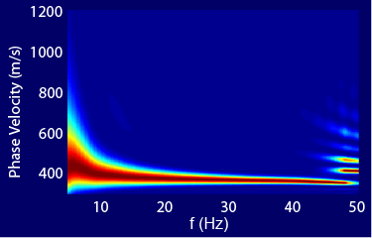
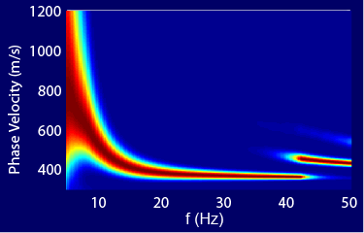
Background
V(z)_{s} inverted from surface wave dispersion curve.
Key point: Dispersion curve is mostly sensitive to Vs, not Vp or density.
Key point: Dispersion curve is mostly sensitive to Vs, not Vp or density.
Test Model
0
20
z (m)
Parameters: Vp, Vs and density
Dispersion curve
0 x (m) 120
Dispersion of Vp
Dispersion of Density
Dispersion of Vs
800
400
800
400
800
400
v (m/s)
v (m/s)
v (m\s)
10 f (Hz) 50
10 f (Hz) 50
10 f (Hz) 50

Slide 4
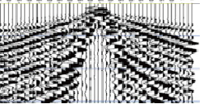
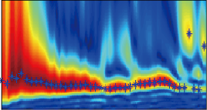
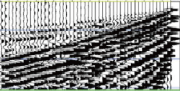
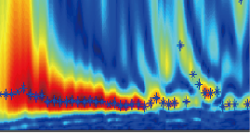
Problem & Solution
Problem: 1D Dispersion inversion assumes layered medium (Xia et al. 1999).
Solution: Wave-equation dispersion inversion (WD) with 2D/3D data (Li and Schuster, 2016).
CSGs
Dispersion Curves
v (m/s)
True model
RT
1D
Inversion
0
30
1D Vs Tomogram
t(s)
V (m/s)
WD Vs Tomogram
Z (m)
0
30
0
30
Z (m)
x (m)
(Radon Transform)
f (Hz)
2D
WD
Z (m)
CSGs
Dispersion Curves
Z (m)
v (m/s)
RT
1D
Inversion
t(s)
V (m/s)
Z (m)
0 60 120
x(m)
0 60 120
x(m)
0 60 120
x(m)
x (m)
f (Hz)

Slide 5
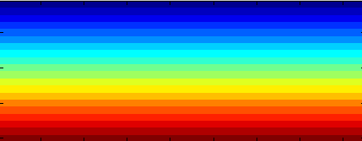

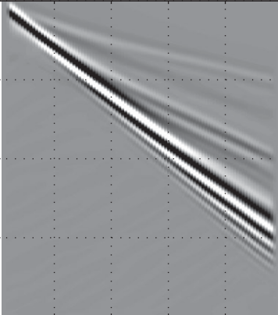
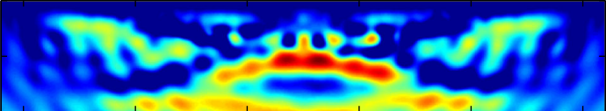

Comparison of 2D WD Inversion with FWI
Start Model
FWI of Surface Waves
Easy to get stuck in a local minimum (Solano, et al., 2014).
Vs True Model
A shot gather
Vs Tomogram
FD
FWI
z (m)
t (s)
z (m)
x (m)
x (m)
x (m)
2D WD of Surface Waves
Avoid local minimum and apply in 2D/3D model.
Dispersion curve
Vs Tomogram
WD
v (m/s)
t (s)
z (m)
x (m)
f (Hz)
x (m)

Slide 6
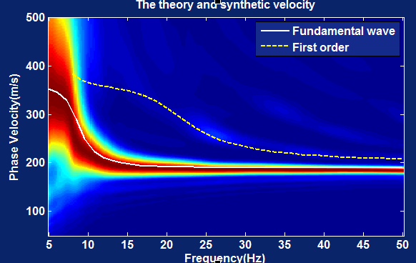
Outline
Phase Velocity
Motivations
Theory
  Radon Transform
  Skeletonized Inversion Theory
  Checkerboard Test
Results (Synthetic and Field Data)
Conclusions and Future Work
500
100
v (m/s)
5 f (Hz) 50
Notes:
My talk is organized in the following way:
1. The first part is motivation. I will talk about a least squares migration (LSM ) advantages and challenges.
2. The second part is theory for a deblurring filter, which is an alternative method to LSM.
3. In the third part, I will show a numerical result of a deblurring filter.
4. The fourth is the main part of my talk.
Deblurred LSM (DLSM) is a fast LSM with a deblurring filter.
I will explain how to use the filter in LSM algorithm.
5. Then I will show numerical results of the DLSM.
6. Then I will conclude my presentation.
Each figure has a slide number is shown at the footer.
6

Slide 7
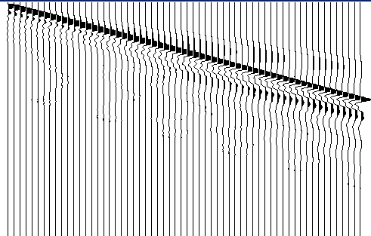
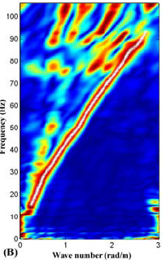
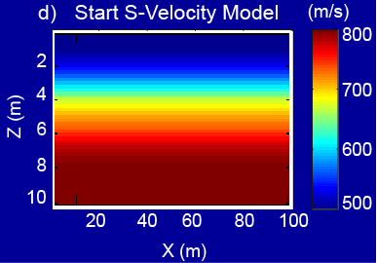
Theory: Radon Transform
Synthetic Model
Shot Gather D(x,t)
Shot Gather D(k,w)
0
30
50
5
0
2
FD
FFT
z (m)
t (s)
f (Hz)
0 x (m) 120
0 x (m) 120
0 k (m⁻¹) 0.2
Radon Transform
Pred. Model
Dispersion Curve
0
30
500
100
500
100
Observed
High order
Fundamental mode
Predicted
Pick
z (m)
v (m/s)
v (m/s)
0 x (m) 120
5 f (Hz) 50
5 f (Hz) 50

Slide 8
Outline
Motivations
Theory
  Radon Transform
  Skeletonized Inversion Theory
  Checkerboard Test
Results (Synthetic and Field Data)
Conclusions and Future Work
Phase Velocity
Predicted
Observed
v (m/s)
Frequency (Hz)
Notes:
My talk is organized in the following way:
1. The first part is motivation. I will talk about a least squares migration (LSM ) advantages and challenges.
2. The second part is theory for a deblurring filter, which is an alternative method to LSM.
3. In the third part, I will show a numerical result of a deblurring filter.
4. The fourth is the main part of my talk.
Deblurred LSM (DLSM) is a fast LSM with a deblurring filter.
I will explain how to use the filter in LSM algorithm.
5. Then I will show numerical results of the DLSM.
6. Then I will conclude my presentation.
Each figure has a slide number is shown at the footer.
8

Slide 9

Wave-equation Traveltime (WT) vs Wave-equation Dispersion (WD)
Properties:
Wave-equation traveltime
tomography (Luo and Schuster, 1991)
Wave-equation dispersion tomography (Li and Schuster, 2016)
Misfit function:
Predicted
$$Δτ$$
k (m-1)
Observed
Wave-equation computation
Frequency (Hz)
Gradient:

Slide 10
WD Algorithm
Wavenumber-f
There are 3 steps:
Predicted
Observed
k (m-1)
Gradient
1)
Frequency (Hz)
2)
3)
Weighted source field
Backpropagated weighted field

Slide 11
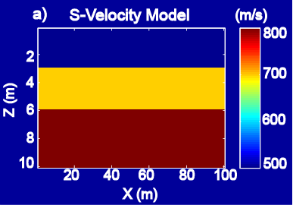
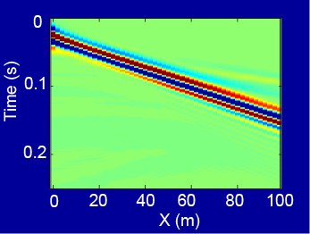
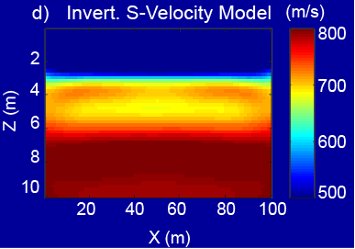
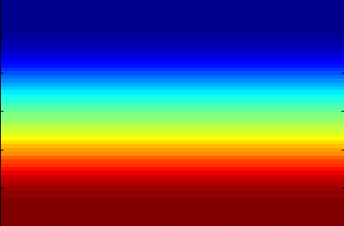
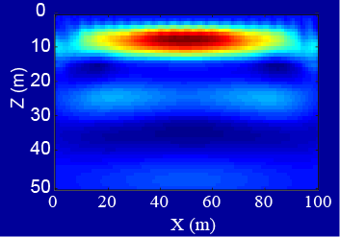
WD Workflow
Weighted Source
True Vs Model
Obs. Dispersion
1
0
-1
0
10
800
600
400
v (m/s)
Residual Dispersion
z (m)
k (m-1)
0 0.2 0.4 0.6
t (s)
0 60 x (m) 120
Data
f (Hz)
Weighted Data
Pred. Vs Model
Pred. Dispersion
0
2
RT
0
10
800
600
400
f (Hz)
v (m/s)
t (s)
RTM
z (m)
Update
Small ?
0 60 x (m) 120
0 60 x (m) 120
f (Hz)
Inverted Vs
Gradient
0
10
0
10
CG
z (m)
z (m)
0 60 x (m) 120
0 60 x (m) 120

Slide 12
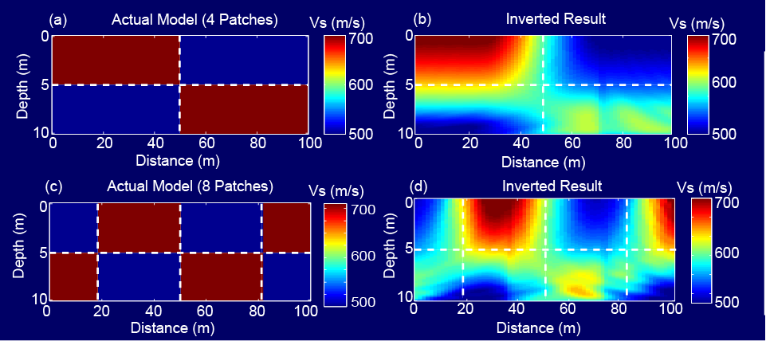
Outline
Motivations
Theory
  Radon Transform
  Inversion Theory
  Checkerboard Test
Results (Synthetic and Field Data)
Conclusions and Future Work
0
15
0
15
z (m)
z (m)
0 60 120
x(m)
0 60 120
x(m)
Notes:
My talk is organized in the following way:
1. The first part is motivation. I will talk about a least squares migration (LSM ) advantages and challenges.
2. The second part is theory for a deblurring filter, which is an alternative method to LSM.
3. In the third part, I will show a numerical result of a deblurring filter.
4. The fourth is the main part of my talk.
Deblurred LSM (DLSM) is a fast LSM with a deblurring filter.
I will explain how to use the filter in LSM algorithm.
5. Then I will show numerical results of the DLSM.
6. Then I will conclude my presentation.
Each figure has a slide number is shown at the footer.
12

Slide 13
Checkerboard Test
Checkerboard Model 1 m/s
WD Vs Tomogram m/s
0
15
700
600
500
0
15
700
600
500
z (m)
z (m)
0 60 120
x(m)
0 60 120
x(m)
Checkerboard Model 2 m/s
WD Vs Tomogram m/s
0
15
0
15
700
600
500
700
600
500
z (m)
z (m)
0 60 120
x(m)
0 60 120
x(m)

Slide 14
Outline
Motivations
Theory
  Radon Transform
  Inversion Theory
  Checkerboard Test
Results (Synthetic and Field Data)
Conclusions and Future Work
z (m)
x (m)
z (m)
x (m)
Notes:
My talk is organized in the following way:
1. The first part is motivation. I will talk about a least squares migration (LSM ) advantages and challenges.
2. The second part is theory for a deblurring filter, which is an alternative method to LSM.
3. In the third part, I will show a numerical result of a deblurring filter.
4. The fourth is the main part of my talk.
Deblurred LSM (DLSM) is a fast LSM with a deblurring filter.
I will explain how to use the filter in LSM algorithm.
5. Then I will show numerical results of the DLSM.
6. Then I will conclude my presentation.
Each figure has a slide number is shown at the footer.
14

Slide 15
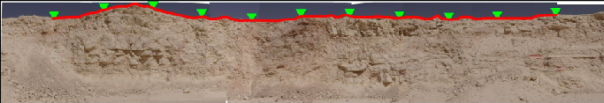
2D Potash Model Test
True Model m/s
Start Model m/s
0
30
800
600
400
0
30
800
600
400
z (m)
z (m)
0 60 120
x(m)
0 60 120
x(m)
WD Vs Tomogram m/s
1D Vs Tomogram m/s
0
30
0
30
800
600
400
800
600
400
z (m)
z (m)
0 60 120
x(m)
0 60 120
x(m)

Slide 16
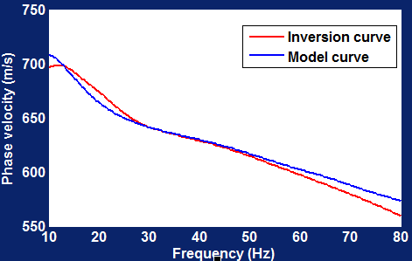
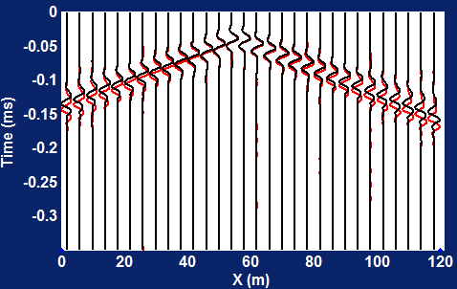
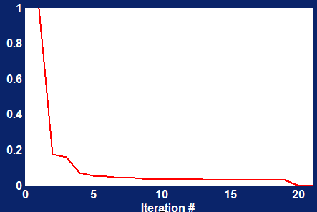
2D Potash Model Test
Dispersion Curve
750
600
550
v (m/s)
50 80
Predicted Data vs Observed Data
Residual vs Iter. #
0
1.0
2.0
1
0.6
0.2
t (s)
misfit
Pred. Data
Obs. Data
0 60 120
x(m)
10 20
Iteration (#)

Slide 17

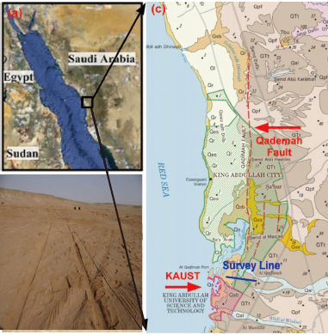
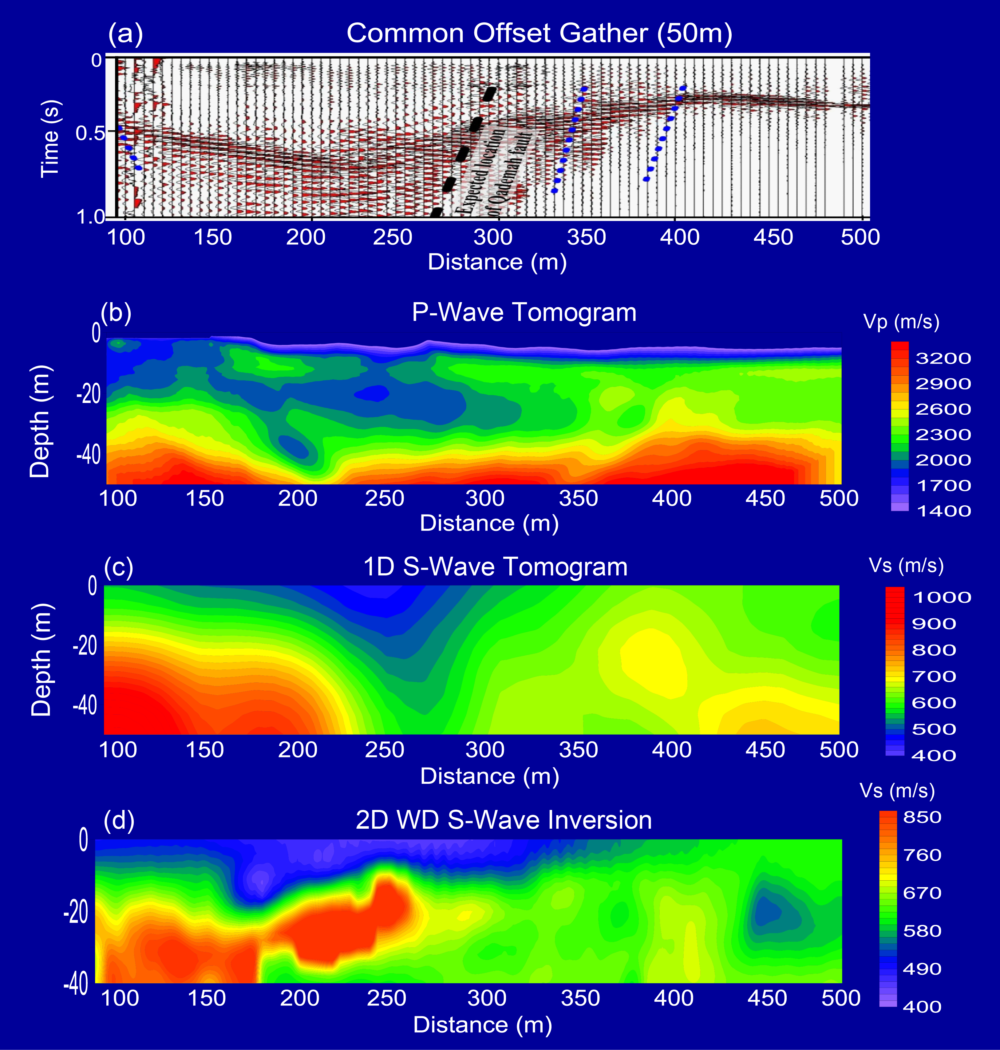
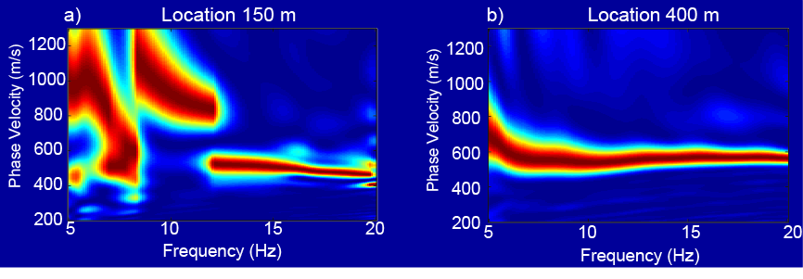
Qademah Fault, Saudi Arabia Field Data
P-wave Tomogram
2D WD S-wave Tomogram
1D S-wave Tomogram

Slide 18
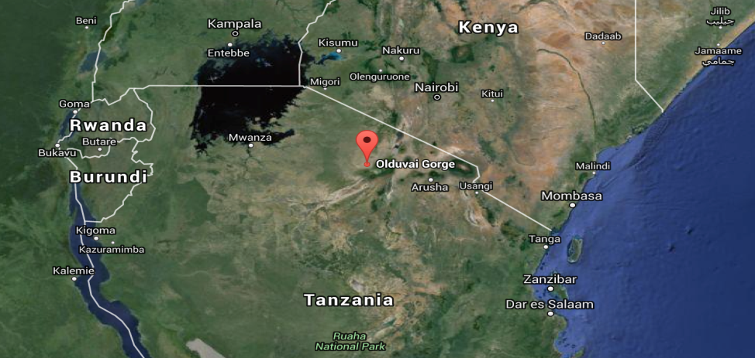
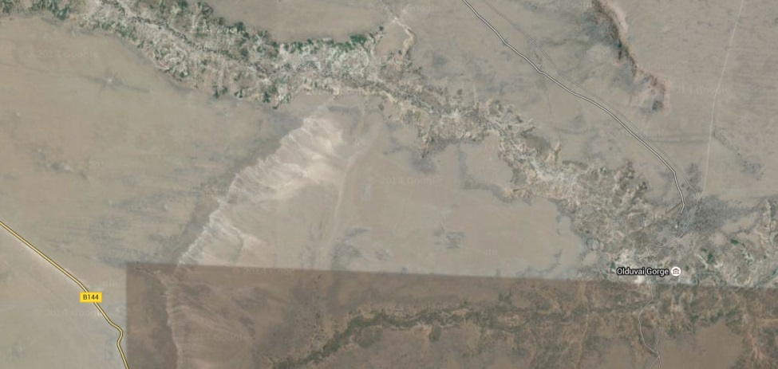
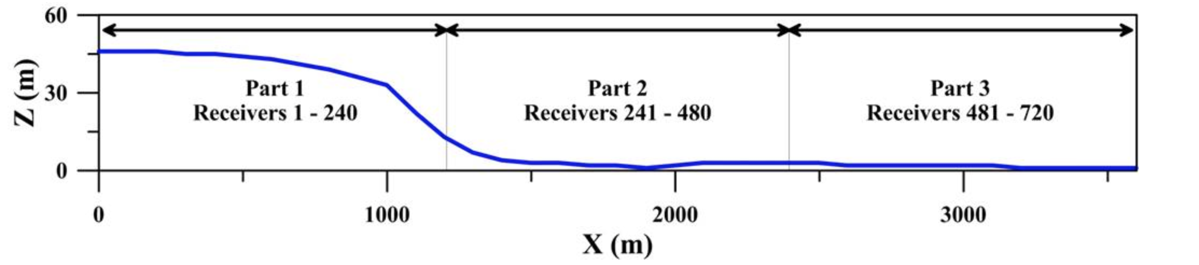
Olduvai, Tanzania Seismic Data
3.6 km
Fifth Fault
Borehole 2A
The Fifth Fault
Borehole 2A
Survey Line (Courtesy of Kai Lu et al, 2016)

Slide 19
Olduvai, Tanzania Seismic Data
The Fifth Fault
COG
0
0.6
z (m)
0 500 1000 1500 2000 2500 3000 3500
The Fifth Fault
S-wave Velocity Tomogram (WD)
m/s
0
0.6
1000
800
600
z (m)
0 500 1000 1500 2000 2500 3000 3500
The Fifth Fault
P-wave Velocity Tomogram Tomogram
m/s
0
0.6
3500
2000
1500
z (m)
0 500 1000 1500 2000 2500 3000 3500

Slide 20
Outline
Motivations
Theory
  Radon Transform
  Skeletonized Inversion Theory
  Checkerboard Test
Results (Synthetic and Field Data)
Conclusions and Future Work
Notes:
My talk is organized in the following way:
1. The first part is motivation. I will talk about a least squares migration (LSM ) advantages and challenges.
2. The second part is theory for a deblurring filter, which is an alternative method to LSM.
3. In the third part, I will show a numerical result of a deblurring filter.
4. The fourth is the main part of my talk.
Deblurred LSM (DLSM) is a fast LSM with a deblurring filter.
I will explain how to use the filter in LSM algorithm.
5. Then I will show numerical results of the DLSM.
6. Then I will conclude my presentation.
Each figure has a slide number is shown at the footer.
20

Slide 21
Conclusions
WD inversion can be applied to 2D or 3D data;
True Model m/s
2D WD Vs Tomogram m/s
0
30
800
600
400
0
30
800
600
400
z (m)
z (m)
0 60 120
x(m)
0 60 120
x(m)
z (m)
x (m)
z (m)
x (m)

Slide 22
Conclusions
2. Avoid the local minimum;
Vs model
Vs Tomogram
FWI
z (m)
z (m)
x (m)
x (m)
Start model
WD
Vs Tomogram
z (m)
z (m)
x (m)
x (m)

Slide 23
Limitations
Computation costly.
Moderate resolution.
Pick dispersion curve in low SNR field data.

Slide 24
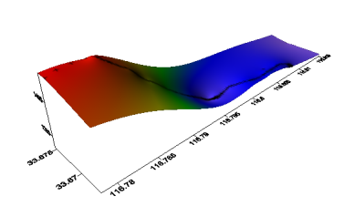
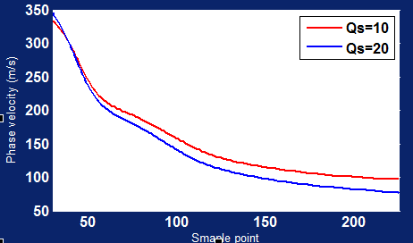
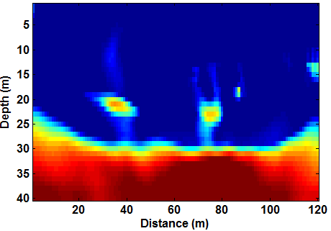
Future Work
Consider the effect of attenuation and topography;
Topography
Vs Model with Topography
0
30
50
z (m)
0 60 120
x(m)
Effect of attenuation
WD Inversion with Topography
700
500
300
0
30
50
V (m/s)
z (m)
10 50 80
f (Hz)
0 60 120
x(m)

Slide 25










Acknowledgements
Sponsors of the CSIM (csim.kaust.edu.sa) consortium.
KAUST Supercomputing Laboratory (KSL) and IT research computing group.

Slide 26
Thank you

