Slide 1
Machine Learning and Wave Equation Inversion of Skeletonized Data
G. Schuster and Jing Li
King Abdullah University Science and Technology

Slide 2
Outline
Motivation
Theory of Skeletonized Inversion
Example
Inverting V_{p} from Guided-Wave C(ω)
Summary

Slide 3
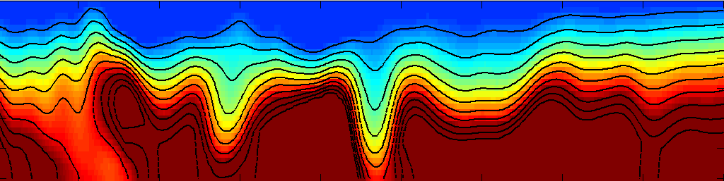
Machine Learning &Wave Equation Inversion of Skeletonized Data
FWI
Input
Data d
[L^{T}L]⁻¹L^{T}
Model
m
Skeletonized
Wave Eqn. Inv.
Input
Data d
Skeletal
Features
[L^{T}L]⁻¹L^{T}
Model
m
GW
GW
Implicit
Function
Theorem
(Luo+Schuster, 1991)
SW
SW

Slide 4
Machine Learning +Wave Equation Inversion of Skeletonized Data
Machine Learning &Wave Equation Inversion of Skeletonized Data
FWI
Input
Data d
[L^{T}L]⁻¹L^{T}
Model
m
Skeletonized
Wave Eqn. Inv.
Input
Data d
Model
m
Skeletal
Features
[L^{T}L]⁻¹L^{T}
Neural
Network
Target
Model
m
Input
Data d
Machine
Learning
Machine
Learning
Features

Slide 5
Outline
Motivation
Theory of Skeletonized Inversion
Example
Inverting V_{p} from Guided-Wave C(ω)
Summary

Slide 6
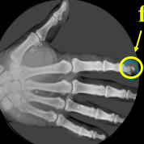
Skeletonization of Geophysical Data
d
?
Skeletonization Problem:
dc
Solution: Implicit Function Theorem
2
∂P
P + (ω/c)² P = F → Fre’chet deriv. (easy)
∂c
∂τ/
∂c
∂AVO
∂c
What about ? ? ? / ? …
∂C/
∂c
∂z/
∂c
dF
dF
Constraint: F(P,c,τ) = 0 → dF = dc + dτ = 0
dc
dτ
F(P,c,τ)=P ⊗ P^{obs} = 0
.
dτ
dP ⊗ P^{obs}
dF/dc
= -
dc
= -
.
dc
dF/dτ
dP ⊗ P^{obs}
dτ

Slide 7

Implicit Function Theorem
dτ
dF/dc
= -
F(P,c,τ) = 0
(Luo+Schuster, 1991)
dc
dF/dτ
The implicit function theorem plays a key role in economics, particularly in constrained optimization problems ….(Simon&Blume, 1994, Chapt 15).
In the mid-'80s, Wall Street turned to the quants—brainy financial engineers—to invent new ways to boost profits. Their methods (Gaussian Copula formula) for minting money worked brilliantly… until one of them devastated the global economy.

Slide 8
Outline
Motivation
Theory of Skeletonized Inversion
Example
Inverting V_{p} from Guided-Wave C(ω): Theory
Summary

Slide 9
Wave Equation Dispersion Inversion of Guided P-Waves (WDG)
Problem: Near-surface P-velocity imaging→low resolution & cycle skipping in FWI.
Solution: Invert phase velocity C(ω) of waveguide P-waves
GW
GW: Guided wave
SW: Surface wave
GW
SW
SW
Theory:
Misfit function:
ω
∂C
Gradient (RTM):
Conjugate Gradient method:
ΔC

Slide 10
Outline
Motivation
Theory of Skeletonized Inversion
Example
Inverting V_{p} from Guided-Wave C(ω)
Synthetic Example without Machine Learning
Summary

Slide 11

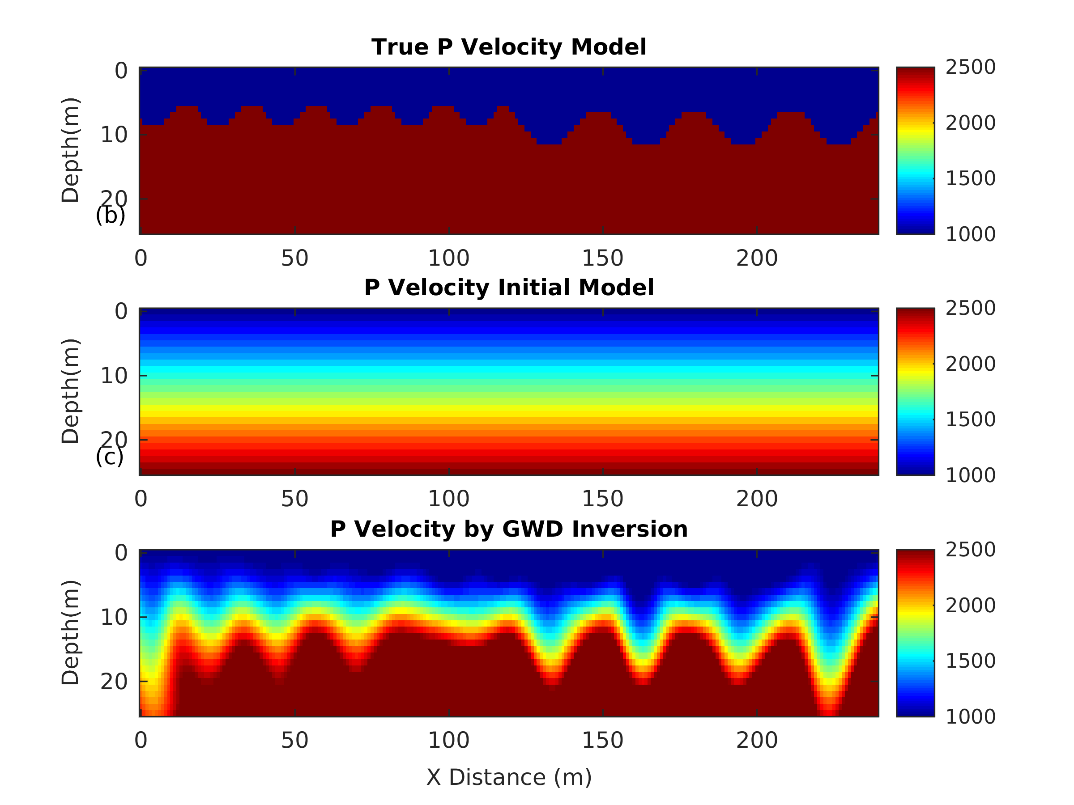
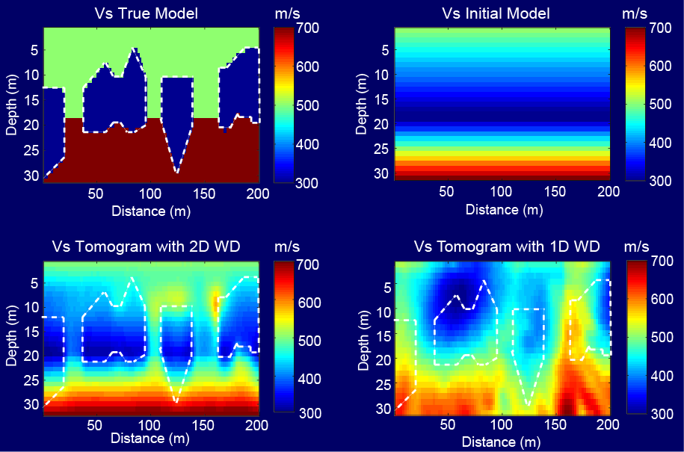
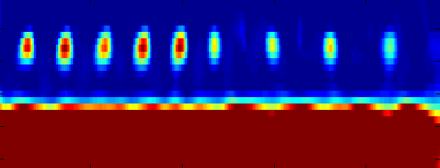
Wave Equation Dispersion Inversion of Guided P-Waves (WDG)
True P-velocity Model
Parameter:
• V1=1000 m/s V2=2500 m/s.
• f=40 Hz,
• Dominate wavelength=25 m
• Sr=60, Re=120;
0
20
40
z (m)
0 50 100 150 200
0
20
40
Starting P-velocity Model
2500
2000
1500
1000
λ=25m
z (m)
0 50 100 150 200
0
20
40
WDG P-velocity tomogram
z (m)
λ=25m
0 50 X(m) 150 200
Courtesy of Jing Li

Slide 12
Pred. vs Obs. CSGs
Pred. vs Obs. CSGs
obs. CSGs
.02 s
Observed
Inverted
.18 s
190
X (m)
Courtesy of Jing Li

Slide 13
Pred. vs Obs. Traces
0
0.1
0.2
Time (s)
0 200
X (m)
Courtesy of Jing Li

Slide 14
Outline
Motivation
Theory of Skeletonized Inversion
Example
Inverting V_{p} from Guided-Wave C(ω)
Synthetic Example with Machine Learning
Summary

Slide 15
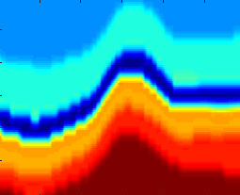
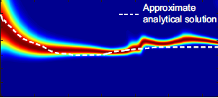
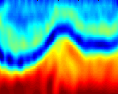

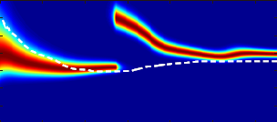
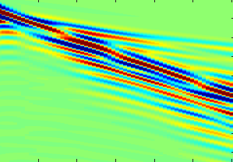
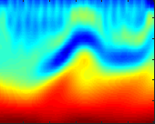
Wave Equation Dispersion Inversion of Guided P-Waves (WDG)
V_{s}
V_{s}
0.9
Kernel
SVM
FK Filter
+ Picking
30 m
C (km/s)
0.3
120 m
120 m
0.9
Pie
FK Filter
+ Manual
Picking
CSG
C (km/s)
0.4 s
0.3
120 m
120 m
ω
10 70

Slide 16
Outline
Motivation
Theory of Skeletonized Inversion
Example
Inverting V_{p} from Guided-Wave C(ω)
Field Data Example without Machine Learning
Summary

Slide 17
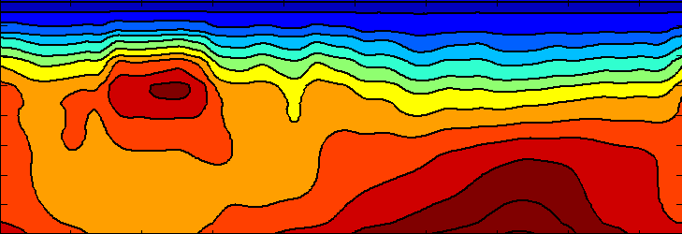
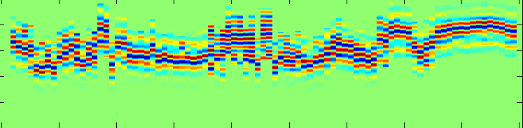
Wave Equation Dispersion Inversion of Guided P-Waves (WDG)
Ray Tracing P-velocity Tomogram
0
20
40
2900 m/s
1800 m/s
700 m/s
z (m)
0 150 300 450
COG Profile (x=20 m)
0
0.1
0.2
t (s)
0 150 300 450
WDG P-velocity Tomogram
0
20
40
2900 m/s
1800 m/s
700 m/s
z (m)
0 150 X (m) 450
Courtesy of Jing Li

Slide 18
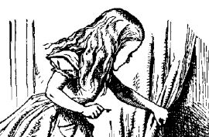
Summary
FWI
Input
Data d
[L^{T}L]⁻¹L^{T}
Model
m
Skeletonized
Wave Eqn. Inv.
Unsupervised
Input
Data d
Skeletal
Features
[L^{T}L]⁻¹L^{T}
Model
m
Neural
Network
Target
Model
m
Input
Data d
Machine
Learning
Machine
Learning
Features

Slide 19
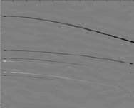

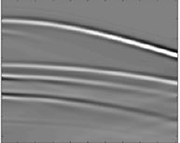


Summary
FWI
Input
Data d
[L^{T}L]⁻¹L^{T}
Model
m
Skeletonized
Wave Eqn. Inv.
Unsupervised
Input
Data d
Skeletal
Features
[L^{T}L]⁻¹L^{T}
Model
m
Skeletal
Features
Machine
Learning
Neural
Network
Unsupervised
NN
Target
Model
m
Input
Data d
Input
Data d
Machine
Learning
Machine
Learning
Features

Slide 20






Thanks to sponsors of CSIM
consortium

Slide 21
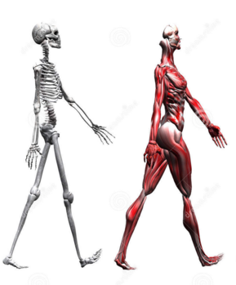
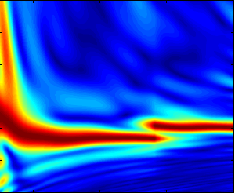
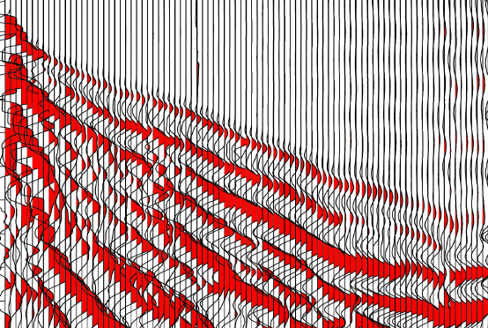

Summary
but typically less resolution
1. Skeletonize data → more robust convergence but typically less resolution
complex
complex
simple
complex
simple
Dispersion
curve
t
C(k_{x} )
x
kx
2.
Multidimensional implicit function theorem opens new doors
F(t, dz, AVO, df, c(w), attr.,..)→ NxN equations
3. All that glitters is not gold:

