Slide 1
Multiscale and Layer-Stripping Wave-Equation Dispersion Inversion of Rayleigh Waves
Zhaolun Liu^{1,2} and Lianjie Huang¹
¹Geophysics Group, Los Alamos National Laboratory, Los Alamos, NM 87545, USA
²King Abdullah University of Science and Technology (KAUST), Saudi Arabia
Notes:
Hi everyone, I am Zhaolun. Today, I will present my recent work “Layer-stripping ….”. The work is done during my internship at Los Alamos National Laboratory.

Slide 2
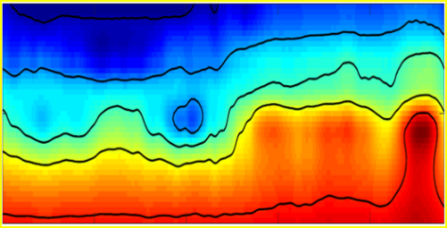
Outline
Local minima
Motivation
Theory
Numerical Examples
Conclusions
m
Global minima
X (m)
1
Z (m)
2
3
S-velocity Tomo.
0
z (km)
0.25
0
x (km)
4
Notes:
Firstly, I will introduce my outline.

Slide 3
Outline
Motivation
Theory
Numerical Examples
Conclusions
Local minima
m
Global minima

Slide 4
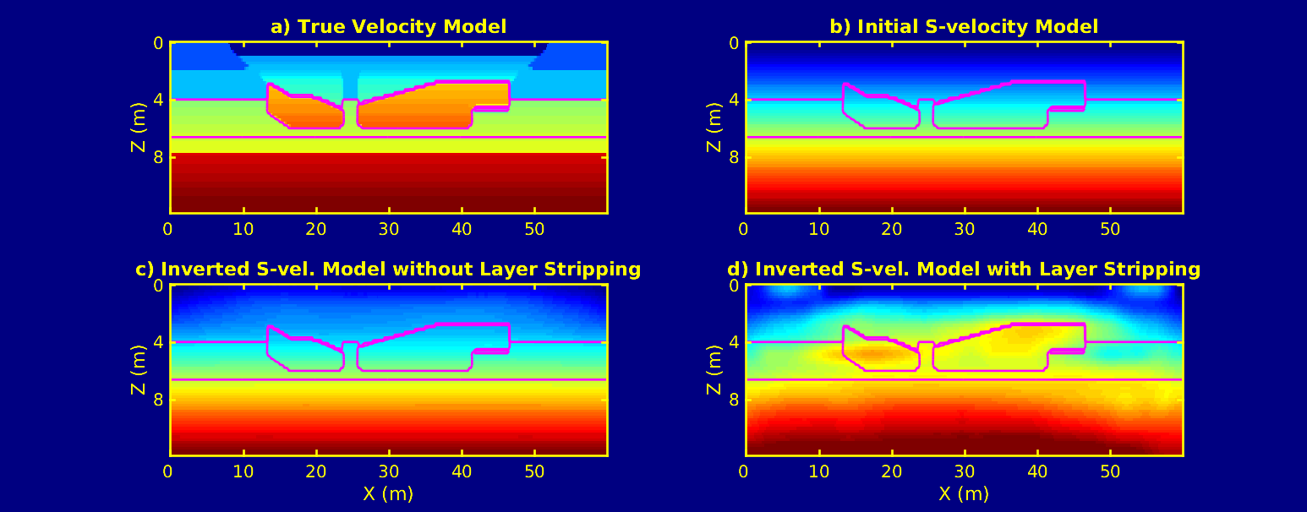
Motivation
Problem: the wave-equation dispersion inversion (WD) of Rayleigh waves could converge to a local minimum.
Local minima
True S-velocity Model
S-velocity Tomogram
0
340
0
z (m)
z (m)
S-velocity (m/s)
x
12
12
0
x (m)
60
164
0
x (m)
60
Global minimum
S-velocity Tomogram
Solutions:
Multiscale strategy
Layer-stripping approach
0
z (m)
12
0
x (m)
60
Notes:
Our problem is that “the wave-equation dispersion inversion (WD) of Rayleigh waves gets stuck in a local minimum.” in some complicate medium. For example, we have a true model and this is a s-vel. Tomo., we cannot see these two anomalies.
The solutions are: Multiscale strategy + Layer-stripping approach. Hopefully, we can get the global minimum.
]

Slide 5
Outline
Motivation
Theory
Numerical Examples
Conclusions
X (m)
1
Z (m)
2
3
Notes:
Next I will introduce the theory part.

Slide 6
Wave-equation Dispersion Inversion (WD) Method
Dispersion Curves
1) Misfit Function
c (m/s)
2) Gradient
f (Hz)
Backpropagated field
Source field
3) Velocity Update
Notes:
First, I will introduce the method of “wave equation dispersion inversion”, denoted by WD.

Slide 7
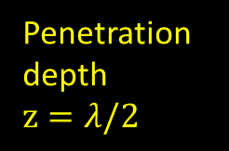

Multi-scale and Layer-stripping Strategies for Surface Wave Inversion
High-freq. surface wave
Short offset
range $∆X=3.5λ$
S-Velocity Tomogram
X (m)
1
Freeze shallow region
Penetration depth $z=λ/2$
2
Z (m)
3
4

Slide 8

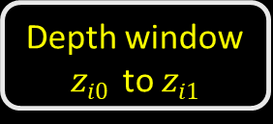





Workflow for Layer-stripping WD
Raw Data
N freq. bands
Dispersion Curves
$$f\text{i}\text{0}$$
$$c\text{i}0$$
$$f\text{i}1$$
c (m/s)
For i-th freq. band, do:
$$c\text{i}1$$
f (Hz)
$λ=c/f$: $λ\text{i}\text{0} to λ\text{i}\text{1}$
Previous update
Offset range
S-velocity Tomogram
z_{i0}
v_{i}
z_{i1}
Offset $ΔX$: $ΔX=3.5λmax$
Depth window $zi0$ to $zi1$
Penetration depth
Inverted model v_{i}

Slide 9
Outline
Motivation
Theory
Numerical Examples
Conclusions
S-velocity Tomo.
0
z (km)
0.25
0
x (km)
4

Slide 10
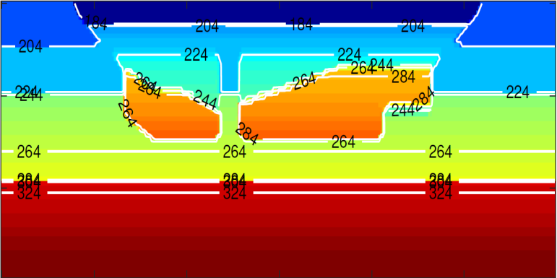
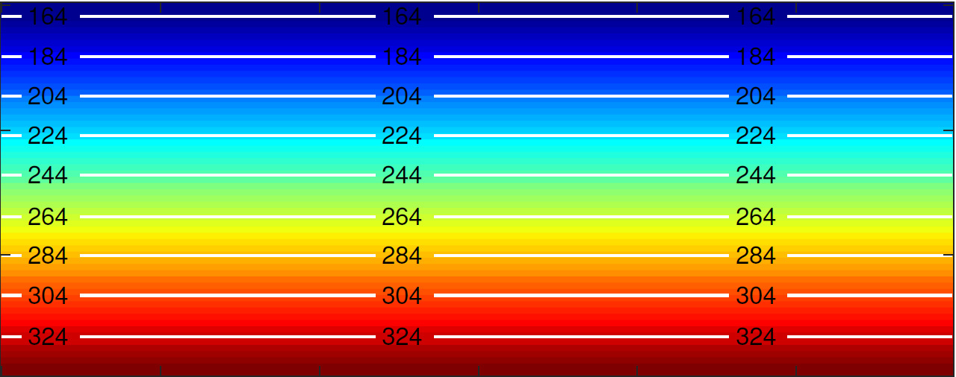
Synthetic Tests
True S-velocity Model
Acquisition Parameters
0
40 sources:
1.5 m spacing and z=0.2 m
150 receivers:
1 m spacing and z=0.2 m
Ricker wavelet (40 Hz)
z (m)
340
12
0
x (m)
60
S-velocity (m/s)
Initial S-velocity Model
0
164
z (m)
12
0
x (m)
60

Slide 11
Synthetic Tests
True S-velocity Model
True S-velocity Model
0
0
Acquisition Parameters
40 sources:
1.5 m spacing and z=0.2 m
150 receivers:
1 m spacing and z=0.2 m
Ricker wavelet (40 Hz)
z (m)
340
z (m)
340
12
12
0
x (m)
60
0
x (m)
60
S-velocity (m/s)
S-velocity (m/s)
Initial S-velocity Model
Initial S-velocity Model
0
0
164
164
z (m)
z (m)
12
12
0
x (m)
60
0
x (m)
60

Slide 12
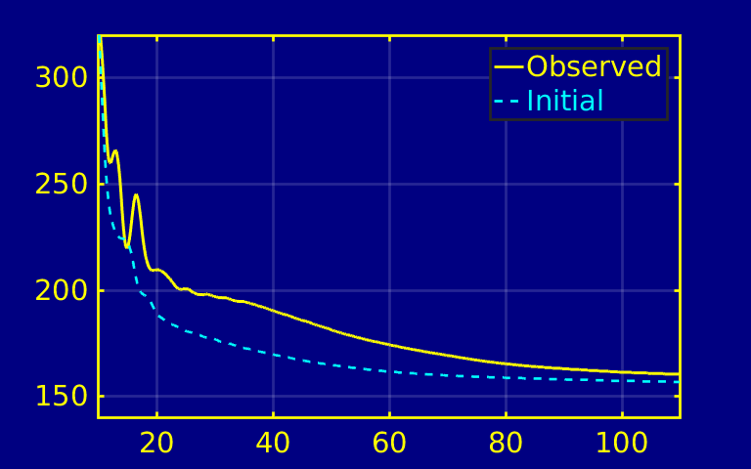
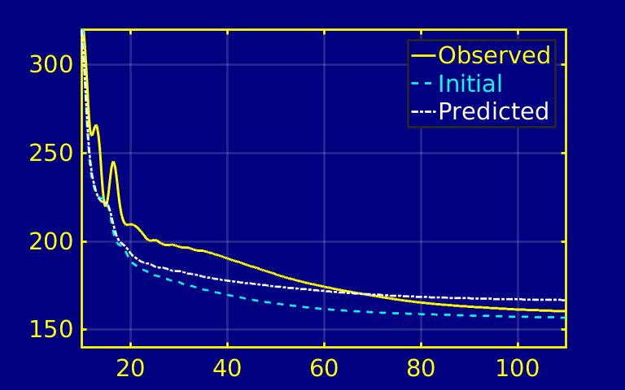

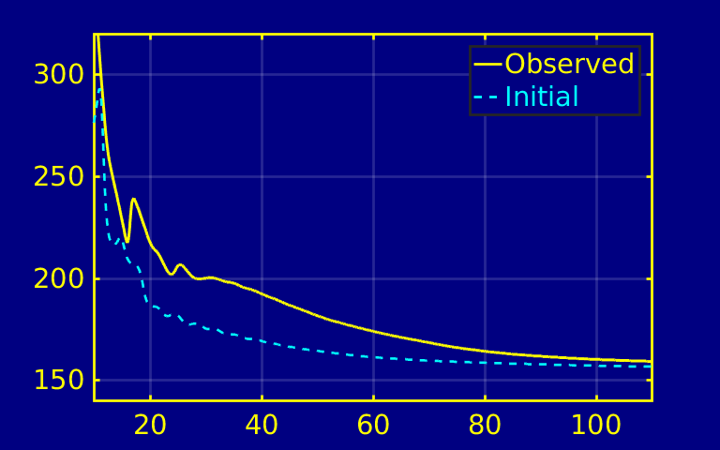
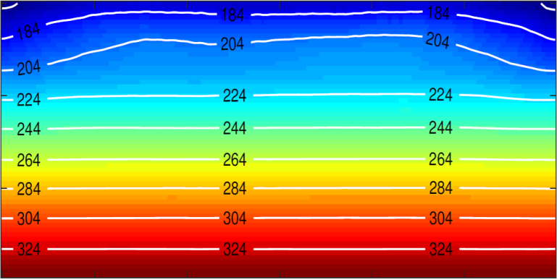

Standard WD Test
WD stuck in a local minimum
Dispersion Curve Comparison
True S-velocity Model
Offset $ΔX$=20 m
320
0
CSG No.11
Observed
Initial
c (m/s)
Predicted
z (m)
340
12
140
10
f (Hz)
110
0
60
S-velocity (m/s)
Initial S-velocity Model
320
S-velocity Tomogram
CSG No. 21
0
Observed
Initial
164
c (m/s)
Predicted
z (m)
140
12
10
f (Hz)
110
0
x (m)
60

Slide 13
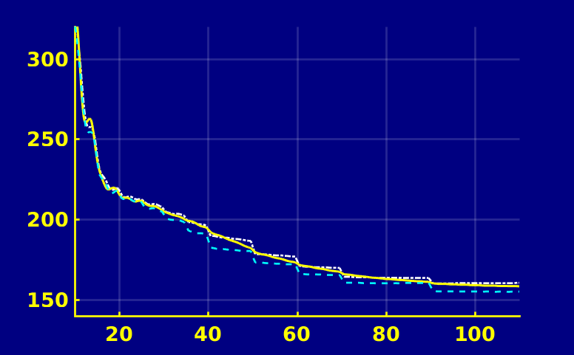
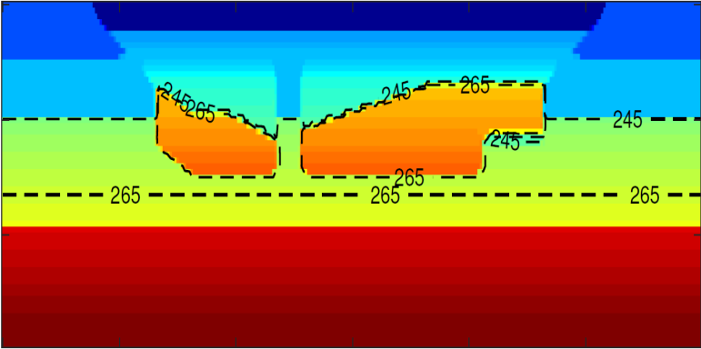
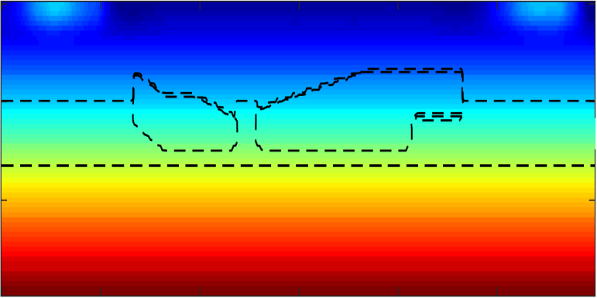
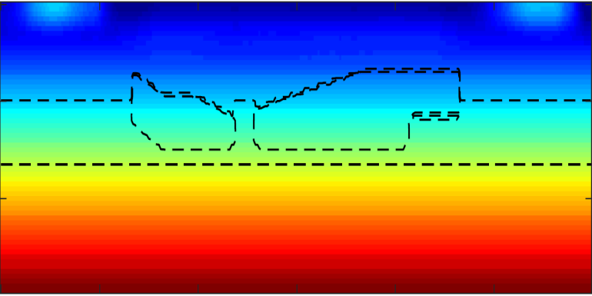
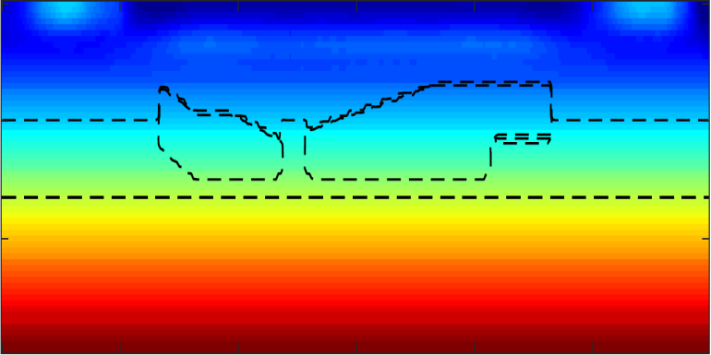
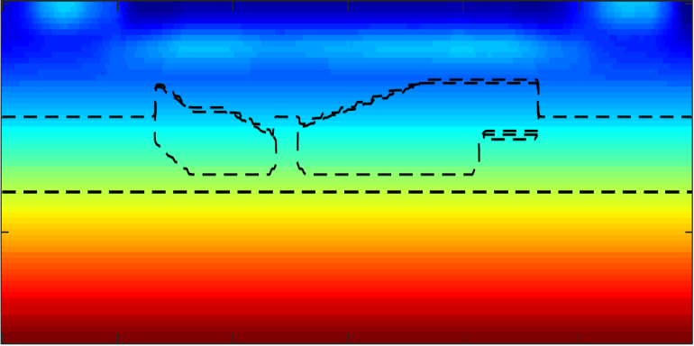
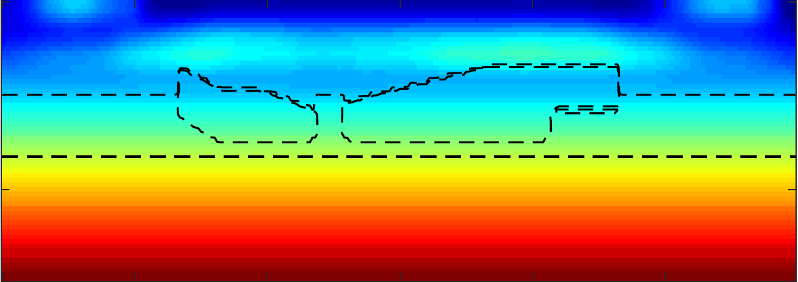
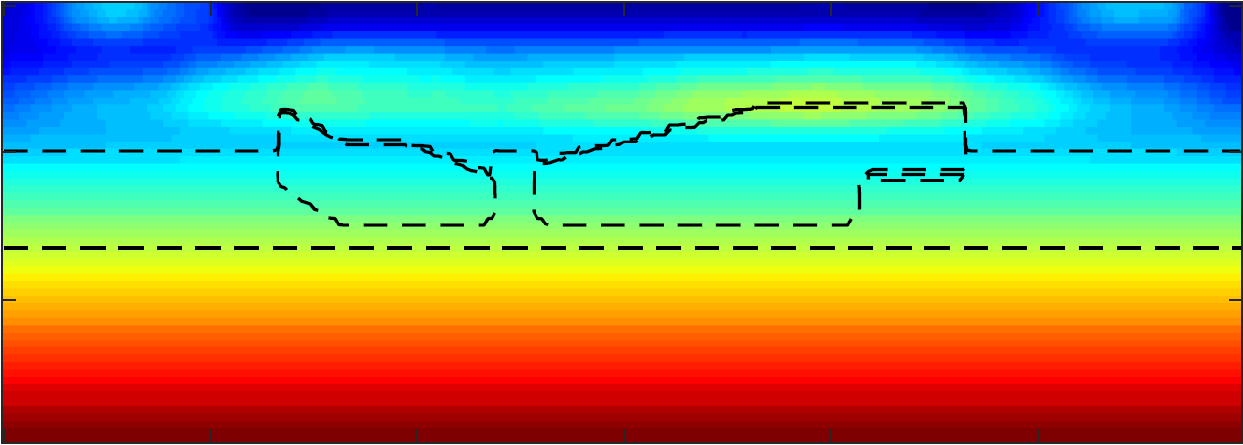
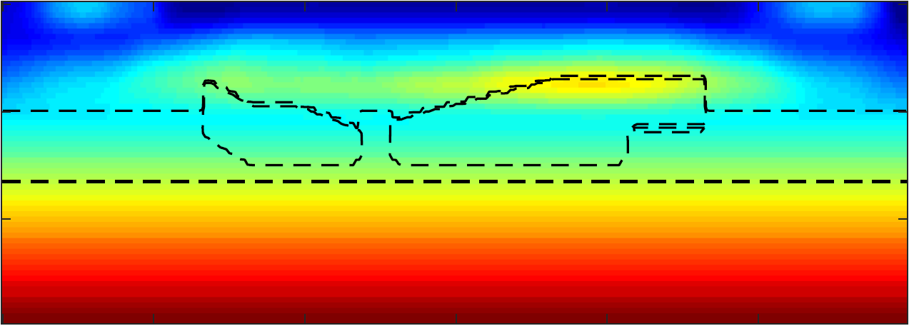
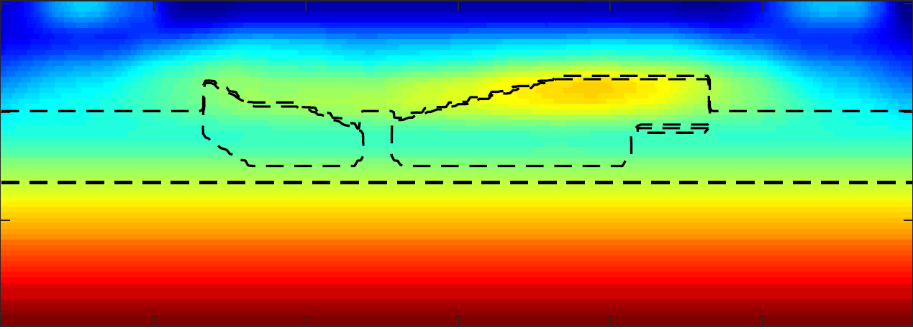
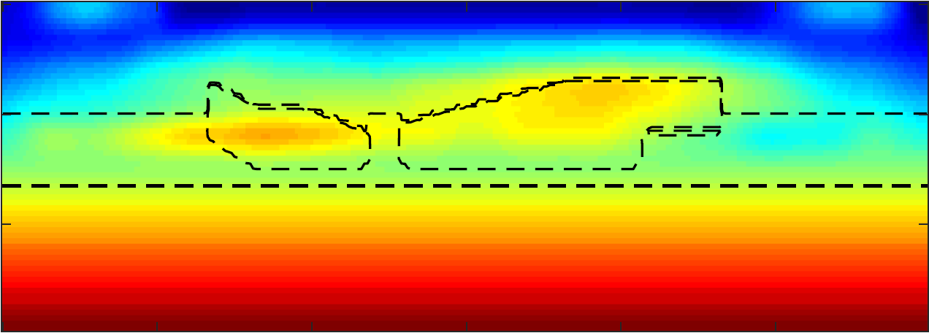
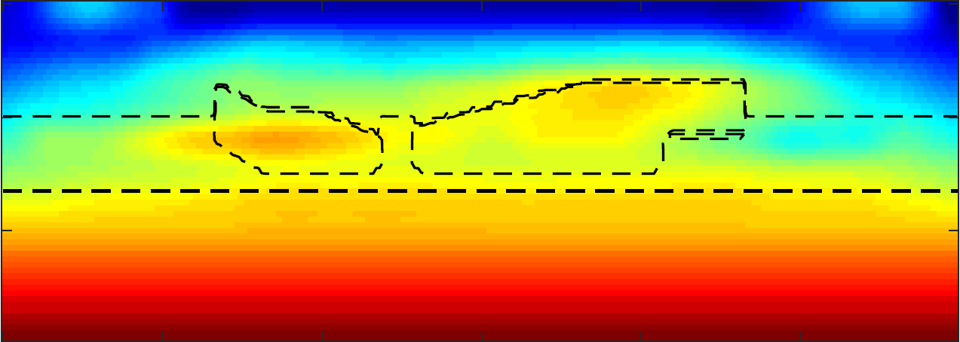
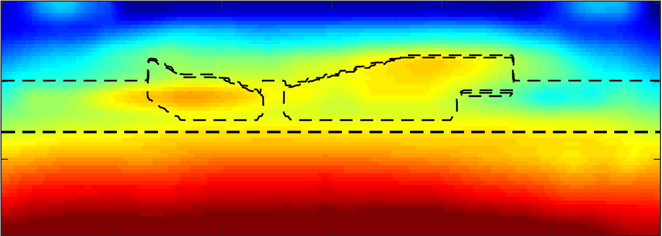










Layer-stripping WD Test
Dispersion Curve Comparison
True S-velocity Model
320
0
CSG No.11
Observed
Initial
c (m/s)
Predicted
z (m)
340
12
140
0
60
10
f (Hz)
110
S-velocity (m/s)
S-vel. Tomo.: 90-110Hz , $∆X$=7m
S-vel. Tomo.: 70-90 Hz , $∆X$=9m
S-vel. Tomo.: 60-70 Hz , $∆X$=11m
S-vel. Tomo.: 50-60 Hz , $∆X$=13m
S-vel. Tomo.: 40-50 Hz , $∆X$=17m
S-vel. Tomo.: 35-40 Hz , $∆X$=21m
S-vel. Tomo.: 30-35 Hz , $∆X$=24m
S-vel. Tomo.: 25-30 Hz , $∆X$=30m
S-vel. Tomo.: 20-25 Hz , $∆X$=37m
S-vel. Tomo.: 15-20 Hz, ∆𝑋=46m
S-vel. Tomo. : 10-15 Hz, $∆X$=60m
Initial S-velocity Model
0
164
z (m)
12
0
x (m)
60

Slide 14
Layer-stripping WD Test
Dispersion Curve Comparison
True S-velocity Model
320
0
CSG No.11
Observed
Initial
c (m/s)
Predicted
z (m)
340
12
140
0
60
10
f (Hz)
110
S-velocity (m/s)
S-vel. Tomo.: 90-110Hz , $∆X$=7m
S-vel. Tomo.: 70-90 Hz , $∆X$=9m
S-vel. Tomo.: 60-70 Hz , $∆X$=11m
S-vel. Tomo.: 50-60 Hz , $∆X$=13m
S-vel. Tomo.: 40-50 Hz , $∆X$=17m
S-vel. Tomo.: 35-40 Hz , $∆X$=21m
S-vel. Tomo.: 30-35 Hz , $∆X$=24m
S-vel. Tomo.: 25-30 Hz , $∆X$=30m
S-vel. Tomo.: 20-25 Hz , $∆X$=37m
S-vel. Tomo.: 15-20 Hz, ∆𝑋=46m
S-vel. Tomo. : 10-15 Hz, $∆X$=60m
Initial S-velocity Model
0
164
z (m)
12
0
x (m)
60

Slide 15
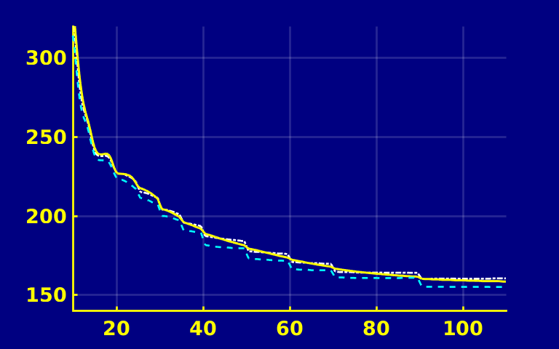
Layer-stripping WD Test
Dispersion Curve Comparison
True S-velocity Model
320
0
CSG No.11
Observed
Initial
c (m/s)
Predicted
z (m)
340
12
140
0
60
10
f (Hz)
110
S-velocity (m/s)
S-vel. Tomo.: 90-110Hz , $∆X$=7m
S-vel. Tomo.: 70-90 Hz , $∆X$=9m
S-vel. Tomo.: 60-70 Hz , $∆X$=11m
S-vel. Tomo.: 50-60 Hz , $∆X$=13m
S-vel. Tomo.: 40-50 Hz , $∆X$=17m
S-vel. Tomo.: 35-40 Hz , $∆X$=21m
S-vel. Tomo.: 30-35 Hz , $∆X$=24m
S-vel. Tomo.: 25-30 Hz , $∆X$=30m
S-vel. Tomo.: 20-25 Hz , $∆X$=37m
S-vel. Tomo.: 15-20 Hz, ∆𝑋=46m
S-vel. Tomo. : 10-15 Hz, $∆X$=60m
320
Initial S-velocity Model
CSG No. 21
0
Observed
Initial
164
c (m/s)
Predicted
z (m)
140
12
10
f (Hz)
110
0
x (m)
60

Slide 16
Standard VS. Layer-stripping WD
Standard WD Dispersion Curves
Layer-stripping WD Dispersion Curves
320
320
CSG No.11
Observed
Initial
CSG No.11
Observed
Initial
c (m/s)
Predicted
Predicted
c (m/s)
140
140
10
f (Hz)
110
10
f (Hz)
110
320
CSG No. 21
320
CSG No. 21
Observed
Initial
Observed
Initial
c (m/s)
Predicted
c (m/s)
Predicted
140
140
10
f (Hz)
110
10
f (Hz)
110

Slide 17
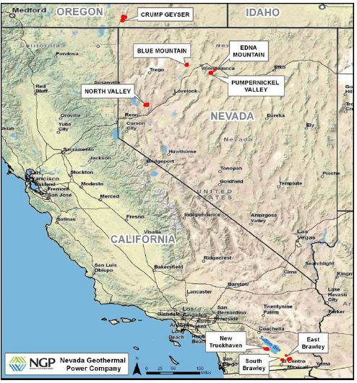
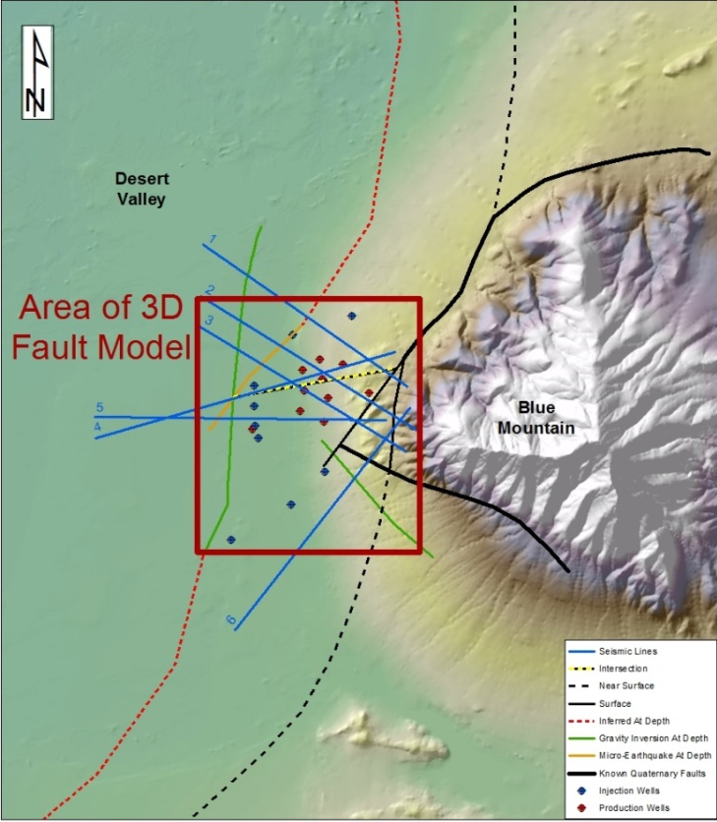
Blue Mountain Geothermal Field in Nevada
Blue Mountain
Line 1
1 mile

Slide 18
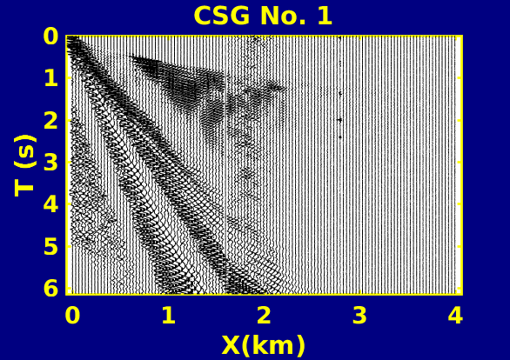
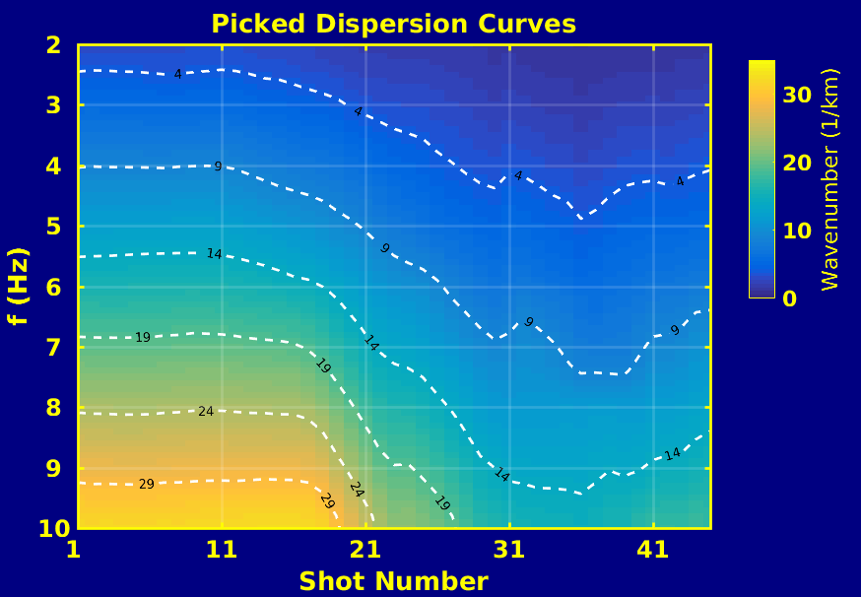
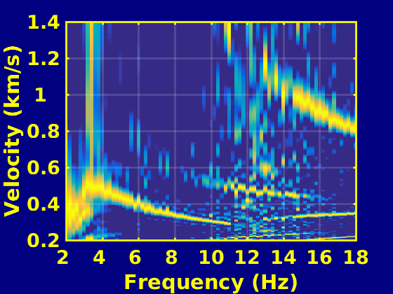
Blue Mountain Surface Seismic Data
CSG No. 1
Acquisition Parameters
0
57 dynamite sources: 67 m spacing
121 receivers: 33.5 m spacing
Record time: 6 s
3
T (s)
1
2
6
0
x (km)
4
Dispersion Curve for CSG No.1
Picked Dispersion Curve for All CSGs
1.4
30
3
Dispersion Contours
c (km/s)
1
2
k (1/km)
0.2
0
2
10
18
2
f (Hz)
1
2
3
47
f (Hz)
Shot No.

Slide 19
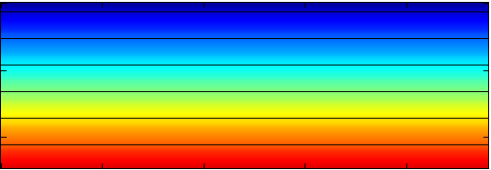
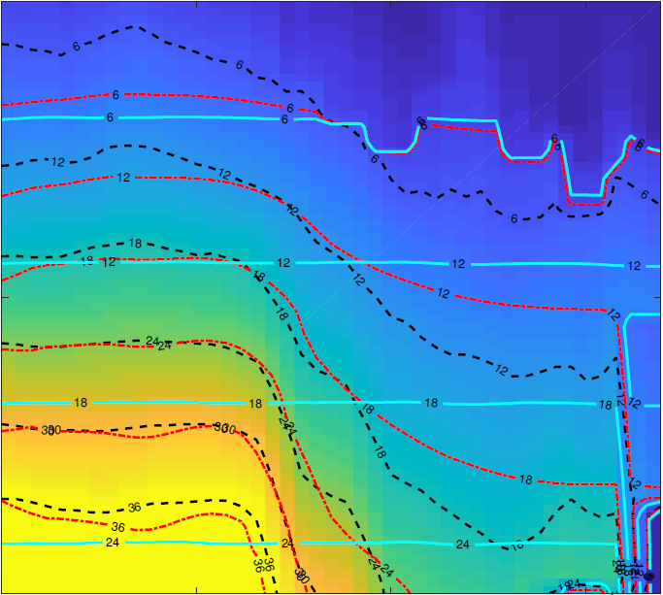
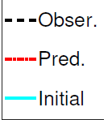
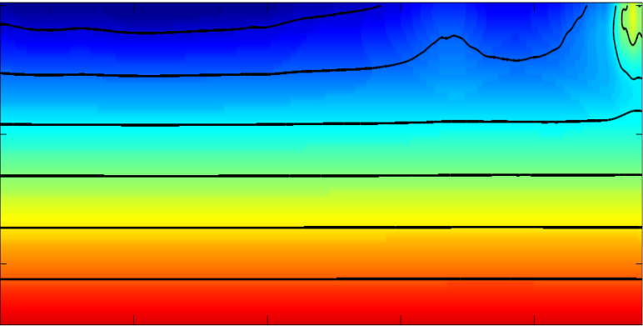


Standard WD Results
Initial S-velocity Model
Offset $ΔX$=1 km
0
Dispersion Contours Comparison
2
36
2
z (m)
1.7
$κ$ (1/km)
f (Hz)
f (Hz)
0
250
0
4
S-velocity (km/s)
Inverted S-velocity Tomo.
0
0.3
10
10
z (m)
1
Shot No.
47
250
0
x (km)
4

Slide 20
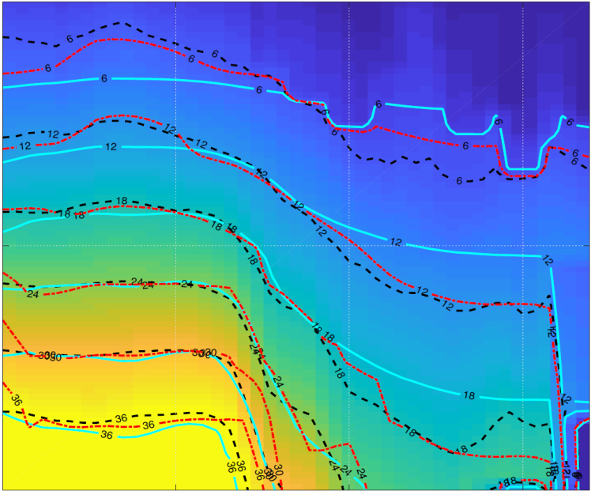
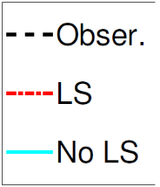
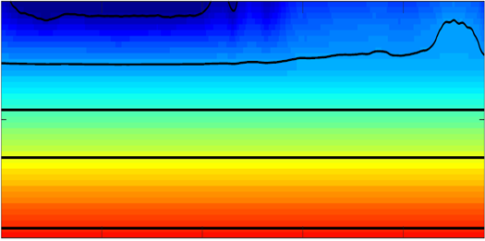
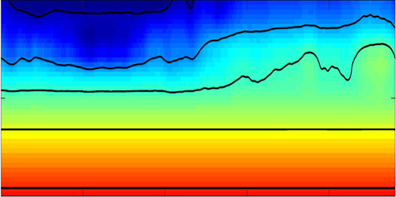
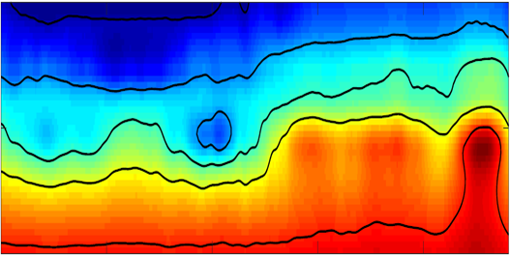
Layer-stripping WD Results
Initial S-velocity Model
0
Dispersion Contours Comparison
2
36
z (m)
1.5
$κ$ (1/km)
f (Hz)
0
200
0
4
S-velocity (km/s)
Inverted S-velocity Tomo. (4-8 Hz)
Inverted S-velocity Tomo. (2-6 Hz)
Inverted S-velocity Tomo. (6-10 Hz)
0
0.28
10
z (m)
1
Shot No.
47
200
0
x (km)
4

Slide 21
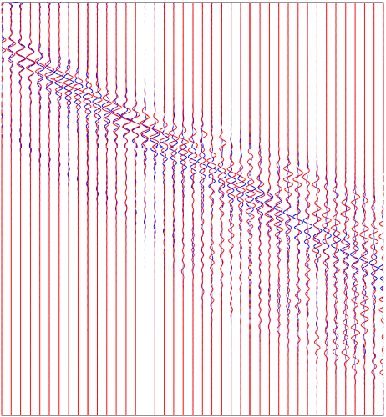
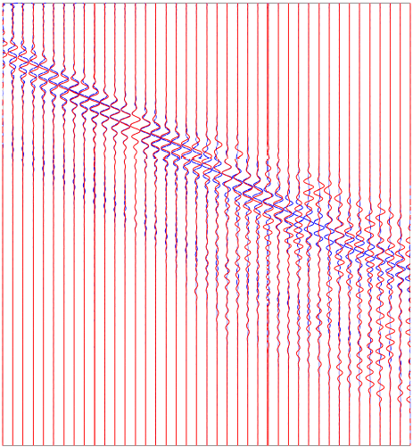
Accuracy of the Results
Layer-stripping WD
Traditional WD
0
0
Comparison of Common Offset Gather
(match filter)
Red: Observed
Blue: Predicted
T (s)
T (s)
6.14
6.14
110
70
110
70
Trace No.
Trace No.

Slide 22
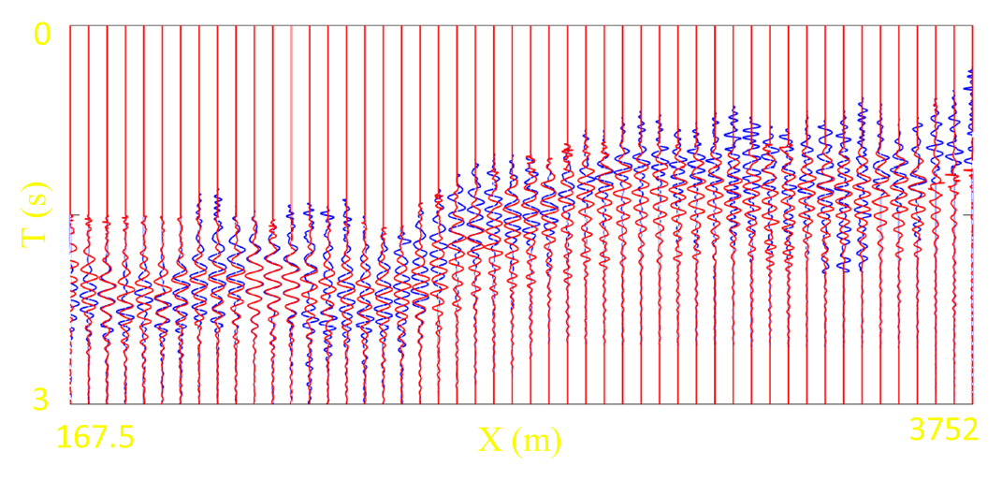
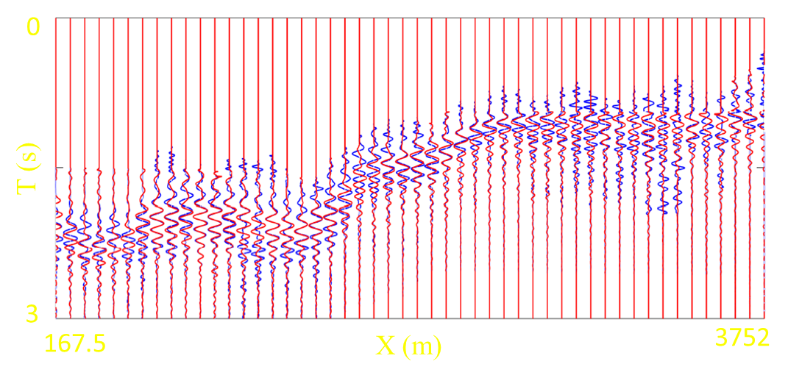
Accuracy of the Results
Comparison of Common Offset Gather with match filter
Layer-stripping WD (X=335m)
Traditional WD (X=335m)
Blue: Observed
Red: Predicted

Slide 23
Outline
Motivation
Theory
Numerical Examples
Conclusions

Slide 24
Conclusions
We have developed a new multiscale and layer-stripping wave-equation dispersion inversion method for Rayleigh waves.
It can mitigate the local minima problem of wave-equation dispersion inversion of surface waves.
Limitations: Frequency bands Depth windows

Slide 25
Acknowledgments
This work was supported by U.S. Department of Energy through contract DE-AC52-06NA25396 to Los Alamos National Laboratory (LANL).
The computation was performed using super-computers of LANL's Institutional Computing Program.
Additional computational resources were made available through the KAUST Supercomputing Laboratory (KSL).

Slide 26
Thank you for your attention!

