Slide 1
Language Learning by Experience and Rules
Language Learning by Experience
Language Learning by Rules
To be or not to be,
that is the question
me hungry
Newtonian Machine Learning
Machine Learning by Experience
Inversion of Skeletal Features by Wave Equation Rules
Input Data
d
Skeletal
Features
Model
m
[L^{T}L]⁻¹L^{T}

Slide 2
Seismic Inversion by Newtonian Machine Learning
Yuqing Chen^{(1,2)} , Han Yu^{(1,3)} and Gerard Schuster⁽¹⁾
King Abdullah University of Science and Technology
Deep Earth Imaging, Future Science Platform, CSIRO
Nanjing University of Posts and Telecommunications

Slide 3
Outline
Waveform Misfit V.S. Velocity
Traveltime Misfit V.S. Velocity
1.0
1.0
Motivations
Theory of Inversion
Numerical Results
Discussions
Normalized Misfit
Normalized Misfit
0.0
0.0
2.4
3.4
2.4
3.4
Velocity (km/s)
Velocity (km/s)
True Model
Inverted Model
m/s
0
0
2350
Depth (km)
Depth (km)
2
2
2000
0
1
0
1
X (km)
X (km)

Slide 4
Outline
Waveform Misfit V.S. Velocity
Traveltime Misfit V.S. Velocity
1.0
1.0
Motivations
Theory of Inversion
Numerical Results
Discussions
Normalized Misfit
Normalized Misfit
0.0
0.0
2.4
3.4
2.4
3.4
Velocity (km/s)
Velocity (km/s)

Slide 5
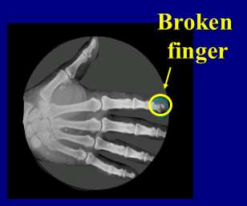
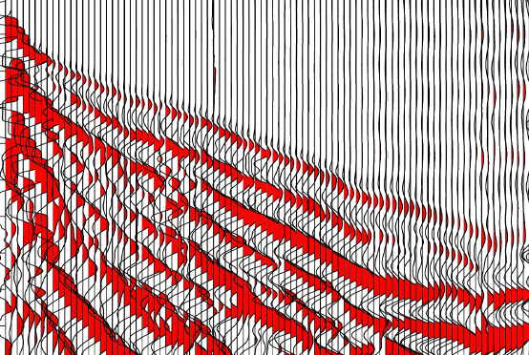
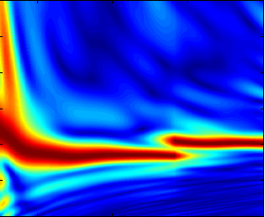
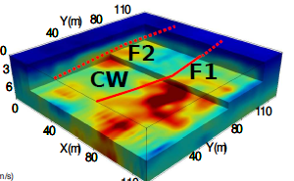
Motivation
FWI suffers from cycle-skipping problem. Skeletonize the data can reduce the non-linearity.
Complex
Simple
Broken Figure
Waveform Misfit V.S. Velocity
Traveltime Misfit V.S. Velocity
1.0
1.0
Shot Gather
Dispersion Curve
Normalized Misfit
Normalized Misfit
Time (s)
0.0
C
0.0
2.4
Velocity (km/s)
3.4
2.4
Velocity (km/s)
3.4
Traces
k_{x}

Slide 6
Outline
Motivations
Theory of Inversion
Numerical Results
Discussions

Slide 7
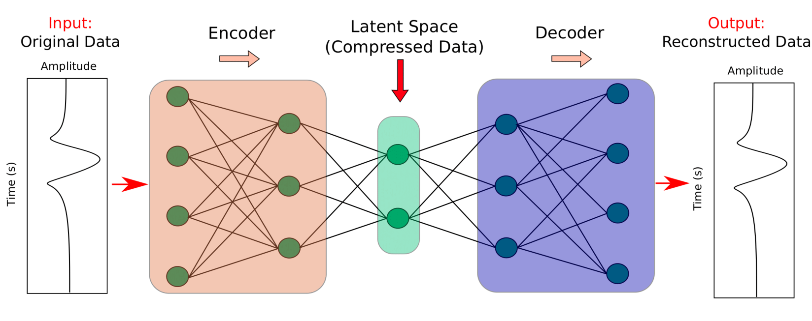
Autoencoder
What is autoencoder?
Encoder : Compress high-dimension input data into low-dimension representation by a series of neural layer with decreasing number of neurons.
Latent Space : The lowest dimension space in which the input data is reduced and the key information is preserved
Decoder: Reconstructs the input data from the latent space representation by a series of neural network layers with an increasing number of neurons

Slide 8
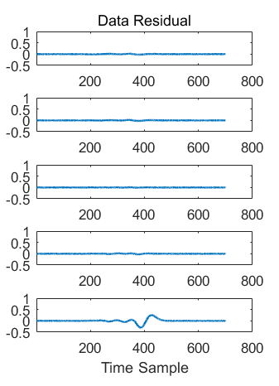
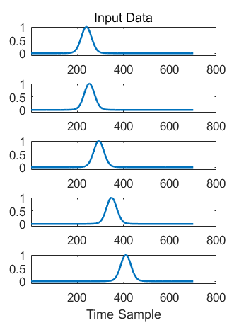
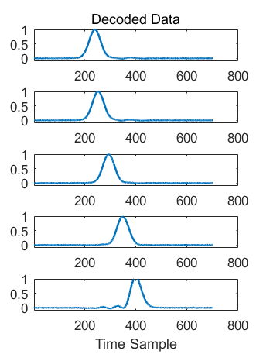
Find Skeletal Info by Autoencoder
Find the skeletonized representation of seismic signals.
Is the autoencoder well-trained? (the output should as same as the input)
$$90 ×1$$
$$90 ×1$$
$$200 ×1$$
$$200 ×1$$
$$700 ×1$$
$$700 ×1$$

Slide 9
Find Skeletal Info by Autoencoder
How are the latent variables related to the velocity inversion?
Latent Space
Obs Data
Velocity is wrong!
Pred. Data
$$∆l$$
$$⋮$$
$$⋮$$

Slide 10
Find Skeletal Info by Autoencoder
How the latent variables related to the velocity inversion?
Latent Space
Obs Data
Velocity is correct!
$∆l$=0
Syn Data
$$⋮$$
$$⋮$$

Slide 11
Skeletonized Inversion with Autoencoder
Latent space coefficients
Misfit Function
$$ε={\left\|l_{obs}−l_{syn}\right\|}_{2}^{2}$$
Gradient and Updates
Implicit function theorem
(Luo and Schuster, 1991)
FWI Frechet Derivative
v^{k+1)} = v^{(k)} – α $\frac{∂ε}{∂v}$
$$\frac{∂ε}{∂v}={\left(\frac{∂l_{syn}}{∂v}\right)}^{T}∆l$$
$$\frac{∂ε}{∂v}={\left(\frac{∂p}{∂v}\right)}^{T}\dot{p}∆l$$
$$\frac{∂p}{∂v}$$
connect
$$\frac{∂l}{∂v}$$
Inversion Strategy

Slide 12
Outline
Motivations
Theory of Inversion
Numerical Results
Discussions
True Model
Inverted Model
m/s
0
0
2350
Depth (km)
Depth (km)
2
2
2000
0
1
0
1
X (km)
X (km)

Slide 13
Synthetic Test: Layer Model
(a) True Velocity Model
(b) Initial Velocity Model
0
0
Source: Ricker wavelet (15 Hz)
Source well: 99 shots/ ds=20m/ x=10 m
Depth (km)
Depth (km)
Receiver well: 200 shots/ dg=10m/ x=1000 m
Simulation time: 2s/ dt = 1ms
2
2
0
1
0
1
X (km)
X (km)
2000
2350
m/s

Slide 14
Synthetic Test: Layer Model
Training set: the training set includes 4000 observed seismic traces because every five shots we take one shot gather as part of the training set.
The autoencoder network for training

Slide 15
Synthetic Test: Layer Model
Training set: the training set includes 4000 observed seismic: 1/5 of the CSGs
~Equivalent to Wave Equation Traveltime Inversion of 1st Arrivals, Except no Picking/Correlation
True Velocity Model
Inverted Velocity Model
Vel at 0.4 km
Vel at 0.6 km
0
0
0
Depth (km)
Depth (km)
Depth (km)
2
2
2
0
1
0
1
2000
2200
2000
2200
X (km)
X (km)
Velocity (m/s)
Velocity (m/s)

Slide 16
Synthetic Test: Sinusoid Model
True Velocity Model
CSG
0
Depth (m)
25
0
120
X (m)
True Velocity Model
0
WT Gradient
Newtonian ML Gradient
Newtonian ML Tomogram
WT Tomogram
Depth (m)
25

Slide 17
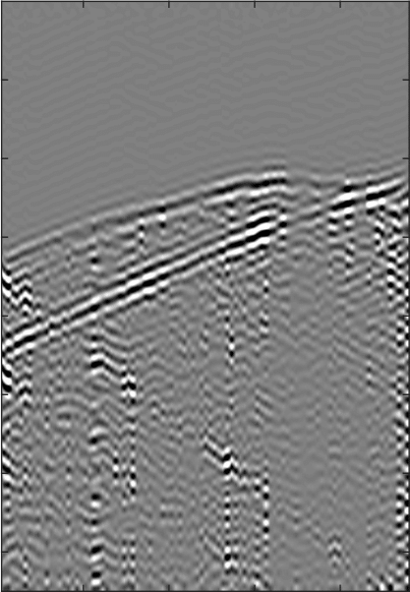
Friendswood Crosswell Field Data
Processed CSG
0.05
Two 305-m-deep cased wells separated by 183 m were used as the source and receiver well.
Source well: ds = 3m from 9 m to 305 m
Receiver well: 96 receivers from 3 m to 293 m
Time (s)
Data process: (1) Low-pass filtered to 100 Hz with a peak frequency
of 58 Hz.
(2) We mainly focus the inversion on the transmitted
arrivals by windowing the input data around the
early arrivals.
0.35
20
80
Traces

Slide 18
Friendswood Crosswell Field Data
Initial Velocity Model
Inverted Velocity Model
m/s
0
0
2400
Depth (m)
Depth (m)
305
305
1600
0
183
0
183
X (m)
X (m)

Slide 19
Friendswood Crosswell Field Data
Encoded Value of Initial Data
Encoded Value of Inverted Data
20
20
Sources
Sources
Encoded Value of Observed Data
80
80
20
Misift between Obs and Ini Data
Misift between Obs and Inv Data
Sources
80
20
20
20
80
Sources
Sources
Receivers
80
80

Slide 20
Outline
Motivations
Theory of Inversion
Numerical Results
Summary
True Model
Inverted Model
m/s
0
0
2350
Depth (km)
Depth (km)
2
2
2000
0
1
0
1
X (km)
X (km)

Slide 21
Summary
Language Learning by Experience
Language Learning by Rules
To be or not to be,
that is the question
me hungry
Newtonian Machine Learning
Inverted Velocity Model
Wave-path
Autoencoder
$$\frac{∂p}{∂t}+ρc^{2}∇∙v=S$$
$$\frac{1}{ρ}∇p+\frac{θv}{∂t}=0$$
Mitigate cycle skipping | No picking | Provide good initial model for FWI

Slide 22
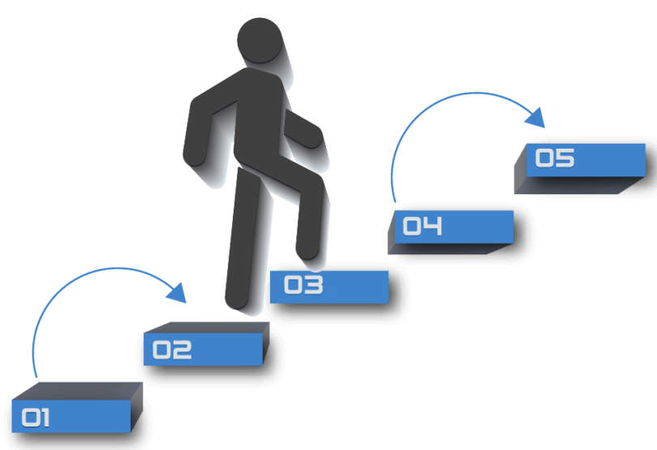
Summary
Limitations:
Model Resolution
Increase the dimension of latent space

Slide 23
Autoencoder
What is autoencoder?
An ideal autoencoder neural network seeks to identify the common characteristic of all training examples in the training set and encapsulates these within the encoder and decoder functions.
(2) The information contained in the latent space only that necessary to distinguish between individual examples in the dataset.

Slide 24
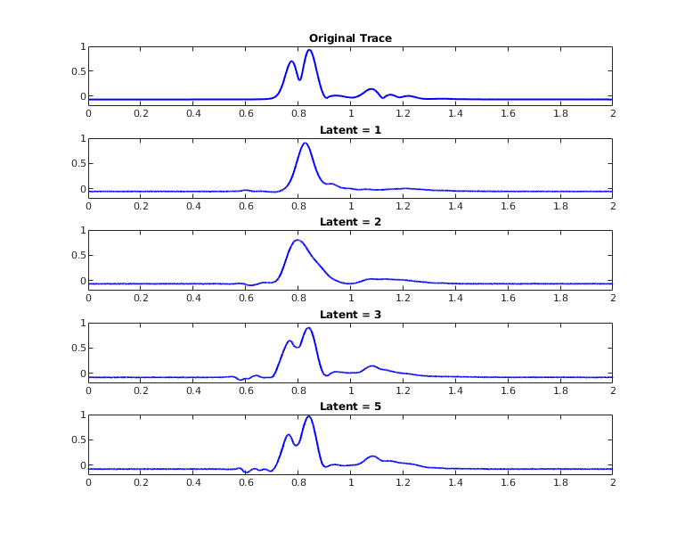
Summary
(1) Skeletal info extracted by autoencoder →more flexible than conventional skeletal data.
Model Resolution
Increase the dimension of latent space

Slide 25
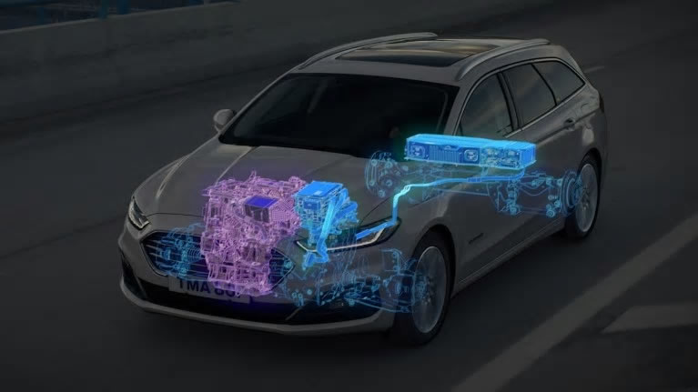
Summary
(2) Hybrid Inversion Strategy.
Hybrid Methods
Deterministic Methods
Machine Learning Methods
Machine Learning
Deterministic
Inverted Velocity Model
Wave-path
Autoencoder
Seismic Inversion by Newtonian Machine Learning
$$\frac{∂p}{∂t}+ρc^{2}∇∙v=S$$
$$\frac{1}{ρ}∇p+\frac{θv}{∂t}=0$$
Mitigate cycle skipping | No picking | Provide good initial model for FWI

Slide 26
Find Skeletal Info by Autoencoder
Find the skeletonized representation of seismic signals.
What the latent variable controls?
$$l=0$$
$$l=1$$
$$l=0$$
$$l=1$$
$$l=3$$
$$l=5$$
$$l=8$$
$$l=3$$
$$90 ×1$$
$$90 ×1$$
$$l=5$$
$$200 ×1$$
$$200 ×1$$
$$700 ×1$$
$$700 ×1$$
$$l=8$$

Slide 27
Synthetic Test: Sinusoid Model
WT Gradient
0
Depth (m)
25
Newtonian ML Gradient
0
Depth (m)
25
0
120
X (m)

Slide 28
Synthetic Test: Sinusoid Model
WT Tomogram
0
Depth (m)
25
Newtonian ML Tomogram
0
Depth (m)
25

