Slide 1
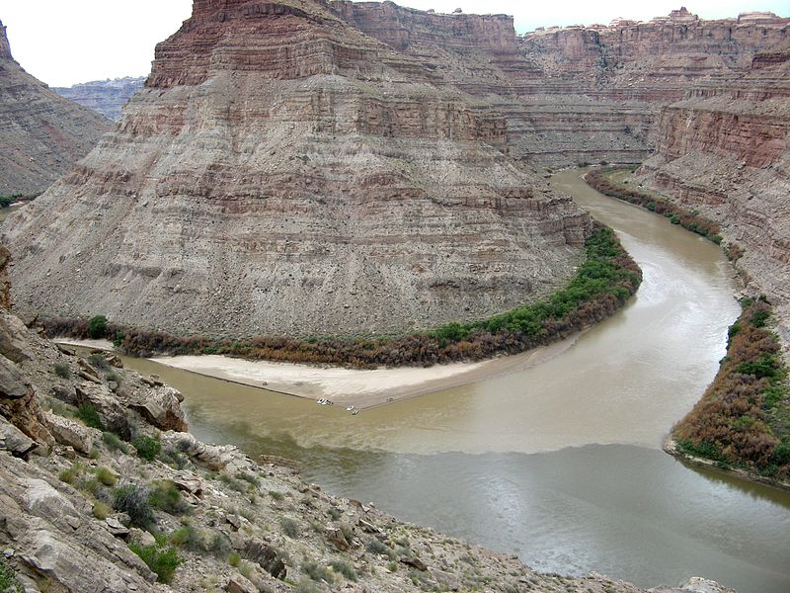
Multilayer Sparse LSM=Deep Neural Network
Zhaolun Liu and Gerard Schuster
KAUST
LSM
Neural Network LSM
Deep CNN
Notes:
In the last 30 years, we have seen very strong development in deep convolutional NN partically in commercial industry of machine translations, self-driving cars, image recogniation, medical diagnosis, and so on.
Also in the last 30 year, we see the developemtn of migration going to be improved by LSM. And now, we see them coming together last year or so. They are combining in our case for the first time, we call it “NNLSM” which combines the best of the both worlds, the strong statistic capability holding large data set from NN, as well as very strong predictive property of determintive physics LSM. Let’s see what’s mean by this.

Slide 2
Outline
Neural Networks & Sparse LSM
Neural Networks Least Squares Migration
Numerical Results
Summary
Notes:
This is my outline. First is the Motivation.
Then is the theory part, next is numerical Examples,
and finally is the conclusion.

Slide 3
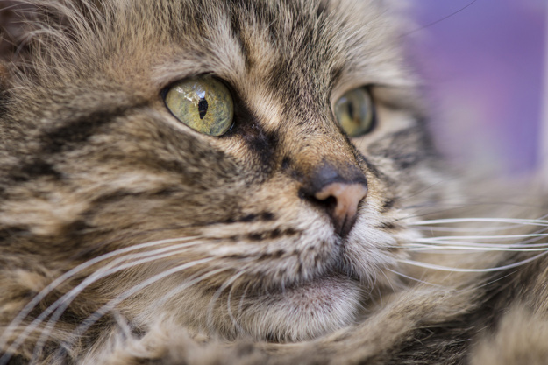
Single-Layer Neural Network
x
y
H₁
Σ
σ
1
0
If 1 then a cat
0
If 1 then a dog
Σ σ
1
.
.
.
.
.
.
.
.
.
.
.
.
Σ
σ
0
0
0
0
σ(H₁x)=ReLu(H₁x)
Σ
σ
H₁x
Matrix-vector multiplication
Task: learn weights, i.e. filters, in H₁
y=σ(H₁◦x)
Notes:
here, we see a single-layer nn, which is often used for picture classification in the commercial industry. The input is a pic of cat. They discretize it and the intensity value of each pixel is flattening into a talk vector. And we call it x. The output is much sparse representation, and we call it y, because it only classify it either a cat or not a cat. So, this vector on the right-hand side only contains a lot of zeros and few ones which corresponds to a cat or a dog. We can represent it mathematically. It’s very simple operation. We first take the weights H1, multiple the input vector x. Each output of the matrix-vector multiplication is threshold by sigma and we get the output vector y. The threshold function will be used in our neural network. It has 2-side relu function

Slide 4
FeedForward Neural Network
x
FeedForward Neural Network
y
.
.
.
.
Layer 1
Layer 2 Layer N-1 Layer N
.
.
.
H₁
H₂
H_{N}
Σ
σ
Σ
σ
Σ
σ
Σ
σ
1
Σ σ
Σ σ
Σ σ
Σ σ
0
.
.
.
.
.
.
.
.
.
.
.
.
.
.
.
.
.
.
.
.
.
Σ
σ
Σ
σ
Σ
σ
Σ
σ
0
LSM
.
.
.
0
Σ
σ
Σ
σ
Σ
σ
Σ
σ
Deep CNN
.
.
.
.
σ(H₁x)
σ(H₂σ(H₁x))
y=σ(H_{N}σ(…σ(H₁x))…)
Notes:
The single layer NN can be extended to multilayer NN. Each layer have the same operation as the matrix-vector multiplication. We do’t need to give much details in this. In the our experiments, we find that multilayer NN doesn’t give us desirable output compared to single layer NN. So, we will only talk about single layer.

Slide 5
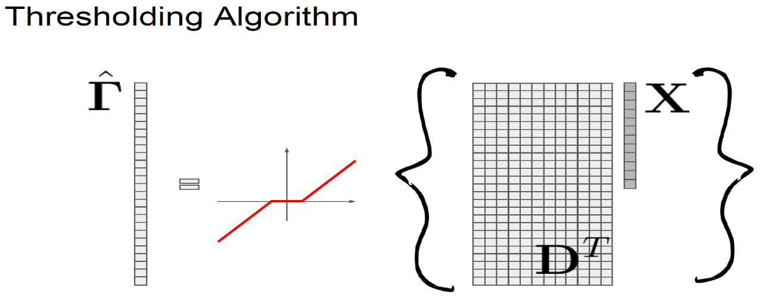



Sparse LSM (Image Domain)
Basis pursuit
Learn H from m^{mig} :
NN→ NNLSM
Let k=0, α/λ=1 and $\tilde{m}$⁽⁰⁾=0
Soft thresholding
$$σ\left(x\right)$$
Conclusion: 1st iterate
Sparse Inversion =
Feedforward single-layer NN
2λ
$$x$$
Notes:
For sparse

Slide 6
Outline
Neural Networks & Sparse LSM
Neural Networks Least Squares Migration
Numerical Results
Summary
Notes:
This is my outline. First is the Motivation.
Then is the theory part, next is numerical Examples,
and finally is the conclusion.

Slide 7
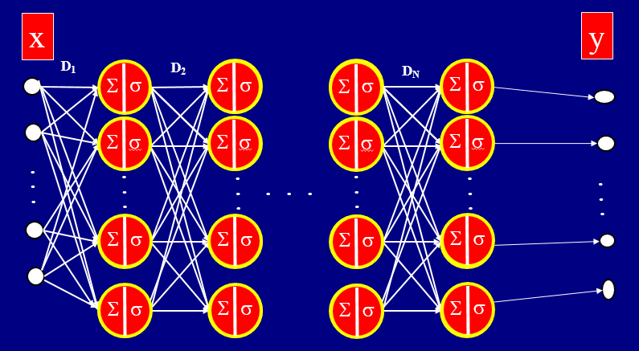
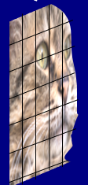

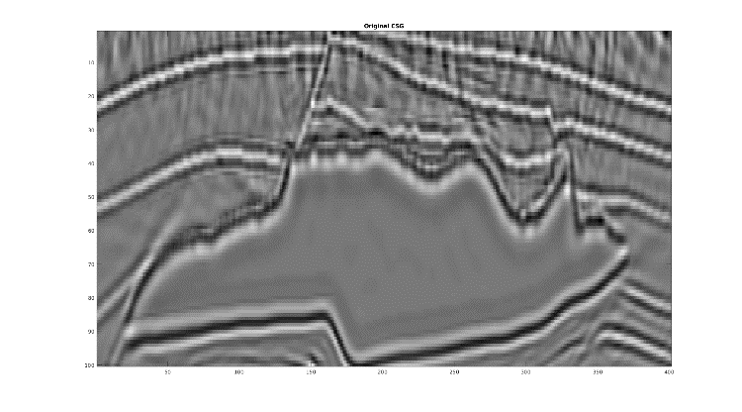

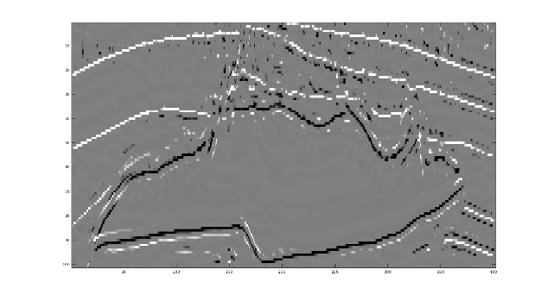


₂
argmin_{y} ½ ||x-Dy||₂ + l||z||₁
σ(x)=ReLu(x)
NNLSM
x
migration
reflectivity
Given: m^{mig}
H^{T}
ε
m^{mig}
Find: H and m
m
s.t. argmin ||Hm –m^{mig}||₂ + λ||m||₁
$m_{i}^{(k+1)}$ = σ_{λ}($m_{i}^{(k)}$ - α/λ[ H^{T}( Hm^{(k)} -m^{mig} )]_{i} )
H_{ij}^{(k+1)} = H_{ij}^{(k)} – α∂ε/∂H_{ij}
Previous Sparse LSM only found m
m^{mig}
m
NNLSM: Find both m and H
Benefits: No finite difference solvers
Liability: m $≠reflectivity$

Slide 8
Outline
Neural Networks & Sparse LSM
Neural Networks Least Squares Migration
Numerical Results
Summary
Notes:
This is my outline. First is the Motivation.
Then is the theory part, next is numerical Examples,
and finally is the conclusion.

Slide 9
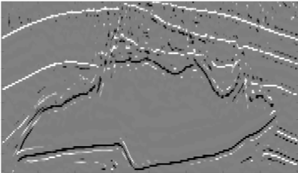
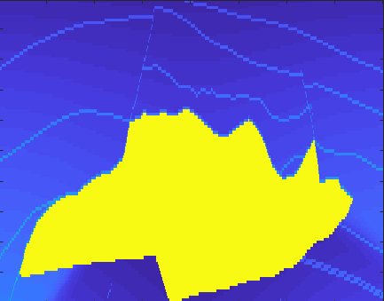

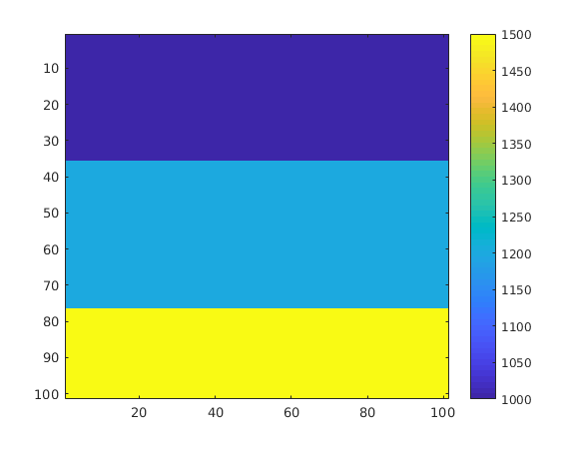
Find m that minimizes ||Hm - m^{mig}||² +α||m||₁
NNLSM
Migration Image
Velocity Model
0.3
0.3
km/s
4.5
Z (km)
m
Z (km)
m^{mig}
1.7
2.3
2.3
12
4
X (km)
12
4
X (km)
Alternating
Gradient Descent
Step 1: m^{(k+1)} = σ_{λ}(m^{(k)} – α ∂ε/∂m); k=1,…15
H₁x
Step 2: H^{(k+1)} = (H^{(k)} – α ∂ε/∂H ); k=1,…15
ij
ij
ij
Notes:
Need to be more simple

Slide 10

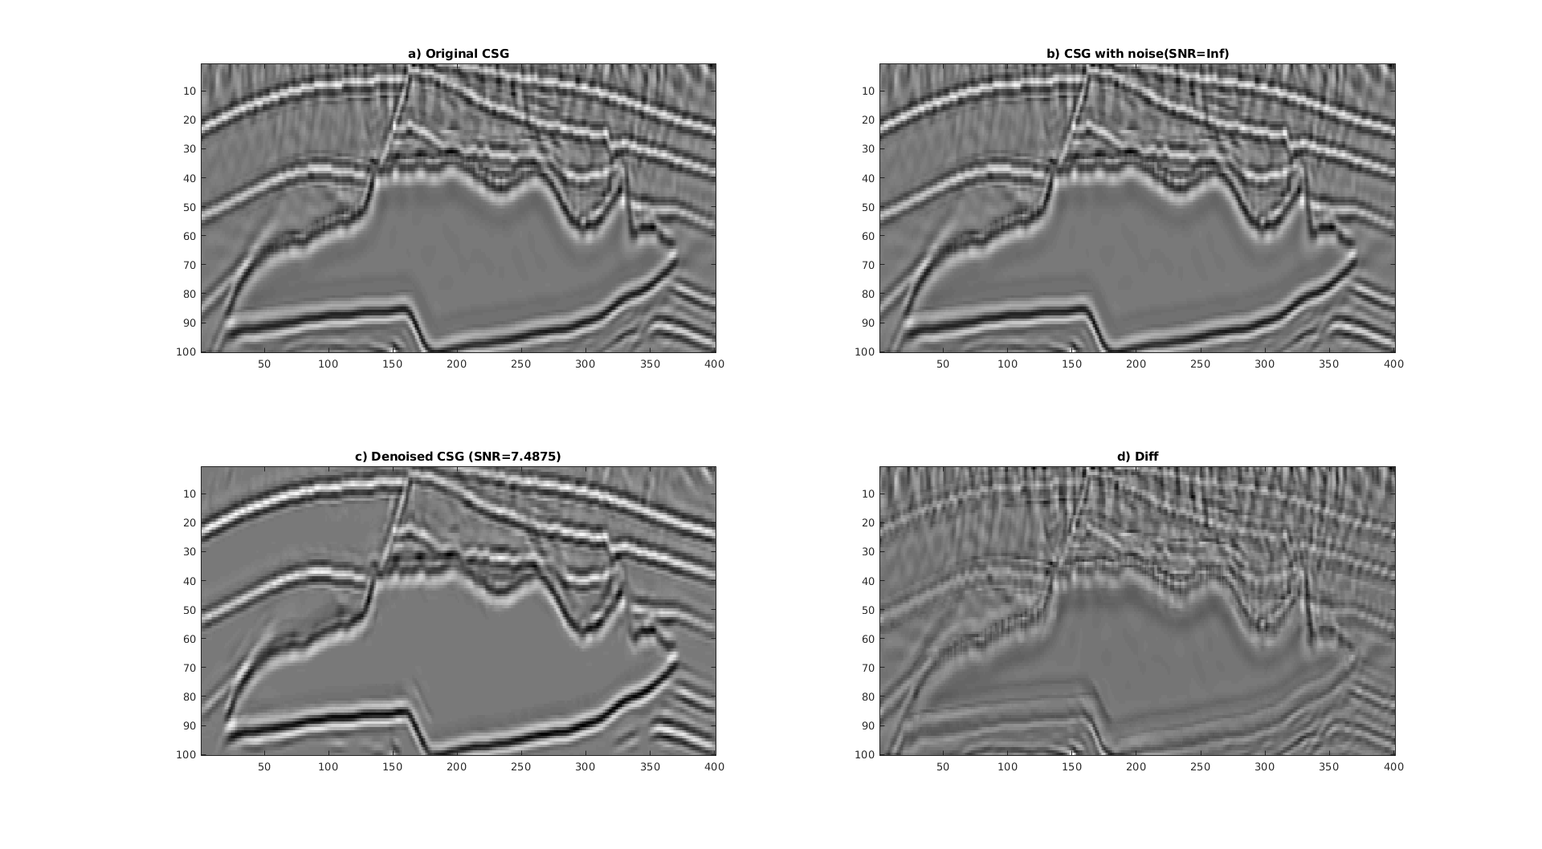





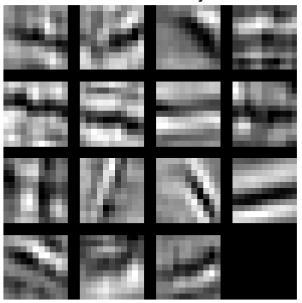

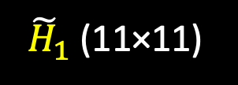
Find m that minimizes ||Hm - m^{mig}||² +α||m||₁
m^{mig}
Feature Map
(sub-Reflectivity)
~LSM
(~Reflectivity)
CNN Filters
(~PSFs)
${\tilde{H}}_{1}$ (11×11)
Benefits: Inexpensive ~LSM
Coherent Noise Killer
Incoherent Noise Killer
For detail: Liu et al 2019, Multilayer Sparse Least Squares Migration=Deep Convolutional Neural Network, arXiv:1904.09321
Liability: m$≠$Reflectivity

Slide 11
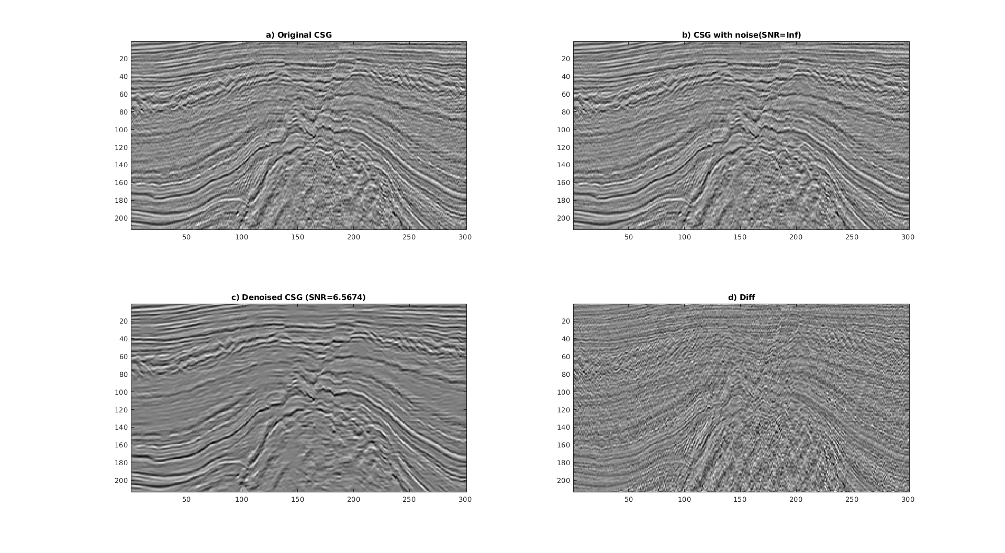
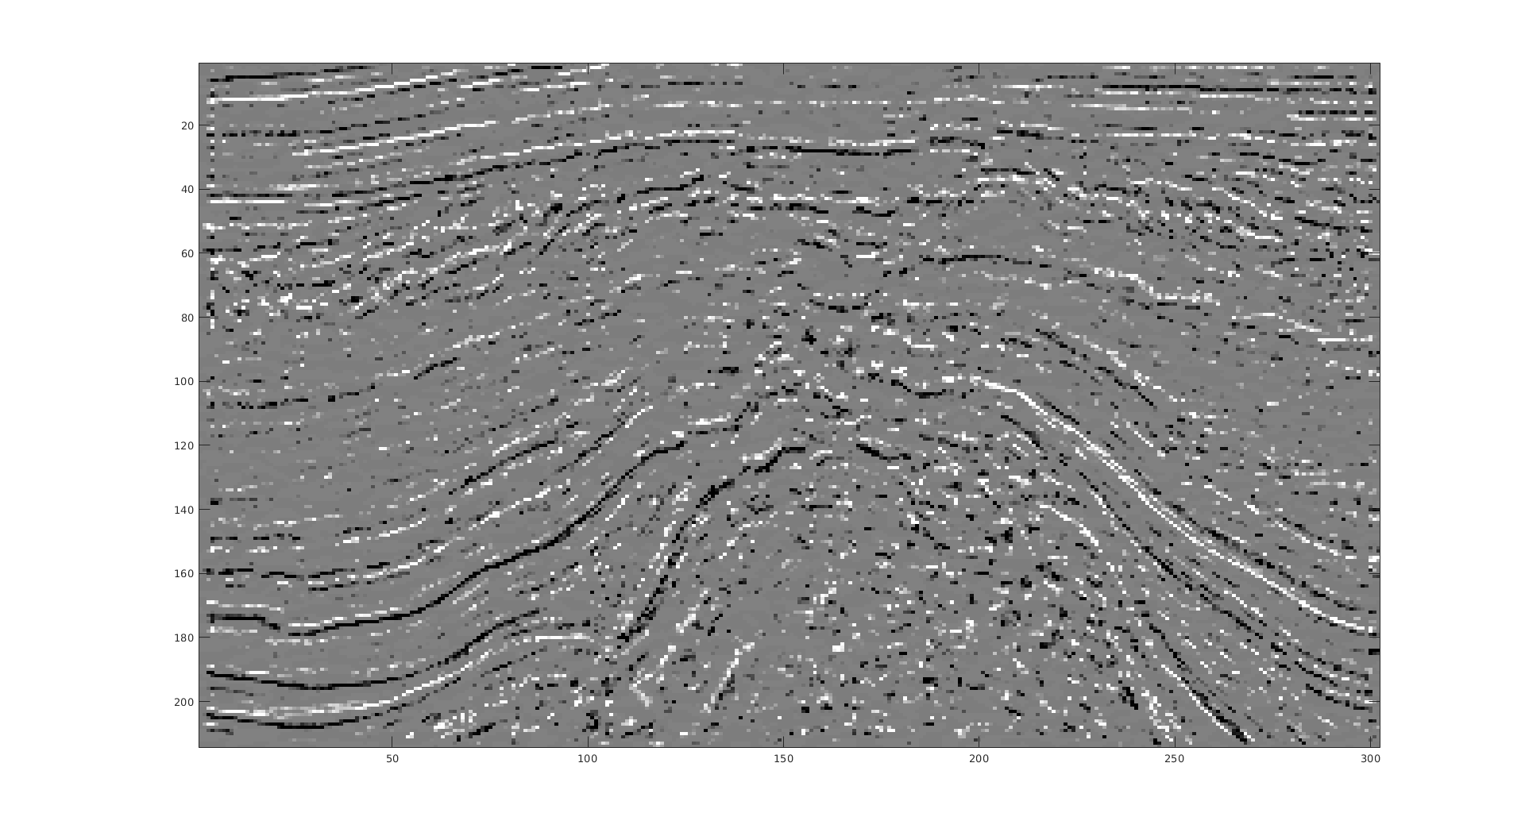
Field Data Test: F3 Block in Netherlands
Reflectivity
Migration Image
Migration Image
1
1
t (s)
t (s)
1.85
1.85
5
X (km)
8
5
X (km)
8
Notes:
Need to be more simple

Slide 12

Field Data Test: F3 Block in Netherlands
Migration Image
Reconstructed Migration Image
$\sum{\tilde{H}k\tilde{m}k}$
1
t (s)
1.85
5
X (km)
8
Notes:
Need to be more simple

Slide 13

Field Data Test: F3 Block in Netherlands
Migration Image
Reconstructed Migration Image
$\sum{\tilde{H}k\tilde{m}k}$
1
t (s)
1.85
5
X (km)
8

Slide 14
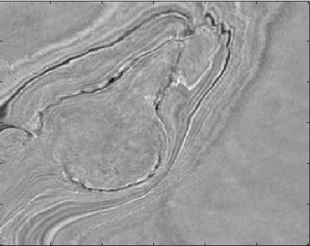
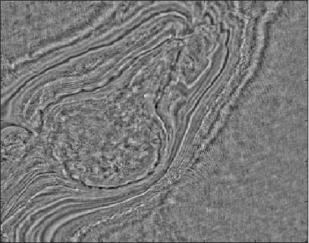
Field Data Test: F3 Block in Netherlands
Time Slice at t=1.63 s
Time Slice after Local Contrast Filter
5
5
X (km)
X (km)
8
8
2
Y (km)
5
2
Y (km)
5

Slide 15
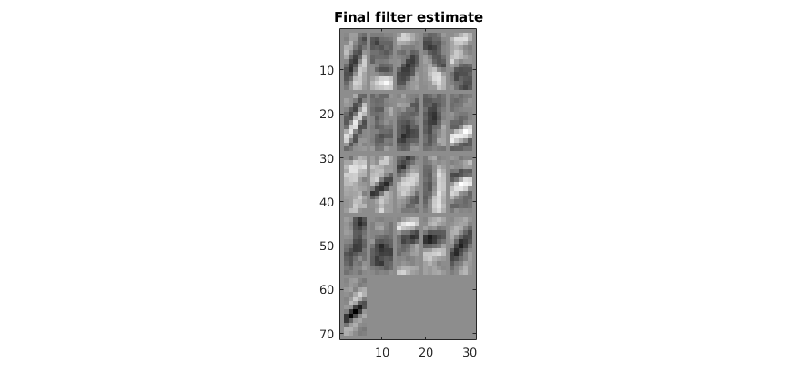
Field Data Test: F3 Block in Netherlands
Time Slice
Learned Filters
5
X (km)
8
2
Y (km)
5

Slide 16
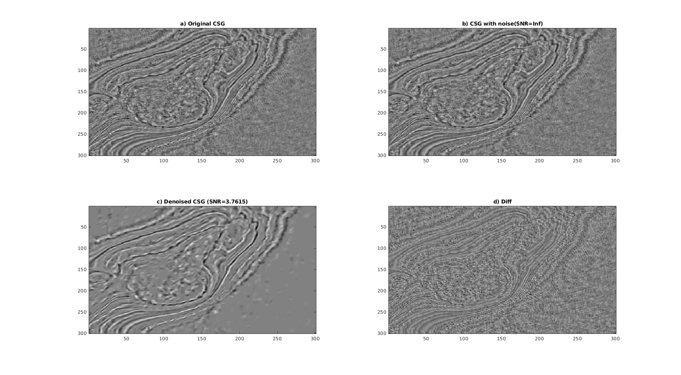
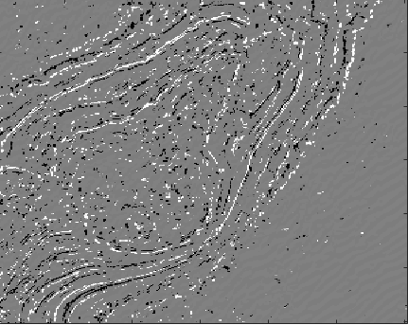
Field Data Test: F3 Block in Netherlands
Feature Map
Reconstructed Time Slice
Time Slice
Time Slice
5
5
X (km)
X (km)
8
8
2
Y (km)
5
2
Y (km)
5

Slide 17
Outline
Neural Networks & Sparse LSM
Neural Networks Least Squares Migration
Numerical Results
Summary
Notes:
This is my outline. First is the Motivation.
Then is the theory part, next is numerical Examples,
and finally is the conclusion.

Slide 18

Summary
FeedForward of NN = Sparse LSM
Sparse LSM VS. NNLSM (how to calculate Hessian)
FeedForward of multilayer CNN = multilayer sparse LSM
  quasi-migration Green’s functions=CNN filters=basis functions
  reflectivity maps=CNN feature maps=weights for the basis functions.
Practical Uses of NNLSM:
  Inexpensive ~LSM
  Eliminate Random+Coherent Noise
  Liability: m$≠$Reflectivity
Notes:
This is my outline. First is the Motivation.
Then is the theory part, next is numerical Examples,
and finally is the conclusion.

Slide 19
LSM
Neural Network LSM
Deep CNN

Slide 20
Acknowledgements
The research reported in this publication was supported by the King Abdullah University of Science and Technology (KAUST) in Thuwal, Saudi Arabia. We are grateful to the sponsors of the Center for Subsurface Imaging and Modeling Consortium for their financial support. For computer time, this research used the resources of the Supercomputing Laboratory at KAUST and the IT Research Computing Group. We thank them for providing the computational resources required for carrying out this work.

