Slide 1
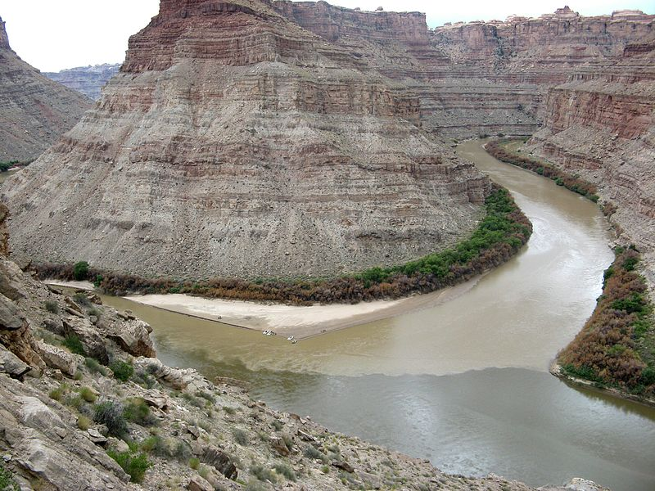
Machine Learning in Geosciences
Gerard Schuster & Shi Yongxiang
paleontology
gravity
structural
Geosciences
geochem
stratigraphy
sedimentology
convolutional neural
networks
seismology
planetology
exploration
kernel methods
neural networks
Machine Learning
Ensemble learning
Hidden Markov chains
decision trees
Random Forest
Semi-supervised learning overfitting
stochastic gradient descent

Slide 2
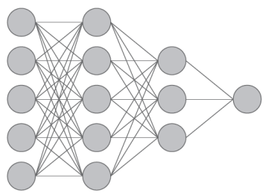
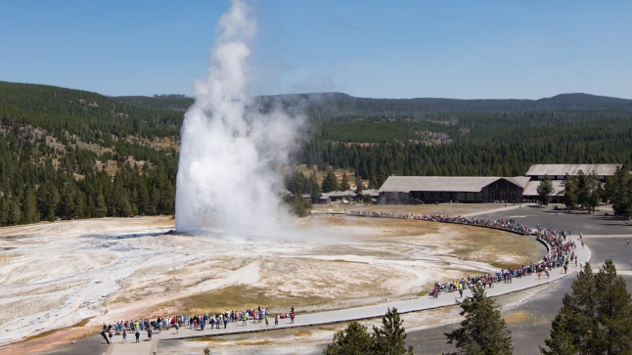
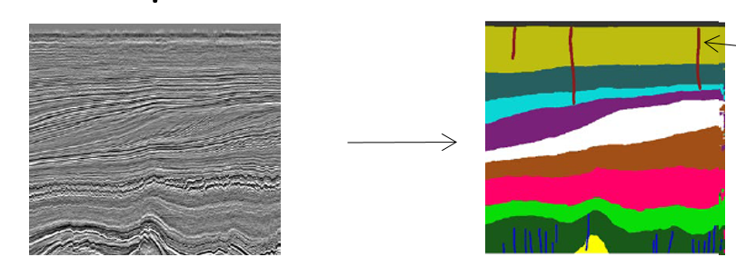
Today’s Talks+Labs
Introduction: Three Classes Machine Learning
Unsupervised Learning Cluster Analysis: K-Means & DBSCAN
Labs
Supervised Learning: Neural Networks

Slide 3
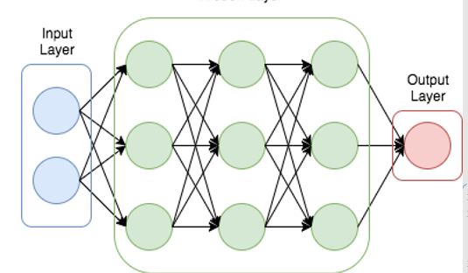
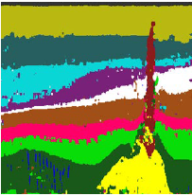
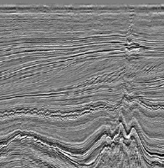
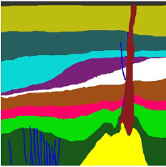
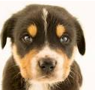
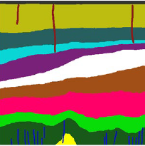
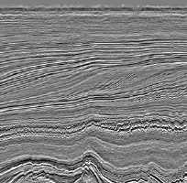
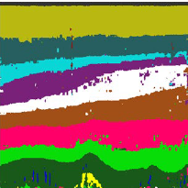
Three Major Types of Machine Learning
input weights output
x^{(n)}
W
y^{(n)}
Supervised
Learning
x
y
Given: training pairs (
x^{(n)}
, y^{(n)})
Find: W
x
y
flattening
Prograde & regressional features
4
26
256
2
.
.
.
88
0
1
0
0
.
.
.
0
Deformed reflections features
.
.
.
Salt dome
Faults missed
Di et al., 2019, GJI

Slide 4
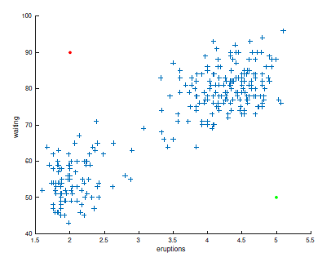
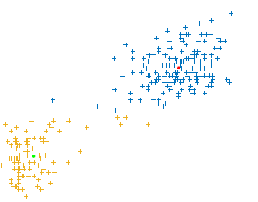
Three Major Types of Machine Learning
input neural weights output
x^{(n)}
W
y^{(n)}
Supervised
Learning
Unsupervised Learning
(x^{(n)} , ?)
Given: training pairs (
x^{(n)}
, y^{(n)})
Separates CSG Into clusters; finds
patterns/structure in data. No labeling y
Find: W
x
y
CSG
FK Spectrum
4
26
256
2
.
.
.
88
0
1
0
0
.
.
.
0
Rayleigh
t
ω
Eruption Waiting Time (minutes)
reflection
x
k_{x}
PCA, SVD, Cluster Analysis
Old Faithful Eruption Duration (minutes)

Slide 5
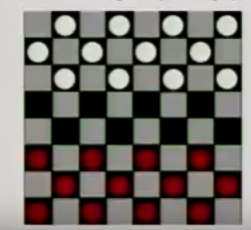
Three Major Types of Machine Learning
input neural weights output
x^{(n)}
W
y^{(n)}
Supervised
Learning
Unsupervised Learning
Reinforcement Learning
(x^{(n)} , ?)
Given:
Given: training pairs (
(x^{(n)} ,some output, grade)
x^{(n)}
, y^{(n)})
Separates CSG Into clusters; finds
patterns/structure in data. No labeling y
Find: W
Find: W
x
y
x
y
CSG
FK Spectrum
grade
4
26
256
2
.
.
.
88
0
1
0
0
.
.
.
0
Rayleigh
1
1
1
0
.
.
-1
-1
1
-1
0
1
.
.
.
1
Good if
more +
than -
t
ω
Eruption Waiting Time (minutes)
reflection
x
k_{x}
PCA, SVD, Cluster Analysis
Old Faithful Eruption Duration (minutes)

Slide 6
Today’s Talks+Labs
Introduction: Three Classes Machine Learning
Unsupervised Learning Cluster Analysis: K-Means & DBSCAN
Labs
Supervised Learning: Neural Networks

