Slide 1
Instructions for Executing Refraction Tomography Inversion Code
Yicheng Zhou

Slide 2
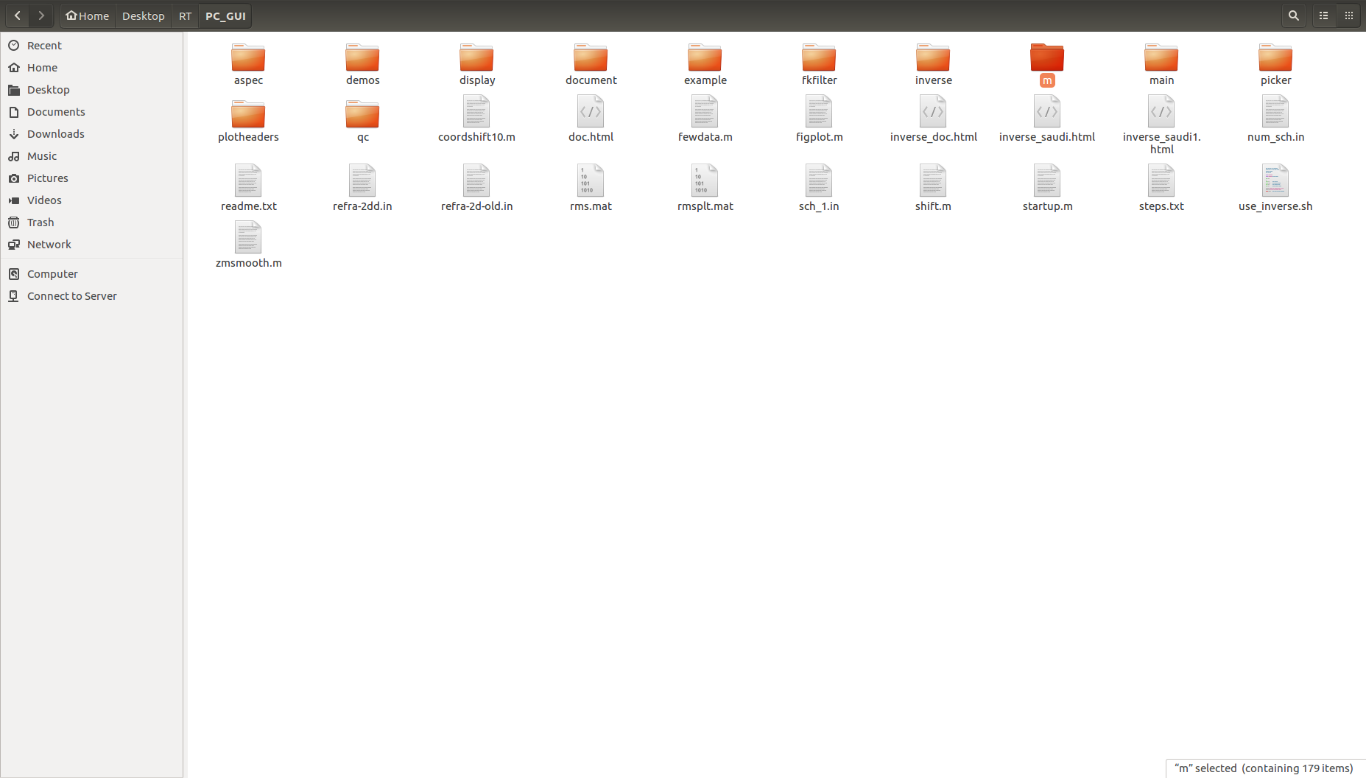
Part-2, Inversion Code
Copy coord.temp into ./PC_GUI/m
Generated by mk2017.m
Notes:
Fine, Next we could do refraction traveltime tomography, there is no theory in PPT, only operation. You should download PC_GUI on the website of this homework, and copy coord.temp file to ./PC_GUI/m file. Change the workdir in this file into the currect file. Now you could run startup.m command using matlab. You must know that we should operate this software in Windows machine, because there are many exe.files in m file at least.
Now, this GUI, you should change dynamic schudule by yourself,
You can check your result here, including velocity model, ray path, and time residual, this figure is only one example of time residual. You can check your input data here. Finally, you could save your current figure using save figure choice. I tested each choices and checked some of these codes, there is almost no problem in this code, if you find, you can send me one email, and we could have a talk together.

Slide 3
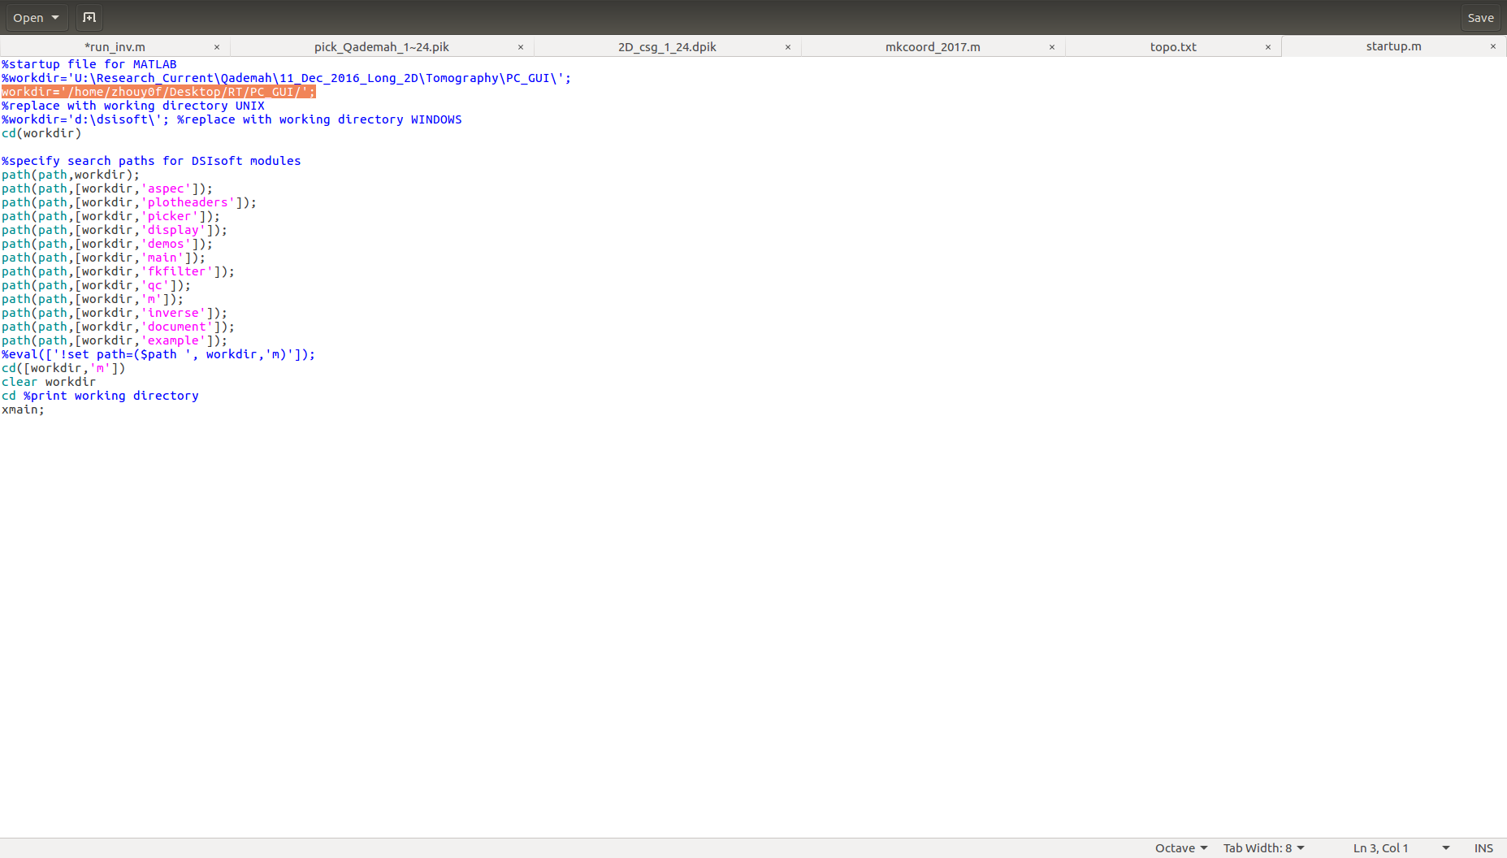
Part-2, Inversion Code
Change workdir in startup.m in ‘./PC_GUI/startup.m’ into current dir
workdir=‘U:\Research_Current\Qademah\11_Dec_2016_Long_2D\Tomography\PC_GUI\’
Your current dir

Slide 4
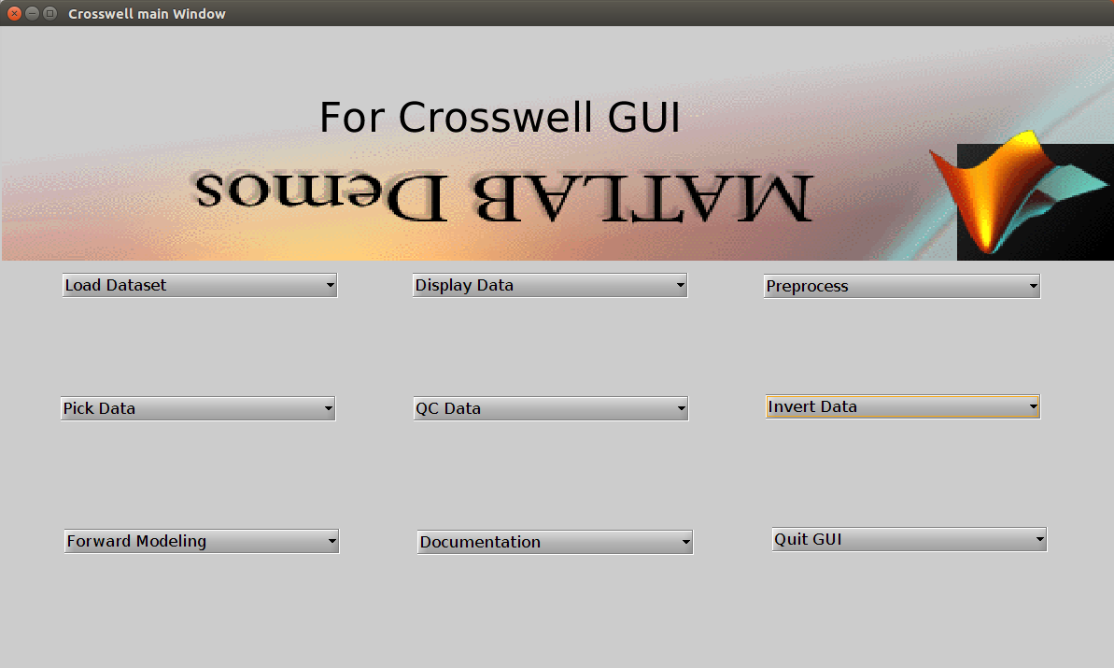
Part-2, Inversion Code
Run startup.m (MATLAB)
Output data is in PC_GUI/m
Run it

Slide 5
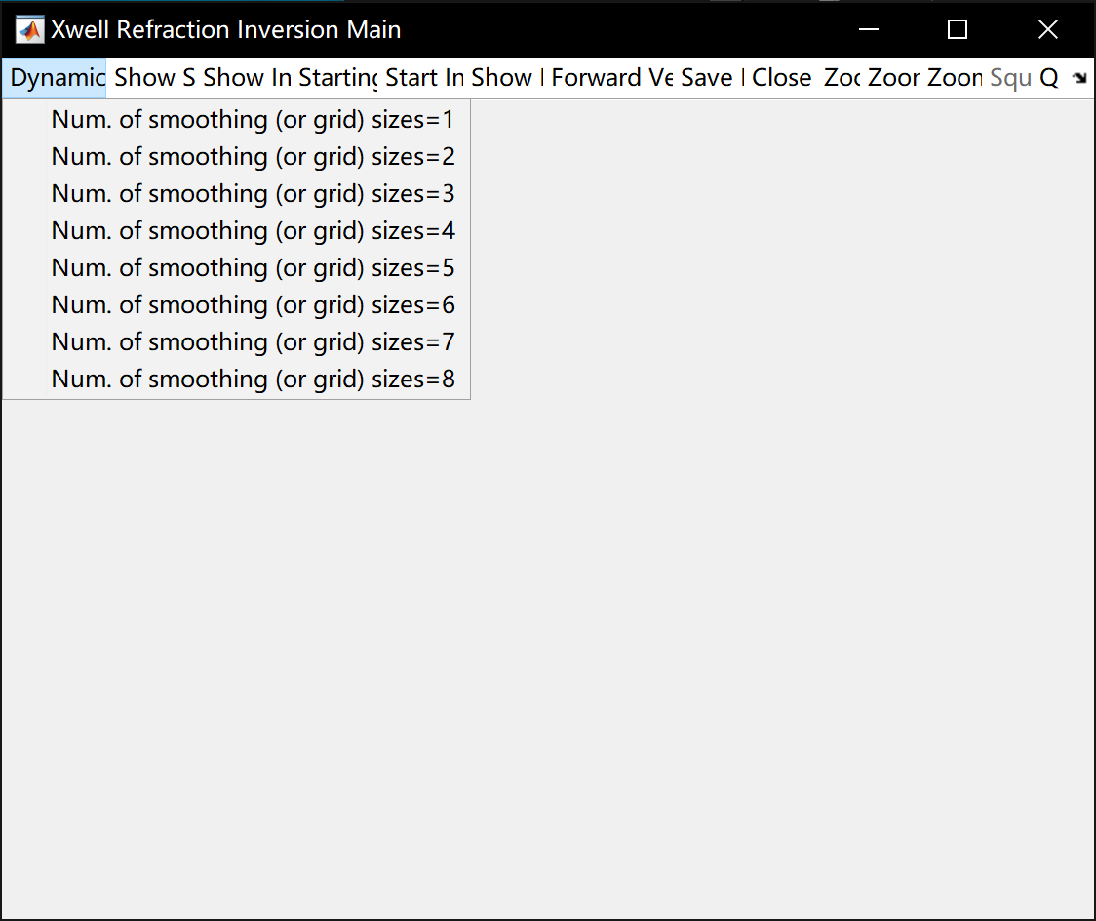
Part-2, Inversion Code

Slide 6
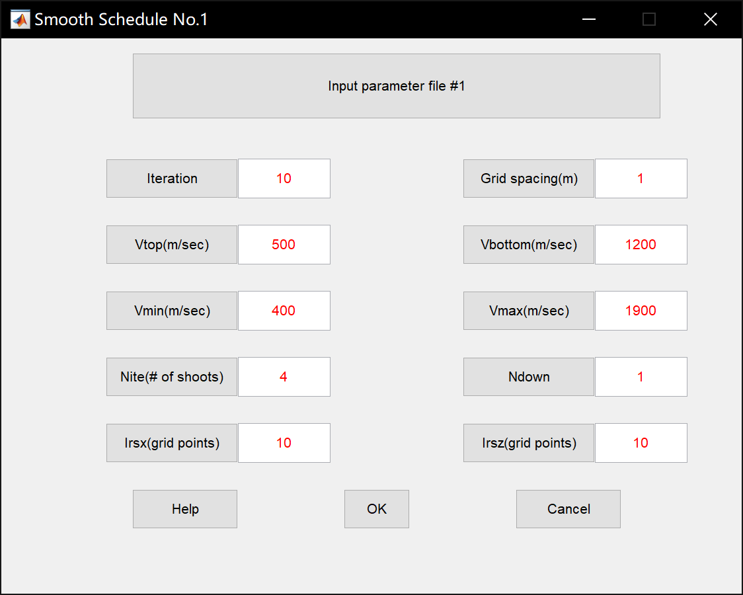
Part-2, Example
Iteration: number of iterations at each smooth schedule
Grid spacing: the grid spacing in forward modelling
Vtop & Vbottom: Initial model (linear model)
Vmin & Vmax: the velocity used in inversion
Ndown: I usually choose 1, extrapolate gradient. If 2, extrapolate slowness.
Irsx & Irsz: use these two values to maintain the number of pixels larger than the data number (number of pickings through reciprocity and deleted bad traces)
$$pixels: \frac{x_{max}}{grid_spacing×irsx}×\frac{z_{max}}{grid_spacing×irsz}$$
Nite: number of srcs to calculate step length, 4 is good

Slide 7
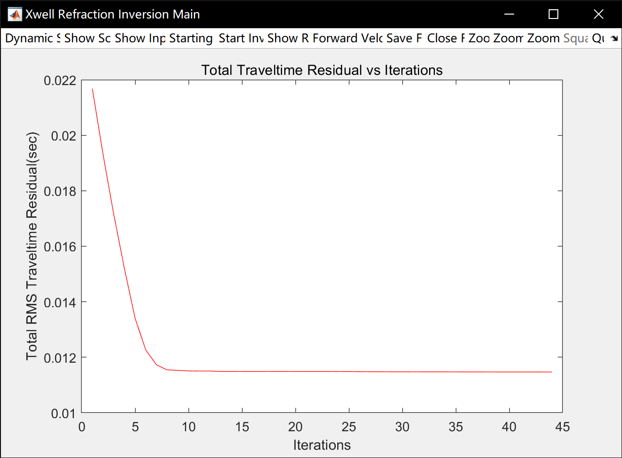
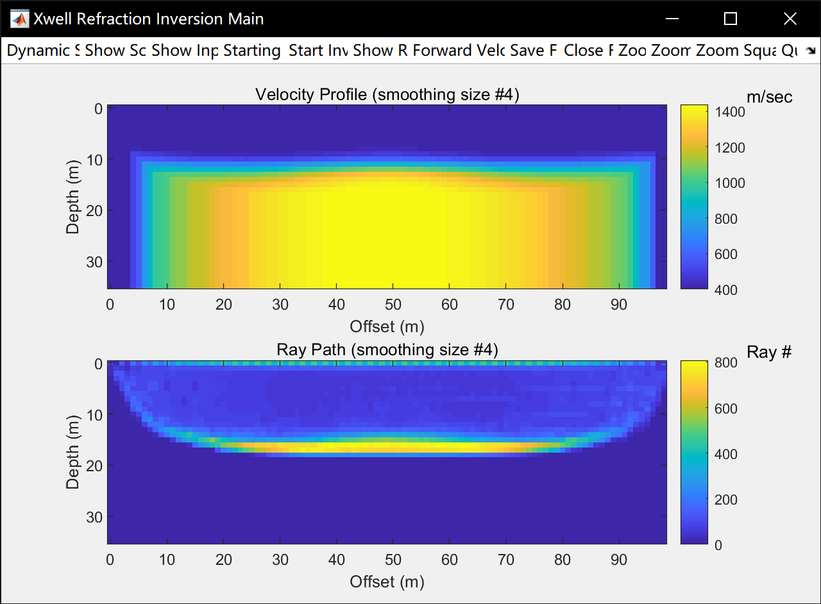
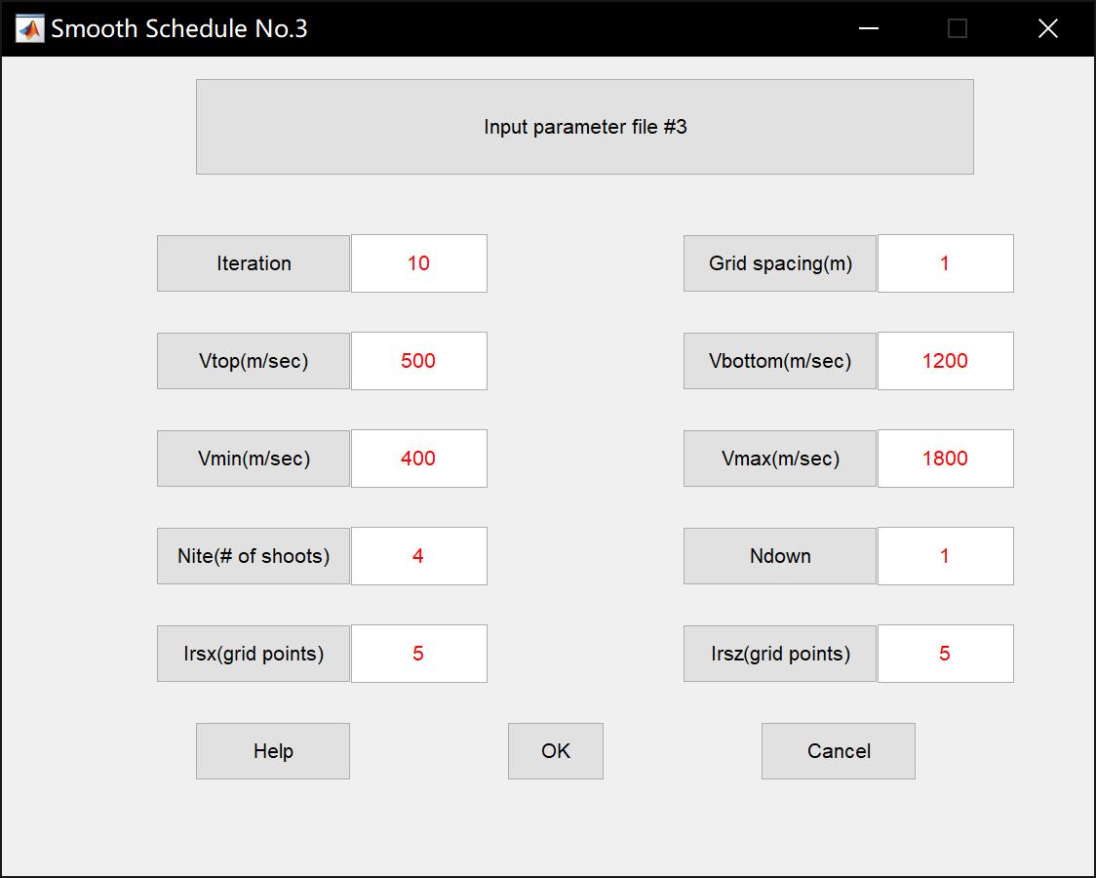
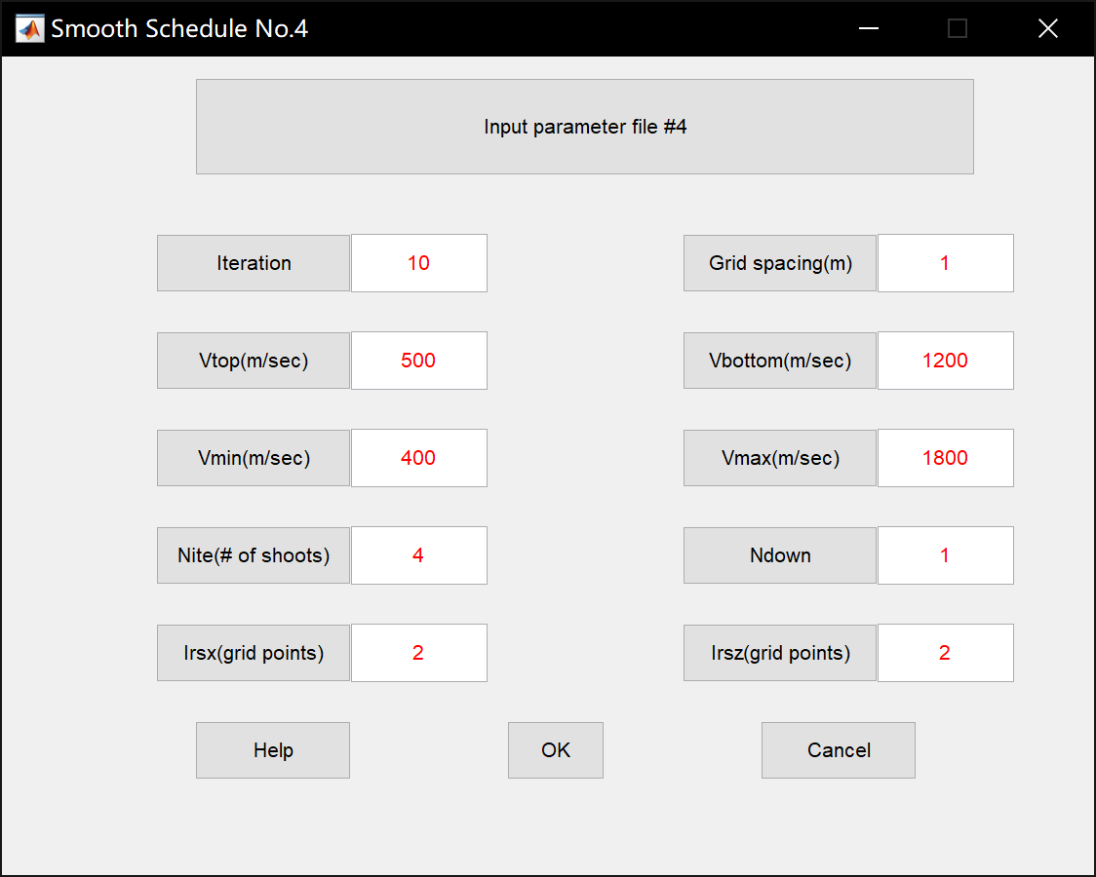
Part-2, Example, homogeneous

Slide 8
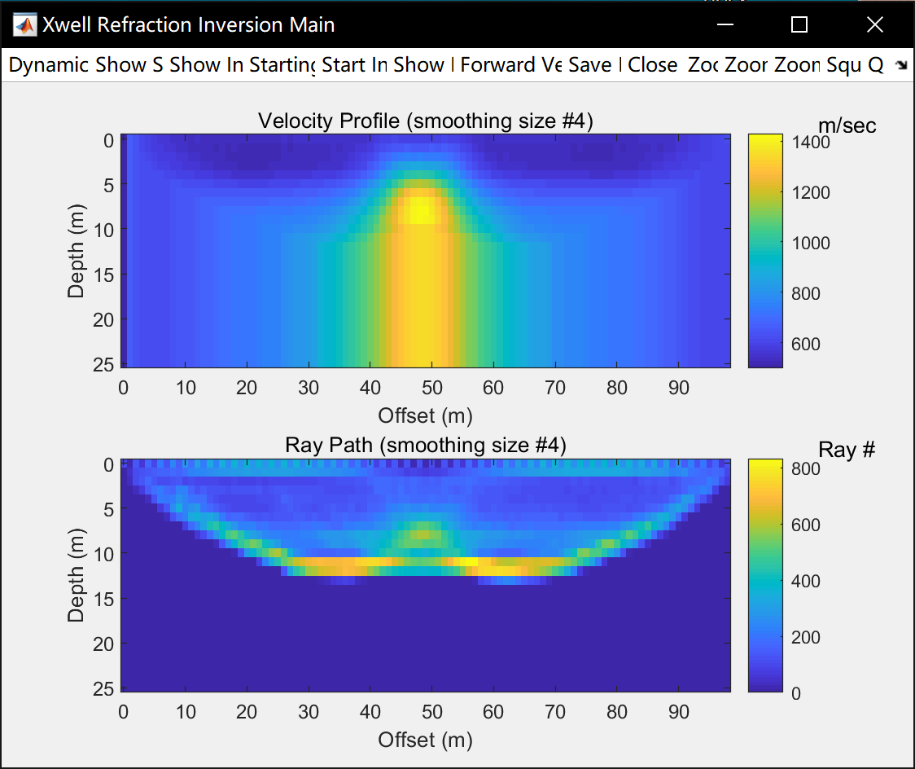
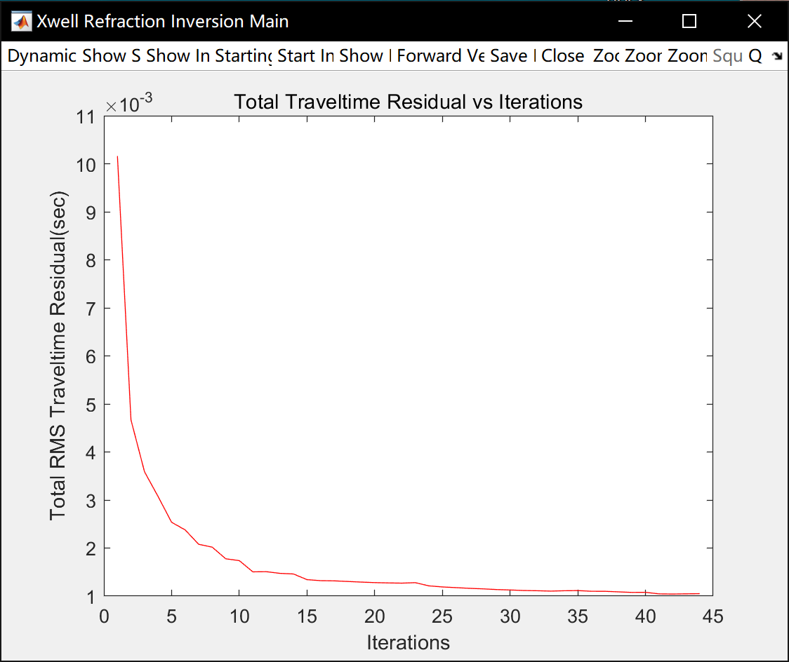
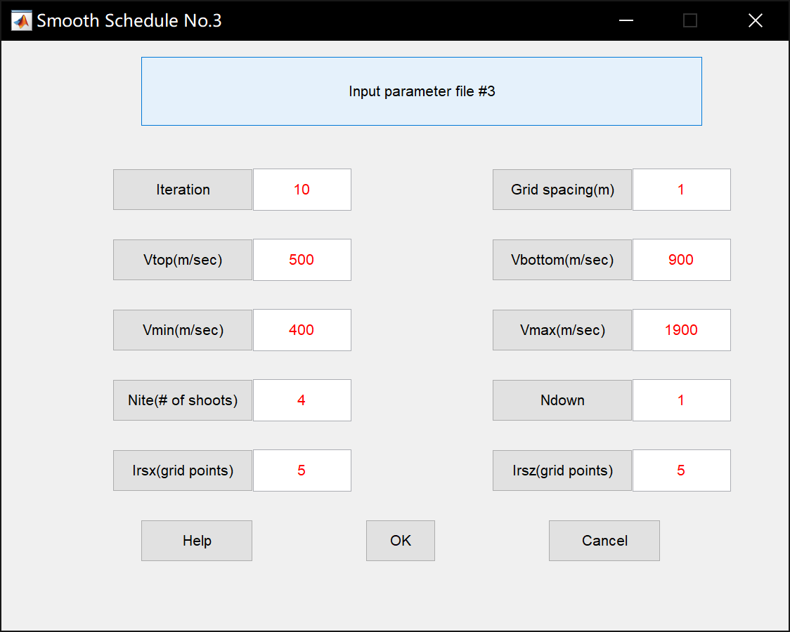
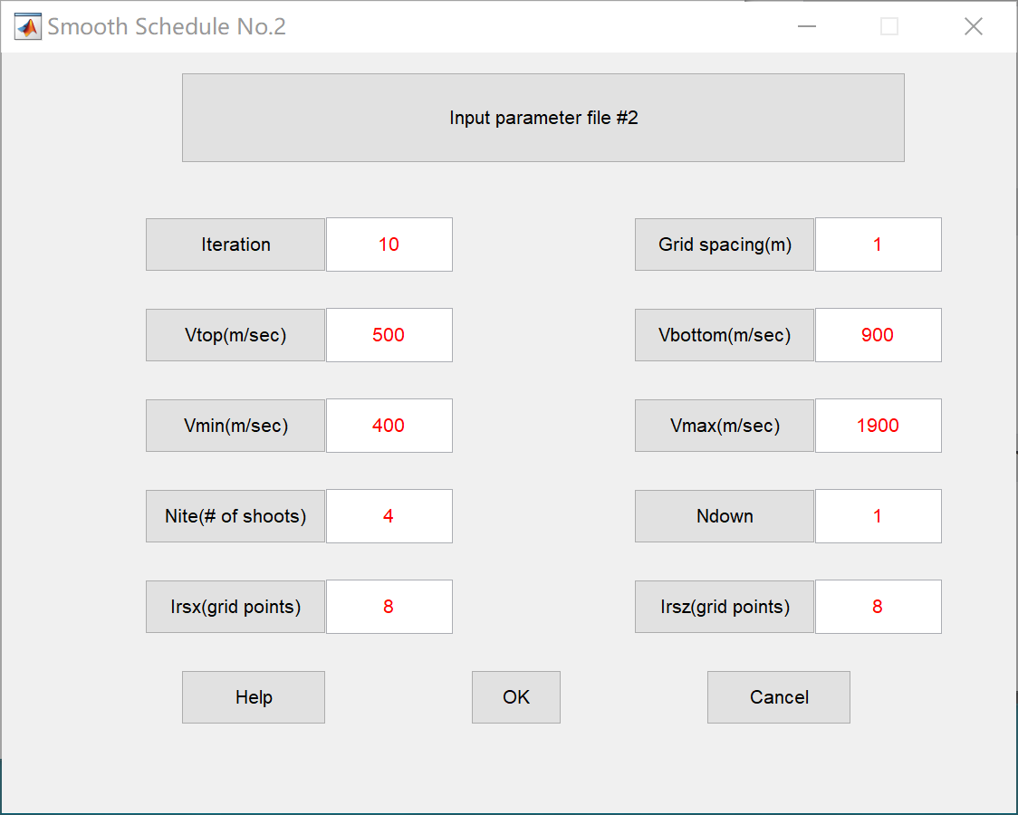
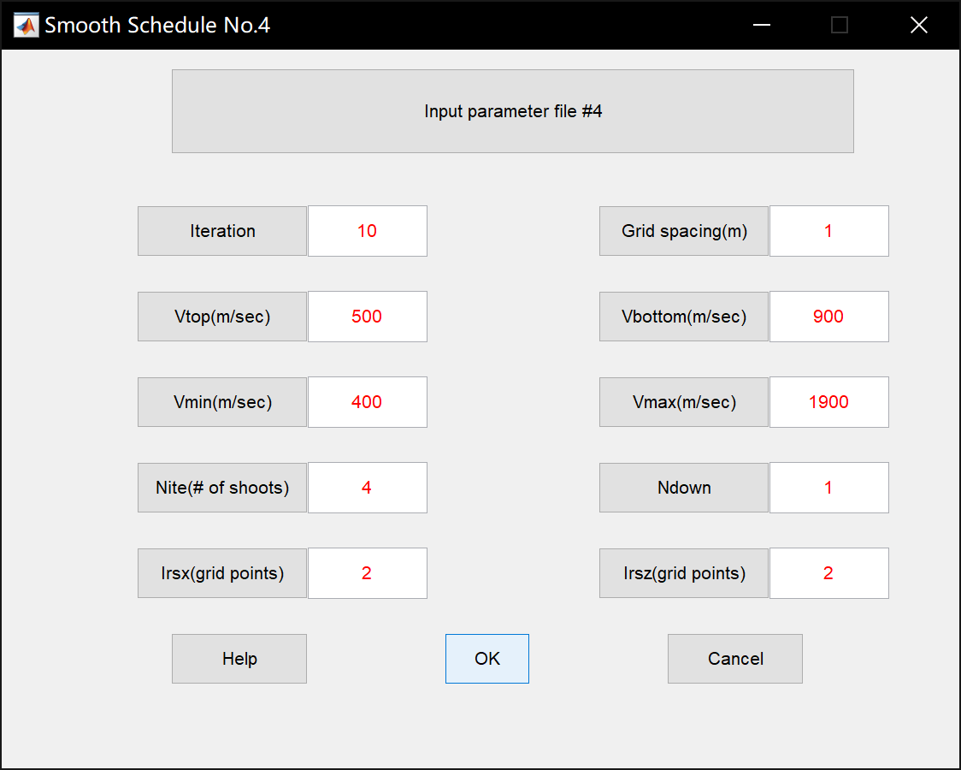
Part-2, Example, homogeneous

