Slide 1
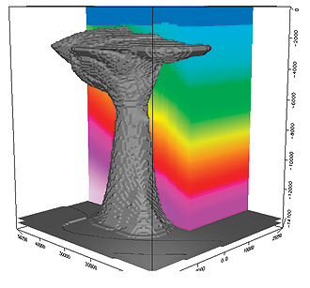
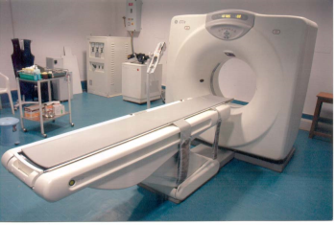
Overview of Multisource Phase
Encoded Seismic Inversion
Wei Dai, Ge Zhan, and Gerard Schuster
KAUST

Slide 2
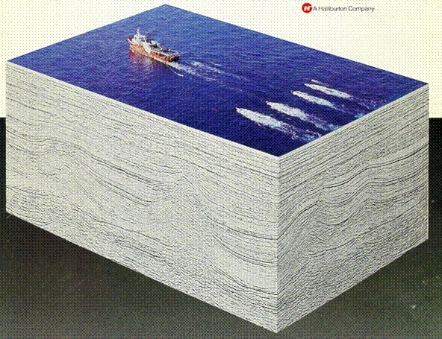
Outline
L m = d
Seismic Experiment:
1
1
L m = d
.
2
.
2
.
L m = d
N
N
2. Standard vs Phase Encoded Least Squares Soln.
L
d
1
m =
1
vs
[
N L + N L
]m = [N d + N d ]
L
d
1
1
2
2
1
1
2
2
2
2
3. Theory Noise Reduction
4. Summmary and Road Ahead

Slide 3
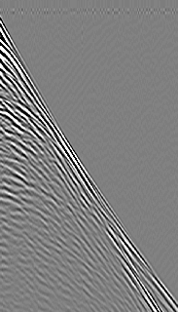
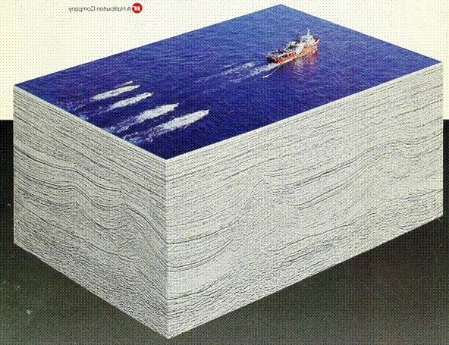
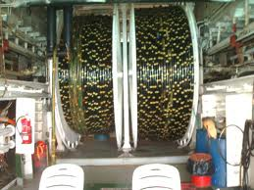
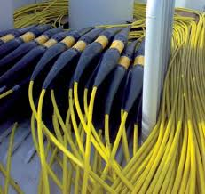
Gulf of Mexico Seismic Survey
Predicted data
L m = d
Observed data
Common Shot Gather
Goal: Solve overdetermined
System of equations for m
4
d
Time (s)
0
4 km
Streamer Reel
Streamer Cables
m(x,y,z)

Slide 4
Details of Lm = d
4
d
Time (s)
1
Reflectivity
or velocity
model
0
6 X (km)
G(s|x)G(x|g)m(x)dx = d(g|s)
Predicted data = Born approximation
Solve wave eqn. to get G’s
m

Slide 5
Outline
L m = d
Seismic Experiment:
1
1
L m = d
.
2
.
2
.
L m = d
N
N
2. Standard vs Phase Encoded Least Squares Soln.
L
d
1
m =
1
vs
[
N L + N L
]m = [N d + N d ]
L
d
1
1
2
2
1
1
2
2
2
2
3. Theory Noise Reduction
4. Summmary and Road Ahead

Slide 6
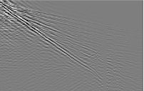


Conventional Least Squares Solution: L= & d =
L
d
1
1
L
d
Given: Lm=d
2
2
Find: m s.t. min||Lm-d||
In general, huge
dimension matrix
2
Solution: m = [L L] L d
T
-1
T
or if L is too big
m = m – α L (Lm - d)
(k+1)
(k)
(k)
T
(k)
= m – α L (L m - d )
(k)
[
T
]
+ L (L m - d )
T
1
1
1
2
2
2
Problem:
L is too big for IO bound hardware
Notes:
My talk is organized in the following way:
1. The first part is motivation. I will talk about a least squares migration (LSM ) advantages and challenges.
2. The second part is theory for a deblurring filter, which is an alternative method to LSM.
3. In the third part, I will show a numerical result of a deblurring filter.
4. The fourth is the main part of my talk.
Deblurred LSM (DLSM) is a fast LSM with a deblurring filter.
I will explain how to use the filter in LSM algorithm.
5. Then I will show numerical results of the DLSM.
6. Then I will conclude my presentation.
Each figure has a slide number is shown at the footer.
6

Slide 7
Conventional Least Squares Solution: L= & d =
L
d
1
1
L
d
Given: Lm=d
2
2
Find: m s.t. min||Lm-d||
In general, huge
dimension matrix
2
Solution: m = [L L] L d
T
-1
T
or if L is too big
m = m – α L (Lm - d)
(k+1)
(k)
(k)
T
(k)
= m – α L (L m - d )
(k)
[
T
]
+ L (L m - d )
T
1
1
1
2
2
2
Note: subscripts agree
Problem:
L is too big for IO bound hardware
Notes:
My talk is organized in the following way:
1. The first part is motivation. I will talk about a least squares migration (LSM ) advantages and challenges.
2. The second part is theory for a deblurring filter, which is an alternative method to LSM.
3. In the third part, I will show a numerical result of a deblurring filter.
4. The fourth is the main part of my talk.
Deblurred LSM (DLSM) is a fast LSM with a deblurring filter.
I will explain how to use the filter in LSM algorithm.
5. Then I will show numerical results of the DLSM.
6. Then I will conclude my presentation.
Each figure has a slide number is shown at the footer.
7

Slide 8
Conventional Least Squares Solution: L= & d =
L
d
1
1
L
d
Given: Lm=d
2
2
Find: m s.t. min||Lm-d||
In general, huge
dimension matrix
2
Solution: m = [L L] L d
T
-1
T
m = m – α L (Lm - d)
(k+1)
(k)
(k)
T
(k)
= m – α L (L m - d )
(k)
[
T
]
+ L (L m - d )
T
1
1
1
2
2
2
Problem: Each prediction is a FD solve
Solution: Blend+encode Data
Problem:
L is too big for IO bound hardware
Notes:
My talk is organized in the following way:
1. The first part is motivation. I will talk about a least squares migration (LSM ) advantages and challenges.
2. The second part is theory for a deblurring filter, which is an alternative method to LSM.
3. In the third part, I will show a numerical result of a deblurring filter.
4. The fourth is the main part of my talk.
Deblurred LSM (DLSM) is a fast LSM with a deblurring filter.
I will explain how to use the filter in LSM algorithm.
5. Then I will show numerical results of the DLSM.
6. Then I will conclude my presentation.
Each figure has a slide number is shown at the footer.
8

Slide 9
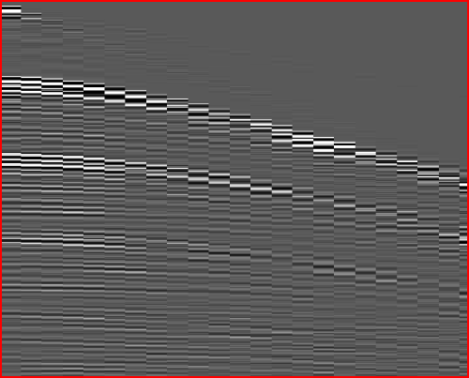
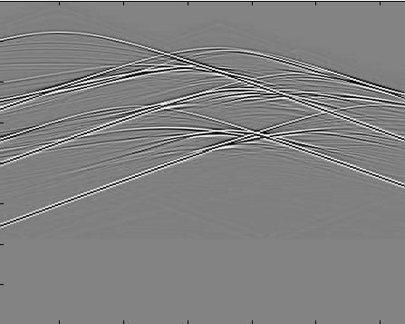
Blending+Phase Encoding
Blending
Blending
Phase
Phase
L m=
d
L m=
d
L m=
d
1
1
2
2
3
3
O(1/S) cost!
d = N d + N d + N d
Encoding Matrix
Supergather
1
1
2
2
3
3
L =
Encoded supergather modeler
m
N L + N L
+ N L
[ ]m
1
1
2
2
3
3

Slide 10
Blended Phase-Encoded Least Squares Solution L = & d = N d + N d
N L + N L
1
1
2
2
1
1
2
2
Given: Lm=d
Find: m s.t. min||Lm-d||
In general, SMALL
dimension matrix
2
Solution: m = [L L] L d
T
-1
T
or if L is too big
m = m – α L (Lm - d)
(k+1)
(k)
(k)
T
(k)
= m – α L (L m - d )
(k)
[
T
]
+ L (L m - d )
T
1
1
1
2
2
2
Iterations are proxy
For ensemble averaging
+ Crosstalk
+ L (L m - d )
+ L (L m - d )
T
T
2
1
1
1
2
2
Notes:
My talk is organized in the following way:
1. The first part is motivation. I will talk about a least squares migration (LSM ) advantages and challenges.
2. The second part is theory for a deblurring filter, which is an alternative method to LSM.
3. In the third part, I will show a numerical result of a deblurring filter.
4. The fourth is the main part of my talk.
Deblurred LSM (DLSM) is a fast LSM with a deblurring filter.
I will explain how to use the filter in LSM algorithm.
5. Then I will show numerical results of the DLSM.
6. Then I will conclude my presentation.
Each figure has a slide number is shown at the footer.
10

Slide 11
Brief History Multisource
Phase Encoded Imaging
Migration
Romero, Ghiglia, Ober, & Morton, Geophysics, (2000)
Waveform Inversion and Least Squares Migration
Krebs, Anderson, Hinkley, Neelamani, Lee, Baumstein,
Lacasse, SEG, (2009)
Virieux and Operto, EAGE, (2009)
Dai, and Schuster, SEG, (2009)
Biondi, SEG, (2009)

Slide 12
Outline
L m = d
Seismic Experiment:
1
1
L m = d
.
2
.
2
.
L m = d
N
N
2. Standard vs Phase Encoded Least Squares Soln.
L
d
1
m =
1
vs
[
N L + N L
]m = [N d + N d ]
L
d
1
1
2
2
1
1
2
2
2
2
3. Theory + Numerical Results
4. Summmary and Road Ahead

Slide 13
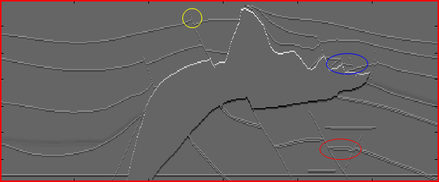
SEG/EAGE Salt Reflectivity Model
Z (km) 0
1.4
0
X (km)
6
Use constant velocity model with c = 2.67 km/s
Center frequency of source wavelet f = 20 Hz
320 shot gathers, Born approximation
Encoding: Dynamic time, polarity statics + wavelet shaping
Center frequency of source wavelet f = 20 Hz
320 shot gathers, Born approximation

Slide 14
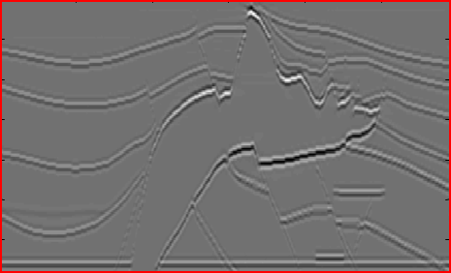
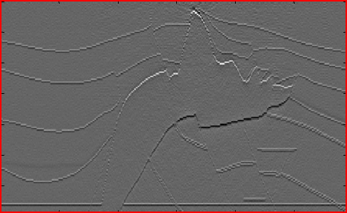
Standard Phase Shift Migration vs MLSM
(Yunsong Huang)
Standard Phase Shift Migration (320 CSGs)
0
1 x
Z k(m)
1.4
0
X (km)
6
Multisource PLSM (320 blended CSGs, 7 iterations)
0
Z (km)
1 x
44
1.4
0
X (km)
6

Slide 15
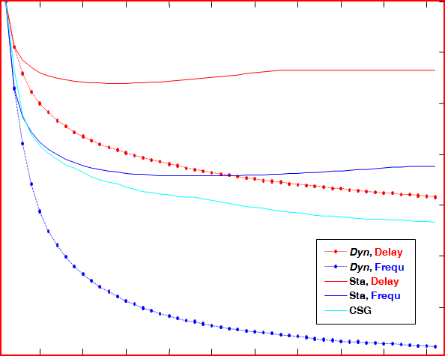
Single-source PSLSM
(Yunsong Huang)
1.0
Conventional encoding: Polarity+Time Shifts
Model Error
Unconventional encoding
0.3
0
Iteration Number
50
Notes:
Jerry,
The multi-source and single-source approaches have used different strategies for the step length. Therefore direct comparison of their misfit error is not applicable. Sorry about that.

Slide 16
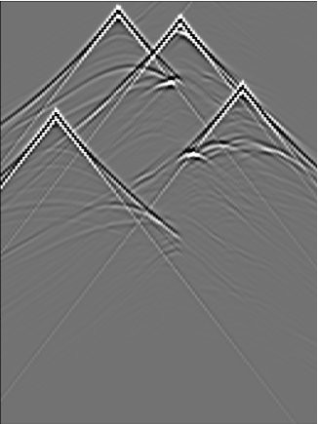
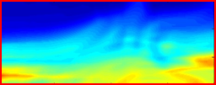
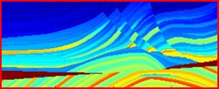
Multi-Source Waveform Inversion Strategy
(Ge Zhan)
144 shot gathers
Generate multisource field data with known time shift
Initial velocity model
Generate synthetic multisource data with known time shift from estimated velocity model
Multisource deblurring filter
Using multiscale, multisource CG to update the velocity model with regularization

Slide 17
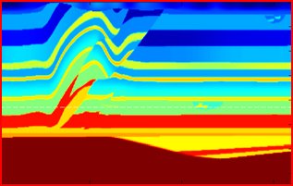
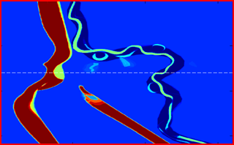
3D SEG Overthrust Model (1089 CSGs)
15 km
3.5 km
15 km

Slide 18
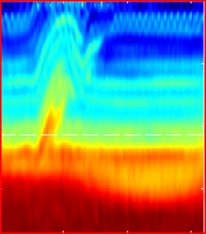
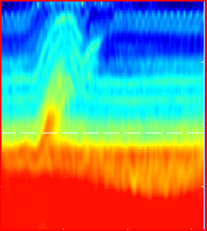
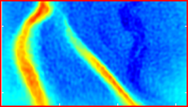
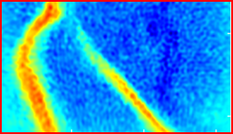
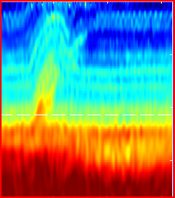
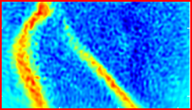
Numerical Results
300x
Dynamic QMC Tomogram
(99 CSGs/supergather)
300x
Static QMC Tomogram
(99 CSGs/supergather)
3.5 km
Dynamic Polarity Tomogram
(1089 CSGs/supergather)
15 km
1000x

Slide 19
Outline
L m = d
Seismic Experiment:
1
1
L m = d
.
2
.
2
.
L m = d
N
N
2. Standard vs Phase Encoded Least Squares Soln.
L
d
1
m =
1
vs
[
N L + N L
]m = [N d + N d ]
L
d
1
1
2
2
1
1
2
2
2
2
3. Theory + Numerical Results
4. Summmary and Road Ahead

Slide 20






Multisource Least Squares Migration
{
{
d
L
Forward Model:
d +d =[L +L ]m
₁
₂
₁
₂
Phase encoding
m_{mig}=L^{T}d
Multisource Migration:
Kirchhoff kernel
Standard migration
Crosstalk term
34

Slide 21
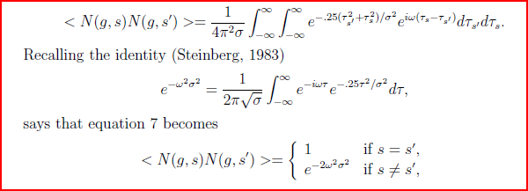
Multisource Least Squares Migration
Crosstalk term

Slide 22
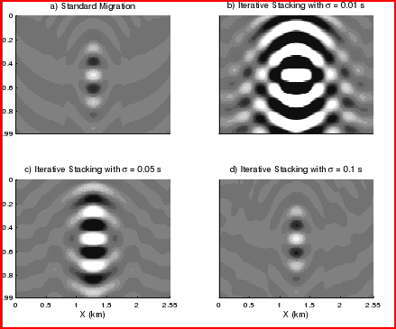
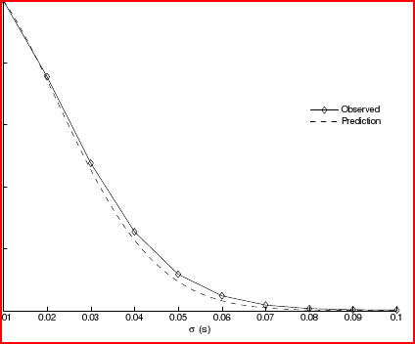
Crosstalk Prediction Formula
e
2 2
~
-σ ω
X =
L (L m - d )
+ L (L m - d )
O( )
T
T
2
1
1
1
2
2
X
.01 1.0
σ

Slide 23

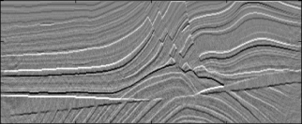


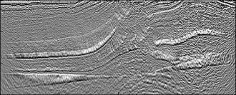
Standard Migration SNR
Assume:
[S(t) +N(t) ]
Zero-mean white noise
d(t) =
Standard Migration SNR
Neglect geometric spreading
Cost ~ O(S)
migrate
# CSGs
.
SNR=
GS
.
.
# geophones/CSG
Iterative Multisrc. Mig. SNR
Cost ~ O(I)
Standard Migration SNR
1
SNR=
GS
G
SNR=
GI
~
S
~
S
# iterations
+
stack
migrate
iterate
+
+

Slide 24
The SNR of MLSM image grows as the square root of the number of iterations.
7
SNR =
GI
SNR
0
1
Number of Iterations
300

Slide 25

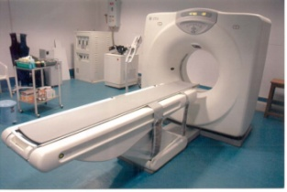
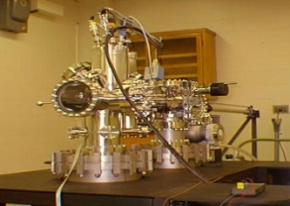
Summary
L
d
1
m =
1
L
d
[
N L + N L
]m = [N d + N d ]
2
2
1
1
2
2
1
1
2
2
Stnd. Mig Multsrc. LSM
IO 1 1/320
1 <1/44
Cost ~
1
Less 1
SNR~
Resolution dx 1 1
Cost vs Quality

Slide 26
Multisource FWI Summary
(We need faster migration algorithms & better velocity models)
Future: Multisource MVA, Interpolation, Field Data, Migration Filtering, LSM
Issues: Optimal encoding strategies, data
compression, loss of information.

Slide 27

Summary
(We need faster migration algorithms & better velocity models)
Stnd. FWI Multsrc. FWI
IO 1 vs 1/20 or better
Cost 1 vs 1/20 or better
Sig/MultsSig ?
Resolution dx 1 vs 1

Slide 28
Multisource Least Squares Migration
{
{
d
L
Forward Model:
d +d =[L +L ]m
₁
₂
₁
₂
Phase encoding
m_{mig}=L^{T}d
Multisource Migration:
Kirchhoff kernel
Standard migration
Crosstalk term
34

Slide 29
Multisource Least Squares Migration
Crosstalk term

Slide 30
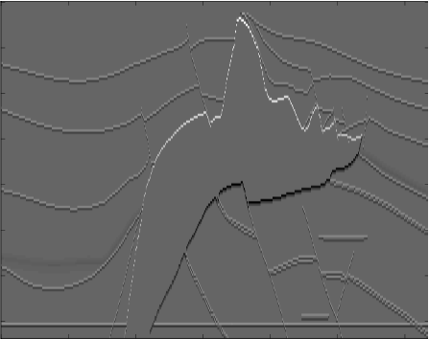
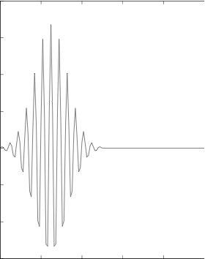
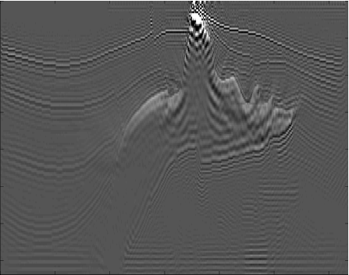
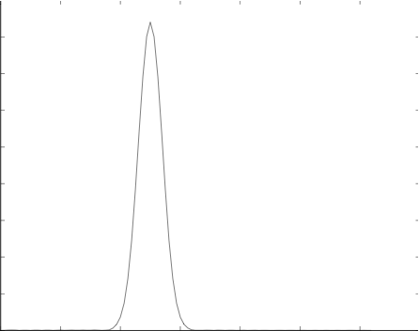
Numerical Result of Multi-source Super stacking
(Xin Wang)
Reflectivity model
Narrowed Spectrum Wavelet
0
0.4
Z (km)
Amplitude
1.4
-0.3
0
X (km)
5.9
0
time (s)
0.5
KM of 320 Single Source CSG
FT of Wavelet
0
4.5
Z (km)
Signal
Dominant frequency
1.4
0
0
X (km)
5.9
0
50
Frequency (Hz)
0.5
Notes:
Downleft is the Fourier Transform of the Narrowed Spectrum wavelet, the dominant frequency is 50 Hz. We use this narrowed spectrum wavelet to simulate the relationship of SNR with the variance of Gaussian distribution at a single frequency.

Slide 31
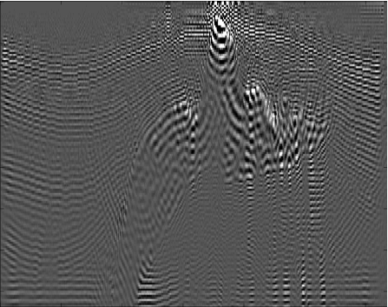
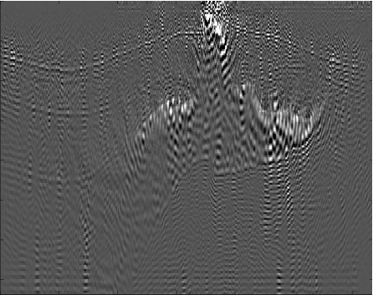
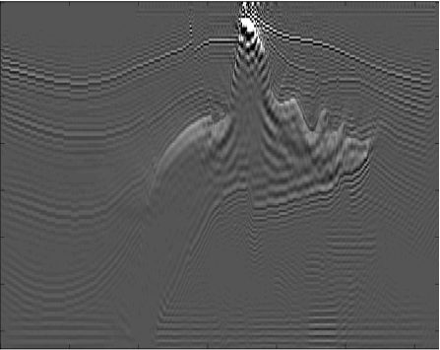
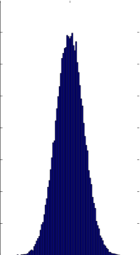
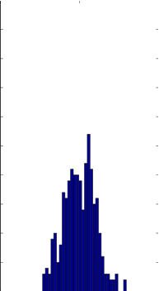
Numerical Result of Multi-source Super stacking
(Xin Wang)
KM of 320 Shots Supergather w/o PE
KM of 320 Shots Supergather with PE
0
0
Z (km)
Z (km)
Signal + Noise
Singal + Noise
1.4
1.4
0
X (km)
5.9
0
X (km)
5.9
KM of 3000 Stacking Supergather
Gaussian Distribution
0
4000
50
320 × 3000
320
Z (km)
Singal + Noise
1.4
0
0
0
X (km)
5.9
-0.05
0.05
-0.05
0.05
Notes:
(1) Upper left depicts the KM of only one Super-gather consisting 320 shots without any Phase Encoding( PE).
Upper right is the the result with PE – source side time shift with σ=0.01
Down right are the two gaussian distributions, right one is the source time shift of one super stacking consisting of 320 shots. Left one is the 3000 super stacking, so the total time shift for ensemble average is 3000*320.
Down left is the 3000 super stacking with σ=0.01

Slide 32
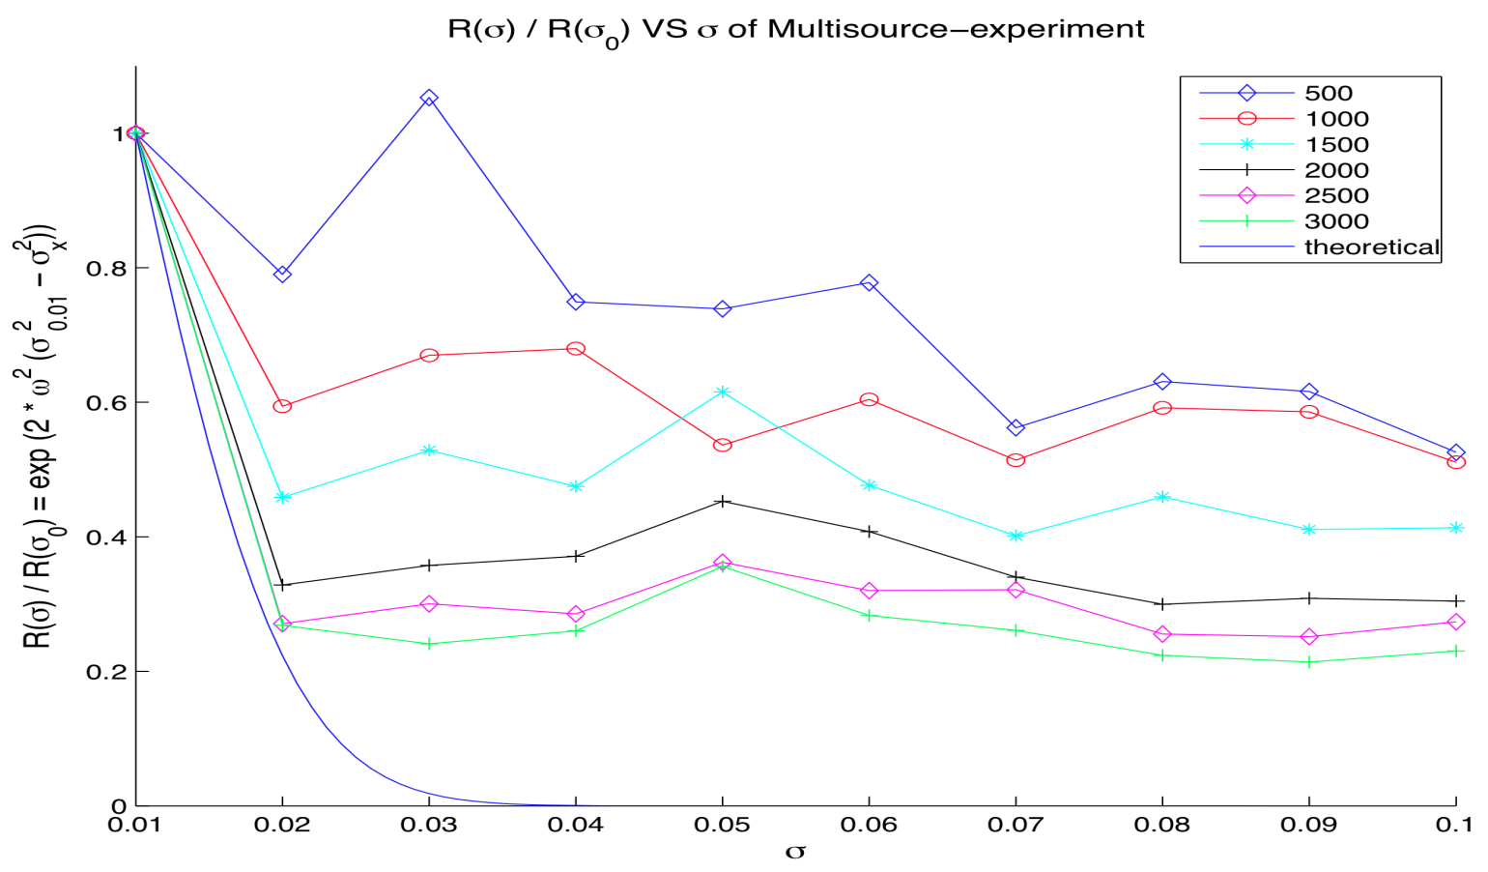
Numerical Result of Multi-source Super stacking
(Xin Wang)
Noise
= Signal + Noise
− Signal
= Σ Σ Γ(g,x,s)* D₀ (g|s)
+ R Σ Σ Σ Γ (g,x,s)* D₀ (g|s’)
g
s
g
s≠s’
s
2
= < N (g,s) N (g,s’)* > if s≠s’
R = e^{-2ω σ}
Crosstalk damping coefficient
2
R (σ) /
R (σ₀)
2
2
2
= e ^{2ω (σ}0 ^{- σ} ⁾

Slide 33
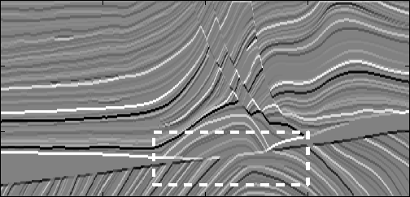
The Marmousi2 Model
(Wei Dai)
0
Z k(m)
3
0
X (km)
16
The area in the white box is used for SNR calculation.
200 CSGs.
Born Approximation
Conventional Encoding: Static Time Shift & Polarity Statics

Slide 34

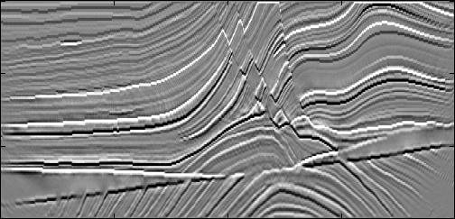
Conventional Source: KM vs LSM (50 iterations)
Conventional KM
0
Z k(m)
1x
3
0
X (km)
16
Conventional KLSM
0
Z (km)
50x
3
0
X (km)
16

Slide 35

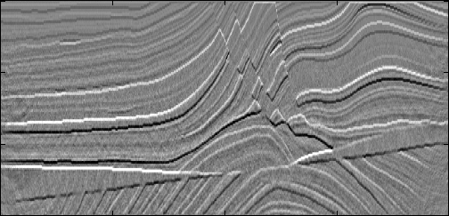
200-source Supergather: Multisrc. KM vs LSM
Multisource KM (1 iteration)
0
1 x
Z k(m)
200
3
0
X (km)
16
Multisource KLSM (300 iterations)
0
Z (km)
3
0
X (km)
16

Slide 36
Outline
1. Migration Problem and Encoded Migration
2. Standard vs Monte Carlo Least Squares Soln.
L
d
1
m =
1
vs
[
N L + N L
]m = [N d + N d ]
L
d
1
1
2
2
1
1
2
2
3. Numerical Results: Kirchhoff, Phase Shift, RTM
2
2
4. Summary

Slide 37
SEG/EAGE Salt Reflectivity Model
Z (km) 0
1.4
0
X (km)
6
Use constant velocity model with c = 2.67 km/s
Center frequency of source wavelet f = 20 Hz
320 shot gathers, Born approximation
Encoding: Dynamic time, polarity statics + wavelet shaping
Center frequency of source wavelet f = 20 Hz
320 shot gathers, Born approximation

Slide 38
Standard Phase Shift Migration vs MLSM
(Yunsong Huang)
Standard Phase Shift Migration (320 CSGs)
0
1 x
Z k(m)
1.4
0
X (km)
6
Multisource PLSM (320 blended CSGs, 7 iterations)
0
Z (km)
1 x
44
1.4
0
X (km)
6

Slide 39
Single-source PSLSM
(Yunsong Huang)
1.0
Conventional encoding: Polarity+Time Shifts
Model Error
Unconventional encoding
0.3
0
Iteration Number
50
Notes:
Jerry,
The multi-source and single-source approaches have used different strategies for the step length. Therefore direct comparison of their misfit error is not applicable. Sorry about that.

Slide 40
Outline
1. Migration Problem and Encoded Migration
2. Standard vs Monte Carlo Least Squares Soln.
L
d
1
m =
1
vs
[
N L + N L
]m = [N d + N d ]
L
d
1
1
2
2
1
1
2
2
3. Numerical Results: Kirchhoff, Phase Shift, RTM
2
2
4. Summary

Slide 41
3D SEG Overthrust Model (1089 CSGs, Chaiwoot)
15 km
3.5 km
15 km

Slide 42
300x
Numerical Results
(Chaiwoot Boonyasiriwat)
Dynamic QMC Tomogram
(99 CSGs/supergather)
300x
Static QMC Tomogram
(99 CSGs/supergather)
3.5 km
Dynamic Polarity Tomogram
(1089 CSGs/supergather)
15 km
1000x

Slide 43


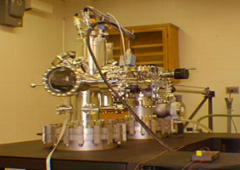
What have we empirically learned?
Stnd. Mig Multsrc. LSM
IO 1 1/320
1 1/44
Cost ~
S=320
I=7
SNR~
Resolution dx 1 1/2
Cost vs Quality: Can I<<S? Yes.

Slide 44
Outline
1. Migration Problem and Encoded Migration
2. Standard vs Monte Carlo Least Squares Soln.
L
d
1
m =
1
vs
[
N L + N L
]m = [N d + N d ]
L
d
1
1
2
2
1
1
2
2
3. Numerical Results
2
2
4. S/N Ratio

Slide 45
Standard Migration SNR
Assume:
[S(t) +N(t) ]
Zero-mean white noise
d(t) =
Standard Migration SNR
Neglect geometric spreading
Cost ~ O(S)
migrate
# CSGs
.
SNR=
GS
.
.
# geophones/CSG
Iterative Multisrc. Mig. SNR
Cost ~ O(I)
Standard Migration SNR
1
SNR=
GS
G
SNR=
GI
~
S
~
S
# iterations
+
stack
migrate
iterate
+
+

Slide 46
The SNR of MLSM image grows as the square root of the number of iterations.
7
SNR =
GI
SNR
0
1
Number of Iterations
300

Slide 47
Summary
L
d
1
m =
1
vs
[
N L + N L
]m = [N d + N d ]
L
d
1
1
2
2
1
1
2
2
2
2
Stnd. Mig Multsrc. LSM
IO 1 1/100
S I
Cost ~
GS
GI
SNR
Resolution dx 1 1/2
Cost vs Quality: Can I<<S?

Slide 48
Outline
Motivation
Multisource LSM theory
Signal-to-Noise Ratio (SNR)
Numerical results
Conclusions
Notes:
My talk is organized in the following way:
1. The first part is motivation. I will talk about a least squares migration (LSM ) advantages and challenges.
2. The second part is theory for a deblurring filter, which is an alternative method to LSM.
3. In the third part, I will show a numerical result of a deblurring filter.
4. The fourth is the main part of my talk.
Deblurred LSM (DLSM) is a fast LSM with a deblurring filter.
I will explain how to use the filter in LSM algorithm.
5. Then I will show numerical results of the DLSM.
6. Then I will conclude my presentation.
Each figure has a slide number is shown at the footer.
48

Slide 49
Conclusions Mig vs MLSM
1.
GS
GI
SNR: VS
2. Memory 1 vs 1/S
2. Cost: S vs I
3. Caveat: Mig. & Modeling were adjoints of one another. LSM sensitive starting model
4. Unconventional encoding: I << S
Next Step: Sensitivity analysis to starting model
Notes:
Second I compute reflectivity model within this offset range from the velocity and density models.
I also created a source wavelet that mimics an air gun source signature.
Fdom = 25 Hz.
49

Slide 50
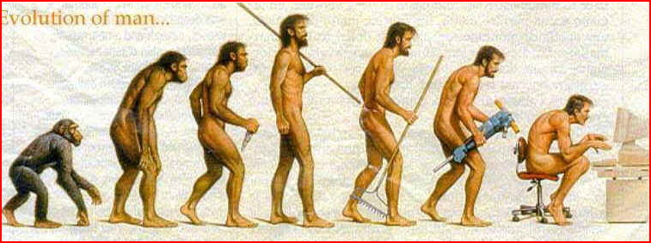
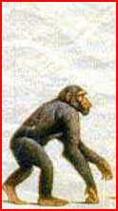
Back to the Future?
Evolution of Migration
1960s-1970s
1980s
1980s-2010
2010?
Poststack
migration
DMO
Prestack
migration
Poststack
encoded migration
Notes:
Second I compute reflectivity model within this offset range from the velocity and density models.
I also created a source wavelet that mimics an air gun source signature.
Fdom = 25 Hz.
50

Slide 51
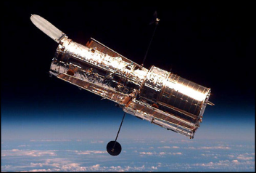
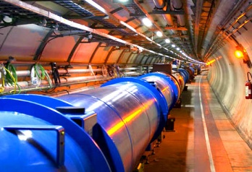
Multisource Seismic
Imaging
vs
CPU Speed vs Year
100000
10000
copper
1000
Aluminum
Speed
100
VLIW
10
Superscalar
RISC
1
1970
1980
1980
1990
2000
2010
2020
Year

Slide 52

Multisource Phase Encoded Imaging
{
{
d
L
Forward Model:
d +d =[L +L ]m
₁
₂
₁
₂
m_{mig}=L^{T}d
Multisource Migration:
^{T}
^{T}
=[L +L ](d + d )
₁
₂
₁
₂
m = m +
^{T}
^{T}
^{T}
^{T}
(k+1)
(k)
= L d +L d +
L d +L d
₁
₁
₂
₂
₁
₂
₂
₁
Standard migration
Crosstalk noise

Slide 53
FWI Problem & Possible Soln.
Problem: FWI computationally costly
Solution: Multisource Encoded FWI
Preconditioning speeds up by factor 2-3
Iterative encoding reduces crosstalk
Notes:
My talk is organized in the following way:
1. The first part is motivation. I will talk about a least squares migration (LSM ) advantages and challenges.
2. The second part is theory for a deblurring filter, which is an alternative method to LSM.
3. In the third part, I will show a numerical result of a deblurring filter.
4. The fourth is the main part of my talk.
Deblurred LSM (DLSM) is a fast LSM with a deblurring filter.
I will explain how to use the filter in LSM algorithm.
5. Then I will show numerical results of the DLSM.
6. Then I will conclude my presentation.
Each figure has a slide number is shown at the footer.
53

Slide 54
Outline
1. Migration Problem and Encoded Migration
2. Standard vs Monte Carlo Least Squares Soln.
L
d
1
m =
1
vs
[
N L + N L
]m = [N d + N d ]
L
d
1
1
2
2
1
1
2
2
3. Numerical Results: Kirchhoff, Phase Shift, RTM
2
2
4. Summary

