Slide 1
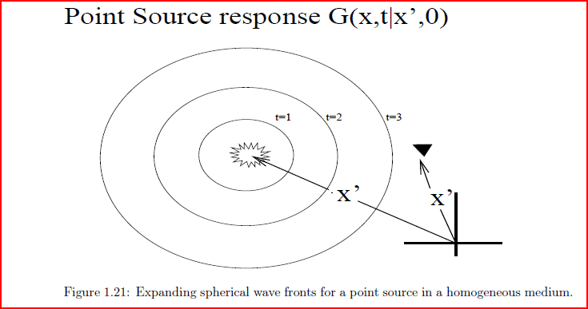


Green’s Functions

Slide 2
Outline
Attenuation
Eikonal Eqn
FD Solution to Eikonal Eqn
Ray Tracing from T(x,z)
Traveltime Integral
Ray Tracing from ODE

Slide 3
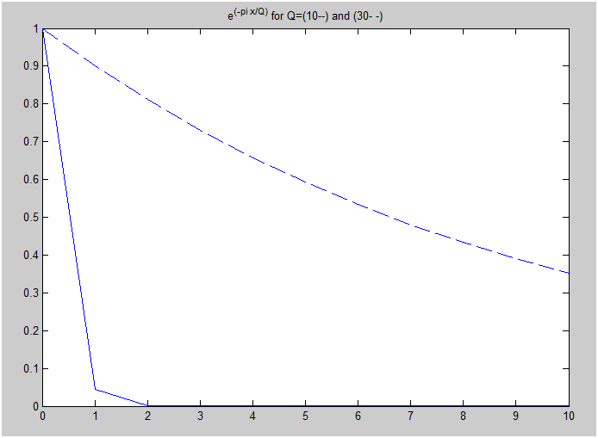
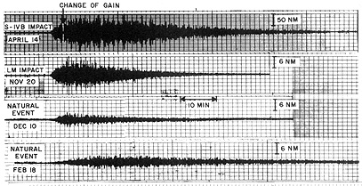
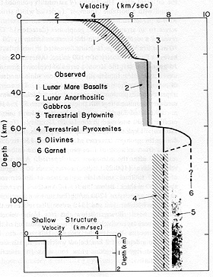

All these records differ from those associated with terrestrial earthquakes in lacking S (secondary or shear) waves. They also last for much longer than earthquakes - up to an hour, as though the Moon were "ringing" like a bell. The bulk of the moonquakes originate from depths of 600 km or more (attributed to the seismic signals bouncing back and forth in the low velocity surface layers [ejecta blanket]). They tend to occur in swarms associated both with preferred spatial locations and specific time intervals (probably accounted for by stresses induced by terrestrial tidal forces).
If Q=1, then one wavelength traveled, amplitude diminishes by e^(-pi)
Seismic Attenuation
(Att. Mechanism=Fluid Sloshing)
Q=30
Q=10
Larger Q = smaller attenuation
Smaller Q = greater attenuation
Larger ω = greater attenuation
Smaller ω = smaller attenuation
Larger r = greater attenuation
Note the two velocity discontinuities at about 20 and 60 km. Velocities within this interval are consistent with anorthosites. The higher velocities deeper than 60 km are associated with a proposed pyroxene-olivine upper mantle. Velocities between 4 and 20 km are indicative of a fractured basaltic flow sequence responding to load pressure. The shallow velocities (lower left inset) are attributed to the lunar ejecta blanket units discussed on the preceding page, overlain by comminuted regolith.
e^{-πr/(λQ)}
The inverse Fourier transform of the damped
exponential gives rise to an acausal bell-shaped curve.
Convolving this with the original Green’s
function gives an acausal response. Not realistic.
If Q=1, then one wavelength traveled , amplitude diminishes by e^(-pi)
If Q=2, then two wavelengths traveled , amplitude diminishes by e^(-pi)
If Q=N, then N wavelengths traveled , amplitude diminishes by e^(-pi)

