Slide 1
The Damping Factor for Evanescent Wave in Total Internal Reflection Zongcai Feng 11 May 2017
AGL Research Presentations & Update Meeting 2012

Slide 2
Total Internal Rreflection

Slide 3
Total Internal Rreflection

Slide 4

Total Internal Rreflection
Evanescent Wave

Slide 5
Snell’s Law

Slide 6
Snell’s Law
Snell’s law:
Evanescent Wave:

Slide 7
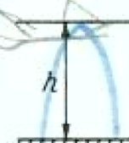
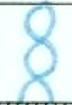
Waveguide Modes
fundamental
High-order
Evanescent Wave:
Damping faster
Damping slower

