Slide 1
An acoustic wave equation for pure P wave in 2D TTI media
Ge Zhan, Reynam C. Pestana and Paul L. Stoffa
Sept. 21, 2011

Slide 2


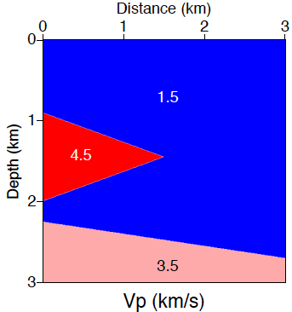
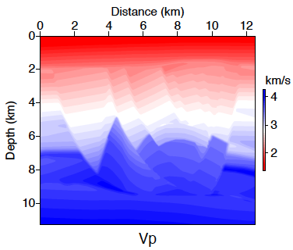
Outline
Motivation
Introduction
Theory
  TTI coupled equations (coupled P and SV wavefield)
  TTI decoupled equations (pure P and pure SV wavefield)
  Numerical implementation
Numerical Results
  Impulse response result
  Wedge model result
  BP TTI model result
Conclusions

Slide 3
Outline
Motivation
Introduction
Theory
  TTI coupled equations (coupled P and SV wavefield)
  TTI decoupled equations (pure P and pure SV wavefield)
  Numerical implementation
Numerical Results
  Impulse response result
  Wedge model result
  BP TTI model result
Conclusions
V_{s0}=0

Slide 4
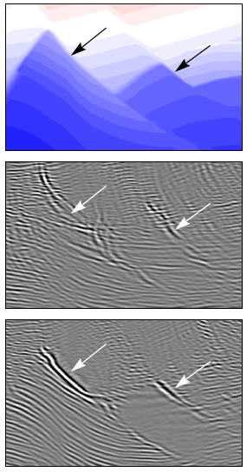
Motivation
Why go TTI (Tilted Transversely Isotropy)?
  Isotropic assumption is not always appropriate (this fact has been recognized in North Sea, Canadian Foothills and GOM).
  Conventional isotropic/VTI methods result in low resolution and misplaced images of subsurface structures.
  To obtain a significant improvement in image quality, clarity and positioning.
Pure P wave equation VS. TTI coupled equations
  TTI coupled equations are not free of SV wave.
  SV wave component leads to instability problem.
  To model clean and stable P wave propagation.
Model
VTI RTM
TTI RTM

Slide 5
Outline
Motivation
Introduction
Theory
  TTI coupled equations (coupled P and SV wavefield)
  TTI decoupled equations (pure P and pure SV wavefield)
  Numerical implementation
Numerical Results
  Impulse response result
  Wedge model result
  BP TTI model result
Conclusions
V_{s0}=0

Slide 6
Introduction
• Coupled equations (suffer from shear-wave artifacts, unstable)
  4th-order equation: Alkhalifah, 2000;
  2nd-order equations: Zhou et al., 2006; Du et al., 2008; Duveneck et al., 2008; Fletcher et al., 2008; Zhang and Zhang, 2008.
• Coupled equations (combined with shear-wave removal)
  Setting ε=δ around source: Duveneck, 2008;
  Model smoothing: Zhang and Zhang, 2010; Yoon et al., 2010
• Decoupled equations (free from shear-wave artifacts)
  Muir-Dellinger approximation (Dellinger and Muir, 1985; Dellinger et al., 1993; later reinvented by Stopin, 2001)
  Approximated VTI dispersion relation: Harlan, 1990&1995; Fowler, 2003; Etgen and Brandsberg-Dahl, 2009; Liu et al., 2009; Pestana et al., 2011

Slide 7
Outline
Motivation
Introduction
Theory
  TTI coupled equations (coupled P and SV wavefield)
  TTI decoupled equations (pure P and pure SV wavefield)
  Numerical implementation
Numerical Results
  Impulse response result
  Wedge model result
  BP TTI model result
Conclusions
V_{s0}=0

Slide 8
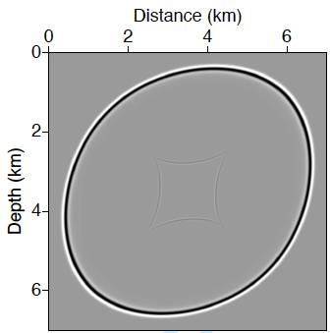
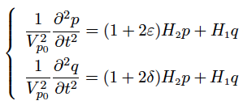
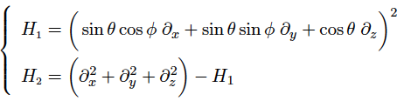
TTI Coupled Equations
Start with the P-SV dispersion relation for TTI media, set V_{s0}=0 along the symmetry axis （”pseudo-acoustic” approximation）
TTI Coupled Equations
(Zhou, 2006; Du et al., 2008; Fletcther et al., 2008; Zhang and Zhang, 2008)
Vertical
Tilted Axis
θ
North
Φ
Tilted Axis
V_{p0}=3000 m/s, epsilon=0.24
delta=0.1, theta=45 degree

Slide 9
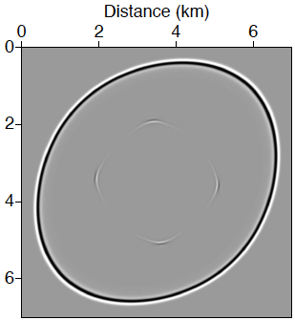

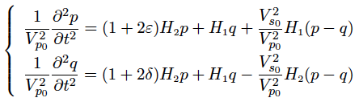
TTI Coupled Equations
Re-introduce non-zero V_{s0} (Fletcher et al., 2009),
the above equations become
V_{s0}=V_{p0}/2
V_{s0}=0
V_{p0}=3000 m/s, epsilon=0.24
delta=0.1, theta=45 degree

Slide 10
Outline
Motivation
Introduction
Theory
  TTI coupled equations (coupled P and SV wavefield)
  TTI decoupled equations (pure P and pure SV wavefield)
  Numerical implementation
Numerical Results
  Impulse response result
  Wedge model result
  BP TTI model result
Conclusions
V_{s0}=0

Slide 11

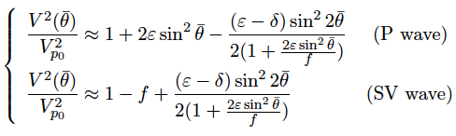
Square-root Approximation
Exact phase velocity expression for VTI media (Tsvankin, 1996)
where
expand the square root to 1st-order
_
_
(Muir-Dellinger approximation)

Slide 12
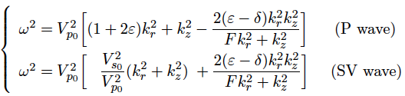

VTI Decoupled Equations
P wave and SV wave phase velocity for VTI media
P wave and SV wave dispersion relations for VTI media

Slide 13
VTI Decoupled Equations
P wave and SV wave dispersion relations for VTI media
pure-P
pure-SV
coupled P & SV
V_{p0}=3000 m/s epsilon=0.24 delta=0.1

Slide 14

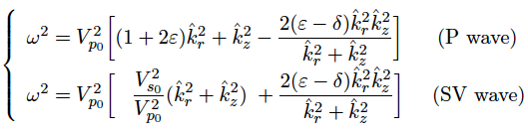
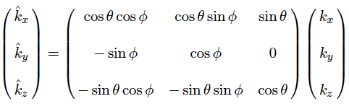
TTI Decoupled Equations
Replace ( , , ) by ( , , ), and
Dispersion relations for TTI media

Slide 15
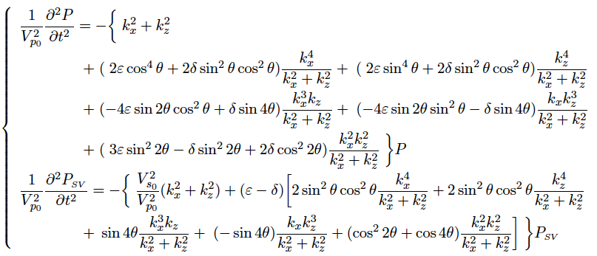
TTI Decoupled Equations
P-wave and SV-wave equations in 2D time-wavenumber domain

Slide 16
Outline
Motivation
Introduction
Theory
  TTI coupled equations (coupled P and SV wavefield)
  TTI decoupled equations (pure P and pure SV wavefield)
  Numerical implementation
Numerical Results
  Impulse response result
  Wedge model result
  BP TTI model result
Conclusions
V_{s0}=0

Slide 17
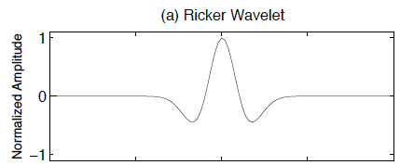

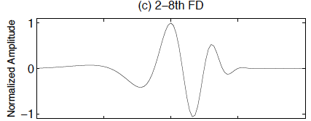
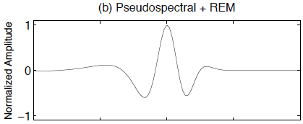
Numerical Implementation
Pseudospectral in space coupled with REM in time.

Slide 18
Outline
Motivation
Introduction
Theory
  TTI coupled equations (coupled P and SV wavefield)
  TTI decoupled equations (pure P and pure SV wavefield)
  Numerical implementation
Numerical Results
  Impulse response result
  Wedge model result
  BP TTI model result
Conclusions
V_{s0}=0

Slide 19
2D Impulse Responses ( epsilon > delta )
Tilted Axis
Vertical
θ
Coupled
Equations
V_{p0}=3000 m/s
epsilon=0.24
delta=0.1
theta=45 degree
V_{s0}=0
V_{s0}≠0
V_{s0}=0
V_{s0}≠0
Decoupled
Equations
pure-P
pure-SV
pure-P
pure-SV

Slide 20
2D Impulse Responses ( epsilon < delta )
Coupled
Equations
NaN
NaN
V_{p0}=3000 m/s
epsilon=0.1
delta=0.24
theta=45 degree
V_{s0}=0
V_{s0}≠0
V_{s0}=0
V_{s0}≠0
Decoupled
Equations
pure-P
pure-SV
pure-P
pure-SV

Slide 21
Outline
Motivation
Introduction
Theory
  TTI coupled equations (coupled P and SV wavefield)
  TTI decoupled equations (pure P and pure SV wavefield)
  Numerical implementation
Numerical Results
  Impulse response result
  Wedge model result
  BP TTI model result
Conclusions
V_{s0}=0

Slide 22
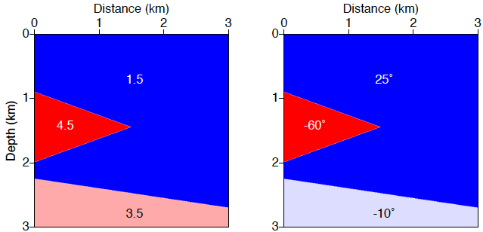
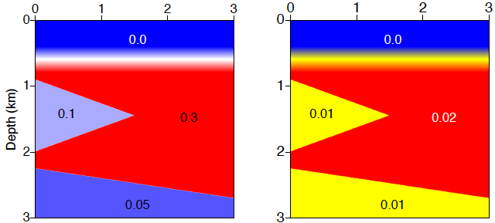
Wedge Model (coutesy of Duveneck and Bakker, 2011)
V_{p} (km/s)
theta (degree)
epsilon
delta

Slide 23
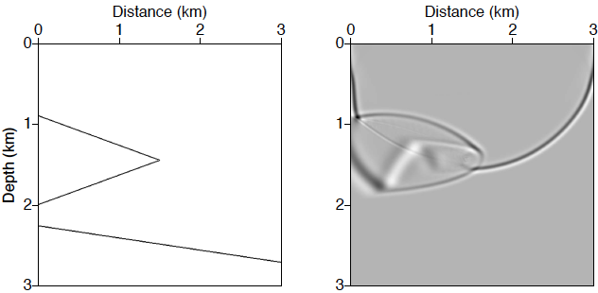
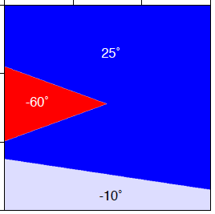
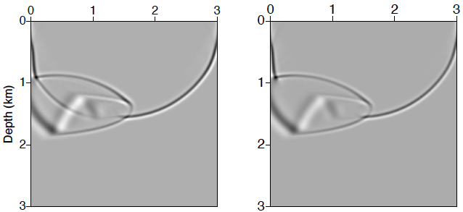
Wavefield Snapshots ( t =1 s)
V_{s0}=0
V_{s0}≠0
pure-P

Slide 24
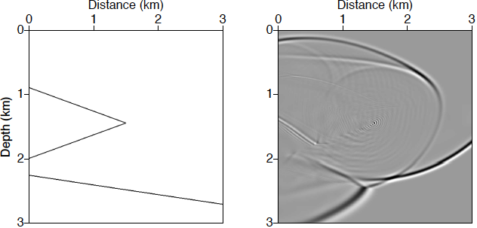
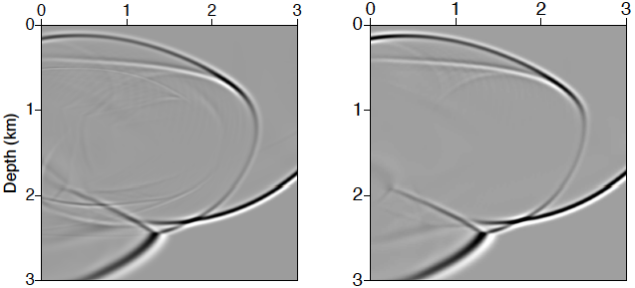
Wavefield Snapshots ( t =1.5 s)
instability
V_{s0}=0
V_{s0}≠0
pure-P

Slide 25
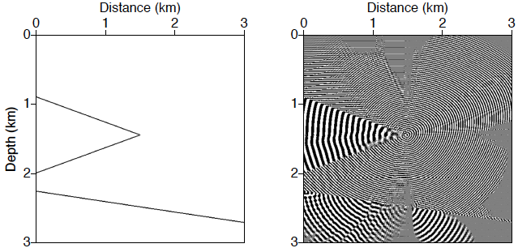
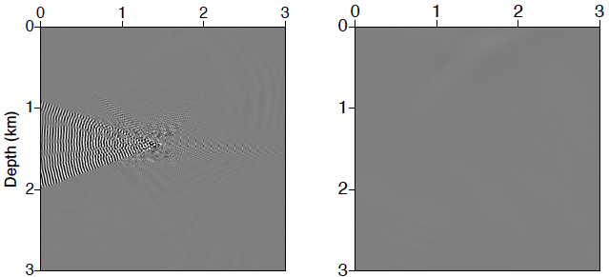
Wavefield Snapshots ( t =4 s)
unstable
V_{s0}=0
unstable
stable
V_{s0}≠0
pure-P

Slide 26
Outline
Motivation
Introduction
Theory
  TTI coupled equations (coupled P and SV wavefield)
  TTI decoupled equations (pure P and pure SV wavefield)
  Numerical implementation
Numerical Results
  Impulse response result
  Wedge model result
  BP TTI model result
Conclusions
V_{s0}=0

Slide 27
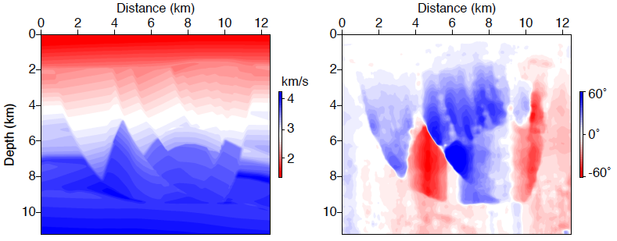
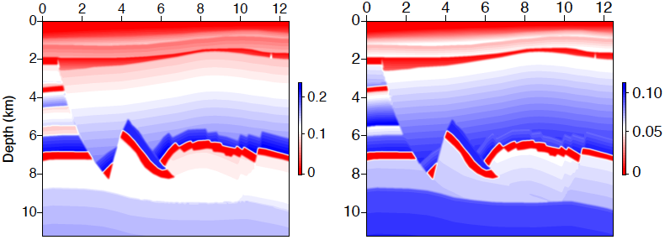
BP TTI Model
V_{p}
theta
epsilon
delta

Slide 28
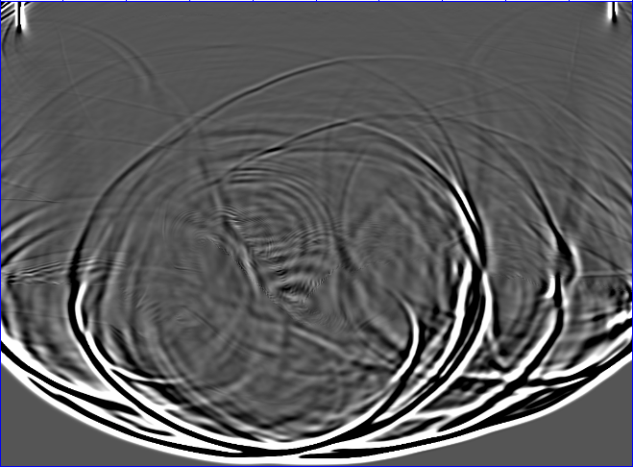
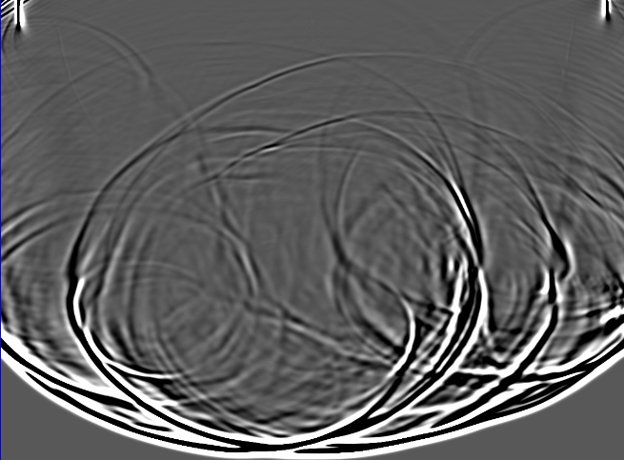
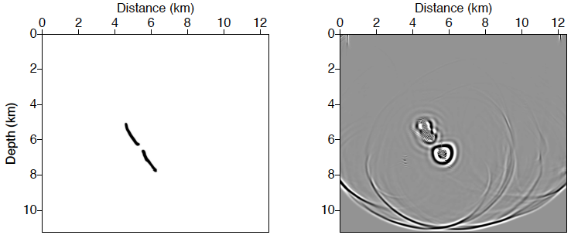
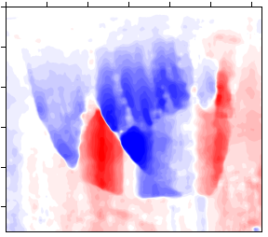
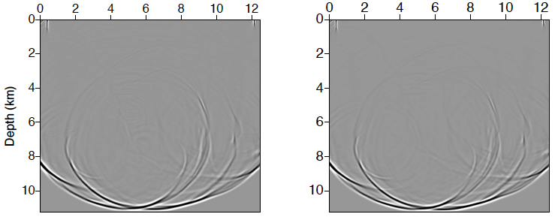
Wavefield Snapshots ( t=4 s)
insitibility
V_{s0}=0
V_{s0}≠0
pure-P

Slide 29
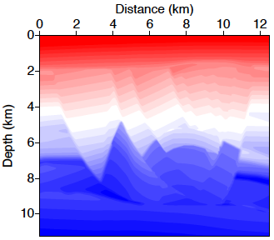
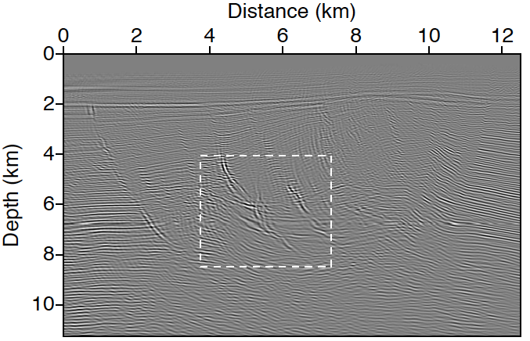
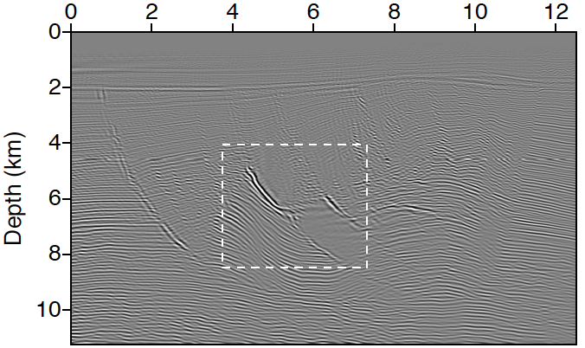
RTM Image
Model
VTI RTM
VTI RTM
TTI RTM
TTI RTM

Slide 30
Outline
Motivation
Introduction
Theory
  TTI coupled equations (coupled P and SV wavefield)
  TTI decoupled equations (pure P and pure SV wavefield)
  Numerical implementation
Numerical Results
  Impulse response result
  Wedge model result
  BP TTI model result
Conclusions
V_{s0}=0

Slide 31
Conclusions
TTI coupled and decoupled equations have long history with many contributors and derivations and methods of implementation.
We have shown that the numerical implementation using pseudospectral in space coupled with REM in time provides stable, near-analytically-accurate and numerical clean results.
Due to many FFTs (7 terms for 2D, 21 terms for 3D) per time step in the implementation, large clusters are needed for practical applications.

Slide 32
Acknowledgments
The authors wish to thank King Abdullah University of Science and Technology (KAUST) for providing research funding to this project.
We would like to thank BP for making the TTI model and dataset available.
We are also grateful to Faqi Liu, Hongbo Zhou, John Etgen and Paul Fowler for many useful suggestions on this work.

Slide 33
Thank you for your attention!
Questions?

