Slide 1
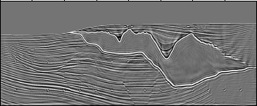
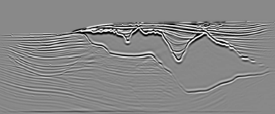
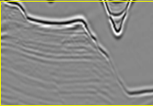
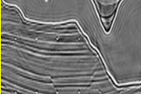
_{Benefits & Limitations of}
_{Least Squares Migration}
_{W.Dai,D.Zhang,X.Wang,GTS}
_{KAUST}
RTM Least Squares RTM
GOM RTM GOM LSRTM

Slide 2
_{Can We Improve Quality Seismic}
_{Imaging?}
Better Velocity Updates: FWI & MVA
Better Quality Images: LSM & Multiples

Slide 3
Outline
Theory: Multisource LSM
Examples: Synthetic & Field Data
Summary

Slide 4
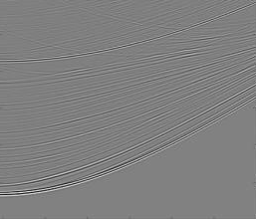
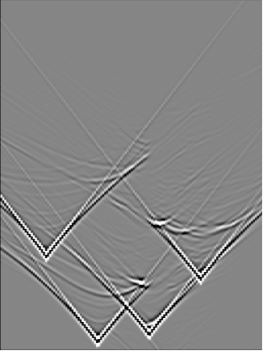
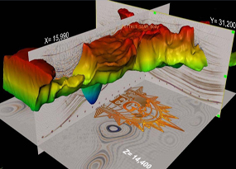
Standard Migration vs Multisource Migration
Romero, Ghiglia, Ober, & Morton, Geophysics, (2000)
Given: d1 and d2
Given: d1 + d2
Find: m
Find: m
Soln: m = (L1 + L2)(d1+d2)
T
T
T
Soln: m=L1 d1 + L2 d2
T
T
Benefit: Reduced computation and memory
= L1 d1 + L2 d2
Liability: Crosstalk noise …
T
T
+ L1 d2 + L2 d1

Slide 5
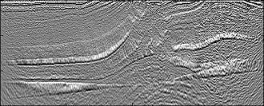
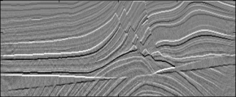
Multisource LSM & FWI
Inverse problem:
1
~
~
arg min
J =
|| d – L m ||²
m
2
δ
misfit
Iterative update:
~_{T}
m^{(k+1)} = m^{(k)} + α L δ
T
T
L1 d1 + L2 d2
T
T
K=10
+ L1 d2 + L2 d1
K=1

Slide 6
Brief Early History Multisource
Phase Encoded Imaging
Migration
Romero, Ghiglia, Ober, & Morton, Geophysics, (2000)
Waveform Inversion and Least Squares Migration
Krebs, Anderson, Hinkley, Neelamani, Lee, Baumstein,
Lacasse, SEG Zhan+GTS, (2009)
Virieux and Operto, EAGE, (2009)
Dai, and GTS, SEG, (2009)
Biondi, SEG, (2009)

Slide 7
Outline
Theory: Multisource LSM
Examples: 2D Marmousi Data
Summary

Slide 8
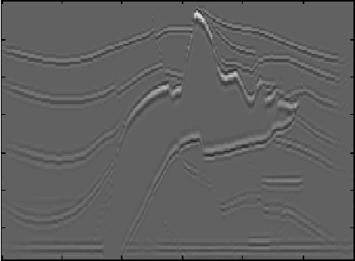
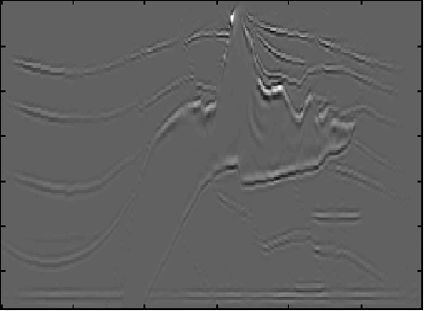
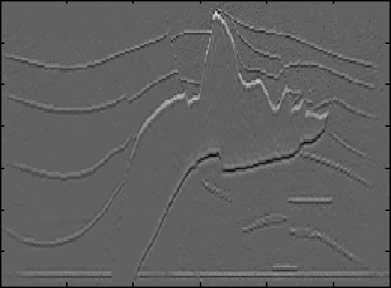
Migration Images (input SNR = 10dB)
(Huang and Schuster, 2011, Multisource Least-squares Migration of Marine Streamer with Frequency-division Encoding )
304 shots in total
an example shot and its aperture
0
a) Original
b) Standard Migration
Z (km)
1.48
0
X (km)
6.75
0
Computational gain
d) 304 shots/gather
26 iterations
c) Standard Migration with 1/8 subsampled shots
9.4
SNR=30dB
8.0
Z (km)
6.6
5.4
Comp. Gain
1.48
Conventional migration:
1
0
76
X (km)
152
6.75
0
X (km)
6.75
38
304
Shots per supergather

Slide 9
Sensitivity to input noise level
9.4
8.0
SNR=30dB
6.6
5.4
SNR=10dB
3.8
Computational gain
SNR=20dB
Conventional migration:
1
38
76
152
304
Shots per supergather

Slide 10
Outline
Theory: Multisource LSM
Examples: 3D SEG Salt
Summary

Slide 11
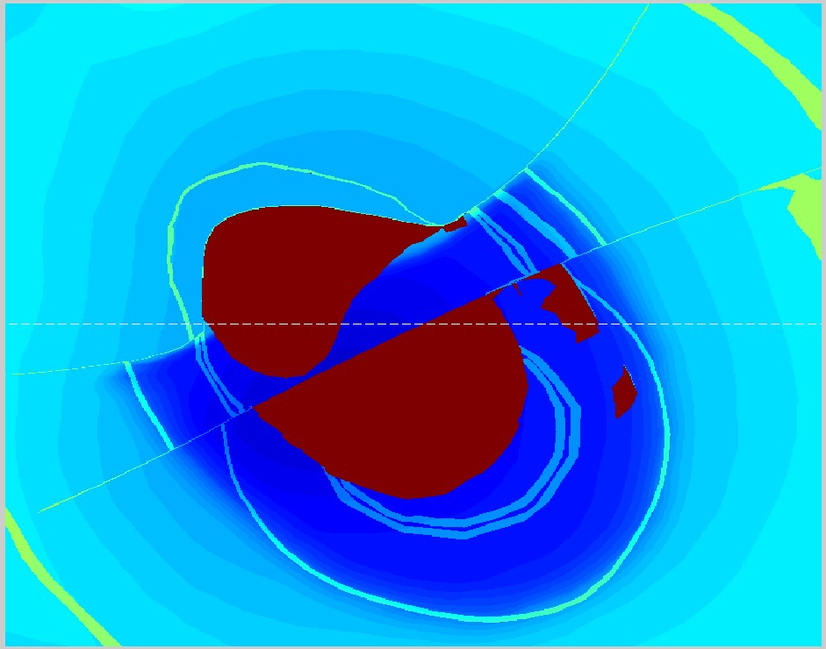
SEG/EAGE Model+Marine Data
(Yunsong Huang)
sources in total
40 m
100 m
16 swaths,
50% overlap
256 sources
a swath
6 km
20 m
3.7 km
16 cables
13.4 km

Slide 12
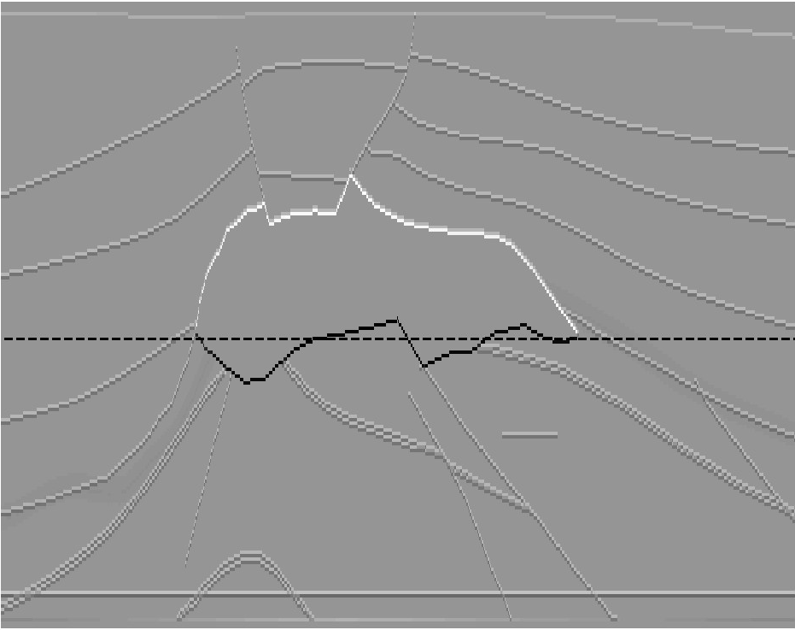
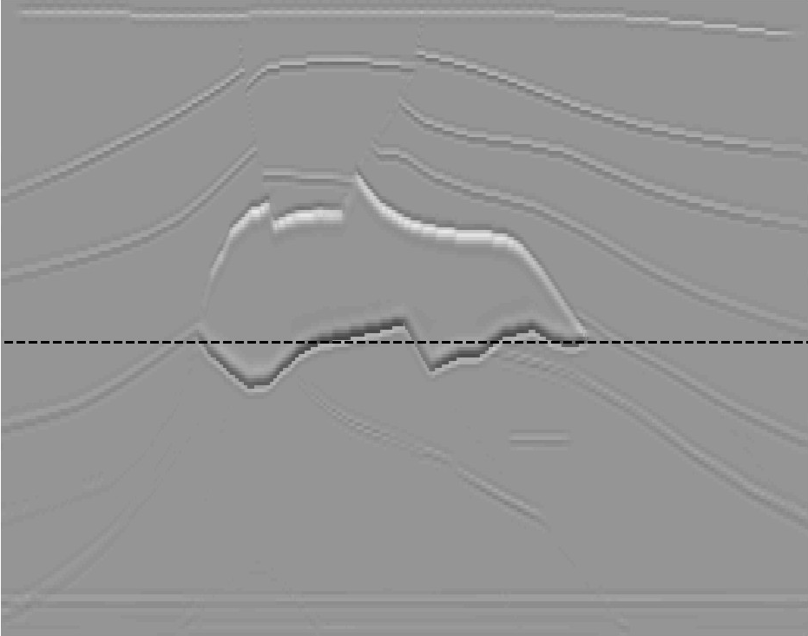
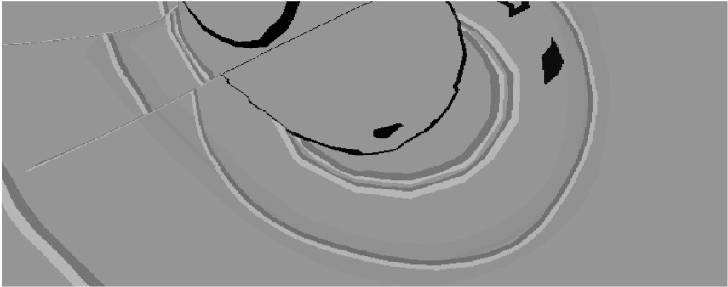
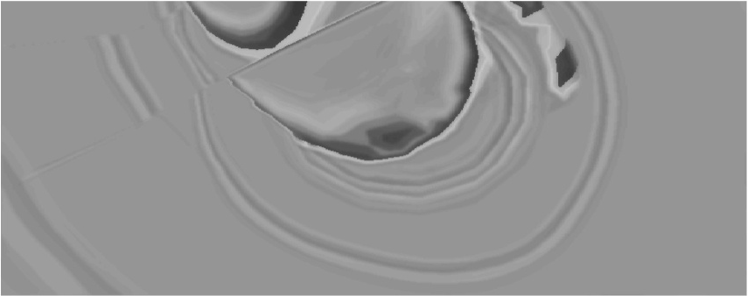
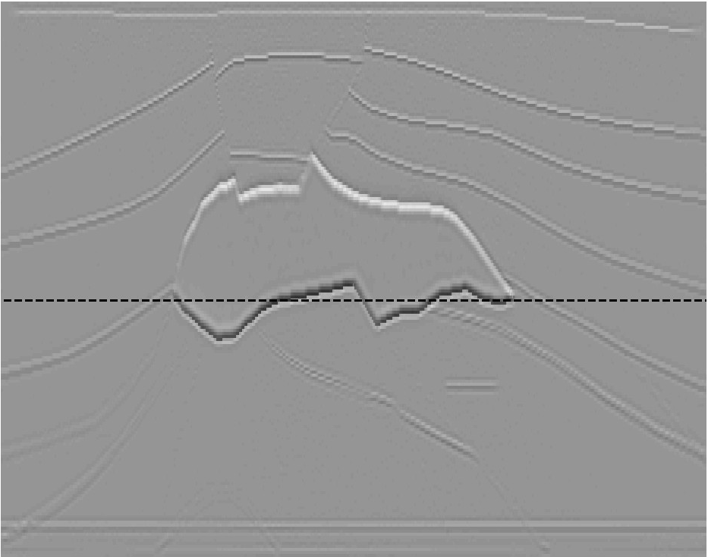

Numerical Results
(Yunsong Huang)
True reflectivities
6.7 km
Conventional migration
3.7 km
256 shots/super-gather, 16 iterations
3.7 km
13.4 km
8 x gain in computational
efficiency
Notes:
The multisource result is of slightly higher resolution than the conventional shot-gather migration; indistinguishable in this size on screen.

Slide 13
Outline
Theory: Multisource LSM
Examples: 2D GOM Data LSRTM
Summary

Slide 14
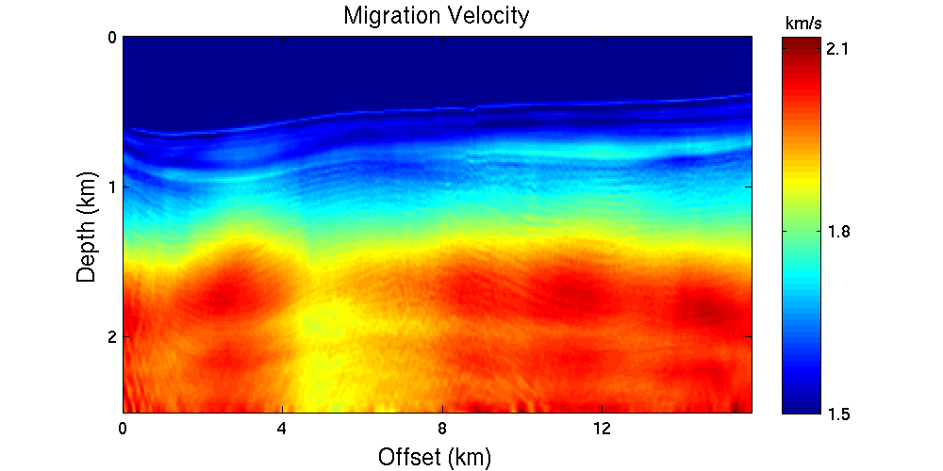
Plane-wave LSRTM of 2D GOM Data
Model size: 16 x 2.5 km.
Source freq: 25 hz
Shots: 515
Cable: 6km
Receivers: 480
0
km/s
2.1
Z (km)
2.5
1.5
0
X (km)
16

Slide 15
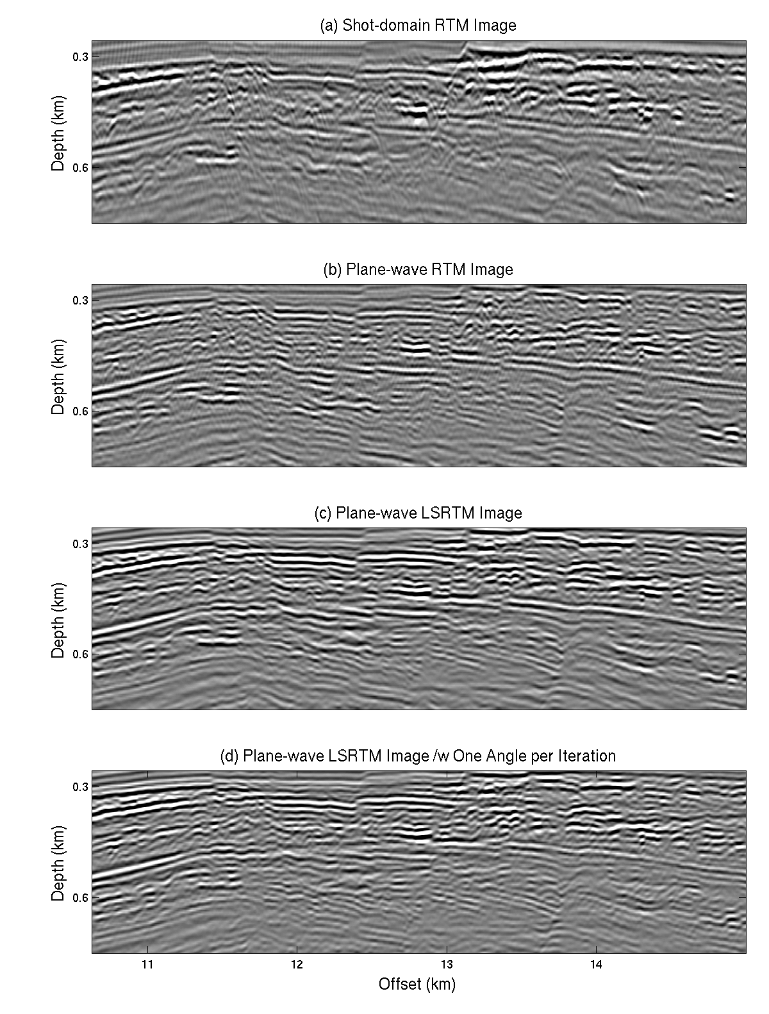
Conventional GOM RTM (cost: 1)
(Wei Dai)
0
Z (km)
2.5
Encoded Plane-wave LSRTM (cost: 0.4)
Plane-wave LSRTM (cost: 12)
Plane-wave RTM (cost: 0.2)
0
Z (km)
2.5
0
X (km)
16

Slide 16
Conventional GOM RTM (cost: 1)
(Wei Dai)
0
Z (km)
LSM
RTM
2.5
Encoded Plane-wave LSRTM (cost: 0.4)
Plane-wave LSRTM (cost: 12)
Plane-wave RTM (cost: 0.2)
0
Z (km)
2.5
0
X (km)
16

Slide 17
Outline
Theory: Multisource LSM
Examples: 2D GOM Data KLSM
Summary
Theory: Multisource LSM
Examples: 2D GOM Data LSRTM
Summary

Slide 18
Kirchhoff Migration Image (1X)
1.5 Z (km) 0.9
K M
KLS M (X. Wang)
Multisource Least-squares Migration Image (>10X)
1.5 Z (km) 0.9
10.5 X (km) 11.5

Slide 19
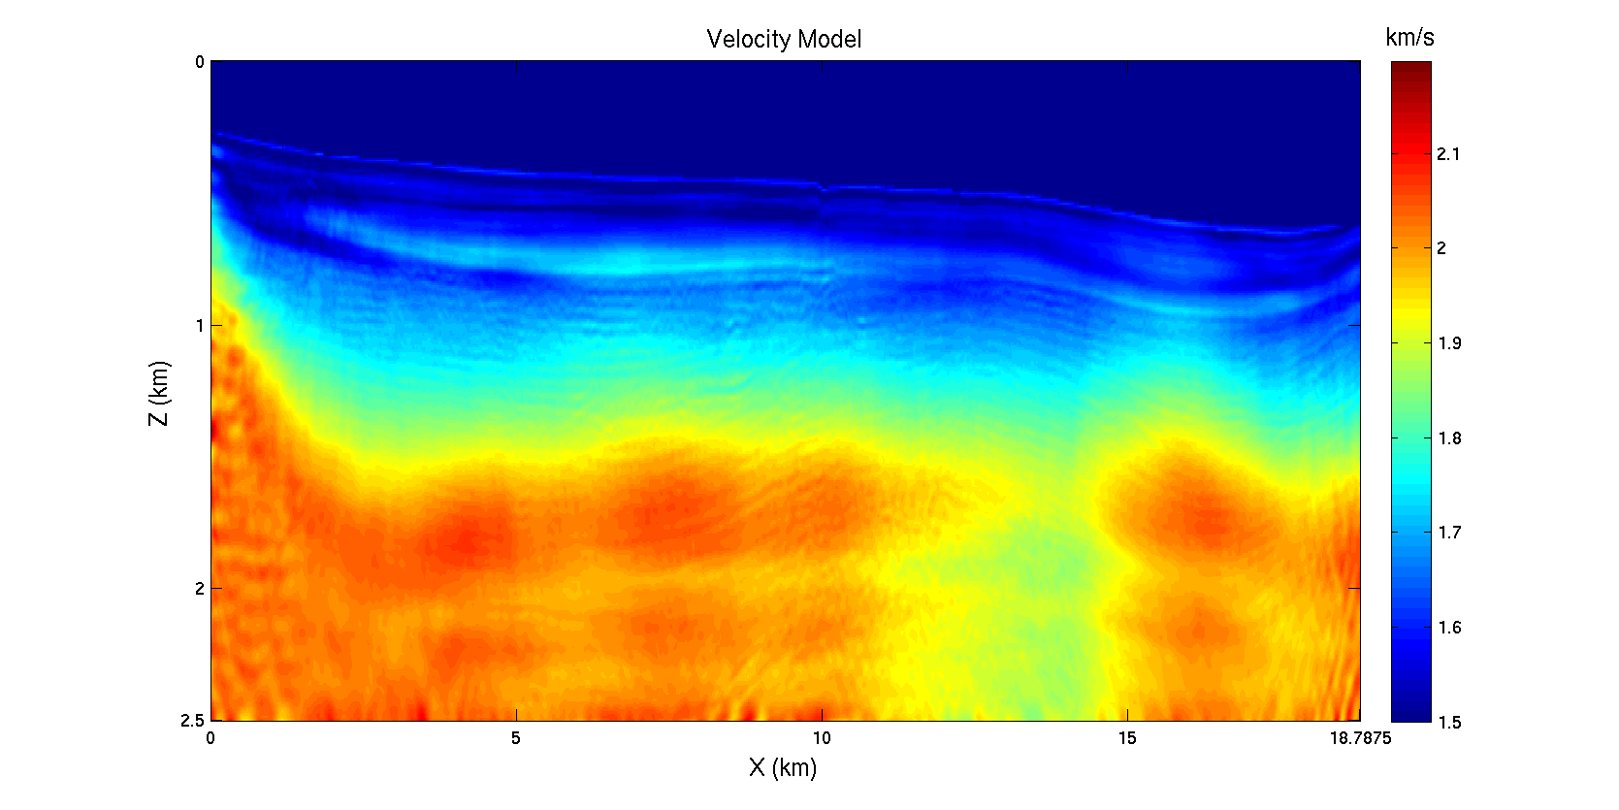
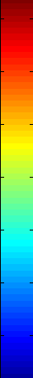
Alias and Gap Data
GOM data, aliased source and gap between 9.5 km and 10 km
Velocity model
km/s
Model Size: 3407 X 401
2.5 Z (km) 0
2.2
Interval: 6.25 m
# of shots: 248, ds = 75 m
# of receiver: 480, dg = 12.5 m
Streamer length: 6 km
Record length: 10.24 s, dt=2ms
1.5
0 X（km) 18.8
# of supergather: 32
# of shots in supergather: 16
Velocity model is from FWI. (Boonyasiriwat et al., 2010)
A 10-15-70-75 Hz bandpass filter is applied.
Source wave is generated from stacking near offset ocean bottom reflections.

Slide 20
Plane-wave LSRTM of 2D GOM Data
Model size: 16 x 2.5 km.
Source freq: 25 hz
Shots: 515
Cable: 6km
Receivers: 480
0
Mute 0.5 km data
km/s
2.1
Z (km)
2.5
1.5
0
X (km)
16

Slide 21
KM VS LSM VS MSLSM
KM image

Slide 22
KM VS LSM VS MSLSM
LSM Image after 30 Iterations

Slide 23
KM VS LSM VS MSLSM
MSLSM Image after 30 Iterations

Slide 24
Outline
Theory: Multisource LSM
Examples: 2D Salt Body with Multiples
Summary

Slide 25
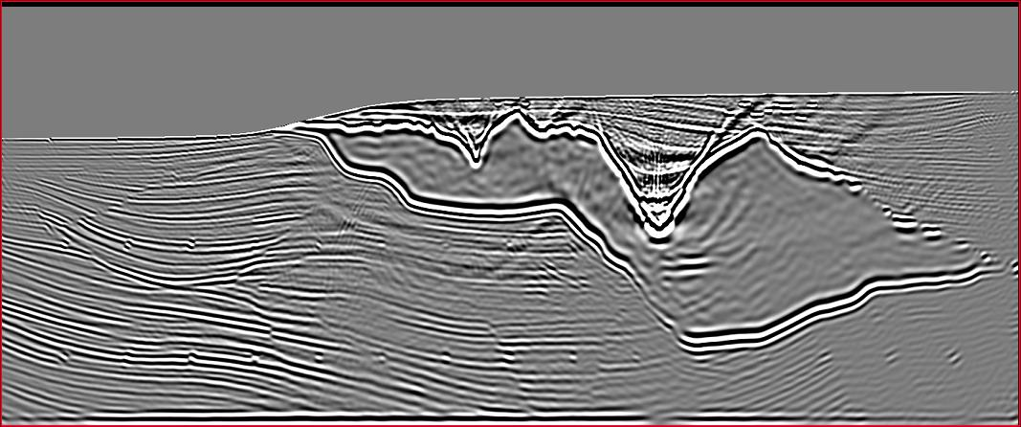
RTM SEG Salt Data
(Dongliang Zhang)
0
Z (km)
16
LSRTM with Born Multiples
0
1st-order Multiples
Z (km)
16
0
X (km)
16

Slide 26
RTM SEG Salt Data
(Dongliang Zhang)
0
Z (km)
16
LSRTM with Born Multiples
0
RTM
LSRTM
Z (km)
16
0
X (km)
16

Slide 27
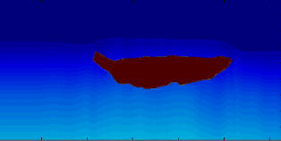
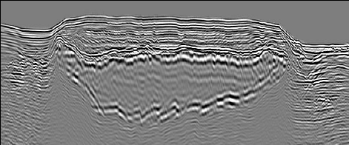
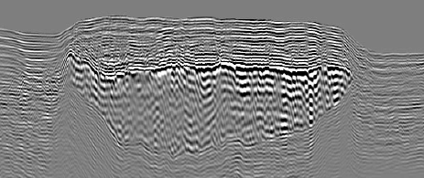
GOM Salt Data
(Dongliang Zhang)
0
Z (km)
3.0
RTM with Multiples
0
Z (km)
3.0
0
X (km)
30

Slide 28
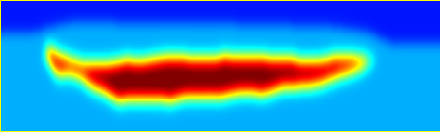
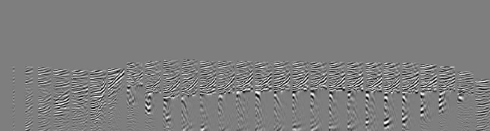
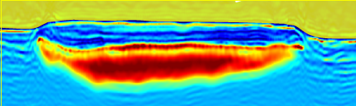
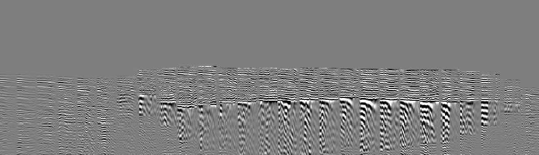
Starting Velocity Model
0
Z (km)
3.0
FWI
(Abdullah AlTheyab)
0
Z (km)
3.0
0
X (km)
30

Slide 29
What have we Empirically Learned about Quality?
LSM no better than RTM if inaccurate v(x,y,z)
2. Cost MLSM ~ RTM; MLSM better resolution
3. Speckle noise in LSM
4. Multiples can be significantly enhanced if separated
properly from primaries
5. FWI works for easy GOM data, not for hard salt
6. FWI & LSM quality degrades below 2 km?
7. Why? Unaccounted Physics? 1). Attenuation,
2). V(x,y,z), 3). ???

Slide 30
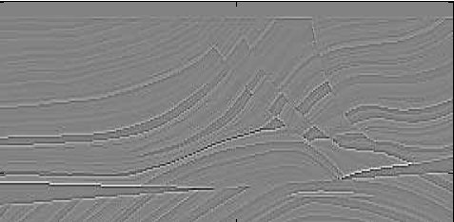
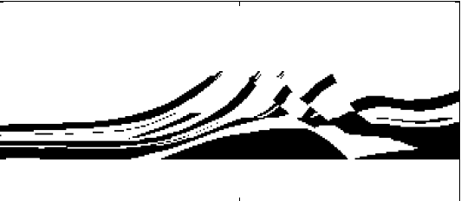
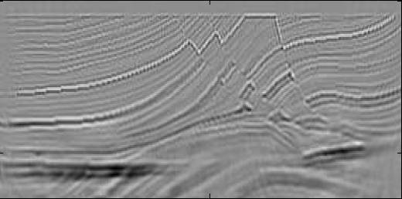
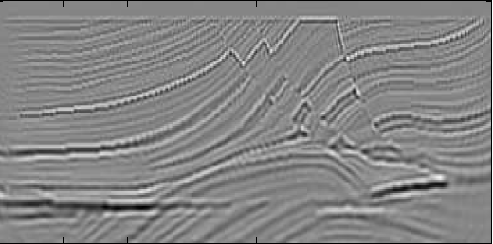
True Reflectivity
Q Model
0 Z (km) 1.5
0 Z (km) 1.5
Q=20000
Q=20
0 X (km) 2
0 X (km) 2
Acoustic LSRTM
Viscoelastic LSRTM
0 Z (km) 1.5
1.0 -1.0
1.0 -1.0
0 X (km) 2
0 X (km) 2

Slide 31

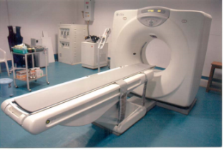
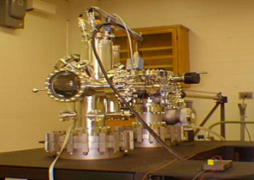
What have we empirically learned about MLSM?
Stnd. Mig Multsrc. LSM
IO 1 ~1/36
1 ~0.1
Cost
Migration
SNR
1
~1
Resolution dx 1 ~double
Cost vs Quality: Can I<<S? Yes.

