Slide 1
Extracting 200 Hz Information from 50 Hz Data
G. Schuster, S. Hanafy, and Y. Huang,
KAUST
Rayleigh Resolution Profile
Superresolution Profile
Sinc
function
Spiking
function

Slide 2
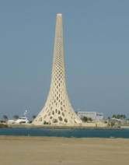
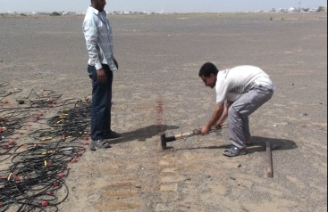
Outline
Motivation: Why Resolution Matters
Diffraction vs Specular Resolution: Example
Evanescence Resolution
Field Test
Conclusions

Slide 3
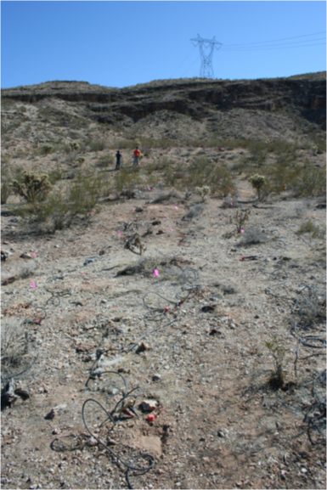

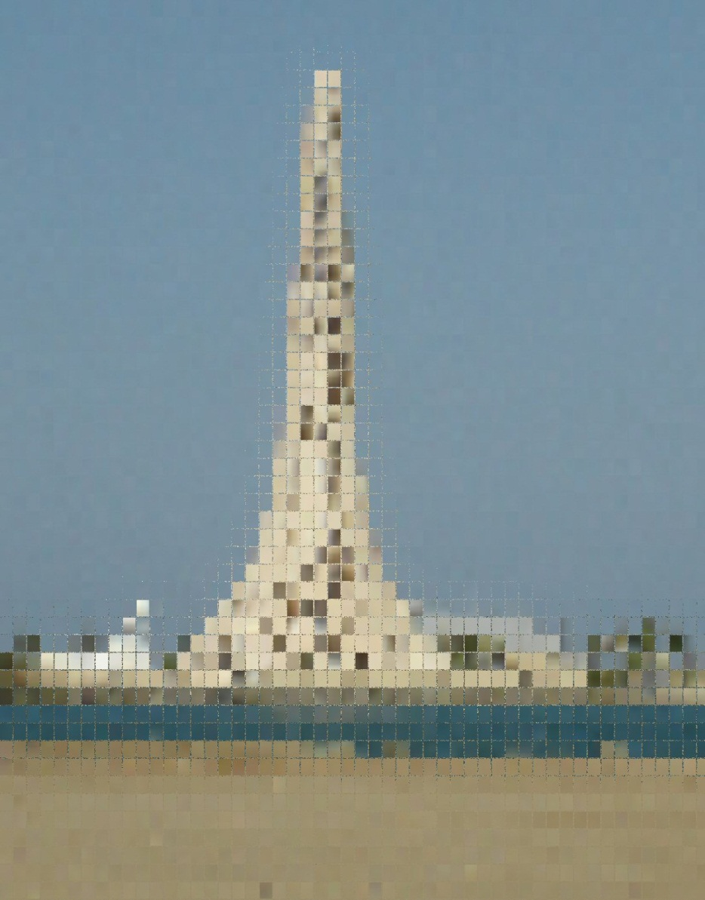
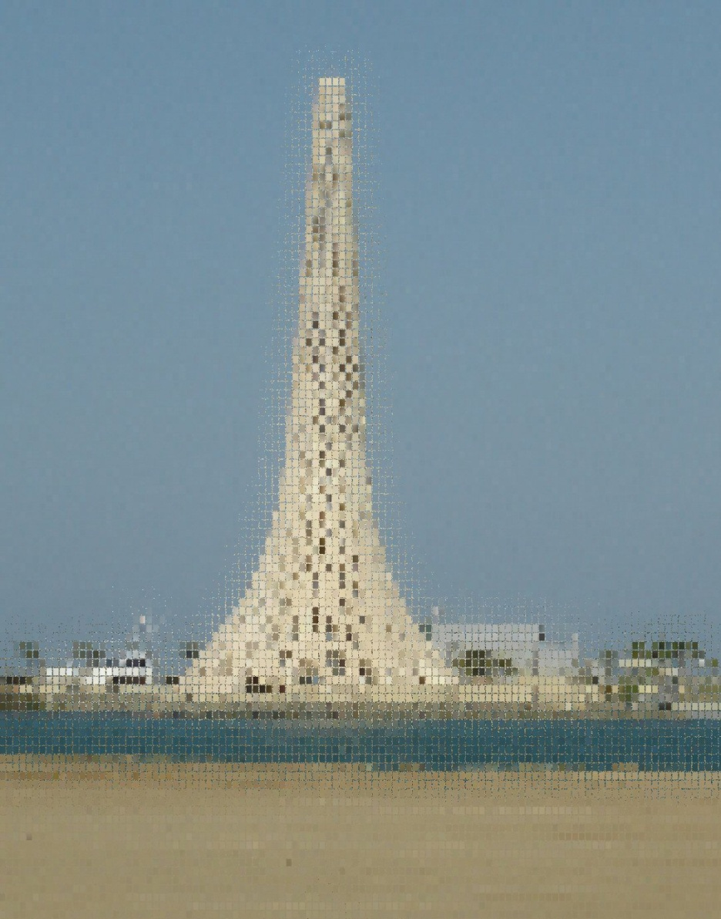
Resolution Δx~λ/2
L
Depth
Z
Δx
Δx =
λz
Δx
Rayleigh Resolution:
4L
Δx =
λ
KAUST yacht
Abbe Resolution:
2
Δx <<
λ
Super Resolution?:
2

Slide 4

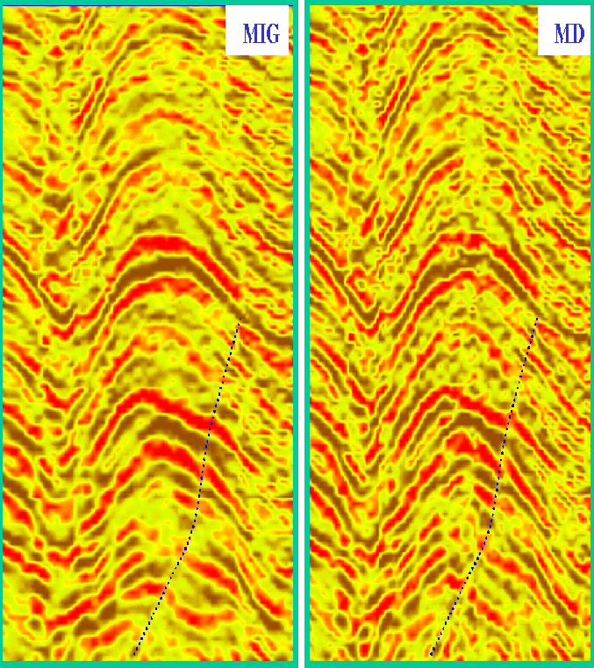
Geophysical Resolution
0 km
3 km
?
(Jianhua Yu)
0 km 7 km
0 km 7 km

Slide 5

Transmission+Reflection Wavepaths
(Woodward, 1992)
d
FWI rabbit ears
Z
RTM smile
RTM Resolution: Δx=Rayleigh, Δz=λ/4
FWI Resolution: ?
X

Slide 6

Transmission+Reflection Wavepaths
(Woodward, 1992)
d
FWI rabbit ears
Z
FWI Resolution: Δx = $√$2λd (Williamson, 1991)
FWI Resolution:
X

Slide 7
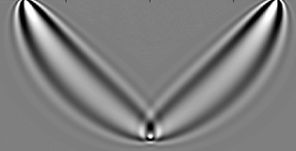


Transmission+Reflection Wavepaths
(Woodward, 1992)
Diff. FWI Resolution: Δx^{diff} = $√$λd
d
FWI rabbit ears
3
Δx
= $√$2
FWI Resolution: Δx = $√$2λd (Williamson, 1991)
Δx^{diff}
FWI Resolution:
Benefit: Diffractions transform
SSP→Xwell or VSP Data
Liability: SNR^{diff} << SNR^{spec}
X

Slide 8
Summary
Diff. FWI Resolution: Δx^{diff} = $√$λd vs Specular FWI Resolution: Dx = $\sqrt{2\text{l}d}$
Benefit: Diffractions transform SSP→Xwell or VSP Data
Liability: SNR^{diff} << SNR^{spec}
FWI rabbit ears
3

Slide 9
Outline
Motivation: Why Resolution Matters
Diffraction vs Specular Resolution: Example
Evanescence Resolution
Field Test
Conclusions

Slide 10
Diffraction Waveform Modeling
Scattered CSG
Velocity
0
0
Depth (km)
1.2
time (s)
Born
Reflectivity
Modeling
0
Depth (km)
4.0
1.2
0
Distance (km)
3.8
0
Distance (km)
3.8

Slide 11
Diffraction Waveform Inversion
Initial Velocity
Inverted Velocity
0
0
Depth (km)
Depth (km)
1.2
1.2
Estimated Reflectivity
True Velocity
0
0
Depth (km)
Depth (km)
1.2
1.2
0
Distance (km)
3.8
0
Distance (km)
3.8

Slide 12
Outline
Motivation: Why Resolution Matters
Diffraction vs Specular Resolution: Example
Evanescence Resolution
Field Test
Conclusions

Slide 13
Far-field Propagation → λ-limited Resolution
e^{iωτxg}
G(g|x)=
r
Mig(z)
Time
λ

Slide 14
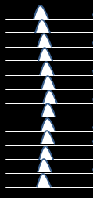
Near-field Propagation → λ/20 Resolution
e^{iωτxg}
G(g|x)=
r
r
Evanescent energy
Mig(z)
Mig(z)
Note: Time delay unable to
distinguish 2 scatterers, but
near-field amplitude changes can:
Δx=λ/20
Time
λ

Slide 15
Near-field Propagation → λ/20 Resolution
e^{iωτxg}
G(g|x)=
r
r
Evanescent energy
Mig(z)
Note: Time delay unable to
distinguish 2 scatterers, but
near-field amplitude changes can:
Δx=λ/20
If source is in farfield of scatterers
& geophones in nearfield,
superresolution possible
Time
λ

Slide 16
Summary
1. Near-field Propagation → λ/20 Resolution
Mig(z)
If source is in farfield of scatterers
& geophones in nearfield,
superresolution possible
reciprocity
If source is in nearfield of scatterers
& geophones in farfield,
superresolution possible
Time
λ

Slide 17
Summary
1. Near-field Propagation → λ/20 Resolution
CRG
Mig(z)
If source is in farfield of scatterers
& geophones in nearfield,
superresolution possible
reciprocity
If source is in nearfield of scatterers
& geophones in farfield,
superresolution possible
Time
λ

Slide 18
Outline
Motivation: Why Resolution Matters
Diffraction vs Specular Resolution: Example
Evanescence Resolution
Field Test
Conclusions

Slide 19
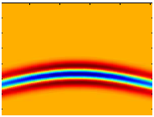
Near-Field Scatterer Images
Δx ~
0.01λ
λ
λ
Δx ~
0.1λ
λ
λ
0.7λ
Δx ~
λ
λ

Slide 20
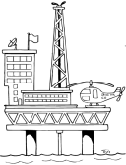
25 Near-Field Scatterers Image
Δ z ~
0.1λ
λ
λ

Slide 21
25 Near-Field Scatterers Image
λ
Migration image at superresolution

Slide 22
25 Near-Field Scatterers Image
λ

Slide 23
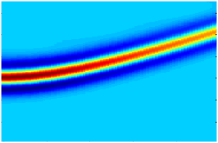
25 Near-Field Scatterers Image

Slide 24
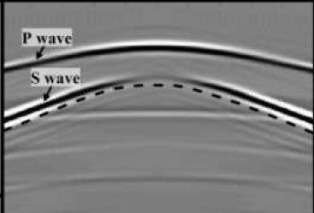
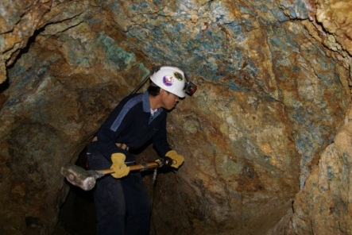
Elastic Tunnel Test: 6 Near-Field Scatterers
S wave
P wave
Vp=1.5 km/s
Vs=0.75 km/s
40 m
Vp=3.0 km/s
Vs=1.5 km/s
100 m

Slide 25
Elastic Tunnel Test: 6 Near-Field Scatterers
S wave
P wave
Vp=1.5 km/s
Vs=0.75 km/s
No scatterer data
40 m
scattered
data
Vp=3.0 km/s
Vs=1.5 km/s
100 m

Slide 26
Outline
Motivation: Why Resolution Matters
Diffraction vs Specular Resolution: Example
Evanescence Resolution
Field Test
Conclusions

Slide 27
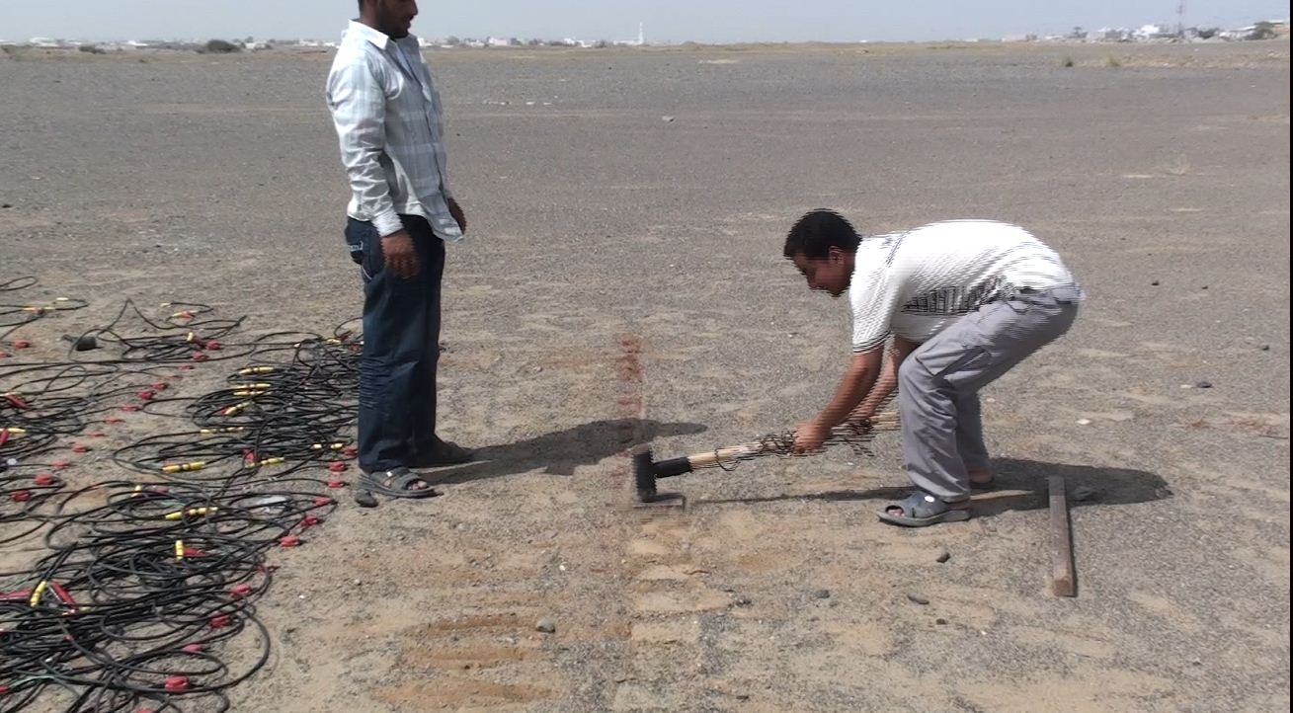
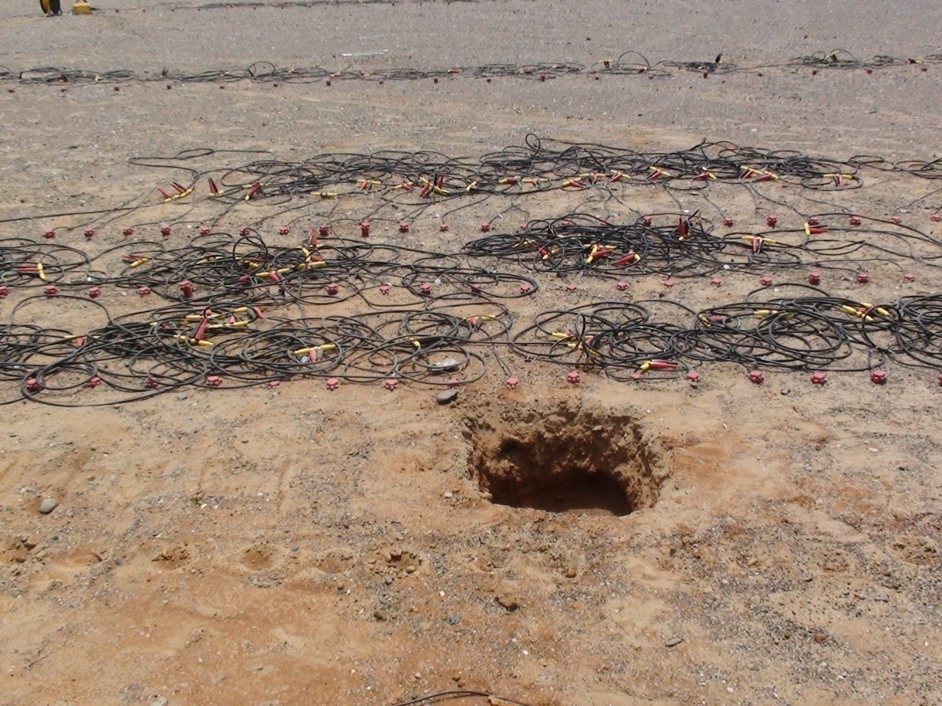

Superresolution Test
Experimental Setup
(Not to Scale)
Goal: Test superresolution imaging by seismic
experiment
Experiment: Data with and without a scatterer
λ=1.6 m

Slide 28
Superresolution Test
Experimental Setup
(Not to Scale)
Goal: Test superresolution imaging by seismic
experiment
Experiment: Data with and without a scatterer
λ=1.6 m
0.2 m
0.6 m

Slide 29
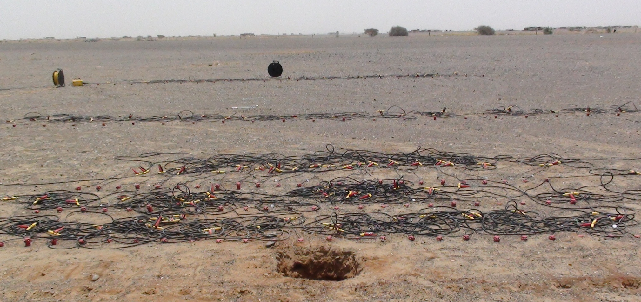
TRM Profiles

Slide 30


λ/4 Resolution (110 Hz)
0.5 m
w/o scatterer
with scatterer
λ/8 Resolution (55 Hz)
Theory
λ
0.5 m
with scatterer
220 Hz information from 55 Hz data

Slide 31
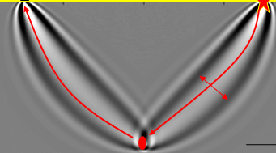
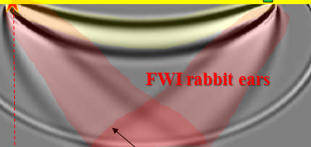

Summary
Diff. FWI Resolution: Δx^{diff} = $√$λd vs Specular FWI Resolution: Dx = $\sqrt{2\text{l}d}$
Workflow
1. Collect Shot gathers G(g|s ), separate scattered field
2. m(s’) = Σ G(g,t|s’)* G(g,t|s )
3. TRM profiles
Synthetic Results Δx~λ/10
Limitations
Either src or rec in nearfield of subwavelength scatterer
Scattered field separated from specular fields is Big Challenge

Slide 32
Possible Applications
SSP: Detect local anomalies, faults, and scatterer points around surface
VSP: Find local anomalies, faults, and scatterer points around boreholes in VSP data
Farfield?
Ground
Borehole

Slide 33
Earthquakes along a Fault Detect Fault Roughness
Subduction zone
TRM Profile

Slide 34
Earthquakes US Array Detect Near Surface
Subduction zone
TRM Profile

