Slide 1
Angle-domain Wave-equation
Reflection Traveltime Inversion
Sanzong Zhang, Yi Luo and Gerard Schuster
(1) KAUST, (2) Aramco
1
2
1
Notes:
Good afternoon, everyone. The title of my talk is wave-equation reflection traveltime inversion. The coauthors are Dr. Yi Luo from Aramco, and Prof. Schuster.

Slide 2
Outline
Introduction
Theory and method
Numerical examples
Conclusions

Slide 3
Outline
Introduction
Theory and method
Numerical examples
Conclusions

Slide 4
Velocity Inversion Methods
Ray-based tomography
Data space
(Tomography)
Wave-equ. Reflection traveltime inversion
Full Waveform inversion
Inversion
Ray-based MVA
Image space
Wave-equ. Reflection traveltime inversion
(MVA)
Wave-equ. MVA
Notes:
The current velocity inversion methods can be divided into two types. One type defines the objective function in data space, such as traveltime tomography and full waveform inversion. The other type defines the objective function in model space, such as ray-based MVA and wave-equation-based MVA.

Slide 5
Problem
The waveform (image) residual is highly nonlinear with respect to velocity change.
2
ε =
-
$$ε$$
$$∆τ$$
Pred. data – Obs. data
$$∆τ$$
Model Parameter
The traveltime misfit function enjoys a somewhat linear relationship with velocity change.

Slide 6
Angle-domain Wave-equation
Reflection Traveltime Inversion
Traveltime inversion without high-frequency approximation
Misfit function somewhat linear with respect to velocity perturbation.
Wave-equation inversion less sensitive to amplitude
Multi-arrival traveltime inversion
Beam-based reflection traveltime inversion
Notes:
To exploit the strengths and avoid the weaknesses of both traveltime tomography and full waveform inversion, wave-equation-based transimission traveltime inversion was developed to invert the velocity model. This method tried to invert the transmission traveltime informaiton using the method similar to full waveform inversion.

Slide 7
Outline
Introduction
Theory and method
Numerical examples
Conclusions

Slide 8
Wave-equation Transmission
Traveltime Inversion
1). Observed data $p^{obs}$
0
Time (s)
5
$$p^{calc}$$
2). Calculated data
0
Time (s)
5
$$p^{calc}$$
3). $p^{obs}$
$$∆τ$$
-1.5
0
1.5
Lag time (s)
4). Smear time delay $∆τ$
along wavepath
Notes:
For transmission tomography, the receiver records the first arrival initiated by the source. The misfit function is defined to minimize the traveltime difference between the observed data and the calculated data. This misfit function is similar to that of ray-based traveltime tomography.

Slide 9
Angle-domain Wave-equation
Reflection Traveltime Inversion
Suboffset-domain crosscorrelation function :
$f\left(x,z,h,τ\right)=\int{dx_{s}}\int{p_{f}}(x−h,z,t+τ|x_{s})p_{b}(x+h,z,t|x_{s}$)$dt$
s
g
$p_{f}(x−h,z,t|x_{s})$
$p_{b}(x+h,z,t|x_{s})$
x-h
x
x+h
$h$: $suboffset$
${ p}_{f: }$ $foward propagated data$
$τ$: time shift
$$p_{b: } backward propagated data$$

Slide 10
Angle-domain Crosscorrelation
Angle-domain CIG decomposition (slant stack ):
$$f\left(x,z,θ,τ\right)=\int{f}\left(x,z+h\tan{θ},h,τ | x_{s}\right) dh$$
angle-domain
suboffset-domain
Angle-domain crosscorrelation function :
$$f\left(x,z,θ,τ\right)=\int{dx_{s}}\int{dh}\int{p_{f}}\left(x−h,z+h\tan{θ},t+τ | x_{s}\right)$$
${ p}_{b}(x+h,z+h\tan{θ},t|x_{s}$) $dt$

Slide 11
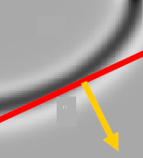
Angle-domain Crosscorrelation:
physical meaning
$$f\left(x,z,θ,τ=0\right)=\int{dx_{s}}\int{dh}\int{p_{f}}\left(x−h,z+h\tan{θ},t | x_{s}\right)$$
${ p}_{b}(x+h,z+h\tan{θ},t|x_{s}$) $dt$
$$z$$
$$z$$
$$x$$
$$θ$$
$$θ$$
$$x$$
${ p}_{f}(x−h,z+h\tan{θ},t|x_{s}$)
${ p}_{b}(x+h,z+h\tan{θ},t|x_{s}$)
Local plane wave
Local plane wave
Angle-domain crosscorrelation is the crosscorrelation
between downgoing and upgoing beams with a certain angle.
The time delay for multi-arrivals is available in angle
-domain crosscorrelation function .

Slide 12
Angle-domain Wave-equation Reflection Traveltime Inversion
Objective function:
$$ε=\frac{1}{2}\sum_{x}{\sum_{θ}{{\left[∆τ(x,θ)\right]}^{2}}}$$
Velocity update:
$c_{k+1}$(x)= $c_{k}$(x) + $α_{k}∙γ_{k}$(x)
Gradient function:
$$γ_{k}\text{(}\text{x}\text{)}\text{=}\text{ − }\frac{∂ε}{∂c(x)}\text{=}\text{−}\sum_{x}{\sum_{θ}{∆τ\frac{∂(∆τ)}{∂c(x)}}}$$
Traveltime wavepath

Slide 13
Traveltime Wavepath
Angle-domain time delay $∆τ\left(θ\right)$
$$f\left(x,z,θ,∆τ\right)=\max_{−T<τ<T}{f\left(x,z,θ,τ\right)}$$
$$f\left(x,z,θ,∆τ\right)=\min_{−T<τ<T}{f\left(x,z,θ,τ\right)}$$
Angle-domain connective function
$${\dot{f}}_{∆τ}={\left.\frac{∂f(x,z,θ,τ)}{∂τ}\right|}_{τ=∆τ}=0$$
Traveltime wavepath
$$\frac{∂(∆τ)}{∂c(x)}=−{\frac{∂{\dot{f}}_{∆τ}}{∂c(x)}}/{\frac{∂{\dot{f}}_{∆τ}}{∂(∆τ)}}$$

Slide 14
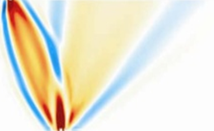
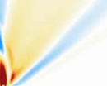
Transforming CSG Data → Xwell Trans. Data
reflection
transmission
transmission
=
+
Src-side Xwell Data
source
Redatuming data
Rec-side Xwell Data
Observed data
Redatuming source

Slide 15
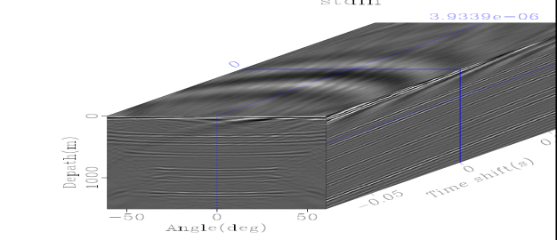
Workflow
Forward propagate source to trial image points and get downgoing beams
Backward propagate observed reflection data from geophonses to trial image points , and get upgoing beams
Crosscorrelate downgoing beam and upgoing beam, and pick angle-domain time delay
$$∆τ$$
$$z$$
$$θ$$
Smear time dealy along wavepath to update velocity model

Slide 16
Outline
Introduction
Theory and method
Numerical examples
Simple Salt Model
Sigsbee Salt Model
Conclusions

Slide 17
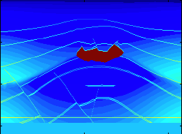
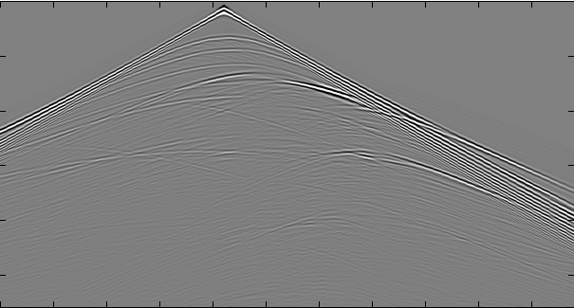
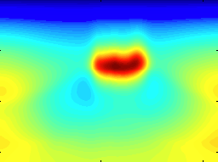
Simple Salt Model
(a) True velocity model
(b) CSG
0
0
z (km)
t (s)
5
4
5
V(km/s)
0
x (km)
8
0
x (km)
8
(c) Initial Velocity Model
(d) RTM image
0
0
1
z (km)
z (km)
4
4
0
x (km)
8
0
x (km)
8

Slide 18
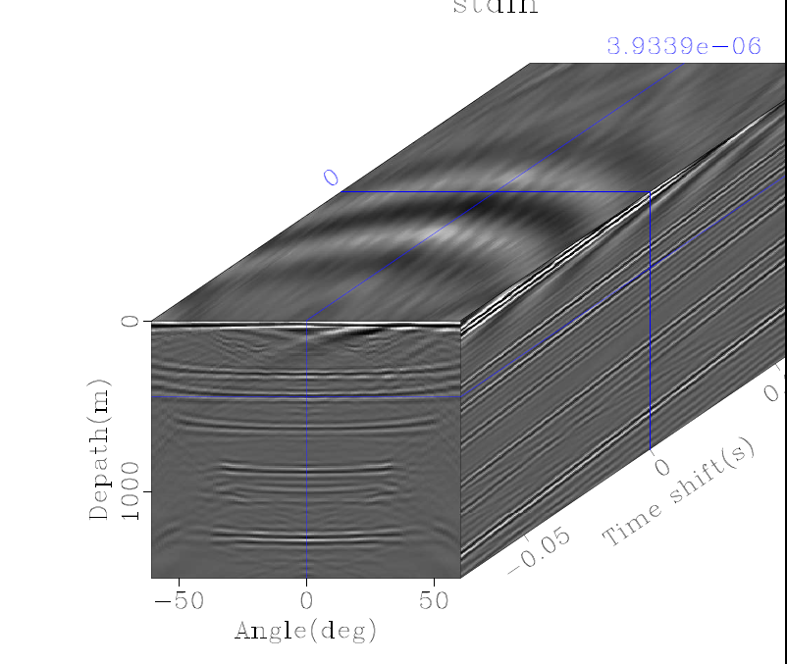
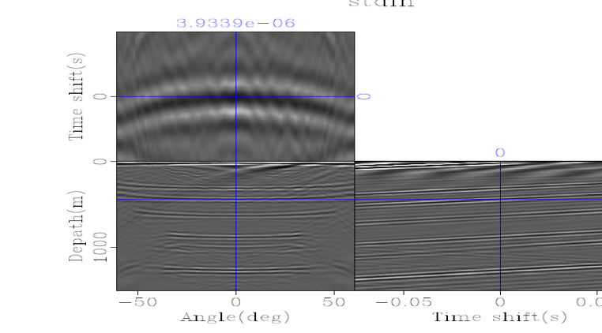
Angle-domain Crosscorrelation
(a) Initial Velocity Model
(b) Angle-domain Crosscorrelation
0
$$∆τ$$
z (km)
$$z$$
4
$$θ$$
0
x (km)
8
$$f\left(z,θ,∆τ\right)$$
(c) Angle-domain Crosscorrelation
$$∆τ=α{(\tan{θ})}^{2}$$
$$∆τ$$
$$∆τ:$$
time delay
$$α:$$
curvature
$$z$$
$$θ:$$
reflection angle
$$θ$$
$$f\left(x,z,θ,∆τ\right)$$

Slide 19
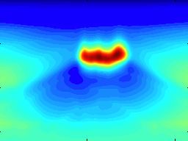
Inversion Result
(a) Initial velocity model
0
z (km)
5
4
0
x (km)
8
Velocity(km/s)
(b) Inverted velocity model
0
1
z (km)
4
0
x (km)
8

Slide 20
Inversion Result
(a) RTM image
0
z (km)
4
0
x (km)
8
(b) RTM image
0
z (km)
4
0
x (km)
8

Slide 21
Outline
Introduction
Theory and method
Numerical examples
Simple Salt Model
Sigsbee Salt Model
Conclusions

Slide 22
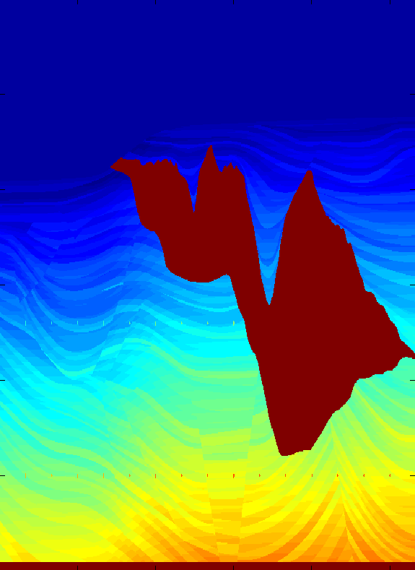
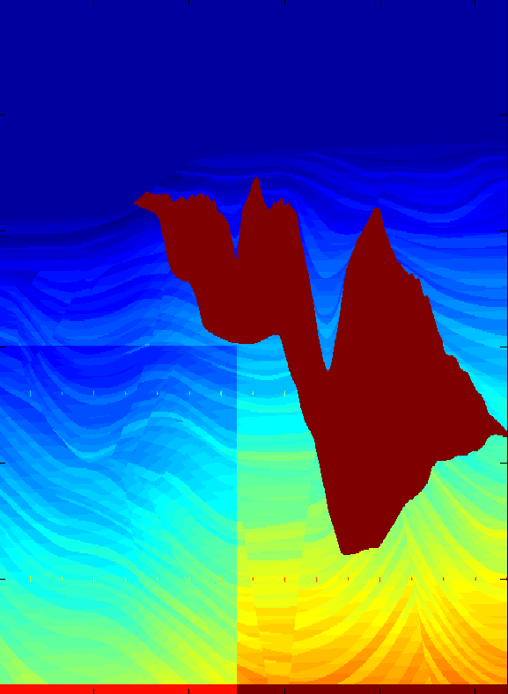
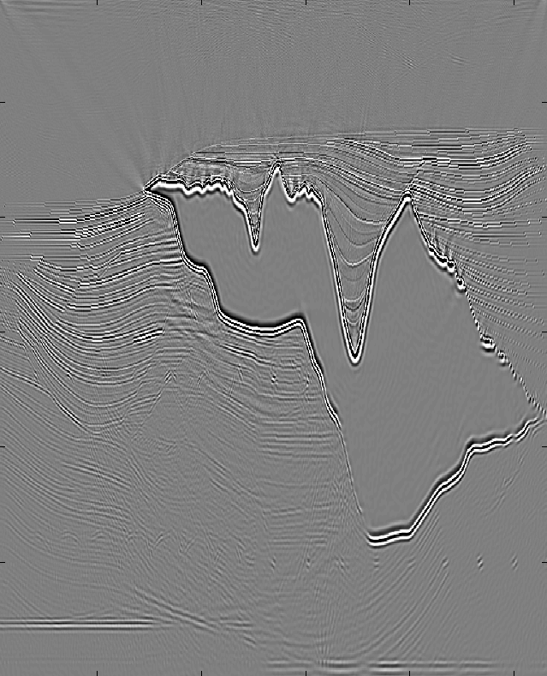
Sigsbee Model
(a) True velocity model
(b) Initial velocity model
0
0
z(km)
z(km)
Vinitial = 0.85 Vtrue
6
6
0
x(km)
12
0
x(km)
12
(c) RTM image
0
4.5
Velocity (km/s)
z(km)
6
1.5
0
x(km)
12

Slide 23
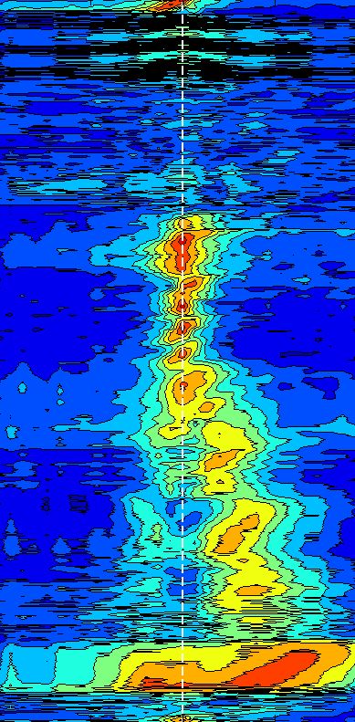
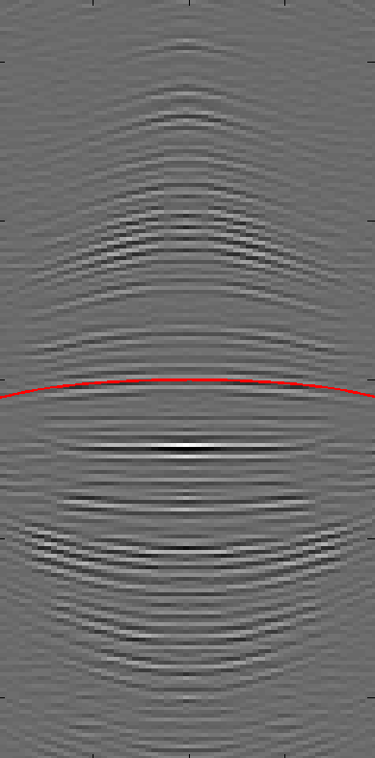
Initial Velocity Model
0
z(km)
6
0
x(km)
12
CIG
Semblance
Crosscorrelation
0
0
-0.2
z(km)
z(km)
$$∆τ(s)$$
$$∆τ=α{(\tan{θ})}^{2}$$
6
6
0.2
-50°
$$θ$$
+50°
-0.04
$$α$$
0.04
-50°
$$θ$$
+50°

Slide 24
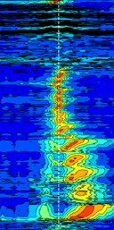
Initial Velocity Model
0
z(km)
6
0
x(km)
12
CIG
Semblance
Crosscorrelation
0
0
-0.2
z(km)
z(km)
$$∆τ(s)$$
$$∆τ=α{(\tan{θ})}^{2}$$
6
6
0.2
-50°
$$θ$$
+50°
-0.04
$$α$$
0.04
-50°
$$θ$$
+50°

Slide 25
Initial Velocity Model
0
z(km)
6
0
x(km)
12
CIG
Semblance
Crosscorrelation
0
0
-0.2
z(km)
z(km)
$$∆τ(s)$$
$$∆τ=α{(\tan{θ})}^{2}$$
6
6
0.2
-50°
$$θ$$
+50°
-0.04
$$α$$
0.04
-50°
$$θ$$
+50°

Slide 26
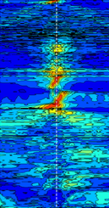
Inverted Velocity Model
0
z(km)
6
0
x(km)
12
CIG
Semblance
Crosscorrelation
0
0
-0.2
z(km)
z(km)
$$∆τ(s)$$
$$∆τ=α{(\tan{θ})}^{2}$$
6
6
0.2
-50°
$$θ$$
+50°
-0.04
$$α$$
0.04
-50°
$$θ$$
+50°

Slide 27
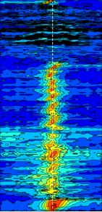
Inverted Velocity Model
0
z(km)
6
0
x(km)
12
CIG
Semblance
Crosscorrelation
0
0
-0.2
z(km)
z(km)
$$∆τ(s)$$
$$∆τ=α{(\tan{θ})}^{2}$$
6
6
0.2
-50°
$$θ$$
+50°
-0.04
$$α$$
0.04
-50°
$$θ$$
+50°

Slide 28
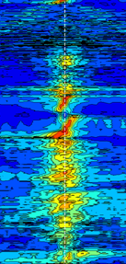
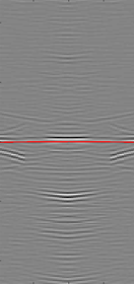
Inverted Velocity Model
0
z(km)
6
0
x(km)
12
CIG
Semblance
Crosscorrelation
0
0
-0.2
z(km)
z(km)
$$∆τ(s)$$
$$∆τ=α{(\tan{θ})}^{2}$$
6
6
0.2
-50°
$$θ$$
+50°
-0.04
$$α$$
0.04
-50°
$$θ$$
+50°

Slide 29
RTM Image
(a) RTM image using initial velocity
(b) RTM image using inverted model
0
0
z(km)
z(km)
6
6
0
x(km)
12
0
x(km)
12

Slide 30
Outline
Introduction
Theory and method
Numerical examples
Conclusions

Slide 31
Velocity Inversion Methods
Ray-based tomography
Data space
(Tomography)
Wave-equ. traveltime
inversion
Full Wavform inversion
Inversion
Ray-based MVA
Image space
Wave-equ. traveltime
inversion
(MVA)
Wave-equ. MVA
Notes:
The current velocity inversion methods can be divided into two types. One type defines the objective function in data space, such as traveltime tomography and full waveform inversion. The other type defines the objective function in model space, such as ray-based MVA and wave-equation-based MVA.

Slide 32
Angle-domain Wave-equation
Reflection Traveltime Inversion
Traveltime inversion without high-frequency approximation
Misfit function somewhat linear with respect to velocity perturbation.
Wave-equation inversion less sensitive to amplitude
Multi-arrival traveltime inversion
Beam-based reflection traveltime inversion
Notes:
To exploit the strengths and avoid the weaknesses of both traveltime tomography and full waveform inversion, wave-equation-based transimission traveltime inversion was developed to invert the velocity model. This method tried to invert the transmission traveltime informaiton using the method similar to full waveform inversion.

Slide 33
Thank you for your attention

