Slide 1
Fault Detection by a Seismic Scanning Tunneling Macroscope
Sherif M. Hanafy

Slide 2
Outline
Introduction
Motivation. Get super resolution by TRM
Method. TRM & mute-window test
Synthetic Test. 2D elastic simulation
Field Test. 3D fault test
Conclusions

Slide 3
Outline
Introduction
Motivation. Get super resolution by TRM
Method. TRM & The mute-window test
Synthetic Test. 2D elastic simulation
Field Test. 3D fault test
Conclusions

Slide 4
Introduction: Resolution
L
X
Depth
Z
Δx
Rayleigh resolution
Abbe resolution
Super resolution

Slide 5
Outline
Introduction
Motivation. Get super resolution by TRM
Method. TRM & The mute-window test
Synthetic Test. 2D elastic simulation
Field Test. 3D fault test
Conclusions

Slide 6
Motivation
Motivation: Achieve super resolution
IBM, 1986, Scanning Tunneling Microscope
Problem: Source and receiver need to be in the near-field
Solution: Use scatterer points

Slide 7
Outline
Introduction
Motivation. Get super resolution by TRM
Method. TRM & The mute-window test
Synthetic Test. 2D elastic simulation
Field Test. 3D fault test
Conclusions

Slide 8
Post-stack Migration
$$s_{o}$$
Image
Plane
$$s^{′}$$
ZO Migration Formula
$$m\left(s^{′}\right)=\sum_{g}{G^{∗}(g|s^{′})G(g|s_{o}) }$$
Calculated
Data
Measured
Data
$$G(g|s_{o})$$

Slide 9
Post-stack Migration with Point Scatterer
$$s$$
Image
Plane
$$s^{′}$$
$$G(s_{o}|s)$$
$$s_{o}$$
$$m\left(s^{′}\right)=\int_{−ω}^{ω}{\int_{−L}^{L}{G\left(s_{o} | s\right)G\left(g | s_{o}\right)}}G^{∗}\left(s_{o} | s^{′}\right)G^{∗}\left(g | s_{o}\right)dgdω$$
Measured
Data
Calculated
Data
$$G(g|s_{o})$$
ZO Migration Formula
$$G(s_{o}|s)G(g|s_{o})$$

Slide 10
Post-stack Migration with Point Scatterer
$$m\left(s^{′}\right)=\int_{−ω}^{ω}{\int_{−L}^{L}{G\left(s_{o} | s\right)G\left(g | s_{o}\right)}}G^{∗}\left(s_{o} | s^{′}\right)G^{∗}\left(g | s_{o}\right)dgdω$$
$$G\left(x | x^{′}\right)=\frac{e^{iω\left|x−x^{′}\right|/c}}{|x−x^{′}|}$$
$$m\left(s^{′}\right)=\int_{−ω}^{ω}{\frac{e^{iω(\left|s−s_{o}^{}\right|−\left|s^{′}−s_{o}^{}\right|)/c}}{(\left|s−s_{o}^{}\right|\left|{s^{′}−s}_{o}^{}\right|)}}dω\int_{−L}^{L}{\frac{1}{|g−s_{o}|^{2}}dg}$$
$$m\left(s^{′}\right)=\frac{sin[ω(\left|s−s_{o}^{}\right|−\left|s^{′}−s_{o}^{}\right|)/c}{\left|s−s_{o}^{}\right|−\left|s^{′}−s_{o}^{}\right|}.\frac{1}{(\left|s−s_{o}^{}\right|\left|{s^{′}−s}_{o}^{}\right|)}\int_{−L}^{L}{\frac{1}{|g−s_{o}|^{2}}dg}$$
|s-s0| ~ λ/40
|s-s0| ~ λ
$$m\left(s^{′}\right)=A.B$$
0.2 0.7
0.2 0.7
S’
S’
Near-field->super-resolution
Far-field->Rayleigh resolution

Slide 11
Time Reversal Mirror (TRM)

Slide 12
Time Reversal Mirrors (TRM)
$$s_{o}$$
Image
Plane
$$s^{′}$$
ZO Migration Formula
$$m\left(s^{′}\right)=\sum_{g}{G^{∗}(g|s^{′})G(g|s_{o}) }$$
Calculated
Data
Measured
Data
$$G(g|s_{o})$$

Slide 13
Time Reversal Mirrors (TRM)
TRM Profile
Image
Plane
$$s^{′}$$
$$s′$$
$$s_{o}$$
ZO Migration Formula
$$m\left(s^{′}\right)=\sum_{g}{G^{∗}(g|s^{′})G(g|s_{o}) }$$
Calculated
Data
Measured
Data
Measured
Data
$$G(g|s_{o})$$

Slide 14
Summary
|s-s0| ~ λ/40
|s-s0| ~ λ
0.2 0.7
0.2 0.7
S’
S’
Near-field->super-resolution
Far-field->Rayleigh resolution
TRM Profile
Image
Plane
$$s′$$
$$s_{o}$$

Slide 15
Outline
Introduction
Motivation. Get super resolution by TRM
Method. The mute-window test
Synthetic Test. 2D elastic simulation
Field Test. 3D fault test
Conclusions

Slide 16
Velocity Model
0
Depth (m)
40
0
X (m)
120
500
3500
Vp (m/s)
250
1750
Vs (m/s)
2.0
2.6
Density (gm/cc)
120 receivers at 1 m receiver interval
120 shots at 1 m shot interval

Slide 17
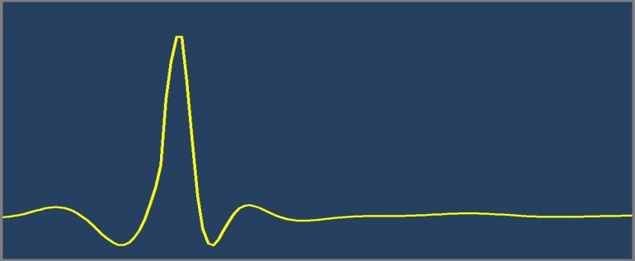
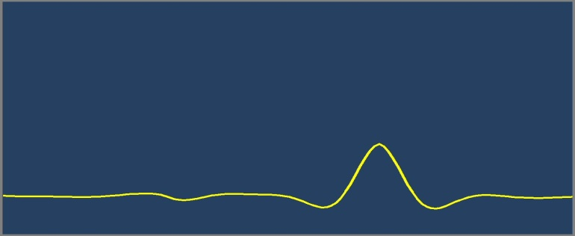
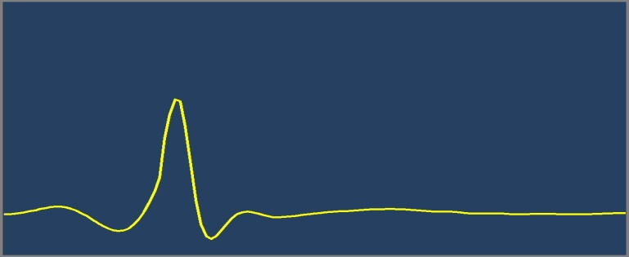
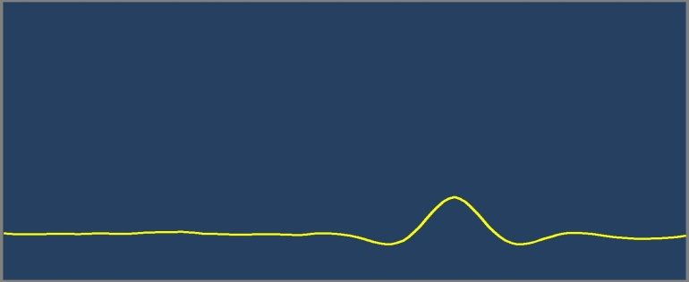
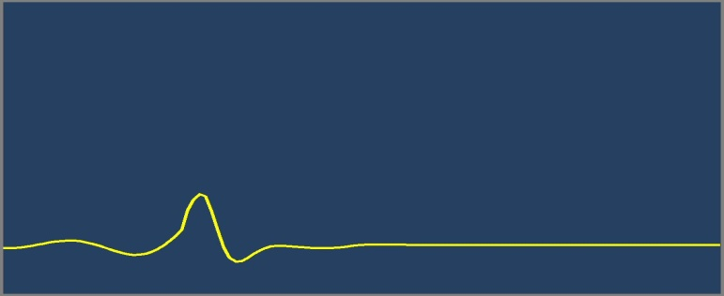
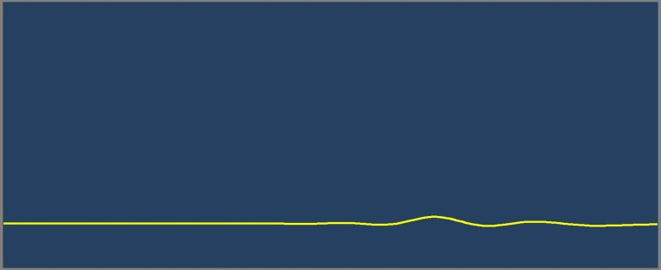
TRM Profiles
Source # 34
Source # 80
1
TRM Profile
No traces are muted
1
TRM Profile
No traces are muted
Amplitude
Amplitude
-0.2
120
-0.2
120
1
Trial Source
1
Trial Source
1
TRM Profile
21 traces are muted
1
TRM Profile
21 traces are muted
Amplitude
Amplitude
-0.2
120
-0.2
120
1
Trial Source
1
Trial Source
1
TRM Profile
101 traces are muted
1
TRM Profile
101 traces are muted
Amplitude
Amplitude
-0.2
120
-0.2
120
1
Trial Source
1
Trial Source

Slide 18
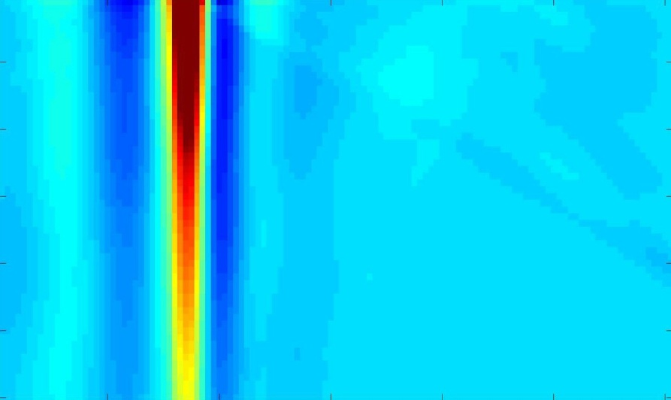
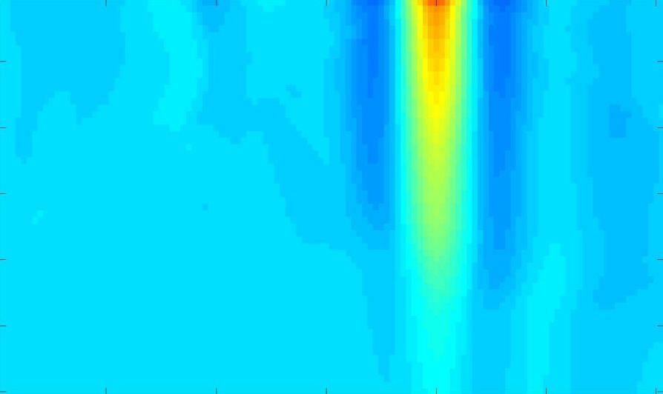
TRM Images
Source # 34
Source # 80
a) TRM Image of Shot # 34
b) TRM Image of Shot # 80
0
Source Location
0
Source Location
Mute-window Size
Mute-window Size
111
111
1
Trial Source
120
1
Trial Source
120
Scatterers in the near-field of the source
Receiver are only at far-field
Scatterers in the far-field of the source
Receiver are only at far-field

Slide 19
Outline
Introduction
Motivation. Get super resolution by TRM
Method. TRM & The mute-window test
Synthetic Test. 2D elastic simulation
Field Test. 3D fault test
Summary

Slide 20
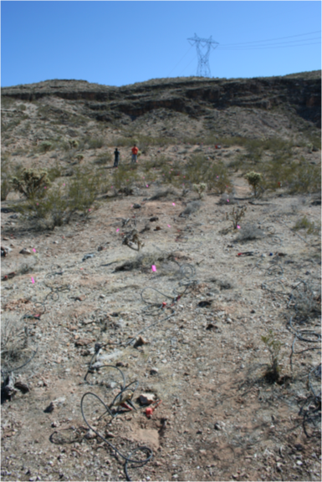
Field Test
Data Collected at Washington Fault Area, north of Arizona, USA.
6 Lines of receivers/shots
80 receivers/line at 1 m receiver interval
40 shots/line at 2 m shot interval

Slide 21
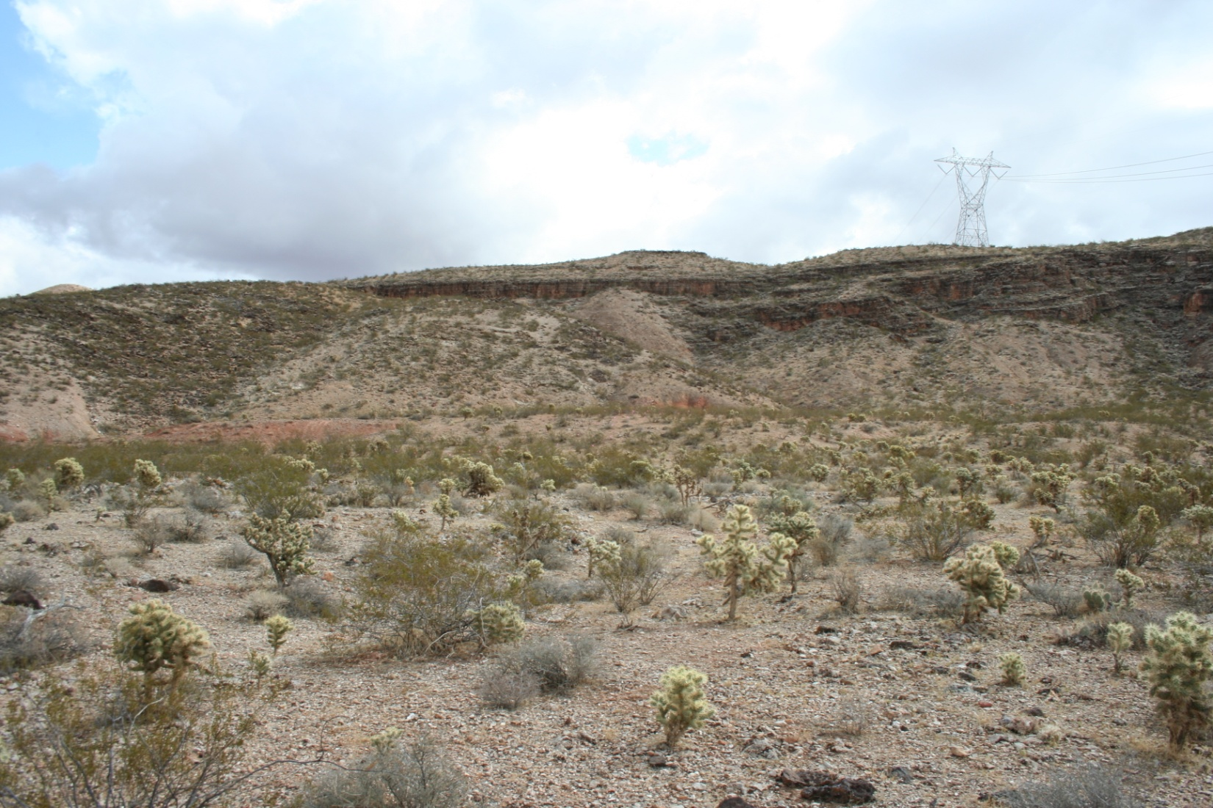
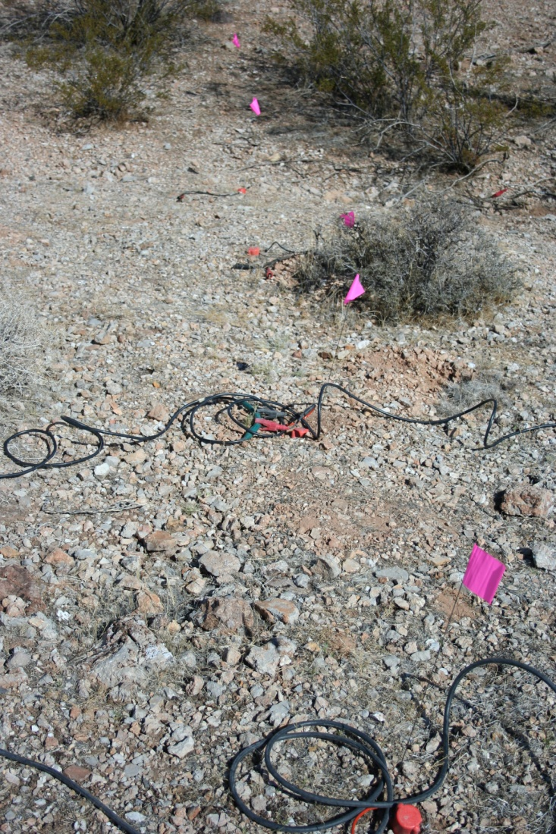
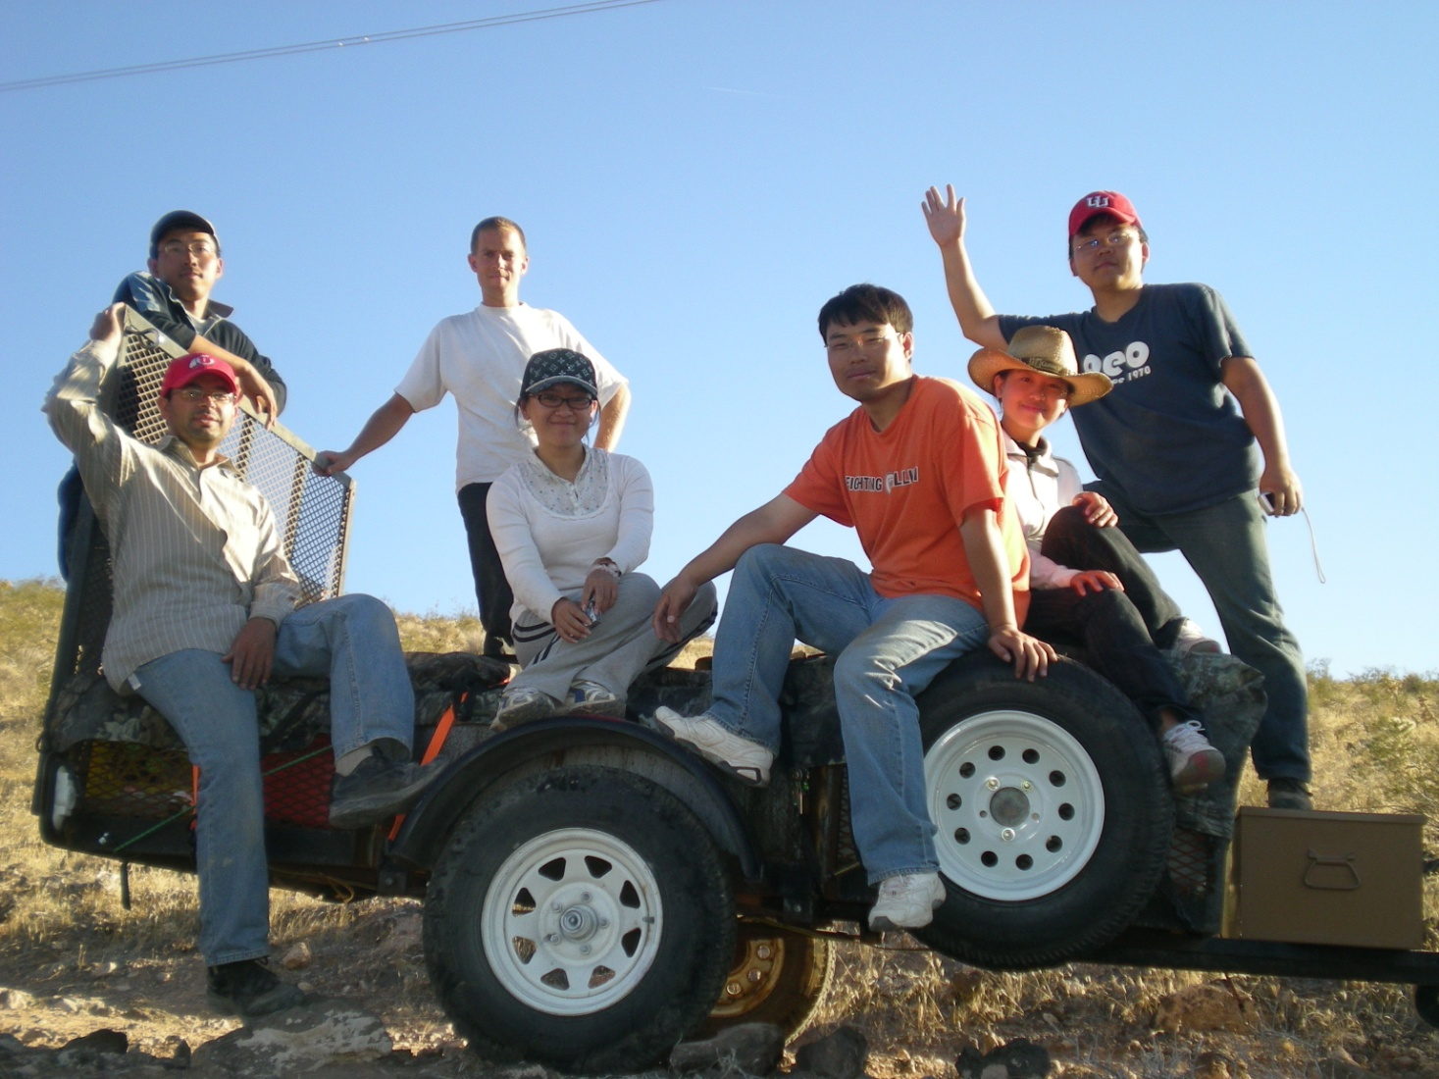
Data Collection

Slide 22
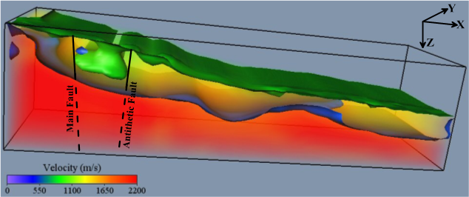
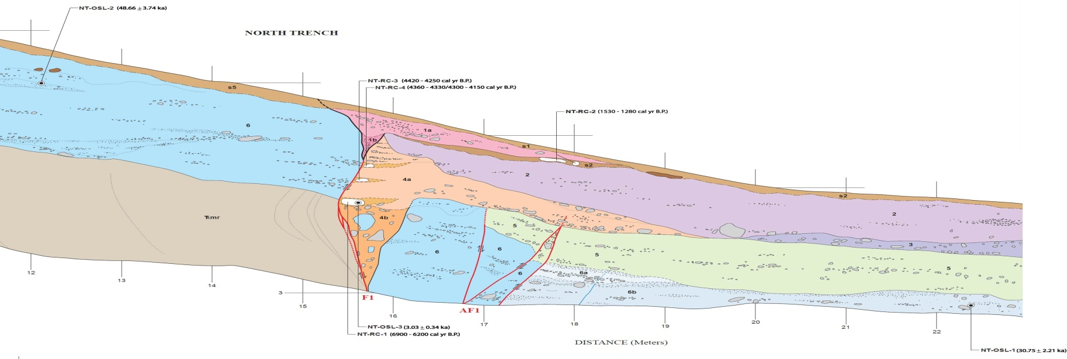
Tomography and Ground Truth

Slide 23
Super Resolution Test
Fault
Pixel size: 2 x 1.5 m²
Wavelength: 10 m

Slide 24
Super Resolution Results
Migration Image – Traces within 0.8 λ are muted
Migration Image – Traces within 0.4 λ are muted
Migration Image – Traces within 0.1 λ are muted
Migration Image using All Traces
Fault

Slide 25
Outline
Introduction
Motivation. Get super resolution by TRM
Method. TRM & The mute-window test
Synthetic Test. 2D elastic simulation
Field Test. 3D fault test
Conclusions

Slide 26
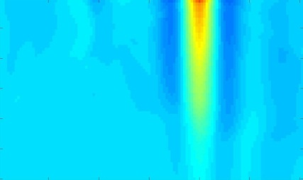
Conclusions
TRM profiles have the shape of a sink curve if no scatterer in the near-field of the shot point
TRM profiles have the shape of a spike if scatterer exists in the near-field of the shot point
Muting the near-field traces tends to decrease the amplitude of the TRM profile and its resolution
|s-s0| ~ λ/40
|s-s0| ~ λ
0.2 0.7
0.2 0.7
S’
S’

Slide 27
Possible Applications
Find local anomalies, faults, and scatterer points around boreholes in VSP data
Ground
Borehole

Slide 28
Thank You

