Slide 1
Multisource Full Waveform Inversion of Marine Streamer Data with Frequency Selection
Yunsong Huang and Gerard Schuster
KAUST

Slide 2
Outline
Goal of the study
Multisource
Mismatch solution with marine data
Low-discrepancy frequency coding
Numerical results
Conclusions
Notes:
2

Slide 3
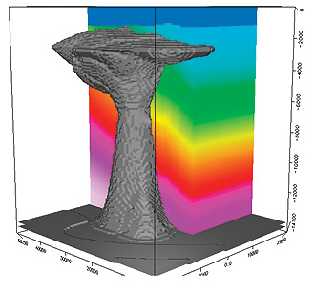
Goal of the Study
Multisource optimization for marine FWI
Standard optimization for FWI
Speed and quality
comparison
Notes:
How the alternative methods fare with local minima is not included in this study.
Nevertheless, generally speaking, a method with randomness fares better combating local minima.
A school of thought believes stochastic method might fail to converge.
But in practice, as shown in this study, reasonable convergence is already achieved.
As for the very precise convergence behavior, we believe that is only of academic interest in the field of FWI.

Slide 4
Outline
Aim of the study
Multisource Migration
Least Squares Multisource Migration
Low-discrepancy frequency coding
Numerical results
Conclusions
Notes:
4

Slide 5
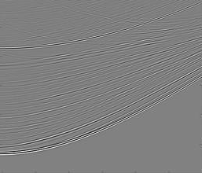
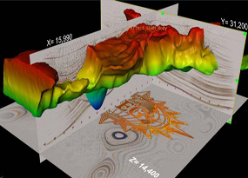
Standard Migration vs Multisource Migration
Romero, Ghiglia, Ober, & Morton, Geophysics, (2000)
Given: d1 and d2
Given: d1 + d2
Find: m
Find: m
Soln: m = (L1 + L2)(d1+d2)
T
T
T
Soln: m=L1 d1 + L2 d2
T
T
Benefit: Reduced computation and memory
= L1 d1 + L2 d2
Liability: Crosstalk noise …
T
T
+ L1 d2 + L2 d1
Src. imaging cond. xtalk

Slide 6
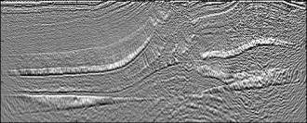
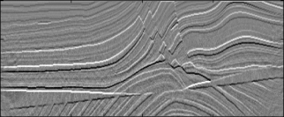
Multisource LSM & FWI
Inverse problem:
1
~
~
arg min
J =
|| d – L m ||²
m
2
Δd
misfit
Iterative update:
~_{T}
m^{(k+1)} = m^{(k)} + α L Δd
T
T
L1Δd1 + L2Δd2
T
T
K=10
+ L1 Δd2 + L2 Δd1
K=1

Slide 7
Brief Early History Multisource
Phase Encoded Imaging
Migration
Romero, Ghiglia, Ober, & Morton, Geophysics, (2000)
Waveform Inversion and Least Squares Migration
Krebs, Anderson, Hinkley, Neelamani, Lee, Baumstein,
Lacasse, SEG Zhan+GTS, (2009)
Virieux and Operto, EAGE, (2009)
Dai, and GTS, SEG, (2009)
Biondi, SEG, (2009)

Slide 8
Outline
Aim of the study
Multisource Migration
Mismatch solution with marine data
Low-discrepancy frequency coding
Numerical results
Conclusions
Notes:
8

Slide 9
Land Multisource FWI
Fixed spread
Simulation geometry must be consistent with
the acquisition geometry

Slide 10
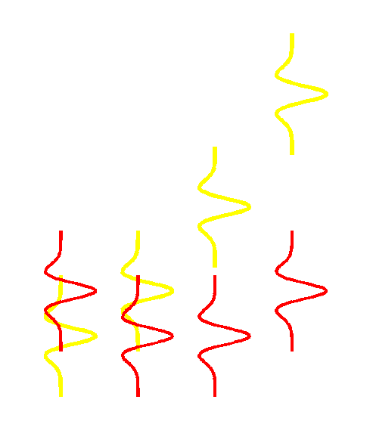
Marine Multisource FWI
Mismatch solution with marine data
Observed
marine data
purify
Simulated
land data
Freq. encoding
Decode & mute
4 Hz
8 Hz
4 Hz
4 Hz
8 Hz
8 Hz
F.T.,
freq. selec.
wrong
misfit
Blend
4 Hz
8 Hz
Notes:
Let’s focus on the white receiver…, how the frequency encoding could save the day.

Slide 11
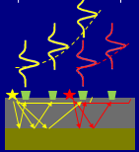
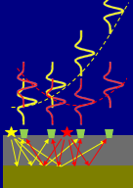
Multisource FWI Freq. Sel. Workflow
For k=1:K
Select unique frequency for each src
d d
Filter and blend observed data: d→d
→
d_{pred} d_{pred}
Purify predicted data: d_{pred}→d_{pred}
→
Data residual: Δd=d_{pred}-d
~_{T}
m^{(k+1)} = m^{(k)} + α L Δd
end
Notes:
Let’s focus on the white receiver…, how the frequency encoding could save the day.

Slide 12
Outline
Aim of the study
Multisource
Mismatch solution with marine data
Low-discrepancy frequency coding
Numerical results
Conclusions
Notes:
12

Slide 13
Low-discrepancy Frequency Encoding
Standard
Low-discrepancy
encoding
encoding
60
60
60
Frequency index
Frequency index
Frequency index
1
1
1
1
Source index
60
1
Source index
60

Slide 14
Outline
Aim of the study
Multisource
Mismatch solution with marine data
Low-discrepancy frequency coding
Numerical results
Conclusions
Notes:
14

Slide 15
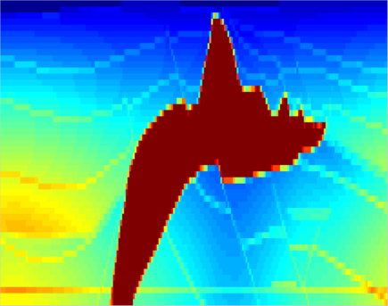
Frequency-selection FWI of 2D Marine Data
Shots: 60
Source freq: 8 Hz
Receivers/shot: 84
Cable length: 2.3 km
0
4.5
(km/s)
Z (km)
1.5
1.5
0
X (km)
6.8

Slide 16
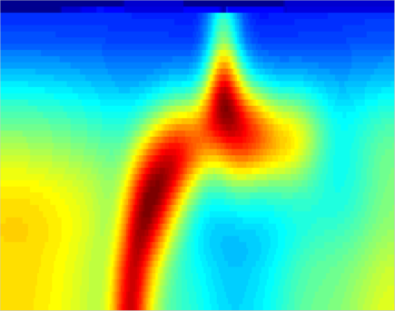
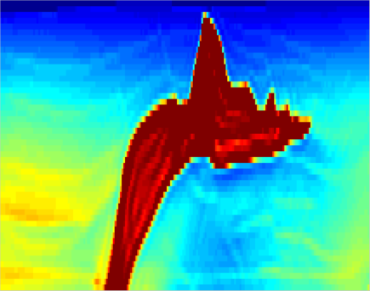
FWI images
0
Actual model
Starting model
Z (km)
1.5
0
Standard FWI
(69 iterations)
Multisource FWI
(262 iterations)
Z (km)
1.5
0
X (km)
6.8
0
X (km)
6.8

Slide 17
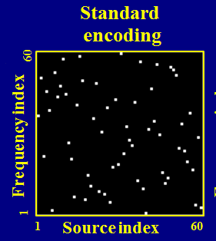
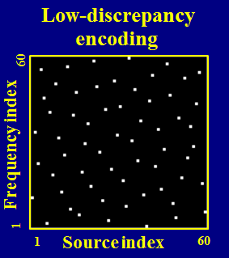
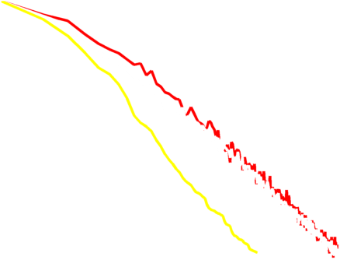
Convergence Rates
Waveform error
Faster initial convergence rate of the white curve
1
1 supergather,
standard encoding
Same asymptotic convergence rate of the red and white curves
Log normalized
by individual sources
3.8 x
1 supergather,
low-discrepancy encoding
0.025
1
69
262
Log iteration number

Slide 18
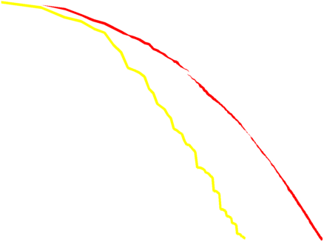
Convergence Rates
Speedup
60 / 2 / 2 / 3.8 = 4
Velocity error
1
Gain
60: sources
Overhead factors:
2 x FDTD steps
2 x domain size
3.8 x iteration number
1 supergather,
standard encoding
Log normalized
by individual sources
3.8 x
1 supergather,
low-discrepancy encoding
0.35
1
69
262
Log iteration number

Slide 19
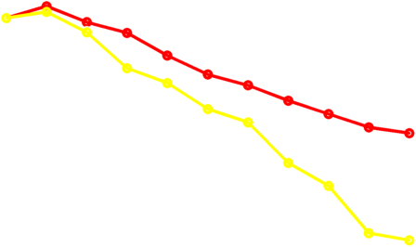
Convergence Rates
Velocity error (normalized)
Low-discrepancy encoding is
12% to 3x faster initially than
Standard encoding
1
standard encoding
10
0.75
1
iteration number

Slide 20
Conclusions
Frequency selection is implemented in FDTD
2 x time steps per forward or backward modeling
Low-discrepancy frequency encoding
affects no asymptotic rate of convergence
helps to reduce model error in the beginning of simulation
4x speedup for the multisource FWI on the synthetic marine model
Notes:
20

Slide 21
Thanks
Sponsors of the CSIM (csim.kaust.edu.sa) consortium at KAUST & KAUST HPC

Slide 22
Thank you!

Slide 23
In the case of multiscale
At lower (say 1/2) frequencies, the frequency selection strategy sees fewer frequency resources, but
Computation cost:
(Nx x Nz) x Ns x Nt is reduced by 1/16,
since each factor is halved.
This part does not degrade the overall speedup much.
Notes:
…, since it only accounts for roughly 1/16 of the total computation cost (assuming with the same iteration number)
23

Slide 24
Convergence Rates
Slew rate = H/L
Velocity error (normalized)
L
1
1 supergather,
standard encoding
H
by individual sources
1 supergather,
low-discrepancy encoding
0.75
1
10
iteration number

Slide 25
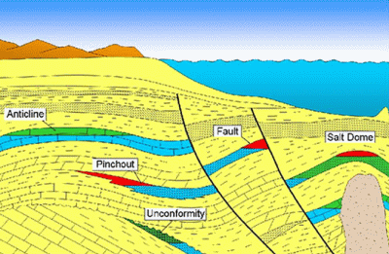
Low-discrepancy Frequency Encoding
Standard
Freq. #60
assigned to
source #31
Prefers uniformity in freq. assignment / encoding.
encoding
60
Frequency index
crowded
vacant
1
1
Source index
60
Notes:
Showing a frequency code book, in which each bright dot represents a mapping: frequency index → source index

