Slide 1
Multisource Full Waveform Inversion with Topography Using Ghost Extrapolation
Dongliang Zhang
King Abdullah University of Science and Technology
9/19/2012

Slide 2
Outline
Motivation
Irregular surface problems
Theory
Using ghost extrapolation method to handle the irregular surface
Numerical Example
Test marmousi model
Conclusions

Slide 3
Irregular Surface Problems
Problems
Solutions
Datuming the data from irregular surface to flat surface
FWI directly from the irregular surface
Forward modeling with irregular surface will generate the diffraction
Using Ghost extrapolation
FWI is very expensive
Multi-source FWI

Slide 4
Theory
Standard FWI
Misfit function
Image of data residual
Forward propagation
Back propagation
Update velocity/slowness

Slide 5

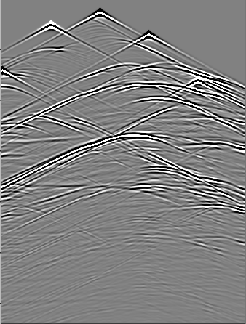
Multi-source FWI
Source encoding
Residual wavefields encoding

Slide 6
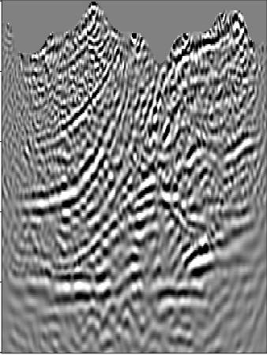
Multi-source FWI

Slide 7
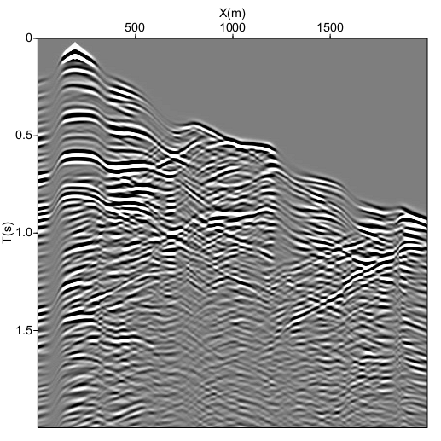
Workflow of FWI with Topography
Calculate the data residual
with topography
Single source
Multisource
2. Calculate gradient (RTM image) of data residual with topography
3. Update the velocity using the conjugate gradient method

Slide 8
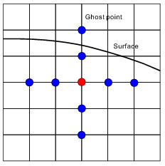
Forward Modeling with Topography
Acoustic equation:
Difficulty : implement free surface boundary condition

Slide 9
Ghost Extrapolation
Zi+2,j
Zi+1,j
Zb
Zi,j
Surface
Zi-1,j
Zi-2,j
0
Notes:
9

Slide 10
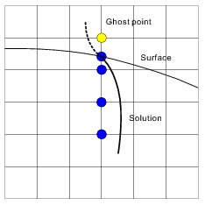
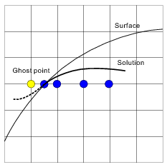
Extrapolation in z direction
Extrapolation in x direction

Slide 11
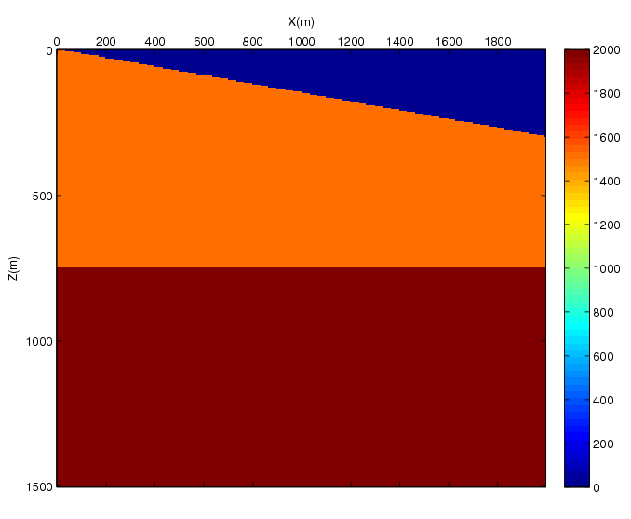
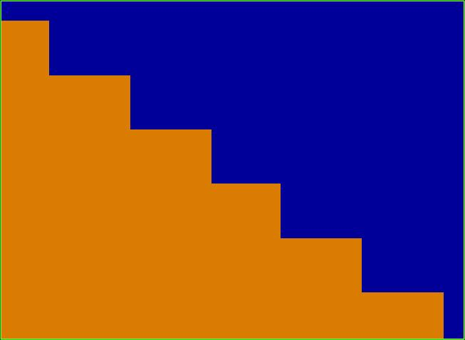
Simple example
0 X (m) 2000
0 Z (m) 1500
Surface
Dip surface
Stair line
Air
Surface
Zoom the area of box
Subsurface

Slide 12
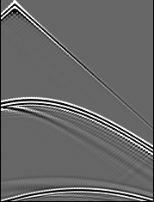
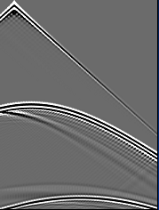
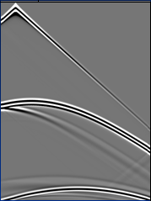
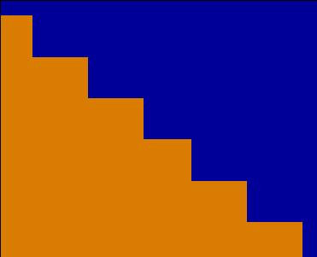
Common Shot Gather
Zero velocity layer
Mirror image
Ghost extrapolation
0 T (s) 2.0
0 X (m) 2000
Air
Pi+2,j=-Pi-2,j
V=0
Pi+1,j=-Pi-1,j
Air
Subsurface
Pi-1,j
Pi-2,j

Slide 13
FWI Test on Marmousi Model
True velocity
Initial velocity
0 Z (km) 1.5
5.5 V (km/s) 0
0 X (km) 2
0 X (km) 2

Slide 14
Single source
Gradient of 1st iteration
Velocity of 85th iteration
0 Z (km) 1.5
Gradient of 1st iteration
Velocity of 85th iteration
Multi-source
0 Z (km) 1.5
0 X (km) 2
0 X (km) 2

Slide 15
True velocity
0 Z (km) 1.5
5.5 V (km/s) 0
Single source inverted result
Multi-source inverted result
0 Z (km) 1.5
5.5 V (km/s) 0
0 X (km) 2
0 X (km) 2

Slide 16
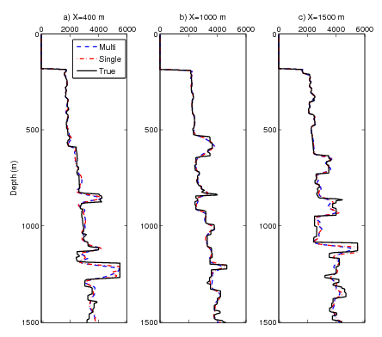
Comparison of true velocity and inverted velocity

Slide 17
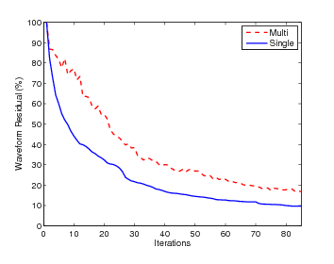
Convergence curve

Slide 18
Conclusions
Ghost extrapolation can eliminate diffraction artifacts
FWI with topography gain the correct velocity, so this method is feasible
Multisource can accelerate the calculation

Slide 19
Thank you!

