Slide 1
Multi-source Least-squares Migration with Topography
Dongliang Zhang and Gerard Schuster
King Abdullah University of Science and Technology

Slide 2
Outline
Motivation
Irregular surface problems
Theory
Use ghost extrapolation to reduce stair-step diffractions from irregular surfaces
Numerical Example
Tests on Marmousi model and Foothills model
Summary

Slide 3
Outline
Motivation
Irregular surface problems
Theory
Use ghost extrapolation to reduce stair-step diffractions from irregular surfaces
Numerical Example
Tests on Marmousi model and Foothills model
Summary

Slide 4
Irregular Surface Problems
Motivation
Datuming the data from irregular surface to flat surface

Slide 5
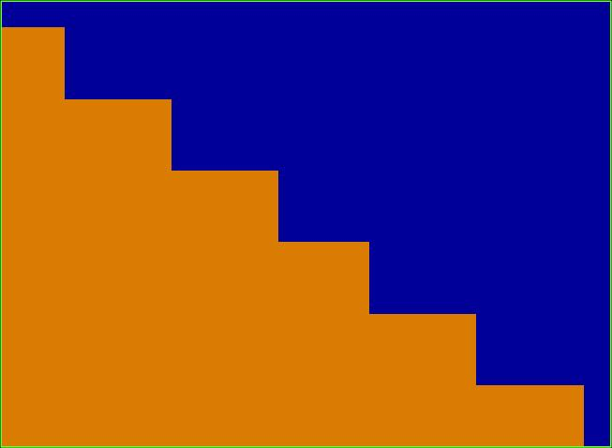
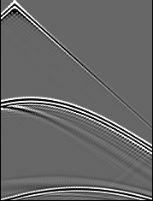

Problem: Irregular Surface
Motivation
RTM migrates directly from the irregular surface
Stair step
Air
Surface
Subsurface
Solution: Ghost RTM
Using Ghost extrapolation

Slide 6
Outline
Motivation
Irregular surface problems
Theory
Use ghost extrapolation to reduce stair-step diffractions from irregular surfaces
Numerical Example
Tests on Marmousi model and Foothills model
Summary

Slide 7
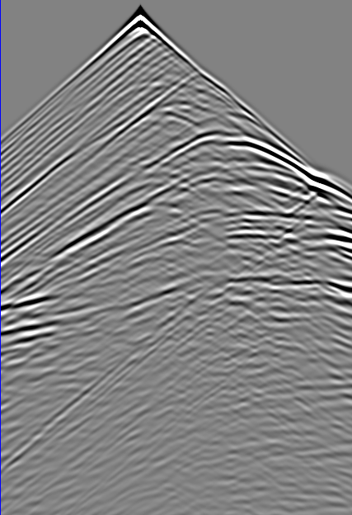
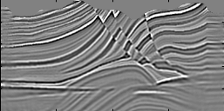





Least-squares Migration
$$d=\text{L}m$$
f(m)$\text{=}\frac{1}{2}{\left\|\text{Lm}\text{−}\text{d} \right\|}^{2}$+regularization term
g$\text{=}L^{T}\text{(}\text{Lm}\text{−}\text{d}$)
$${\text{m}}^{k+1}\text{=}{\text{m}}^{k}−α{\text{g}}^{k}$$
$$α\text{=}\frac{{({\text{g}}^{k})}^{T}{\text{g}}^{k}}{{({\text{Lg}}^{k})}^{T}{\text{Lg}}^{k}}$$

Slide 8
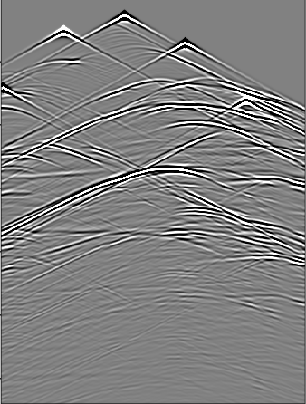
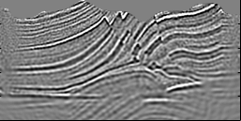
Workflow of Multisource LSM with Topography
Forward modeling with topography to calculate the data residual
Blended encoded shot gathers
2. Calculate gradient (RTM image) of data residual with topography
3. Update the reflectivity using the conjugate gradient method

Slide 9
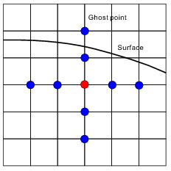
Forward Modeling with Topography
Acoustic equation:
Difficulty :
Implement free surface boundary condition
Calculate the pressure on the points near by the free surface
Ghost point

Slide 10
Ghost Extrapolation
Zi+2,j
Zi+1,j
Zb
Zi,j
Surface
Zi-1,j
Taylor Series
Zi-2,j
0
Notes:
10

Slide 11
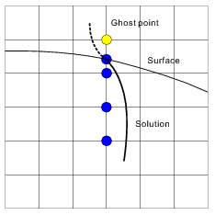
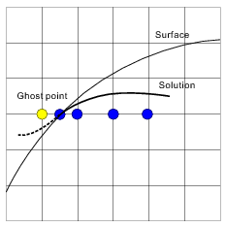
Ghost Extrapolation
Extrapolation in z direction
Extrapolation in x direction

Slide 12
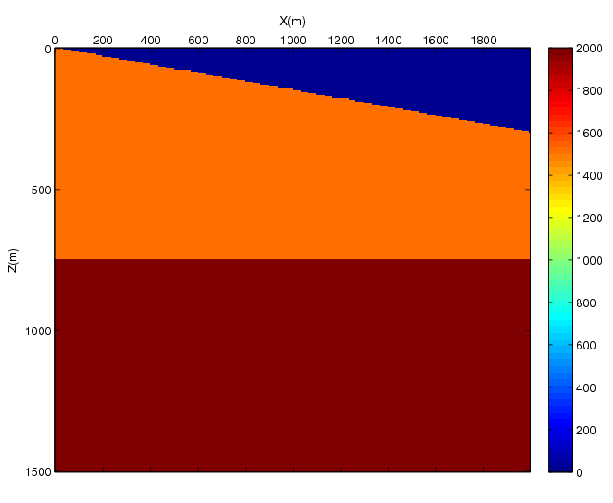
Example of Dipping Surface
Model
Zoom
0
Stair step
Air
Surface
Z (km)
Surface
Subsurface
1.5
0 X (km) 2

Slide 13
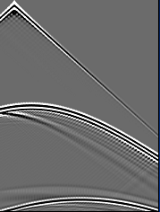
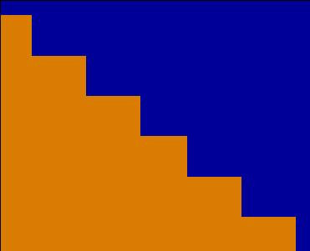
Common Shot Gather
Zero velocity layer
Mirror image
Ghost extrapolation
0
Z (km)
1.5
0 X (km) 2
Air
Pi+2,j=-Pi-2,j
V=0
Pi+1,j=-Pi-1,j
Air
Subsurface
Pi-1,j
Pi-2,j

Slide 14
Zoom Views
Conventional method
New method

Slide 15
Outline
Motivation
Irregular surface problems
Theory
Use ghost extrapolation to reduce stair-step diffractions from irregular surfaces
Numerical Example
Tests on Marmousi model and Foothills model
Summary

Slide 16
Marmousi Model
Grids size: 201 x 400 dx=dz=5 m Peak Freq.: 25 Hz Shots: 200 Receiver: 400
Max difference of elevation: 180 m
0
0
Z (km)
V (km/s)
1
1
0 X (km) 2

Slide 17
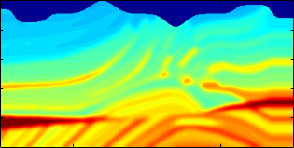
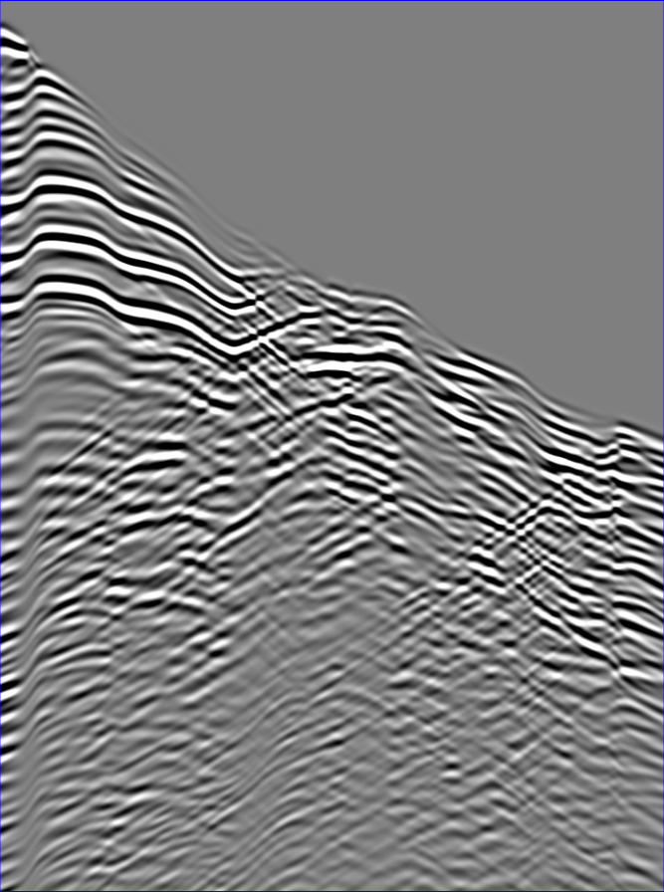
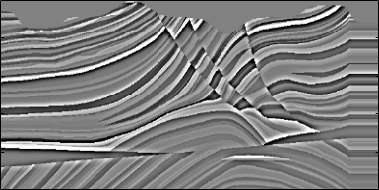
Marmousi Model
Migration Velocity
0
Common Shot Gather
0
Z (km)
1
T (s)
Reflectivity Model
0
Z (km)
Ghost FD
2
0 X (km) 2
1
0 X (km) 2

Slide 18
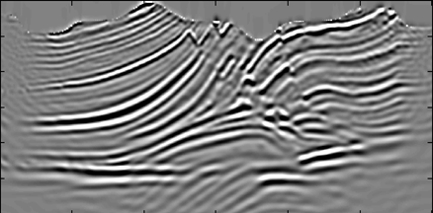
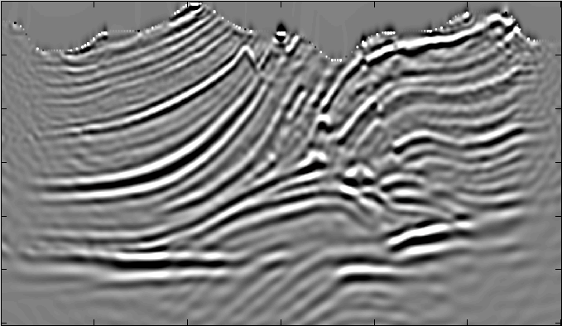
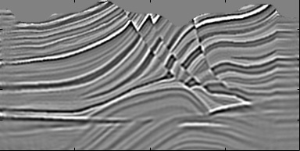
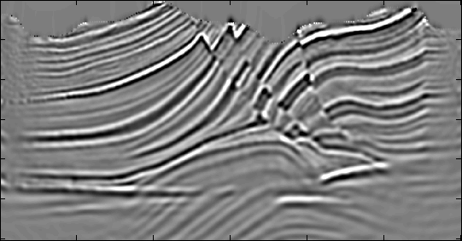
Marmousi Model
Ghost RTM Image
RTM Image
0
Z (km)
1
Ghost FD
Conventional FD
Ghost LSRTM Image
LSRTM Image
0
Z (km)
1
Ghost FD
Conventional FD
0 X (km) 2
0 X (km) 2

Slide 19
Zoom Views
Ghost RTM Image
RTM Image
Ghost FD
Conventional FD
Ghost LSRTM Image
LSRTM Image
Ghost FD
Conventional FD

Slide 20
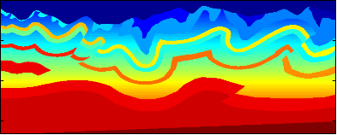
Foothills Model
Grids size: 333 x 833 dx=dz=10 m Peak Freq.: 15 Hz Shots: 208 Receiver: 833
Max difference of elevation: 500 m
0
0
Z (km)
V (km/s)
3
6
0 X (km) 8

Slide 21
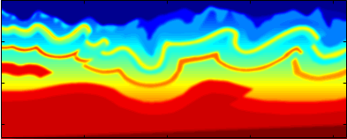
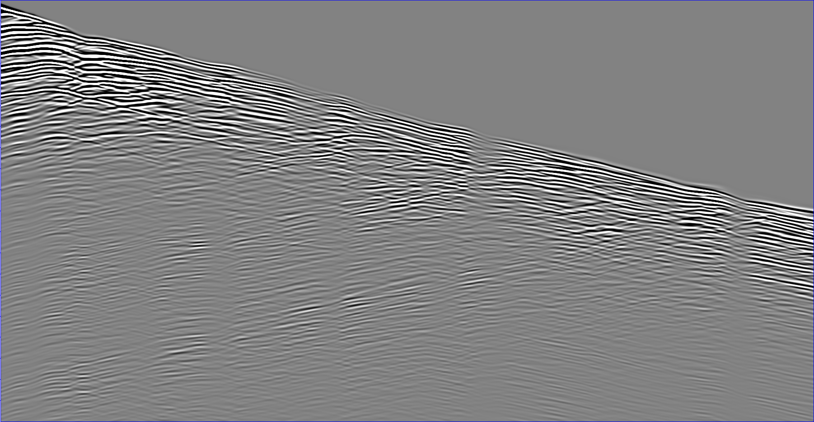
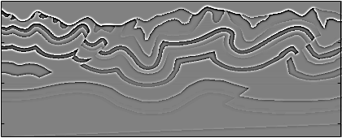
Foothills Model
Migration Velocity
0
Common Shot Gather
0
Z (km)
3
T (s)
Reflectivity Model
0
Z (km)
Ghost FD
2
3
0 X (km) 8
0 X (km) 2

Slide 22
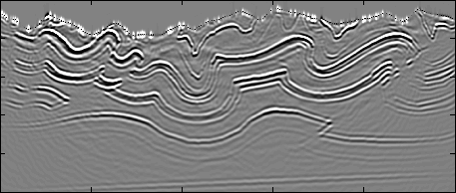
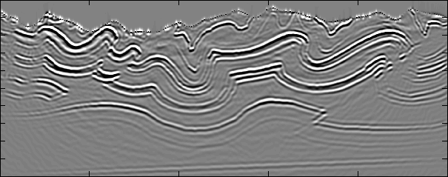
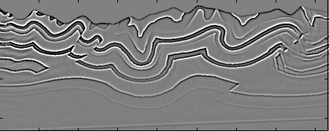
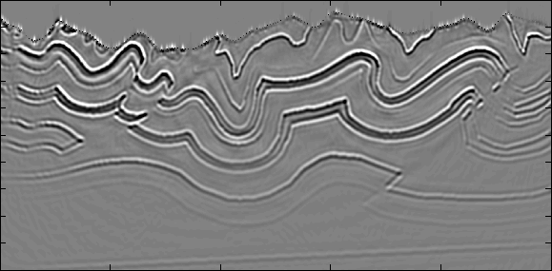
Foothills Model
Ghost RTM Image
RTM Image
0
Z (km)
3
Ghost FD
Conventional FD
Ghost LSRTM Image
LSRTM Image
0
Z (km)
3
Ghost FD
Conventional FD
0 X (km) 8
0 X (km) 8

Slide 23
Zoom Views
Ghost RTM Image
RTM Image
Ghost FD
Conventional FD
Ghost LSRTM Image
LSRTM Image
Ghost FD
Conventional FD

Slide 24
Summary
MLSM can produce high quality images efficiently:
Ghost extrapolation can reduce stair-step diffraction artifacts
MLSM with topography produces high quality image, multi-source saves the computational time
High accuracy for the free surface boundary condition
Future work:
Using 2D ghost extrapolation
Elastic
Test on field data

Slide 25
Thank you!

