Slide 1
Reverse Time Migration of Prism Waves for Salt Flank Delineation
Wei Dai, WesternGeco
Gerard T. Schuster, King Abdullah University of Science and Technology
Sep 25, 2013

Slide 2
Outline
Introduction and motivation
Theory
Numerical Results
L model
Salt model
Summary

Slide 3
Introduction
Problem: Vertical boundaries (salt flanks) are difficult to image because they are usually not illuminated by primary reflections.
Solution: Prism waves contain valuable information.

Slide 4
Conventional Method
When the known boundaries are embedded in the velocity model, conventional RTM can migrate prism waves correctly.

Slide 5
Recorded Trace $d\left(g | s\right)=d_{1}\left(g | s\right)+d_{2}(g|s)$
0
Time (s)
2

Slide 6
Horizontal Reflector Embedded in the Velocity
0
Z (km)
3
Conventional RTM Image
0
Z (km)
3
0
X (km)
6

Slide 7
Reverse Time Migration Formula
$$m_{mig}(x)=\sum_{ω}{ω^{2}}{W^{∗}(ω)G}^{∗}\left(x | s\right)G^{∗}\left(x | g\right)d\left(g | s\right)$$
Angular Freq.
Source Spectrum
Input Data
Green’s functions
0
$$x$$
Z (km)
3
$$G\left(x | s\right)=G_{o}\left(x | s\right)+G_{1}(x|s)$$
$$G\left(x | g\right)=G_{o}\left(x | g\right)+G_{1}(x|g)$$

Slide 8
$$m_{mig}\left(x\right)=\sum_{ω}{ω^{2}}W^{∗}\left(ω\right)\left[G_{o}^{∗}\left(x | s\right)+G_{1}^{∗}\left(x | s\right)\right]\left[G_{o}^{∗}\left(x | g\right)+G_{1}^{∗}\left(x | g\right)\right]$$
$[d_{1}\left(g | s\right)+d_{2}\left(g | s\right)]$
$=\sum_{ω}{ω^{2}}W^{∗}\left(ω\right)[G_{o}^{∗}\left(x | s\right){G_{o}^{∗}\left(x | g\right)d}_{1}\left(g | s\right)$ +
$$G_{o}^{∗}\left(x | s\right){G_{o}^{∗}\left(x | g\right)d}_{2}\left(g | s\right)$$
Ellipses
+$G_{1}^{∗}\left(x | s\right){G_{o}^{∗}\left(x | g\right)d}_{1}\left(g | s\right)$
+$G_{o}^{∗}\left(x | s\right){G_{1}^{∗}\left(x | g\right)d}_{1}\left(g | s\right)$
Rabbit Ears
+$G_{1}^{∗}\left(x | s\right){G_{o}^{∗}\left(x | g\right)d}_{2}\left(g | s\right)$
+ $G_{o}^{∗}\left(x | s\right){G_{1}^{∗}\left(x | g\right)d}_{2}\left(g | s\right)$
+ Other terms.]
Prism Wave Kernels
0
Z (km)
3
0
X (km)
6

Slide 9
Migration of Prism Waves
$$m_{mig}=\sum_{ω}{ω^{2}}W^{∗}\left(ω\right)G_{1}^{∗}\left(x | s\right){G_{o}^{∗}\left(x | g\right)d}_{2}\left(g | s\right)$$
Born Modeling
$$G_{1}^{}\left(x | s\right)=\int{ω^{2}m\left(x^{′}\right)G_{o}\left(x^{′} | s\right)}G_{o}\left(x^{′} | x\right)dx′$$
0
Z (km)
3
0
X (km)
6

Slide 10
Migration of Prism Waves
$$x_{g}$$
$$x_{s}$$
0
$$x_{2}$$
Z (km)
$$x_{1}$$
3
$$x_{2}^{}′$$
$$\frac{\left|x_{s}−x_{2}′\right|}{c}+\frac{\left|x_{2}−x_{g}\right|}{c}=τ_{sg}$$
0
Z (km)
3
0
X (km)
6

Slide 11
Migration of Prism Waves
$$m_{mig}=\sum_{ω}{ω^{2}}W^{∗}\left(ω\right)G_{o}^{∗}\left(x | s\right){G_{1}^{∗}\left(x | g\right)d}_{2}\left(g | s\right)$$
Born Modeling
$$G_{1}^{}\left(x | g\right)=\int{ω^{2}m\left(x^{′}\right)G_{o}\left(x^{′} | s\right)}G_{o}\left(x^{′} | x\right)dx′$$
0
Z (km)
3
0
X (km)
6

Slide 12
Migration of Prism Waves
0
Z (km)
3
0
Z (km)
3
0
X (km)
6

Slide 13
Outline
Introduction and motivation
Theory
Numerical Results
L model
Salt model
Summary

Slide 14
The L Model
Model size: 301 x 601
Source freq: 20 hz
shots: 32
geophones: 601
0
Z (km)
3
0
X (km)
6

Slide 15
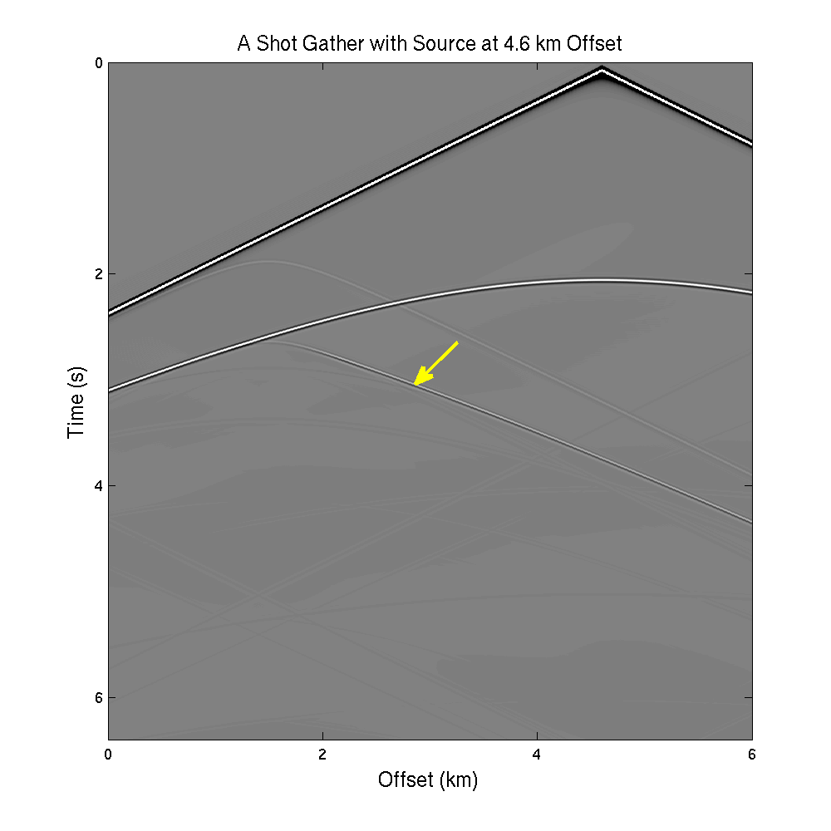
A Shot Gather of the L Model
0
Time (s)
6.4
0
X (km)
6

Slide 16
Prism Wavepath
0
Z (km)
3
0
Z (km)
3
0
X (km)
6

Slide 17
RTM Image /w Smooth Velocity
0
Z (km)
3
Migration Image of Prism Waves
0
Z (km)
3
0
X (km)
6

Slide 18
The Salt Model
0
Model size: 601 x 601
Source freq: 20 hz
shots: 601
Z (km)
geophones: 601
6
0
X (km)
6

Slide 19
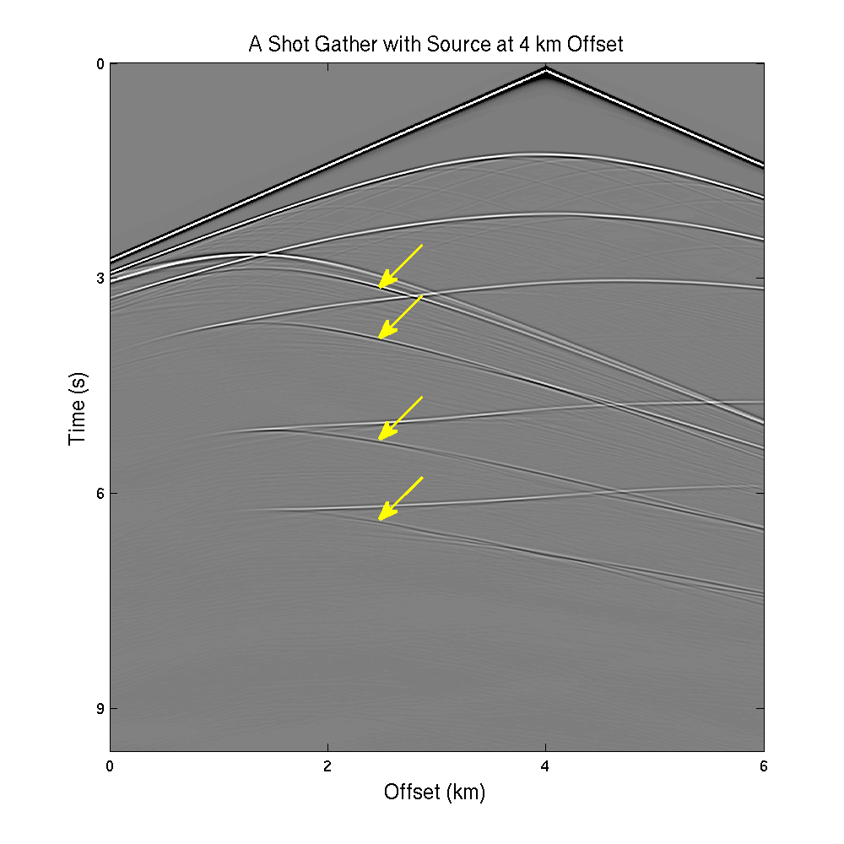
A Shot Gather of the Salt Model
0
Time (s)
10
0
X (km)
6

Slide 20
RTM with Smooth Velocity
Migration Velocity
RTM Image
0
Z (km)
6
0
X (km)
6
0
X (km)
6

Slide 21
If the Horizontal Reflectors are embedded in the velocity
Migration Velocity
RTM Image
0
Z (km)
6
0
X (km)
6
0
X (km)
6

Slide 22
New Method
Migration Velocity
0
Prism Wave Image
Conv. RTM Image
Z (km)
6
RTM Image
0
Z (km)
0
X (km)
6
6
0
X (km)
6

Slide 23
New Method
Migration Velocity
0
Prism Wave Image
Z (km)
6
Filtered RTM Image
0
Z (km)
0
X (km)
6
6
0
X (km)
6

Slide 24
Final Image
Horizontal
0
RTM Image
Final Image
Z (km)
6
Vertical
0
Z (km)
0
X (km)
6
6
0
X (km)
6

Slide 25
Summary
I propose a new method to migrate prism waves separately.
Avoid the modification of migration velocity.
Reduce cross interference between different waves by migrating different waves in separated steps.
Limitations
Computational cost is doubled.

Slide 26
Thanks

