Slide 1
Least-squares Reverse Time Migration with Frequency-selection Encoding for Marine Data
Wei Dai, WesternGeco
Yunsong Huang and Gerard T. Schuster, King Abdulla University of Science and Technology
Sep 26, 2013

Slide 2
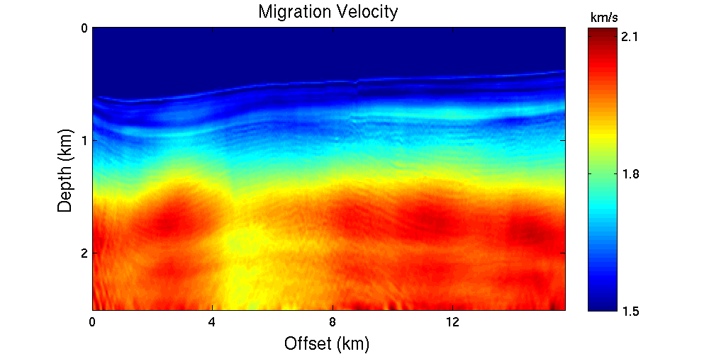
Outline
Introduction and Overview
Theory
Single frequency modeling
Least-squares migration
Numerical Results
Marmousi2
Marine field data
Summary

Slide 3
Motivation of Freq. Select. Encoding
Random encoding is not applicable to marine streamer data.
Marine streamer geometry (observed)
Fixed spread geometry (synthetic)
4 traces
6 traces
Mismatch between acquisition geometries will dominate the misfit.

Slide 4
Marine Data
erroneous
misfit
misfit =
observed
data
simulated
data

Slide 5
Solution
Every source is encoded with a unique signature.
Every receiver acknowledge the contribution from the ‘correct’ sources.
observed
simulated

Slide 6
Frequency Selection
R(ω)
Nω frequency bands of source spectrum:
Accommodate up to Nω shots
ω
4 shots/group
Group 1
2 km
Notes:
The colors of every hydrophone denote its ‘pass frequency’. That is, non-colored frequency bands are filtered out.
By this frequency-selection mechanism, we can winnow out the undesired contributions at each hydrophone from other sources when these sources are grouped together for simulation.

Slide 7
Outline
Introduction and Overview
Theory
Single frequency modeling
Least-squares migration
Numerical Results
Marmousi2
Marine field data
Summary

Slide 8
Single Frequency Modeling
Helmholtz Equation
$$\left(∇^{2}+\frac{ω^{2}}{v^{2}}\right)\tilde{P}=−W\left(ω\right)δ(x−s)$$
Acoustic Wave Equation
$$\left(∇^{2}−\frac{1}{v^{2}}\frac{∂^{2}}{∂^{2}t}\right)P=−Re\{W\left(ω\right)exp⁡(−iωt)\}δ(x−s)$$
Harmonic wave source
Advantages:
Lower complexity in 3D case.
Applicable with multisource technique.

Slide 9
Single Frequency Modeling
$$\left(∇^{2}−\frac{1}{v^{2}}\frac{∂^{2}}{∂^{2}t}\right)P=−Re\{W\left(ω\right)exp⁡(−iωt)\}δ(x−s)$$
Amplitude
T
T

Slide 10
Single Frequency Modeling
Amplitude
0 Frequency (Hz) 50
Amplitude
20 Frequency (Hz) 30

Slide 11
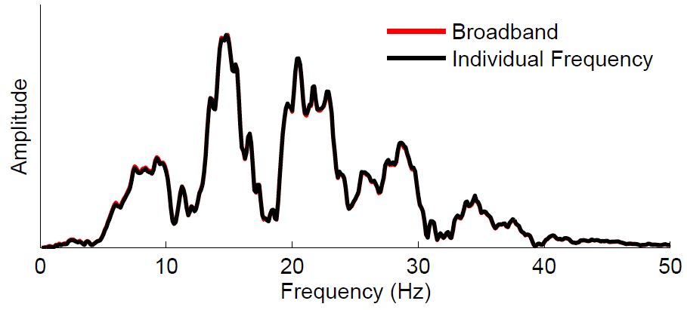
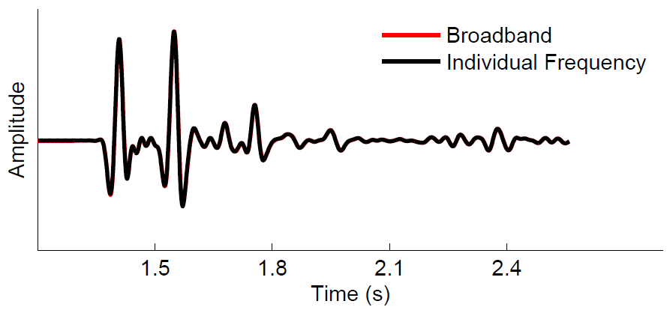
Single Frequency Modeling

Slide 12
Where do the savings come from?
T
T
Frequency sampling rate:
$$∆f=\frac{1}{T}$$
Smaller T → larger $∆f$ → less samples in frequency domain

Slide 13
Estimated Frequency Sampling
$$T_{min}$$
$$∆f_{max}=\frac{1}{T_{max}−T_{min}}$$
$$T_{max}$$
(Mulder and Plessix, 2004)

Slide 14
Theory: Least-squares Migration
$$f\left(m\right)=\frac{1}{2}{\left\|Lm−\tilde{d}\right\|}^{2}$$
Misfit:
Encoded Supergather:
$$\tilde{d}$$
$$d_{it,ig,is}$$
$$N$$
$$d_{iω,ig,is}$$
$$d_{iω_{s},ig}$$
only contains one frequency component for each shot, with
frequency-selection encoding.
Encoding functions are changed at every iteration.
Misfit function is redefined at every iteration.
N frequency components → N iterations.

Slide 15
Outline
Introduction and Overview
Theory
Single frequency modeling
Least-squares migration
Numerical Results
Marmousi2
Marine field data
Summary

Slide 16
Marmousi2
Model size: 8 x 3.5 km
Freq.: 400 (0~50 hz)
Shots: 301
Receivers: 201
Cable: 2km
0
km/s
4.5
Z (km)
3.5
1.5
0
X (km)
8

Slide 17
Marmousi2
Trace length: 8 sec → $∆f$ = 0.125 Hz
For the frequency bank 0~50 Hz, there are 400
frequency channels → accommodate up to 400 shots
According to the formula:
$$∆f_{max}=\frac{1}{T_{max}−T_{min}}≈0.7 Hz$$
We choose $∆f$ = 0.625 Hz. Each shot contains 80 frequency components → 80 iterations needed.
At the first iteration, all 400 shots are randomly assigned with a unique frequency $f$. For next iteration, $f→f+ ∆f.$

Slide 18
Conventional RTM
0
Z (km)
3.5
0
X (km)
8
LSRTM Image (iteration=80)
LSRTM Image (iteration=1)
LSRTM Image (iteration=20)
Cost: 3.2
0
Z (km)
3.5
0
X (km)
8

Slide 19
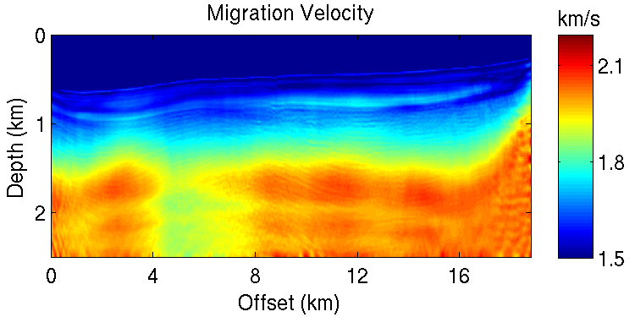
Frequency-selection LSRTM of 2D Marine Field Data
Model size: 18.7 x 2.5 km
Freq: 625 (0-62.5 Hz)
Shots: 496
Cable: 6km
Receivers: 480
0
km/s
2.1
Z (km)
2.5
1.5
0
X (km)
18.7

Slide 20
Marine Field Data
Trace length: 10 sec → $∆f$ = 0.1 Hz
For the frequency bank 0~62.5 Hz, there are 625
frequency channels → accommodate up to 625 shots
According to the formula:
$$∆f_{max}=\frac{1}{T_{max}−T_{min}}≈1 Hz$$
Empirical tests suggest $∆f$ = 0.3 Hz → 208 iterations.
One possible reason is the large shot spacing 37.5 m.

Slide 21
Conventional RTM
0
Z (km)
2.5
Frequency-selection LSRTM
Cost: 5
0
Z (km)
2.5
0
X (km)
18.7

Slide 22
Zoom Views
Conventional RTM
Conventional RTM
Freq. Select LSRTM
Freq. Select LSRTM

Slide 23
Summary
MLSM can produce high quality images efficiently.
LSM produces high quality image.
Frequency-selection encoding applicable to marine data.
Limitation:
High frequency noises are present.
Sensitive to velocity error (5% errors in velocity led to failure).

Slide 24
Thanks

