Slide 1
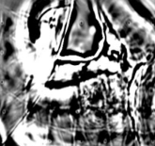
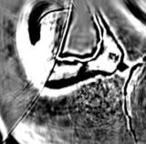
Making the Most from the
Least (Squares Migration)
G. Dutta, Y. Huang, W. Dai, X. Wang, and Gerard Schuster
KAUST
Standard Migration
Least Squares Migration

Slide 2

Outline
Least Squares Migration:
Examples of LSM:
Problems with LSM: Cost and V(x,z) Sensitivity
Multisource LSM: Gulf of Mexico Data
Viscoacoustic LSM: Marmousi & GOM data
Summary and Road Ahead

Slide 3
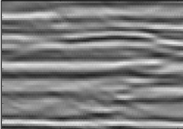
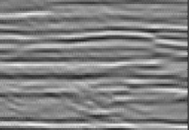
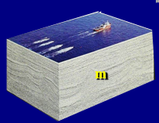
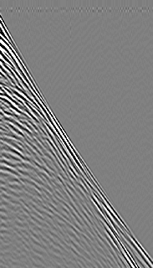
Migration Problems
x-z
x-y
Problem: m^{mig}=L^{T}d
defocusing
Solution: Least squares migration
aliasing
d
Modeling
operator
Given: d = Lm
= L
predicted
observed
2
Find: min ||Lm - d ||
m
T
Soln: m^{(k+1)} = m^{(k)} + α L Δd^{(k)}

Slide 4
Least Squares Migration
T
m^{(k+1)} = m^{(k)} + α L Δd^{(k)}
m = [L^{T}L]⁻¹L^{T} d
Source Decon:
[w(t) w(t)]⁻¹w(t) w(t)
Geom. Spreading: 1 ⁻¹ 1 1
r⁴ r² r²
1/r
1/r
Inconsistent events
Anti-aliasing:
migrate
model
Aliasing
artifacts

Slide 5
Brief History of Least Squares Migration
Linearized Inversion
Lailly (1983), Tarantola (1984)
Least Squares Migration
Cole & Karrenbach (1992), GTS (1993), Nemeth (1996)
Nemeth et al (1999), Duquet et al (2000), Sacchi et al (2006)
Guitton et al (2006),
Multisource Migration
Romero et al. (2000)
Multisource Least Squares Migration
Tang & Biondi (2009), Dai & GTS (2009), Dai (2011, 2012),
Zhang et al. (2013), Dai et al. (2013), Dutta et al (2014)

Slide 6
Outline
Least Squares Migration:
Examples of LSM:
Problems with LSM: Cost and V(x,z) Sensitivity
Multisource LSM: Gulf of Mexico Data
Viscoacoustic LSM: Marmousi & GOM data
Summary and Road Ahead

Slide 7
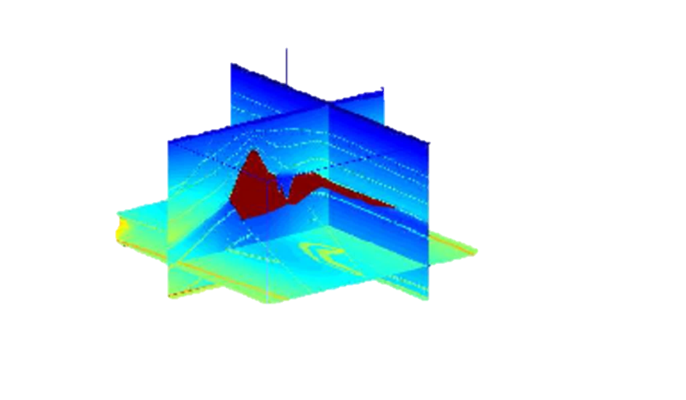
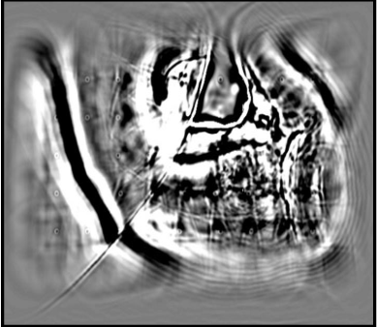
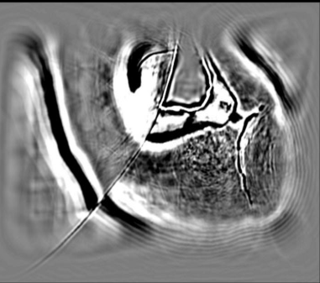
Acquisition Footprint Mitigation
5 sail lines
200 receivers/shot
45 shot gathers
Standard Migration
LSM
0
10
Y (km)
0 10 0 10
X (km)
X (km)

Slide 8
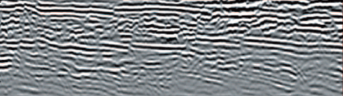
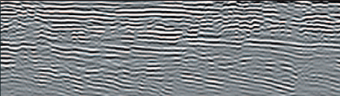
RTM vs LSM
Reverse Time Migration
0.8
1.2
Z (km)
6.3 9.9
X (km)
Plane-Wave LSM
0.8
1.2
Z (km)
6.3 9.9
X (km)

Slide 9
Outline
Least Squares Migration:
Examples of LSM:
Problems with LSM: Cost and V(x,z) Sensitivity
Multisource LSM: Gulf of Mexico Data
Viscoacoustic LSM: Marmousi & GOM data
Summary and Road Ahead

Slide 10
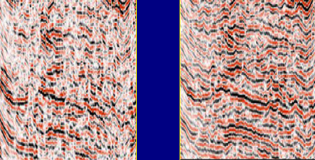
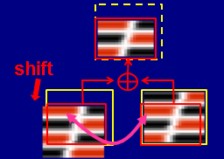

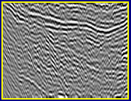
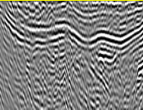
Problem #1 with LSM
Problem: High Sensitivity to Inaccurate V(x,y,z)
Partial Solutions:
a) Statics corrections
LSM
LSM+Statics
LSM
CSG1
LSM
CSG2
b) Iterative LSM+MVA
Sanzong Zhang (2014)
RTM+Traveltime Tomo
RTM+MVA

Slide 11
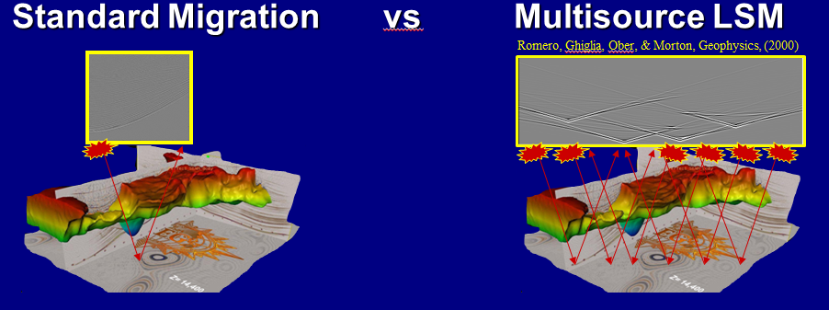
Problem #2 with LSM
Problem: LSM Cost >10x than RTM
Solution: Migrate Blended Supergathers

Slide 12
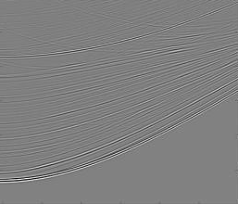
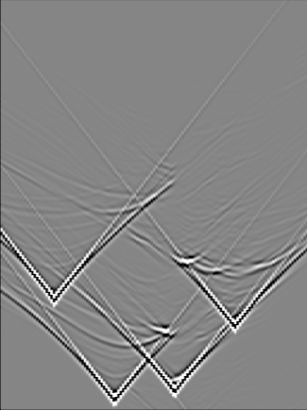
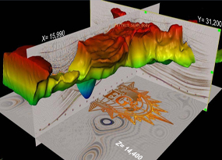
Standard Migration vs Multisource LSM
Romero, Ghiglia, Ober, & Morton, Geophysics, (2000)
Given: d1 and d2
Given: d1 + d2
1 RTM per
shot gather
Find: m
Find: m
1 RTM to migrate many
shot gathers
Soln:
m^{(k+1)} = m^{(k)} + α (L1 + L2)(d1+d2)
T
T
Soln: m=L1 d1 + L2 d2
T
T
T
]
= m^{(k)} + α[L1 d1 + L2 d2
Iteratively encode data so
L1^{T} d2 = 0 and L2^{T} d1 = 0
T
T
+ L1 d2 + L2 d1
Benefit: 1/10 reduced cost+memory

Slide 13
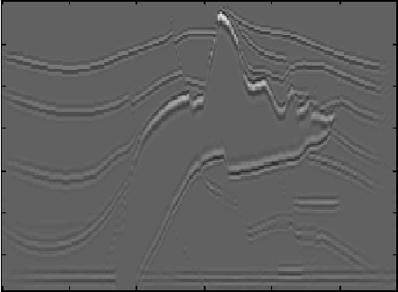
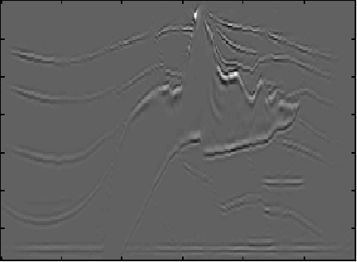
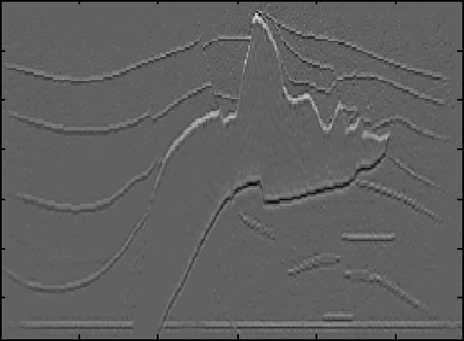
Multisource LSM
(304 blended shot gathers)
0
a) Original
b) Standard Migration
Z (km)
1.48
0
X (km)
6.75
0
Computational gain
d) 304 shots/gather
26 iterations
c) Standard Migration with 1/8 subsampled shots
9.4
SNR=30dB
Z (km)
5.4
Comp. Gain
1.48
Conventional migration:
1
0
76
X (km)
152
304
6.75
0
X (km)
6.75
38
Shots per supergather

Slide 14
Outline
Least Squares Migration:
Examples of LSM:
Problems with LSM: Cost and V(x,z) Sensitivity
Multisource LSM: 3D SEG Salt Model
Viscoacoustic LSM: Marmousi & GOM data
Summary and Road Ahead

Slide 15
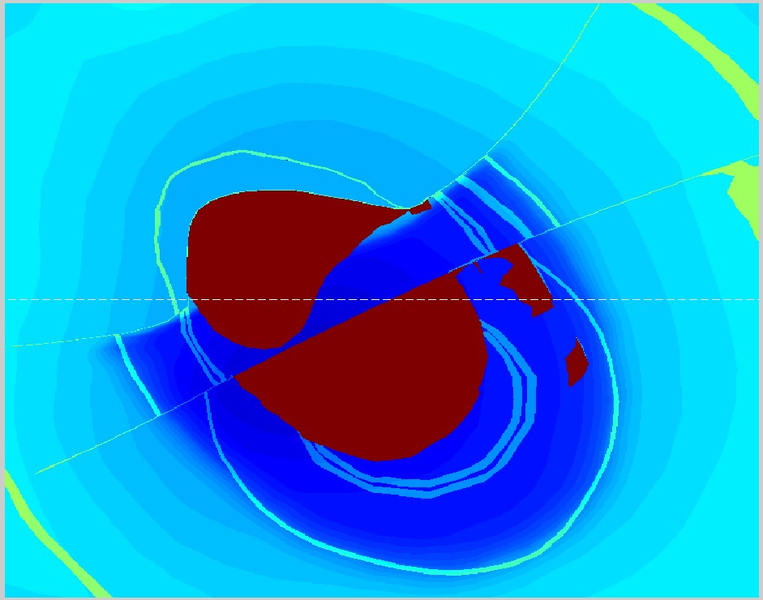
SEG/EAGE Model+Marine Data
(Yunsong Huang)
sources in total
40 m
100 m
16 swaths,
50% overlap
256 sources
a swath
6 km
20 m
3.7 km
16 cables
13.4 km

Slide 16
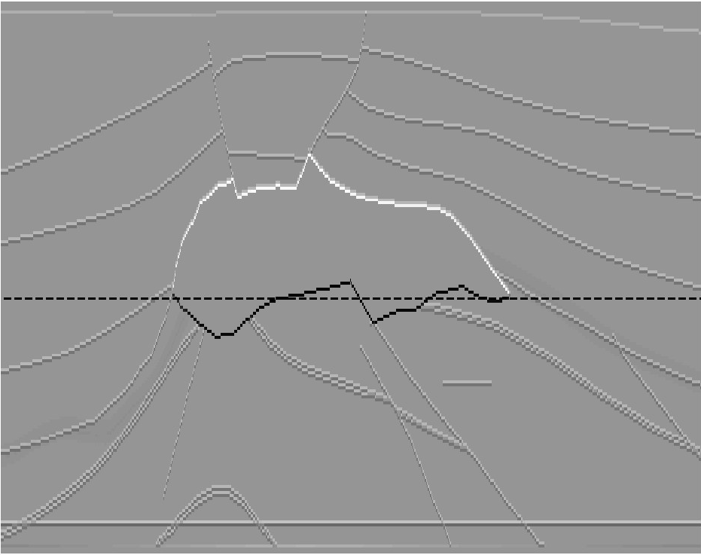
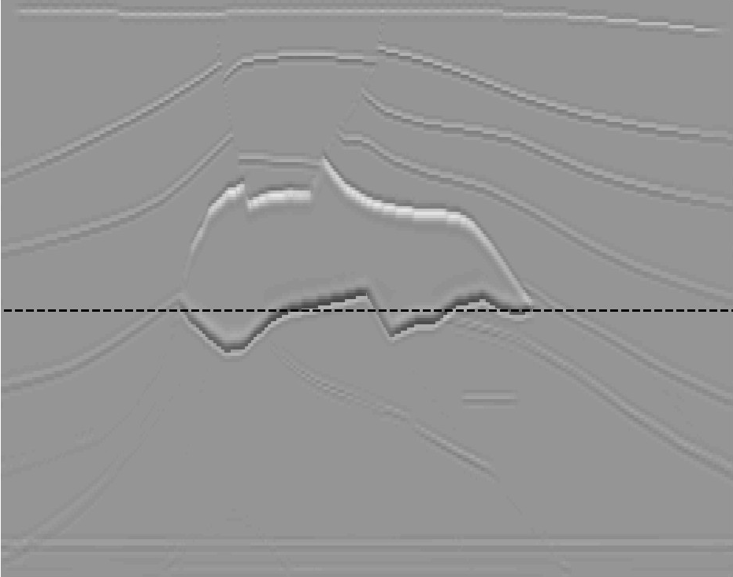
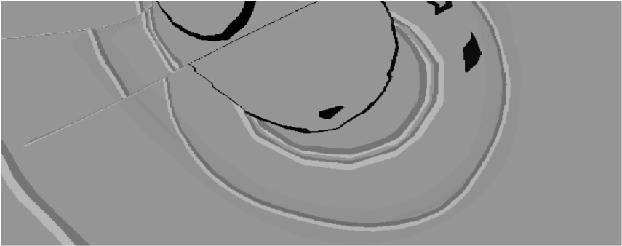
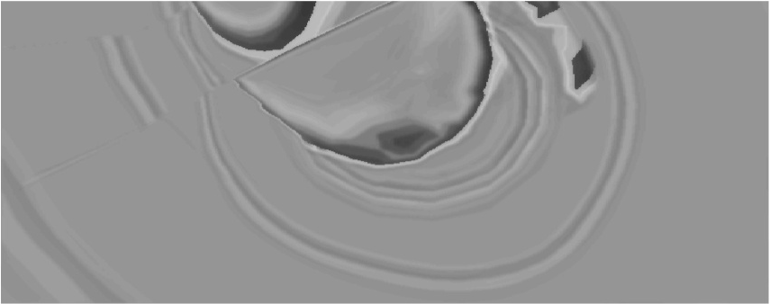
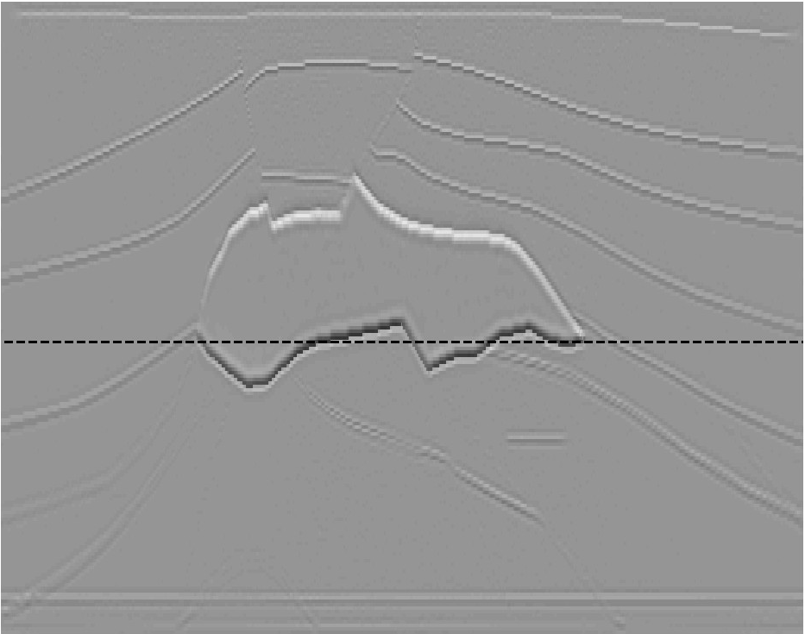

Numerical Results
(Yunsong Huang)
True reflectivities
6.7 km
Conventional migration
3.7 km
256 shots/super-gather, 16 iterations
3.7 km
13.4 km
8 x gain in computational
efficiency
Notes:
The multisource result is of slightly higher resolution than the conventional shot-gather migration; indistinguishable in this size on screen.

Slide 17
Outline
Least Squares Migration:
Examples of LSM:
Problems with LSM: Cost and V(x,z) Sensitivity
Multisource LSM: Gulf of Mexico Data
Viscoacoustic LSM: Marmousi & GOM data
Summary and Road Ahead

Slide 18
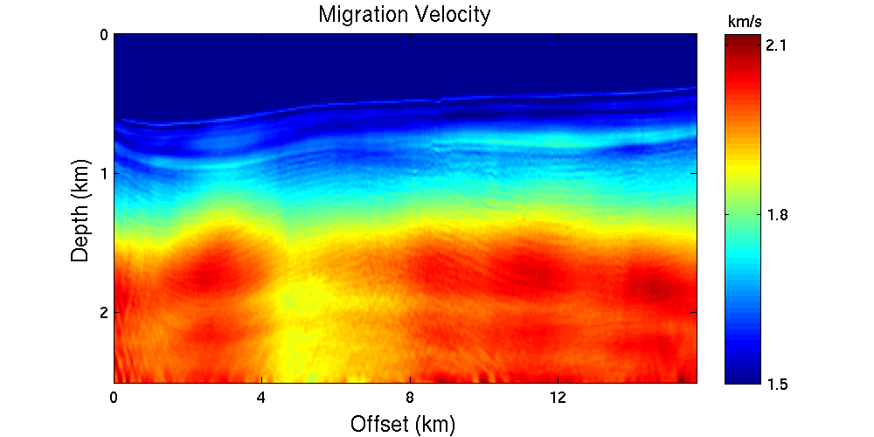
Plane-wave LSRTM of 2D GOM Data
Model size: 16 x 2.5 km.
Source freq: 25 hz
Shots: 515
Cable: 6km
Receivers: 480
0
km/s
2.1
Z (km)
2.5
1.5
0
X (km)
16

Slide 19
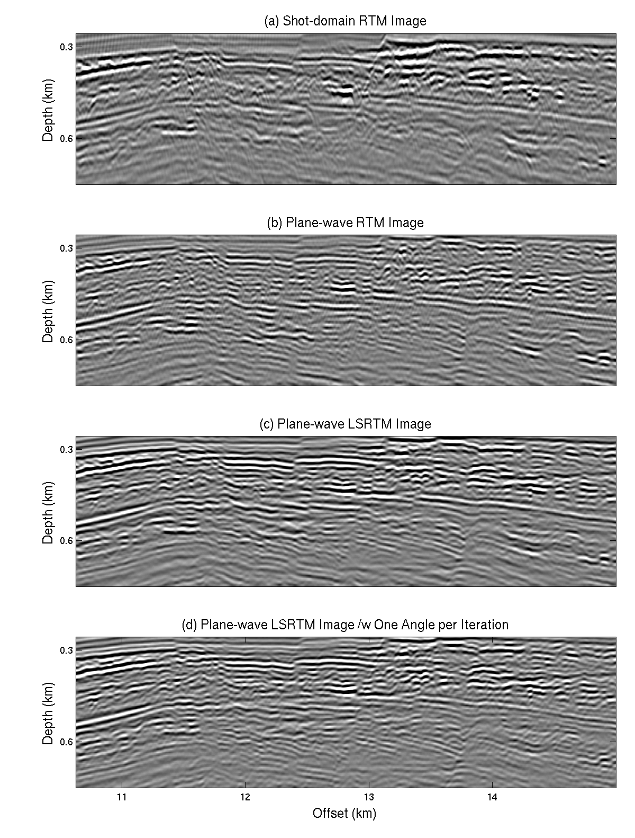
Conventional GOM RTM (cost: 1)
(Wei Dai)
0
Z (km)
2.5
Encoded Plane-wave LSRTM (cost: 0.4)
Plane-wave LSRTM (cost: 12)
Plane-wave RTM (cost: 0.2)
0
Z (km)
2.5
0
X (km)
16

Slide 20
Conventional GOM RTM (cost: 1)
(Wei Dai)
0
Z (km)
LSM
RTM
2.5
Encoded Plane-wave LSRTM (cost: 0.4)
Plane-wave LSRTM (cost: 12)
Plane-wave RTM (cost: 0.2)
0
Z (km)
2.5
0
X (km)
16

Slide 21
Outline
Least Squares Migration:
Examples of LSM:
Problems with LSM: Cost and V(x,z) Sensitivity
Multisource LSM: 3D SEG Salt Model
Viscoacoustic LSM: Marmousi & GOM data
Summary and Road Ahead

Slide 22
Viscoacoustic Least Squares Migration
T
m^{(k+1)} = m^{(k)} + α L Δd^{(k)}
L = viscoacoustic wave equation

Slide 23
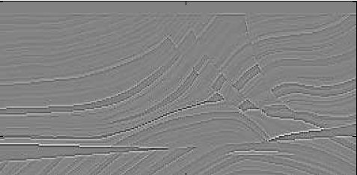
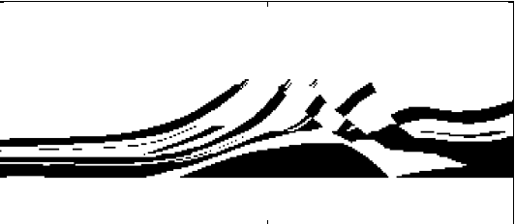
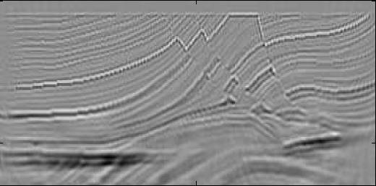
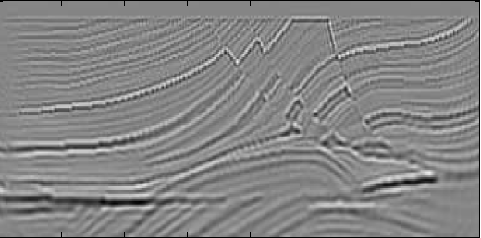
True Reflectivity
Q Model
0 Z (km) 1.5
0 Z (km) 1.5
Q=20000
Q=20
0 X (km) 2
0 X (km) 2
Acoustic LSRTM
Viscoacoustic LSRTM
0 Z (km) 1.5
1.0 -1.0
1.0 -1.0
0 X (km) 2
0 X (km) 2

Slide 24
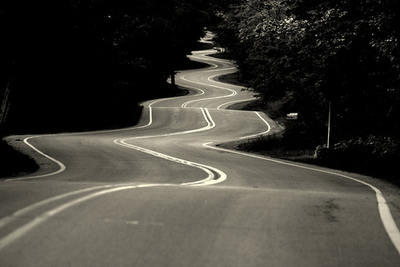
Road Ahead Summary
1. LSM Benefits: Anti-aliasing, better resolution, focusing
2. Cost: MLSM ~ RTM, MLSM has better resolution
3. Sensitivity: Quality LSM = RTM if inaccurate v(x,y,z)
4. Viscoacoustic LSM: Required if Q<25?
Broken LSM: Multiples. Quality degrades below 2 km?
Collect 4:1 data?
6. Road Ahead: Iterative MVA+MLSM+Statics

Slide 25

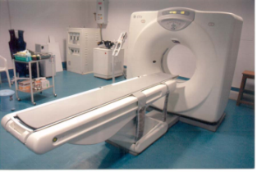
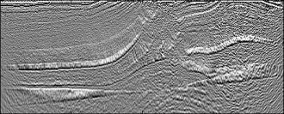
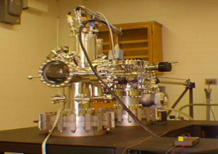
What have we empirically learned about MLSM?
Stnd. Mig Multsrc. LSM
IO 1 ~1/36
1 .1-8
Cost
Migration
SNR
1
~1
Resolution dx 1 ~double
Cost vs Quality: Can I<<S? Yes.

Slide 26
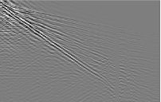
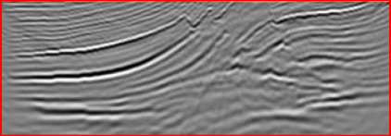
Conventional Least Squares Solution: L= & d =
L
d
1
1
L
d
Given: Lm=d
2
2
Find: m s.t. min||Lm-d||
In general, huge
dimension matrix
2
Solution: m = [L L] L d
T
-1
T
or if L is too big
m = m – α L (Lm - d)
(k+1)
(k)
(k)
T
(k)
= m – α L (L m - d )
(k)
[
T
]
+ L (L m - d )
T
1
1
1
2
2
2
Non-Linear Optimization =
Full Waveform Inversion
Linear Optimization =
Least Squares Migration
Notes:
My talk is organized in the following way:
1. The first part is motivation. I will talk about a least squares migration (LSM ) advantages and challenges.
2. The second part is theory for a deblurring filter, which is an alternative method to LSM.
3. In the third part, I will show a numerical result of a deblurring filter.
4. The fourth is the main part of my talk.
Deblurred LSM (DLSM) is a fast LSM with a deblurring filter.
I will explain how to use the filter in LSM algorithm.
5. Then I will show numerical results of the DLSM.
6. Then I will conclude my presentation.
Each figure has a slide number is shown at the footer.
26

Slide 27
Numerical Results
1. Land and Marine MLSM
2. Multiscale Waveform Inversion
3. Multisource Waveform Inversion

Slide 28
Numerical Results
1. Land and Marine MLSM
2. Multiscale Waveform Inversion
3. Multisource Waveform Inversion

Slide 29
Sensitivity to input noise level
9.4
8.0
SNR=30dB
6.6
5.4
SNR=10dB
3.8
Computational gain
SNR=20dB
Conventional migration:
1
38
76
152
304
Shots per supergather

Slide 30
Data Misfit Function
Difference between predicted and observed traces.
Match phase and amplitudes
ε=||D-d||² = D² + d² – 2Re(D*d)
ε=||D*d||² = 2Re(D*d) = |D||d|cos(Φ-φ)
Correlation between predicted and observed traces.
Match phase, no need to match amplitudes

Slide 31
Model Misfit Function
Difference between predicted and observed migration
Match phase and amplitudes
ε=1/2||mL^{T} Lm-m^{mig}||²
ε=1/2||m^{mig} m||²
Correlation between predicted and observed traces.
Match phase, no need to match amplitudes

Slide 32
Data Misfit Function
Difference between predicted and observed traces.
Match phase and amplitudes
ε=||D-d||² = D² + d² – 2Re(D*d)
ε=||D*d||² = 2Re(D*d) = |D||d|cos(Φ-φ)
Correlation between predicted and observed traces.
Match phase, no need to match amplitudes
Zhang et al. (2013) Dutta et al. (2014)

Slide 33
Outline
Least Squares Migration:
Examples of LSM:
Problems with LSM: Cost and V(x,z) Sensitivity
Multisource LSM: 3D SEG Salt Model
Viscoacoustic LSM: Marmousi & GOM data
Summary and Road Ahead

