Slide 1
3D Super-virtual Refraction Interferometry
Kai Lu
King Abdullah University of Science and Technology

Slide 2
Outline
Introduction and Motivation
Theory: conventional SVI with stationary phase integration
Synthetic data example
Field data example
Conclusion
Acknowledgement

Slide 3
Outline
Introduction and Motivation
Theory: conventional SVI with stationary phase integration
Synthetic data example
Field data example
Conclusion
Acknowledgement

Slide 4
2D Super-virtual Interferometry
1.Stacked Refractions: + Stacking
d d
virtual
~ d
~
A
AB
AC
BC
Common Pair Gather (Dong et al., 2006)
dt
dt
Benefit: SNR = N
dt
dt
A
A3
A2
A1
B C
B C
B C

Slide 5
2. Dedatum Virtual Refraction to Known Surface Point
2D Super-virtual Interferometry
Datuming
Dedatuming
d d
virtual
d d
~ d
supervirtual
~ d
*
virtual
AB
AC
BC
Brec
AB
BC
AC
Asrc
Brec
Asrc
real
super-virtual
A
B C
B C
A
B C
*
=
Raw trace
Virtual trace
(Calvert+Bakulin, 2004)
Super-virtual trace
+
*
=
Notes:
The solution is the convolve the redatumed shot record with a real trace recorded at y from a new source position. The unknown time advance is cancelled out and result of the convolution is a virtual trace located at z.

Slide 6
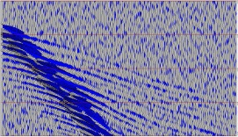
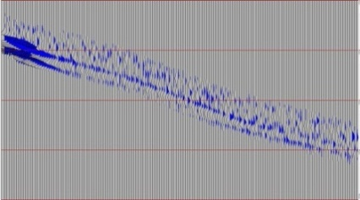
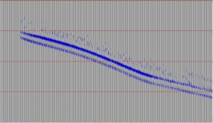
2D Super-virtual Interferometry
Theory and workflow:
Raw Data
Input Data
Windowed Data
Iterative SVI
Window around first arrivals and mute near offset
Correlate and stack to generate virtual refractions
Ʃ
Convolve and stack to generate Super-virtual refractions
Ʃ
Are first arrivals at far-offsets pickable ?
N
Super-virtual refraction Data
Output Data

Slide 7
Difficulties from 2D to 3D
Difficulty to find locations of stationary sources and receivers
Limited number of sources and receivers
Unknown Path
A₁
A₂
S
Few sources and receiver available

Slide 8
Solution
2D: all traces are stationary
3D: stationary phase integration
Virtual Trace
A
B
S1
S2
S3
S*
• • •
Sn
$\sum_{S_{1}}^{S_{n}}{G\left(A | S\right)G^{∗}(B|S)}$ $\sim {G(B|A)}^{virt}$
Virtual Trace

Slide 9
Outline
Introduction and Motivation
Theory: conventional SVI with stationary phase integration
Synthetic data example
Field data example
Conclusion
Acknowledgement

Slide 10
Stationary Phase Integration
Stationary phase analysis (Bleistein, 1984) applied to the line integral:
$$f\left(ω\right)=\int_{−∞}^{∞}{g(x)e^{iω∅(x)}}dx \sim αe^{iω∅\left(x^{∗}\right)}g(x^{∗})$$
A
B
Applied to SVI:
S1
S2
S3
S*
• • •
Sn
$$\int_{S_{1}}^{S_{n}}{G\left(A | S\right)G^{∗}\left(B | S\right)dS}\sim G\left(A | S^{∗}\right)G^{∗}\left(B | S^{∗}\right)$$
Virtual trace AB

Slide 11
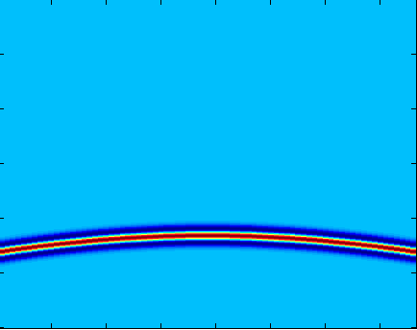
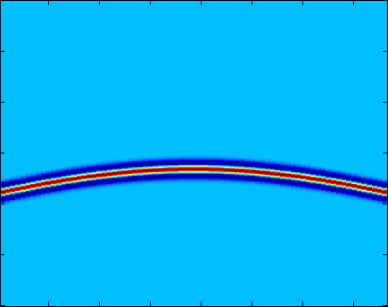
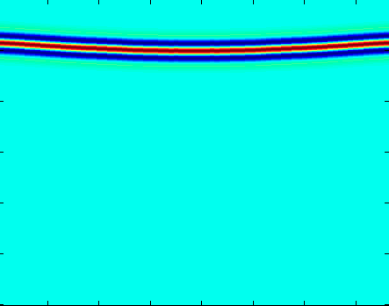
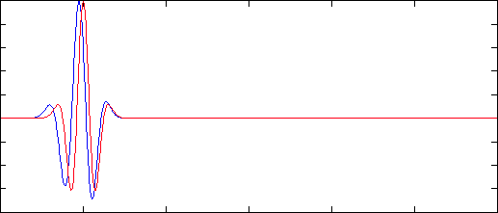
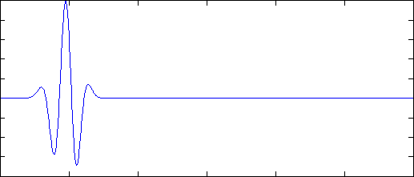
Cross-correlation Type
A
B
S₁
S*
S_{n}
S₁
S*
S_{n}
Correlation of S*A and S*B
CRG A
CRG B
Cross-correlation Results
Virtual trace AB
0
Ʃ
Time (s)
4
1
Source
180
1
Source
180
1
Source
180
-1
Amplitude
1

Slide 12
Virtual Trace Stacking over Source Lines
2D: Stacking over sources:
A1
A2
A3
B
C
A1
A2
A3
B
C
B
C
=
3D: Stacking over source lines:
A
B
lineN
•
•
•
line2
line1
S₁
S₂
S₃
•
S_{n}
•
•
$$\sum_{{line}_{1}}^{{line}_{n}}{}$$
$$\sum_{S_{1}}^{S_{n}}{G\left(A | S\right)G^{∗}(B|S)}$$
$$\sim {G(B|A)}^{virt}$$

Slide 13
Super Virtual Trace – Convolution Type
2D: Stacking over receivers:
A
B3
B2
B1
C
B3
B2
B1
C
A
B
C
*
=
3D: Stacking over receiver lines:
A
lineN
•
•
•
line2
line1
B₁
B₂
B₃
•
B_{n}
•
•
$$\sum_{{line}_{1}}^{{line}_{n}}{}$$
S
$$\sum_{B_{1}}^{B_{n}}{G\left(B | S\right){G(B|A)}^{virt}}$$
$$\sim {G(A|S)}^{super−virtual}$$

Slide 14
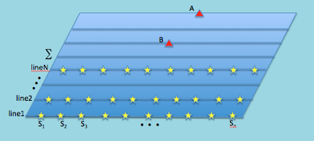
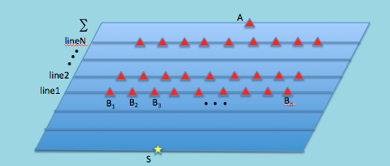
Workflow of 3D SVI
Input Band-pass filtered Data
Window around the targeted refraction
Iterative SVI
Generate virtual trace AB: $\sum_{S_{1}}^{S_{n}}{G\left(A | S\right)G^{∗}(B|S)}$
Stack ${G(B|A)}^{virt}$ generated from different sources
Generate super-virtual trace SA: $\sum_{B_{1}}^{B_{n}}{G\left(B | S\right){G(B|A)}^{virt}}$
Stack ${G(A|S)}^{super−virtual}$ generated from different receiver lines
Output Data

Slide 15
Outline
Introduction and Motivation
Theory: conventional SVI with stationary phase integration
Synthetic data example
Field data example
Conclusion
Acknowledgement

Slide 16
Synthetic Test – Undulating Layer Model
151 receivers, 76 sources on every line
11 survey lines
•
•
•
V1=1500m/s
V2=3000m/s

Slide 17
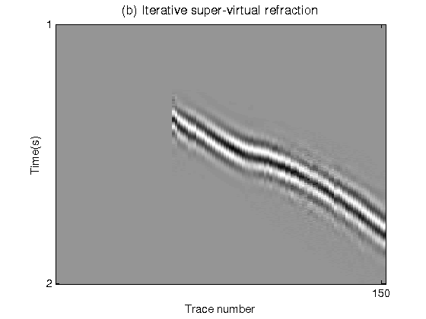
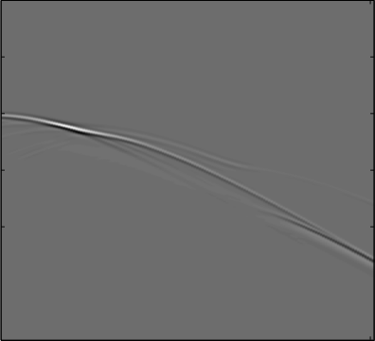
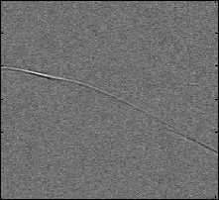
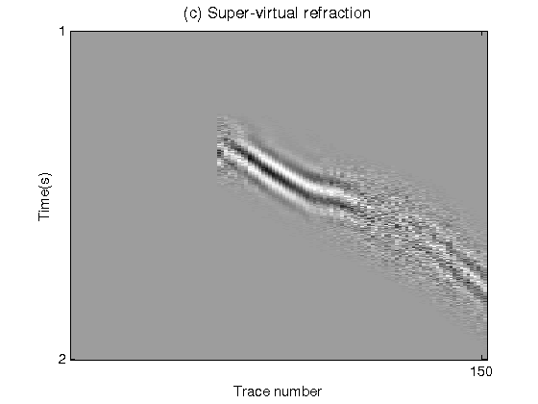
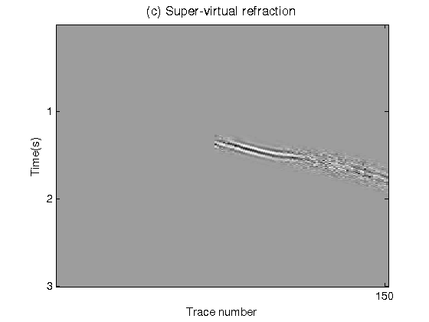
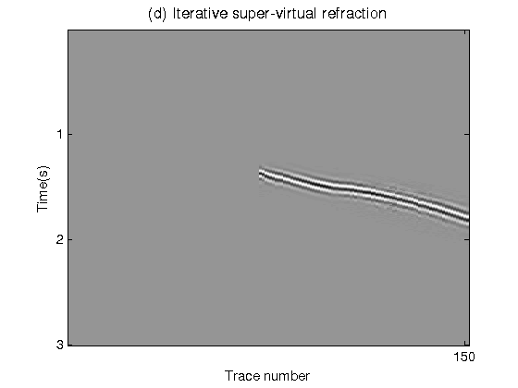
Synthetic Result
Line1
•
•
•
Line11
Original data
Data with random noise
0
0
Time (s)
Time (s)
3
3
1
Trace
151
1
Trace
151
Super-virtual refraction
Iterative Super-virtual Refraction
0
0
Time (s)
Time (s)
3
3
1
Trace
151
1
Trace
151

Slide 18
Outline
Motivation: from 2D to 3D
Theory: conventional SVI with stationary phase integration
Synthetic data example
Field data example
Conclusion
Acknowledgement

Slide 19
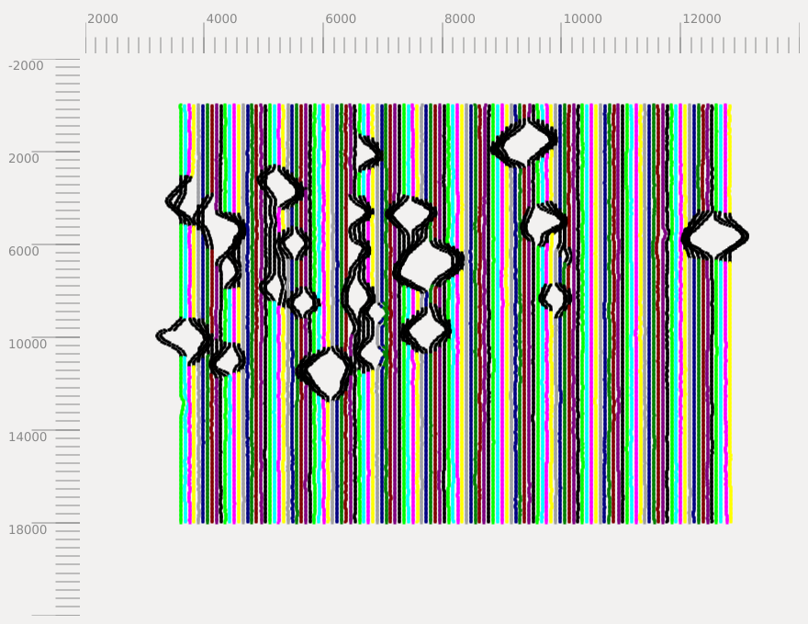
3D OBS Survey Geometry
2
x [km]
14
5 m
-2
Map view
50 m
50 m
400 m
y [km]
Sihil 3D OBS data
234 OBS stations
129 source-lines
Irregular geometry.
18

Slide 20
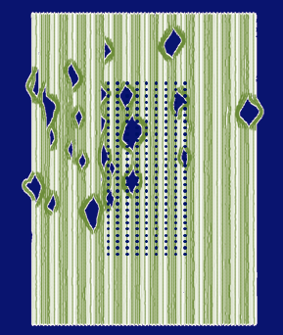
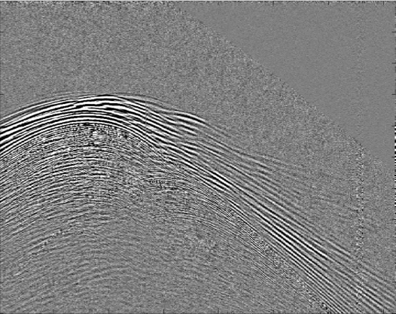
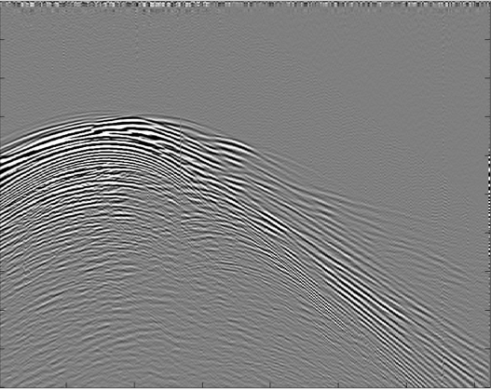
Field Results 1
Raw data
0
Time (s)
4
1
Trace
361
Band-pass filtered data
Super-virtual result
0
0
Time (s)
Time (s)
4
4
1
Trace
361
1
Trace
361

Slide 21
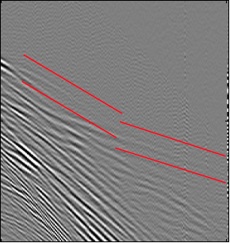
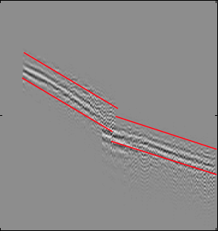
Zoom View Comparison
Zoom view of band-pass filtered data
Zoom view of super-virtual data
Zoom view of super-virtual data
1
1
Unpickable
Time (s)
Time (s)
3
3
1
Trace
361
1
Trace
361

Slide 22
Field Results 2
Raw data
0
Time (s)
4
1
Trace
361
Super-virtual result
Iterative Super-virtual result
0
0
Time (s)
Time (s)
4
4
1
Trace
361
1
Trace
361

Slide 23
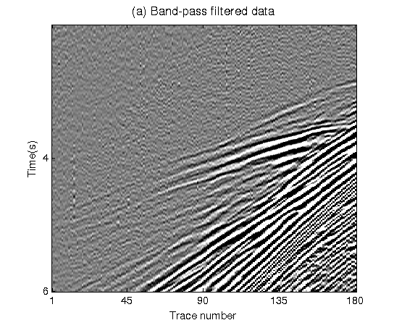
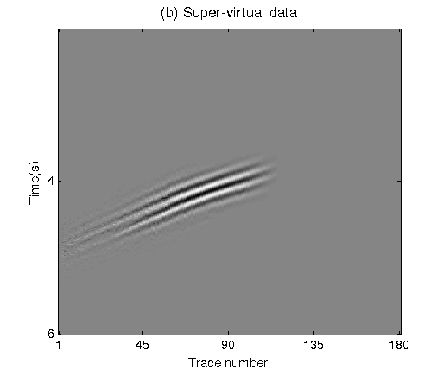
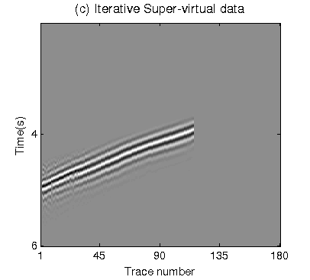
Zoom View Comparison
Raw data
0
Time (s)
Unpickable
4
1
Trace
361
Super-virtual result
Iterative Super-virtual result
0
0
Time (s)
Time (s)
Unpickable
4
4
1
Trace
361
1
Trace
361

Slide 24
Outline
Introduction and Motivation
Theory: conventional SVI with stationary phase integration
Synthetic data example
Field data example
Conclusion
Acknowledgement

Slide 25
Conclusion
We apply stationary phase integration method to achieve super-virtual refraction with enhanced SNR in 3D cases.
Iterative method is an option to further improve SNR when super-virtual refraction is still noisy.
Artifacts can be produced because of the limited aperture for integration as well as a coarse spacing of sources or receivers.

Slide 26
Thank you !

