Slide 1
Non-local Means (NLM) Filter for Trim Statics
Yunsong Huang, Xin Wang,
Gerard T. Schuster
KAUST

Slide 2
Outline
Motivations
NLM filter
NLM filtering of images
NLM+trim statics of migration images
Results (GOM data)
Conclusions
Notes:
My talk is organized in the following way:
1. The first part is motivation. I will talk about a least squares migration (LSM ) advantages and challenges.
2. The second part is theory for a deblurring filter, which is an alternative method to LSM.
3. In the third part, I will show a numerical result of a deblurring filter.
4. The fourth is the main part of my talk.
Deblurred LSM (DLSM) is a fast LSM with a deblurring filter.
I will explain how to use the filter in LSM algorithm.
5. Then I will show numerical results of the DLSM.
6. Then I will conclude my presentation.
Each figure has a slide number is shown at the footer.
2

Slide 3
Motivation
Velocity inaccuracies
Stacking misaligned prestack migration images → blurred migration images
dim spots

Slide 4
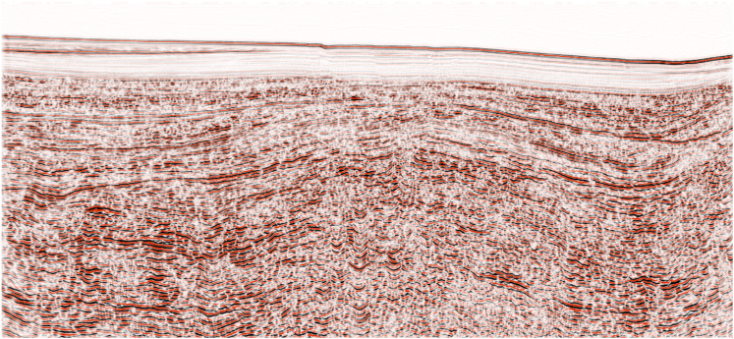
Motivation
CIG 16/31

Slide 5
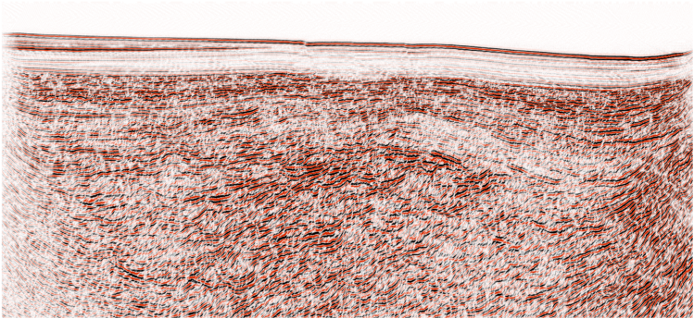
Motivation
CIG 1/31

Slide 6
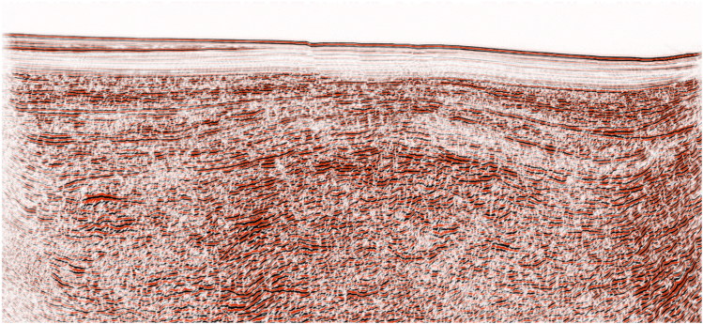
Motivation
CIG 5/31

Slide 7
Outline
Motivations
NLM filter
NLM filtering of images
NLM+trim statics of migration images
Results (GOM data)
Conclusions
Notes:
My talk is organized in the following way:
1. The first part is motivation. I will talk about a least squares migration (LSM ) advantages and challenges.
2. The second part is theory for a deblurring filter, which is an alternative method to LSM.
3. In the third part, I will show a numerical result of a deblurring filter.
4. The fourth is the main part of my talk.
Deblurred LSM (DLSM) is a fast LSM with a deblurring filter.
I will explain how to use the filter in LSM algorithm.
5. Then I will show numerical results of the DLSM.
6. Then I will conclude my presentation.
Each figure has a slide number is shown at the footer.
7

Slide 8
Non-Local Mean Filter
sensitivity controller
normalization
filtering weight
best match survives
p_{b}
patch
p_{a}
search neighborhood
Buades et al., 2005

Slide 9
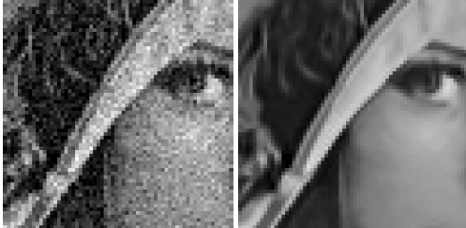
Non-Local Mean Example
favors repetitive structures
A noisy image
Endo-filtered by NLM
filtering weights
patch
search neighborhood

Slide 10
Outline
Motivations
NLM filter
NLM filtering of images
NLM+trim statics of migration images
Results (GOM data)
Conclusions
Notes:
My talk is organized in the following way:
1. The first part is motivation. I will talk about a least squares migration (LSM ) advantages and challenges.
2. The second part is theory for a deblurring filter, which is an alternative method to LSM.
3. In the third part, I will show a numerical result of a deblurring filter.
4. The fourth is the main part of my talk.
Deblurred LSM (DLSM) is a fast LSM with a deblurring filter.
I will explain how to use the filter in LSM algorithm.
5. Then I will show numerical results of the DLSM.
6. Then I will conclude my presentation.
Each figure has a slide number is shown at the footer.
10

Slide 11
Stacking Strategies
Poor candidate for pilot
Washed out
Tree representation
A1
NLM filter+ correlate+shift
stack
B1
B2
Out of phase

Slide 12
Recursive Stacking/Destacking
Stacking prestack images
(no pilot needed)
A
1
B
1
2
C
1
2
3
4
Destacking

Slide 13
Outline
Motivations
NLM filter
NLM filtering of images
NLM+trim statics of migration images
Results (GOM data)
Conclusions
Notes:
My talk is organized in the following way:
1. The first part is motivation. I will talk about a least squares migration (LSM ) advantages and challenges.
2. The second part is theory for a deblurring filter, which is an alternative method to LSM.
3. In the third part, I will show a numerical result of a deblurring filter.
4. The fourth is the main part of my talk.
Deblurred LSM (DLSM) is a fast LSM with a deblurring filter.
I will explain how to use the filter in LSM algorithm.
5. Then I will show numerical results of the DLSM.
6. Then I will conclude my presentation.
Each figure has a slide number is shown at the footer.
13

Slide 14
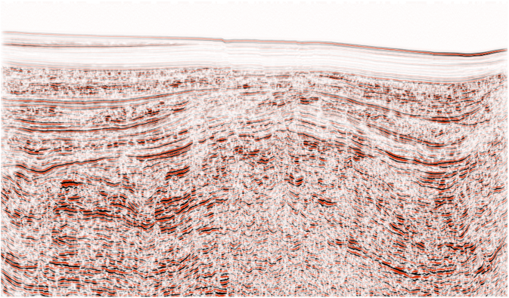
Stacked Prestack Migration Images
0
(31 plane-wave gathers)
Z (km)
3.6
0
X (km)
15

Slide 15
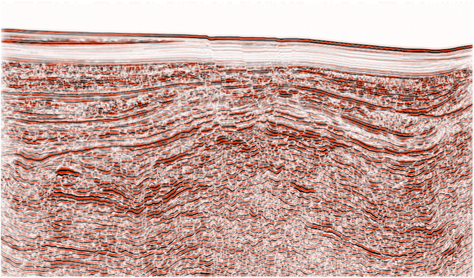
Stacked Prestack+Trim Statics Migration Images
0
(31 plane-wave gathers)
Z (km)
3.6
0
X (km)
15

Slide 16
Stacked Prestack Migration Images
0
(31 plane-wave gathers)
Z (km)
3.6
0
X (km)
15

Slide 17
Stacked Prestack+Trim Statics Migration Images
0
(31 plane-wave gathers)
Z (km)
3.6
0
X (km)
15

Slide 18
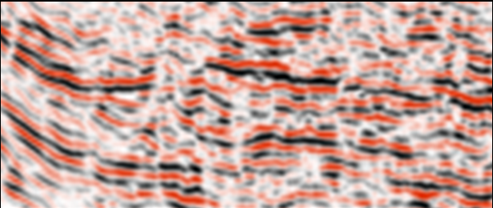
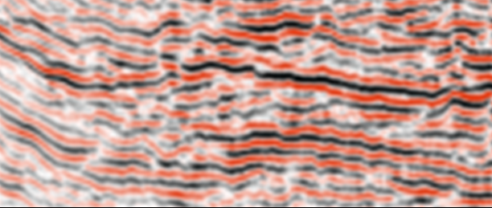
Too Good to be True
0
(31 plane-wave gathers)
Really?
Z (km)
3.6
0
X (km)
15

Slide 19
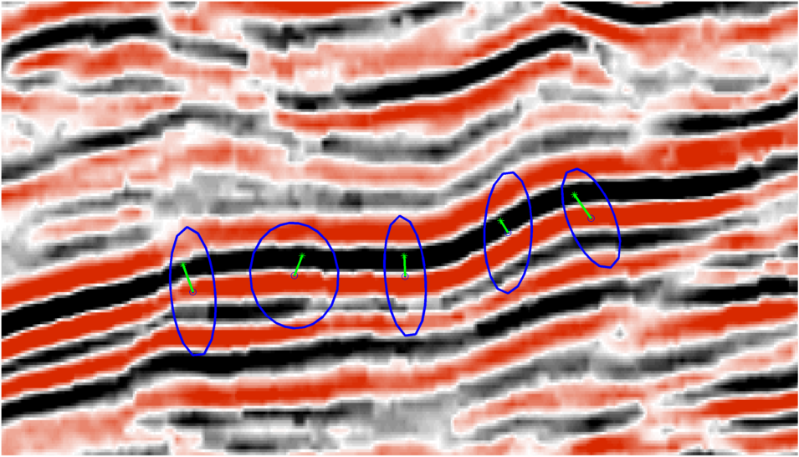
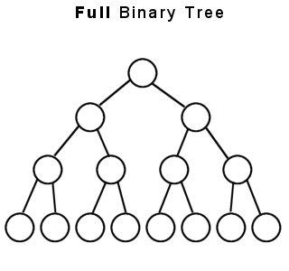
Local Trim Statics Shifts
poststack
*
λ
.
.
.
.
.
.
.
.
prestack
Scatter plot:
.
.
.
x
*
.
.
.
.
.
3σ
z
Cluster mean

Slide 20
Local Trim Statics Shifts
Ideally, we want a v(x,y,z) that reduces
scatter
.
.
x
.
.
.
.
.
.
z

Slide 21
Local Trim Statics Shifts
Reduced scatter implies a more accurate
velocity model: ε = ½ Σ||Ri-R||² → MVA
.
.
x
over iterations
.
Ri
.
Relation to
subsurface offset
.
.
2h₂
.
.
2h₁
x
z
z

Slide 22
Outline
Motivations
NLM filter
NLM filtering of images
NLM+trim statics of migration images
Results (GOM data)
Conclusions
Notes:
My talk is organized in the following way:
1. The first part is motivation. I will talk about a least squares migration (LSM ) advantages and challenges.
2. The second part is theory for a deblurring filter, which is an alternative method to LSM.
3. In the third part, I will show a numerical result of a deblurring filter.
4. The fourth is the main part of my talk.
Deblurred LSM (DLSM) is a fast LSM with a deblurring filter.
I will explain how to use the filter in LSM algorithm.
5. Then I will show numerical results of the DLSM.
6. Then I will conclude my presentation.
Each figure has a slide number is shown at the footer.
22

Slide 23
Conclusions
Trim statics can align reflectors
mispositioned across prestack images due to velocity inaccuracies
Noticeable improvement in feature coherency
Limitation: although features are clearly revealed, their locations might still be wrong
We can quantify and reduce the locational variance of the revealed features,
thereby inverting the velocity

Slide 24
Thanks to Sponsors of CSIM Consortium

Slide 25
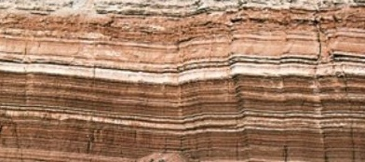
Non-Local Mean Filter
senstivity controller
normalization
best match survives
filtering weight
patch
p_{a}
p_{b}
search neighborhood
Buades et al., 2005

Slide 26
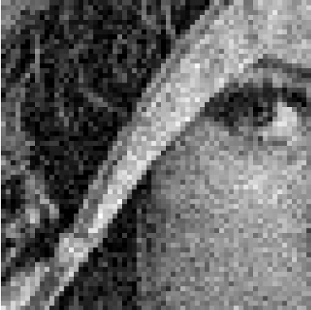
Non-Local Mean Filter
sensitivity controller
normalization
best match survives
filtering weight
p_{b}
patch
search neighborhood
p_{a}
Buades et al., 2005

