Slide 1
Warping for Trim Statics
Dongliang Zhang, Xin Wang,
Yunsong Huang, Gerard Schuster
KAUST

Slide 2
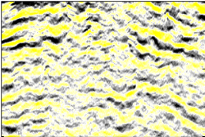
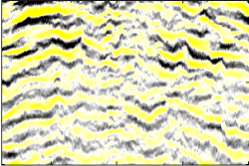
Outline
Motivation
Flatten the common image gathers
Theory
Use warping to flatten the CSGs or warping between prestack image
Numerical Example
Test on Marmousi model and GOM data
Conclusions

Slide 3
Outline
Motivation
Flatten the common image gathers
Theory
Use warping to flatten the CSGs or warping between prestack images
Numerical Example
Test on Marmousi model and GOM data
Conclusions

Slide 4
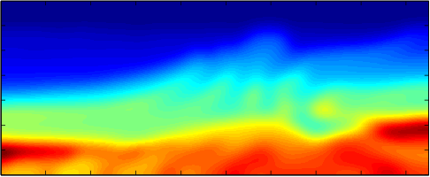
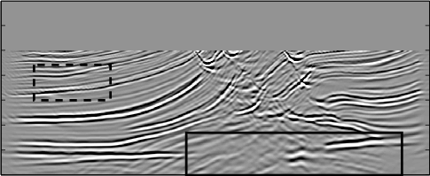
Motivation
Velocity Model with Errors
Image is distorted

Slide 5
Motivation
Common Image Gather
Flattened CIG
Problem: After stacking the unflattened CIGs, the image is blurred
Solution: Before stacking, use warping to flatten the CIGs

Slide 6
Outline
Motivation
Flatten the common image gathers
Theory
Use warping to flatten the CSGs or warping between prestack image
Numerical Example
Test on Marmousi model and GOM data
Conclusions

Slide 7


Dynamic Warping
Trace 1
Trace 2
Space Shifts
0 z (km) 3.5
-50 (m) 50

Slide 8
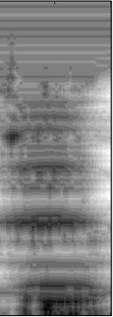

Pilot: Warping of CIGs
CIG
Vertical Space Shifts
Flattened CIG
pilot
3.5 Z (km) 0
-60 Shifts (m) 80
Reference trace: summation of all traces of CIG; summation of part traces of CIG; one trace of CIG

Slide 9
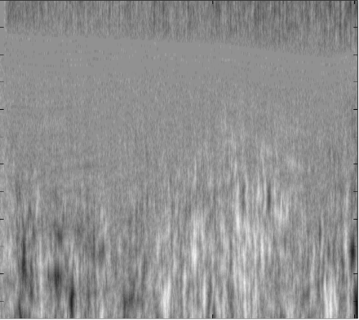
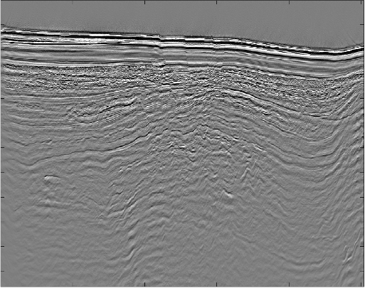
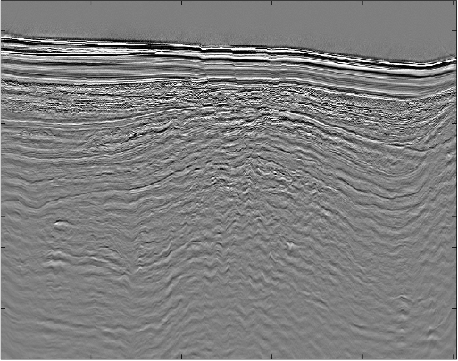
Auto-pilot: Warping of Prestack Images
Vertical Space Shifts
-75 Shifts (m) 75
Prestack Image #15
Prestack Image #16

Slide 10
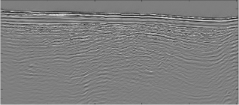


Auto-pilot: Warping of Prestack Images

Slide 11
Outline
Motivation
Flatten the common image gathers
Theory
Use warping to flatten the CSGs or warping between prestack image
Numerical Example
Test on Marmousi model and GOM data
Conclusions

Slide 12
CIG Warping：Marmousi Model
True Velocity Model
1.5 km/s 5.5
3.5 Z (km) 0
Migration Velocity with Errors
3.5 Z (km) 0
1.5 km/s 5.5
0 X (km) 9

Slide 13
Warping of CIG #200
CIG
Vertical Space Shifts
Flattened CIG
3.5 Z (km) 0
-60 Shifts (m) 80

Slide 14
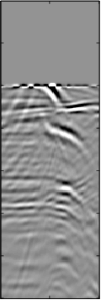
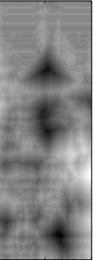
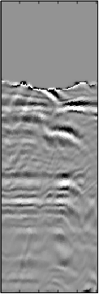
Warping of CIG #450
CIG
Vertical Space Shifts
Flattened CIG
3.5 Z (km) 0
-100 Shifts (m) 100

Slide 15
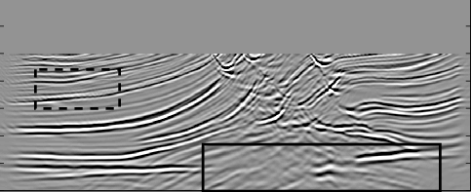
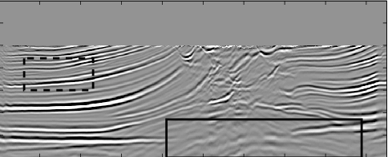
CIG Warping:
Comparison of Images
Migration Image before warping
3.5 Z (km) 0
Migration Image after warping
3.5 Z (km) 0
0 X (km) 9

Slide 16
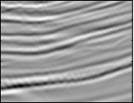
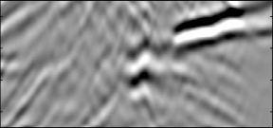
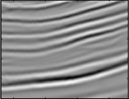
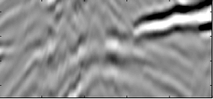
Zoomed Views
Image before Warping
Image before Warping
Image after Warping
Image after Warping

Slide 17
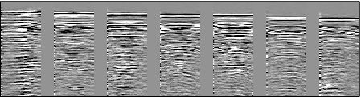
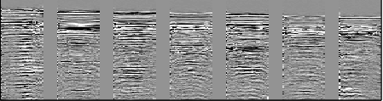
GOM Data
CIGs before Warping
3.5 Z (km) 0
CIGs after Warping
3.5 Z (km) 0

Slide 18
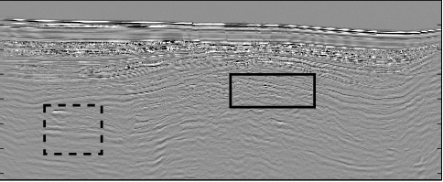
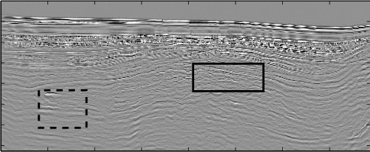
GOM Data
Migration Image before Warping
3.5 Z (km) 0
Migration Image after Warping
3.5 Z (km) 0
0 X (km) 16

Slide 19
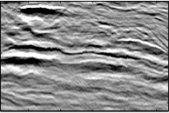
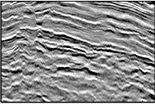
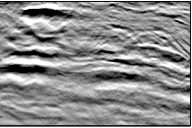
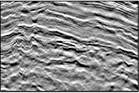
Zoomed Views
Image before Warping
Image before Warping
Image after Warping
Image after Warping

Slide 20
Warping of Prestack Images: GoM Data
Vertical Space Shifts
-75 Shifts (m) 75
Prestack Image #15
Prestack Image #16

Slide 21
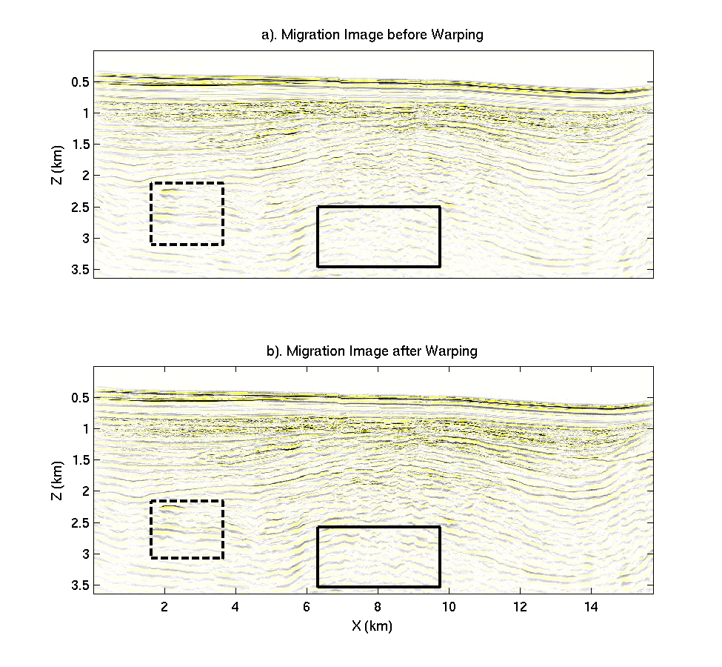
Comparison of Images
Migration Image before Warping
3.5 Z (km) 0
Migration Image after Warping
3.5 Z (km) 0
0 X (km) 16

Slide 22
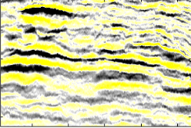
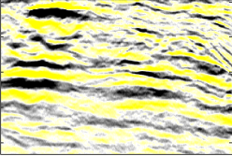
Zoomed Views
Image before Warping
Image before Warping
Image after Warping
Image after Warping

Slide 23
Outline
Motivation
Flatten the common image gathers
Theory
Use warping to flatten the CSGs or warping between prestack images
Numerical Example
Test on Marmousi model and GOM data
Conclusions

Slide 24
Conclusions
Signal-to-noise ratio is enhanced in the migration image
Some structures are more clearly delineated
Warping of prestack images changes image more than warping of CIGs
Position of the structures in the migration image may be still wrong
Warping for MVA

Slide 25
Thank you!

