Slide 1
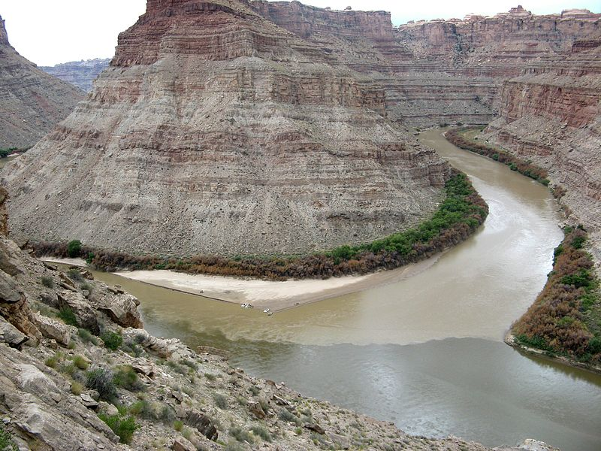
Multilayer Sparse Inversion=Deep CNN
Gerard Schuster and Zhaolun Lin
Sparse
Inversion
Deep CNN

Slide 2
Sparse
Inversion
Deep CNN
σ(H₁x)=ReLu(H₁x)
H₁x

Slide 3
Outline
Problem with CNN: Biology
Theory: ReLu, Sparse Inversion & Sparse Conv. Coding
Sparse LSM= Forward Pass of NN
Numerical Results
Summary
Notes:
This is my outline. First is the Motivation.
Then is the theory part, next is numerical Examples,
and finally is the conclusion.

Slide 4
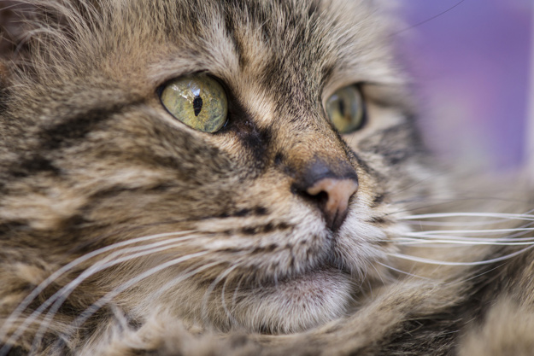
Single-Layer Neural Network
x
y
H₁
Σ
σ
1
0
If 1 then a cat
0
If 1 then a dog
Σ σ
1
.
.
.
.
.
.
.
.
.
.
.
.
Σ
σ
0
0
0
0
σ(H₁x)=ReLu(H₁x)
Σ
σ
H₁x
Matrix-vector multiplication
Task: learn weights, i.e. filters, in H₁
: σ(H₁◦x)
y=σ(H₁◦x)

Slide 5
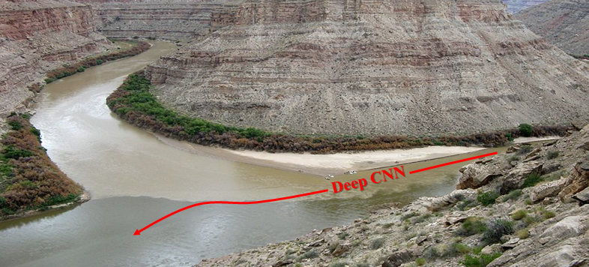
FeedForward Neural Network
x
FeedForward Neural Network
y
.
.
.
.
Layer 1
Layer 2 Layer N-1 Layer N
.
.
.
H₁
H₂
H_{N}
Σ
σ
Σ
σ
Σ
σ
Σ
σ
1
Σ σ
Σ σ
Σ σ
Σ σ
0
.
.
.
.
.
.
.
.
.
.
.
.
.
.
.
.
.
.
.
.
.
Σ
σ
Σ
σ
Σ
σ
Σ
σ
0
.
.
.
0
σ(H₁x)=ReLu(H₁x)
Σ
σ
Σ
σ
Σ
σ
Σ
σ
H₁x
.
.
.
.
σ(H₁x)
σ(H₂σ(H₁x))
y=σ(H_{N}σ(…σ(H₁x))…)
Papyan, Romano, Sulam, and Elad, 2018, IEEE Signal Processing Magazine

Slide 6
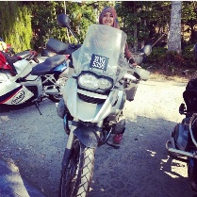
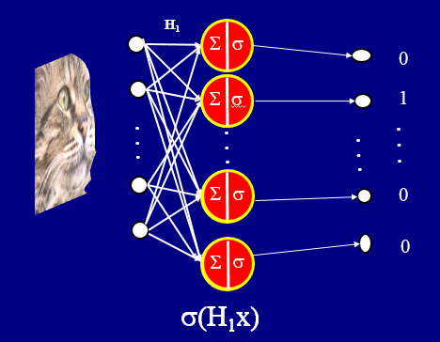
Main Problem with Deep Neural Networks
Answer: Biology
What the Heck is ReLU(in)?
Consequence: No Mathematical Foundation→ Shallow Understanding
response
Hubel & Weisel (1959, 1962)
ReLu(in)
angle input
in
Neuron
Layer I
Neuron
Layer II
Neuron
Layer III
run

Slide 7
What the Heck is ReLU(in)?

Slide 8
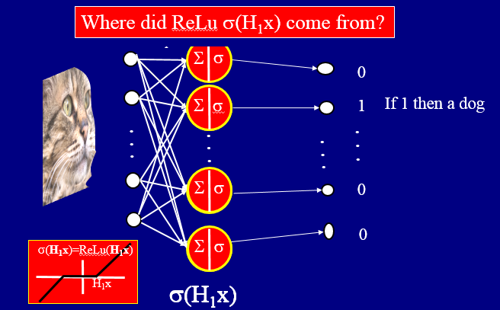
What the Heck is ReLU(in)?
Answer: JPEG Compression
What about Mathematical Foundation of ReLU(in)?
1
22
1
3
.
.
.
6
12
flatten
code
broad-
cast
code
22
.
.
.
6
12
decode
unflatten
decode
.
10 Mbytes
1 Mbytes
Hx
X(f)^{in}
X(f)^{out}
x(t)
FFT
threshold
λ
t
f
f
X^{out}
X^{out}
X^{out}
shrink
ReLu(X^{in})
2λ
X^{in}
X(f)^{outshrink}
X^{in}
X^{in}
y(t)
y=H^{T}(σ(Hx))
σ(Hx)
FFT⁻¹
t
f

Slide 9
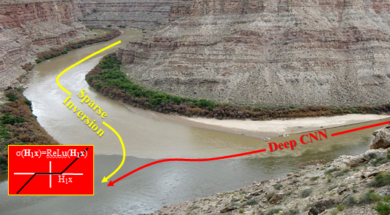
Outline
Problem with CNN: Biology
Theory: ReLu
Sparse LSM
Summary
Notes:
This is my outline. First is the Motivation.
Then is the theory part, next is numerical Examples,
and finally is the conclusion.

Slide 10
Math Foundation ReLU(z): ReLU(z)→ min ½ (||z-z^{in}||₂ )² + λ ||z||₁
z(f)^{in}
z(f)^{shrink}
noise
Given: z(f)^{in} =z(f) + n(f)
f
f
Find: z(f) s.t. z(f) minimizes ε = ½ ||z-z^{in}||₂² + λ ||z||₁
Soln: ∂ε/∂z_{i} = (z_{i} - $z_{i}^{in}$ ) + λ ∂|z_{i}|/∂z_{i}
btw, z(f)=z(f_{i})=z_{i}
z^{in}
= (z_{i} - $z_{i}^{in}$) + λ sgn(z_{i})
= 0
λ
rearrange
z_{i} + λ sgn(z_{i}) = z^{in}
_{i}
z
Rotate
& flip
λ
shrink
^{in}
z_{i} -
z_{i} > λ
λ
Z
z_{i} = z^{in} -
λ sgn(z_{i}) =
Z
_{i}
0 -λ < z_{i} < λ
z^{in}
thresh.
^{in}
z_{i} < λ
λ
z_{i} + λ
z_{i}
Z^{in}

Slide 11
Math Foundation ReLU(z): ReLU(z)→ min ½ (||z-z^{in}||₂ )² + λ ||Z||₁
z(f)^{in}
noise
Given: z(f)^{in} =z(f) + n(f)
f
Find: z(f) s.t. z(f) minimizes ε = ½ (||z-z^{in}||₂ )² + λ ||z||₁
Soln: ∂ε/∂z_{i} = (z_{i} - $z_{i}^{in}$ ) + λ ∂|z_{i}|/∂z_{i}
z_{i} = σ_{λ} ( $z_{i}^{in}$ )
z_{i} = σ_{λ} ($z_{i}^{o}$ - $[z_{i}^{0}−z_{i}^{in}$])
iterative steepest descent
(k+1)
(k)
α
(k)
Iterative soln to quadratic misfit with L1 penalty: one extra line to MATLAB SD code
^{in}
z_{i} -
z_{i} > λ
λ
z_{i} = z^{in} -
λ sgn(z_{i}) =
Z
_{i}
0 -λ < z_{i} < λ
^{in}
z_{i} < λ
λ
z_{i} + λ
Z^{in}

Slide 12
Outline
Problem with CNN: Biology
Theory: ReLu, Sparse Inversion & Sparse Conv. Coding
Sparse LSM= Forward Pass of NN
Numerical Results
Summary
Notes:
This is my outline. First is the Motivation.
Then is the theory part, next is numerical Examples,
and finally is the conclusion.

Slide 13
General Solution: Hz = z^{in} + noise
Blurring Equation: Hz=z^{in} + noise
argmin_{z}
½ || Hz-z^{in} ${||}_{2}^{2}$ + λ ||z${||}_{1}^{ }$
1.0
0.2
-.01
1.0
0.0
0.0
Q: What does sparse ||z||₁~||z||₀ mean?
A: Maximize # of zeros in vector z!
Z =
or
z(f)^{in}
z(f)^{outshrink}
f
f
Notes:
For sparse

Slide 14
General Solution: Hz = z^{in} + noise
Blurring Equation: Hz=z^{in} + noise
Migration Deconvolution: Hm=m^{mig} + noise
PSF Blurring Operator: H = L^{T}L
argmin_{z}
½ || Hz-z^{in} ${||}_{2}^{2}$ + λ ||z${||}_{1}^{ }$
Basis Pursuit
½ || Hm-m^{mig} ${||}_{2}^{2}$ + λ ||m${||}_{1}^{ }$
Basis pursuit
$z_{i}^{(k+1)}$ = σ_{λ}($z_{}^{(k)}$ - α/λ [ H^{T}( Hz^{(k)} -z^{in} )] )
$m_{i}^{(k+1)}$ = σ_{λ}($m_{i}^{(k)}$ - α/λ[ H^{T}( Hm^{(k)} -m^{mig} )]_{i} )
Let k=0, α/λ=1 and z⁽⁰⁾=0
→ $z_{i}^{(1)}$ = σ_{λ}(H^{T}z^{in})
Soft thresholding matched filter
Let k=0, α=1 and m⁽⁰⁾=0
→ m⁽¹⁾= σ_{λ}(H^{T}m^{mig})
Add one line of shrinkage/threshold code to your steepest descent code
: σ(z)
Conclusion: 1st iterate
Sparse Inversion =
Feedforward NN
σ(z)
z
2λ
Notes:
For sparse

Slide 15
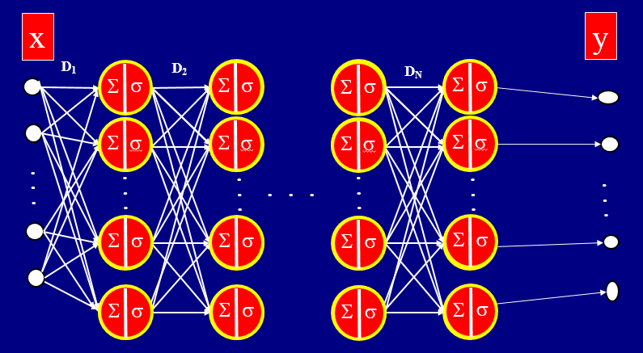
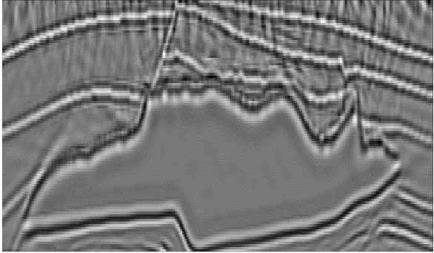
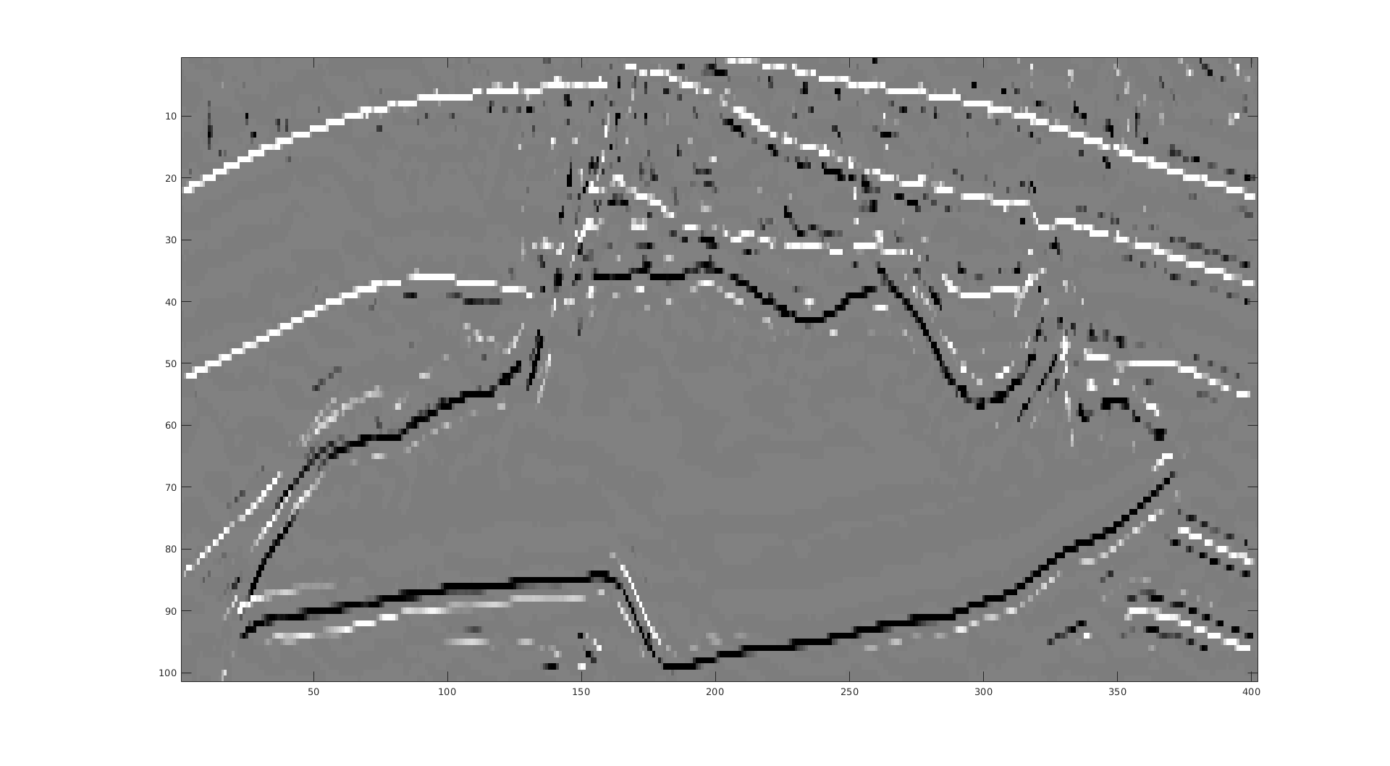
₂
argmin_{y} ½ ||x-Dy||₂ + l||z||₁
Single-layer Sparse LSM
m^{mig}
m₁
Find: m₁
s.t. argmin ||H₁m₁ –m^{mig}||₂ + λ||m₁||₁
$m_{i}^{(k+1)}$ = σ_{λ}($m_{i}^{(k)}$ - α/λ[ H^{T}( Hm^{(k)} -m^{mig} )]_{i} )
1st iteration of MD=Forward pass of Single Layer NN
σ_{λ}(H^{T}m^{mig}) ~ m₁
₁
m^{mig}
m₁
Notes:
软阈值函数

Slide 16
₂
argmin_{y} ½ ||x-Dy||₂ + l||z||₁
Multilayer Sparse LSM
m^{mig}
m_{N}
Find: m₁ ,m₂ , …m_{N}
||H₁m₁ –m^{mig}||₂ + λ||m₁||₁
||H₂m₂ –m₁ ||₂ + λ||m₂||₁
.
.
.
||H_{N}m_{N} –m_{N-1}||₂ + λ||m_{N}||₁
m₁ = σ_{λ}(H^{T}m^{mig})
₁
m₂ = σ_{λ}(H^{T}m$1$)
.
= σ_{λ}(H^{T}σ_{λ}(H^{T}m^{mig} ))
₂
.
₂
₁
.
Papyan, Romano, Sulam, and Elad, 2018, IEEE Signal Processing Magazine
m_{N} = σ_{λ}(H^{T}σ_{λ}(….. (H^{T}m^{mig}))…)
.
Sparse LSM←→NN Forward Pass MNN
.
N 1
.
_{N}
₁
Notes:
软阈值函数

Slide 17
Outline
Problem with CNN: Biology
Theory: ReLu, Sparse Inversion & Sparse Conv. Coding
Sparse LSM= Forward Pass of NN
Numerical Results: Synthetics
Summary
Notes:
This is my outline. First is the Motivation.
Then is the theory part, next is numerical Examples,
and finally is the conclusion.

Slide 18
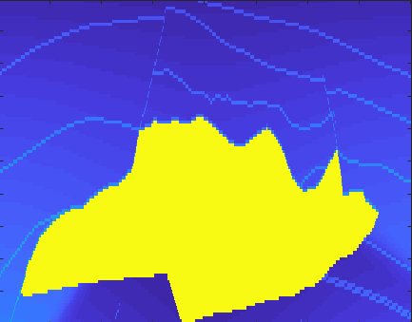
Find m that minimizes ||Hm - m^{mig}||² +α||m||₁
Least Squares Migration
Migration Image
Velocity Model
0.3
0.3
km/s
4.5
Z (km)
m
Z (km)
m^{mig}
1.7
2.3
2.3
12
4
X (km)
12
4
X (km)
Alternating
Gradient Descent
Step 1: m^{(m+1)} = σ_{λ}(m^{(m)} – α ∂ε/∂m); m=1,…15
H₁x
Step 2: H^{(m+1)} = (H^{(m)} – α ∂ε/∂H ); m=1,…15
ij
ij
ij
Notes:
Need to be more simple

Slide 19
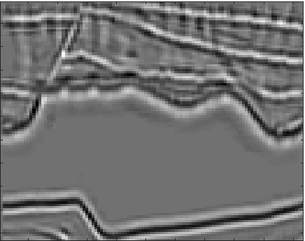
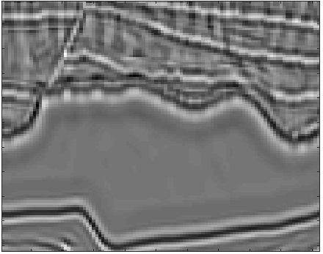
Find m that minimizes ||Hm - m^{mig}||² +α||m||₁
m^{mig}
~LSM
(~Reflectivity)
Feature Map
(sub-Reflectivity)
${\tilde{H}}_{1}$ (11×11)
Benefits: Inexpensive ~LSM
Coherent Noise Killer
Incoherent Noise Killer
CNN Filters
(~PSFs)
Liability: ~Reflectivity$≠$Reflectivity
6 = 6*2 - 1*6
or 6 = 6*1 +1*0

Slide 20
Find m that minimizes ||Hm - m^{mig}||² +α||m||₁
m^{mig}
${\tilde{H}}_{1}{\tilde{H}}_{2}$ (21×21)
${\tilde{H}}_{1}$ (11×11)
CNN Filters
(~PSFs)

Slide 21
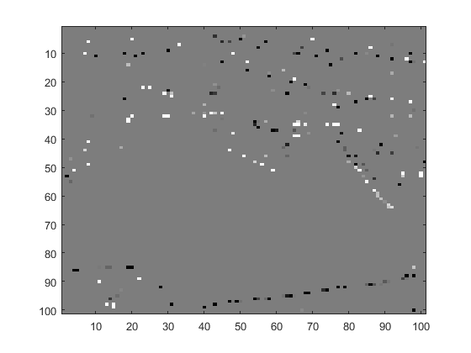
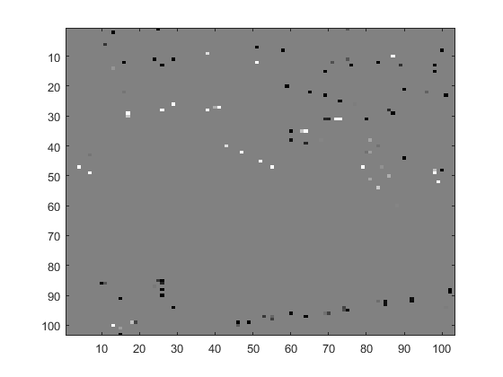
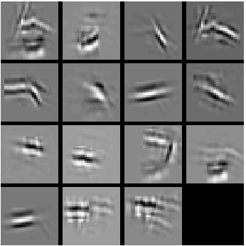
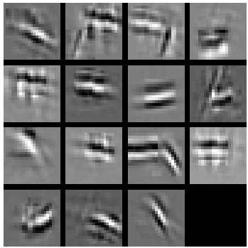
Find m that minimizes ||Hm - m^{mig}||² +α||m||₁
m
m
m^{mig}
${\tilde{H}}_{1}$ (11×11)
${\tilde{H}}_{1}{\tilde{H}}_{2}$ (21×21)
${\tilde{H}}_{1}{\tilde{H}}_{2}{\tilde{H}}_{3}$ (31×31)
CNN Filters
(~PSFs)

Slide 22
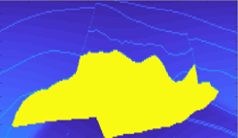
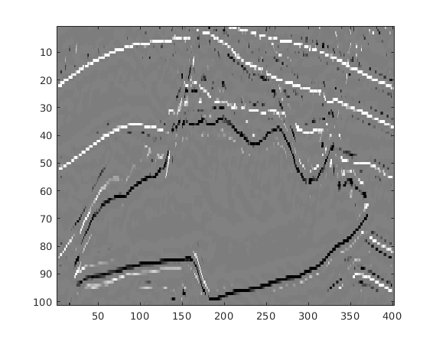
Find m that minimizes ||Hm - m^{mig}||² +α||m||₁
Learned PSF $\tilde{H}$
X
X
X
$$mmig$$
$\sum{\tilde{H}k\tilde{m}k}$ k$≠$2,4,6,8
$\sum{\tilde{m}k}$ k$≠$2,3,4,6,8
$\sum{\tilde{Γ}k\tilde{m}k}$ k$≠$2,3,4,6,8
True Velocity model
0.3
0.3
X
X
Z (km)
Z (km)
2.3
2.3
4
X (km)
12
4
X (km)
12
How did we get H_{k} ?
Alternating
Gradient Descent
Step 1: m^{(m+1)} = σ_{λ}(m^{(m)} – α ∂ε/∂m); m=1,…15
Step 2: H^{(m+1)} = (H^{(m)} – α ∂ε/∂H ); m=1,…15
ij
ij
ij
Notes:
Need to be more simple

Slide 23
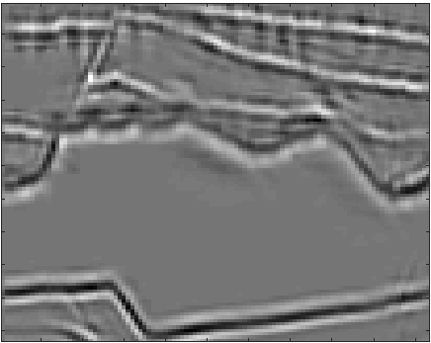
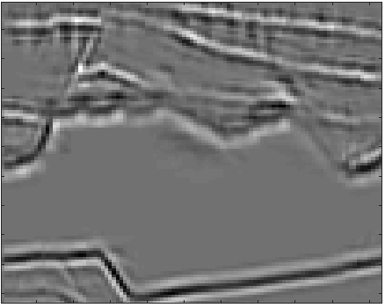
Summary: Find H, m that minimizes ||Hm - m^{mig}||² +α||m||₁
m^{mig}
H₁m₁
H₁ H₂m₂
H₁ H₂ H₃m₃
Σ_{i} m_{1i}
Σ_{i} m_{2i}
Σ_{i} m_{3i}

Slide 24
Outline
Problem with CNN: Biology
Theory: ReLu, Sparse Inversion & Sparse Conv. Coding
Sparse LSM= Forward Pass of NN
Numerical Results: Field Data
Summary
Notes:
This is my outline. First is the Motivation.
Then is the theory part, next is numerical Examples,
and finally is the conclusion.

Slide 25
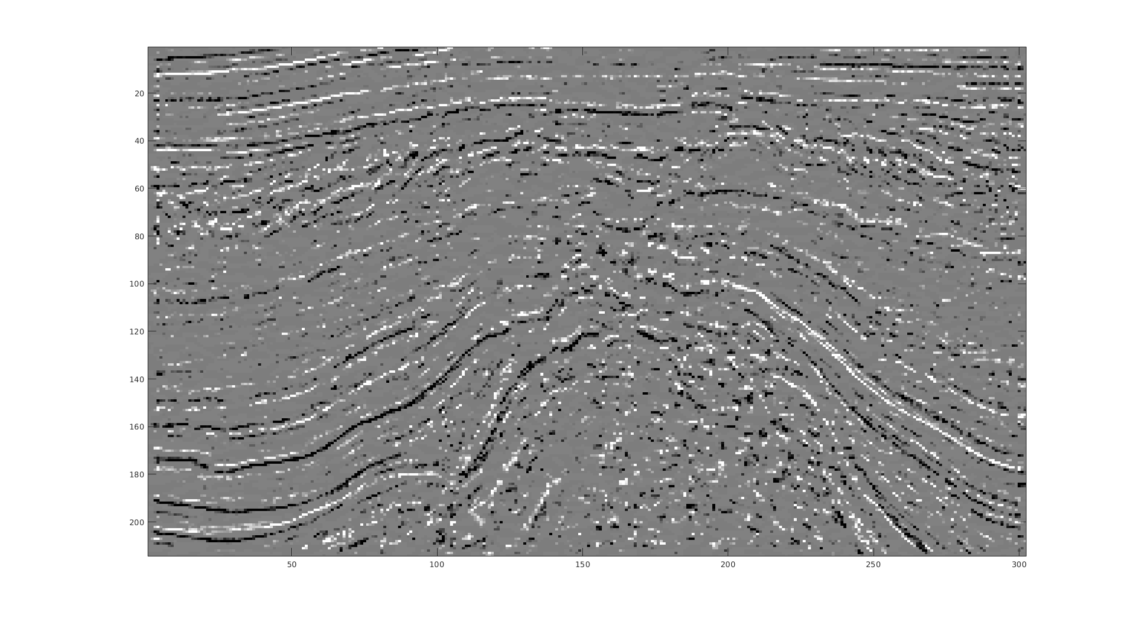
Field Data Test: F3 Block in Netherlands
Reflectivity
Migration Image
Migration Image
1
1
t (s)
t (s)
1.85
1.85
5
X (km)
8
5
X (km)
8
Notes:
Need to be more simple

Slide 26
Field Data Test: F3 Block in Netherlands
Migration Image
Reconstructed Migration Image
$\sum{\tilde{H}k\tilde{m}k}$
1
t (s)
1.85
5
X (km)
8
Notes:
Need to be more simple

Slide 27
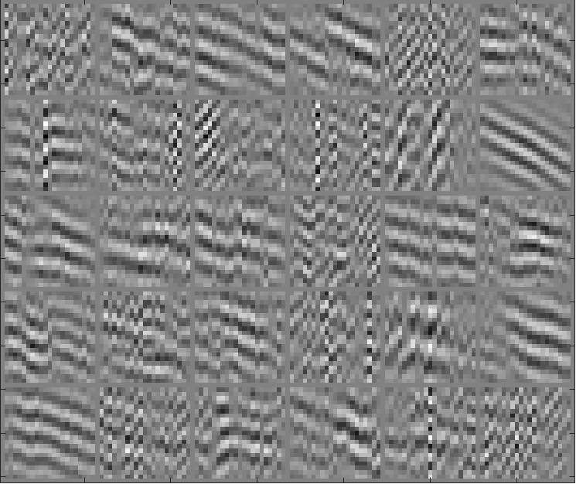
Field Data Test: Qademah Land Data
0.6
Denoised Data
Denoising for surface waves
Learned Filters d
T (s)
Raw Data
0.6
1.4
0.6
Residual
T (s)
1.4
T (s)
0.05
Offset (km)
0.35
1.4
0.05
Offset (km)
0.35
Notes:
Calculated from Marmousi model
dt=0.006 s
dg=20 m
The 2D image size: 181 $×$ 100

Slide 28
Summary
LSM

Slide 29
Summary
LSM:
Sparse LSM:
NNLSM:
Sparse LSM→Forward Modeling of NN
Practical Uses: Eliminate Random+Coherent Noise
m^{(m+1)} = m^{(m)} – α ∂ε/∂m; m=1,…15
m^{(m+1)} = σ_{λ}(m^{(m)} – α ∂ε/∂m); m=1,…15
Step 1: m^{(m+1)} = σ_{λ}(m^{(m)} – α ∂ε/∂m); m=1,…15
Step 2: H^{(m+1)} = (H^{(m)} – α ∂ε/∂H ); m=1,…15
ij
ij
ij
Σ
*
CNN
m_{N} = σ_{λ}(H^{T}σ_{λ}(….. (H^{T}m^{mig}))…)
Inexpensive ~LSM + ~FWI?????
Notes:
This is my outline. First is the Motivation.
Then is the theory part, next is numerical Examples,
and finally is the conclusion.

Slide 30
Sparse
Inversion
Deep CNN
NNLSM?

Slide 31
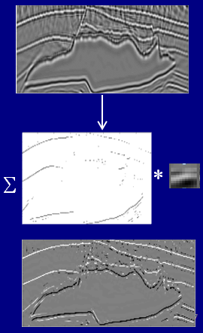
Summary
Future: Dig Deeper → Practical Uses of CNN, Comp. Sensing & NNLSM
Notes:
This is my outline. First is the Motivation.
Then is the theory part, next is numerical Examples,
and finally is the conclusion.

Slide 32
image
SSF
PSF
reflectivity
m
2D Sparse LSM → Forward CNN
m^{mig} = Σ_{k} H_{k} * m _{k}
m^{mig}
30 SSFs (size of 55$×$55)
Dictionary of
elements→m^{mig}
m₁ = σ_{λ}(H^{T} m^{mig})
Reflectivity m_{k}
¹
¹
Input Data m^{mig}
Learned SSF H_{k}
carbon
+n
=
*
nitrogen
Notes:
软阈值函数

Slide 33
image
SSF
PSF
reflectivity
2D LSM → Forward CNN
m^{mig} = Σ_{k} H_{k} * m_{k}
1D Reflectivity=CNN
Given: H and m^{mig}
Find: m
, H
= *
s.t. argmin ||Hm –m^{mig}||₂ + λ||m||₁
m, H
Soln:
Step 1: m^{(k+1)} = σ_{λ}(m^{(k)} – α ∂ε/∂m); k=1,…15
We need more than one SSF H
Step 2: H^{(k+1)} = (H^{(k)} – α ∂ε/∂H ); k=1,…15
ij
ij
ij
m₁
_{i}
Notes:
软阈值函数

Slide 34
Filters:
$\tilde{H}$₁: 15 filters of size 11×11, with stride of 1
$\tilde{H}$₂: 15 filters of size 11×11×15 with stride of 1
$\tilde{H}$₃: 15 filters of size 11×11×15 with stride of 1
${\tilde{H}}_{1}$ (11×11)
${\tilde{H}}_{1}{\tilde{H}}_{2}$ (21×21)
${\tilde{H}}_{1}{\tilde{H}}_{2}{\tilde{H}}_{3}$ (31×31)

Slide 35
$${\tilde{m}}_{1}$$
$${\tilde{m}}_{2}$$
$${\tilde{m}}_{3}$$

Slide 36
m^{mig}

Slide 37
Synthetic Test:
Migration Image
Learned SSF $\tilde{H}$
0.3
0.16 km
0.32 km
Z (km)
2.3
4
X (km)
12
Σ_{k} H_{k} * m_{k} = m^{mig}
Notes:
Need to be more simple

Slide 38
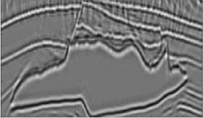
Synthetic Test:
$$\sum{\tilde{m}k}$$
$$\sum{\tilde{m}k}$$
$$m^{mig}$$
$$\sum{\tilde{H}k∗\tilde{m}k}$$
Learned S$SF \tilde{H}$
$$m^{mig}$$
$$m^{mig}$$
0.3
0.3
Z (km)
Z (km)
2.3
2.3
4
X (km)
12
4
X (km)
12
$$\tilde{m}$$
$\tilde{H} ∗ \tilde{m}$
₁
₂
₃
₄
₅
₆
₇
₈
₉
₁₀
₁₁
₁
₂
₃
₄
₅
₆
₇
₈
₉
₁₀
SSF=Segment Response Function
₁₁
₁
₂
₃
₄
₅
₆
₇
₈
₉
₁₀
₁₁
$$\tilde{H}$$
₁
₂
₃
₄
₅
₆
₇
₈
₉
₁₀
₁₁
0.3
0.3
*
₌
Z (km)
Z (km)
2.3
2.3
4
X (km)
12
4
X (km)
12
Notes:
Need to be more simple

Slide 39
Field Data Test: F3 Block in Netherlands
Migration Image
Reconstructed Migration Image
$\sum{\tilde{H}k\tilde{m}k}$
1
t (s)
1.85
5
X (km)
8
Notes:
Need to be more simple

