Slide 1
Micro-seismic Source Imaging with Natural Green’s Function
Hanchen Wang
Dec. 2nd

Slide 2
Outline
Introduction
-- Micro-seismic system
-- Conventional source imaging
Problems and Solutions
Theory
-- Natural Green’s Function
-- Cross-correlation suppressing noise
Numerical Results
-- Three layer model
-- Marmousi model
Conclusion

Slide 3
Outline
Introduction
-- Micro-seismic system
-- Conventional source imaging
Problems and Solutions
Theory
-- Natural Green’s Function
-- Cross-correlation suppressing noise
Numerical Results
-- Three layer model
-- Marmousi model
Conclusion

Slide 4
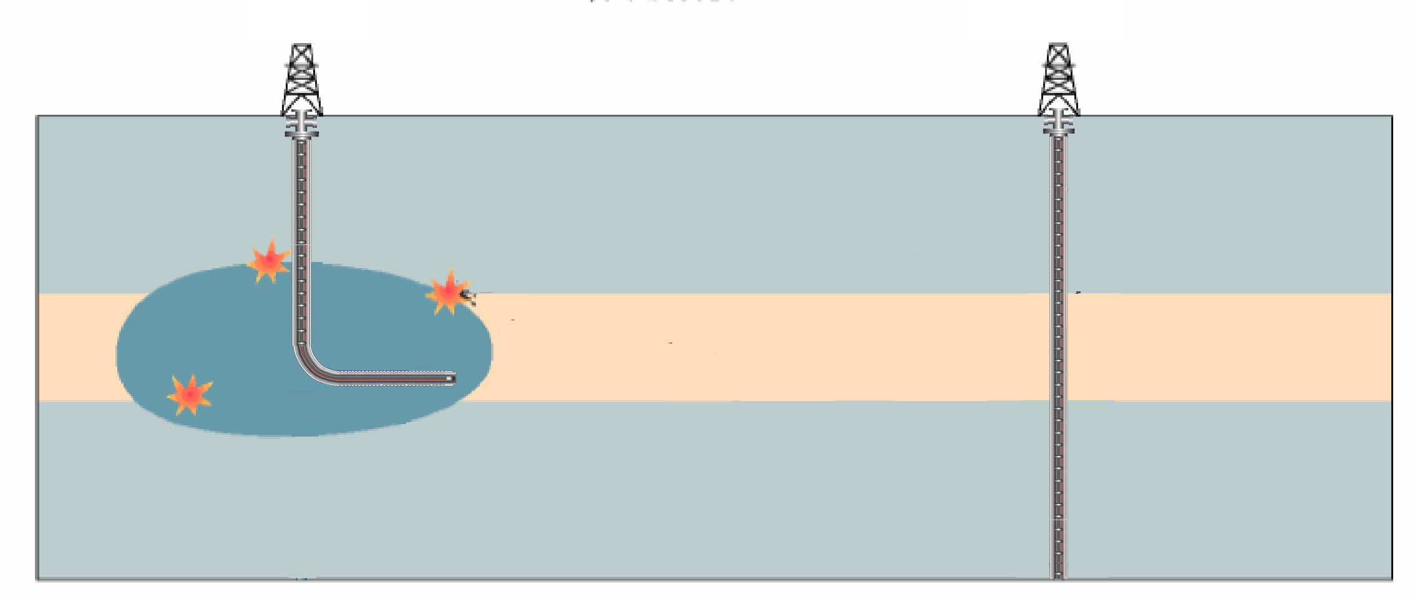
Introduction
Treatment well
Monitoring well
Receivers
Micro-earthquake waves
Receivers
Reservoir
Micro-earthquakes

Slide 5
Introduction
Conventional time reverse migration:
Back-propagate the observed data and apply the image condition (max energy condition).

Slide 6
Introduction
Maximum energy imaging condition
t₀ is unknown
Searching for max energy at every grid point in every time slide.
t
x
Maximum energy point
z

Slide 7
Outline
Introduction
-- Micro-seismic system
-- Conventional source imaging
Problems and Solutions
Theory
-- Natural Green’s Function
-- Cross-correlation suppressing noise
Numerical Results
-- Three layer model
-- Marmousi model
Conclusion

Slide 8
Problems and Solutions
Conventional imaging needs:
1. True velocity model;
Solution:
Natural Green’s function;
2. High S/N ratio data.
Solution:
Natural Green’s function;

Slide 9
Problems and Solutions
Noisy observed data:

Slide 10
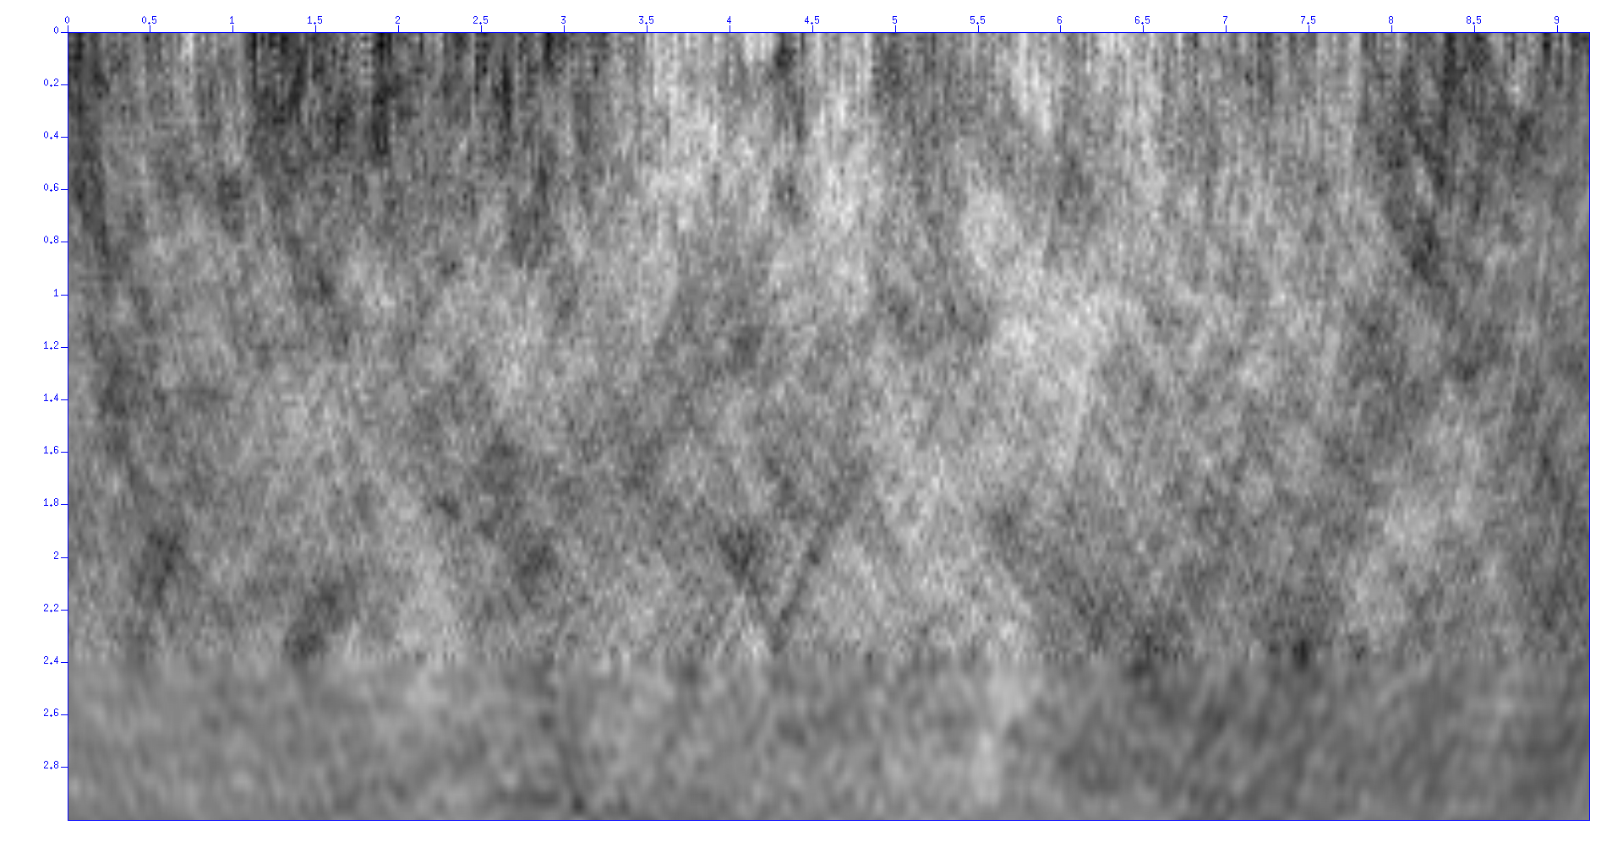
Problems and Solutions
Conventional TRM using noisy data:
0
x(km)
9
0
Z(km)
3

Slide 11
Outline
Introduction
-- Micro-seismic system
-- Conventional source imaging
Problems and Solutions
Theory
-- Natural Green’s Function
-- Cross-correlation suppressing noise
Numerical Results
-- Three layer model
-- Marmousi model
Conclusion

Slide 12
Theory
Natural Green’s function:
is the natural Green’s function.
How to obtain g(x,-t)?

Slide 13
Theory
Natural Green’s function:
x
Geophones
Horizontal well
Wavepaths
z
Image point

Slide 14
Theory
Noisy data:
Back-propagate the x-correlated traces
and apply the imaging condition.
w(t): source wavelet
d(g,t): observed data.

Slide 15
Outline
Introduction
-- Micro-seismic system
-- Conventional source imaging
Problems and Solutions
Theory
-- Natural Green’s Function
-- Cross-correlation suppressing noise
Numerical Results
-- Three layer model
-- Marmousi model
Conclusion

Slide 16
Numerical Results
True velocity model:
50 receivers on the top.
Ricker’s wavelet, 15Hz.

Slide 17
Numerical Results
Local velocity model with top VSP receivers:
Well

Slide 18
Numerical Results
Source image:
X (km)
Z (km)

Slide 19
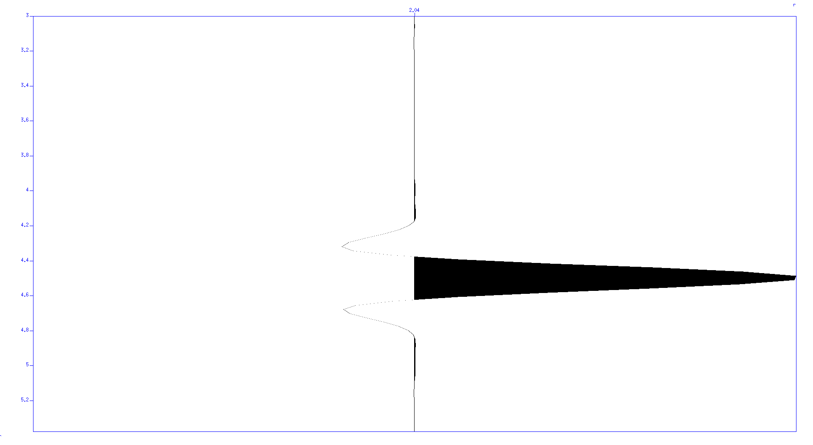
Numerical Results
Resolution at source depth:
Amplitude
0
X (km)
9

Slide 20
Numerical Results
Local velocity model with bottom VSP receivers:
Well

Slide 21
Numerical Results
Source image:
X (km)
Z (km)

Slide 22
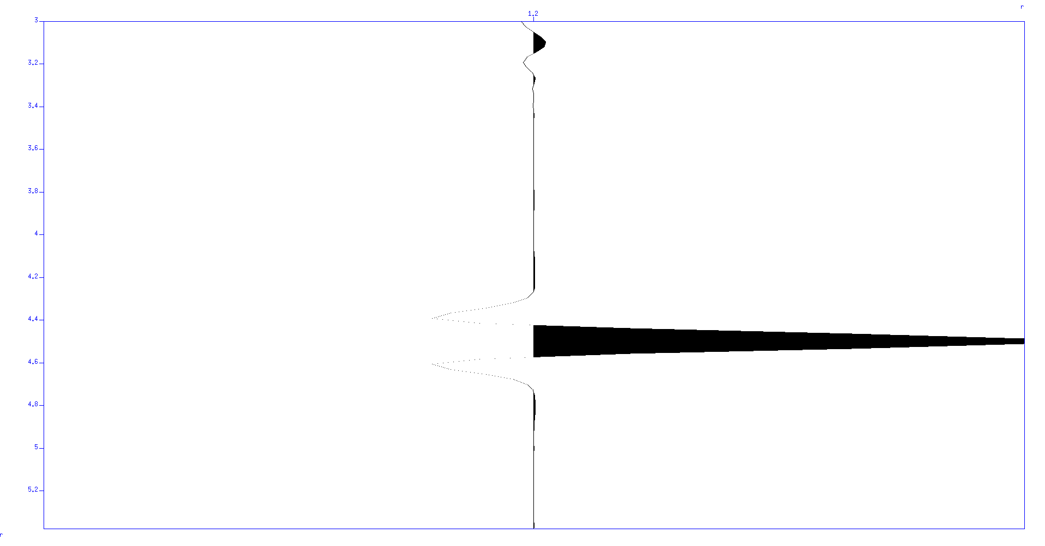
Numerical Results
Resolution at source depth:
Amplitude
0
X (km)
9

Slide 23
Numerical Results
Noisy observed data:

Slide 24
Numerical Results
X-correlated data:

Slide 25
Numerical Results
Conventional TRM using noisy data:
0
x(km)
9
0
Z(km)
3

Slide 26
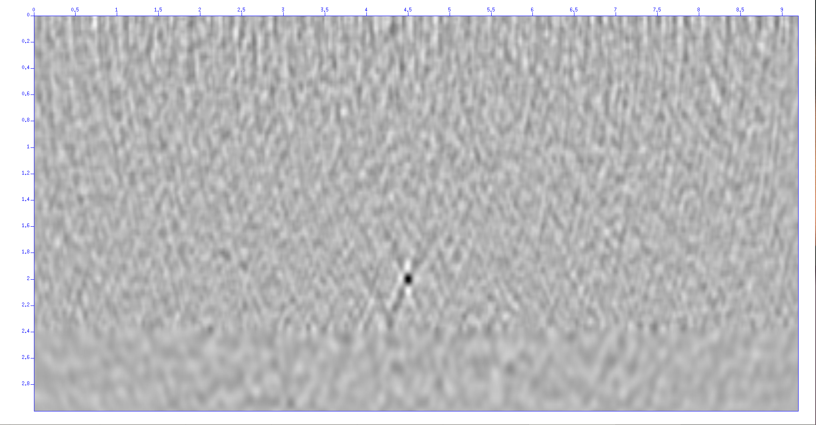
Numerical Results
TRM source image using x-correlated data:
0
x(km)
9
0
Z(km)
3

Slide 27
Numerical Results
Marmousi model:
50 receivers on the top;
Ricker’s wavelet, 15Hz.

Slide 28
Numerical Results
Local velocity model with top VSP receivers:
Well

Slide 29
Numerical Results
Source image:
X (km)
Z (km)

Slide 30
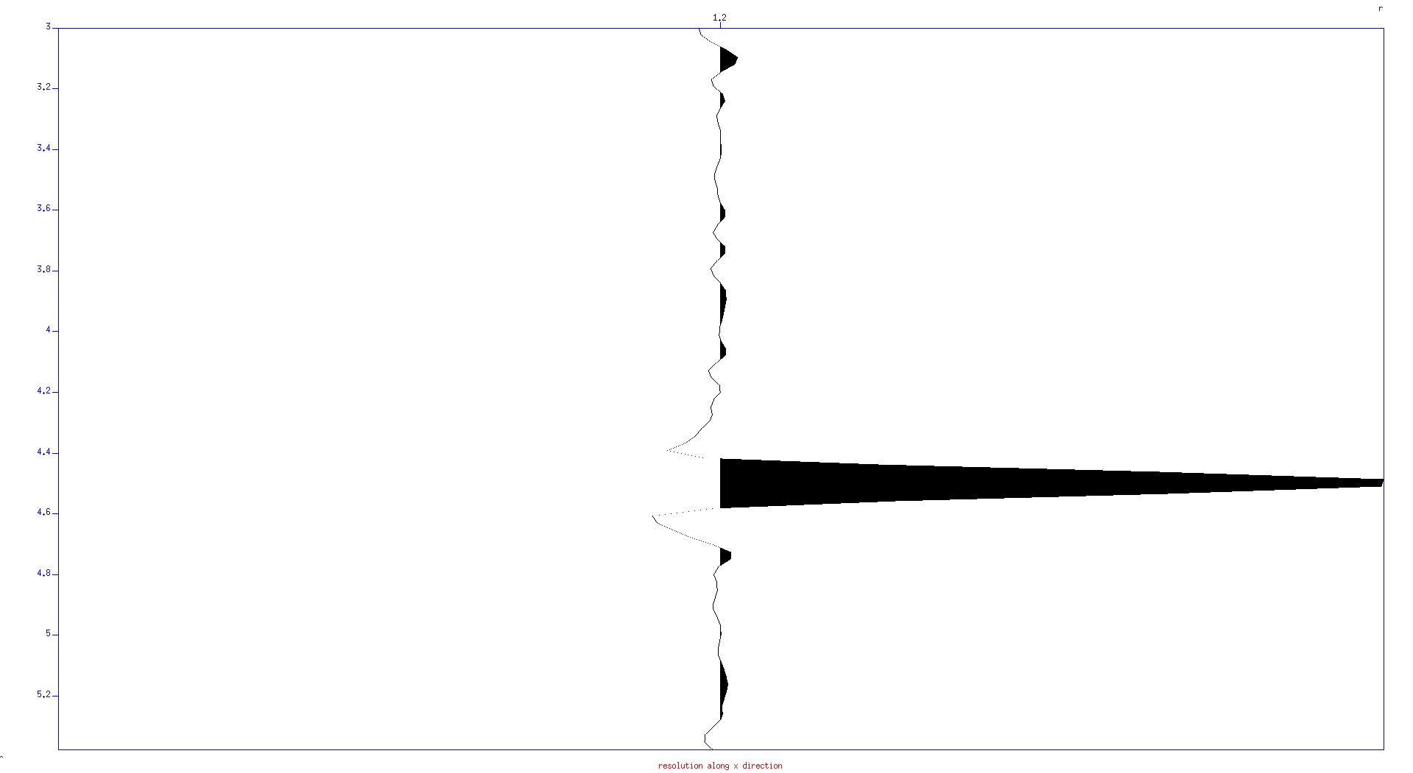
Numerical Results
Resolution at source depth:
Amplitude
0
X (km)
9

Slide 31
Numerical Results
Source image (noisy data after x-correlation):
X (km)
Z (km)

Slide 32
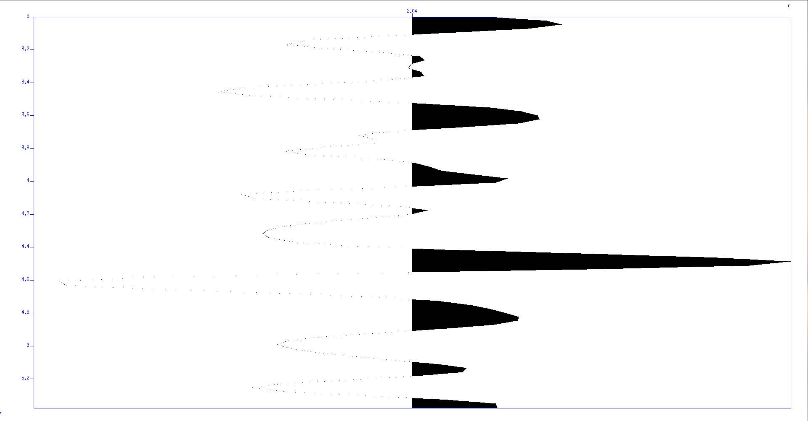
Numerical Results
Resolution (noisy data after x-correlation):
Amplitude
0
X (km)
9

Slide 33
Numerical Results
Local velocity model with bottom VSP receivers:
Well

Slide 34
Numerical Results
Source image:
X (km)
Z (km)

Slide 35
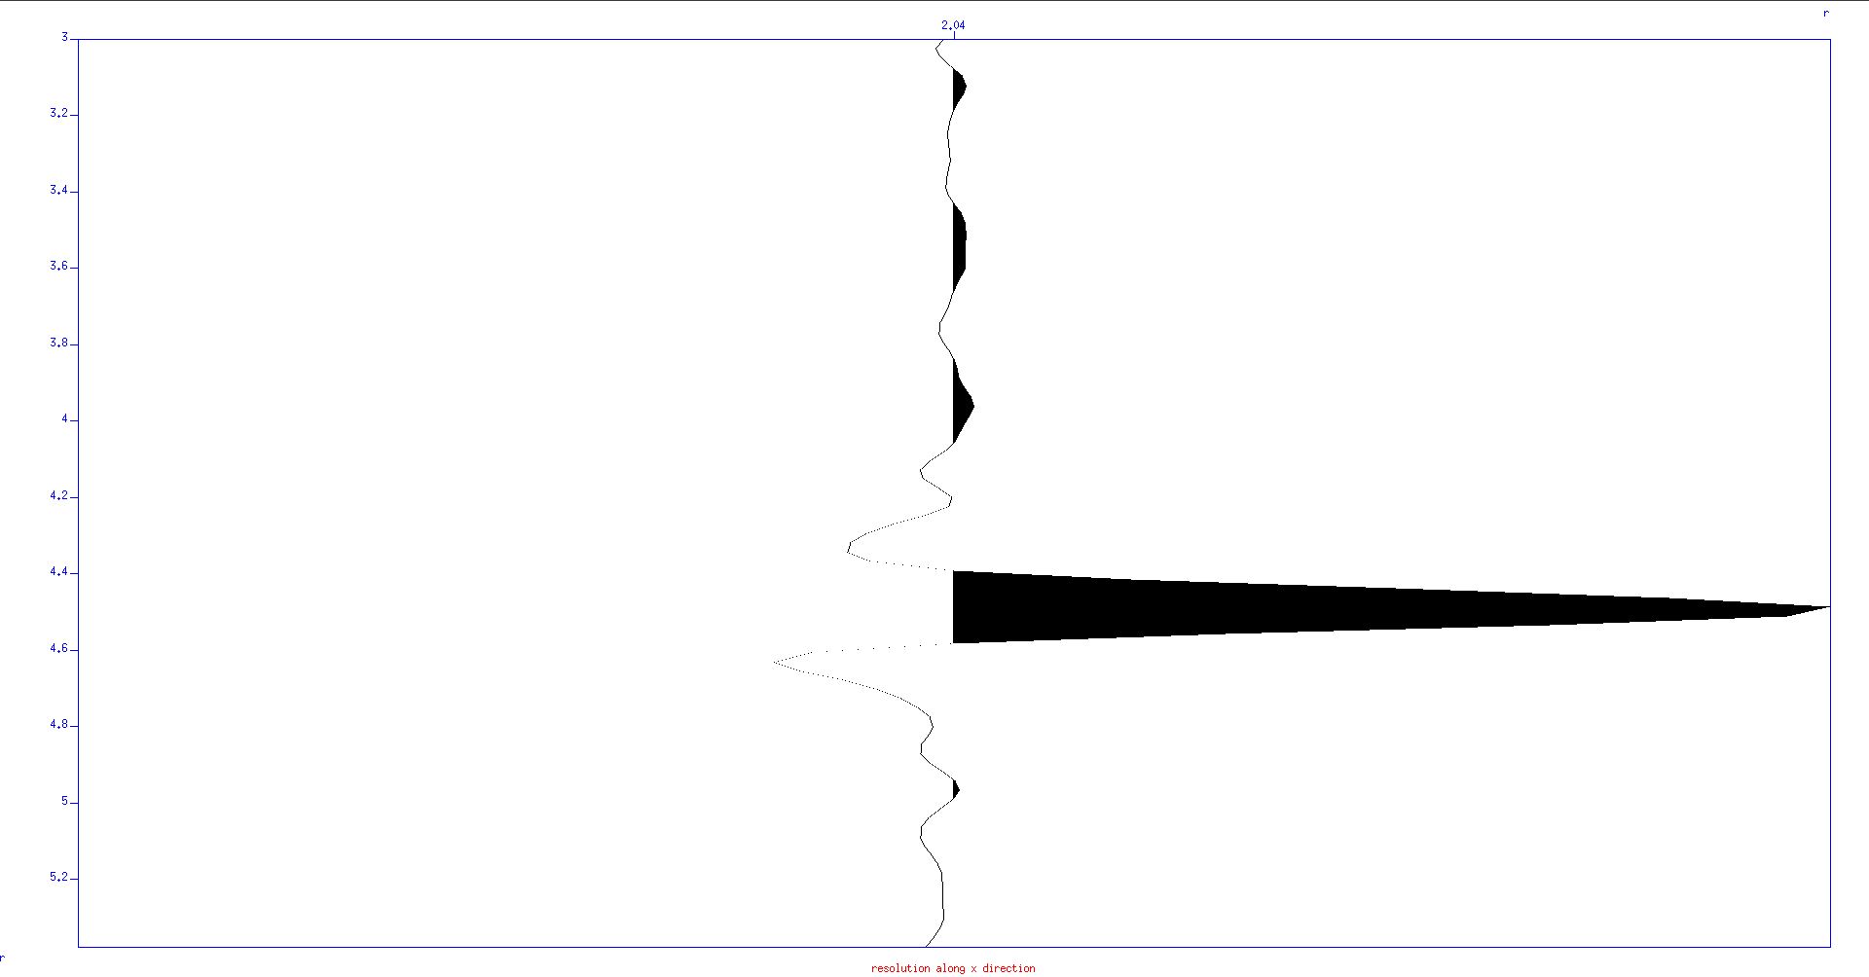
Numerical Results
Resolution at source depth:
Amplitude
0
X (km)
9

Slide 36
Numerical Results
Source image (noisy data after x-correlation):
X (km)
Z (km)

Slide 37
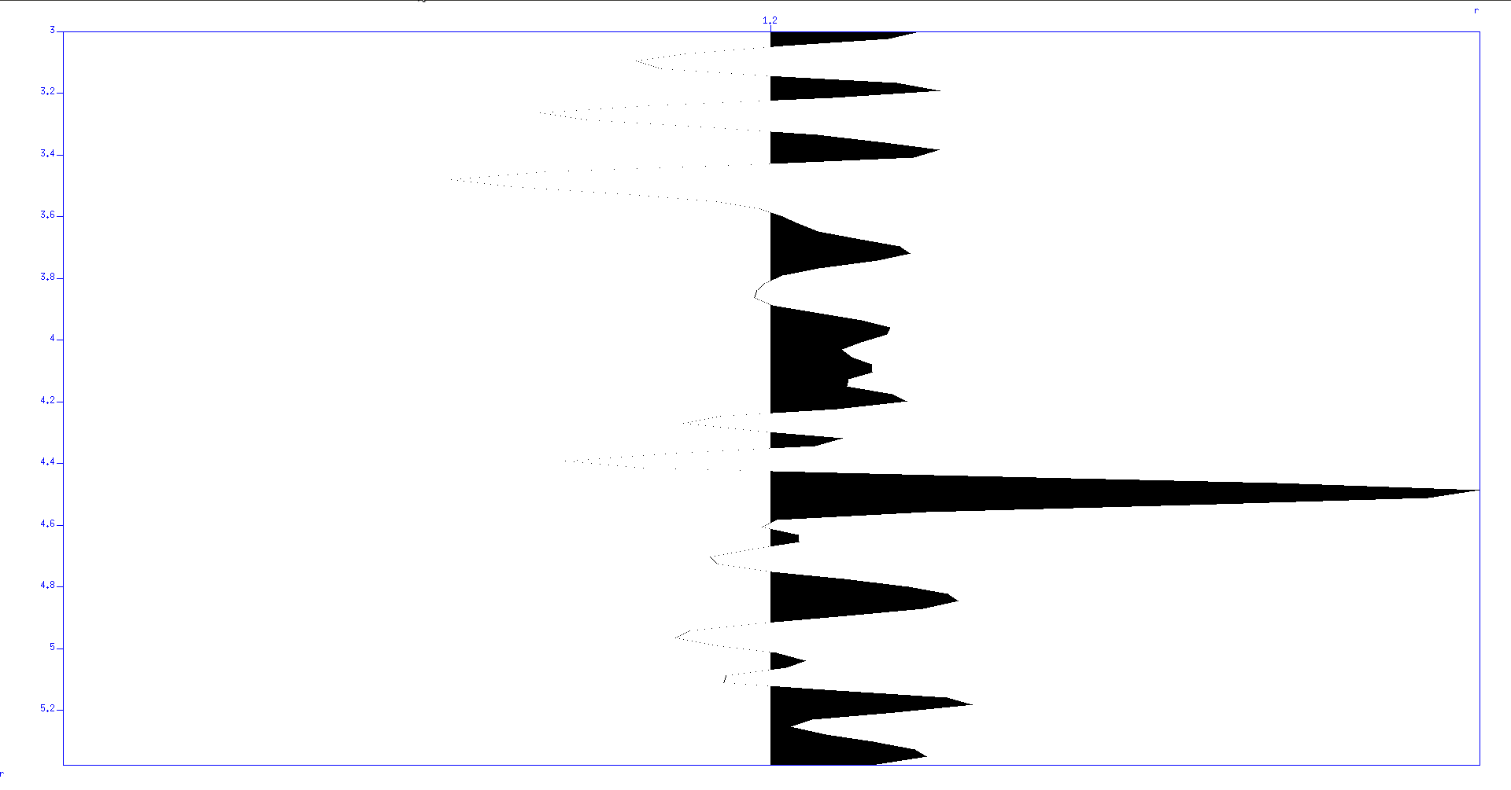
Numerical Results
Resolution (noisy data after x-correlation):
Amplitude
0
X (km)
9

Slide 38
Outline
Introduction
-- Micro-seismic system
-- Conventional source imaging
Problems and Solutions
Theory
-- Natural Green’s Function
-- Cross-correlation suppressing noise
Numerical Results
-- Three layer model
-- Marmousi model
Conclusion

Slide 39
Conclusion
1. True velocity model and noisy data may be problems in micro-seismic imaging;
2. , cross-correlation of traces can be an approach to suppress noise;
3. , imaging with natural Green’s function breaks down the requirement of full velocity model.

