Slide 1
Anisotropic Wave-equation Traveltime Inversion
Shihang Feng

Slide 2
Outline
Motivation
Theory
Synthetic tests
Problems and Solutions

Slide 3
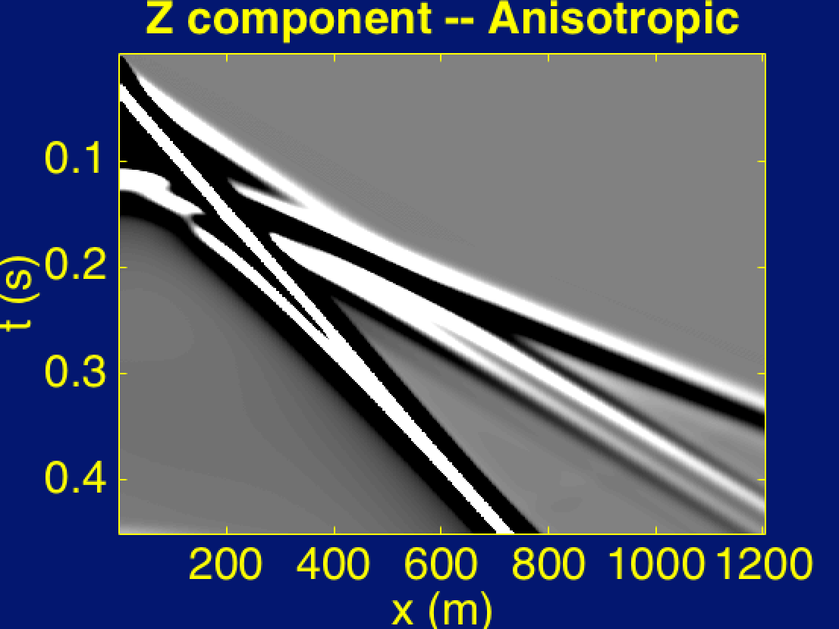
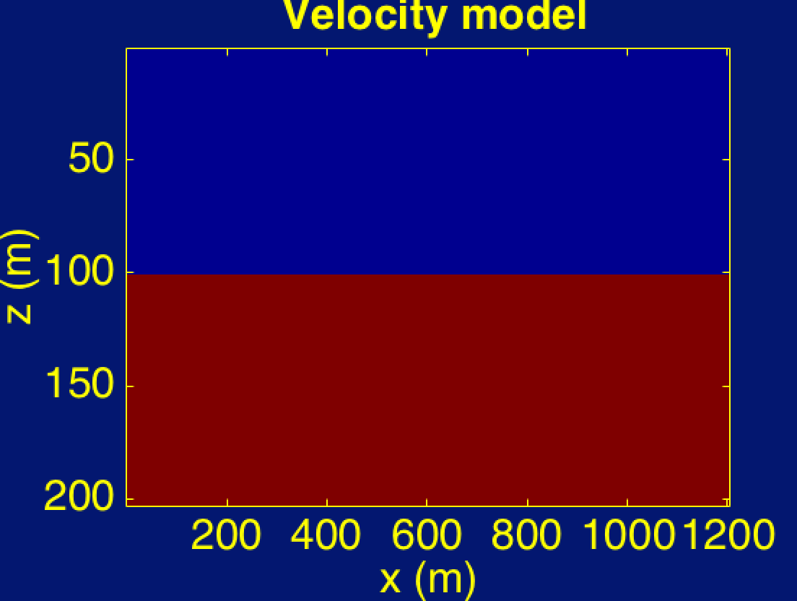
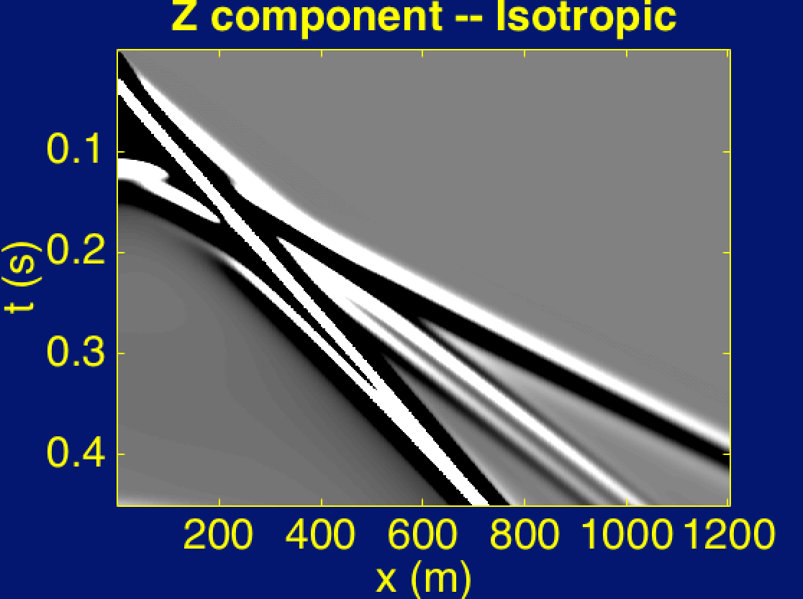
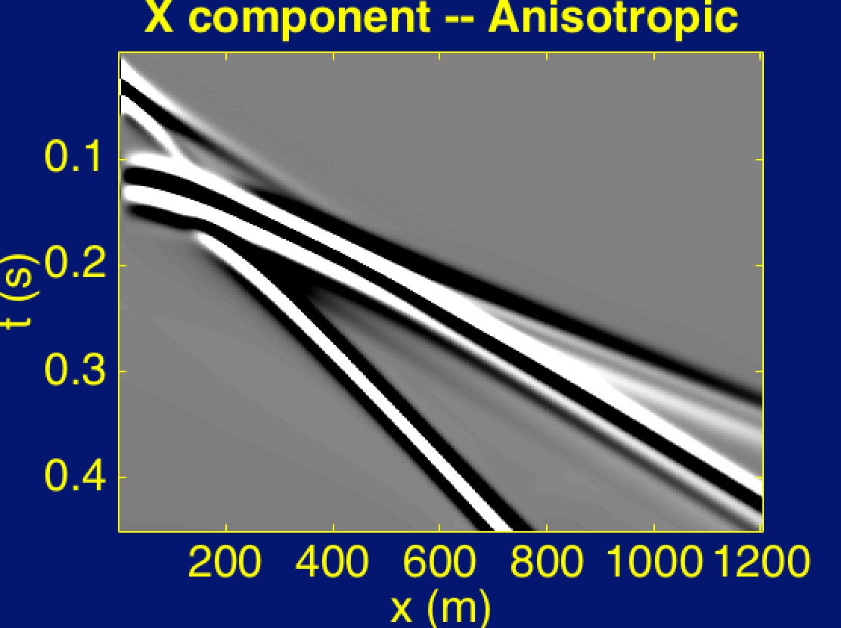
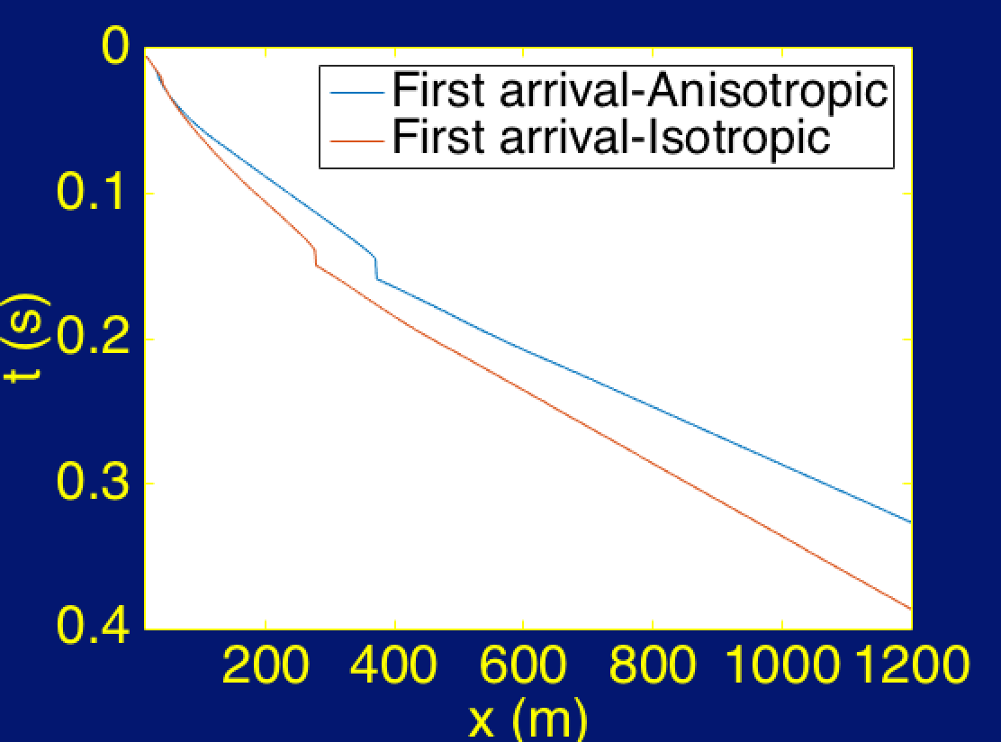
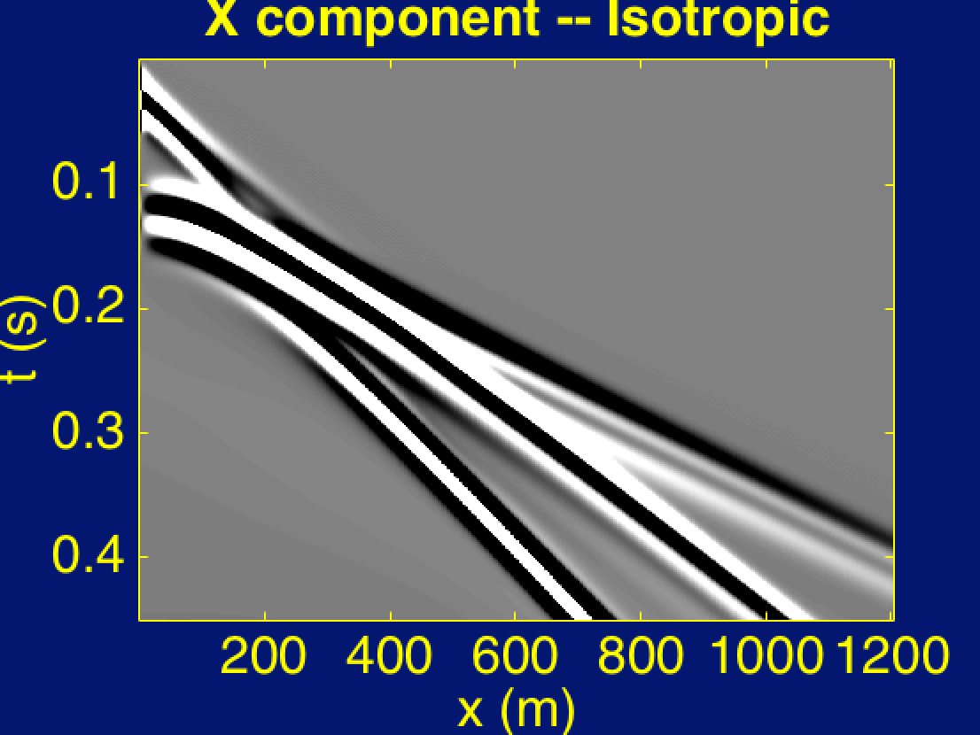
Motivation
Vp=3000 Vs=1732
Eps=0.3 Del=0.1
Vp=3500 Vs=2020
Eps=0.3 Del=0.1

Slide 4
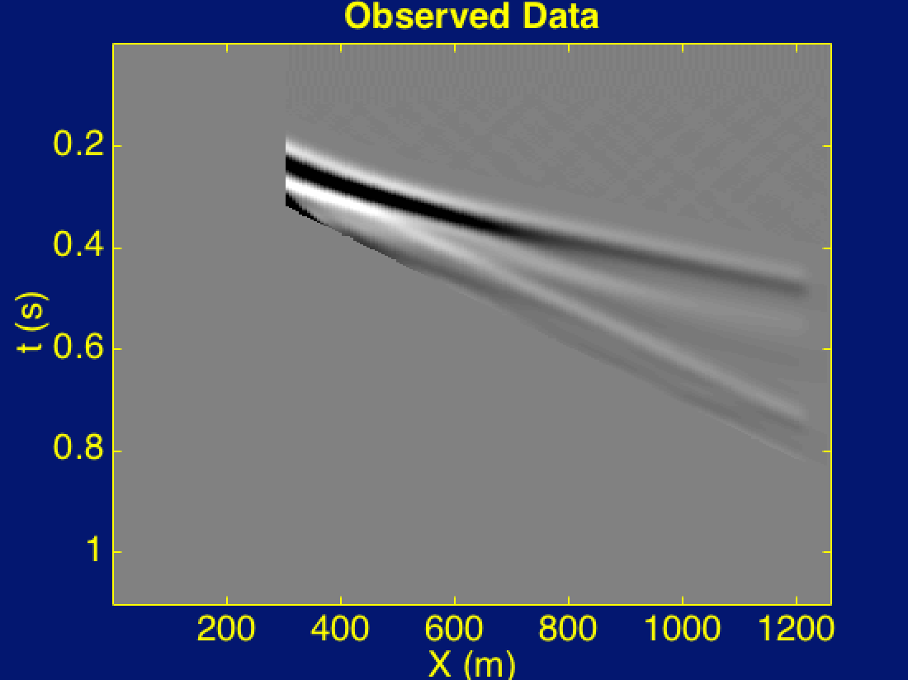
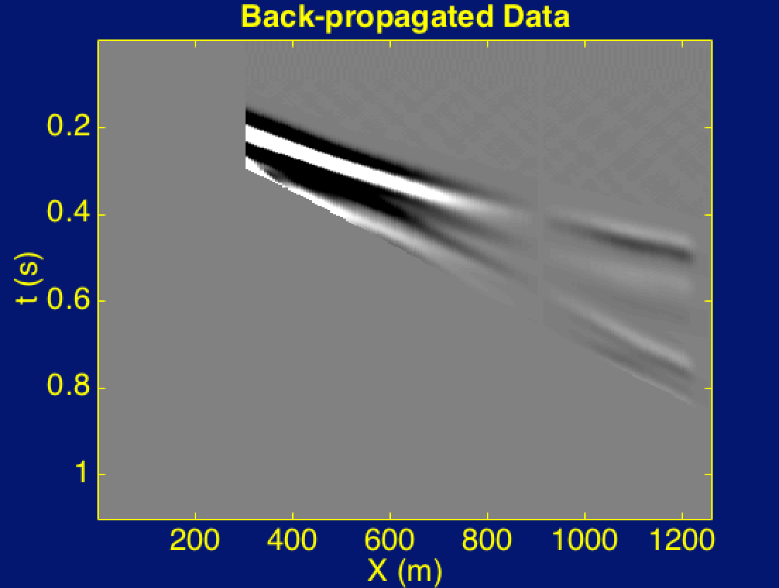
Theory
Misfit function
Steepest descent
Gradient

Slide 5
Outline
Motivation
Theory
Synthetic tests
Problems and Solutions

Slide 6
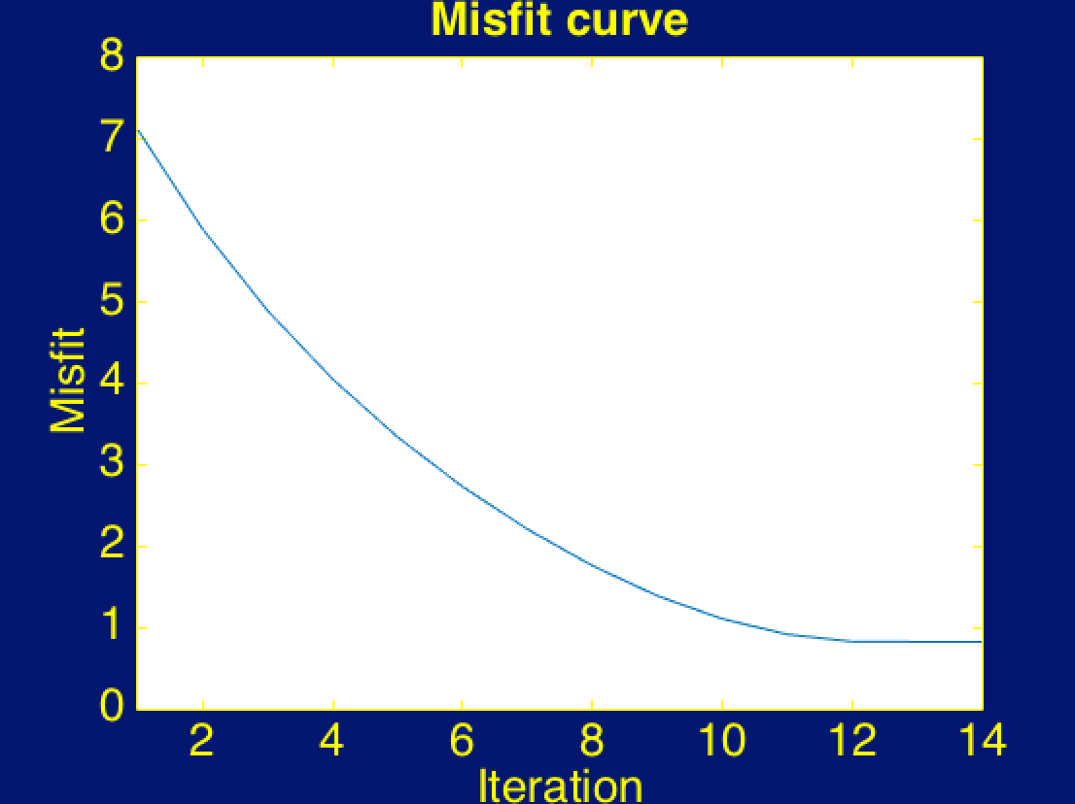
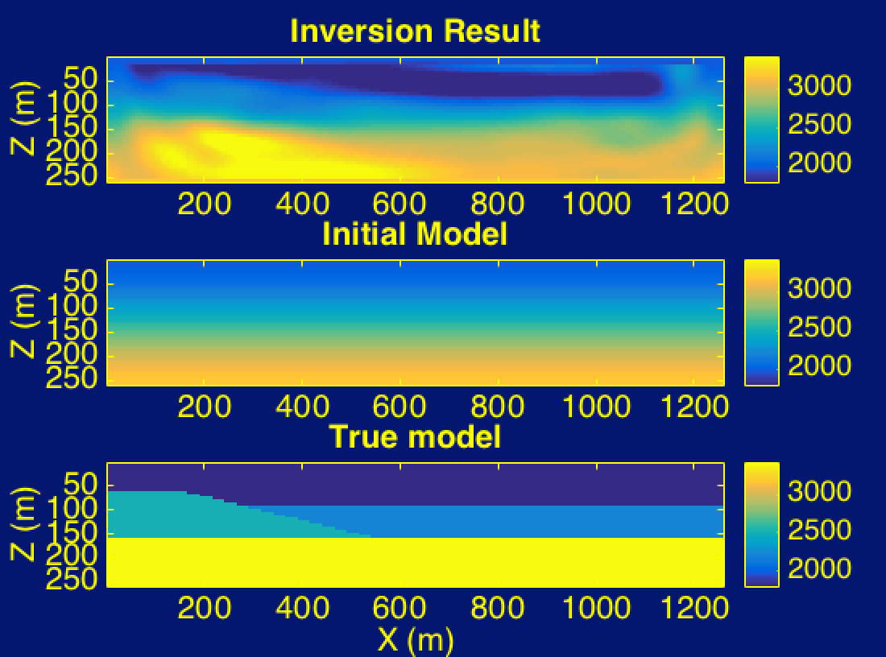
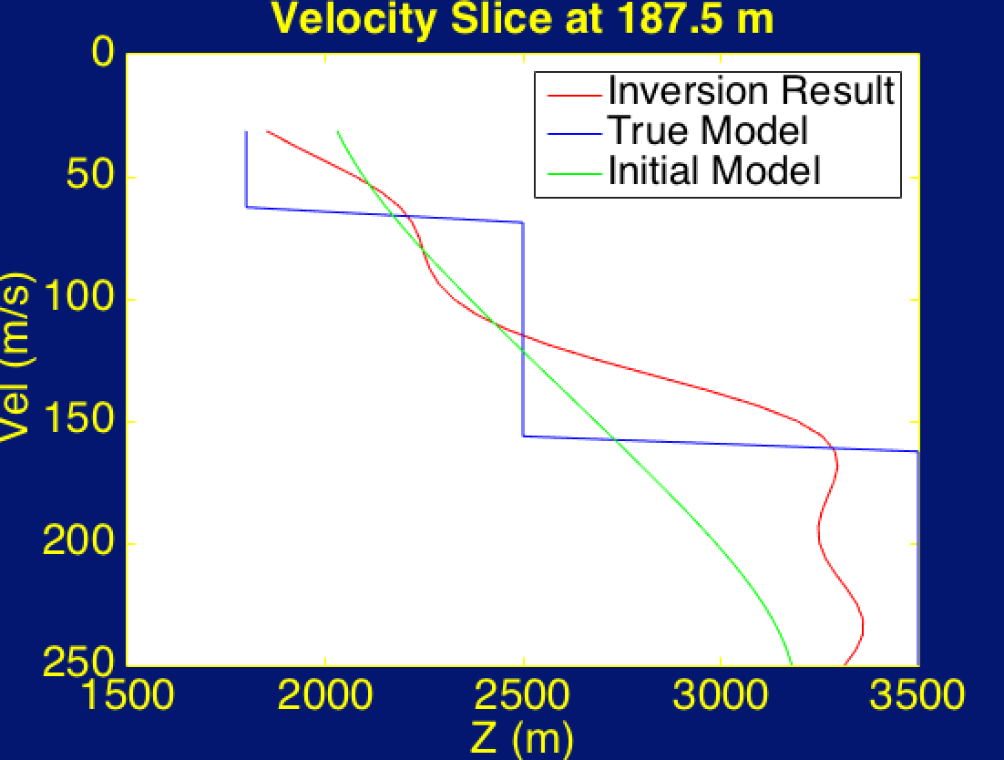
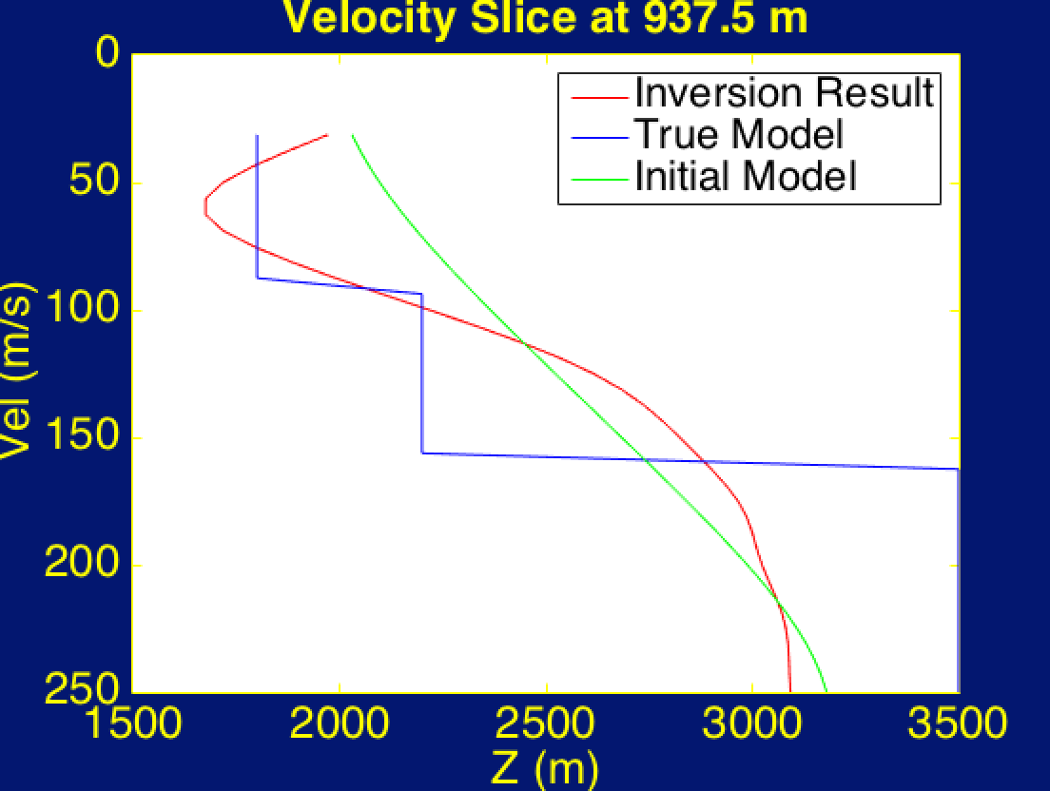
Synthetic tests

Slide 7
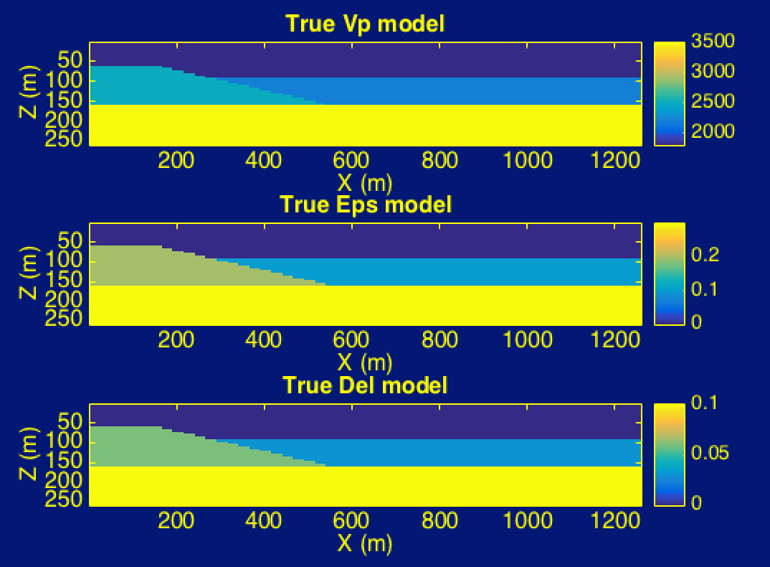
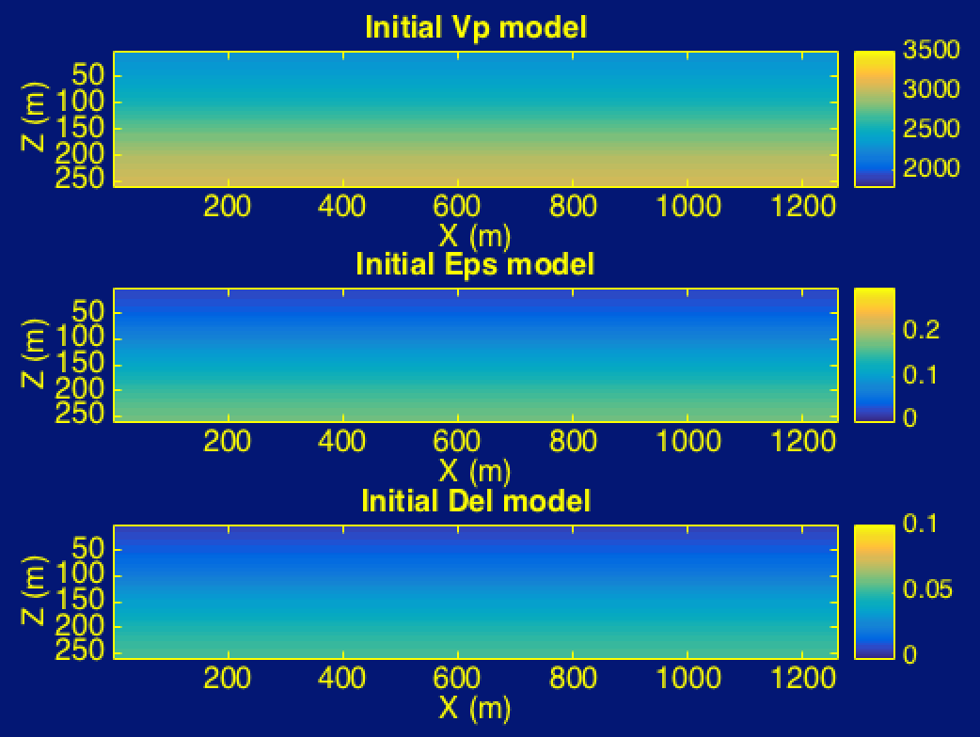
Anisotropic WT model

Slide 8
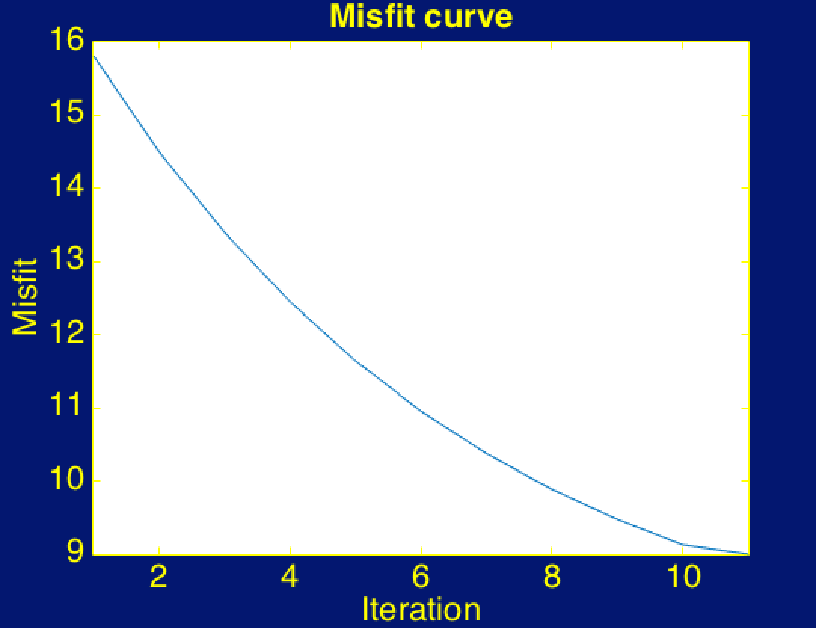
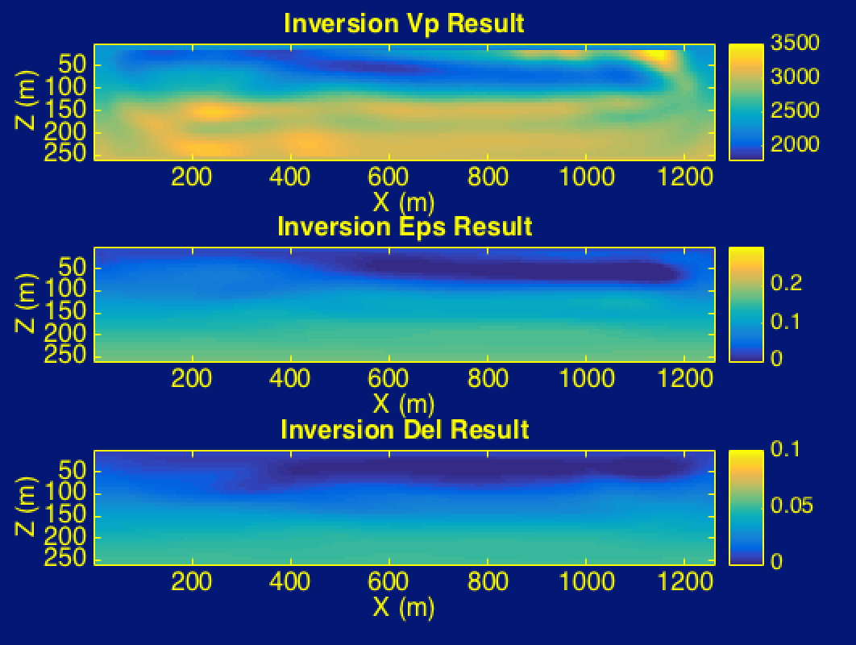
Anisotropic WT Result

Slide 9
Outline
Motivation
Theory
Synthetic tests
Problems and Solutions

Slide 10
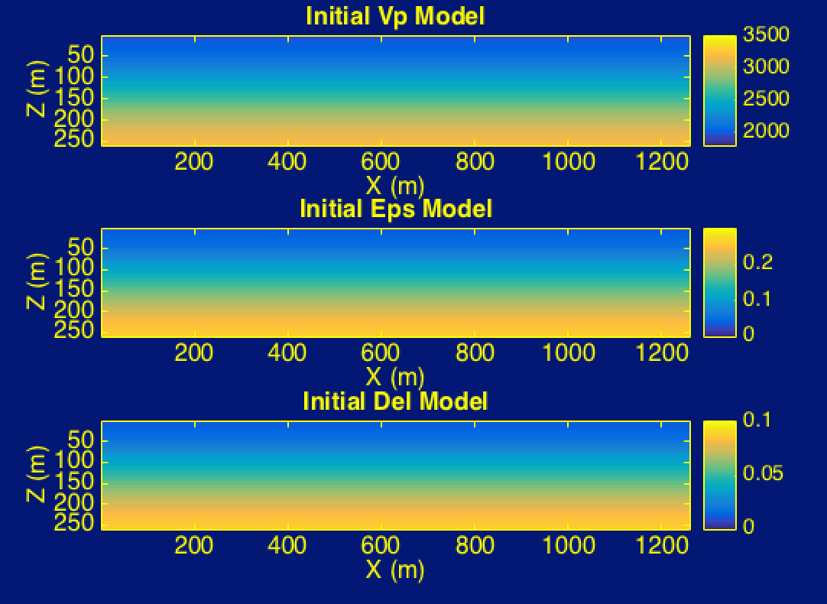
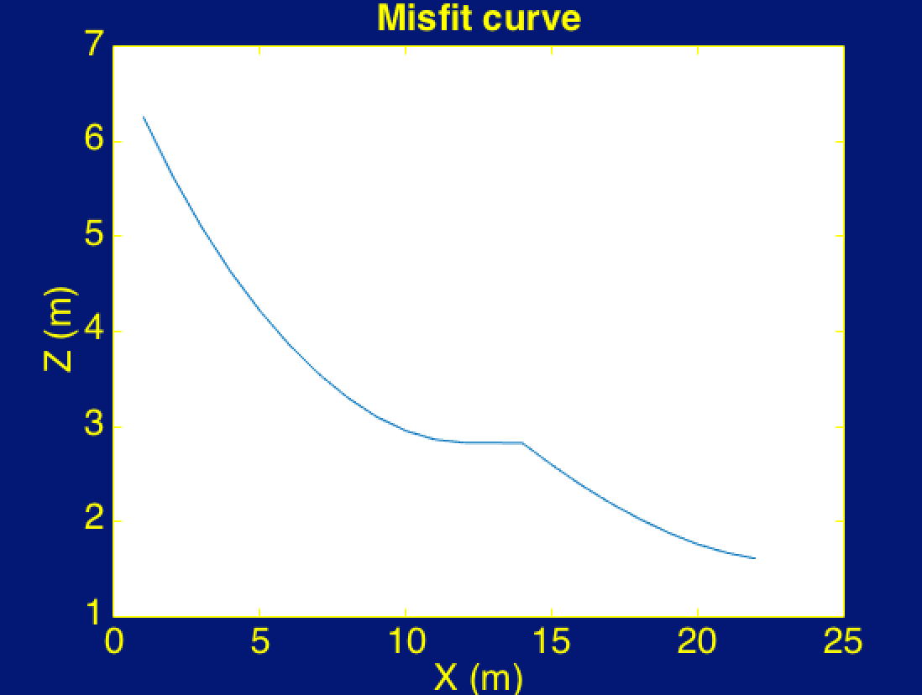
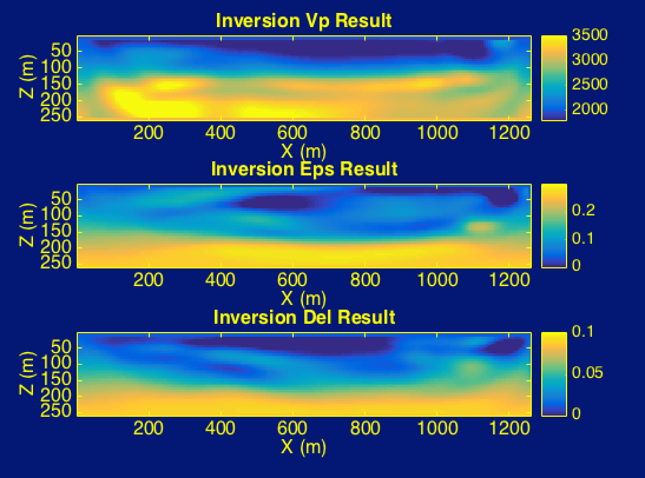
Problem and Solutions
Problem: Invert three parameter simultaneously
Solution: Multi-stage method

Slide 11
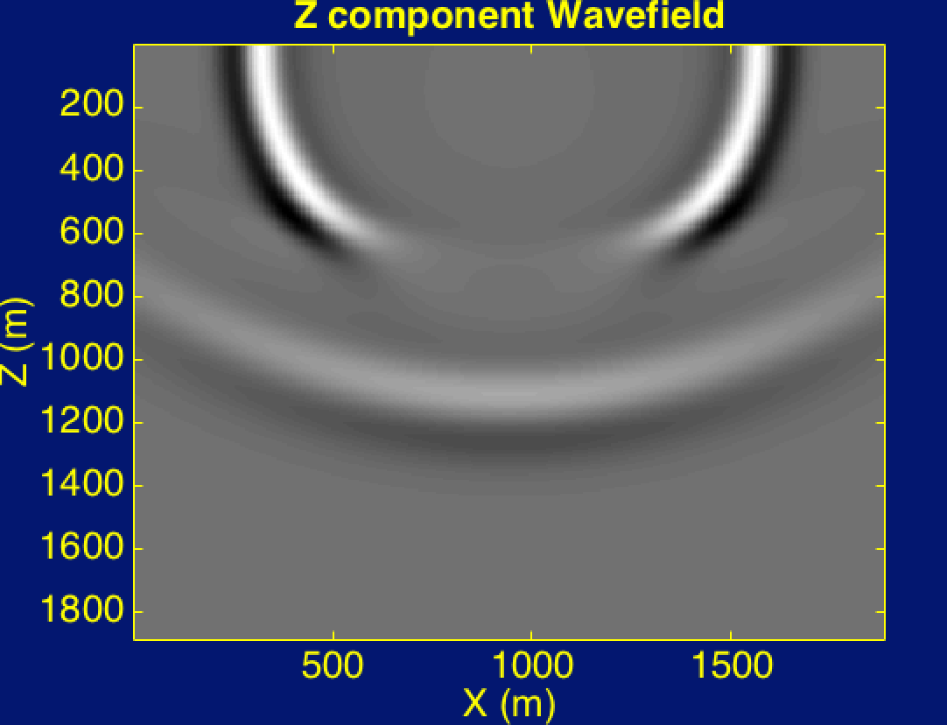
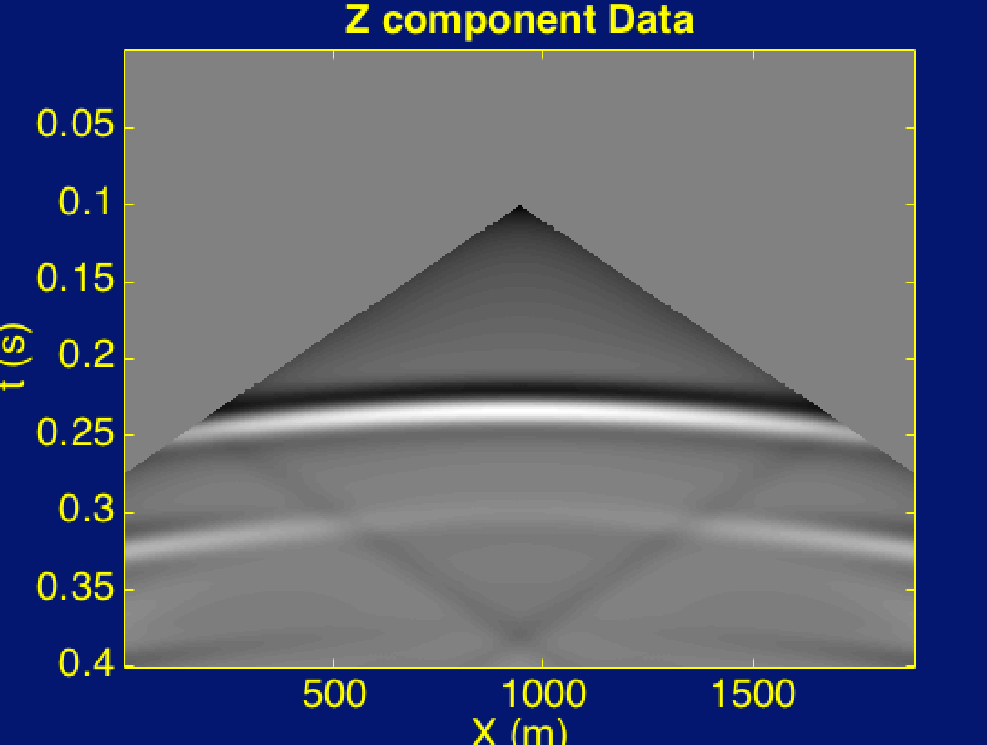
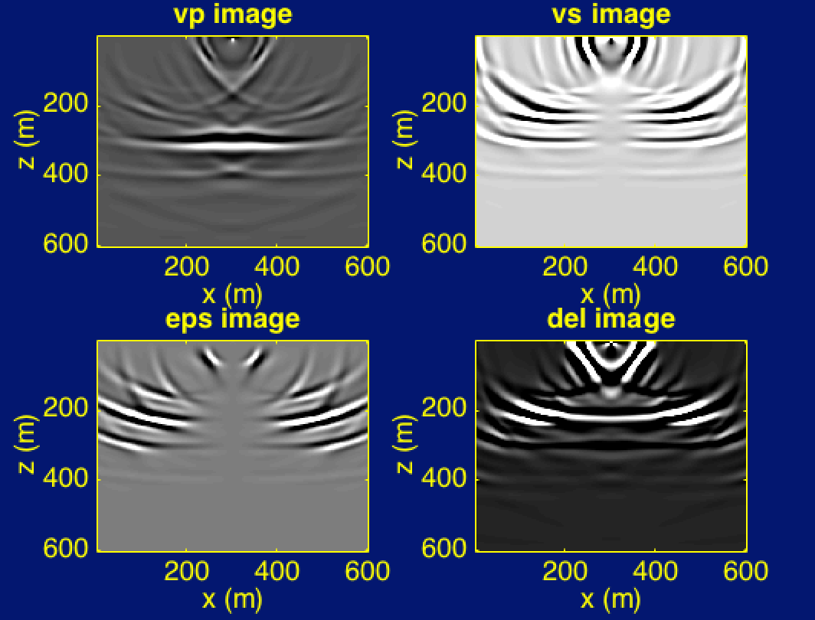
Crosstalk Problem
WT
S
P
RTM
PP
PS+SP
SS

Slide 12
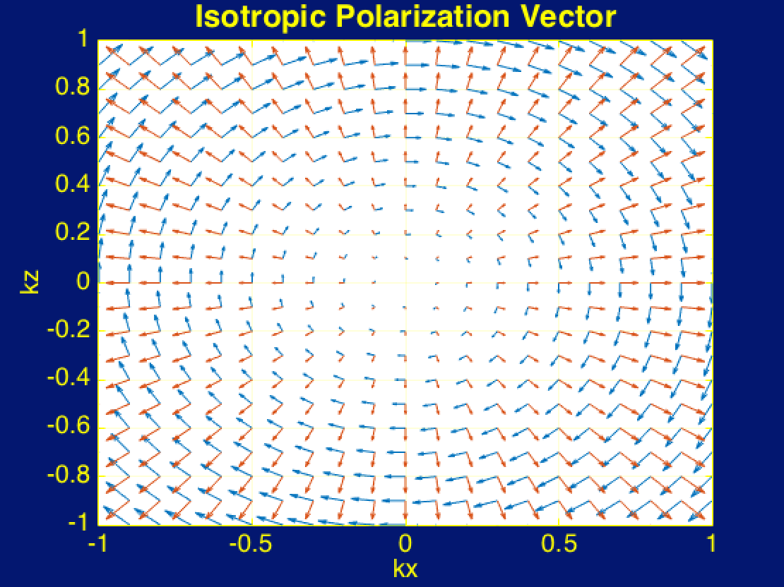
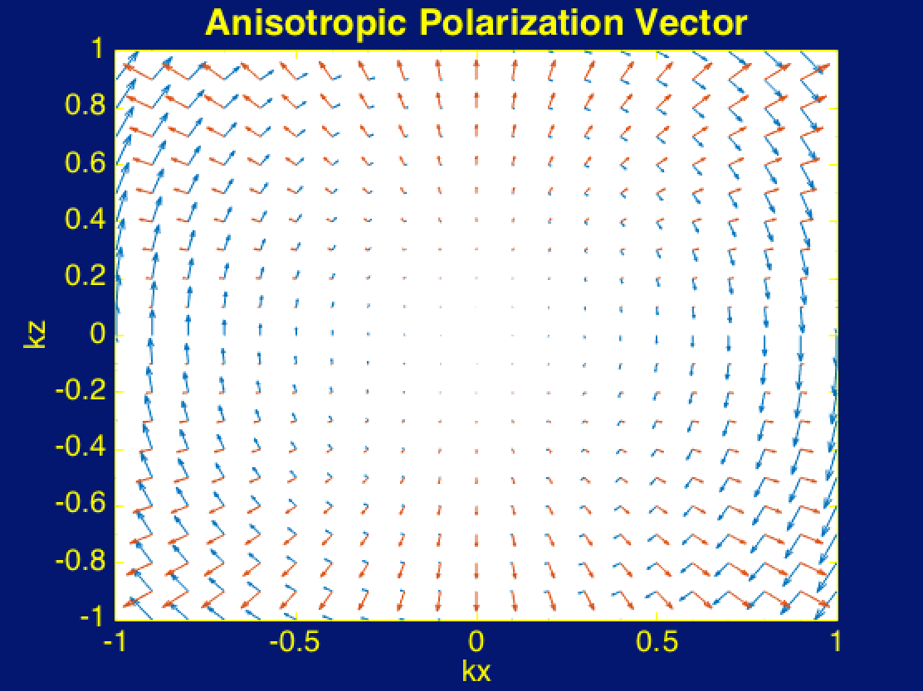
Anisotropic Wavefield vector decomposition
Helmholtz Decomposition
Isotropic vector decomposition
Anisotropic vector decomposition
Zhang and McMechan ( 2010)

Slide 13
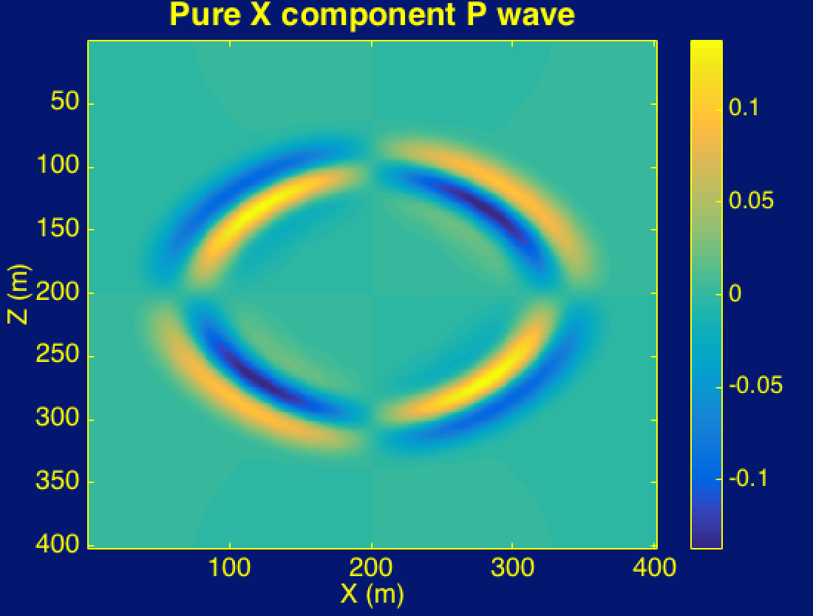
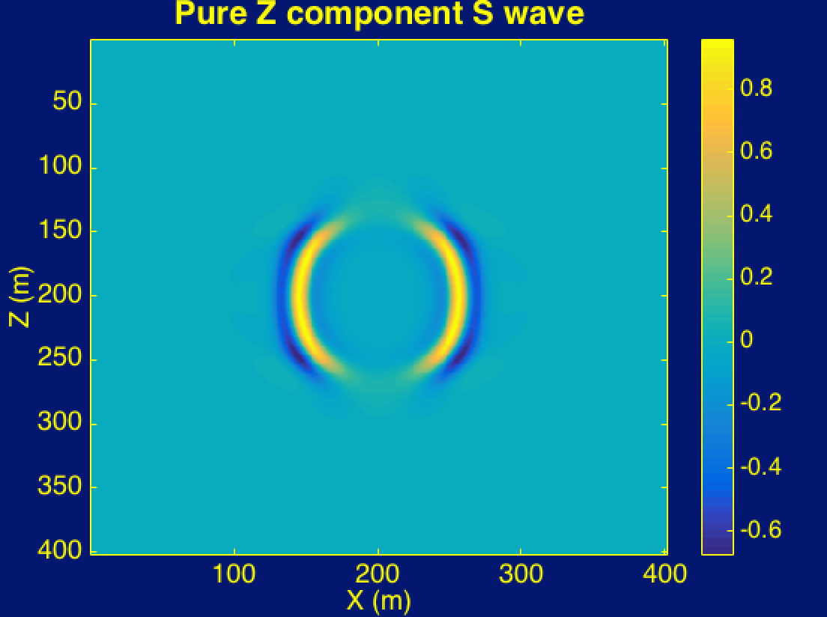
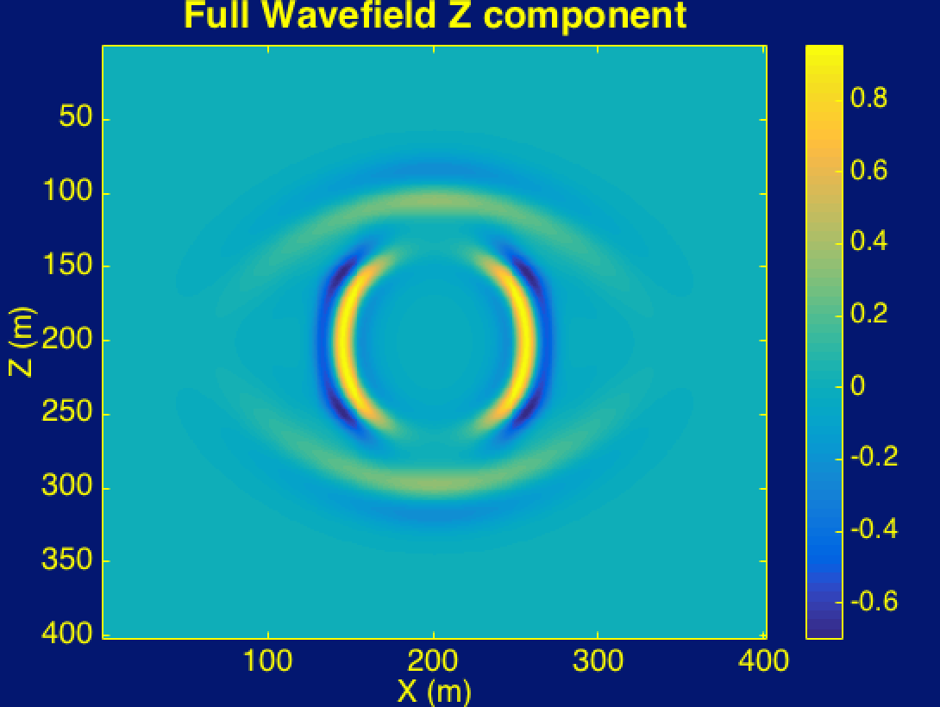
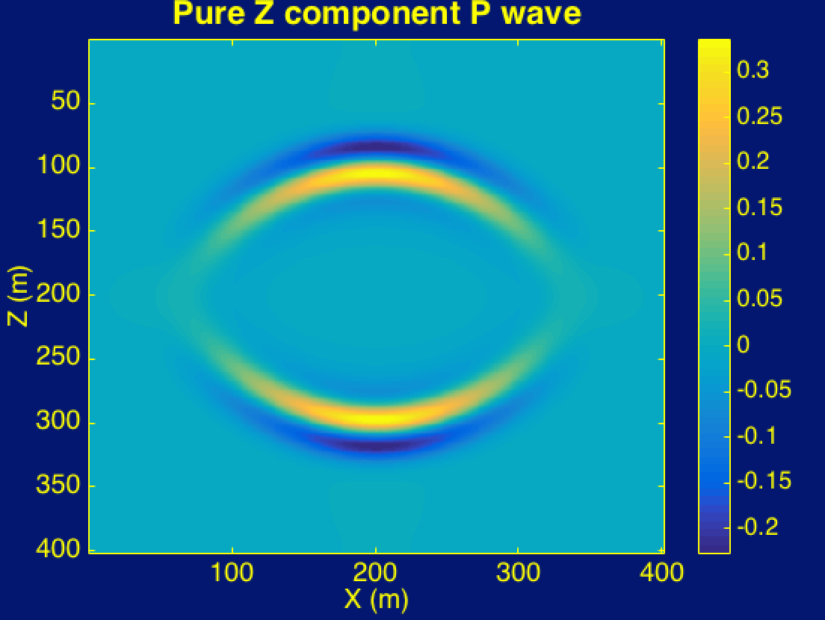
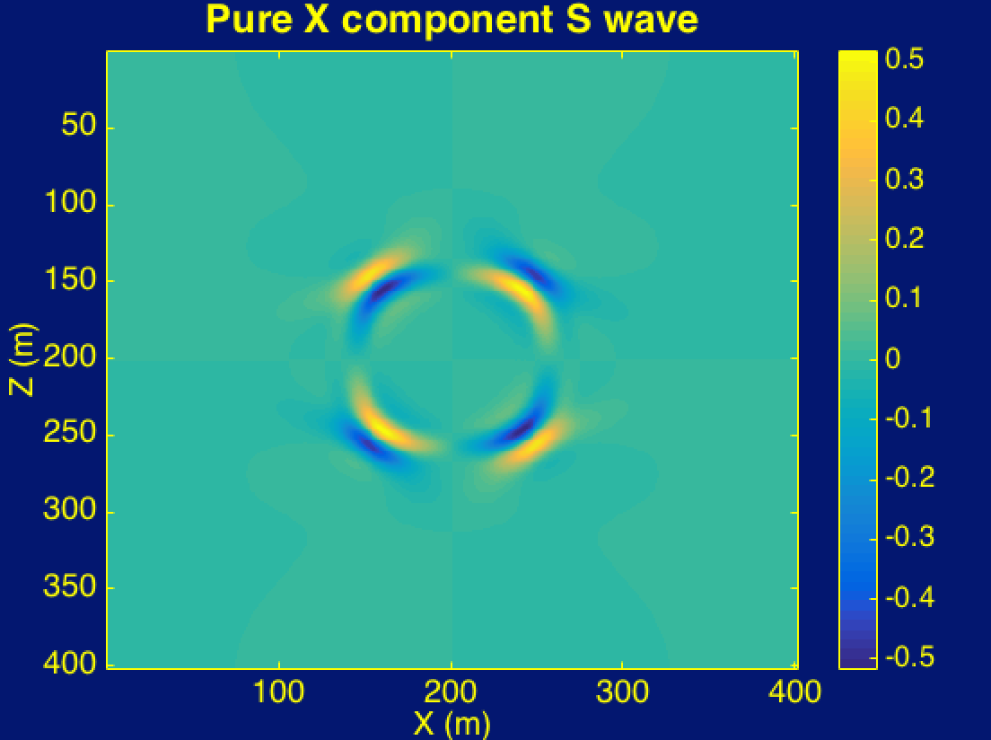
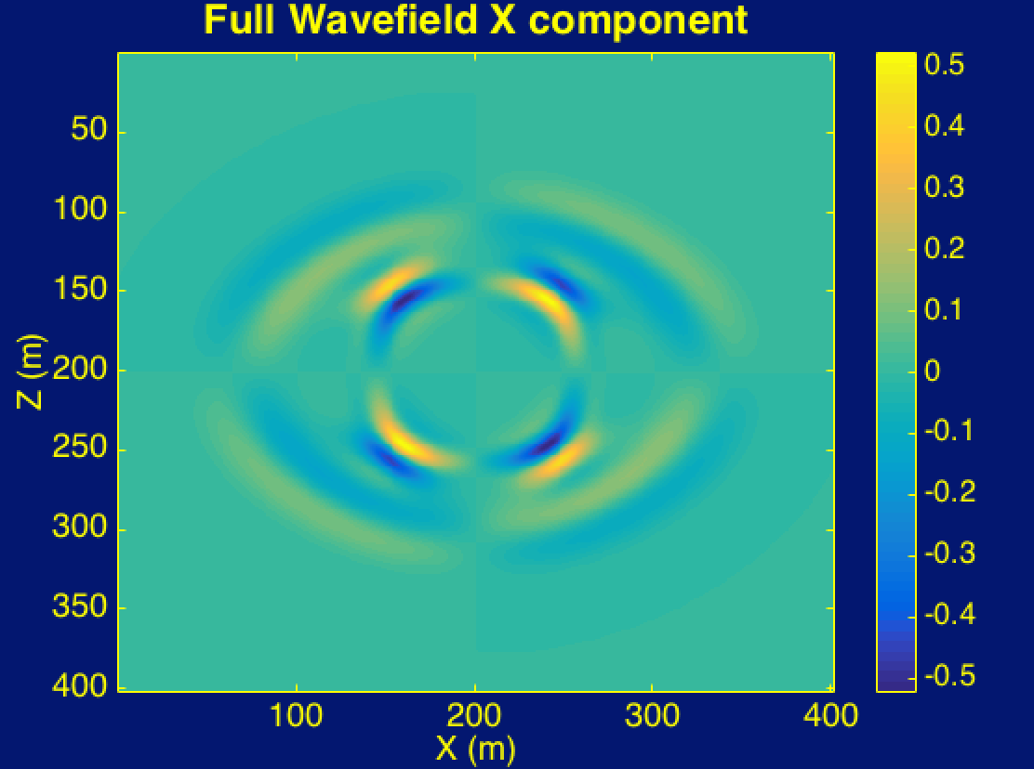
Anisotropic Wavefield vector decomposition

Slide 14
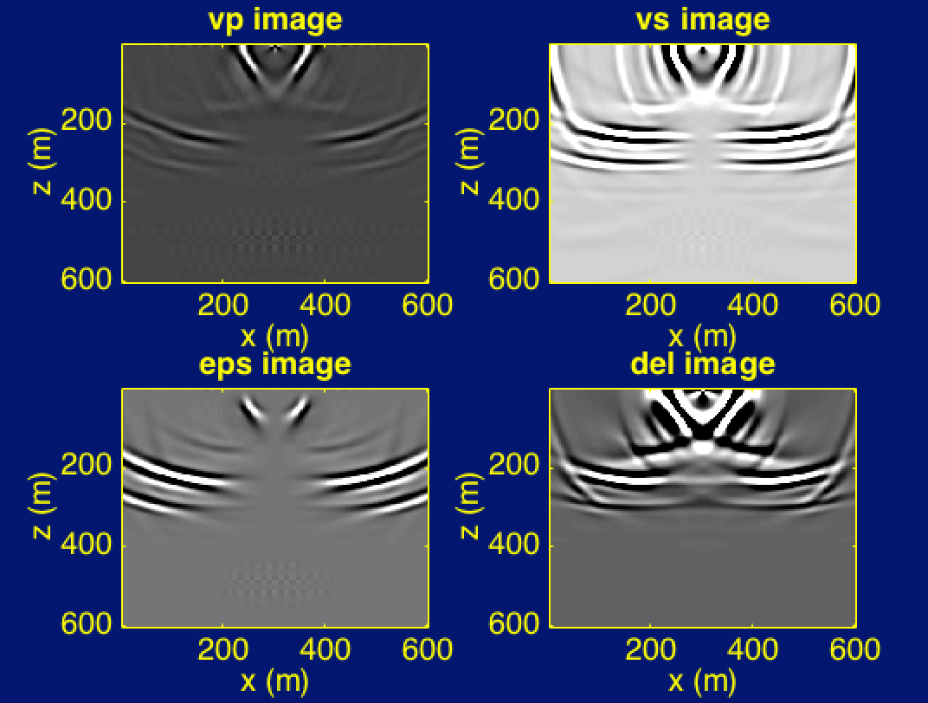
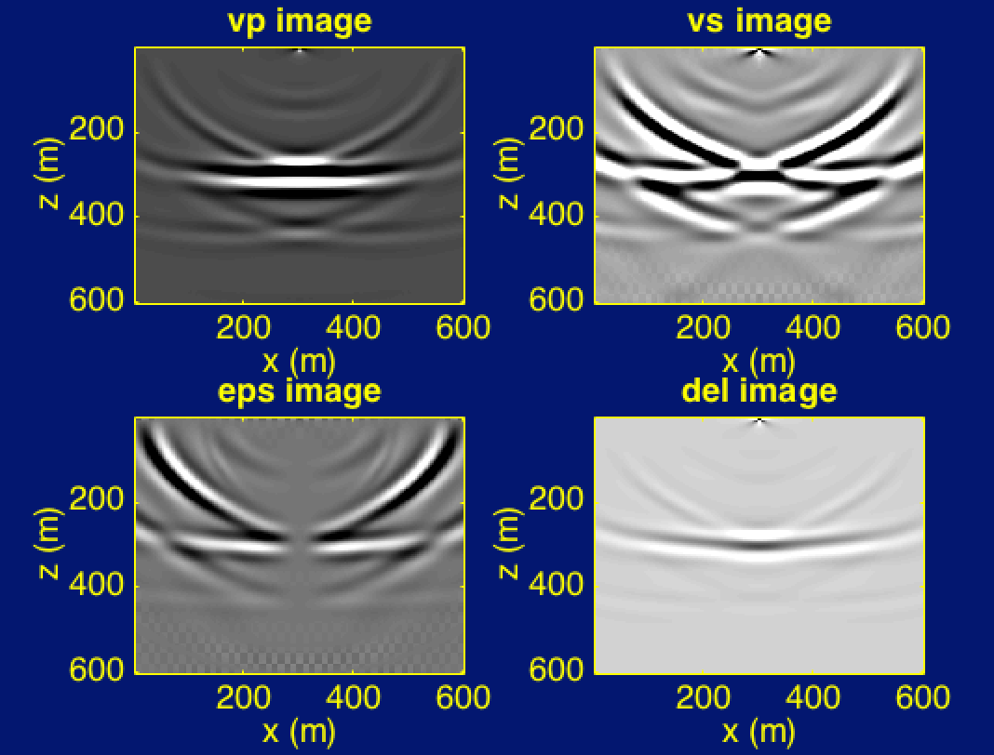
Vector Decomposition RTM
SS image
PP image

Slide 15
Vector Decomposition WT
Drawback of Vector Decomposition
Cannot work on converted wave
High Cost
Require accurate velocity and anisotropic model
Vector Decomposition WT
No PS and SP wave
Less Cost
Model Update

