Slide 1
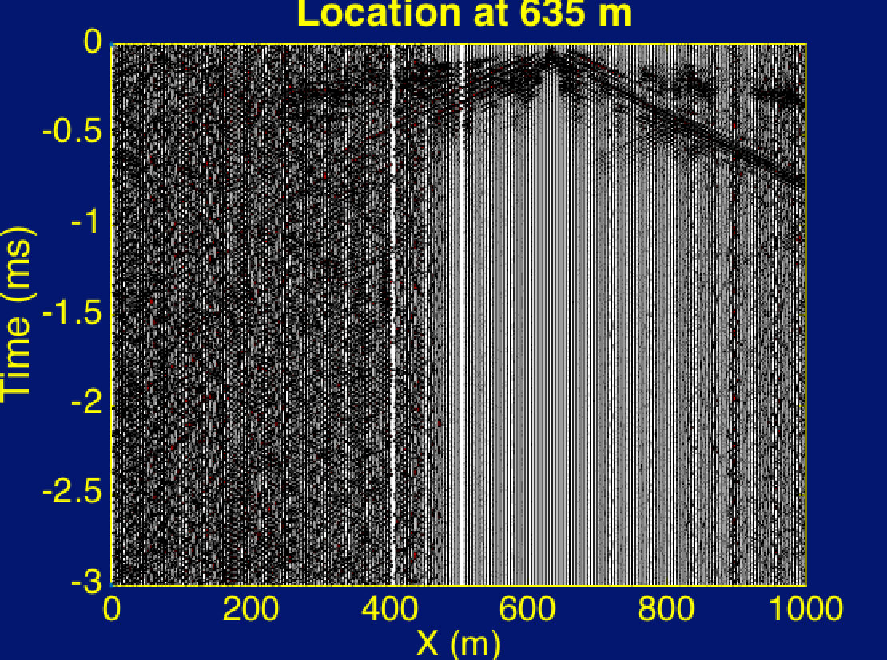

Slide 2
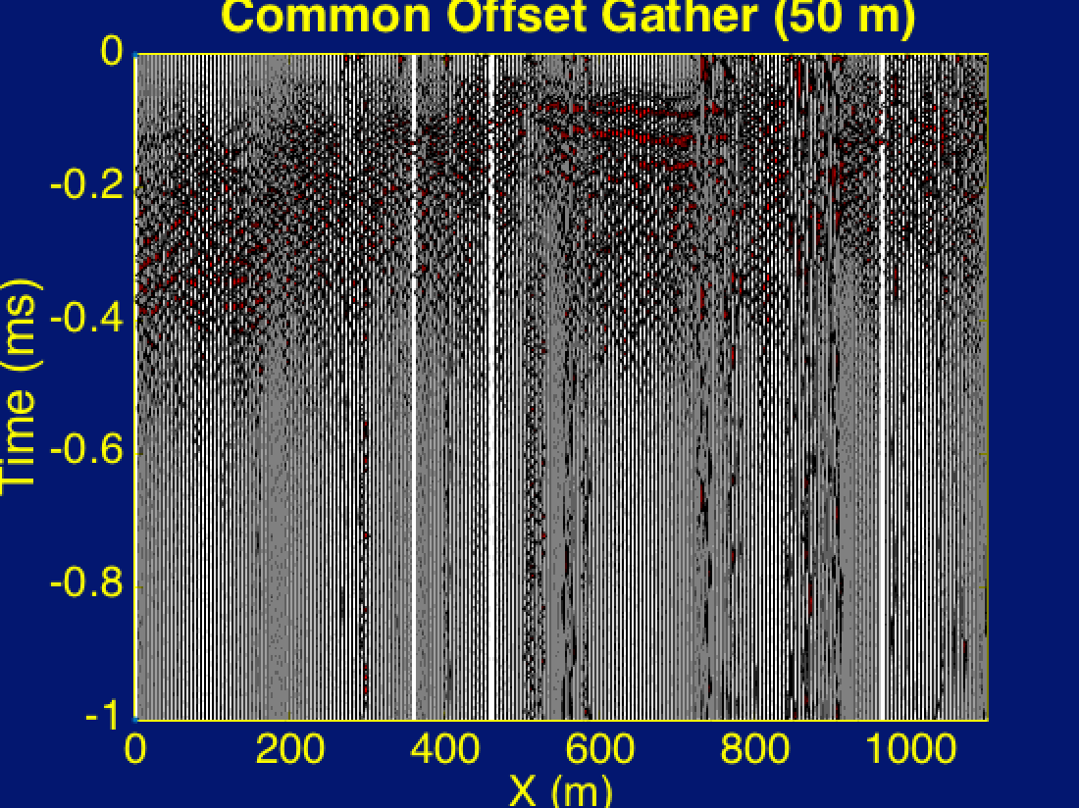

Slide 3
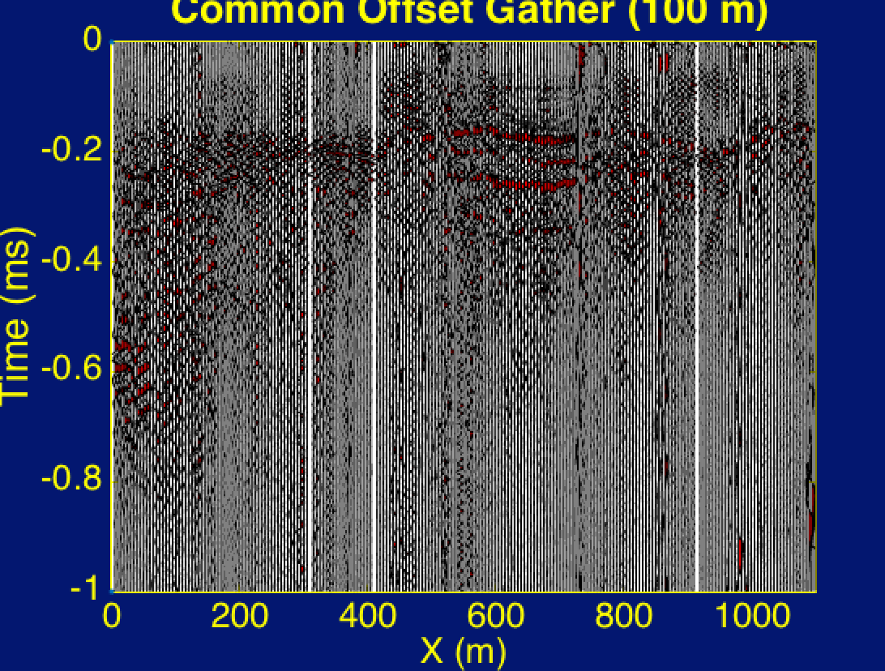

Slide 4
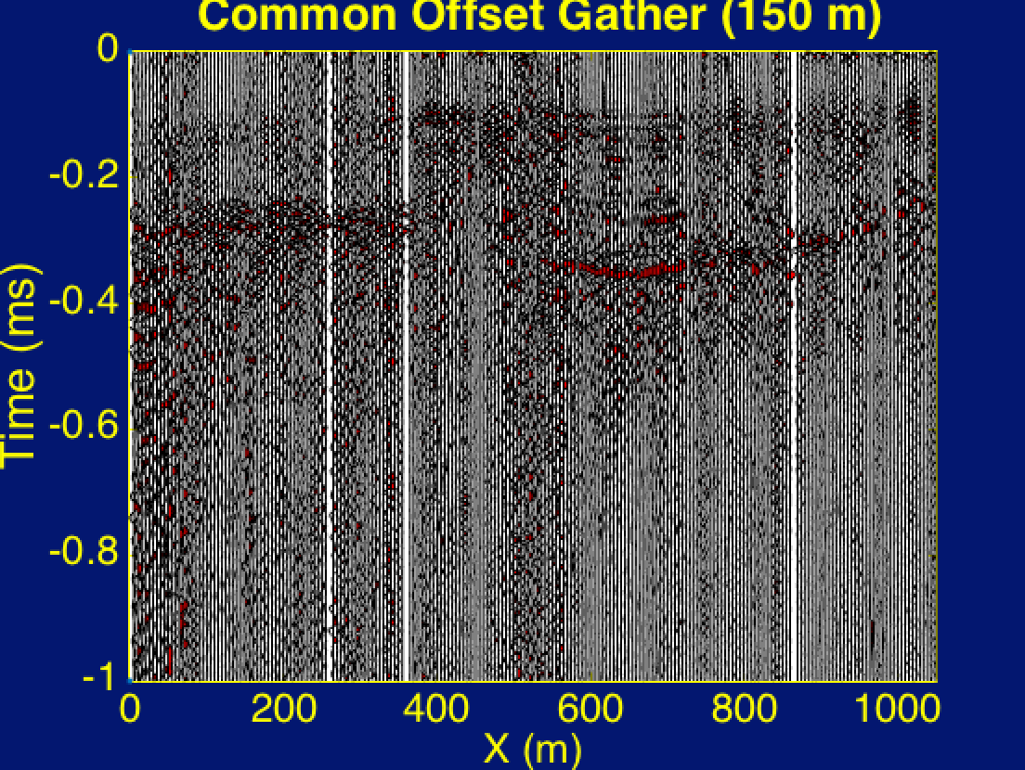

Slide 5
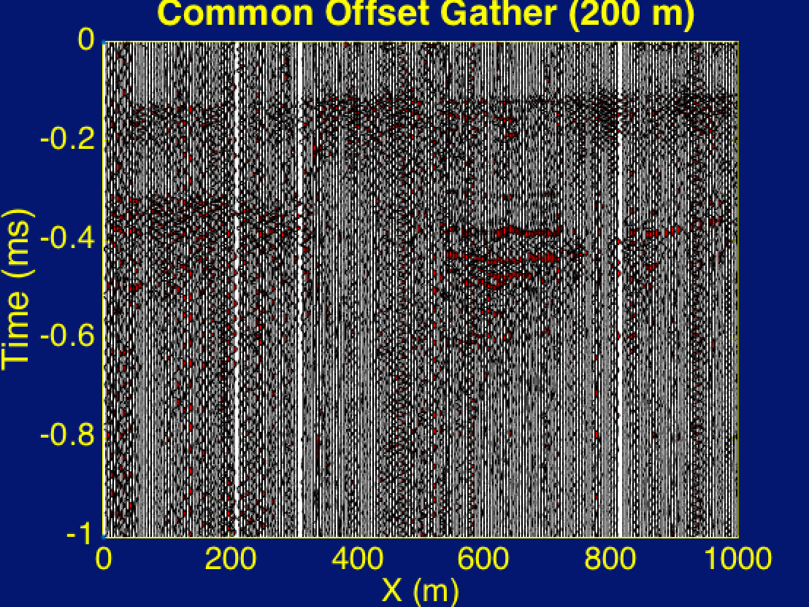

Slide 6
Surface wave Inversion on Golf Club data
Shihang Feng

Slide 7
Outline
Goal and Procedure
Experiment
Processing
Conclusion

Slide 8
Outline
Goal and Procedure
Experiment
Processing
Conclusion

Slide 9
Goal
Use surface wave information in Golf Club data to obtain velocity structure beneath the survey area
Procedure
Step 1: Process data
Step 2: Obtain observed dispersion cure
Step 3: Apply surface wave inversion
where κ(ω) is the fundamental dispersion curve

Slide 10
Outline
Goal and Procedure
Experiment
Processing
Conclusion

Slide 11
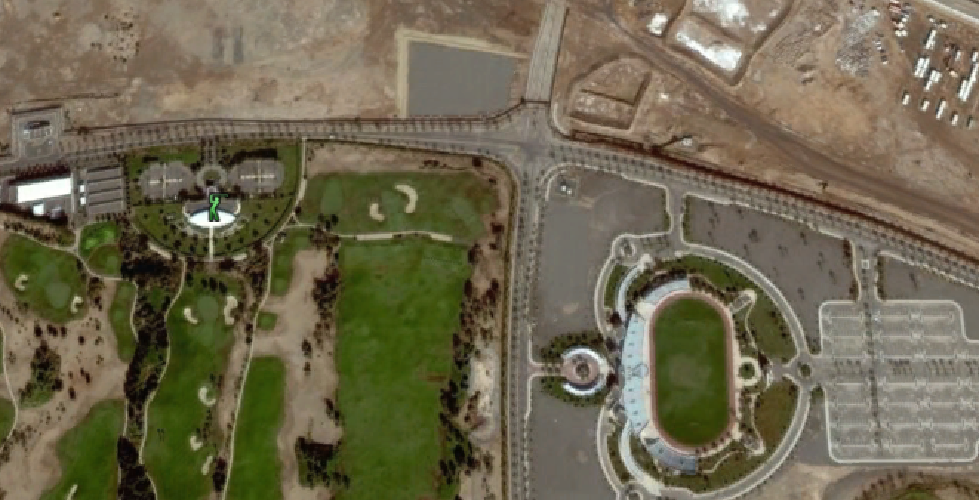
Experiment
Survey line: 1.2 km
240 Receivers, every 5 m
240 Shots, every 5 m
Survey line
Golf club

Slide 12
Outline
Goal and Procedure
Experiment
Processing
Conclusion

Slide 13
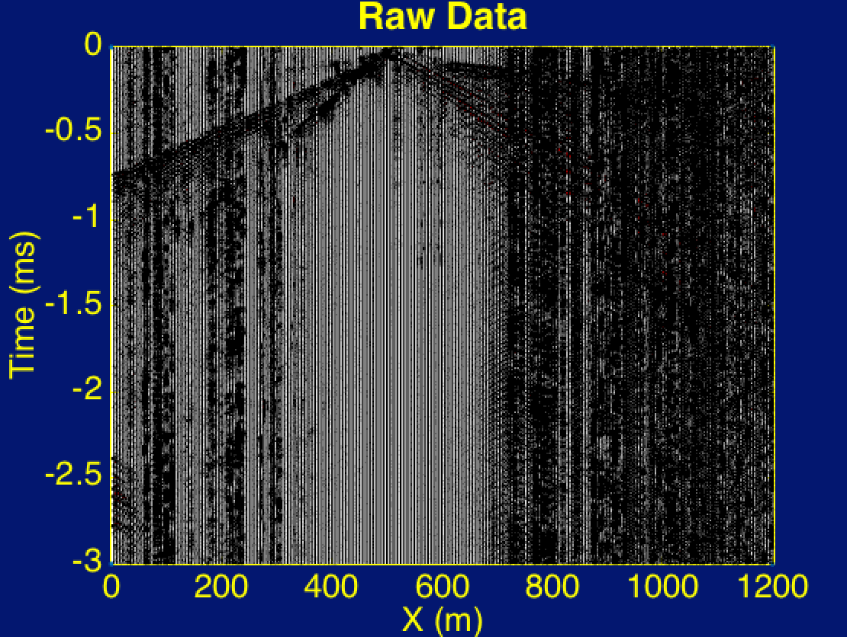
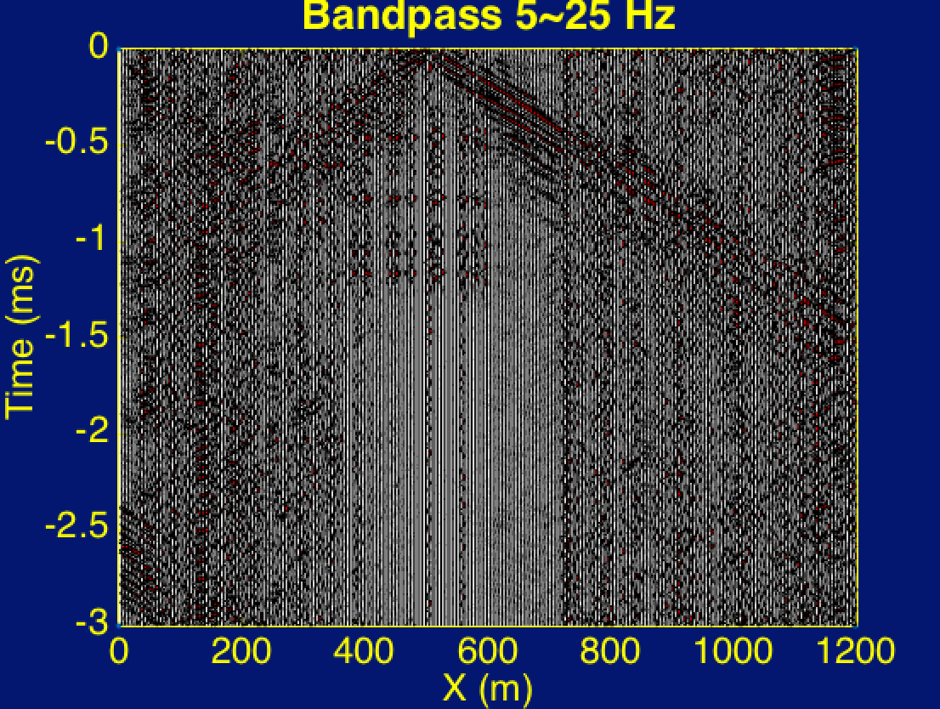
Band-pass Filter
Workflow
Raw Data
Filtered
Data
CRG
Windowed
Data

Slide 14
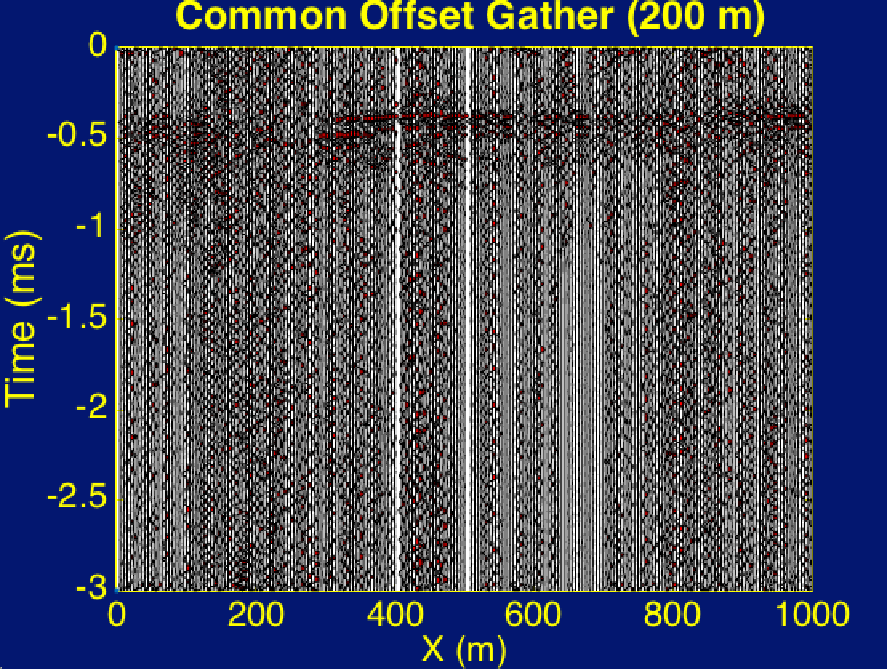
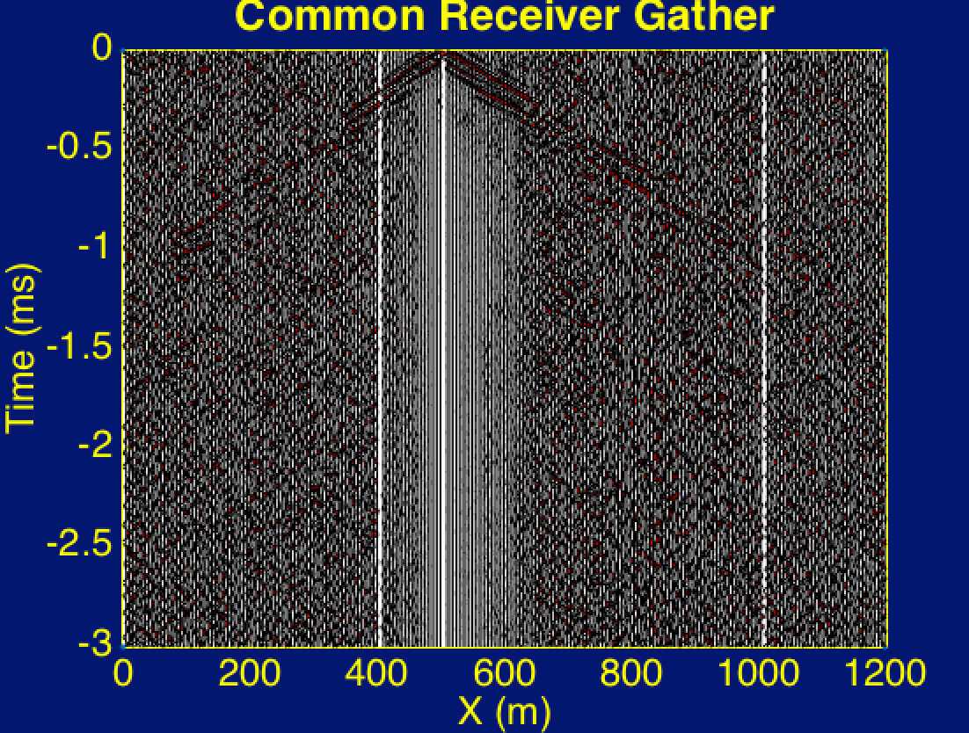
COG and CRG
Workflow
Raw Data
Filtered
Data
CRG
Windowed
Data

Slide 15
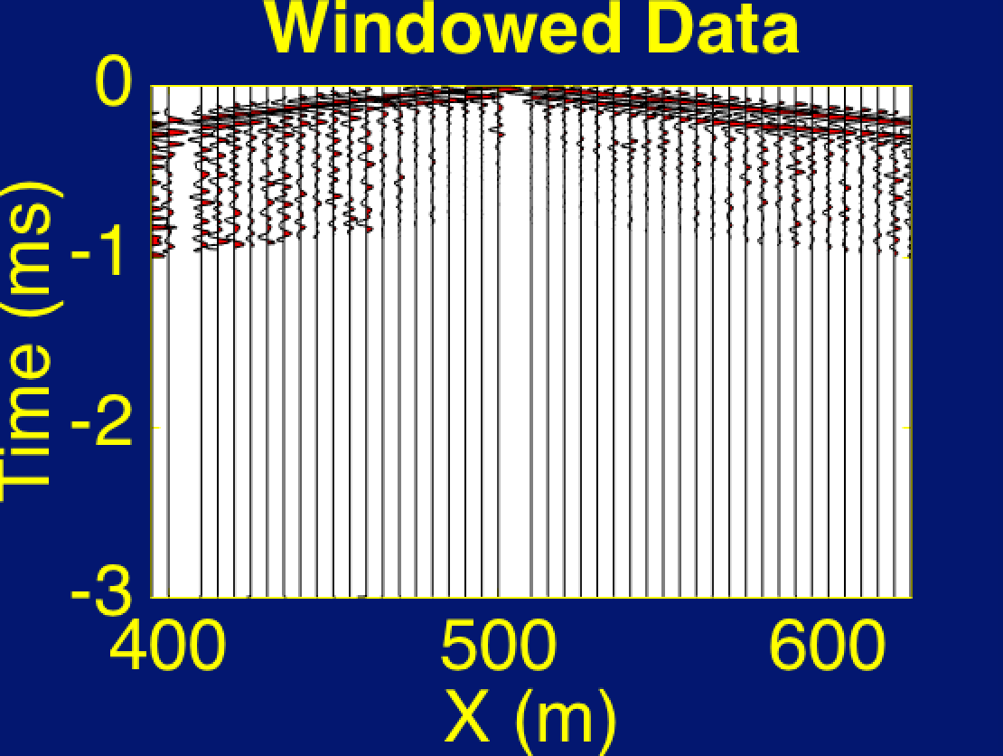
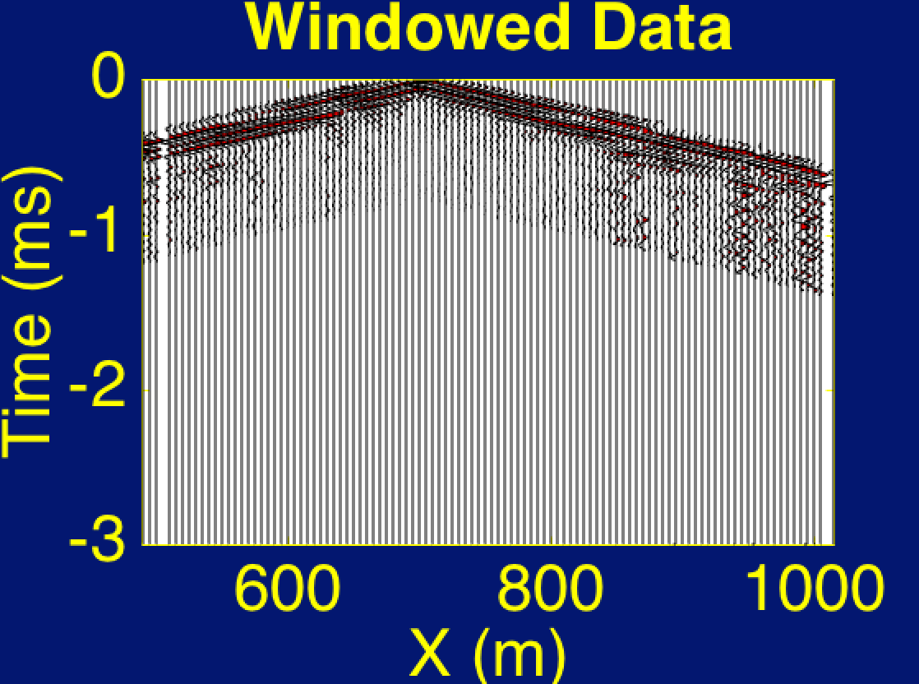
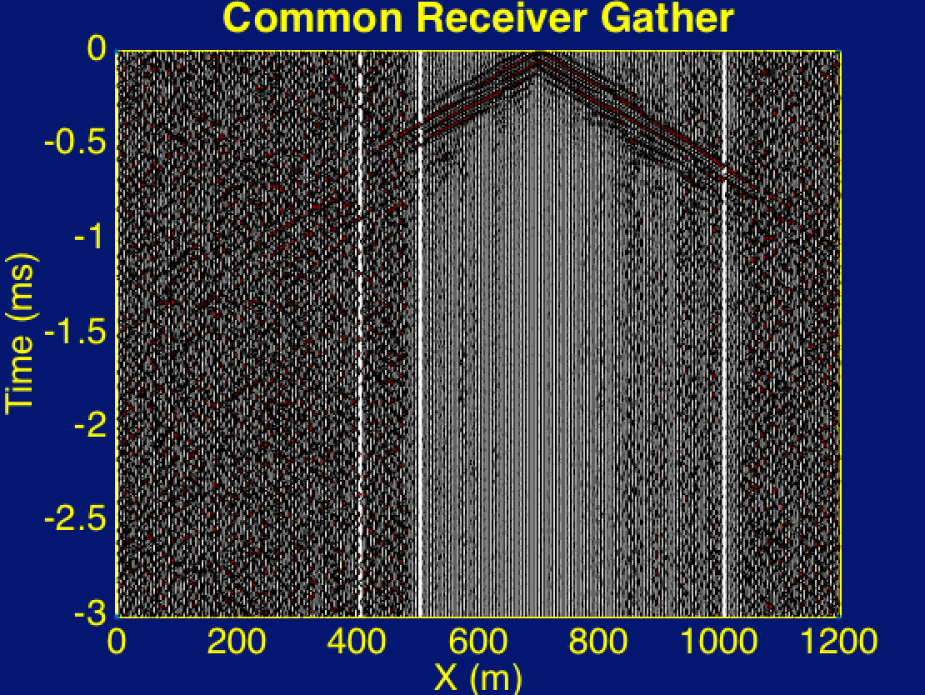
Workflow
Raw Data
Filtered
Data
CRG
Windowed
Data

Slide 16
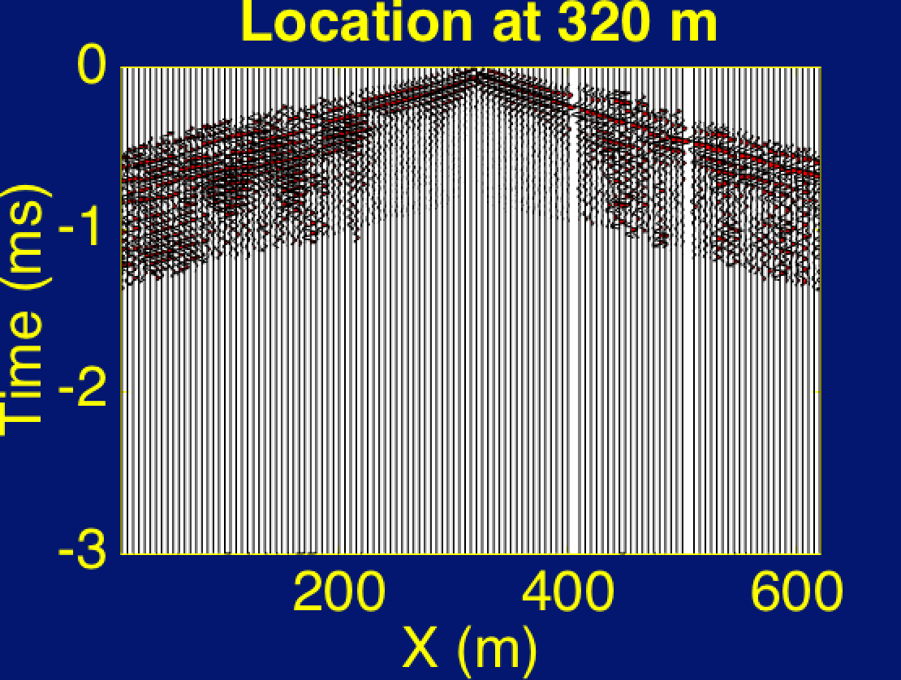
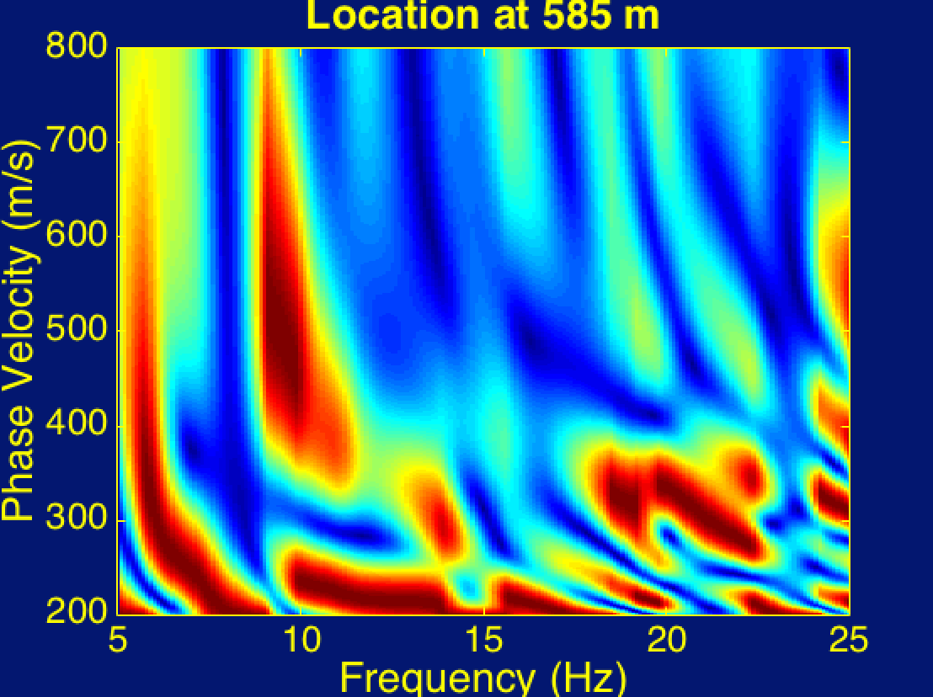
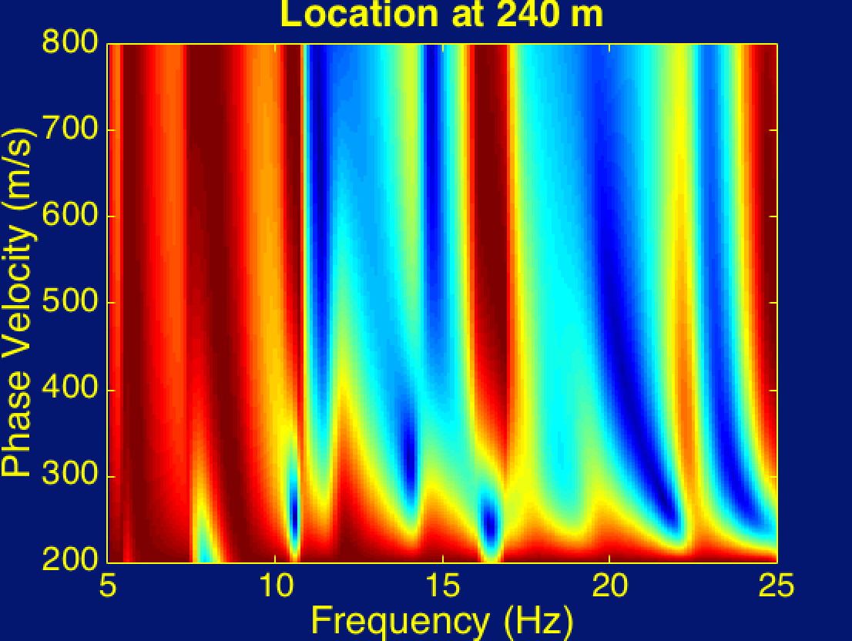
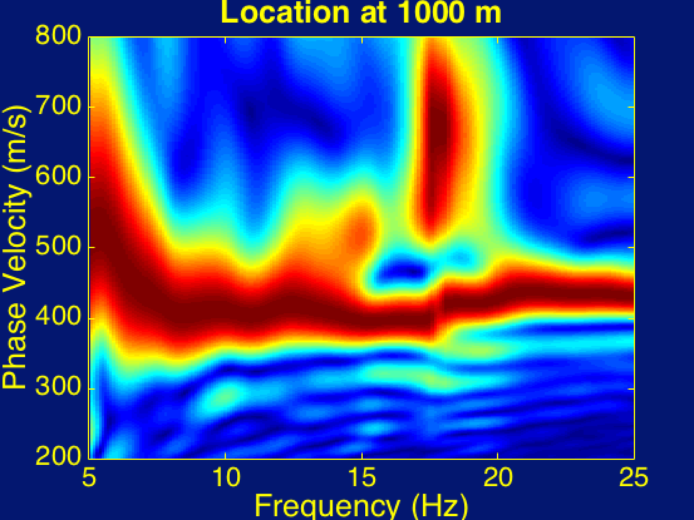
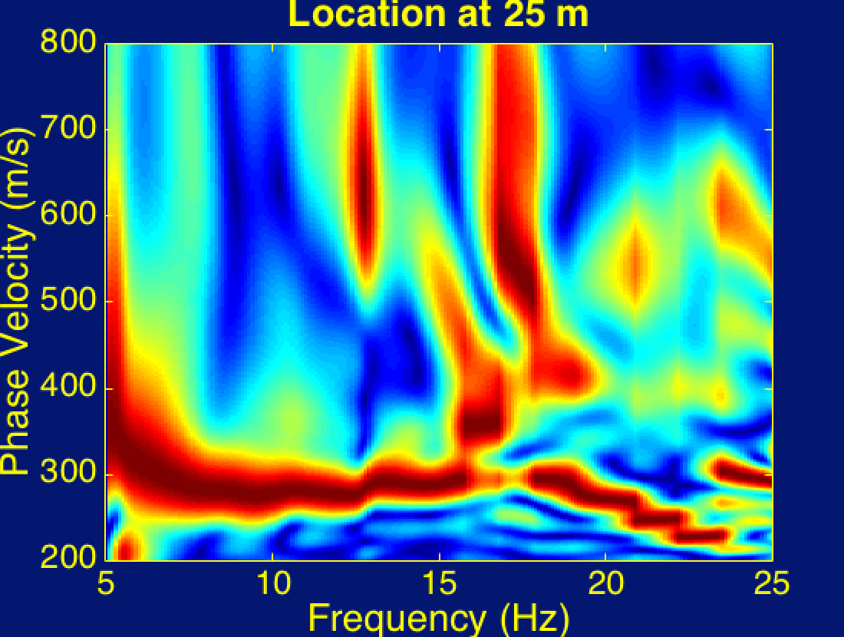
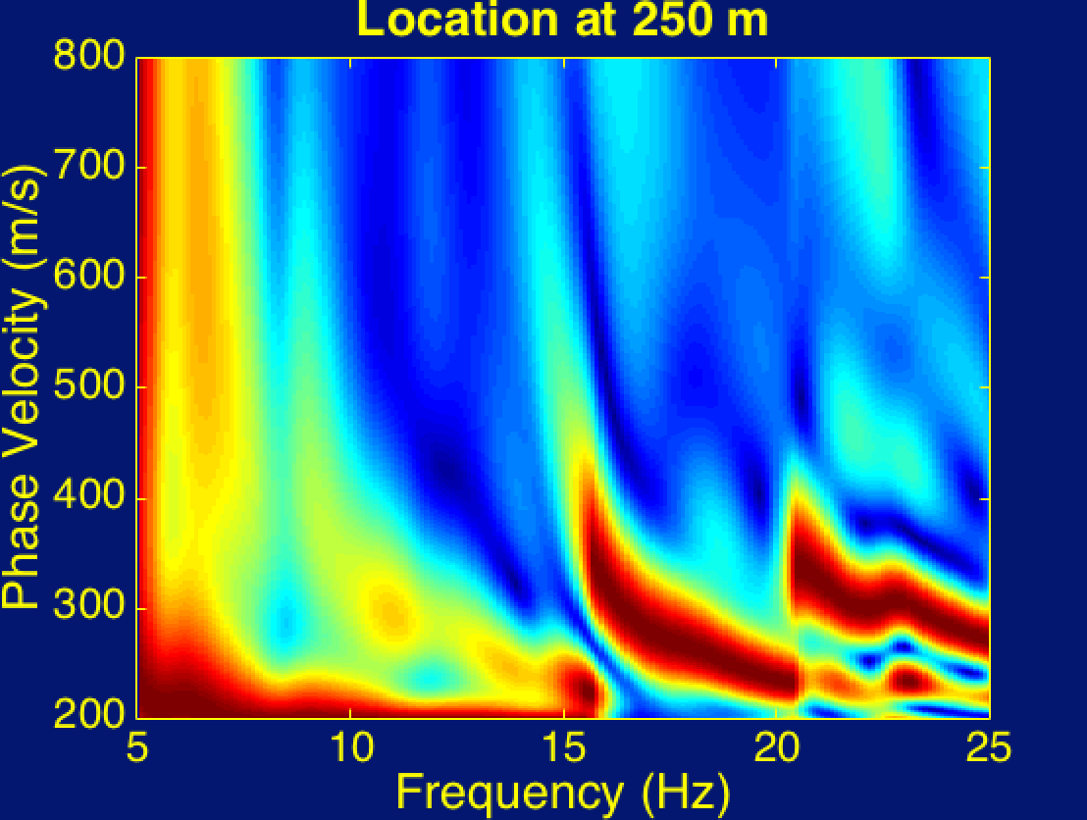
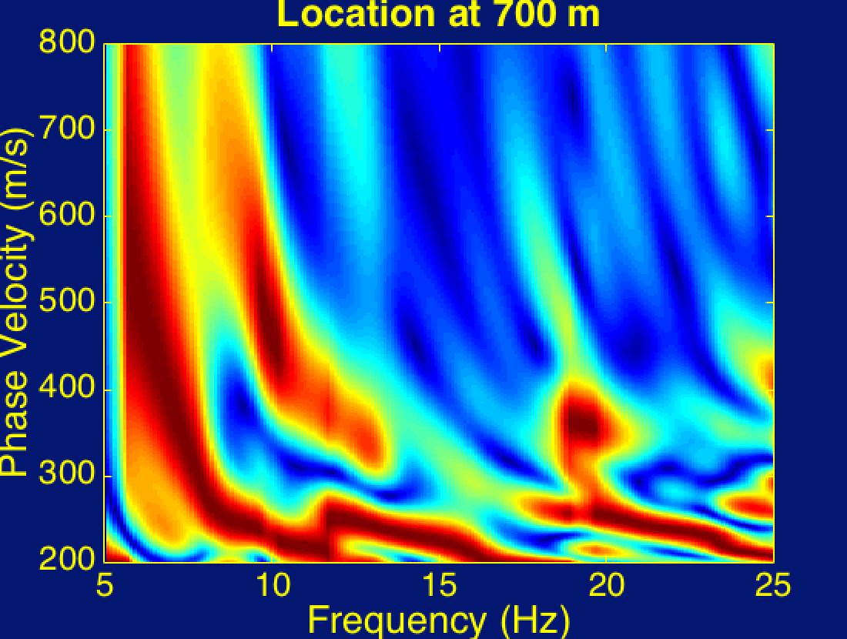
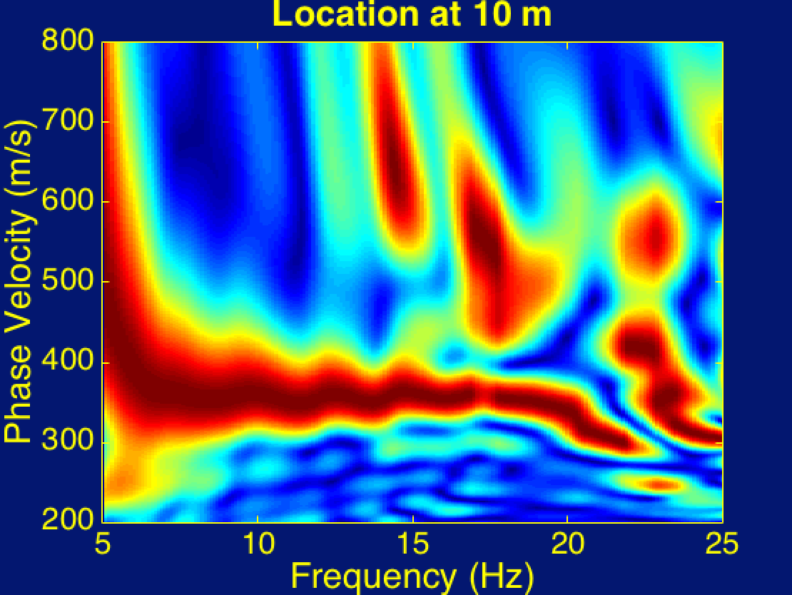
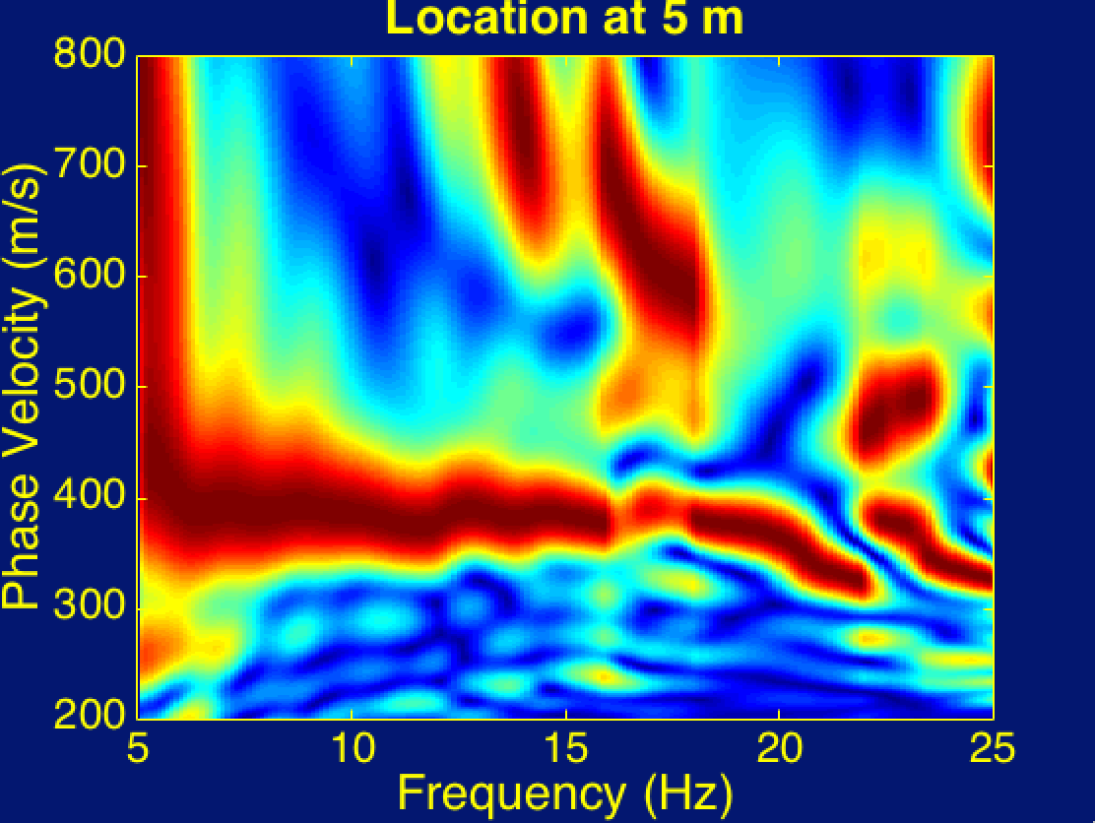
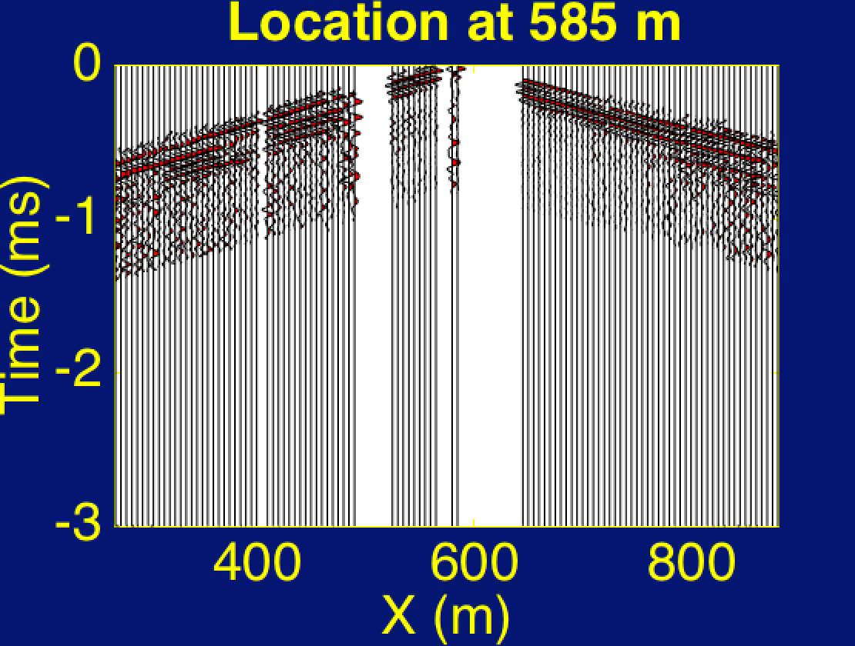
Dispersion Curve
Radom Transform

Slide 17
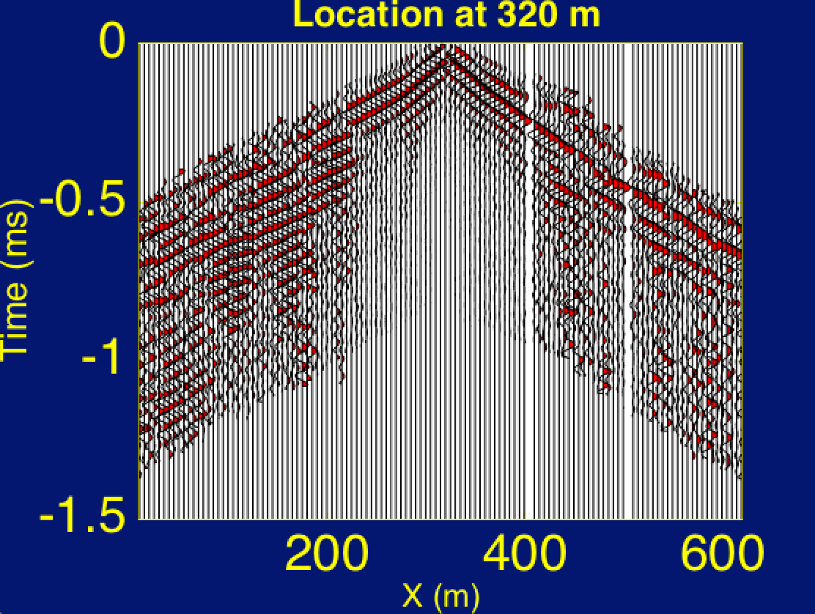
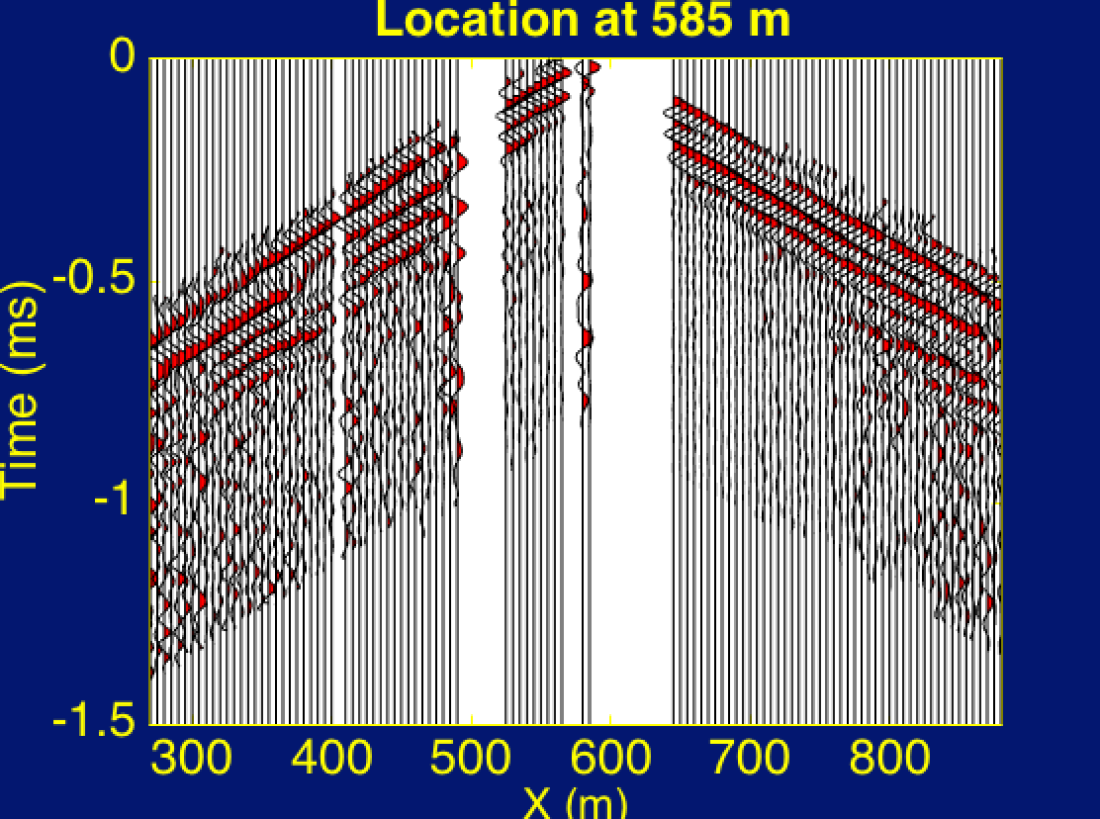
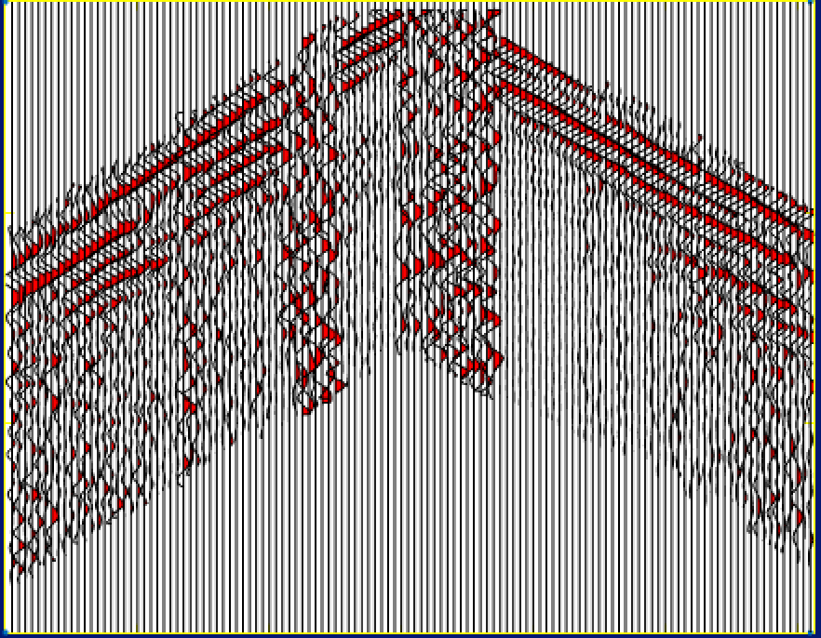
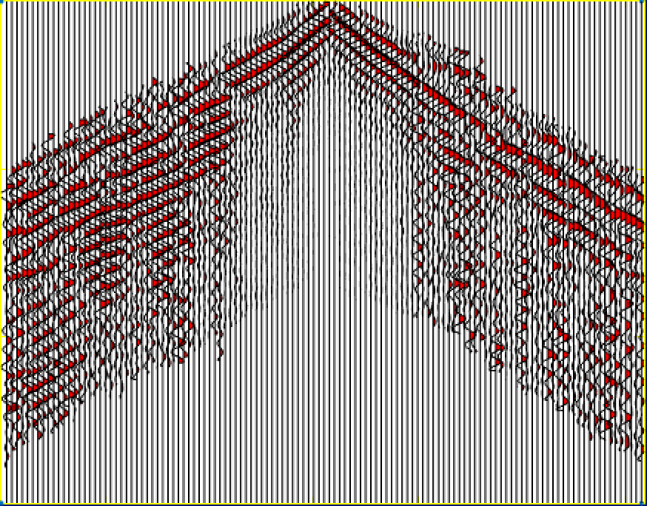
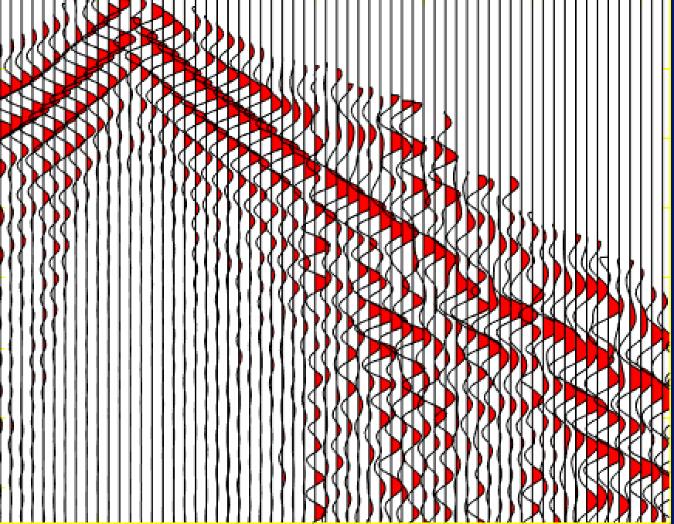
POCS Iterative Method
Fill sparse data
Data
FFT
F-K domain
+
Threshold
Selected
F-K domain
IFFT
Recovered
data

Slide 18
Conclusion
Common receiver gather can give more continuous data set if there are continuous noise from a fixed location near the survey area
Dispersion curves indicate the velocity in this area is roughly 300~500 m/s
POCS cannot work well if too many traces are missing

