Slide 1
Processing of KAUST Golf Data
Liu Zhaolun and Libo Huang
CSIM, KAUST
2015 Dec. 7

Slide 2
Outline
Motivation
Solution and Procedure
Problems
Results
Discussion

Slide 3
Outline
Motivation
Solution and Procedure
Problems
Results
Discussion

Slide 4
Motivation
Practice getting real field data
Practice data processing skills
Find subsurface structure below KAUST
Detect Qademah fault

Slide 5
Outline
Motivation
Solution and Procedure
Problems
Results
Discussion

Slide 6
Solution and Procedure
Collect seismic data at north KAUST campus
Pre-processing
Velocity analysis
Post-stack migration
Interpretation

Slide 7
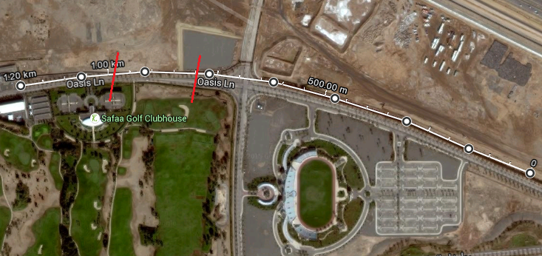
Solution and Procedure
North campus
White: survey
Red: Qademah?
240 shots
240 geophones
5 m spacing

Slide 8
Solution and Procedure
Cut before early arrival
Velocity Analysis
Normal Moveout Correction
Delete bad traces
FK-Filter Remove Surface waves
Stacking
Bandpass
FK-analysis
Analysis

Slide 9
Outline
Motivation
Solution and Procedure
Problems
Results
Discussion

Slide 10
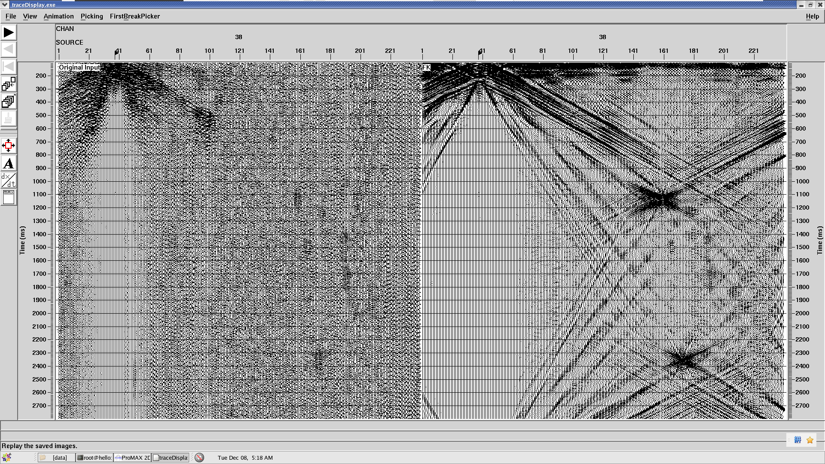
Problems
Bandpass fails to kill surface waves
FK kills but no reflections
FK asterisk artifacts

Slide 11
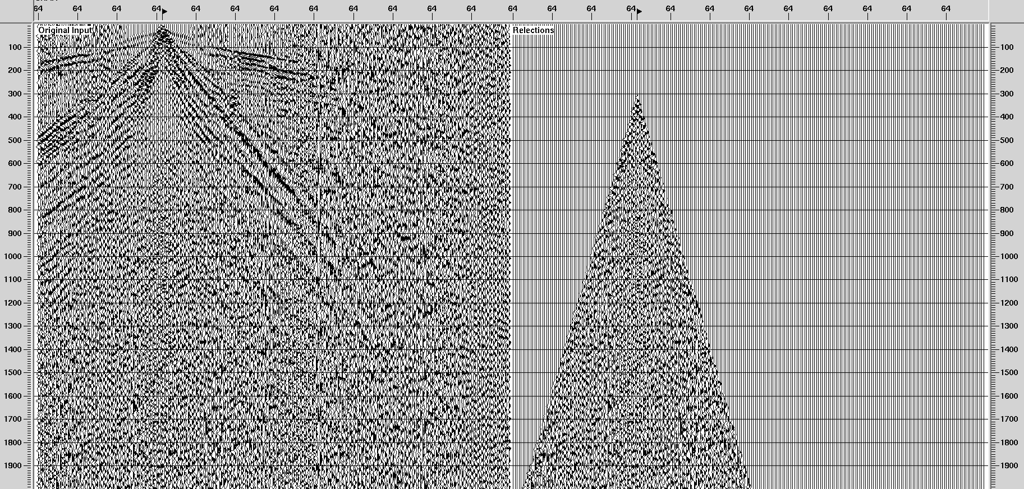
Problems
Fail to find reflection

Slide 12
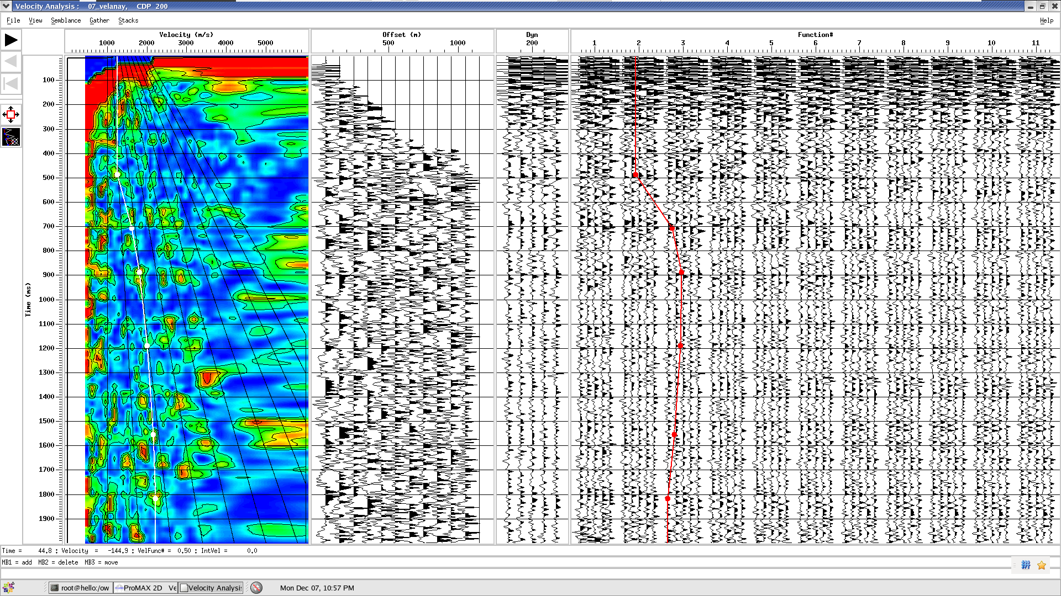
Problems
Velocity analysis doesn’t work

Slide 13
Outline
Motivation
Solution and Procedure
Problems
Results
Discussion

Slide 14
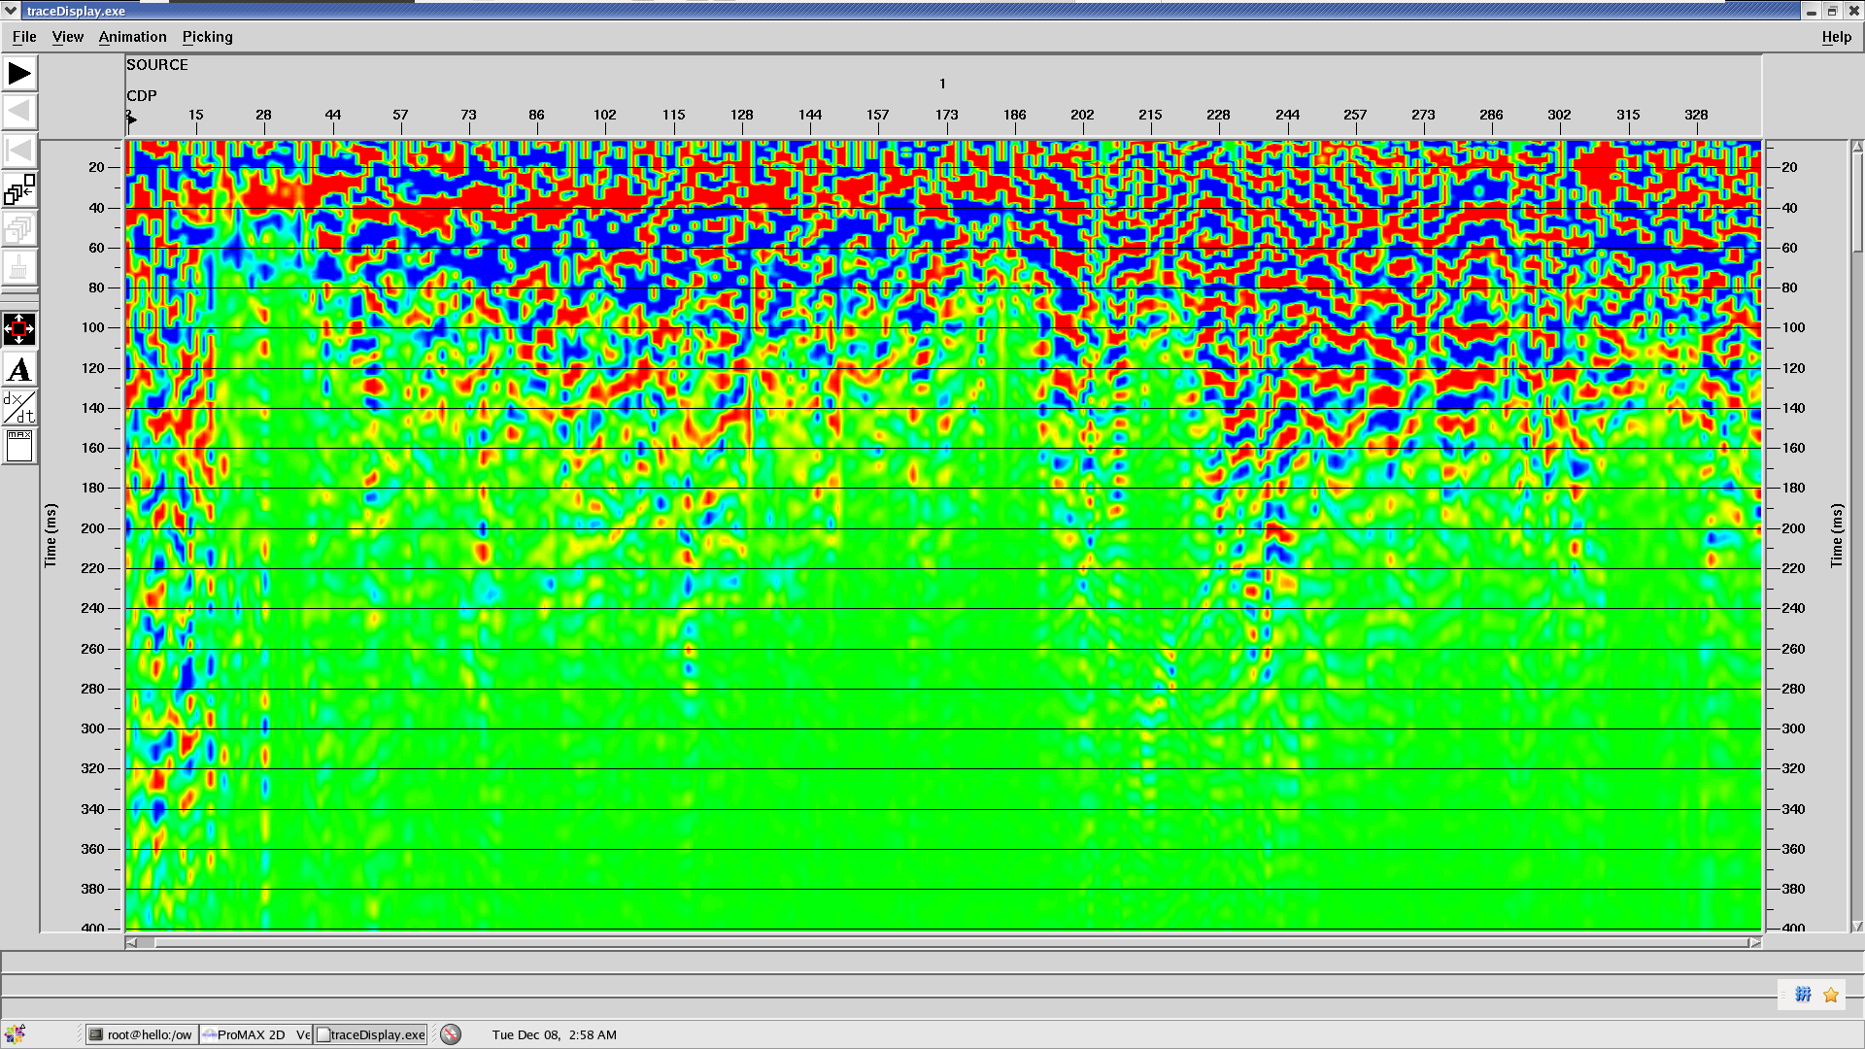
Results
Normal moveout stacking

Slide 15
Outline
Motivation
Solution and Procedure
Problems
Results
Discussion

Slide 16
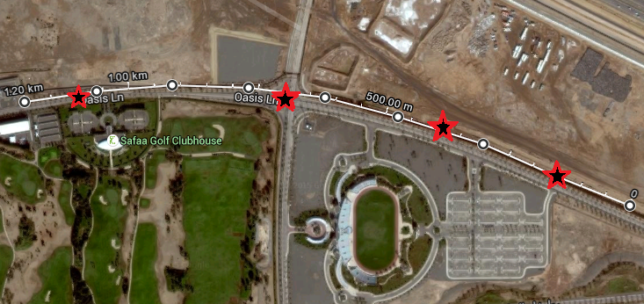
Discussion
One-side back scattering

Slide 17
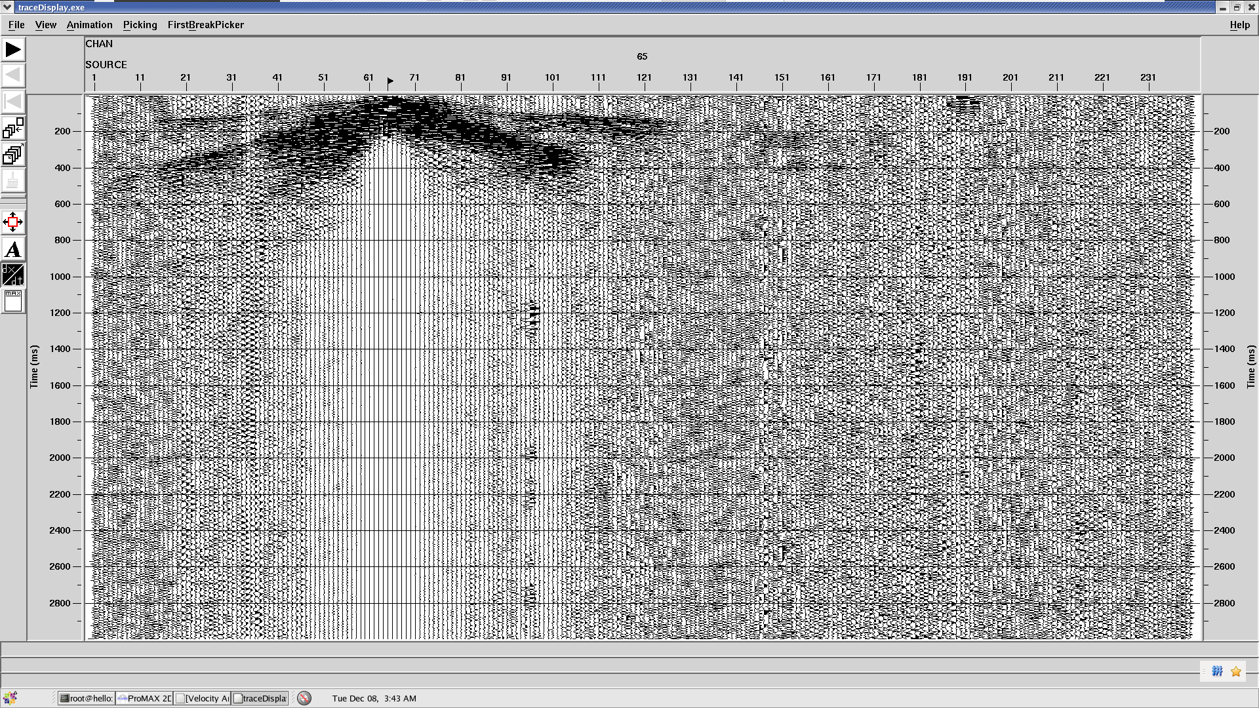
Discussion
First two
back scatter (1)

Slide 18
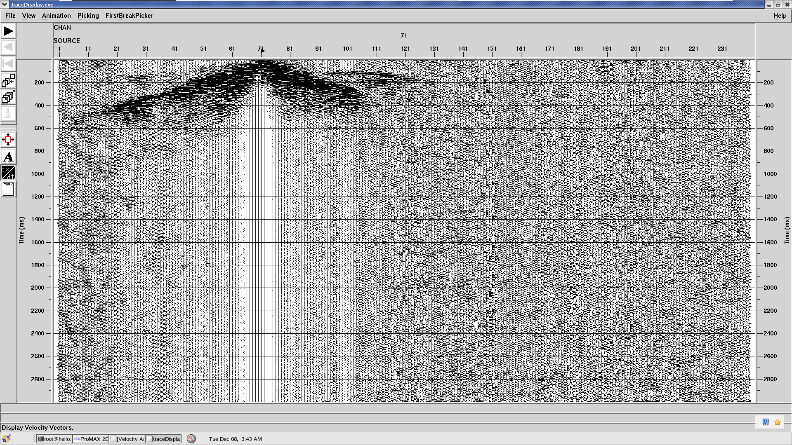
Discussion
First two
back scatter (2)

Slide 19
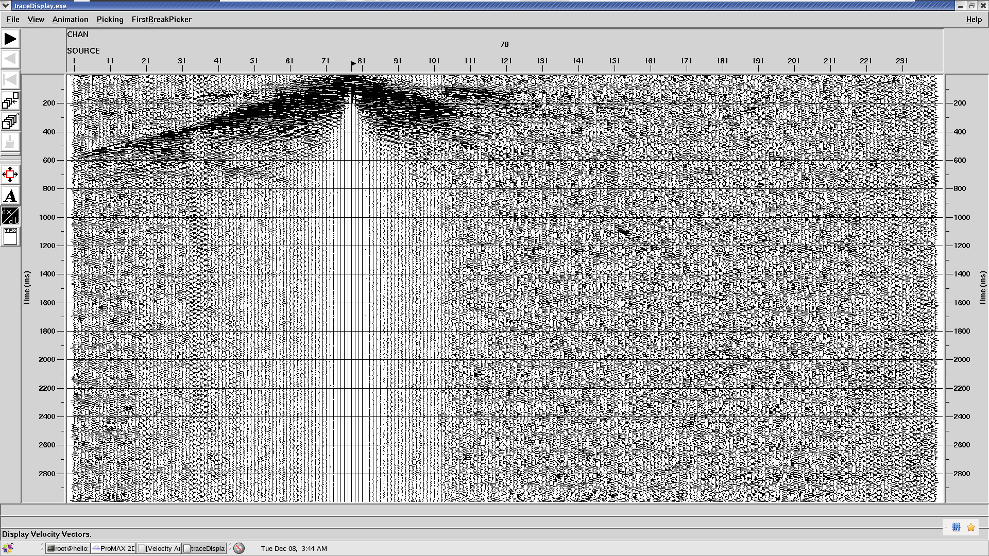
Discussion
First two
back scatter (3)

Slide 20
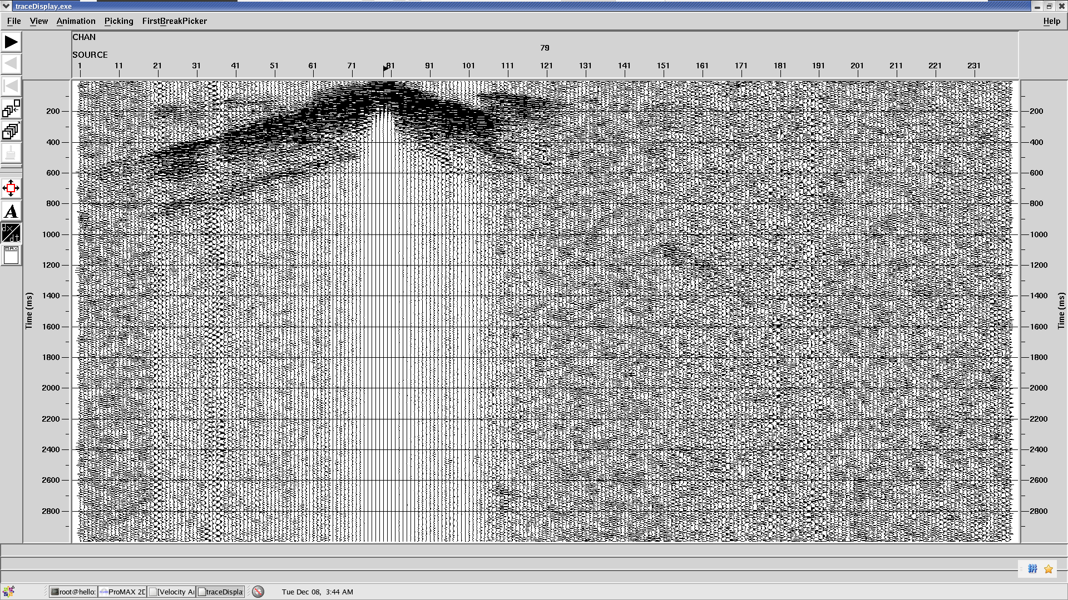
Discussion
First two
back scatter (4)

Slide 21
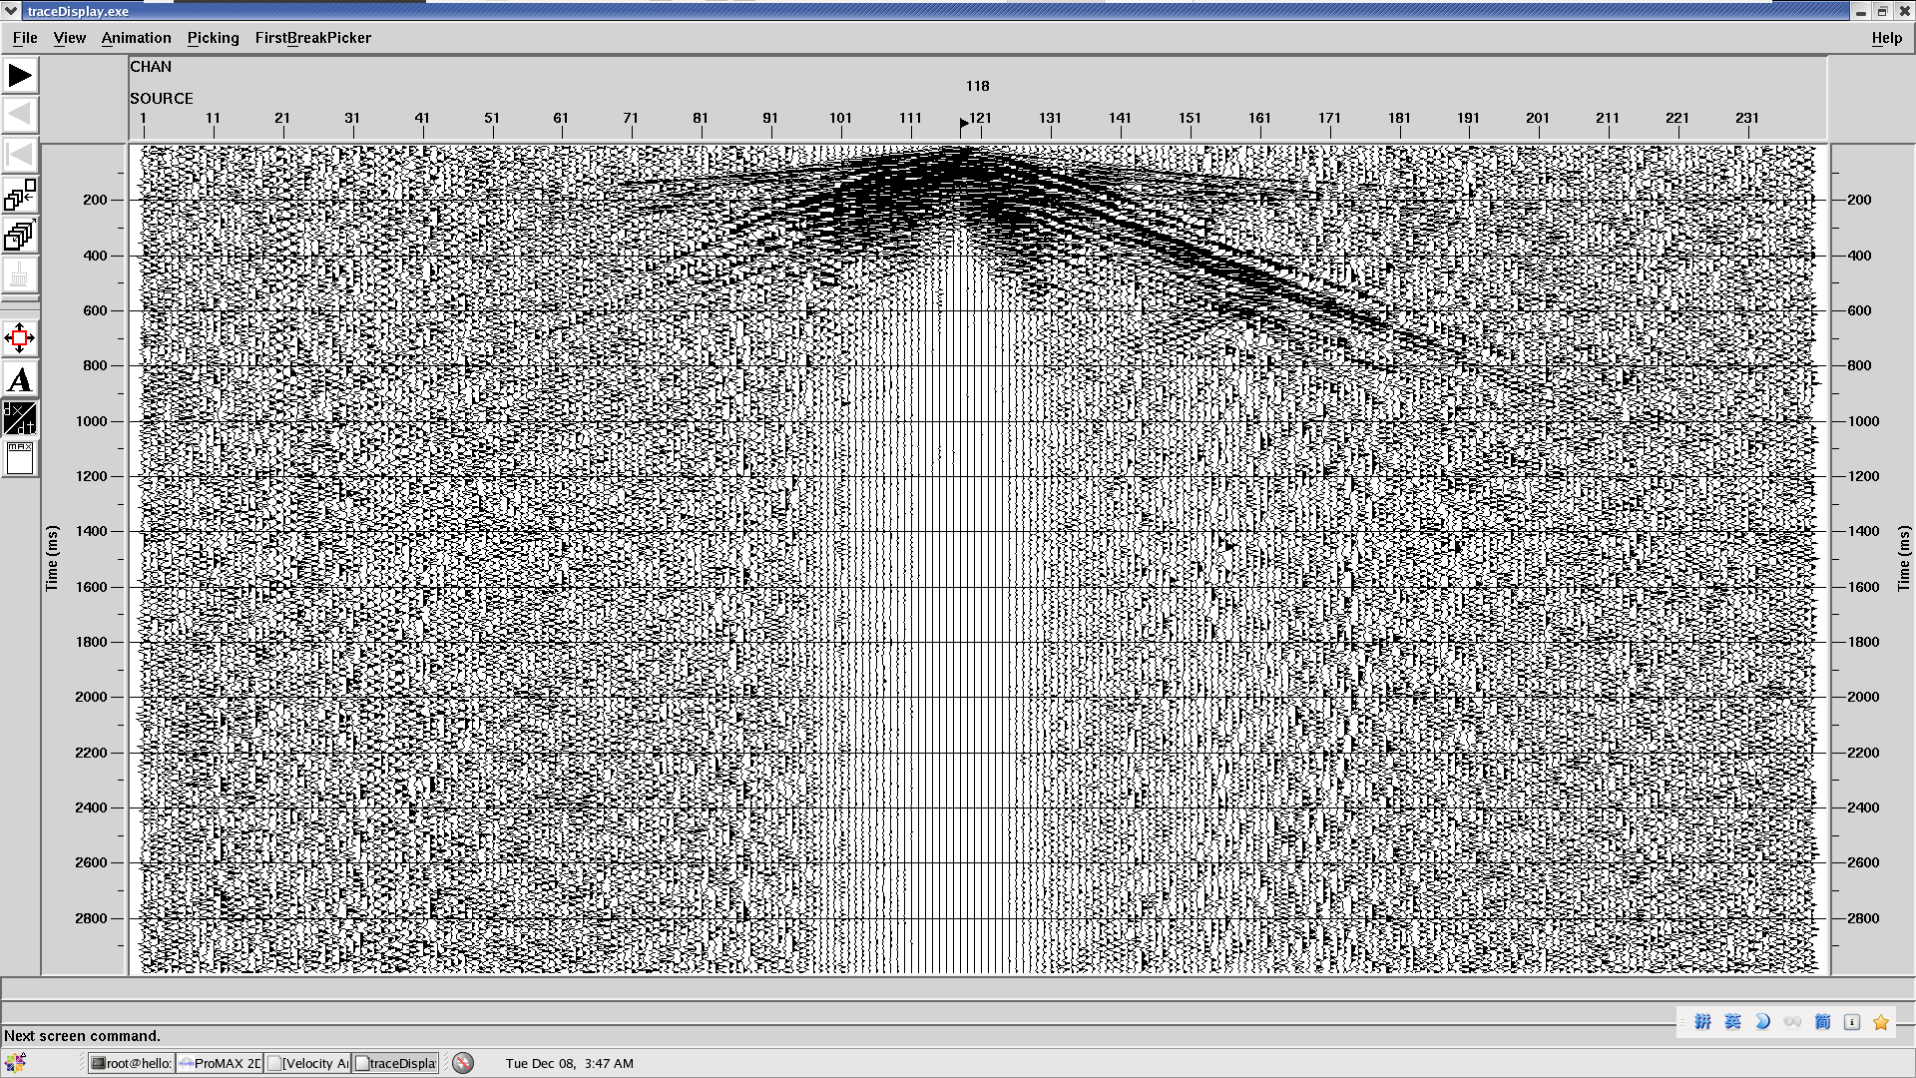
Discussion
Last two
back scatter (1)

Slide 22
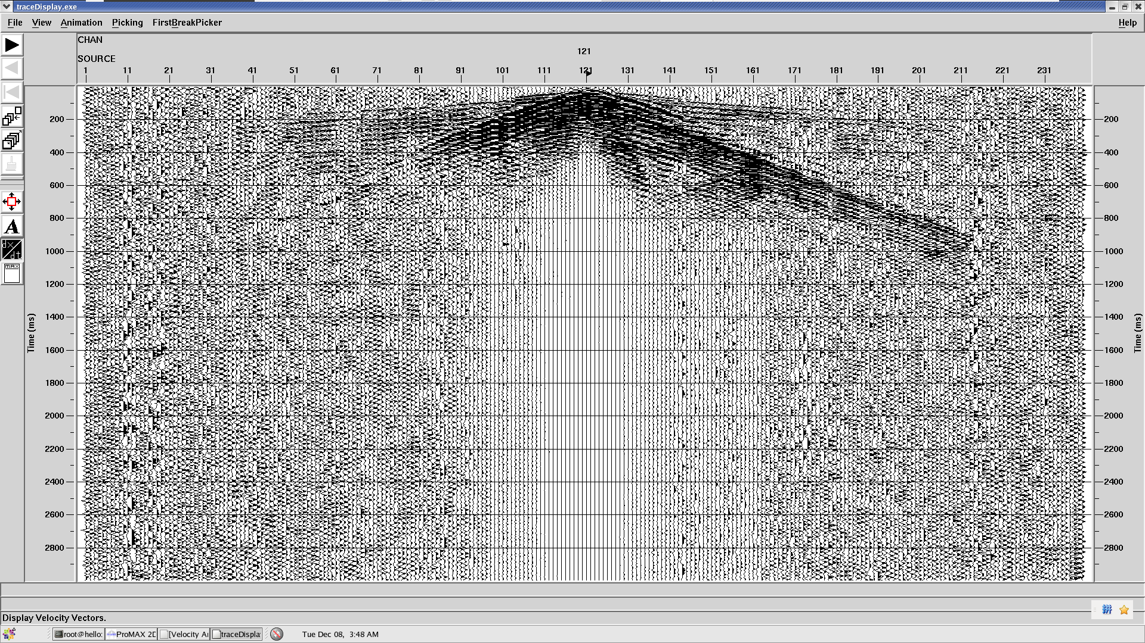
Discussion
Last two
back scatter (2)

Slide 23
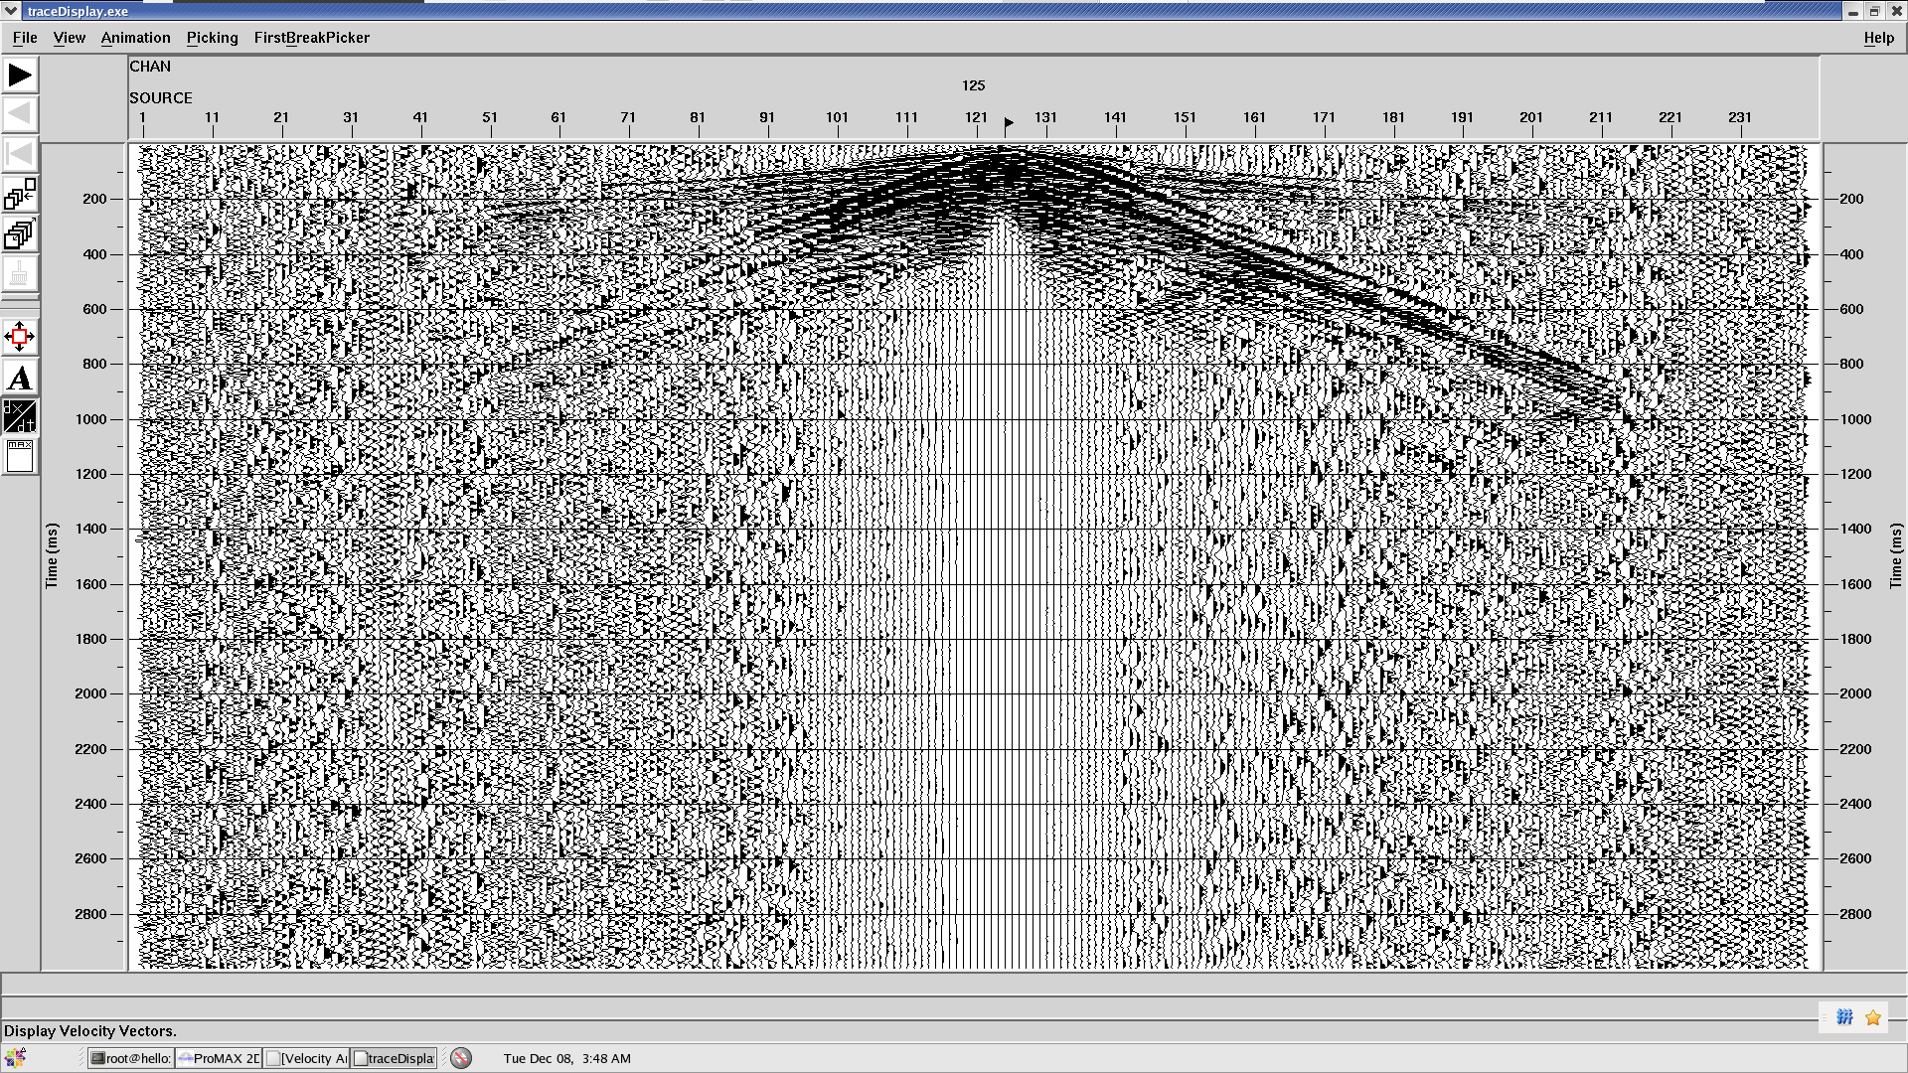
Discussion
Last two
back scatter (3)

Slide 24
Discussion
Last two
back scatter (4)

Slide 25
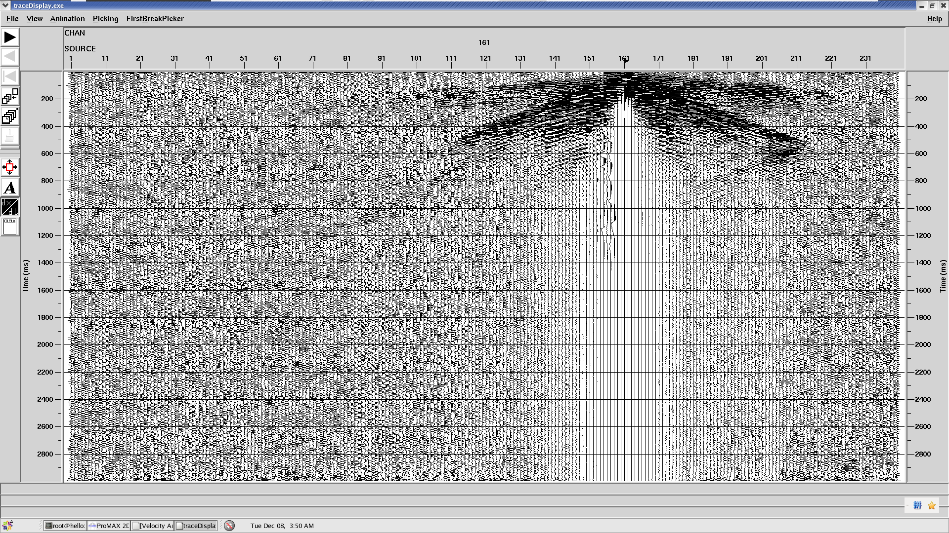
Discussion
Last two
back scatter (5)

